Slide 1

The Backround on Background Tasks
in .NET 9
Scott Sauber
Director of Engineering, Lean TECHniques Inc

Slide 2


Slide 3
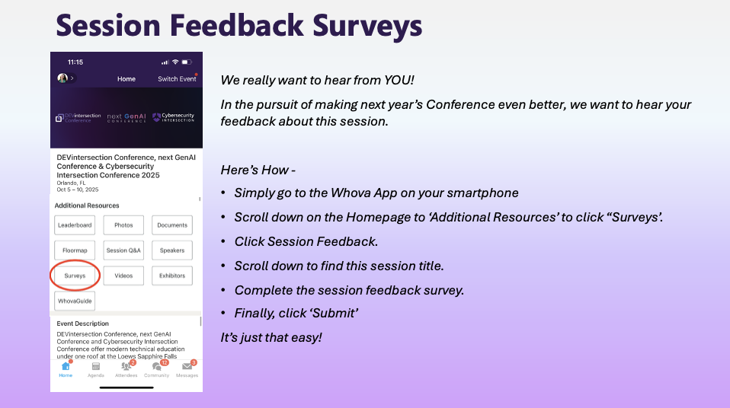

Slide 4

Audience
.NET Developers
In need of running a background task
This is not a talk about how Tasks work in async/await
scottsauber
Notes:
Just to level set expectations and some assumptions I had when I made this talk. I had a very particular audience in mind, so hopefully this is lines up with you, so that you can get the most out of this session. This talk targets existing .NET Core Developers who are familiar with the .NET Core/ASP.NET Core ecosystem and need to run a background task, but are maybe unsure of their options and which one to choose. Or maybe they know all the options but aren’t quite sure when you should use which one. Those are all things we are going to talk about today and get those questions answered.

Slide 5
Agenda
What are background tasks/jobs?
What type of problems are suitable for a background task/job?
What options are out there?
IHostedService
BackgroundService
Worker Service
Hangfire
Why would I choose one over the other?
Deep dive into each
Demos
Questions
scottsauber

Slide 6
Goal
Know all your options for running background tasks
Why choose one over another
scottsauber

Slide 7





Who am I?
Director of Engineering at Lean TECHniques
Microsoft MVP
Dometrain Author
Redgate Community Ambassador
Co-organizer of Iowa .NET User Group

Slide 8
What problem do background tasks solve?
Cron jobs
Process messages from a queue every X minutes
Clean up database or file system every X minutes
Send email notification every X minutes under certain circumstances
Refresh cache every X minutes
Check for updates to database every X minutes and push updates via SignalR
Perform some CPU intensive work asynchronously
Eventual consistency
Re-train ML datasets
scottsauber
Notes:
Perform some CPU intensive work asynchronously outside of the normal request/response pipeline.

Slide 9
Options
IHostedService
BackgroundService
WorkerService
Hangfire
Cloud options
scottsauber

Slide 10

These options are kind of like baking cookies
Notes:
These options are kind of like baking cookies. On one end of the spectrum, you have making your own recipe, where you have the raw ingredients, but it’s up to you how you want to assemble them and cook them and you have full control. On the other end of the spectrum, you have going to the store and buying cookies off the shelf. Obviously it’s way more convenient, but you have a lot less control over how the cookies are made and packaged. Depending on what your requirements are, sometimes you may reach for one or the other depending on your scenario.

Slide 11

IHostedService “Make Your Own Recipe” (Cookie Jar Included)

Slide 12
What is an IHostedService?
Lets you host a background job inside an ASP.NET Core App
ASP.NET Core app is your cookie jar
Interface with StartAsync and StopAsync
Raw, fundamental building block for other options
Register via dependency injection and services.AddHostedService<T>
scottsauber

Slide 13

Demo
Notes:
Show what’s involved with an IHostedService
StartAsync
StopAsync
Show registering
Show what happens when you return the Task or await it

Slide 14
How does an IHostedService work?
Register with DI
StopAsync’s cancellation token has 5 seconds to shutdown gracefully
StopAsync might not be called if the app shuts down unexpectedly
scottsauber

Slide 15
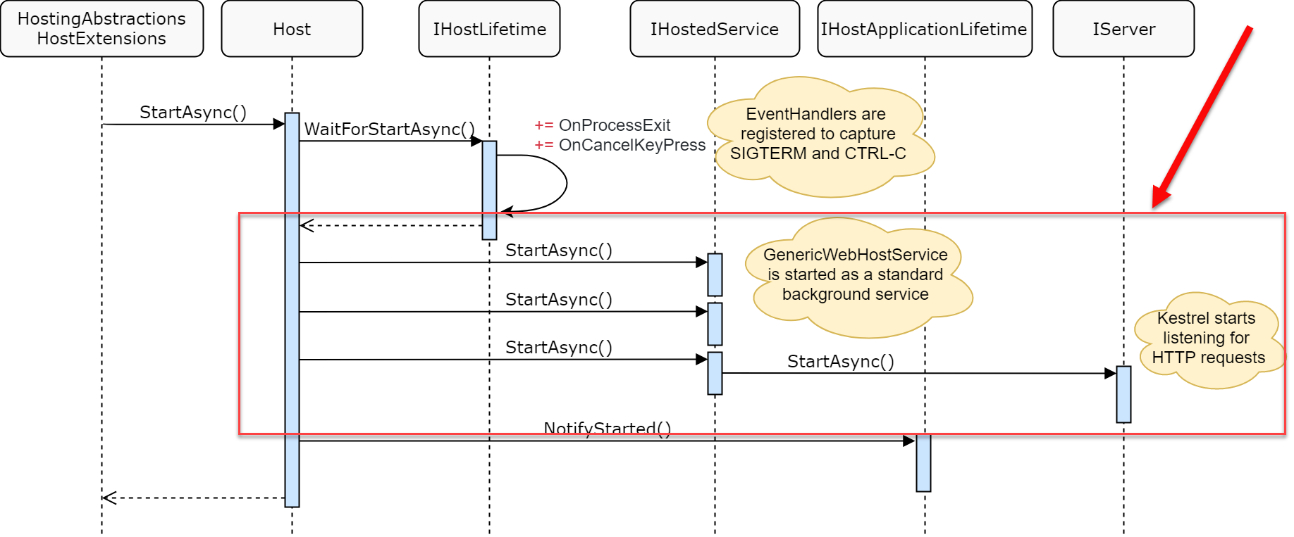
How does an IHostedService work?
Image Credit: Andrew Lock
scottsauber

Slide 16
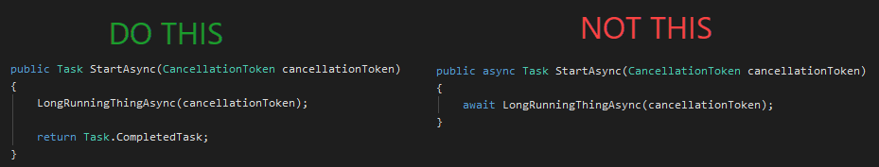
How does an IHostedService work?
StartAsync blocks the rest of your app from starting
Push blocking long-running work out of StartAsync
This goes for BackgroundService later
UNLESS, you truly don’t want your app to boot until this finishes
i.e. Database Migrations
scottsauber

Slide 17
When do I use IHostedService?
You will implicitly use it with BackgroundService and Worker Services
You need full control over Starting and Stopping
AND will not use the base BackgroundService implementation
scottsauber
Notes:
BackgroundService which we’ll talk about later solves some of the basic starting and stopping problems people have, and you can even override each if you need to customize it. But if you’re not going to use the base implementations at all, then you will probably just be better off implementing the IHostedService directly.

Slide 18
When do I NOT use IHostedService?
Should be using BackgroundService or WorkerService 95%+ of the time
Other reasons will be the same as BackgroundService (next)
scottsauber

Slide 19
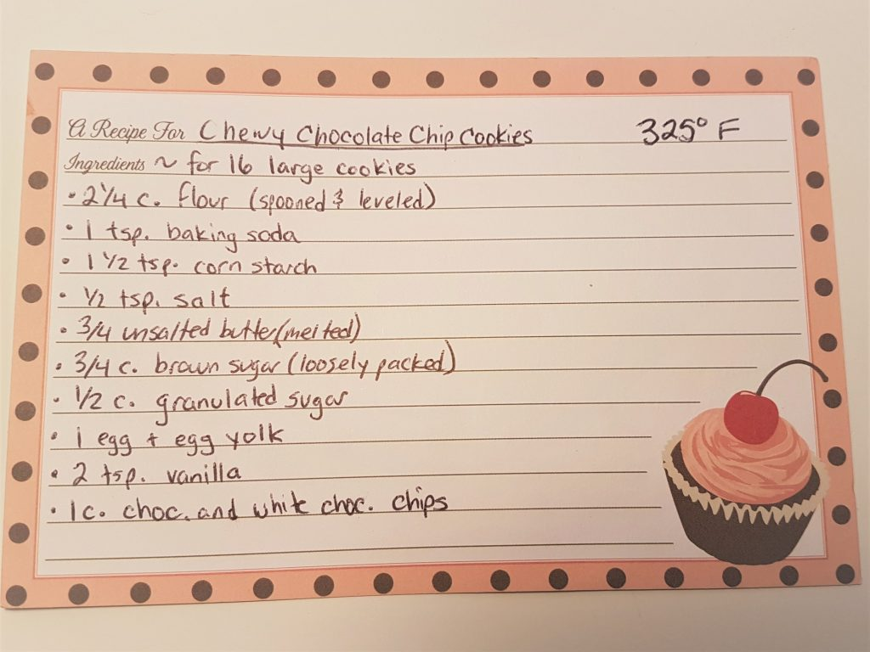

BackgroundService “Follow The Recipe” (Cookie Jar Included)

Slide 20
What is a BackgroundService?
Lets you host a background job inside an ASP.NET Core App
ASP.NET Core app is your cookie jar
Abstract class, implements IHostedService
Exposes ExecuteAsync abstract method
Handles Starting and Stopping
scottsauber

Slide 21
Demo
Notes:
Show what’s involved with a BackgroundService
Execute Async
Override StartAsync
Override StopAsync
Show registering with DI

Slide 22
How does a BackgroundService work?
Register with DI
Exposes ExecuteAsync abstract method
Can still override StartAsync and StopAsync
scottsauber

Slide 23
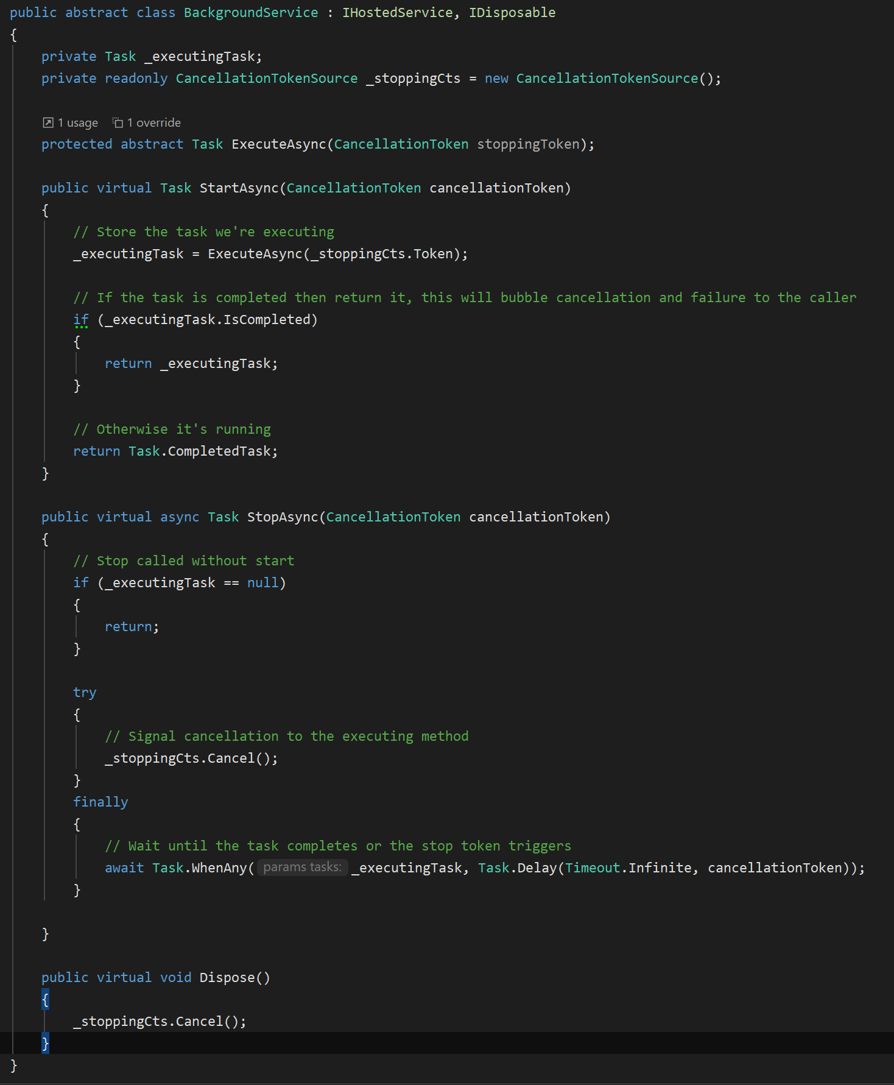
scottsauber

Slide 24
When do I use BackgroundService?
Need a simple background task runner
Either as part of your ASP.NET Core application or by itself
Less gotchas than IHostedService
Can’t accidentally prevent app from booting unless override StartAsync
Handles cancellations
Want an ASP.NET Core endpoint to health check your background task
Instead of WorkerServices
scottsauber

Slide 25
When do I NOT use BackgroundService?
Too much co-location with your app/API can get unruly and outweigh the convenience of co-location
It Depends
Scaling out can be a problem if your code isn’t idempotent
Fix by making code idempotent or not allowing scale out
scottsauber
Notes:
So when do I not use BackgroundServices?
Just like with an IHostedService, a BackgroundService can be hosted inside the same process as the rest of your ASP.NET Core Application. Whether you’re doing server-rendered HTML like Razor Pages or MVC, or if your ASP.NET Core app is simply an API. If you choose to do this, this you assume the risk of co-locating that with your application. The BackgroundService will share the same CPU, Memory, Network, etc. as the rest of the application. Sometimes this is perfectly fine, and other times this will cause a “noisy neighbor” situation, where when your BackgroundService triggers, it will degrade the performance of your WebApp or API.
Now what I just said may seem like I’m advocating for separating all BackgroundServices from the rest of your application. That is absolutely NOT what I’m advocating for. Like all things with software It Depends. I’ve definitely kept BackgroundServices in the same application as the other parts of my app, and I’ve also definitely moved some of them into another process. What it comes down to is, does the inconvenience of having multiple deployables to operate outweigh the impact to the rest of your application. As always the first rule of Distributed Software is…. Don’t, if you can help it.
Another reason for not using a BackgroundService would be is you have some sort of auto-scaler set up that automatically scales out and adds more instances of your application running. This means your application will have multiples of the same BackgroundService running at the same time. Depending on what your code is doing, if you don’t have some sort of locking mechanism, guarantee of only-once delivery from your queue, or some idempotent check to ensure you only process a single message one.

Slide 26
WorkerService “Follow The Recipe” (BYO Cookie Jar)

Slide 27
What is a WorkerService?
Enhanced .NET Console App template
dotnet new worker –o my-custom-worker
Allows you to have an IHost
Configuration, Dependency Injection, Logging, etc.
Registers a Worker class as a HostedService
Does not take an opinion on how to host console app
No cookie jar
Console app called from scheduler
Windows Service
systemd
scottsauber
Notes:
Essentially all the WorkerService is, is a console app with a few pre-configured options.
The WorkerService allows you to boot up a generic IHost using the say CreateDefaultBuilder that you know from ASP.NET Core. This means that you have the same configuration that you know and love from ASP.NET Core such as Configuration using Ioptions and appsettings.json files, environment variables, user secrets, etc. It also gives you Dependency Injection using Microsoft.Extensions.DependencyInjection and the ServiceProvider you know from ASP.NET Core. It also gives you the same ILogger interface you’re likely already familiar with from ASP.NET Core. All of that is wired up for you out of the box in the WorkerService with just a few lines.
On top of that, it also creates you a Worker class that implements the BackgroundService base class and is already hooked up as a HostedService within the Dependency Injection container. All you have to do from this point is plugin your custom code.
After you plugin your custom code, you will need to figure out how you want to host this WorkerService. Do you want it to be a console app that gets triggered by some sort of cloud, enterprise scheduler, Kubernetes cron jobs, or Windows scheduled tasks. If you don’t want it to be a console app, you can also hook up WorkerServices as Windows Services if you’re running on Windows or the starting a daemon in Linux using something like systemd.

Slide 28
Demo
Notes:
Show creating
Show registering

Slide 29
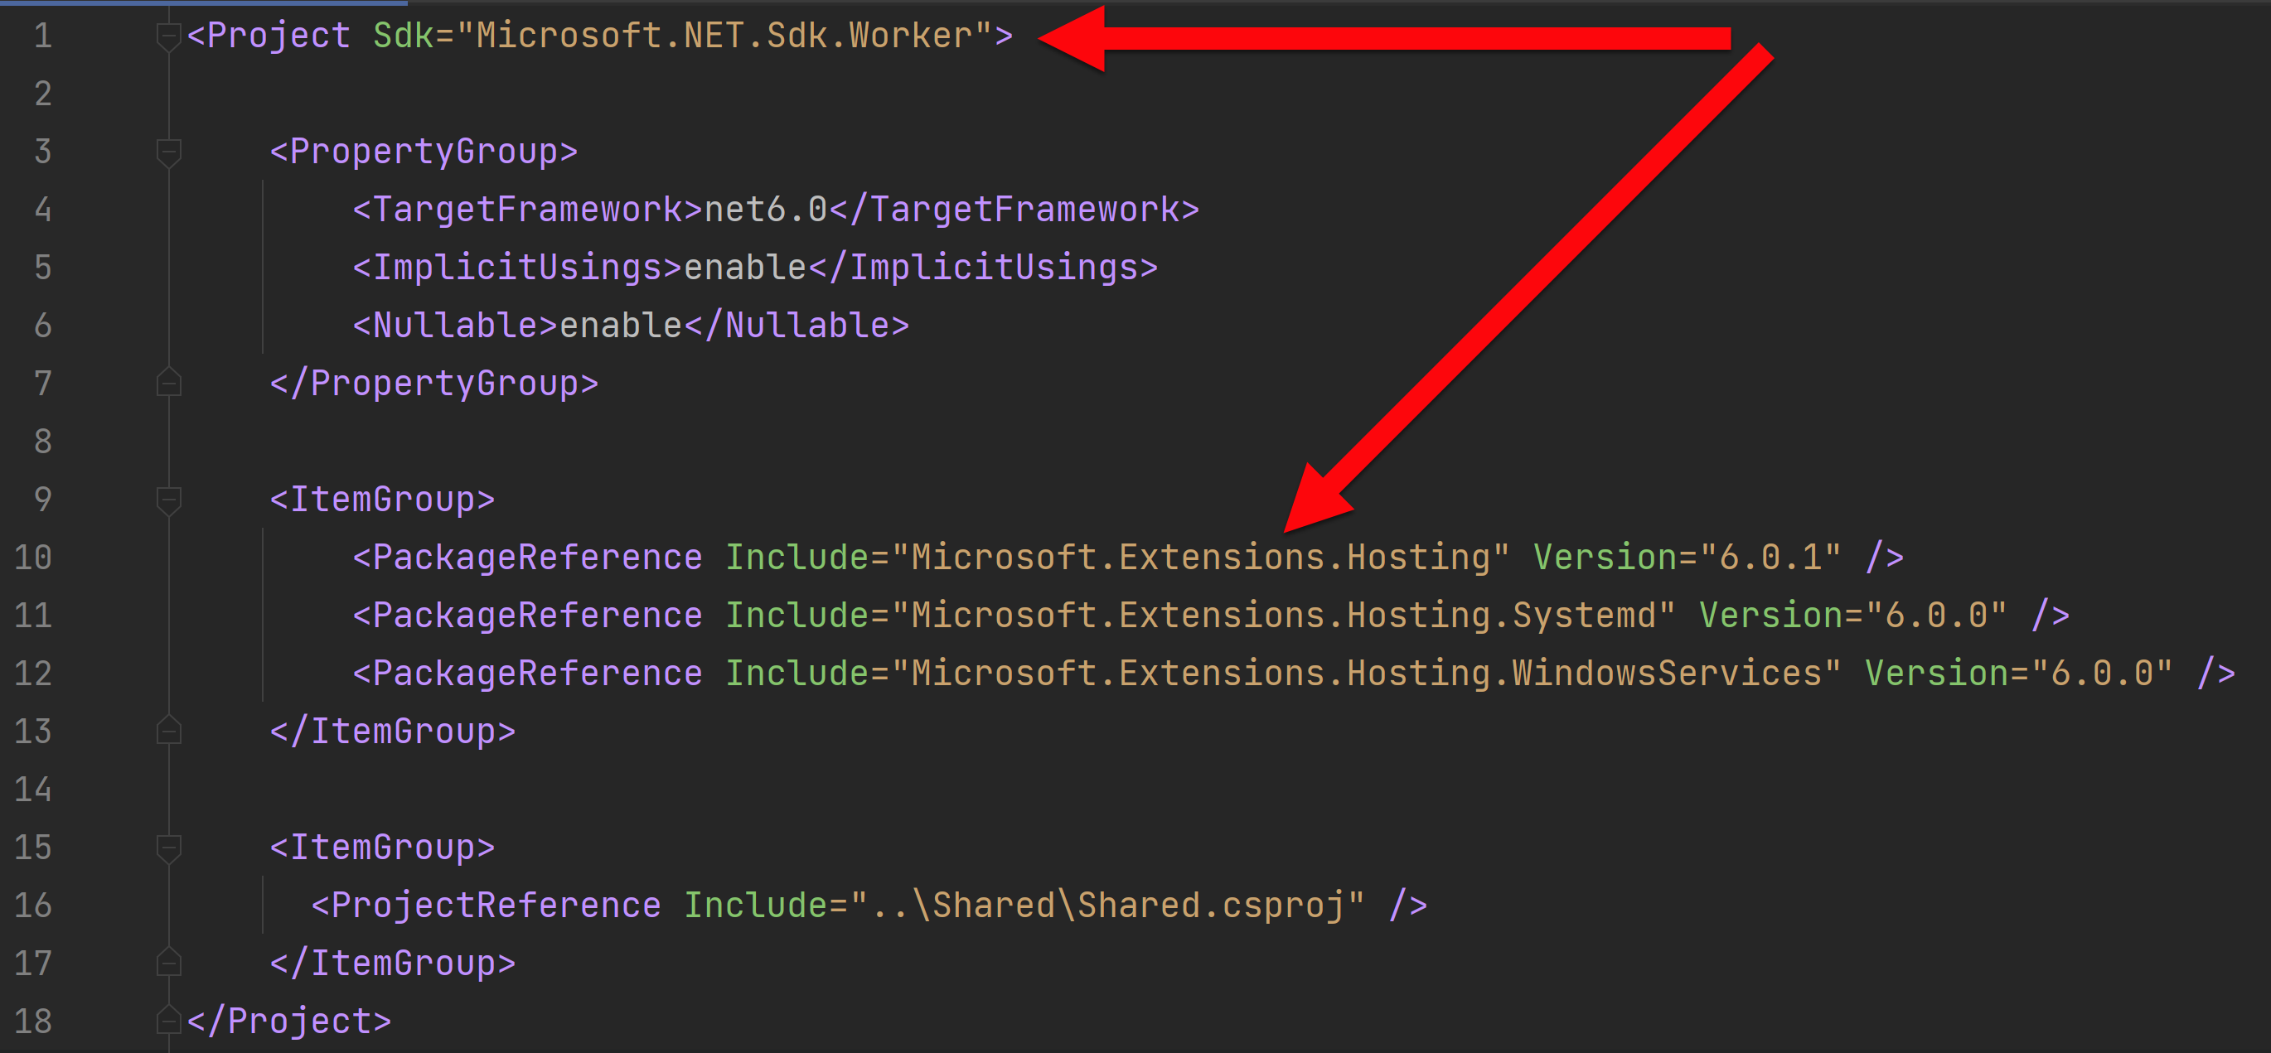
How does a WorkerService work?
Project Sdk of Microsoft.NET.Sdk.Worker
PackageReference to Microsoft.Extensions.Hosting
scottsauber

Slide 30
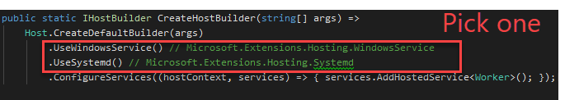
How do I host WorkerServices?
Scheduler calls Console App
Windows Scheduled Tasks, k8s cron jobs, Azure Logic Apps, AWS Scheduled Tasks, GCP Cloud Scheduler
Windows Service or Systemd (Windows or Linux)
scottsauber

Slide 31
When do I use WorkerServices?
Want an out-of-proc way of running background tasks
Prefer hosting background services outside of a web app
Avoid app pool recycles
Natural migration for a full .NET framework Windows Service
scottsauber

Slide 32
When do I NOT use WorkerServices?
Prefer deploying as a web app
Want to co-locate with existing web app/API
Want a healthcheck endpoint
scottsauber

Slide 33

Hangfire “Buy pre-packaged cookies”
Notes:
Go through Program
Dedm

Slide 34
What is Hangfire?
Full featured library for running jobs in ASP.NET Core
Free for commercial use but paid if you want support ($500-$4500/yr)
Comes with UI for monitoring and history
Supports Cron and ad-hoc running of jobs
Allows for continuations
Automatic retries
Supports concurrency limiting
Persists job state to database
scottsauber

Slide 35
Demo
Notes:
You need 3 packages:
Hangfire.Core
Hangfire.AspNetCore
Hangfire.SqlServer (or Redis or MSMQ officially, postgres and others unofficially)
Show Program
Show Cron
Dashboard showing history, recurring, enqueue jobs
Trigger from Controller
Throw exception and show retry with DLQ
Note: BackgroundJobService is a Hangfire thing NOT a BackgroundService

Slide 36
How does Hangfire work?
Serializes method call and all arguments
Creates background job based on that information
Saves job to persistent storage
Starts background job if immediate
scottsauber

Slide 37
When do I use Hangfire?
Want to host jobs in ASP.NET Core
Need features Hangfire offers
Don’t want to write plumbing code
Ok with relying on a 3rd party library
scottsauber

Slide 38
When do I NOT use Hangfire?
Do not want to host jobs in ASP.NET Core
Have basic needs and do not need Hangfire’s features
Do not want to rely on 3rd party library
More control over what happens
scottsauber

Slide 39
Cloud options
Azure Functions
Azure WebJobs
AWS Lambdas
GCP Cloud Scheduler + Cloud Functions
Didn’t cover these to avoid cloud specific
scottsauber

Slide 40
Takeaways
Awareness to all the options available to you
More information to make the best decision for you and your company
scottsauber

Slide 41
Resources
https://docs.microsoft.com/en-us/dotnet/architecture/microservices/multi-container-microservice-net-applications/background-tasks-with-ihostedservice
https://www.hangfire.io/
https://app.pluralsight.com/library/courses/building-aspnet-core-hosted-services-net-core-worker-services/
This slide deck
scottsauber

Slide 42

Questions? ssauber@leantechniques.com @scottsauber.com on Bluesky @scottsauber on Twitter
Add me on LinkedIn:
Slides at scottsauber.com

Slide 43
Thanks!
Slides at scottsauber.com

Slide 44


