Slide 1

Deploying a .NET 8 App to Azure using GitHub Actions and Bicep
Slides at scottsauber.com
scottsauber

Slide 2

What you need
An Editor of some sort that supports .NET 8 and Bicep
Rider 2023 EAP 8
VS 17.8+
VS Code with Bicep Extension recommended
Fork this repo:
https://github.com/scottsauber/workshop-dotnet-azure-github-bicep
Please let Scott know the following if you’re participating:
Email you will use for Azure
GitHub account
WiFi is LTGWHQ-Guest, password is learn@lt
scottsauber

Slide 3
Audience
.NET Developers
Anyone interested in Azure, GitHub or Bicep
scottsauber

Slide 4
Agenda
What is the final state of what we’re building?
What is Azure?
What is Azure App Service? Plans?
What is Bicep?
What are GitHub Actions?
Hands on all throughout
scottsauber

Slide 5
Goals
Learn GitHub Actions, Bicep, and Azure
We likely won’t get to everything in a few hours
This is going to be… a lot
The feedback loop on this is slow
Take home a few things back to work, whether beginner or expert
scottsauber

Slide 6



Who am I?
Director of Engineering at Lean TECHniques
Co-organizer of Iowa .NET User Group
Microsoft MVP
Friend of Redgate
Blog at scottsauber.com

Slide 7
What are we building?
.NET 8 API
Running on Azure App Service
Configured using Infrastructure as Code with Bicep
Deployed via GitHub Actions
scottsauber

Slide 8
Features of What We’re Building
Zero Downtime Deployment
Infrastructure managed by code, not clicking in the portal
Automated Build and Deploys
Follows Azure Naming Standards for naming resources
WhatIf on PR for infrastructure changes
Versioning your app so you know what’s deployed
Health Checks
scottsauber

Slide 9
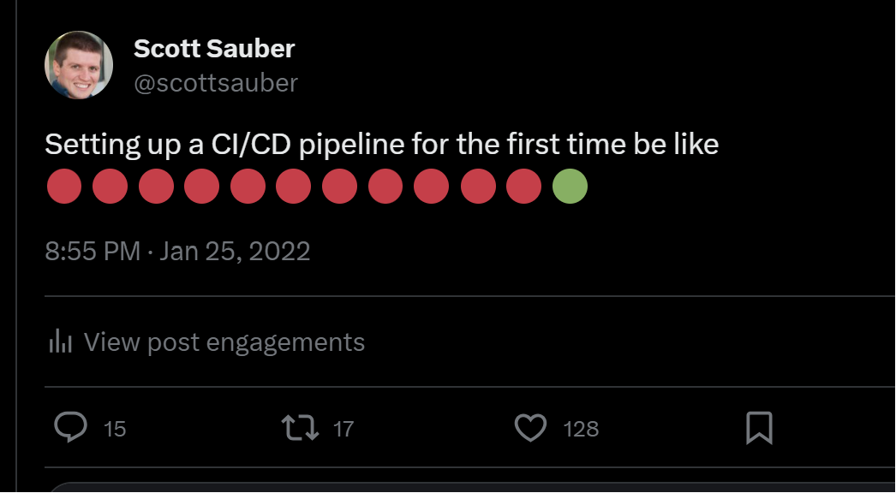
scottsauber

Slide 10

Azure

Slide 11
What is Azure?
Microsoft offering for cloud hosting
Offers many services from hosting web apps to databases to caching to messaging to…
You should probably be picking PaaS offerings (i.e. not VMs)
scottsauber

Slide 12
Subscriptions
Top-ish level organization (ignoring Tenants, Management Groups for a minute)
Recommended per team per environment
My default naming convention: sub-<team/dept>-<environment>
Eg: sub-accounting-dev
Role access separation
Billing separation
scottsauber

Slide 13
Resource Groups
Related groups of resources (i.e. web, DB, Key Vault, etc)
Quickly view all resources related to that app
Conceptually, RG = folder, and Resources = files
Recommended per app per environment
Default naming convention: rg-<product name>-<environment>
Eg: rg-fancyapp-dev
May have many RG’s in a single subscription
Role access separation
Billing separation
scottsauber

Slide 14
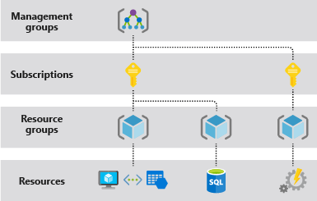
scottsauber

Slide 15

Azure App Service

Slide 16
What is Azure App Service?
PaaS offering for hosting applications
✅Handles OS patches, Framework patches
✅Zero downtime deployments with slots
✅SSL Certs
✅Extremely simple
✅Handles scaling
✅Custom Domains
✅And More
❌Less control because PaaS
scottsauber

Slide 17
What is an Azure App Service Plan?
Think of it like the VM for your App Service(s)
Pick how much memory, CPU, storage you need
You can put multiple app services on an ASP…but should you?
Tiers for Linux
Many apps can get away with S1 in my experience (~$70/mo for Linux)
Need to be at least on Standard to get Deployment Slots (ZDD)
Savings plan – commit to $ amount, 25% (1yr) or 45% savings (3yrs)
Reservation – commit to compute, 35% (1yr) or 55% savings (3yrs)
scottsauber

Slide 18
Live Demo
Notes:
- app service plan in relation to app services
- PaaS nature and all that it handles (server patches, OS patches, Certs, custom domains, etc)
- Env vars
- what slots are
- Kudu is a thing that exists and why it’s useful
- Log stream for really bad stuff going down bc ideally you’re using AppInsights or Log Analytics
- Export template
- What the heck is that
- Let’s deploy that
- Let’s parameterize that

Slide 19

Bicep

Slide 20
What is Bicep?
Infrastructure as Code DSL for Azure
Describe Azure Resources using Bicep’s language
Stored in version control
Repeatable
Auditable
Manage Configuration Drift
Bicep runs in incremental mode by default (will not delete)
No state file required like Terraform does
scottsauber

Slide 21
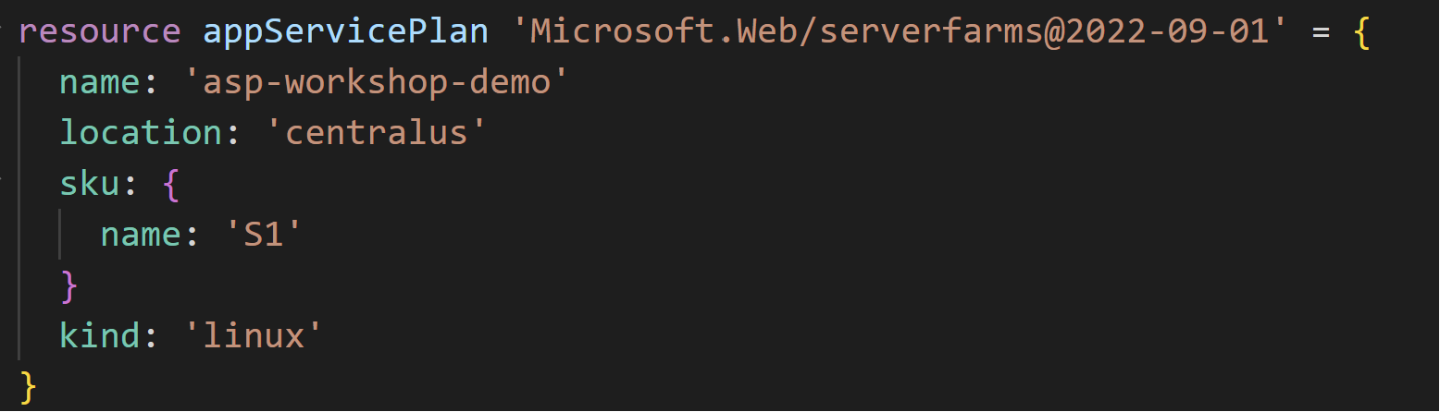
What does Bicep look like?
scottsauber

Slide 22
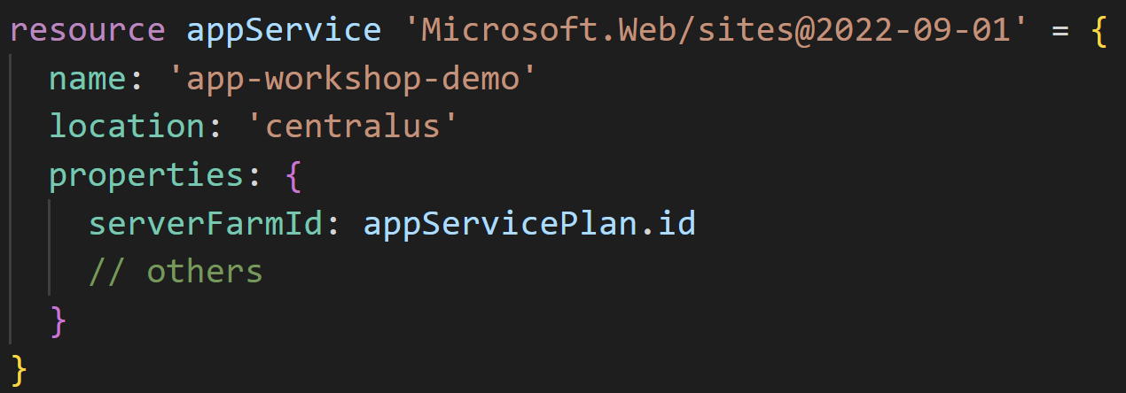
scottsauber
Notes:
Now we can reference resources from one another
This also tells Bicep – create the App Service Plan first before creating the App Service

Slide 23
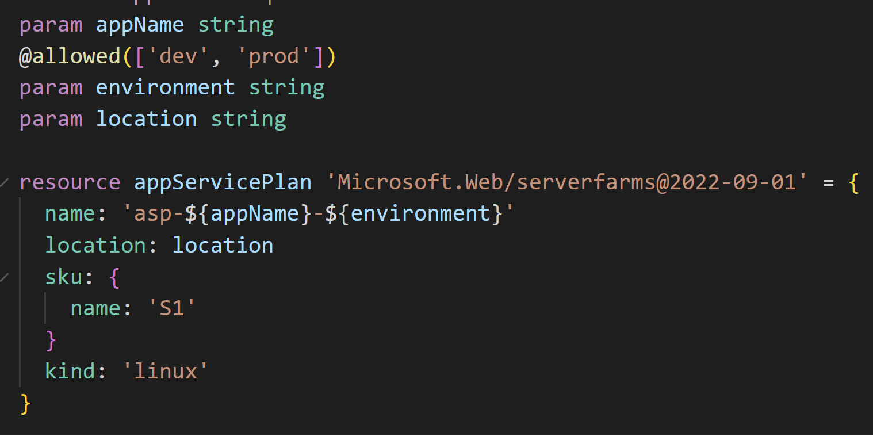
scottsauber
Notes:
Problem with the previous example is those names are hardcoded right. But we probably want like a Dev + Prod name
But how do we create this name dynamically?
Enter Parameter

Slide 24
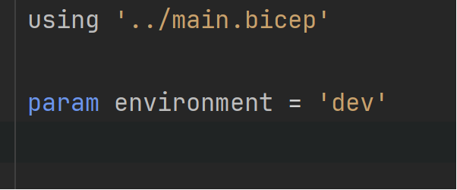
dev.biccepparam file
scottsauber
Notes:
You can store all your Dev values together in a single file
The using tells it what parameters are required and even works with the @allowed value

Slide 25
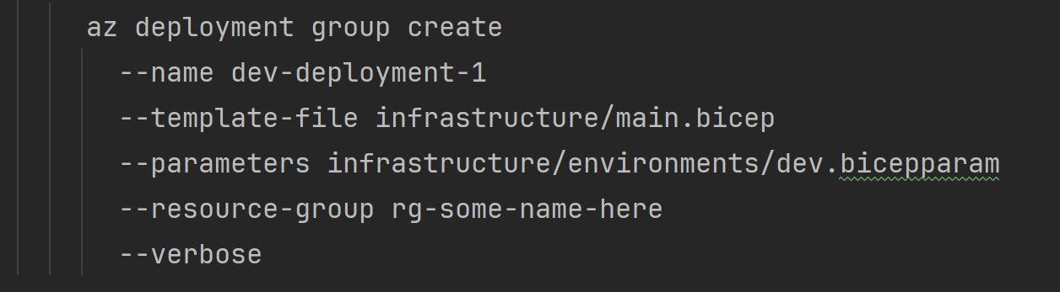
But how do I deploy it?
scottsauber

Slide 26
Key Concepts
Resources
Modules
Parameters
.bicepparam
Outputs
--whatif
scottsauber

Slide 27
Benefits
No manual work of configuring in the portal (and repeating for each env)
Eliminate configuration drift
Traceability of who, did what, and when
Give Contributor access to the pipeline – not to individuals
scottsauber

Slide 28
Additional Resources
Documentation for various Bicep resources:
https://learn.microsoft.com/en-us/azure/templates/microsoft.web/sites?pivots=deployment-language-bicep
scottsauber

Slide 29
Live Demo

Slide 30
Hands On

Slide 31

GitHub Actions

Slide 32
What is GitHub Actions?
Thing doer on a trigger
Trigger could be PR, push to main branch, open an issue, etc
Automatically build and deploys your application
Including the infrastructure (i.e. Bicep)
scottsauber

Slide 33
Concepts
Workflows
Triggers
Jobs
Steps
Secrets
scottsauber

Slide 34
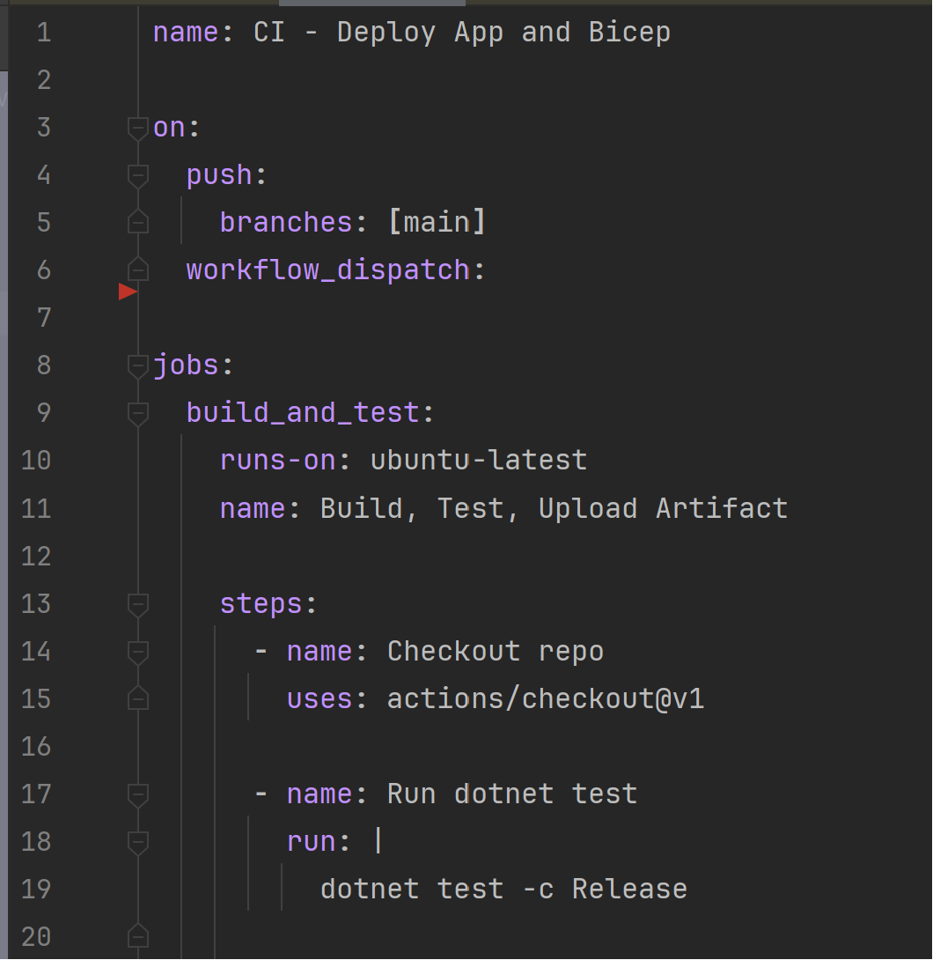
What does GitHub Actions Look Like?
scottsauber

Slide 35
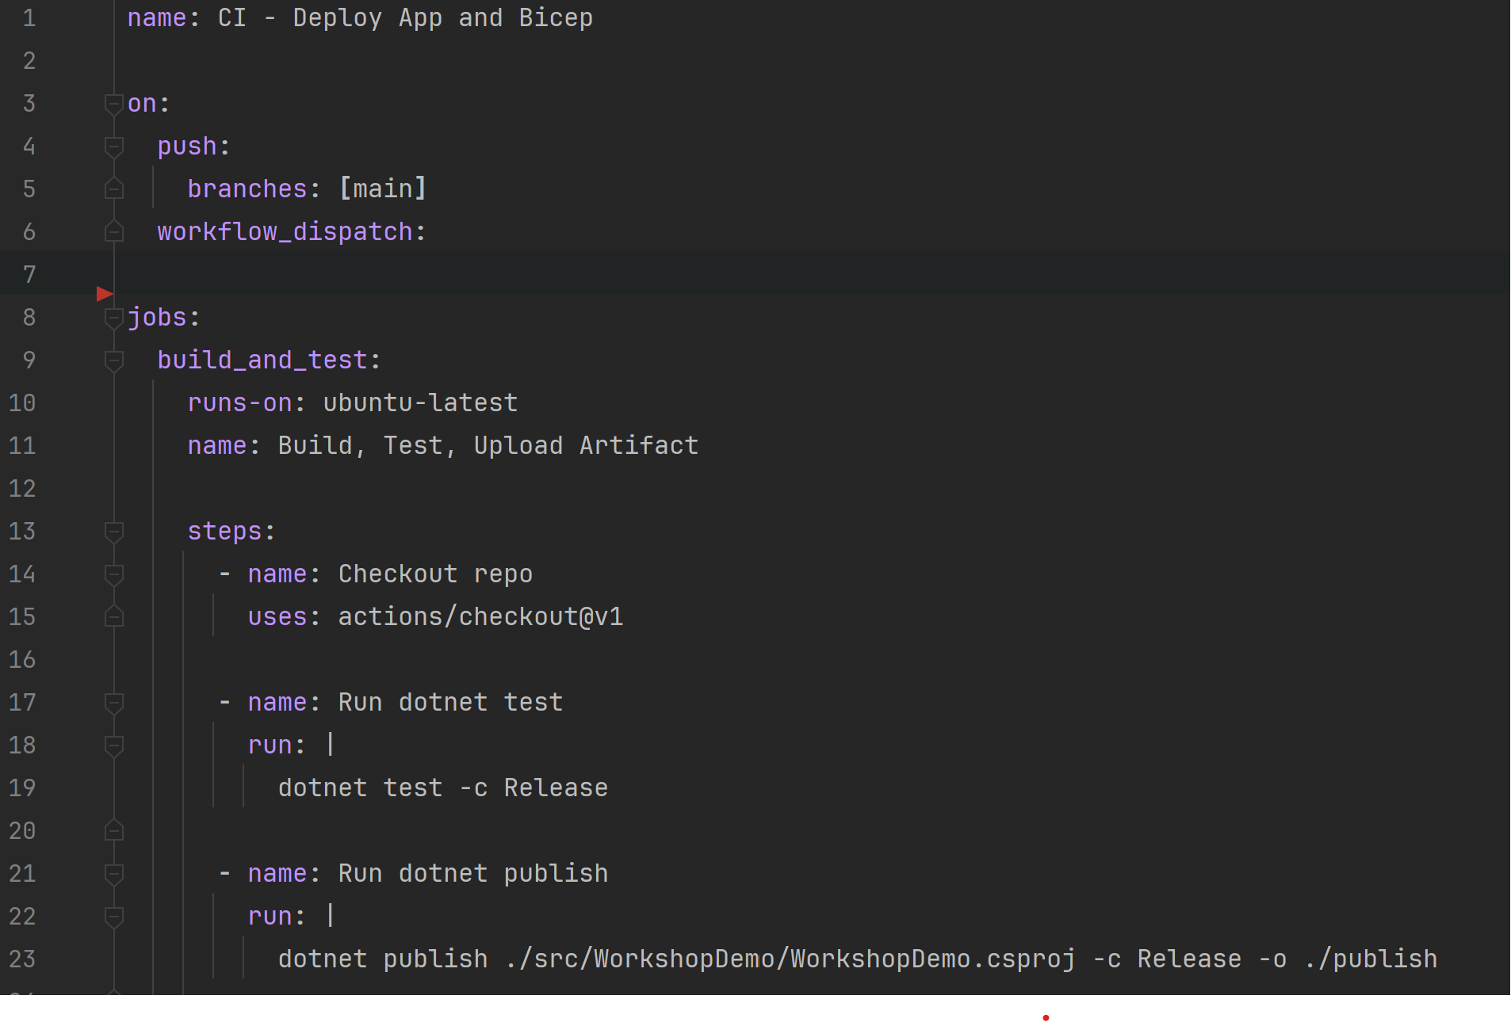
How do I reuse workflows?
scottsauber

Slide 36
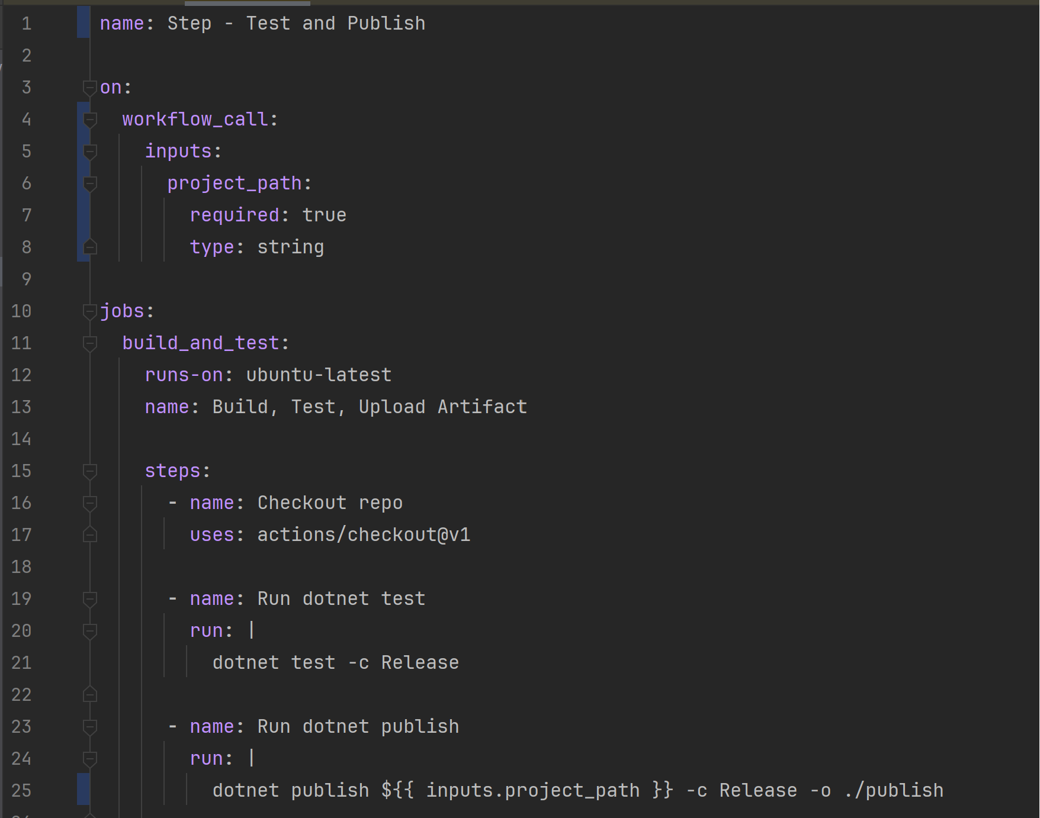
How do I reuse workflows?
scottsauber

Slide 37
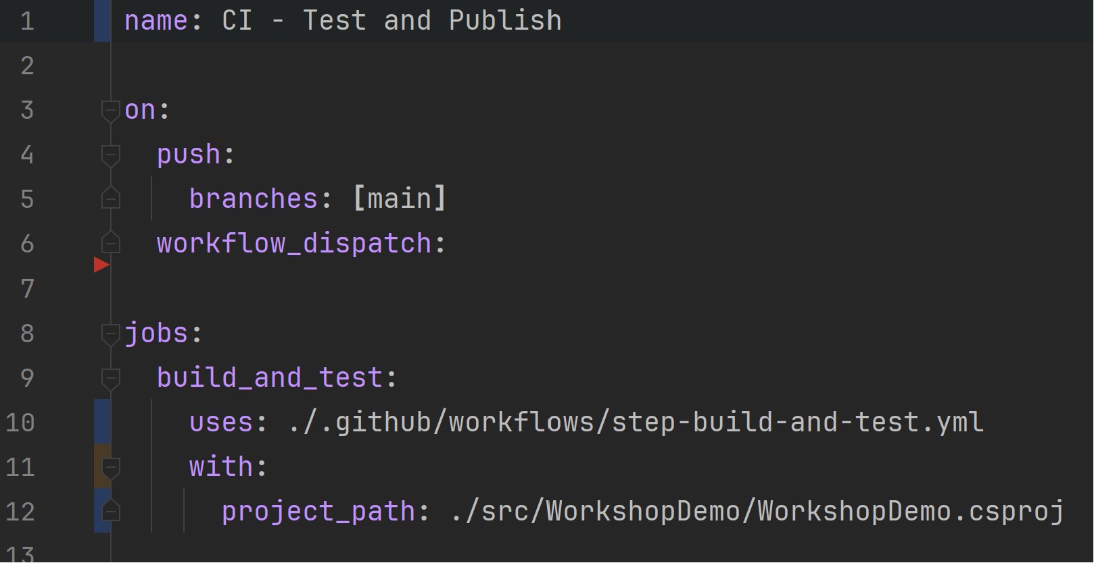
How do I consume this reusable workflow?
scottsauber

Slide 38
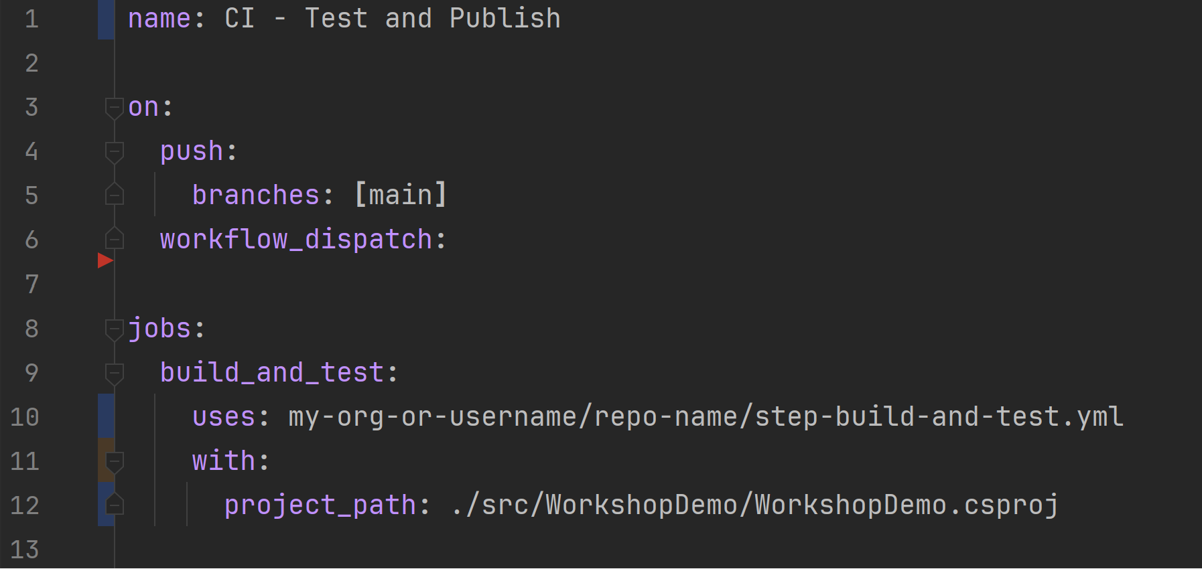
How do I consume this from another repo?
scottsauber

Slide 39
Live Demo

Slide 40
Hands On

Slide 41
Takeaways
How to leverage Azure
Why Infrastructure as Code is useful and how Bicep works
How GitHub Actions fits into the big picture
Some takeaway tips even if you had experience with this stuff
scottsauber

Slide 42
Resources
Slides at scottsauber.com
https://github.com/scottsauber/workshop-dotnet-azure-github-bicep
The “final” branch has the final state of things
scottsauber

Slide 43
Questions? Contact: ssauber@leantechniques.com
Slides at scottsauber.com
scottsauber

Slide 44
Thanks!
Slides at scottsauber.com
scottsauber

