Slide 1

GitHub Actions: From Zero to Hero
Scott Sauber
Director of Engineering, Lean TECHniques Inc

Slide 2


Slide 3
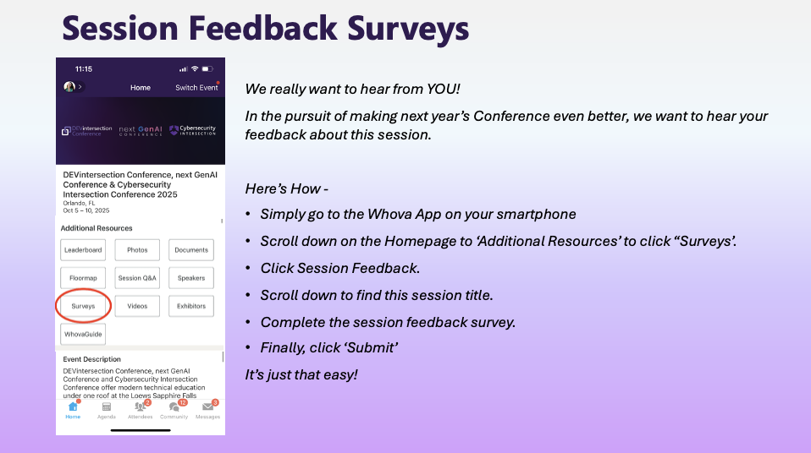

Slide 4
Audience
Anyone using GitHub Actions
Anyone thinking about moving to GitHub Actions (more on this later)
People interested in DevOps but rarely/never get to do it

Slide 5
Agenda
What is CI and the two CDs?
Things every CI/CD workflow should have
What are GitHub Actions
GitHub Actions concepts
How to share GitHub Actions across the enterprise
Configuring Optimal GitHub Settings
Practical GitHub Actions Tips

Slide 6
Goals
Understand what GitHub Actions are
Takeaways even if you’re experienced with GitHub Actions

Slide 7





Who am I?
Director of Engineering at Lean TECHniques
Microsoft MVP
Dometrain Author
Redgate Community Ambassador
Co-organizer of Iowa .NET User Group

Slide 8

Poll
How many people using GitHub already?
How many are using GitHub Actions?
How many feel like they’re pretty intermediate to advanced with GHA?
What other CI/CD tools are people using?
Why are you here? What do you want to learn?
scottsauber

Slide 9
Let’s talk CI + CD + CD first

Slide 10
What is Continuous Integration?
Automated verification of your application
Generates artifacts
Compiles the app
Runs the tests
Independent witness – eliminates “works on my machine”
scottsauber

Slide 11
What is Continuous Delivery?
Takes artifacts from CI and deploys them automatically
Doesn’t deploy all the way to Production
Deploying to Production is a button click
scottsauber

Slide 12
What is Continuous Deployment?
Deploys all the way to Production automatically
If the pipeline is green, it’s going to Production
scottsauber

Slide 13
Why CI/CD?
Avoid manual steps (chances for mistakes)
Repeatable
Auditable
Humans need less permissions
scottsauber

Slide 14
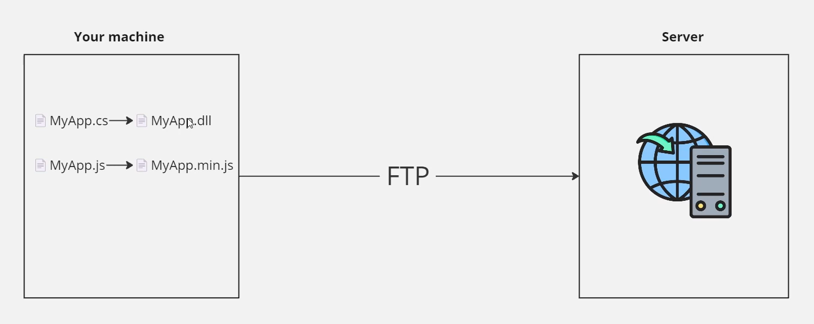
Before CI/CD
scottsauber

Slide 15
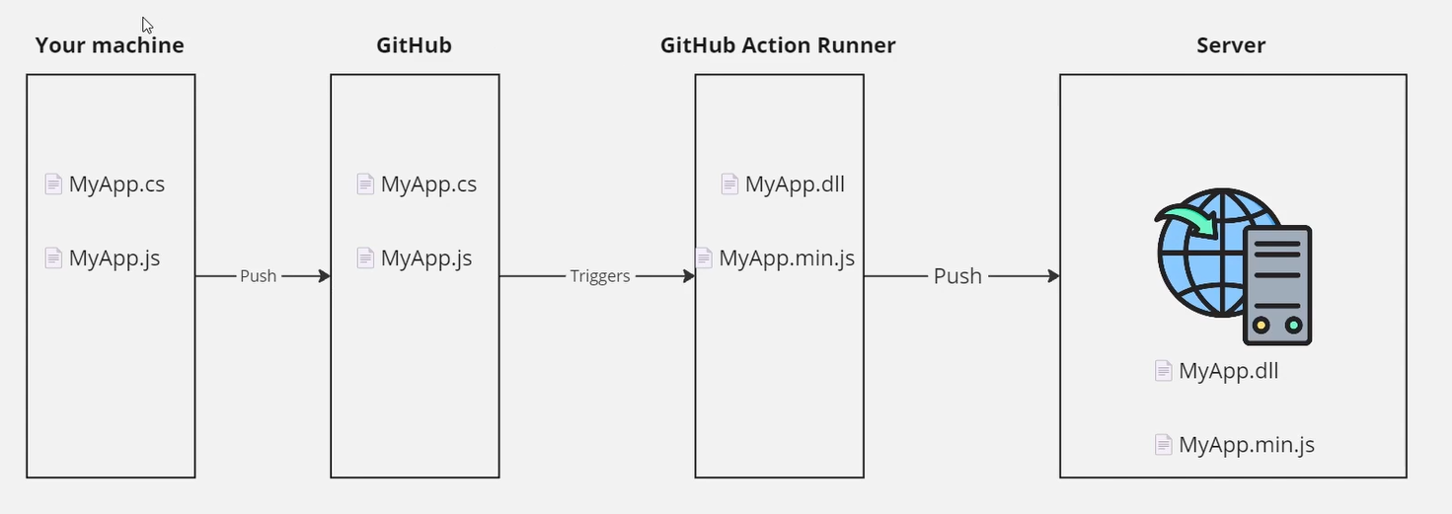
After CI/CD
scottsauber

Slide 16
Confident Green
If our build passes – why aren’t we shipping to Production?
Likely lack of confidence or automation
Likely missing automated tests or zero downtime deployments
Let’s fix that
Ok now why?
Repeat
scottsauber

Slide 17
Ideal CI Pipeline
Restore Packages
Compile
Test
Format
Linting
Security Scans
Upload Artifacts
Alerting on Failure
scottsauber

Slide 18
Ideal CD Pipeline
Download Artifacts
Deploy Artifacts (IAC, DB changes, Application)
Zero Downtime Deployments
Smoke Tests
Security Scans
Alerting on Failure
scottsauber

Slide 19
GitHub Actions

Slide 20
What is GitHub?
Most popular place for storing source code
Both public and private
80% of our clients are on GitHub, ~20% on Azure DevOps
Some moved from BitBucket in last 2-3 years
scottsauber

Slide 21
What are GitHub Actions?
Built into GitHub
Thing Doer on a trigger
Trigger could be PR, push to a branch, open an issue, cron, etc
Usually used to automatically build and deploys your application
Written using YAML
Use a GHA Extension in your editor
~70% of our clients are using GitHub Actions
Most of these have moved in last 2-3 years (Aug 2018 GHA came out)
scottsauber

Slide 22
GitHub Actions Concepts
Steps – individual actions to be executed (ie restore packages, compile, etc)
Jobs – a series of Steps
Workflows – a series of Jobs
Triggers – something that kicks off the workflow
Inputs – parameters to customize a job
Secrets – sensitive data store in GitHub, can be leveraged in a Workflow
Runners – Virtual Machines that run Jobs, could be GH-hosted or self-hosted
scottsauber

Slide 23
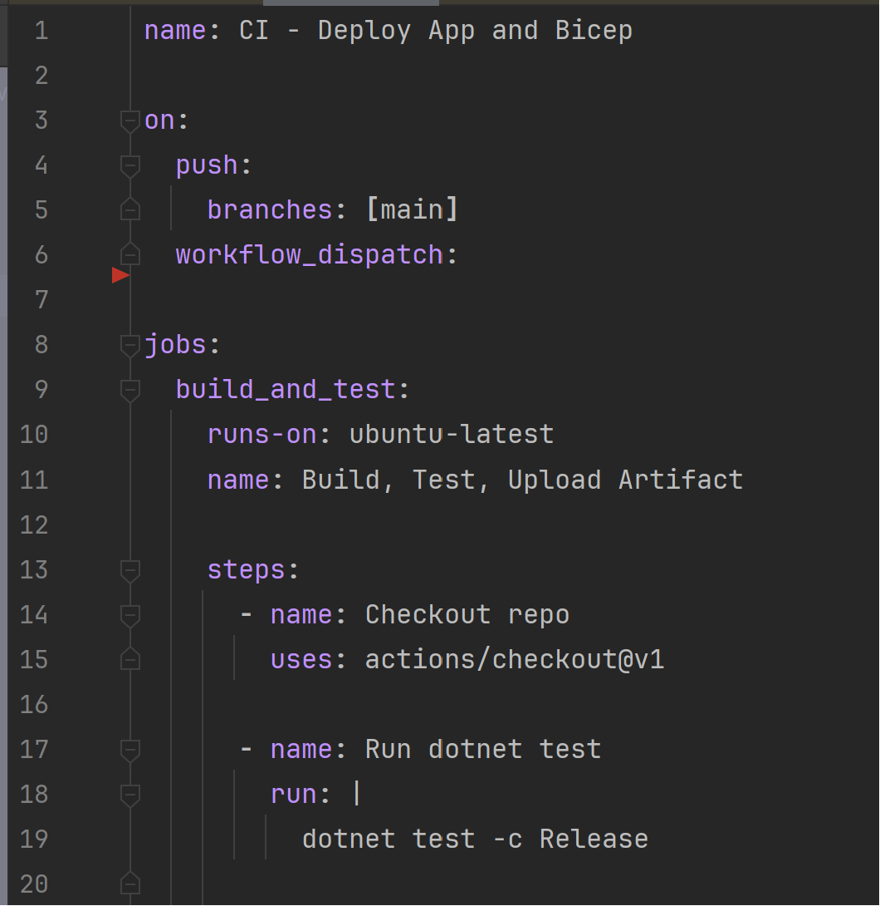
Example
scottsauber

Slide 24
Live Demo
Notes:
Show Market

Slide 25
Optimal* GitHub Settings * synonym for “my opinions”

Slide 26
Optimal GitHub settings
Repo => Settings
Pick 1 merge strategy – I use Squash bc most people suck at making a good history
✅Always suggest updating pull request branches
✅Allow auto-merge
✅Automatically delete head branches (GitHub flow or TBD)
✅Configure required status checks as Ruleset (note: merge first)
scottsauber

Slide 27
Optimal GitHub settings
Ruleset
Enforce PRs
Enforce Reviewer Count
Enforce Status Check must pass
scottsauber

Slide 28
Reusable Workflows

Slide 29
Reusing Workflows
Copying Pasting YAML feels kinda bad
GitHub Actions allows reusing workflows via `workflow_call` trigger
scottsauber

Slide 30
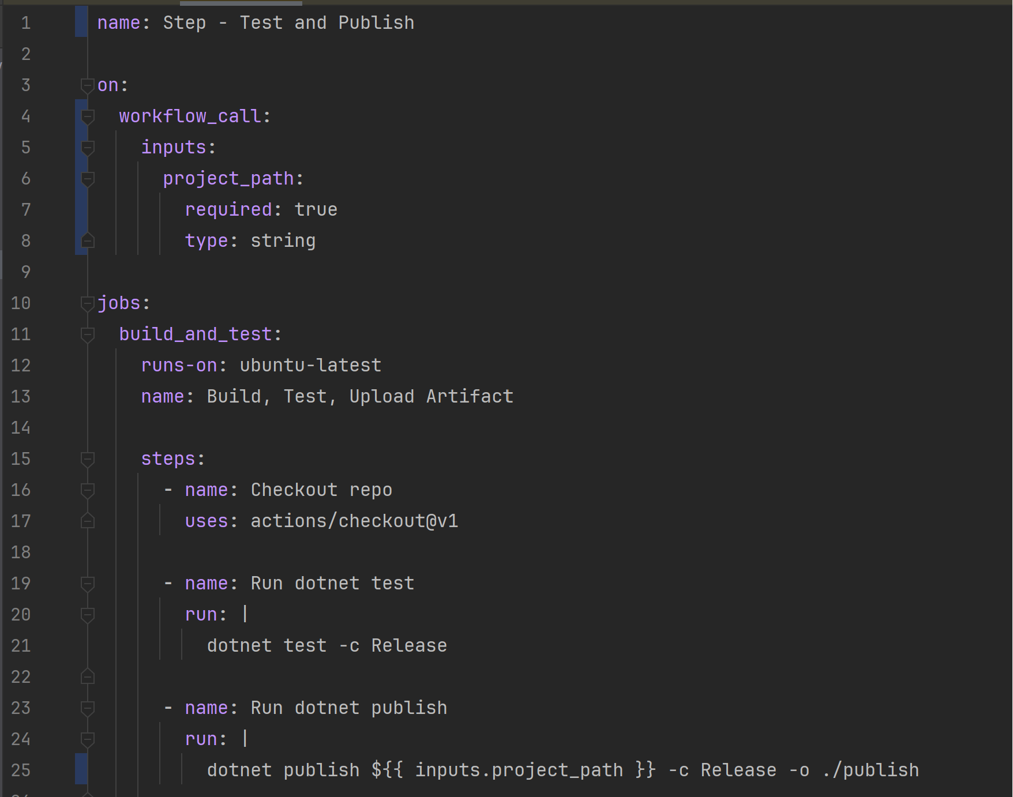
How do I reuse workflows?
scottsauber

Slide 31
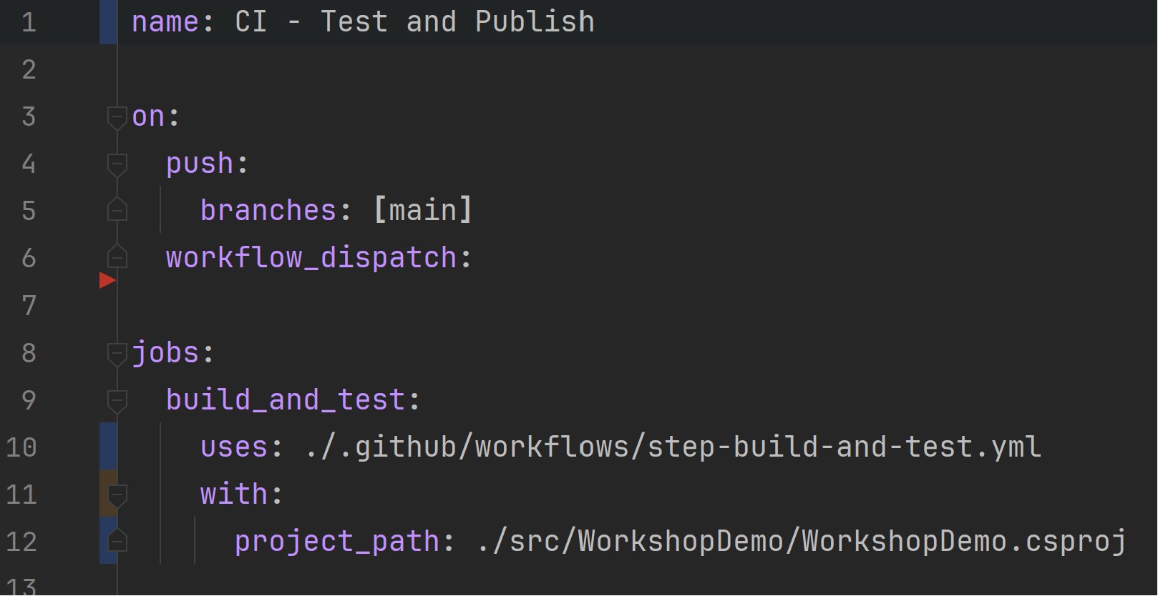
Consume reusable workflow
scottsauber

Slide 32
Reusable Workflows In Another Repository

Slide 33
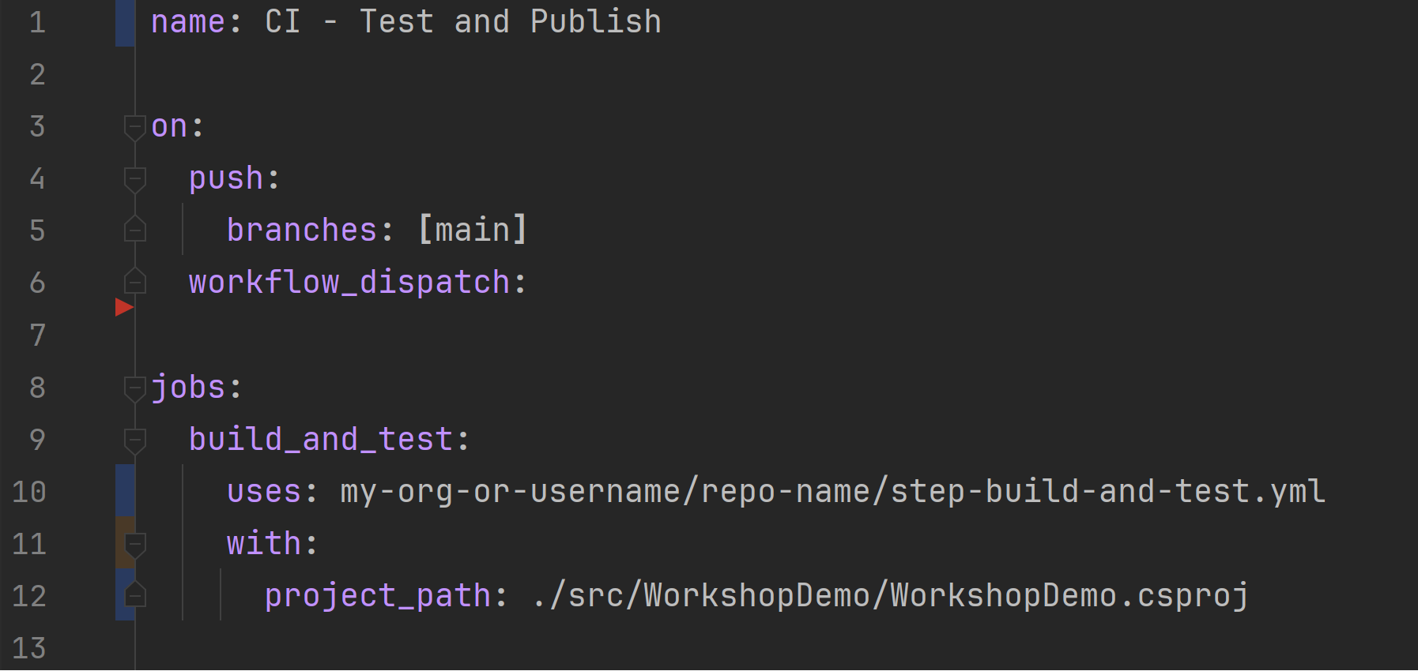
Consume reusable workflow from another repo
scottsauber

Slide 34
Random GHA Tips

Slide 35
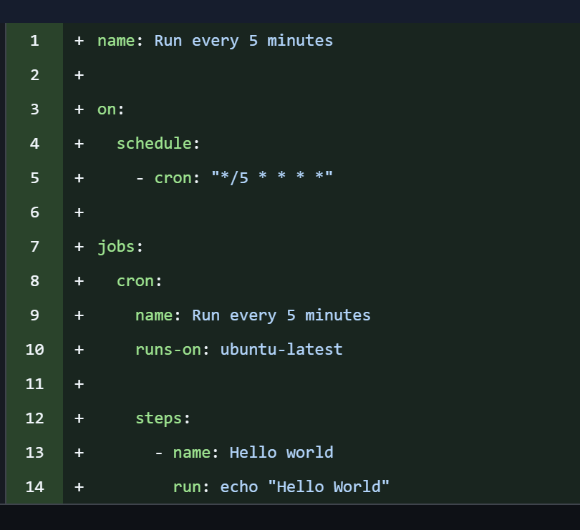
Cron Jobs
Not meant to be an enterprise scheduler
No guarantees it runs the time you tell it to
I’ve seen it run consistently, but up to 15 minutes later
scottsauber

Slide 36
Cron Jobs
Useful for running security scans for repos that don’t get touched very often
But also run security scans on each change
Don’t use this to run a daily build, run a build on every commit
scottsauber

Slide 37
Environments
Allow you to define the environments for deploying your application
Useful to see what’s deployed successfully
Allows you to set “Required Approvers” for things like the Production environment
Allows you to use environment secrets
scottsauber

Slide 38
Live Demo
Notes:
Show Market

Slide 39
More Random tips
Leverage ChatGPT/Copilot/Cursor/Claude Code – they’re really good at YAML
path filters
Sparse checkouts
scottsauber

Slide 40
More Random tips
When deploying to the cloud – use Federated Credentials (Azure) or Federated Identity (AWS)
Passwordless
Allows you to authenticate and say “this org and repo can deploy to this account”
This is something we check on our Azure Cloud Health Check and 90% of companies aren’t doing this
scottsauber

Slide 41
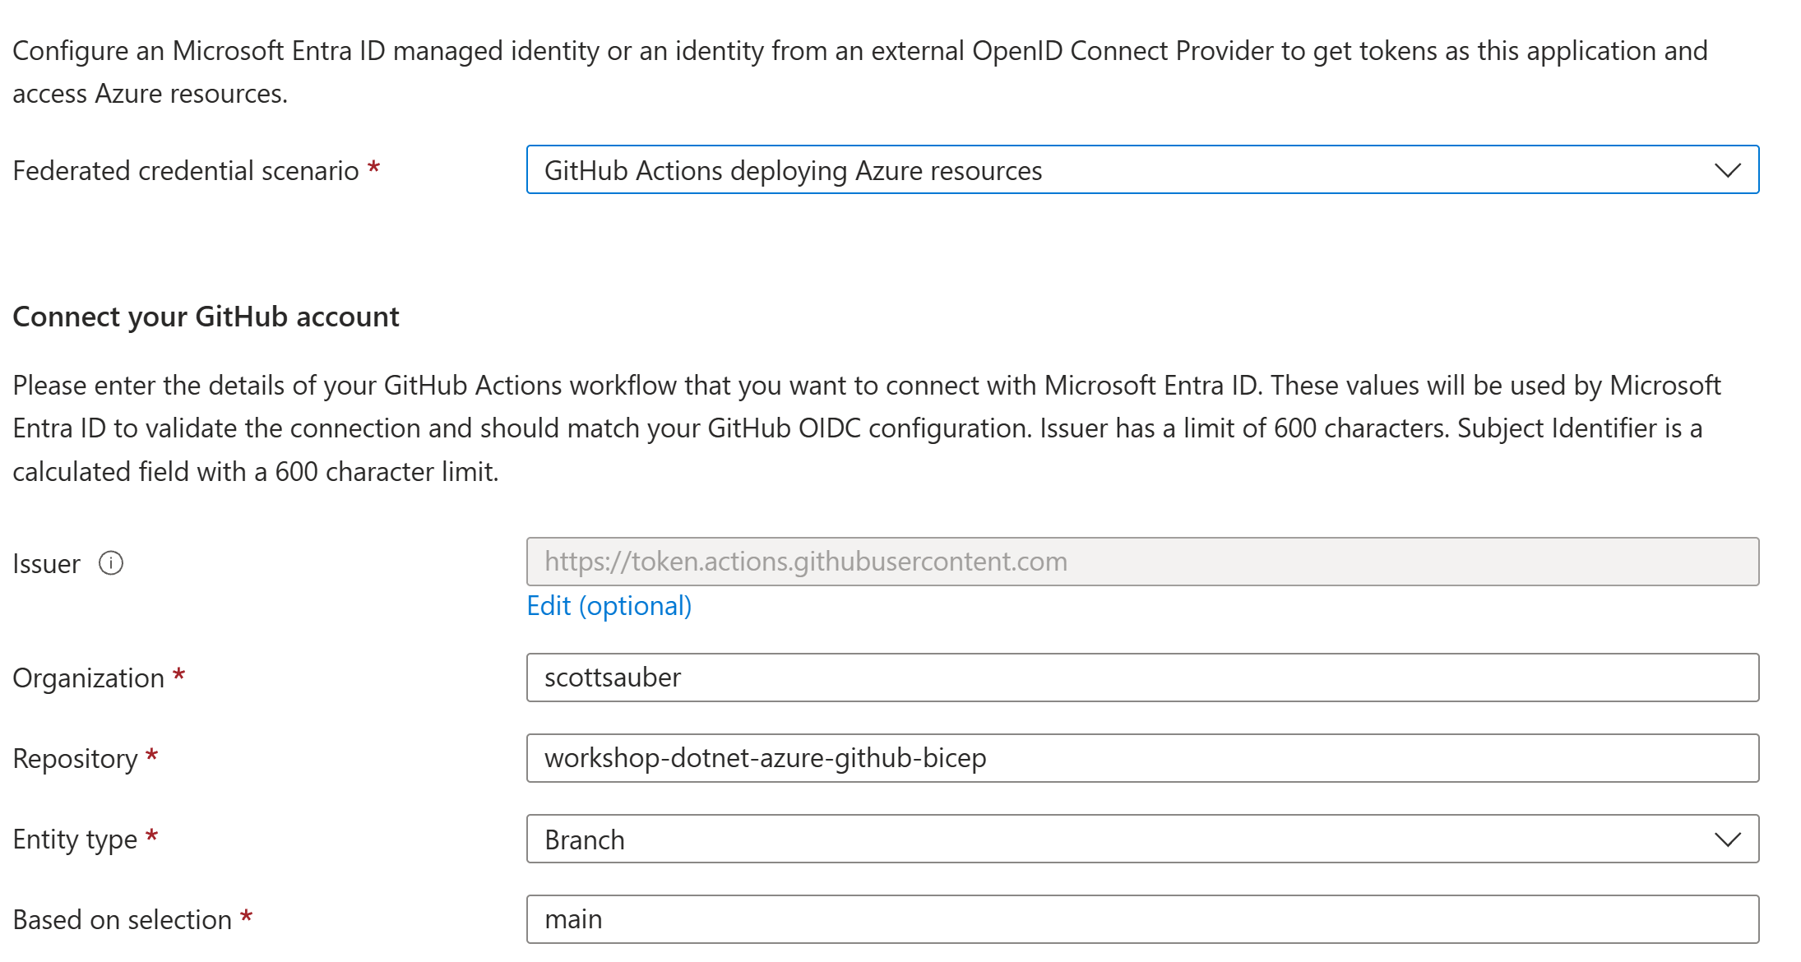
More Random tips
scottsauber

Slide 42
“But I’m on Azure DevOps”
Azure DevOps is NOT going away anytime soon
Azure DevOps is NOT going away anytime soon
Microsoft uses AzDO heavily
“The strategic long term investment is in GitHub”
GitHub has thousands of people working on it, Azure DevOps has a couple hundred
Quietly Microsoft sales folks are pushing people to GitHub
Microsoft Build had 1 session on AzDO, GitHub referenced 67 times
And the AzDO session was - Making Azure DevOps and GitHub Greater than the Sum of their Parts
scottsauber

Slide 43
Resources
This slide deck
https://github.com/scottsauber/github-actions-workshop
https://github.com/scottsauber/workshop-dotnet-azure-github-bicep
scottsauber

Slide 44
Takeaways
Get you familiar with GHA if you weren’t already
Ideas if you’re already on GHA, how you can use it better
scottsauber

Slide 45

Questions? ssauber@leantechniques.com @scottsauber.com on Bluesky @scottsauber on Twitter
Add me on LinkedIn:
Slides at scottsauber.com

Slide 46
Thanks!
Slides at scottsauber.com

Slide 47


