Slide 1

Practical AI Productivity Tips
For The Too Busy Developer
@scottsauber
Slides at scottsauber.com

Slide 2
Audience
Looking for ideas how to best leverage AI
Been too busy shipping value to pay attention
This’ll be a 100-200 level talk
More than just “AI in your IDE”
This an all day workshop, but we have 60 mins
@scottsauber

Slide 3
Poll
Who’s using AI tools? Every day?
Copilot?
Claude Code?
Codex?
Cursor?
Windsurf?
Something else?

Slide 4
Poll
How many people AI is writing 99%+ of their code?
Most of their code?

Slide 5
Agenda
Am I still going to have a job?
Define all the AI Buzzwords like Context, Instructions, Skills, and more
Talk about tools like Copilot and Claude Code
Show some demos
Practical Tips about where AI fits and where it doesn’t

Slide 6
Goals
Give you ideas you can start using today
Where AI tooling is going in the future
@scottsauber

Slide 7





Who am I?
Director of Engineering at Lean TECHniques
Microsoft MVP
Dometrain Author
Redgate Community Ambassador
Co-organizer of Iowa .NET User Group

Slide 8
Am I going to be out of a job?

Slide 9
History Lesson (2000s – Present)
What set teams apart was their commitment to modern engineering practices and modern work practices – proven by DORA
Fast feedback
Working in small batches
Learning Culture
Automated Tests
CI/CD
Cloud
Database Automation
Monitoring and Observability
And more…
@scottsauber

Slide 10
Which ones are still relevant in an
AI-dominated world?

Slide 11
History Lesson (2000s – Present)
What set teams apart was their commitment to modern engineering practices and modern work practices
Fast feedback ✅
Working in small batches ✅
Learning Culture ✅
Automated Tests ✅
CI/CD ✅
Cloud ✅
Database Automation ✅
Monitoring and Observability ✅
And more…
@scottsauber

Slide 12
The Fundamentals
Remain The Same

Slide 13
Jevon’s Paradox
Economic Principle of increasing the the efficiency of a resource actually leads to more use, not less
More fuel efficient engines, means cheaper travel, which encourages people to drive, which means more fuel consumption
Faster Internet speeds has led to more internet usage not less (ie streaming)
If history repeats itself - becoming more efficient with creating software will actually result in MORE software, not less
Building faster changes the Build vs Buy equation
We all still have jobs!
@scottsauber

Slide 14

“SaaS is Dead.”
- Satya Nadella, Microsoft CEO

Slide 15
These tools are the worst they will ever be today.

Slide 16
Alright let’s talk
AI Tools

Slide 17
AI is an Amplifier
Good practices – move faster at high quality
Bad practices – move faster at lower quality
How do you verify your app works? Compile, Tests, Lint, Format. Are you doing those things already?
Do you have judgement to know when AI went off the rails?
Your PR output might 2-10x when using AI correctly
Do your PRs sit for days without reviewing already?
Do you rubberstamp PRs?
You still own the code – not AI
@scottsauber

Slide 18
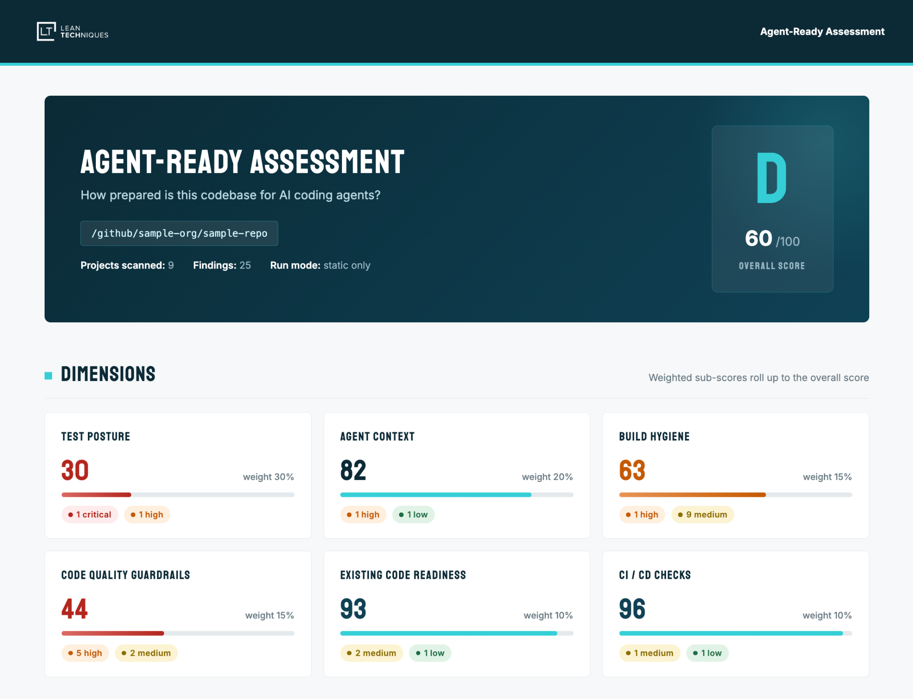
Agent Ready Assessment
@scottsauber

Slide 19
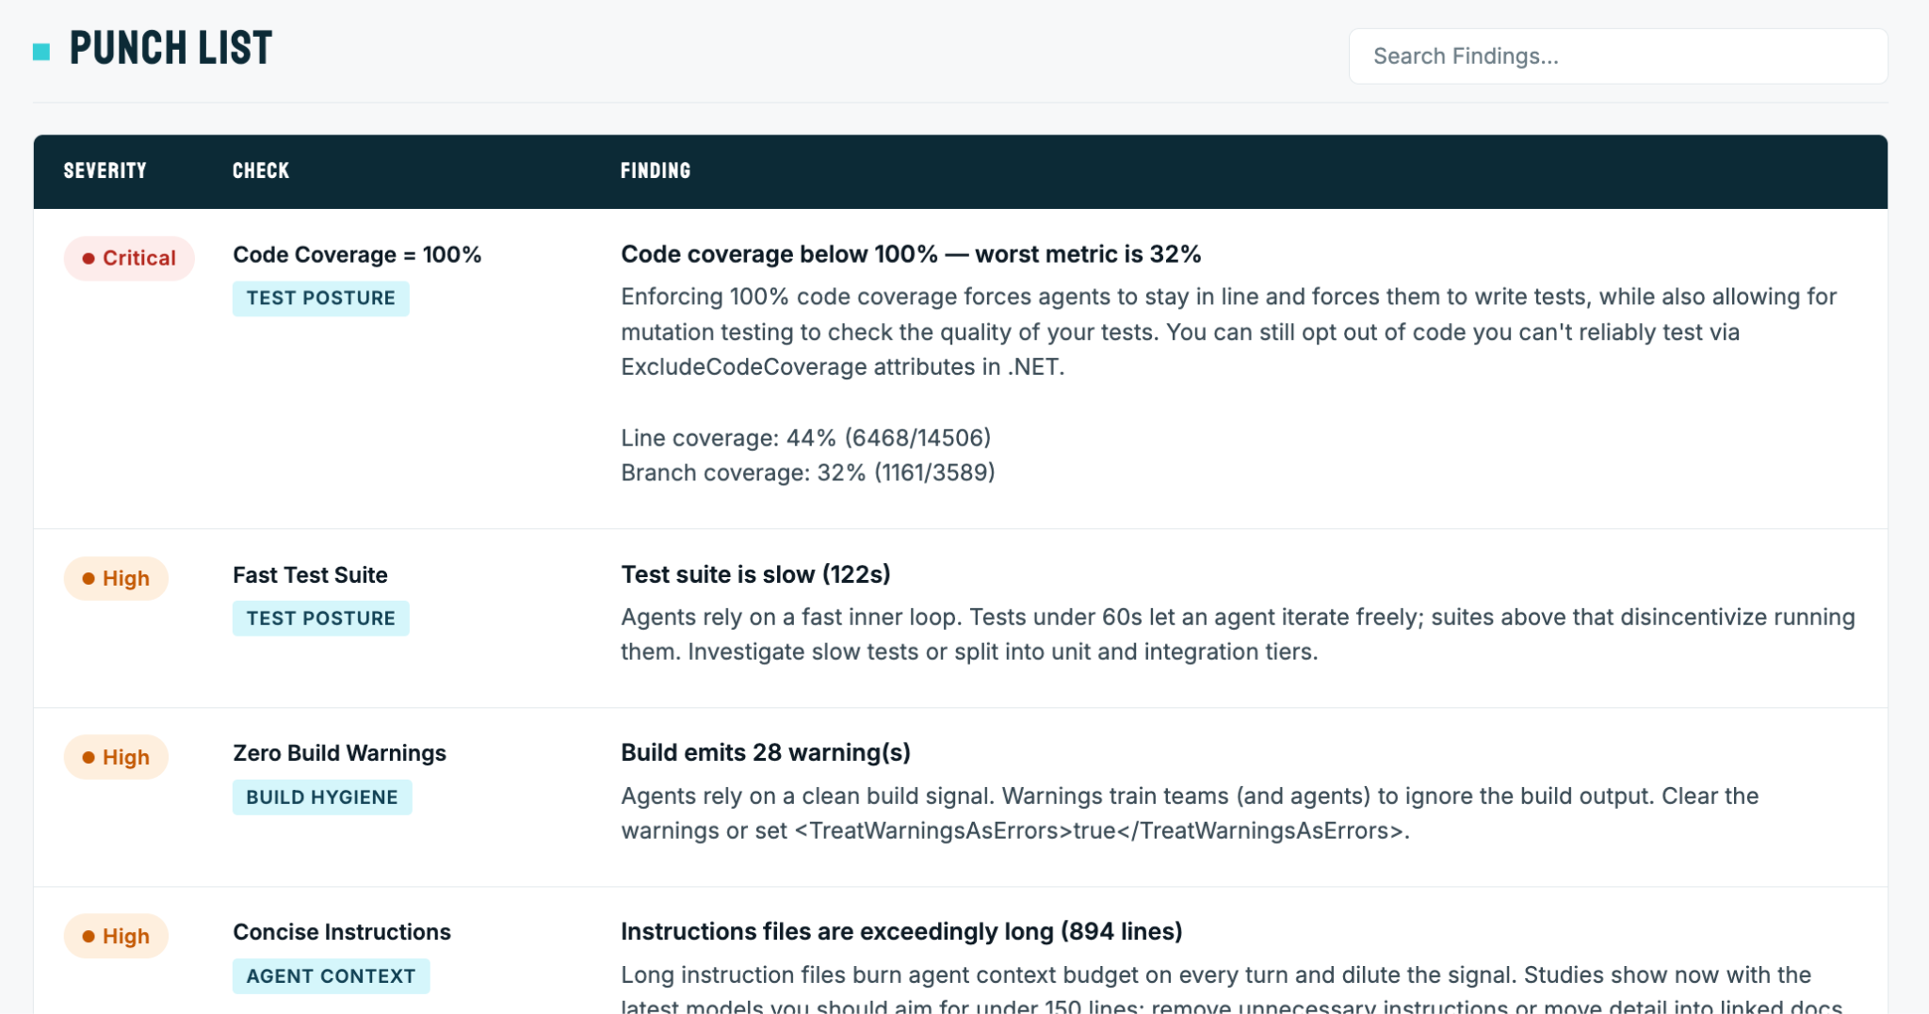
Agent Ready Assessment
@scottsauber

Slide 20
Where I’m at today
AI writes 99% of my code
I review every line – I’m still responsible
Speed is 10x faster, Quality is Higher – forced me to automate more
Running 2-4 agents at once
Mostly use the CLI – you should start here – starting to use Copilot App (when using Copilot)
@scottsauber

Slide 21
Large Language Models
Engine trained on massive amounts of text to learn patterns of meaning
Literally just predicts one token at a time based on probabilities
Best Models is a misnomer – it’s tradeoffs
Accuracy vs Cost vs Speed
Opus is the “best” model for one-shotting code in my experience, but it’s the most* expensive and often slow (* until Fable)
Haiku responds very quickly, but isn’t as deep
Sonnet tries to balance these two
@scottsauber

Slide 22
Context
The information an LLM is allowed to consider for a request
LLMs have a limited Context Window
What makes up Context:
Conversation History
Code in your repo
User Prompt
Instructions
Clearing context is key – when one task is done, /clear
Compacting can also lead to hallucinations
@scottsauber

Slide 23
AI Dev Tools
Unifies LLMs with codebases to provide the most context to get the best results
GitHub Copilot (most ubiquitous)
Claude Code (best AI dev tool)
  Preview Feb ‘25, GA May ‘25
Cursor (best autocomplete)
Lots of others
Best == my opinions and experiences
Autocomplete is nice… but you shouldn’t be using it anymore
@scottsauber

Slide 24
Instructions
Set of Markdown files to define your team’s/organization’s rules
“Don’t use Arrange, Act, Assert comments in tests”
Tip: anything the agent does wrong? Add it to your Instructions
  This is key
Used to be you should tell AI about your standards, your folder structure, etc
Nowadays – delete everything except Don’ts per Boris Cherny
@scottsauber

Slide 25


Slide 26
Instructions Everywhere
Every tool now respects AGENTS.md in the root – except Claude Code
.cursorrules, .cursor/rules
CLAUDE.md
GEMINI.md
.github/instructions/copilot-instructions.md
@scottsauber

Slide 27
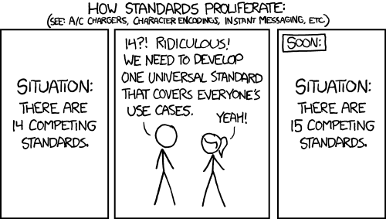

Slide 28
Skills
Rather than loading all those Instructions into context every time, what if we just did it selectively as needed?
Also can be used to automate workflows
.github/skills/<skill name>/SKILL.md
.claude/skills/<skill name>/SKILL.md
  Recognized by Copilot too
.agent/skills/<skill name>/SKILL.md
Just became a thing in October 2025
https://github.com/anthropics/skills
@scottsauber

Slide 29
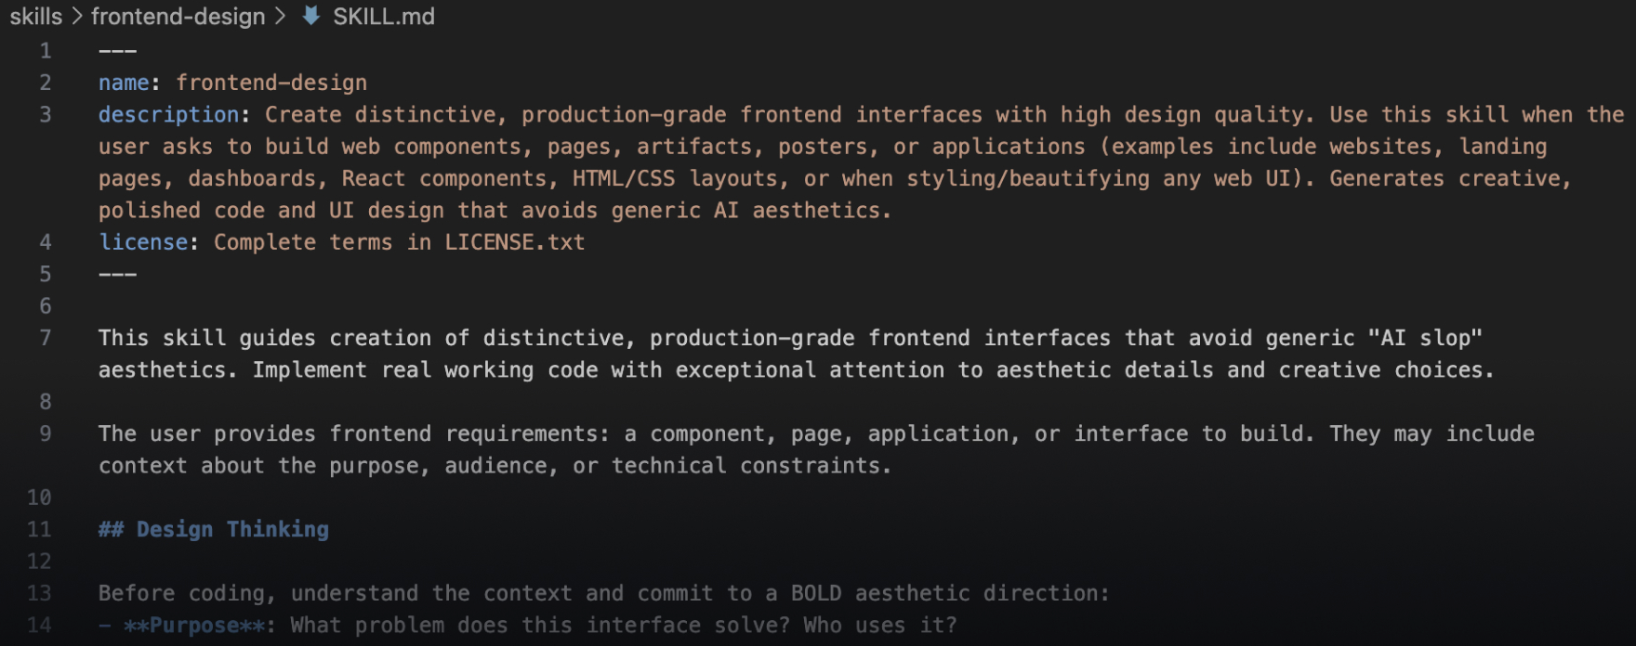
Skills
@scottsauber

Slide 30
Skills vs Commands
Both automate tasks or workflows
Commands can only be invoked by a user by /command-name
Skills can be invoked by a user (by /skill-name) or an agent
In general – prefer Skills
@scottsauber

Slide 31
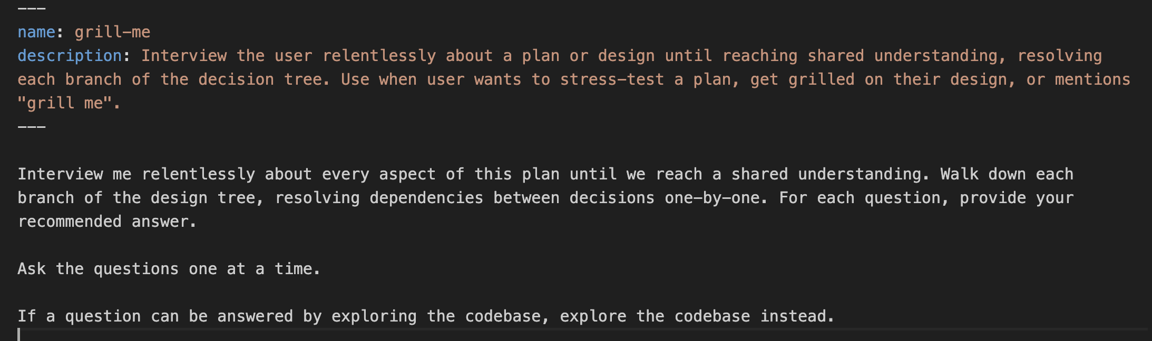
Skills
/grill-me <abc-123>
/grill-me Add a button to this page
@scottsauber

Slide 32
Starter Workflow
👨 Switch to Plan Mode
👨 /grill-me <Jira ID or Task>
👨 Answer any questions
👨 Review and Approve AI generated Plan
🤖 AI executes the code
👨 Reviews what it did
@scottsauber

Slide 33
Demo

Slide 34
Introducing /ship-it
👨 /grill-me on a GH issue, Jira issue, or just free text
👨 Approve plan and go on auto/autopilot mode
🤖 Create a new worktree
🤖 Implement the plan
🤖 Run the verify script til it passes (formatting, linting, tests, etc)
🤖 Run /code-review and fix anything you have a lot of confidence in. If it's a code style, back it up with reduced cyclomatic complexity or another metric that proves the code is better
❓👨 Present anything you're unsure about for approval (rare maybe 2% of the time)
🤖 Run /security-review and fix anything you have a lot of confidence in. If you're unsure then write a test to prove there's an issue
❓👨 Present anything you're unsure about for approval (rare maybe 1% of the time)
🤖 Open a Draft PR in my particular format using the /concise-pr skill
🤖 Watch CI and fix any build errors. If a test is flaky, root cause and fix it
🤖 Watch for the Copilot Code Review and fix any comments
❓👨 Present any comments you're unsure about for my review (uncommon, maybe 25% of the time).
🤖 Notify me when PR is green with no comments and ready for me to review
🤖 Mark PR ready for review (move out of Draft)
👨 Approve or request changes
@scottsauber

Slide 35
Demo

Slide 36
Top 10 AI Tips Today
Give AI a way to validate itself - compile, tests, format, lint, acceptance criteria, code quality, etc
Get good with the CLI first then graduate up (Copilot App is the best desktop UI imo)
Start with Plan Mode by default - graduate out of it when you feel comfortable
Auto Mode via `claude –enable-auto-mode` or autopilot in Copilot
Skills
CLIs over MCP servers - GitHub, Atlassian, Azure, etc
Be aggressive clearing context, <200K tokens is the Smart Zone… >200K is the Dumb Zone
Use AI to do code reviews - in GitHub and locally
Keep your AGENTS.md lean - cross cutting things, how to verify your app, not your code structure, delegate specific concerns to Skills
Keep an 👀 on AI
@scottsauber

Slide 37
How do I stay up to date?
Follow people on Twitter / LinkedIn
@bcherny – Boris Cherny who created Claude Code
@claudedevs – Claude Code Devs
@_evan_boyle – Evan Boyle, Copilot
@leeerob – Lee Robinson, Cursor
@code – VS Code
@housecor – Cory House, consultant
@scottsauber – a humble peasant
@scottsauber

Slide 38
Takeaways
Ideas on where AI is and where it’s going
Ideas you can start using literally today
Now’s the time to jump in, because the productivity is real
“Change has never been this fast but will never be this slow again.”
@scottsauber

Slide 39
Resources
This slide deck at https://scottsauber.com
If you’re interested in us 2x-ing your speed and uplifting your quality with AI Agents – talk to me
@scottsauber

Slide 40



Questions? ssauber@leantechniques.com
Add me on LinkedIn:
Slides at scottsauber.com
@scottsauber
@scottsauber.com

Slide 41
Thanks!
Add me on LinkedIn:
Slides at scottsauber.com

