Slide 1

10 Things Every Dev
Should Know about Azure
@scottsauber
Slides at scottsauber.com

Slide 2
Audience
Developers (examples in C# but if you’re not that’s okay)
Haven’t had much exposure to Azure
@scottsauber

Slide 3
Polls
How often are people in the Azure portal or in an IAC tool?
Every day?
Every week?
Every month?
Longer?
How many people are responsible for Azure?
How many people have a team or a person responsible for Azure who isn’t them?

Slide 4
Agenda
Structured as a series of lightning talks
Account Organization
DefaultAzureCredential (and why you shouldn’t be using it)
Naming Standards
Reservations and Savings Plans
Managed Identities
Federated Credentials
Azure Key Vault
Azure Monitor
Azure App Services
Azure Container Apps
Infrastructure As Code

Slide 5
Goals
Give you practical tips that can be applied immediately
Further understanding how Azure works and things you should be leveraging
@scottsauber

Slide 6

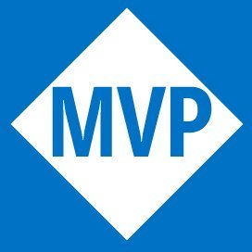


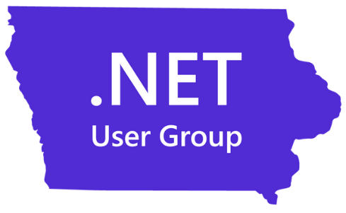
Who am I?
Director of Engineering at Lean TECHniques
Microsoft MVP
Dometrain Author
Redgate Community Ambassador
Co-organizer of Iowa .NET User Group and Iowa Code Camp

Slide 7
Account Organization

Slide 8
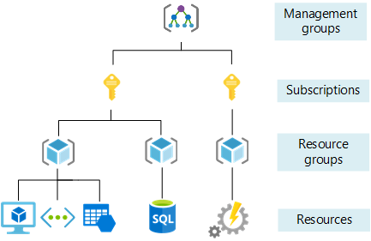
Subscriptions vs Resource Groups
Account Organization
Ignoring Management Groups bc you probably don’t care about those

Slide 9
Develop Account Organization Strategy
Account Organization
Subscriptions - It Depends™️
  Minimum: per environment boundaries
  Maximum: per team per environment boundaries
Resource Groups – always per app per environment
Service Groups – new as of May 2025
  Fancy tags
  Overlay to pull together across subscriptions, resource groups, etc – ie “Production apps” or “PCI Scope” or “MyApp”

Slide 10
Questions?

Slide 11
DefaultAzureCredential
(and why you should
NOT be using it)

Slide 12
Problem: People use DefaultAzureCredential…
DefaultAzureCredential
…without knowing the tradeoffs
DefaultAzureCredential is meant to get you into Azure as quickly as possible
The downside is – performance

Slide 13
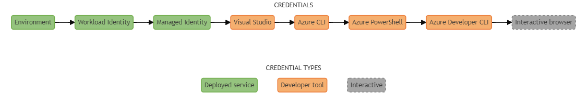
Problem: People use DefaultAzureCredential…
DefaultAzureCredential

Slide 14
Solution: Stop - Be explicit about credentials
DefaultAzureCredential
Locally – use AzureCli or VisualStudioCredential… else use ManagedIdentity
… or use Excludes on DefaultAzureCredential
This will save you ~2-10 seconds when interacting with the credential
DefaultAzureCredential Best Practices
My blog post on this in 2022

Slide 15
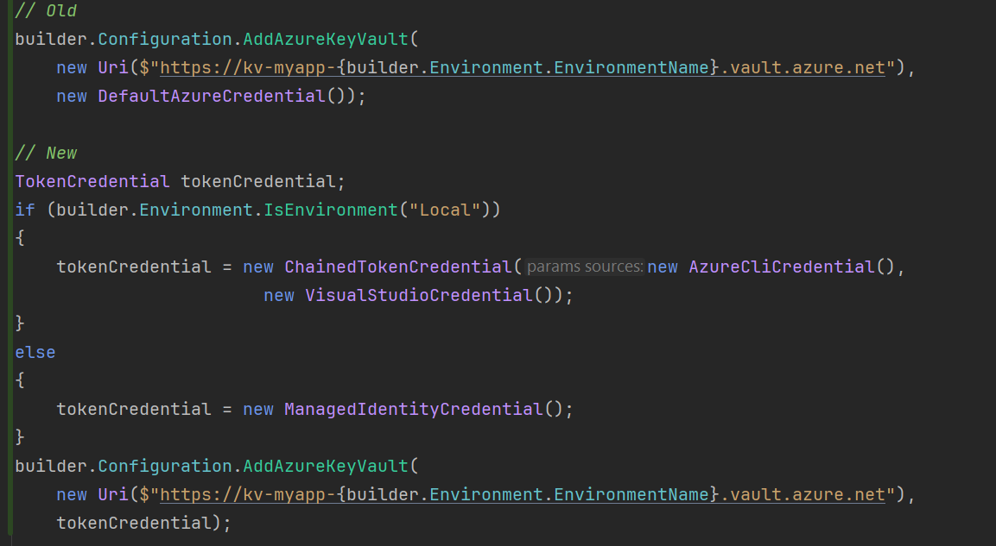
Solution: Be explicit about credentials
DefaultAzureCredential

Slide 16
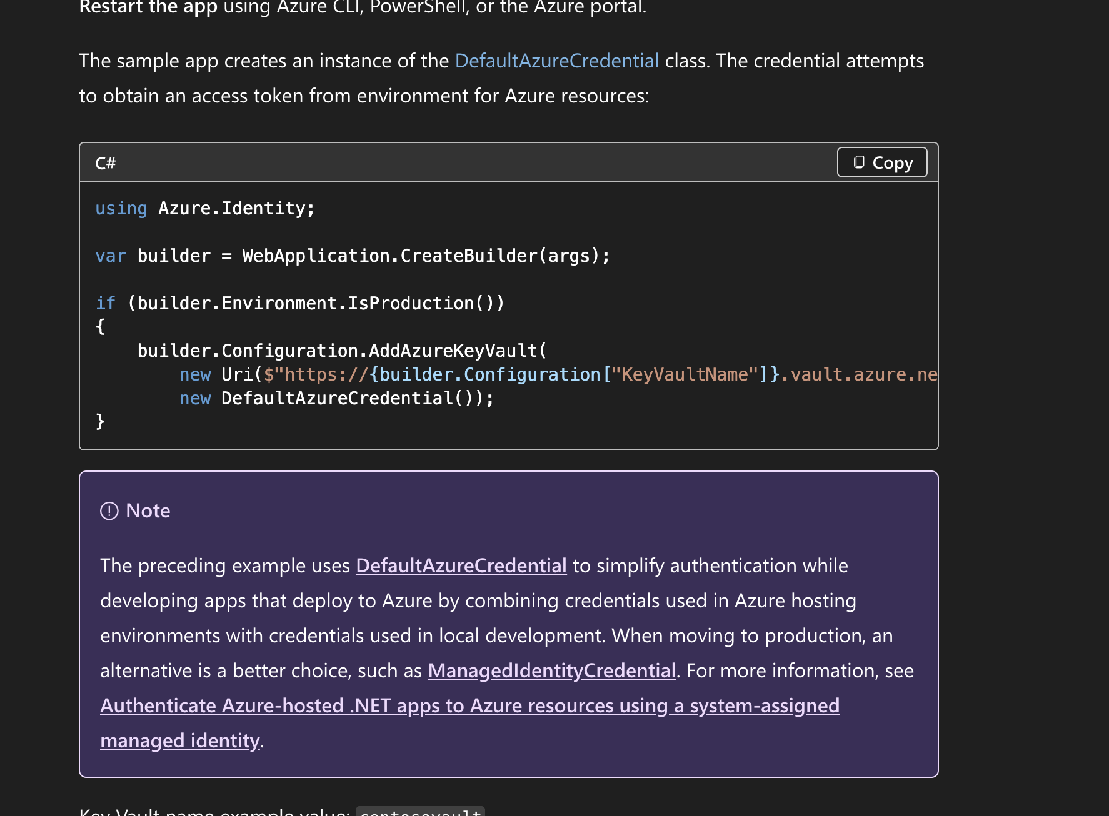
Microsoft trying to fix this
DefaultAzureCredential

Slide 17
Reuse Credential Instances
DefaultAzureCredential
Improve app resilience
Reduce number of token requests to Entra
Microsoft.Extensions.Azure package

Slide 18
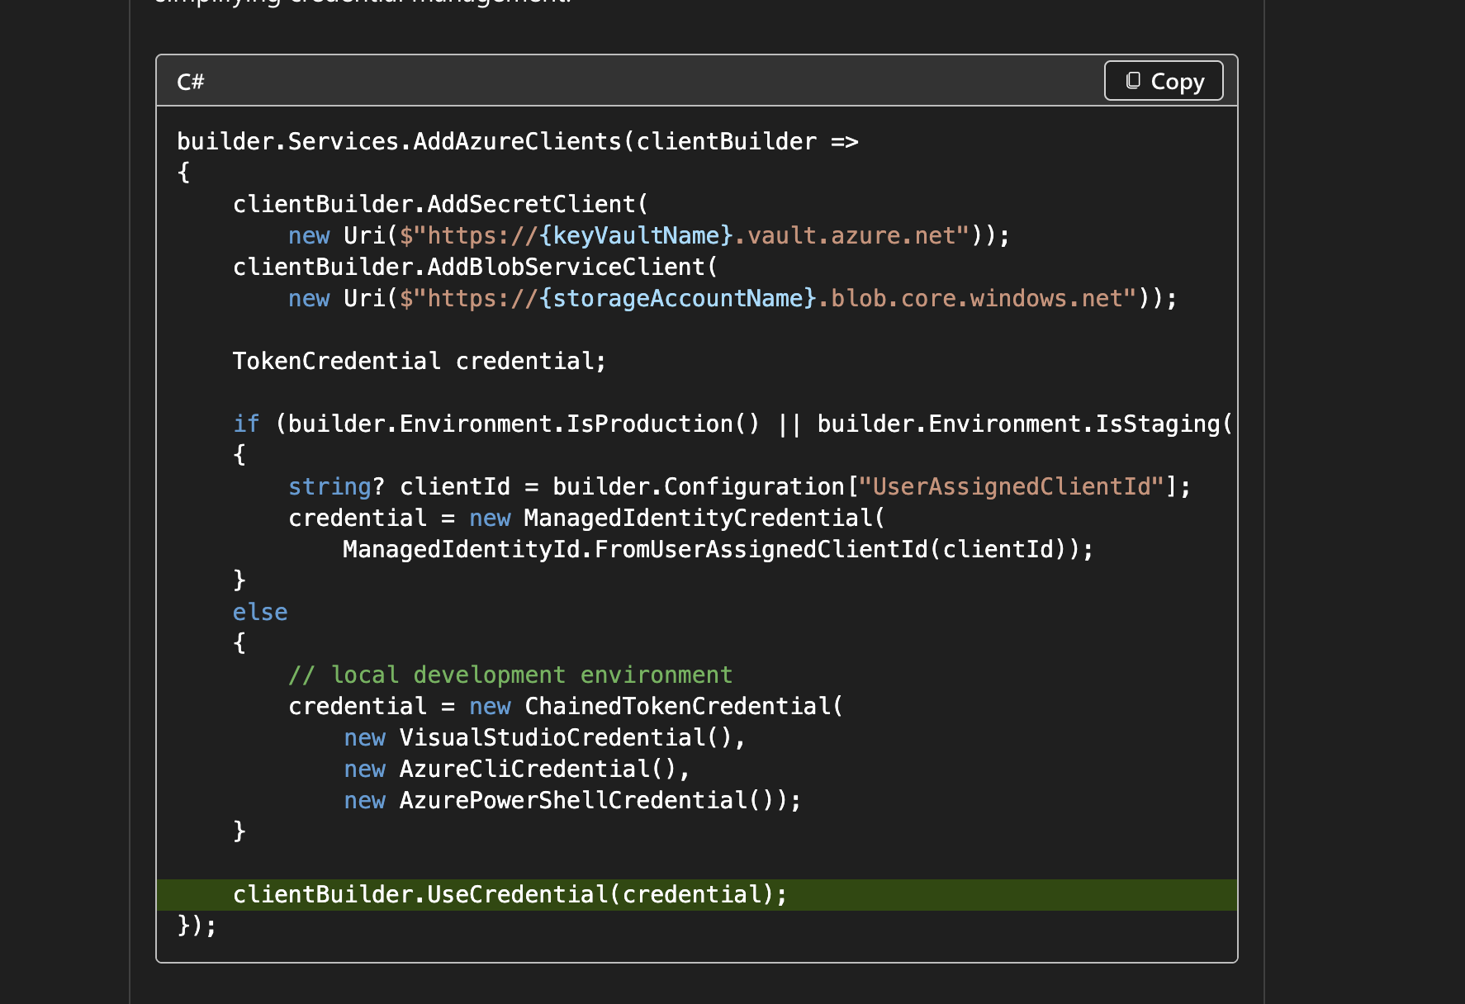
Reuse Credential Instances
DefaultAzureCredential

Slide 19
Resources
DefaultAzureCredential
https://learn.microsoft.com/en-us/dotnet/azure/sdk/authentication/best-practices?tabs=aspdotnet

Slide 20
Questions?

Slide 21
Naming Standards

Slide 22
Problem: Naming is a mess
Naming Standards
Who here feels good about their Azure naming conventions?
Naming has no consistency across apps, teams, divisions

Slide 23
Solution: Implement a Naming Standard
Naming Standards
Microsoft has a recommended naming convention based on recommended abbreviations
Example: app-navigator-dev-001 for an application called Navigator, that’s an App Service running in the Dev env
Azure has a naming tool you can run
AzureNamingTool
More important that you pick something and be consistent
Enforce with Azure Policy (more soon)

Slide 24
Questions?

Slide 25
Reservations
&& Savings Plans

Slide 26
Problem: Cost is getting too high
Cloud isn’t always cheaper up front
Sometimes cloud is about speed, lower TCO, and more visibility

Slide 27
Solution: Azure Reservations
Commit to using certain resources for 1 year or 3 years, get a discount between 20% - 70% depending on the resource (App Service Plans, SQL, VMs, Cosmos, etc)
Downside – what if you get rid of the resource after 2 years but you committed to 3
Still pay monthly or up front (if you want)

Slide 28
Solution: Azure Savings Plans
Commit to using certain spend $ for 1 yr or 3 yrs, get a discount
Can be used however you want across eligible resource types

Slide 29
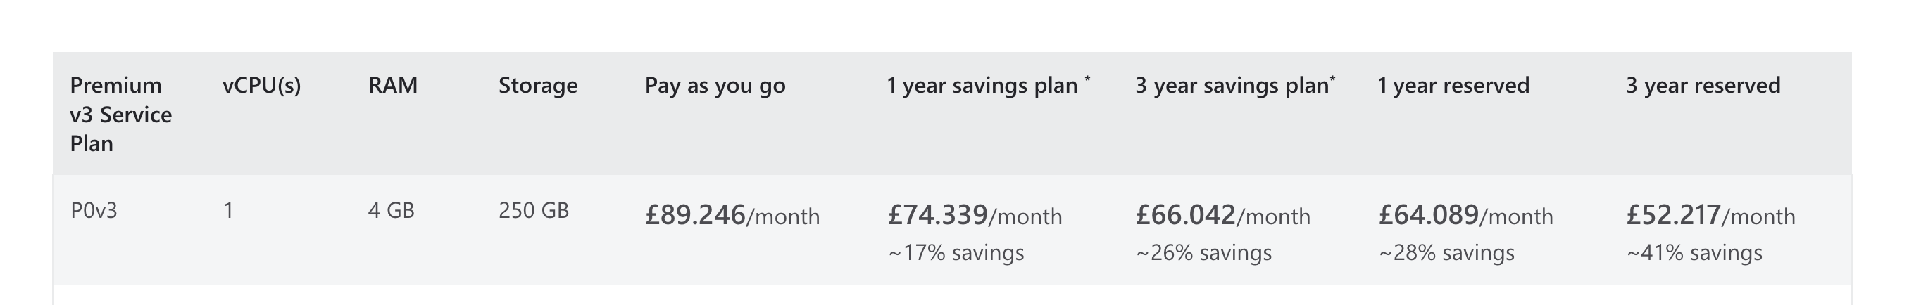
Comparing Savings Plans vs Reservations
Reservations give you more savings, but more risk if you need to change your plans
I recommend everyone use at least Savings Plans
Go tell your boss you can cut the Azure bill by at least 20% and get a promotion
Comparison of a single P0V3 App Service Plan:

Slide 30
Questions?

Slide 31
Managed Identities

Slide 32
Problem: We are managing credentials
Managed Identities
Credentials to manage – create, store, rotate, revoke
Azure SQL still using SQL Auth – username + password
Key Vault still using Client ID + Client Secret
Someone might accidentally commit a secret

Slide 33
Solution: Use Managed Identities
Managed Identities
Managed Identities allow you to give a resource an “identity” (user to run as essentially)
These Identities are managed completely by Azure – no username/password/client id/client secret needed
Assign a Managed Identity to an App Service/Function/etc
Give that Managed Identity access to read secrets, connect to a DB, etc
Completely passwordless
In your code you can use the ManagedIdentityCredential (not DefaultAzureCredential)

Slide 34
Questions?

Slide 35
Federated Credentials

Slide 36
Problem: Not using Federated Credentials
Federated Credentials
Your CI/CD pipelines need to auth to Azure to provision resources, deploy, etc
Without Federated Credentials, you’re managing a Client ID + Client Secret (most likely)
All the same issues managing credentials (create, store, rotate, revoke)
If someone gets these credentials, they can manipulate your Azure environment

Slide 37
Solution: Use Federated Credentials
Federated Credentials
Federated Credentials allows you to “trust” repositories to push to Azure
Passwordless
Short-lived tokens (minutes)
How to do this with GitHub Actions

Slide 38
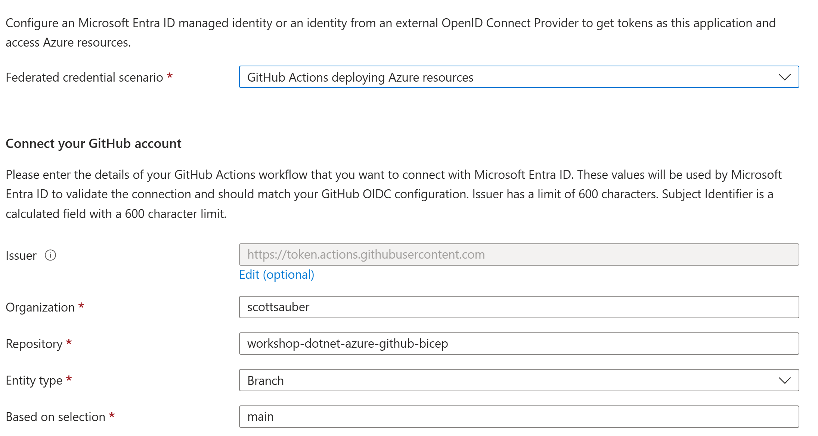
Solution: Use Federated Credentials
Federated Credentials

Slide 39
Questions?

Slide 40
Azure Key Vault

Slide 41
Azure Key Vault
Azure Key Vault
Where you can store Secrets, Keys, Certificates
Most of the time
You should be using RBAC not Access Policies
  Key Vault Secrets User can read secrets
  Key Vault Secrets Officer can read/write secrets
You should be using Managed Identities for your applications to talk to Azure Key Vault
  ie app-myapi-dev can talk to Azure Key Vault with Secrets User RBAC role
Create groups to assign your developers permission to those Key Vaults
Developers need at least ability to list secrets to see what’s there
  Key Vault Reader == list, but Key Vault Secrets Officer for r+w

Slide 42
Azure Key Vault in .NET
Azure Key Vault
$0.03 per 10,000 requests
Load secrets on startup
Azure.Identity Package
Azure.Extensions.AspNetCore.Configuration.Secrets

Slide 43
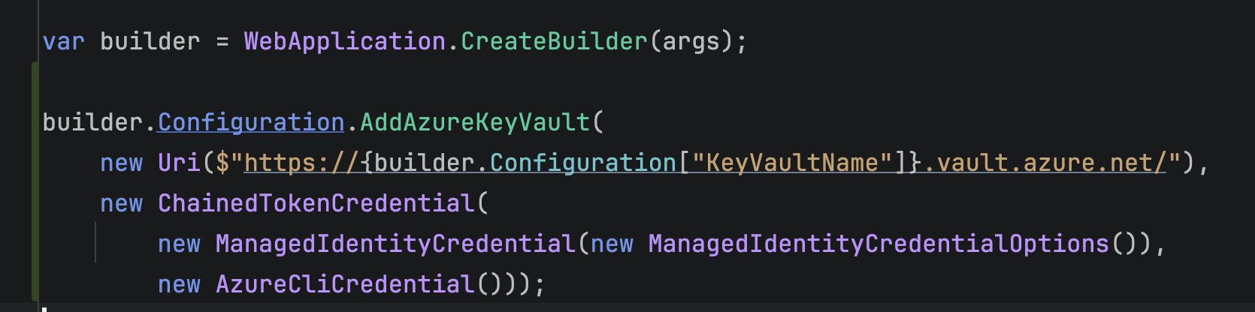
Azure Key Vault in .NET
Azure Key Vault

Slide 44
Use Azure Key Vault for Local Secrets
Azure Key Vault
If you have local secrets… API keys… etc
Don’t use `dotnet-secrets`
It’s ok for 1 or 2 person teams, not ok for large teams
Need to hand around magic JSON files or values
Instead create a Key Vault for local development
Shared by everyone
“But I need offline”
…what are you doing offline that you need a secret for?

Slide 45
Questions?

Slide 46
Azure Monitor

Slide 47
Azure Monitor
Azure Monitor
Conglomerate of Azure services
Azure Application Insights
Azure Log Analytics
Alerts
Dashboards
Workbooks

Slide 48
Azure Application Insights
Azure Monitor
APM tool
Answers questions like “Why is this page slow?” or “How is the system being used in Production?”
Also stores logs
Leverage Managed Identity to talk to Application Insights

Slide 49
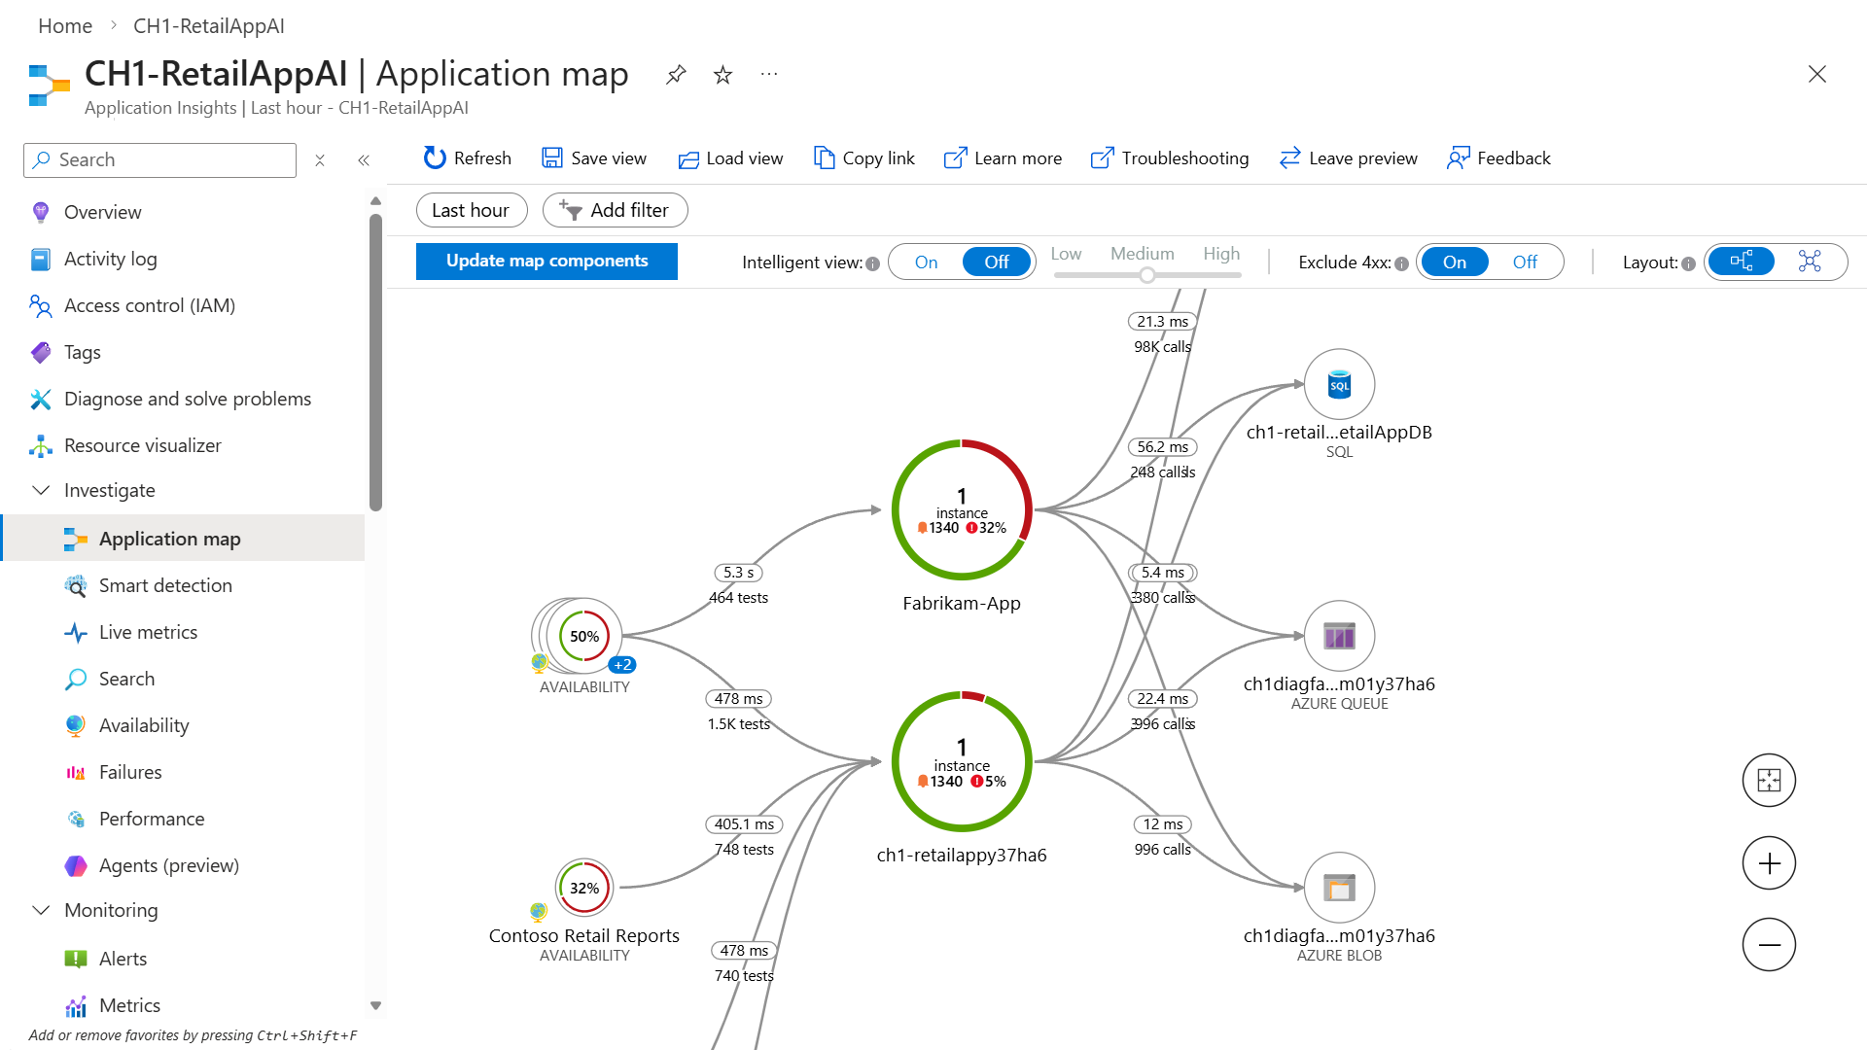
Azure Application Insights
Azure Monitor

Slide 50
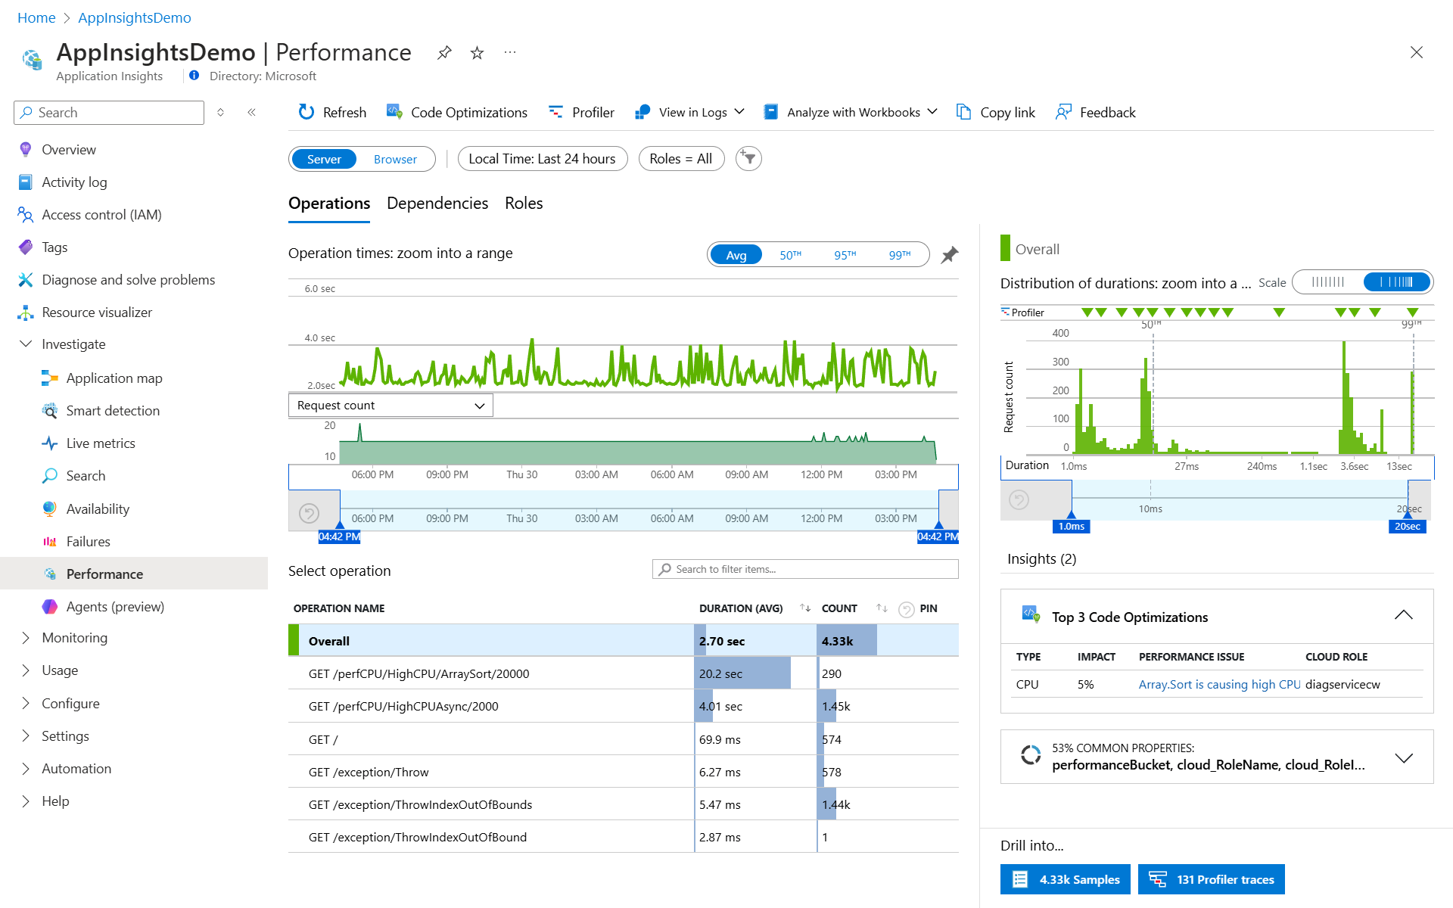
Azure Application Insights
Azure Monitor

Slide 51
Azure Log Analytics
Azure Monitor
Ingest in logs in centralized log aggregator – no log files
Be able to query those logs using KQL
Alert off logs

Slide 52
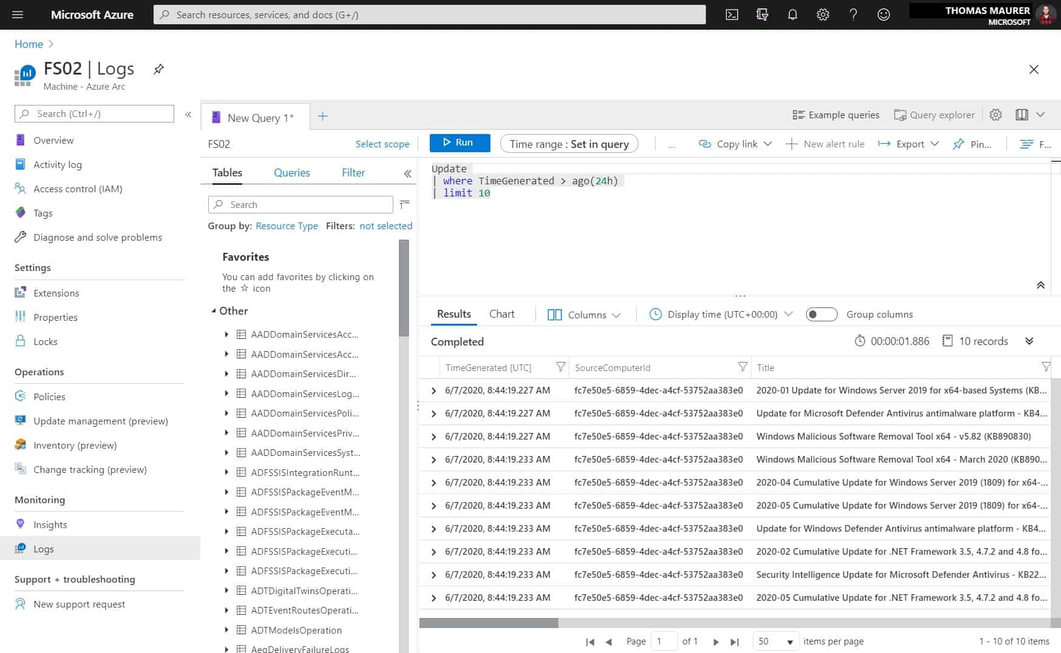
Azure Monitor

Slide 53
Questions?

Slide 54
Azure App Services

Slide 55
Azure App Service
Azure App Service
Simplest way of hosting a web app or API (imo) across major clouds
PaaS
Upload zip, select runtime, and go
Customize environment variables, custom domains, and more
Also able to use containers instead of a zip, just set an env var
Zero Downtime Deployments with Deployment Slots
Try to avoid Slots per environment

Slide 56
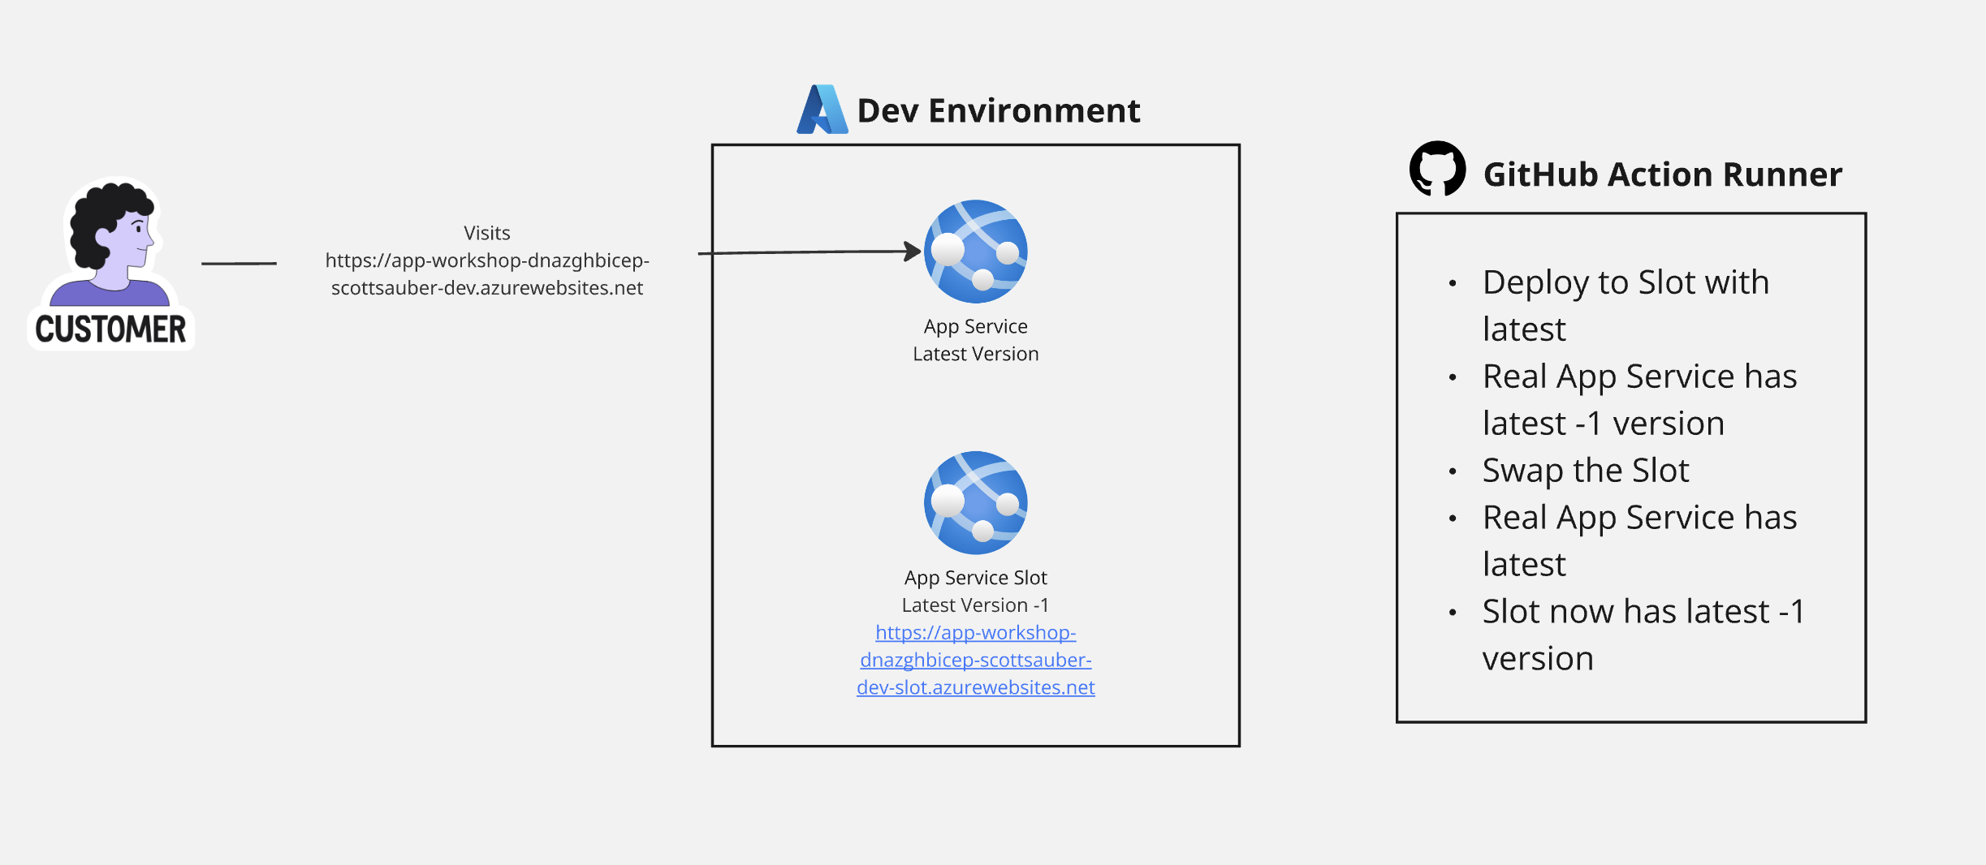
Azure App Service Slots - ZDD
Azure App Service

Slide 57
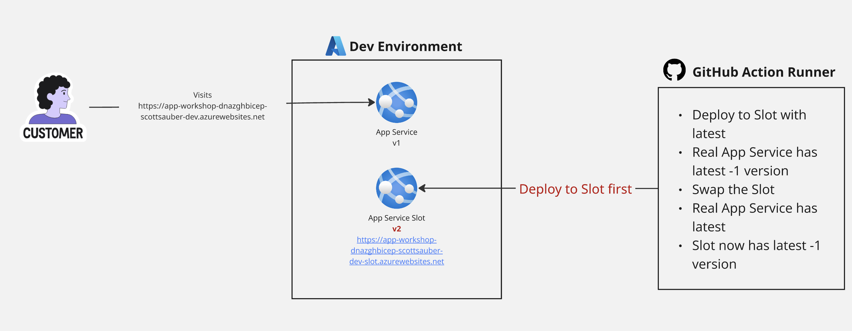
Azure App Service Slots - ZDD
Azure App Service

Slide 58
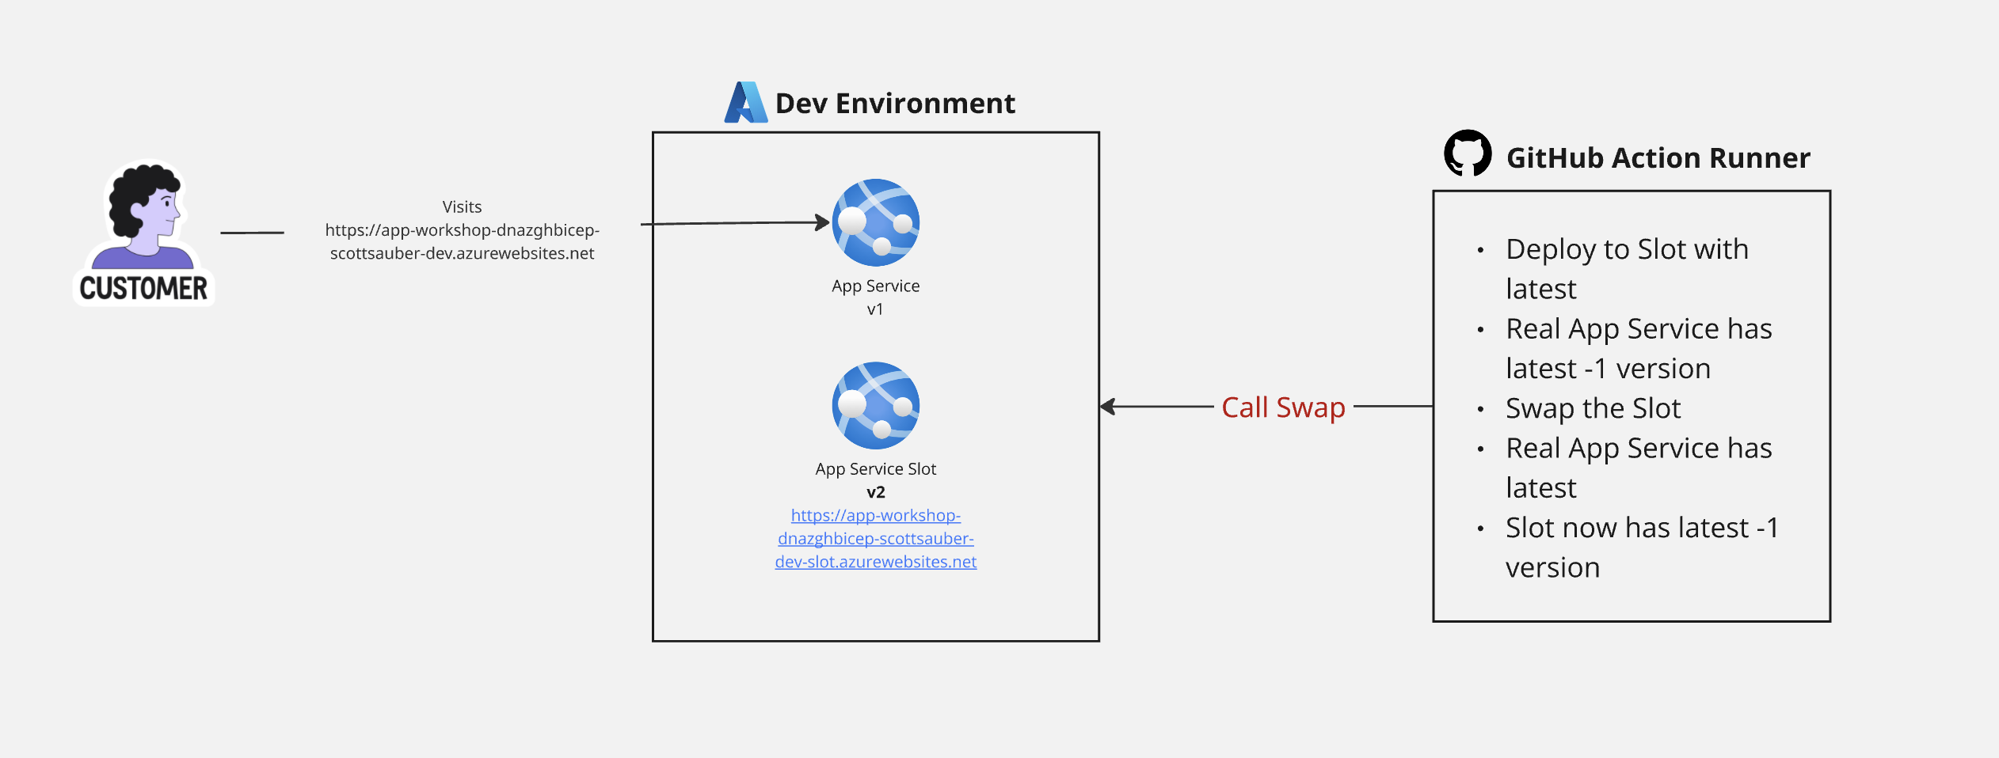
Azure App Service Slots - ZDD
Azure App Service

Slide 59
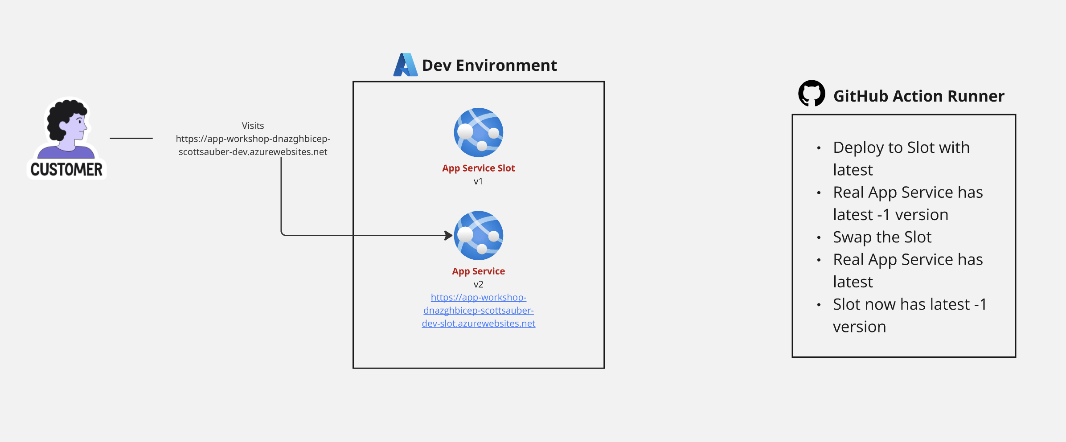
Azure App Service Slots - ZDD
Azure App Service

Slide 60
Azure App Service Plans
Azure App Service
PaaS but it’s a managed VM
You pick memory, CPU, storage, and operating system
Host many App Services on a single App Service Plan
Should you? Noisy Neighbor
You get charged by the App Service Plan not the App Service

Slide 61
Questions?

Slide 62
Azure Container Apps

Slide 63
Azure Container Apps
Azure Container Apps
PaaS
Run a container as a service
Allows you to spin down to zero vs App Services
A Simpler Kubernetes

Slide 64
Azure Container Apps vs Azure App Service
Azure Container Apps
Azure App Service way simpler
Azure Container Apps more powerful, in the right hands

Slide 65
Questions?

Slide 66
Infrastructure as Code

Slide 67
What is IAC?
IAC
Source code that defined provisioning resources that’s configurable and repeatable across all environments
Stored in version control
Declarative – what resources to create, not how to create them
Deployed via automation (ideally pipeline, but could be local)
Resource properties can be linked together

Slide 68
Why IAC?
IAC
Promotes consistency and standardization
“It Works On My Machine” goes away
“It works in Dev, but not in Production” goes away
Audit trail of who did what and when
Resources are Transient not Permanent
Can be deleted and re-created with ease (besides your DB)
Environments stood up in minutes, not days/weeks/months
ClickOps doesn’t scale

Slide 69
What can I create with IAC?
IAC
Virtual Machines
Web Servers
Databases
Secret Stores
Networking
IAM Policies
Monitoring
DNS
…pretty much everything

Slide 70
Ok great... But how?

Slide 71

What is Azure Bicep?
IAC
Used to configure Azure resources
Built and maintained by Microsoft
Domain-specific language (fancy word for custom)
Provides intellisense, error checking, “whatif,” and orders the resource creations
Built on top of Azure Resource Manager (ARM) – don’t use ARM directly
No state file

Slide 72
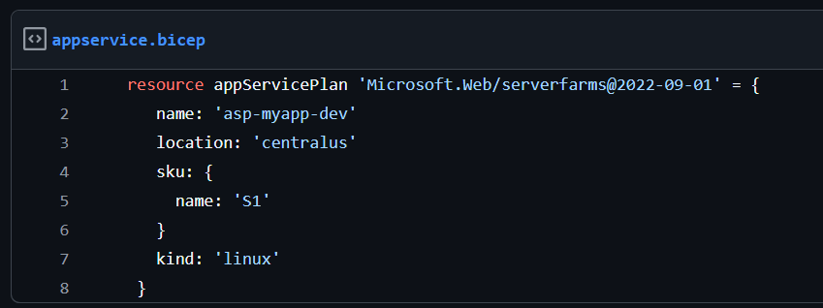
What is Azure Bicep?
IAC

Slide 73
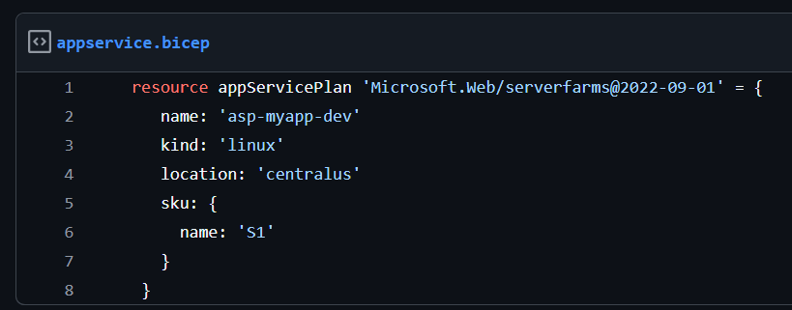
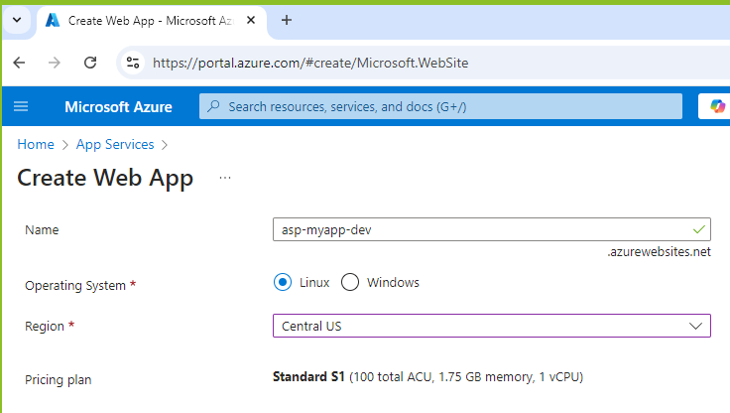
IAC

Slide 74

Terraform
IAC
Created by HashiCorp
Domain-specific language
Configure different clouds (Azure, AWS, GCP, VMware, etc) via Providers
BUT – can’t take same Terraform and run it on both Azure and AWS
Maintains state of infrastructure via state file
Likely the most popular IAC tool in the world
Semi-recently acquired by IBM
OpenTofu – drop-in replacement

Slide 75
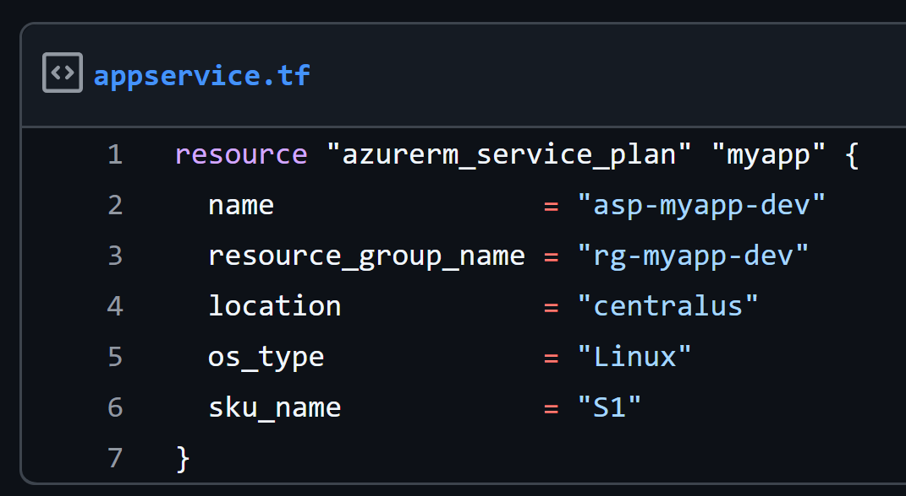
IAC

Slide 77

Pulumi
IAC
Created by Pulumi Corporation
Configure different clouds (Azure, AWS, GCP, etc)
You write your language of choice – TypeScript, JavaScript, Python, Java, C#, Go, or Visual Basic (yes really)
First big player to market with IAC using an existing language

Slide 78
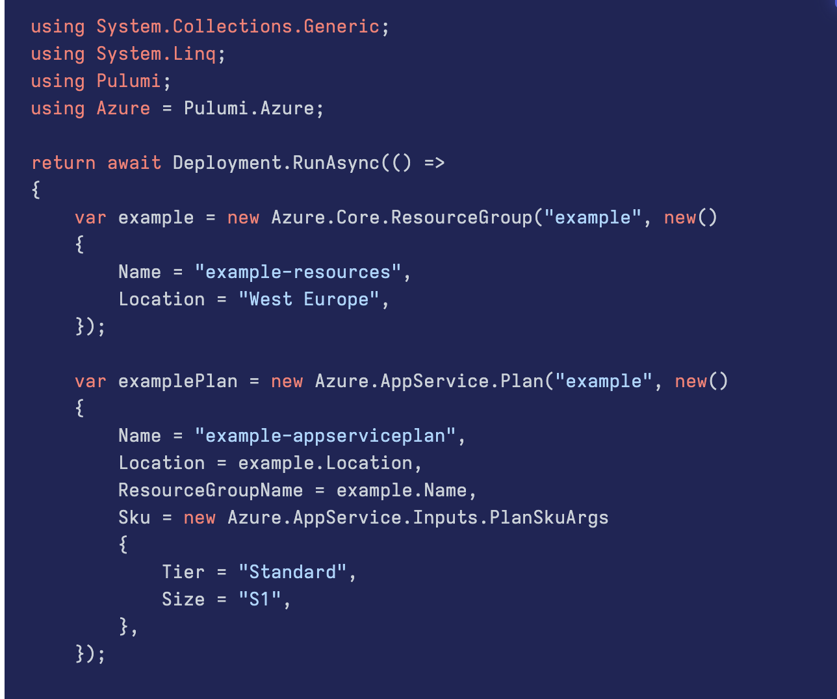
IAC

Slide 79
Configuration Files vs Code Files
IAC
Bicep, ARM, Terraform, and Cloudformation are DSL config files
CDK and Pulumi are libraries of existing languages
CDK for Terraform is CDK but built on Terraform, supported by Hashicorp
Configuration popular with Ops-focused teams
Code popular with Dev-focused teams
Code leverages existing skills – packages, syntax, autocomplete, etc

Slide 80
Questions?

Slide 81
Takeaways
Ideas on what you can apply immediately back at work
Better understanding of how different pieces of Azure works
@scottsauber

Slide 82
Resources
This slide deck at https://scottsauber.com
@scottsauber

Slide 83



Questions? ssauber@leantechniques.com
Add me on LinkedIn:
Slides at scottsauber.com
@scottsauber
@scottsauber.com

Slide 84
Thanks!
Add me on LinkedIn:
Slides at scottsauber.com
@scottsauber
@scottsauber.com

