Slide 1

The Background On
Background Tasks in .NET 9
Scott Sauber
Director of Engineering
Lean TECHniques
Level: Introductory
Notes:
Pre-check:
docker ps and then kill any running container
docker-compose down && docker-compose up -d
Dotnet watch run
New Database for Hangfire
Solution Open

Slide 2
Audience
.NET Developers
In need of running a background task

Slide 3
Agenda
What are background tasks/jobs?
What type of problems are suitable for a background task/job?
What options are out there?
IHostedService
BackgroundService
Worker Service
Hangfire
Why would I choose one over the other?
Deep dive into each
Demos
Questions

Slide 4
Goals
Know all your options for running background tasks
Why choose one over another

Slide 5





Who am I?
Director of Engineering at Lean TECHniques
Microsoft MVP
Dometrain author
Redgate Community Ambassador
Co-organizer of Iowa .NET User Group

Slide 6
What problems do background tasks solve?
Cron jobs
Perform CPU intensive task async
Eventual consistency
Re-train ML datasets

Slide 7
Options
IHostedService
BackgroundService
WorkerService
Hangfire
Cloud options

Slide 8

These options are kind of like baking cookies

Slide 9

IHostedService “Make your own recipe” (Cookie jar included)

Slide 10
What is IHostedService?
Host background job inside ASP.NET Core
ASP.NET Core is your cookie jar
Interface – StartAsync, StopAsync
Raw fundamental building block
Register: services.AddHostedService<T>

Slide 11

Demo

Slide 12
How IHostedService works
Register in DI
StopAsync cancellation has 5 seconds to shutdown gracefully
StopAsync might not get called if app shuts down unexpectedly

Slide 13
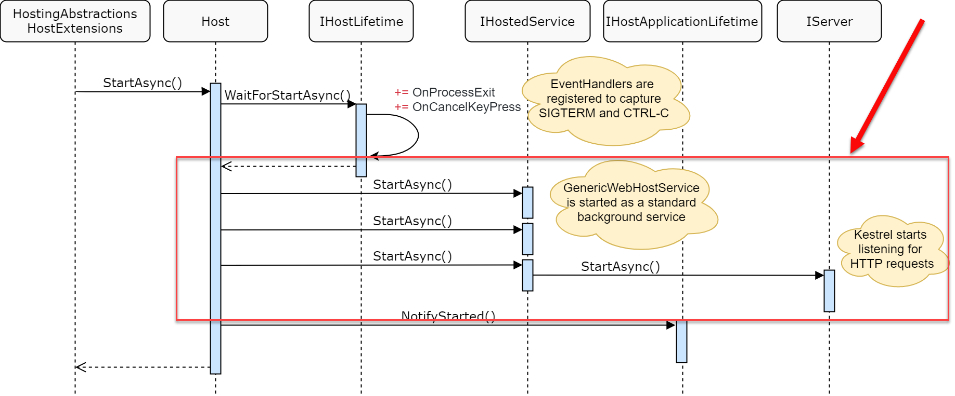
Image Credit: Andrew Lock

Slide 14
How IHostedService works
StartAsync blocks rest of app from starting
Push blocking long running work out of StartAsync
UNLESS you truly don’t want your app to boot until it finishes
Database Migrations, Cache Refresh, etc

Slide 15
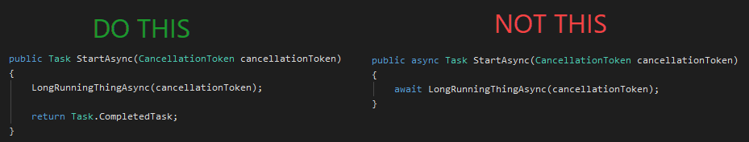

Slide 16
When to use IHostedService
Implicitly used with BackgroundService and Worker
Also Kestrel!
You need full control over Starting/Stopping
Don’t want to use BackgroundService implementation

Slide 17
When NOT to use IHostedService
Should be using BackgroundService/Worker 95%+ of the time
Other reasons same as BackgroundService (next)

Slide 18
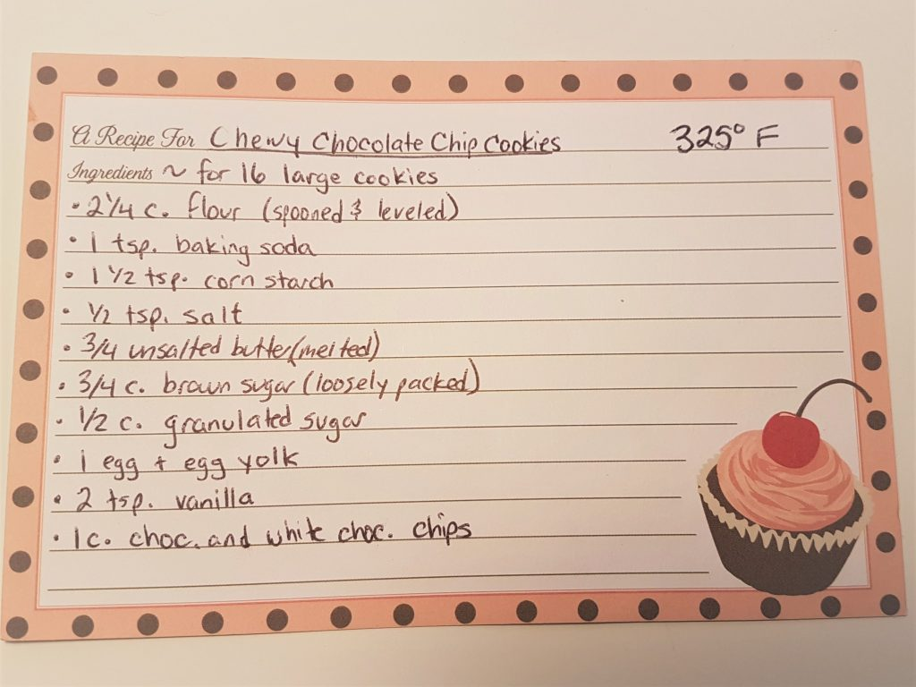

BackgroundService “Follow the recipe” (Cookie jar included)

Slide 19
What is BackgroundService?
Host background job inside ASP.NET Core
ASP.NET Core is your cookie jar
Abstract class, implements IHostedService
Exposes ExecuteAsync abstract method
Handles starting and stopping
Register: services.AddHostedService<T>

Slide 20
Demo

Slide 21
How BackgroundService works
Register with DI
Exposes ExecuteAsync abstract method
Can still override StartAsync + StopAsync
Default StartAsync implementation WILL NOT block app from starting
Handles cancellations (app stopping)

Slide 22
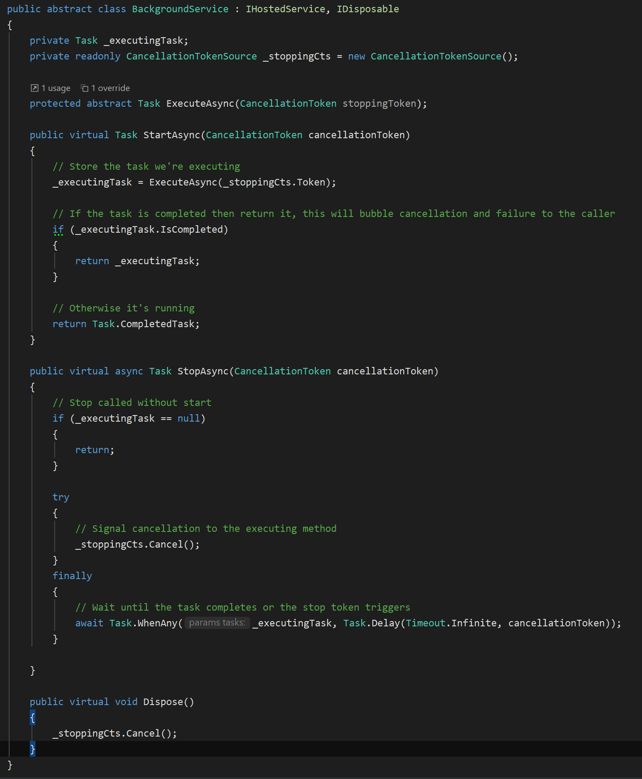

Slide 23
When to use BackgroundService
Need simple background task runner as part of ASP.NET Core application
Less gotchas than IHostedService
Want an ASP.NET Core health check endpoint for your background task (instead of WorkerServices)

Slide 24
When NOT to use BackgroundService
Too much co-location with app can get unruly
It Depends™️
Scaling out if code isn’t idempotent
Or you could just make your code idempotent or not allow scale out (I guess)

Slide 25
WorkerService “Follow the recipe” (BYO Cookie Jar)

Slide 26
What is a WorkerService
Enhanced .NET Console app template
dotnet new worker –o my-worker
Gives you IHost
Configuration, DI, Logging, etc
Registers Worker class as HostedService
Does not take opinion on how to host console app
No cookie jar… scheduler? Windows Service? systemd?

Slide 27
Demo

Slide 28
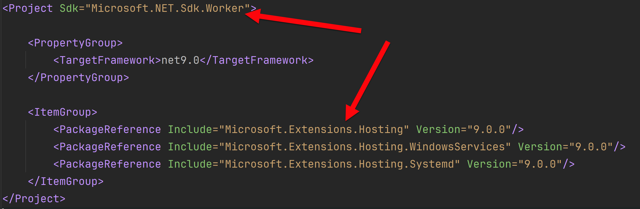
How WorkerService works
Project Sdk of Microsoft.NET.Sdk.Worker
PackageReference to Microsoft.Extensions.Hosting

Slide 29
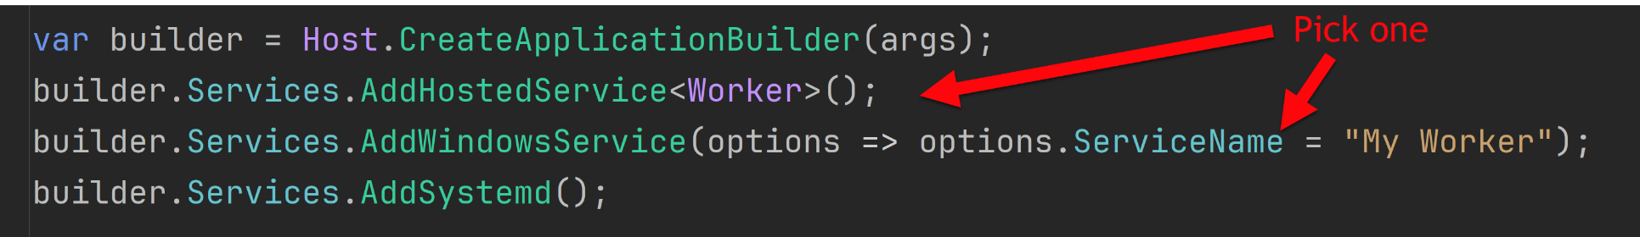
How do I host WorkerServices?
Scheduler calls Console App
Windows Scheduled Tasks, k8s cron jobs, Azure Logic Apps, AWS Scheduled Tasks, etc
Windows Service or system (Windows or Linux)

Slide 30
When to use WorkerService
Want out-of-proc way of running background tasks
Prefer hosting background services outside of web apps
Avoid app pool recycles
Natural migration for .NET Framework Windows Service

Slide 31
When NOT to use WorkerService
Prefer deploying web apps
Want to co-locate with existing wen app/API
Want a health check endpoint

Slide 32

Hangfire “Buy pre-packaged cookies”

Slide 33
What is Hangfire?
Full featured library for running jobs in ASP.NET Core
Free commercial use, but paid for support
Comes with UI for monitoring and history
Supports Cron and ad-hoc running of jobs
Allows for continuations
Automatic retries
Support concurrency limiting
Persists job state to database

Slide 34
Demo
Notes:
You need 3 packages:
Hangfire.Core
Hangfire.AspNetCore
Hangfire.SqlServer (or Redis or MSMQ officially, postgres and others unofficially)
Show Program
Show Cron
Dashboard showing history, recurring, enqueue jobs
Trigger from Controller
Throw exception and show retry with DLQ
Note: BackgroundJobService is a Hangfire thing NOT a BackgroundService

Slide 35
How does Hangfire work?
Serialize method call and arguments
Creates background job based on that info
Saves job to persistent storage
Starts background job if immediate

Slide 36
When to use Hangfire?
Want to host jobs in ASP.NET Core
Need features Hangfire offers
Don’t want to write plumbing code
Ok with relying on 3rd party library

Slide 37
When NOT to use Hangfire?
Do not want to host jobs in ASP.NET Core
Have basic needs, don’t need Hangfire’s features
Do not want to rely on 3rd party library
Want more control over what happens

Slide 38
Cloud options
Azure Functions with Scheduling timer
Azure WebJobs
AWS Lambdas
GCP Cloud Scheduler + Cloud Functions
Didn’t cover these to avoid cloud specific
Everything we covered works with any cloud

Slide 39
Takeaways
Awareness to all the options available to you
Awareness of the pro’s and con’s of the options
Make the best decision for you and your company

Slide 40
Resources
https://learn.microsoft.com/en-us/dotnet/architecture/microservices/multi-container-microservice-net-applications/background-tasks-with-ihostedservice
https://hangfire.io
https://github.com/scottsauber/talks
This slide deck

Slide 41
Questions? ssauber@leantechniques.com @scottsauber on Twitter @scottsauber.com on Bluesky

Slide 42

Session Survey
Your feedback is very important to us
Please take a moment to complete the session survey found in the mobile app
Use the QR code or search for “Converge360 Events” in your app store
Find this session on the Agenda tab
Click “Session Evaluation”
Thank you!

