Slide 1

.NET Aspire: Not just for cloud native distributed systems
Slides up at scottsauber.com
scottsauber

Slide 2

Audience
.NET Developers building APIs or web apps
Cloud Developers curious what this Aspire thing is
scottsauber

Slide 3
Agenda
What is .NET Aspire
Why?
What makes up .NET Aspire
Live Demos
scottsauber

Slide 4
Goals
Expose you to what .NET Aspire is
Understand that it’s not just for cloud native microservices apps
scottsauber

Slide 5

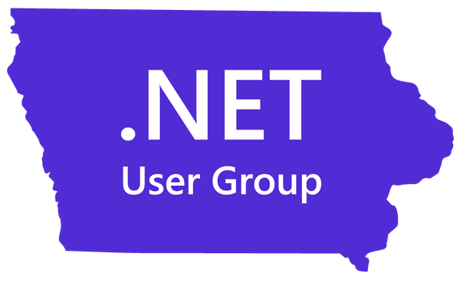
Who am I?
Director of Engineering at Lean TECHniques
Microsoft MVP
Co-organizer of Iowa .NET User Group
Dometrain Author
Blog at scottsauber.com
scottsauber

Slide 6
“.NET Aspire is an opinionated, cloud ready stack for building observable, production ready, distributed applications.”

Slide 8
What is .NET Aspire
Lots of things
Local Dashboard for viewing Open Telemetry
Provides Orchestration
Fancy word for running multiple things – APIs, Frontend, Backend, Local database, etc.
Provides Service Discovery
Fancy words for “how do I call you” – URL, connection string, etc.
Provides Service Defaults
Fancy words for “how do I configure you” – HttpClient, Telemetry, etc.
Provides Integrations
Fancy word for NuGet packages to configure external systems like Azure, AWS, Redis, Databases, etc
I don’t love the Aspire name
scottsauber

Slide 9
Why .NET Aspire
Every app wants better observability
Companies usually have opinions on how things are configured
Orchestrating multiple dependencies and microservices is hard
Aspire… aspires… to solve all of these
scottsauber

Slide 10
“.NET Aspire is an opinionated, cloud ready stack for building observable, production ready, distributed applications.”

Slide 11
“.NET Aspire is an opinionated, stack for building observable, production ready applications.”

Slide 12
“You should be using .NET Aspire for any kind of applications you’re building.”

Slide 13
What is the Dashboard?
View all your running apps in one spot
View logs
View spans and traces
Shippable as a Docker image
Based on OpenTelemetry
scottsauber

Slide 14

What is ?
Open standard all the observability providers are converging on
Avoid vendor lock-in
Azure Monitor supports OpenTelemetry
Been baked into .NET
Aspire Dashboard speaks OpenTelemetry
Aspire wires up OpenTelemetry niceities for you
scottsauber

Slide 15
Before we demo…

Slide 16
Sample Aspire App Structure
4 csproj’s
.Web = Frontend
.ApiService = API the Frontend calls
.ServiceDefaults = Sets some defaults (OTEL, Health Checks, HttpClient defaults, etc) – shared by .Web and .ApiService
.AppHost = Orchestrator booting up all the things
scottsauber

Slide 17
Sample Aspire App Structure
App Host
Web
API
Calls
References
Service
Defaults
References
scottsauber

Slide 18
Demo
Notes:
Show the Dashboard
Show how to configure Dark mode – very important
Show the Resources
Show endpoints
Show details
Show the logs
Show Structured
Dashboard is a Docker image
Dashboard speaks OTEL – not .NET specific

Slide 19
Dashboard FAQ Answered
This is a local only tool
Yes it’s a Docker image, you could host it yourself
But storage…
You should probably use AppInsights or Datadog or w/e for non-local
scottsauber

Slide 20
Feature Check-In
Feature | Useful for cloud-native apps? | Useful for non-cloud-native apps?
Dashboard
✅
✅
scottsauber

Slide 21
Questions about the Dashboard?

Slide 22
What is the AppHost?
AppHost is the orchestrator
Makes sure it boots up all your dependencies
Could be APIs, Frontends, Databases, etc
Almost every app has at least one dependency – not just cloud native distributed apps
scottsauber

Slide 23
Sample Aspire App Structure
App Host
Web
API
Calls
References
Service
Defaults
References
scottsauber

Slide 24
Demo

Slide 25
Feature Check-In
Feature | Useful for cloud-native apps? | Useful for non-cloud-native apps?
Dashboard
AppHost
✅
✅
✅
✅
scottsauber

Slide 26
Questions about the AppHost?

Slide 27
What are the ServiceDefaults?
How you configure your application
OpenTelemetry, HttpClient resiliency, Health Checks, Service Discovery, etc.
Could publish this as a NuGet package internally so all apps use the same ServiceDefaults
scottsauber

Slide 28
Sample Aspire App Structure
App Host
Web
API
Calls
References
Service
Defaults
References
scottsauber

Slide 29
Demo

Slide 30
Feature Check-In
Feature | Useful for cloud-native apps? | Useful for non-cloud-native apps?
Dashboard
AppHost
ServiceDefaults
✅
✅
✅
✅
✅
✅
scottsauber

Slide 31
Questions about ServiceDefaults?

Slide 32
What are Integrations?
NuGet packages to simplify configuration to common services
Postgres, Redis, Azure Key Vault, Azure Service Bus, etc.
Publish data to OTEL
All vetted integrations live under the “Aspire.” prefix ie Aspire.Azure.Storage.Blobs or Aspire.MongoDB.Driver
https://learn.microsoft.com/en-us/dotnet/aspire/fundamentals/integrations-overview#available-integrations
scottsauber

Slide 33
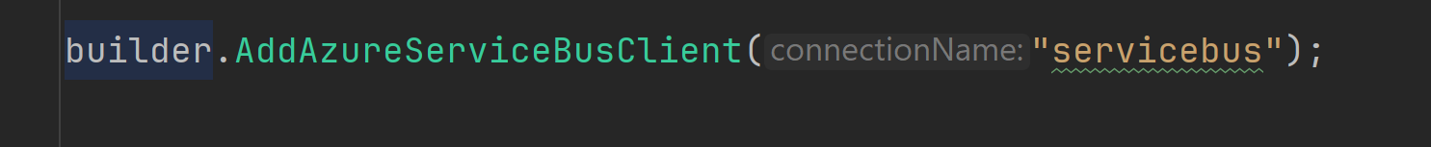
What are Integrations?
Registers ServiceBusClient as singleton with reusing Azure tokens
Automatically sets up Logging, Tracing, Telemetry
Applies any custom configurations
scottsauber

Slide 34
Demo

Slide 35
Feature Check-In
Feature | Useful for cloud-native apps? | Useful for non-cloud-native apps?
Dashboard
AppHost
ServiceDefaults
Integrations
✅
✅
✅
✅
✅
✅
✅
✅
scottsauber

Slide 36
Questions about Integrations?

Slide 37
Current State
Everything I’ve shown is fully usable today
scottsauber

Slide 38
Future State
Deploy using Aspire (can today technically with azd…)
Infrastructure as Code using Aspire
scottsauber

Slide 39
Takeaways
Understand what .NET Aspire is
Why .NET Aspire is useful
Realize it’s useful for any app – small or large… cloud native or not…
scottsauber

Slide 40
Resources
The Microsoft Docs on Aspire
9/18 – Azure Developers - .NET Aspire Day 2024
This slide deck
scottsauber

Slide 41
Questions?
Slides up at scottsauber.com
scottsauber

Slide 42
Thanks!
Slides up at scottsauber.com
scottsauber

