Slide 1
5 Things You Didn’t Know GitHub Actions Could Do

Slide 2
Audience
Assume you know what GitHub Actions is
Want quick tips you can use immediately after this talk is over

Slide 3

Who am I?
Director of Engineering at Lean TECHniques
Microsoft MVP
Co-organizer of Iowa .NET User Group
Dometrain Author

Slide 4
#1. Sparse Checkouts
What is it?
Allows you to checkout just a subset of the repository
Why should I care?
Target certain parts of your repo
Checkout just your IAC folder
Useful for monorepos
One client went from 2.5 mins checkout of 1GB repo to 10 seconds

Slide 5
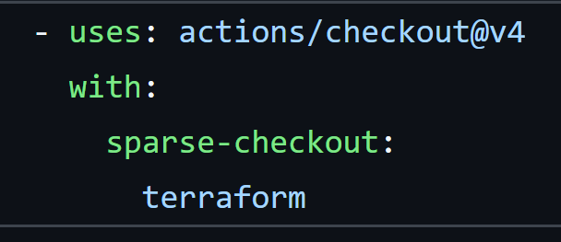
#1. Sparse Checkouts – How?

Slide 6
#2. Run Scheduled Jobs
What is it?
Allows you to run certain jobs on a schedule like daily, hourly, etc.
Why should I care?
Automate simple tasks (ie email me this daily report)
Automate daily security scans for repos that don’t get updated often
This is NOT an enterprise Cron Job solution, no guarantee of running at the exact time
I’ve seen ~15 min variability

Slide 7
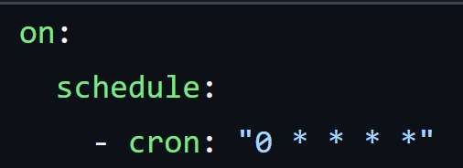
#2. Run Scheduled Jobs – How?

Slide 8
#3. Reusing Workflows
What is it?
Allows you to reuse code in your workflows
Why should I care?
Stop copying and pasting YAML
Reduce duplication which promotes consistency and maintainability
Deploying to different environments usually shares 95% of the same code
Consistency across different repos in your enterprise

Slide 9
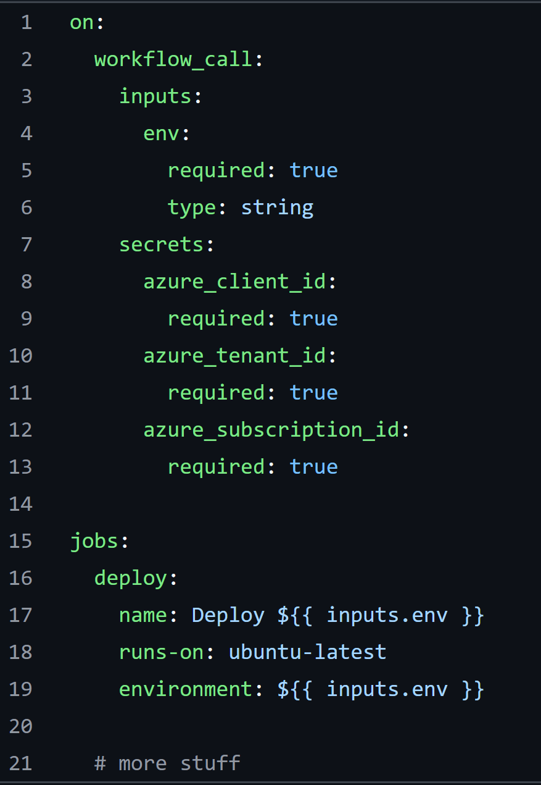
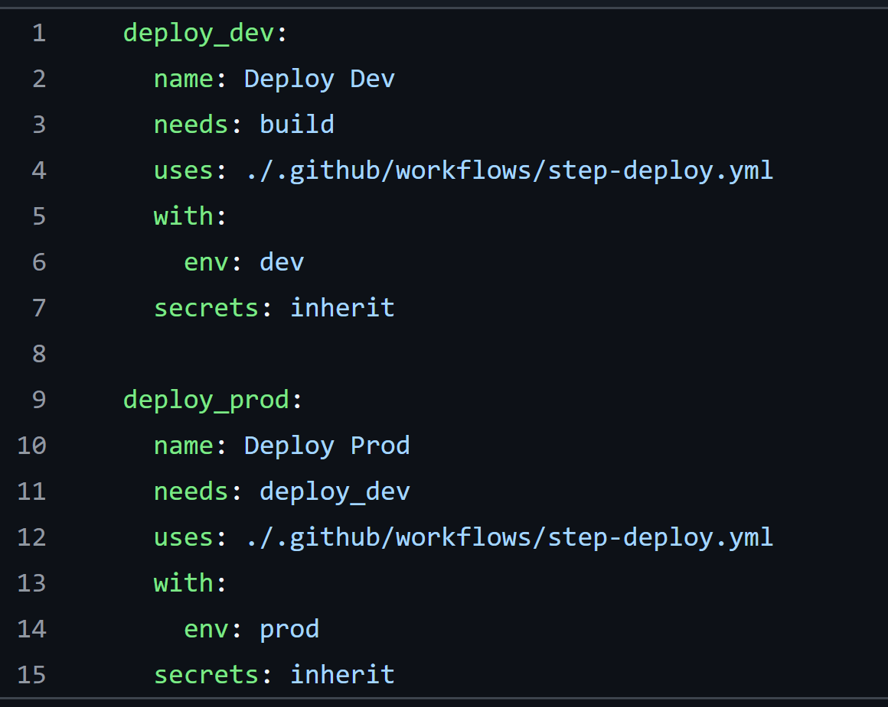
#3. Reusing Workflows – How?

Slide 10
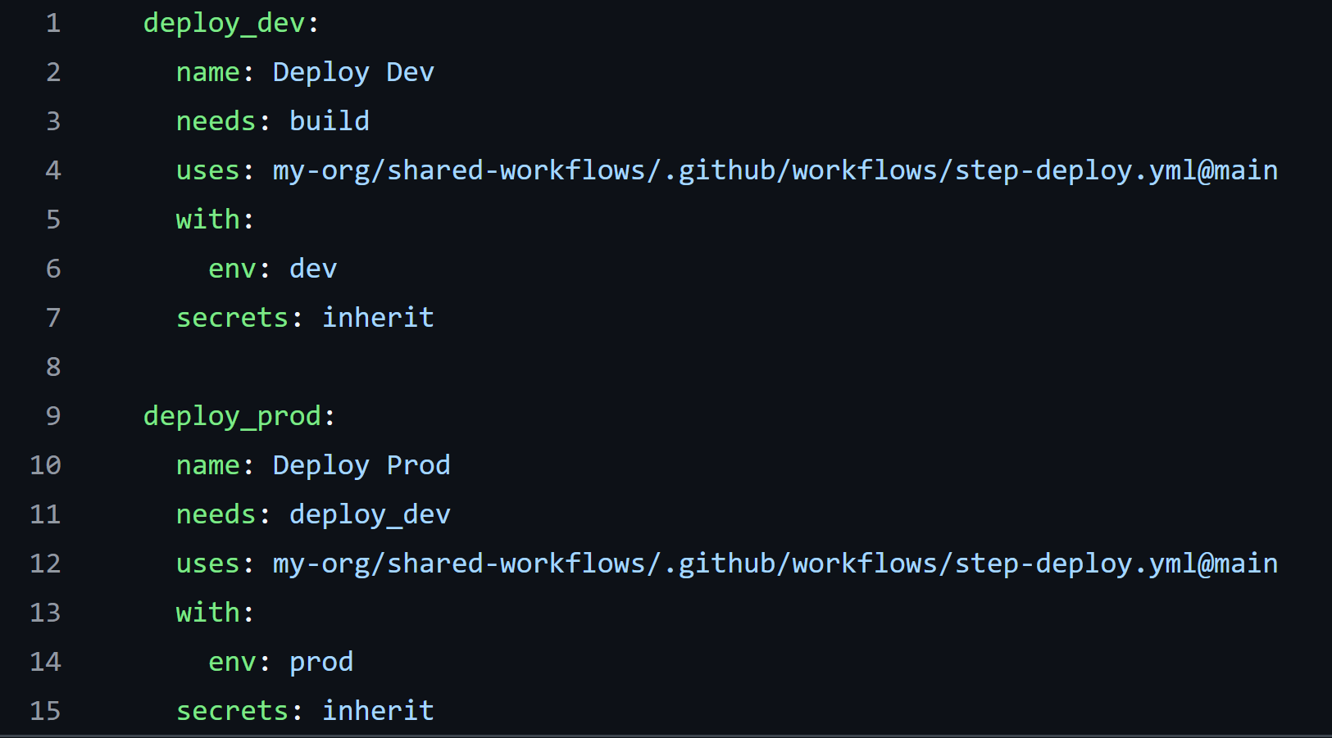
#3. Reusing Workflows – How?

Slide 11
#4. Path Filters
What is it?
Allows you to only run workflow when files that match a pattern change
Why should I care?
Only trigger a workflow when certain files change
Optimizes what runs based on what changed – saves time and $
Could be a change in a /terraform folder on a PR kicks off a a terraform plan
Could be a change in a /sql folder kicks off the SQL migrations

Slide 12
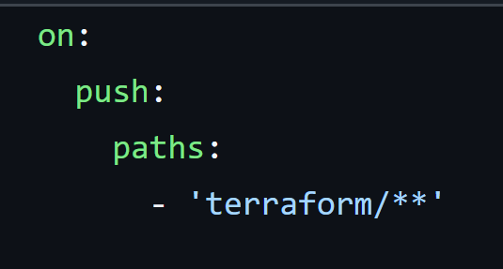
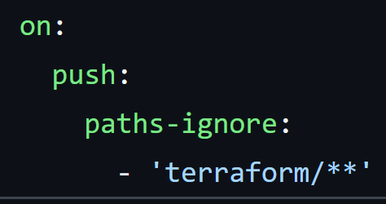
#4. Path Filters – How?

Slide 13
#5. Trigger actions based on external events
What is it?
Run a workflow when calling GitHub REST API
Why should I care?
Able to integrate GitHub Actions with other systems
Could be Slack or Microsoft Teams
Could be Datadog or PagerDuty or equivalents
Could be Jira or other work tracking tool
Could be integrating across multiple repos
Could be a CI system or another source control system

Slide 14
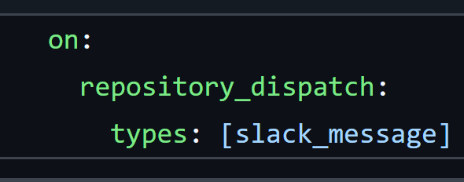
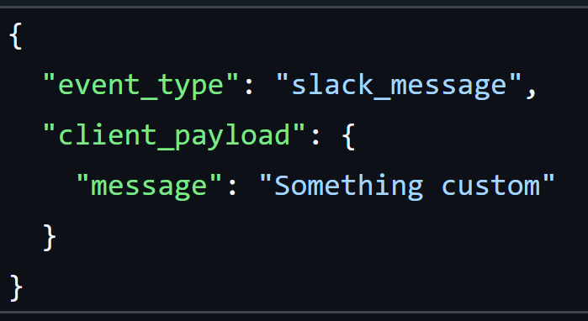
#5. Trigger actions based on external events

Slide 15
Takeaways
Ways to optimize your workflow for speed
See that GitHub is more than just a CI/CD tool, it’s an automation tool

Slide 16
Thanks!
Slides up at scottsauber.com

