Slide 1

Deploying a .NET 10 App to Azure using
Bicep and GitHub Actions
Slides at scottsauber.com
scottsauber

Slide 2

What you need
Required:
  An editor of some sort
  GitHub account
  Some basic Git experience (clone, commit, push, pull)
  Fork this repo: https://github.com/scottsauber/workshop-dotnet-azure-github-bicep
Email scott@saubersoftware.com if you’re doing hands on to get free Azure access
  Email you will use for Azure
  GitHub username
Optional:
  .NET 10 (https://dot.net)
  Editor/IDE that supports .NET 10 (Rider 2025.3+, VS 2026+, VS Code)
  Bicep extensions are recommended
scottsauber

Slide 3
What we all need
Azure to not go down
GitHub to not go down
GitHub Actions to not go down
The conference interest to not go down
🙏🙏🙏🙏🙏
(I do have recordings if needed but that’s less fun)
scottsauber

Slide 4
Audience
Anyone interested in Azure, GitHub, or Bicep
.NET Developers
People interested in DevOps, but never got to do it
People willing to ask questions – ask away – don’t wait!
scottsauber

Slide 5
Poll
How many .NET Developers in the room?
How many using Azure today?
How many aren’t using Azure?
How many have used Bicep?
What about another IAC tool?
How many are using GitHub Actions today?
How many are using something else?
Why are you here? What do you want to learn?

Slide 6
Agenda
What is the final state of what we’re building?
What is Azure?
What is Azure App Service? Plans?
What is Bicep?
What are GitHub Actions?
Hands on all throughout
This is a 2 day workshop, I’m gonna cram into 4 hours
There is walkthroughs if you fall behind
scottsauber

Slide 7
Goals
Learn GitHub Actions, Bicep, and Azure
How they all integrate with a .NET app
We likely won’t get to everything in a few hours
  This is going to be… a lot
The feedback loop on this is slow
Take home a few things back to work, whether beginner or expert
scottsauber

Slide 8







Who am I?
Director of Engineering at Lean TECHniques
Microsoft MVP
Dometrain Author
Redgate Community Ambassador
Co-organizer of Iowa .NET User Group
@scottsauber
@scottsauber.com

Slide 9
What are we building?
.NET 10 API
Running on Azure App Service
Configured using Infrastructure as Code with Bicep
Deployed via GitHub Actions
scottsauber

Slide 10
Features of What We’re Building
Zero Downtime Deployments
Infrastructure managed by code, not clicking in the Azure Portal
Automated Build and Deploys
Follows Azure Naming Standards for naming resources
Versioning your app so you know what’s deployed*
Health Checks*
Secrets in Key Vault, not Source Control*
Observability using Application Insights*
* Might not get to these in 4 hours.
scottsauber

Slide 11
Why is this important?
https://dora.dev/
DORA
We will touch on 6 of the 18 capabilities listed for high performing teams:
  Continuous Delivery
  Deployment Automation
  Flexible Infrastructure
  Continuous Integration
  Version Control
  Monitoring/Observability
scottsauber

Slide 12
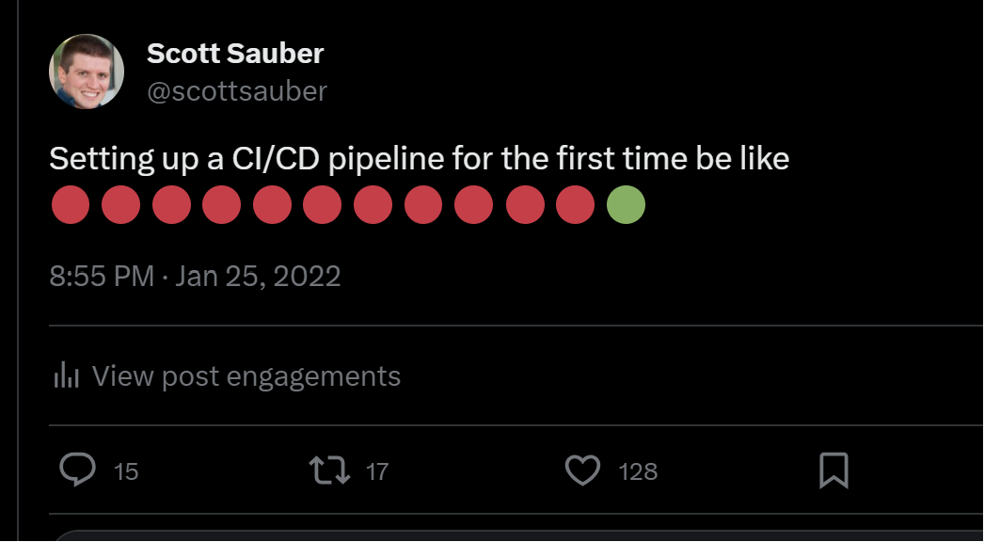
scottsauber

Slide 13
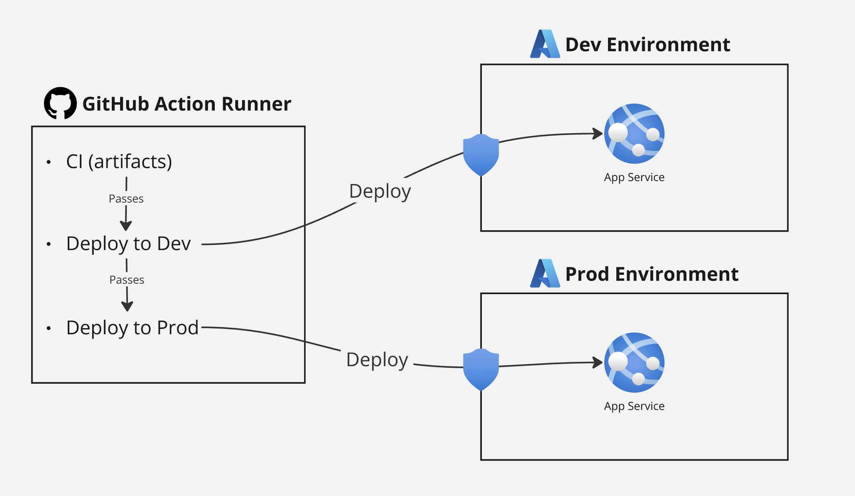
scottsauber

Slide 14

Azure

Slide 15
What is Azure?
Microsoft offering for cloud hosting
Offers many services from hosting web apps to databases to caching to messaging to…
You should probably be picking PaaS offerings (i.e. not VMs)
scottsauber

Slide 16
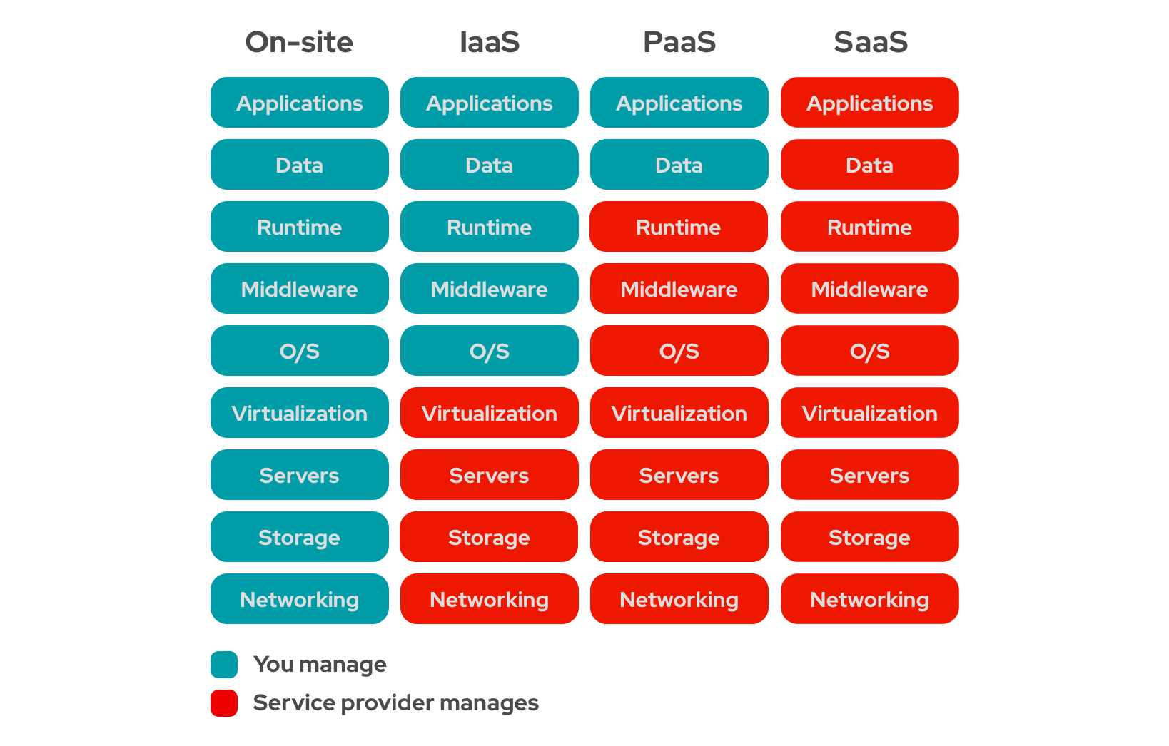
scottsauber

Slide 17
Subscriptions
Top-ish level organization (ignoring Tenants, Management Groups for a minute)
Recommended per team per environment
My default naming convention: sub-<team/dept>-<environment>
  Eg: sub-accounting-dev
Role access separation
Billing separation
scottsauber

Slide 18
Resource Groups
Related groups of resources (i.e. web, DB, Key Vault, etc)
Quickly view all resources related to that app
Conceptually, RG = folder, and Resources = files
Recommended per app per environment
Default naming convention: rg-<product name>-<environment>
  Eg: rg-fancyapp-dev
May have many RG’s in a single subscription
Role access separation
Billing separation
scottsauber

Slide 19
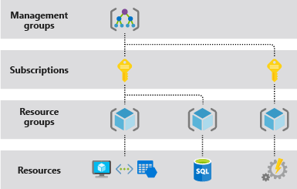
scottsauber

Slide 20
Questions?

Slide 21

Azure App Service

Slide 22
What is Azure App Service?
PaaS offering for hosting applications
✅Handles OS patches, Framework patches
✅Zero downtime deployments with slots
✅SSL Certs
✅Autoscaling
✅Custom Domains
✅Very simple
✅And More
❌Less control because PaaS
scottsauber

Slide 23
What is an Azure App Service Plan?
Kinda like VM for your App Service(s)
Pick how much memory, storage, CPU
Multiple app service on one ASP (should you?)
Many apps can get away with P0V3 ($62/mo for Linux)
Need to be at least Standard to get Slots
scottsauber

Slide 24
$ an issue?
Savings Plan – commit to $ amount
Save 25% for 1 yr or 45% for 3 yr commitment
Reservation – commit to compute tier
Save 35% for 1 yr or 55% for 3 yr commitment
scottsauber

Slide 25
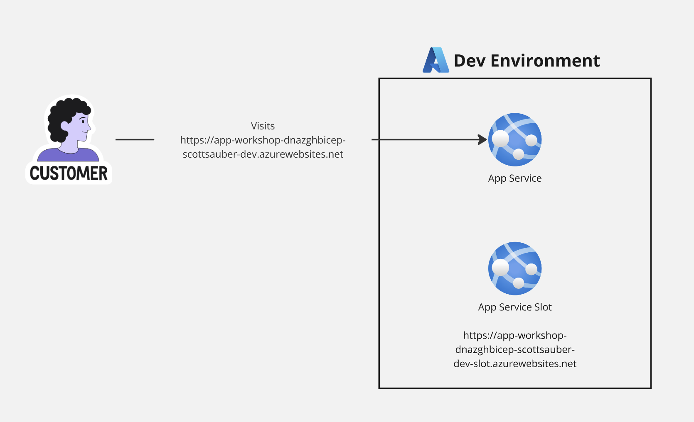
scottsauber

Slide 26
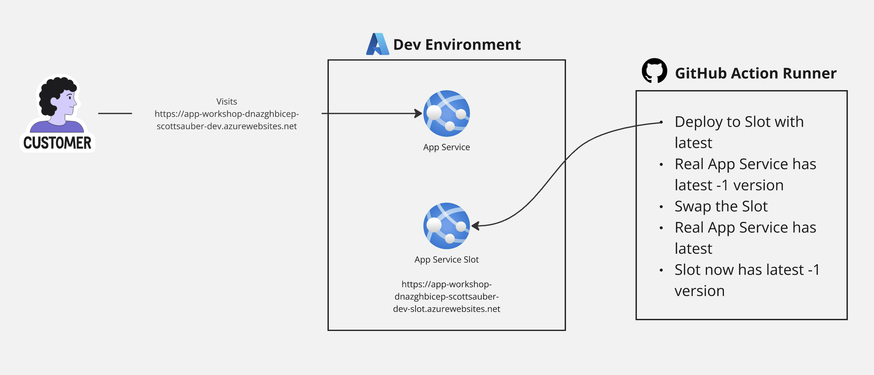
scottsauber

Slide 27
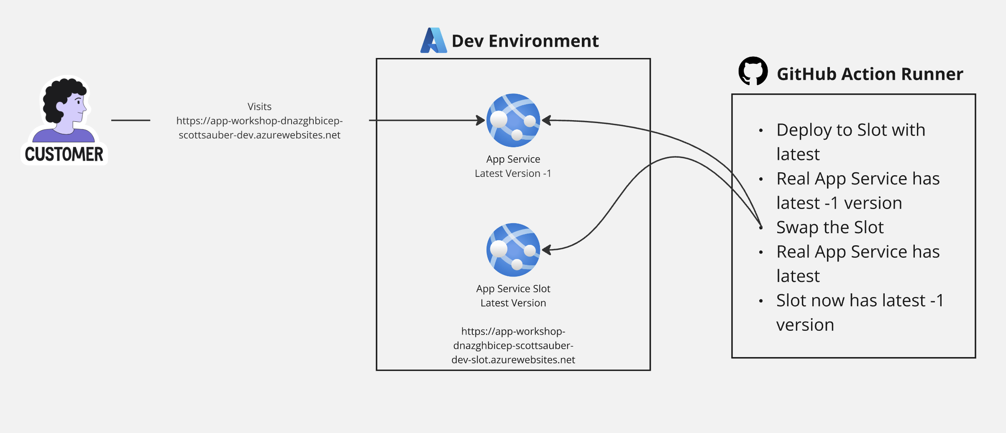
scottsauber

Slide 28
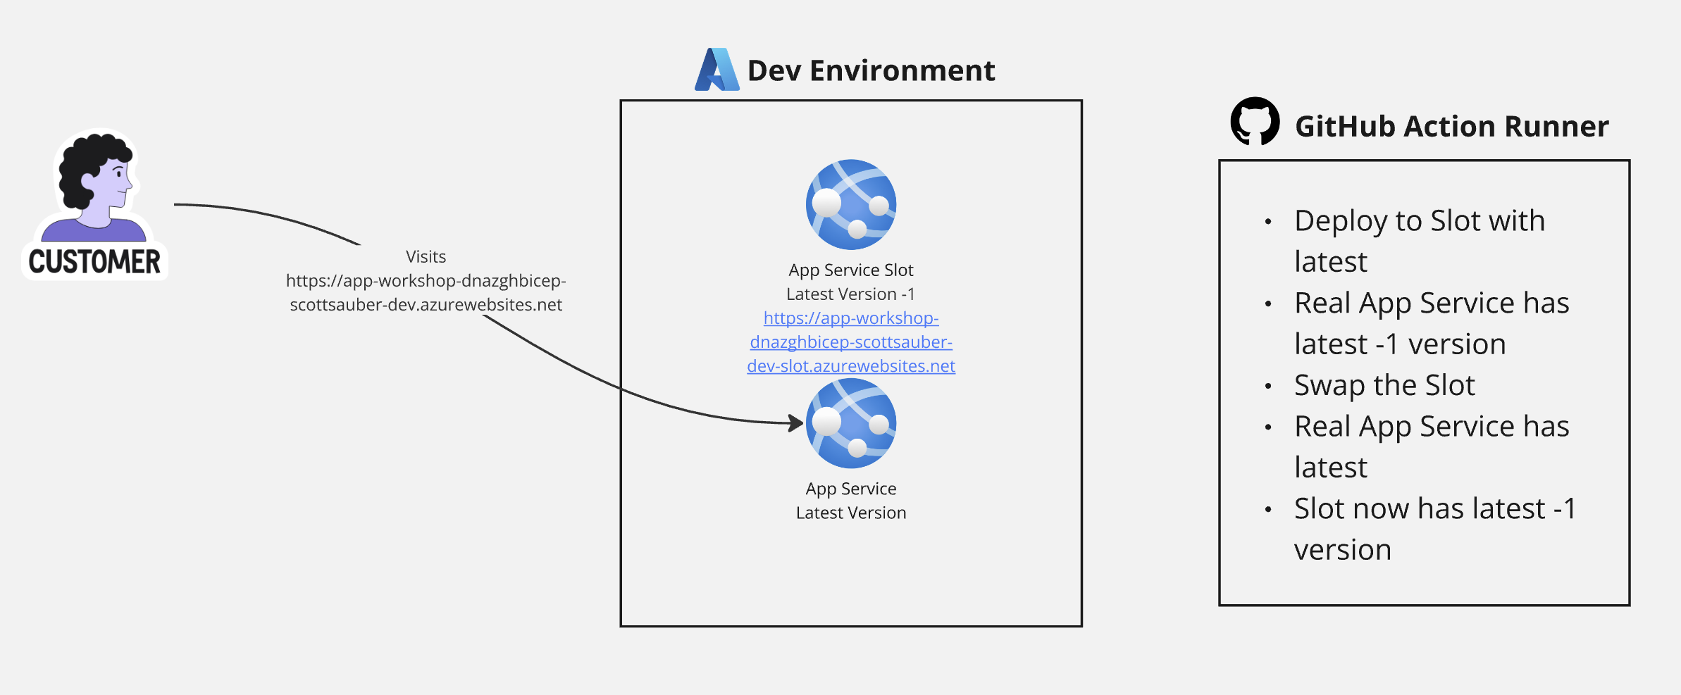
scottsauber

Slide 29
Live Demo
Notes:
- app service plan in relation to app services
- PaaS nature and all that it handles (server patches, OS patches, Certs, custom domains, etc)
- Env vars
- what slots are
- Kudu is a thing that exists and why it’s useful
- Log stream for really bad stuff going down bc ideally you’re using AppInsights or Log Analytics
The app running at a URL
Click on it and go to /api/weatherforecast and /api/weatherforecast/slow

Slide 30
Questions?

Slide 31

Bicep

Slide 32
Infrastructure as Code (IaC)
Source code defining what resources to provision
Stored in version control
Declarative – what resources to create, not how to create them
Deployed via pipeline
Need a new env? Few lines of code
scottsauber

Slide 33
Without IAC
Clickety Clack Configuration™️ (ClickOps)
Repeat yourself for each environment
“It worked in Dev/UAT/Staging, not Prod”
“It works on my machine”
scottsauber

Slide 34
What is Azure Bicep?
Used to configure Azure resources
Built and maintained by Microsoft
Domain-specific language (fancy word for custom)
Provides intellisense, error checking, “whatif,” and orders the resource creations
Built on top of Azure Resource Manager (ARM) – don’t use ARM directly
Can compose multiple files into “modules”
Can pass data between modules via outputs
No state file
scottsauber

Slide 35
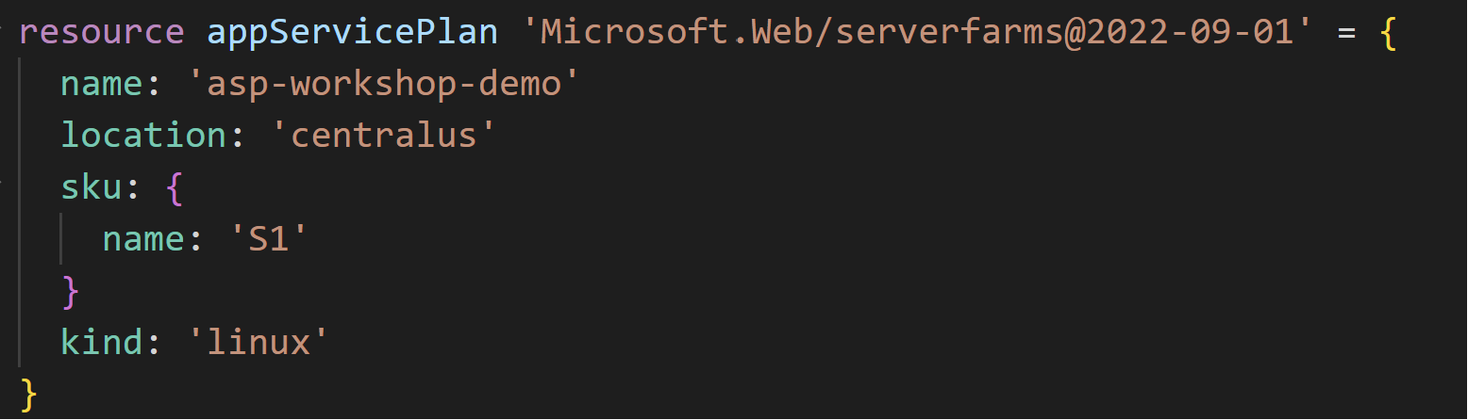
What does Bicep look like?
scottsauber

Slide 36
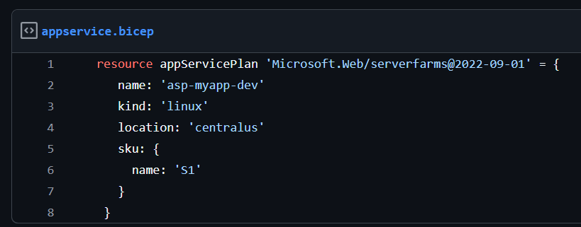
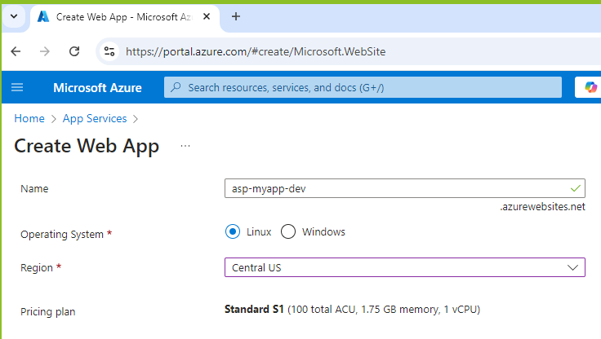
scottsauber

Slide 37
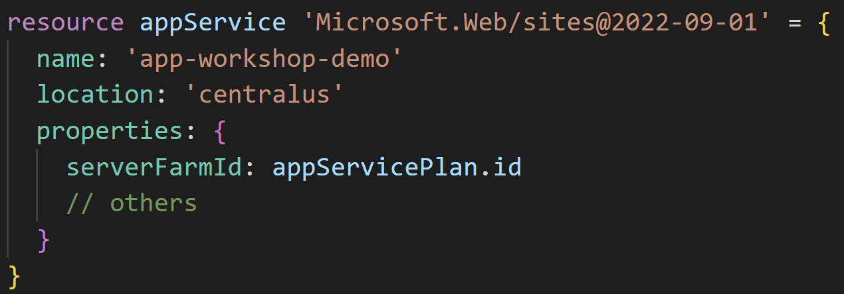
scottsauber
Notes:
Now we can reference resources from one another
This also tells Bicep – create the App Service Plan first before creating the App Service

Slide 38
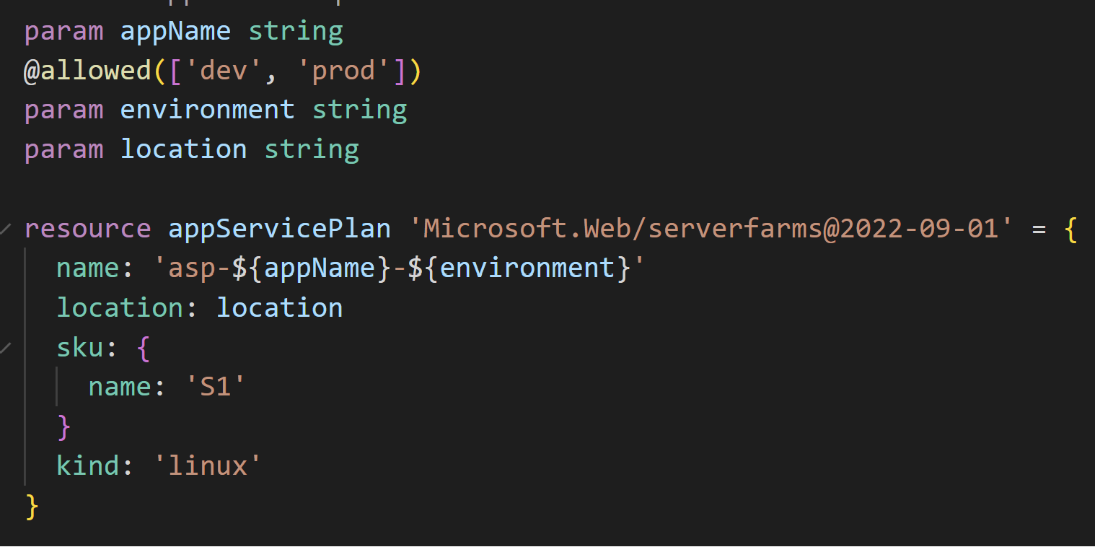
scottsauber
Notes:
Problem with the previous example is those names are hardcoded right. But we probably want like a Dev + Prod name
But how do we create this name dynamically?
Enter Parameter

Slide 39
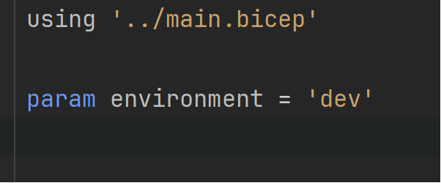
dev.biccepparam file
scottsauber
Notes:
You can store all your Dev values together in a single file
The using tells it what parameters are required and even works with the @allowed value

Slide 40
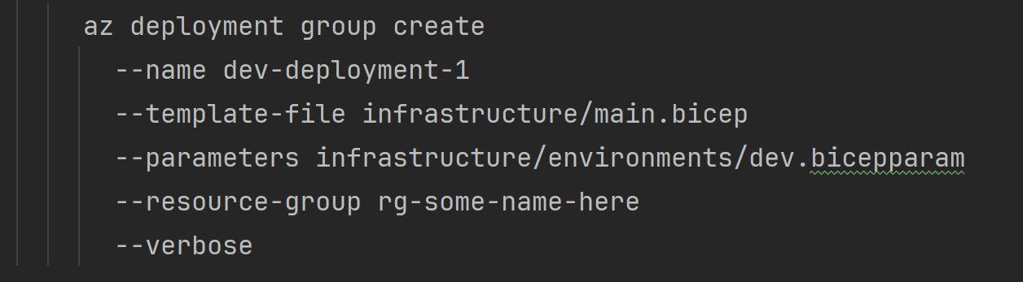
But how do I deploy it?
scottsauber

Slide 41
Key Concepts – Quiz time!
Resources
Modules
Parameters
.bicepparam
Outputs
--whatif
scottsauber

Slide 42
Benefits
No manual work of configuring in the portal (and repeating for each env)
Eliminate configuration drift
Traceability of who, did what, and when
Give Contributor access to the pipeline – not to individuals
scottsauber

Slide 43
Additional Resources
Documentation for various Bicep resources:
  https://learn.microsoft.com/en-us/azure/templates/microsoft.web/sites?pivots=deployment-language-bicep
scottsauber

Slide 44
Live Demo

Slide 45
Questions?
Notes:
VS Code
Show the bicepparam files
Show referencing the code from one another

Slide 46
Break then Hands On

Slide 47
Hands On for 25 mins
Module 4: https://github.com/scottsauber/workshop-dotnet-azure-github-bicep

Slide 48

CI/CD Pipelines

Slide 49
Continuous Integration
Automated verification of your application that generates artifacts
Compiles the app
Runs the tests
Independent witness - eliminates “works on my machine”
scottsauber

Slide 50
Continuous Delivery
Takes the artifacts from CI and deploys them automatically
Doesn’t deploy all the way to Production
Deploying to Production is a button click
scottsauber

Slide 51
Continuous Deployment
Deploys all the way to Production automatically
If the pipeline is green, it’s going to Production
scottsauber

Slide 52
Confident Green
If our build passes – why aren’t we shipping to Production?
Likely lack of confidence
Likely missing automated tests or zero downtime deployments, let’s fix that
Ok now why?
Repeat
scottsauber

Slide 53
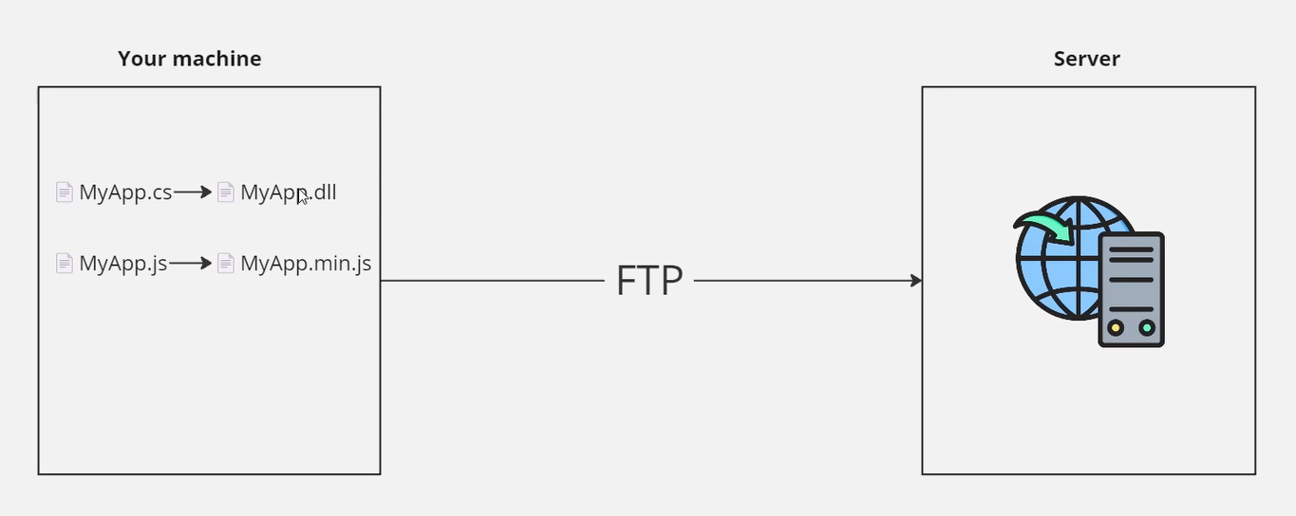
Before CI/CD
scottsauber

Slide 54
After CI/CD
scottsauber

Slide 55
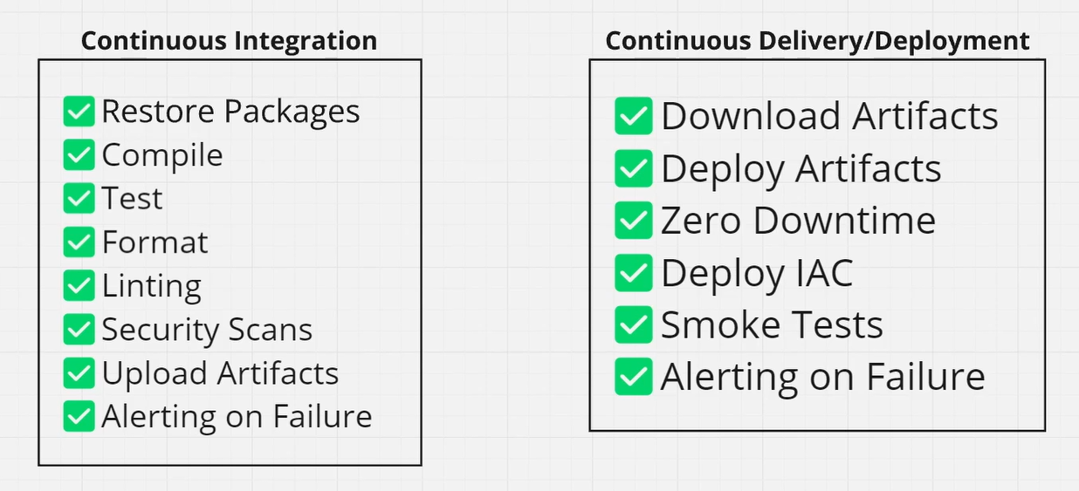
What’s in a Pipeline?
scottsauber

Slide 56
GitHub Actions

Slide 57
What is GitHub Actions?
Thing doer on a trigger
Trigger could be PR, push to main branch, open an issue, etc
Automatically build and deploys your application
Including the infrastructure (i.e. Bicep) and Database Migrations
scottsauber

Slide 58
Concepts
Workflows
Triggers
Jobs
Steps
Inputs
Secrets
scottsauber

Slide 59
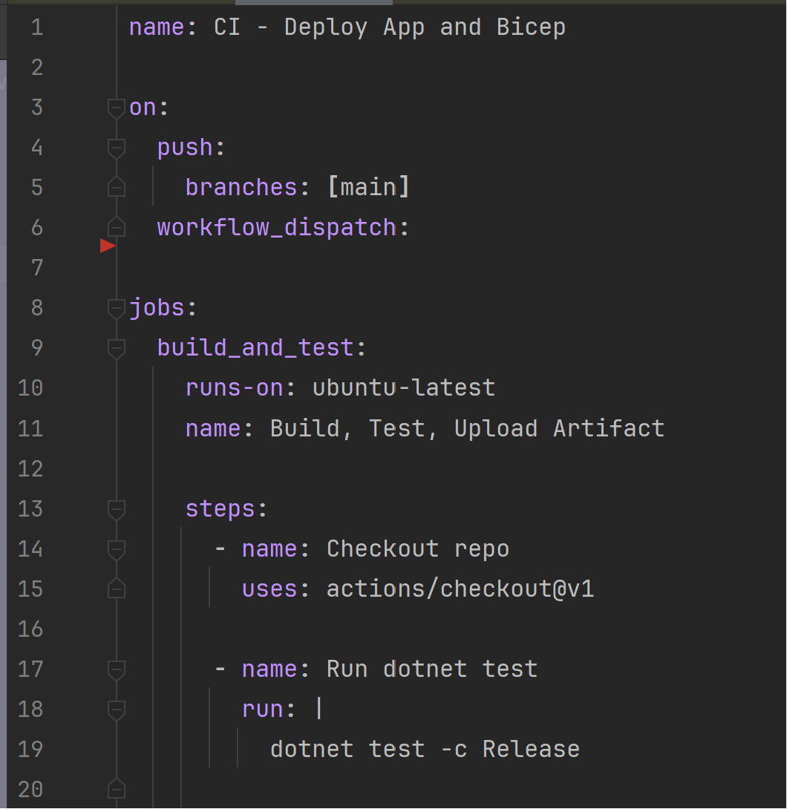
What does GitHub Actions Look Like?
scottsauber

Slide 60
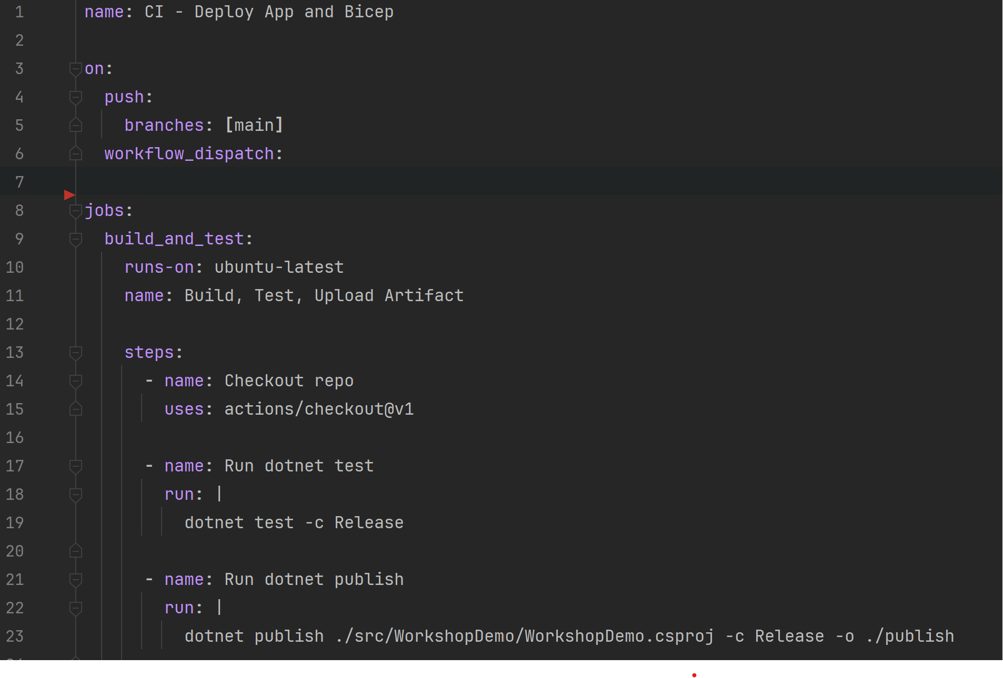
How do I reuse workflows?
scottsauber

Slide 61
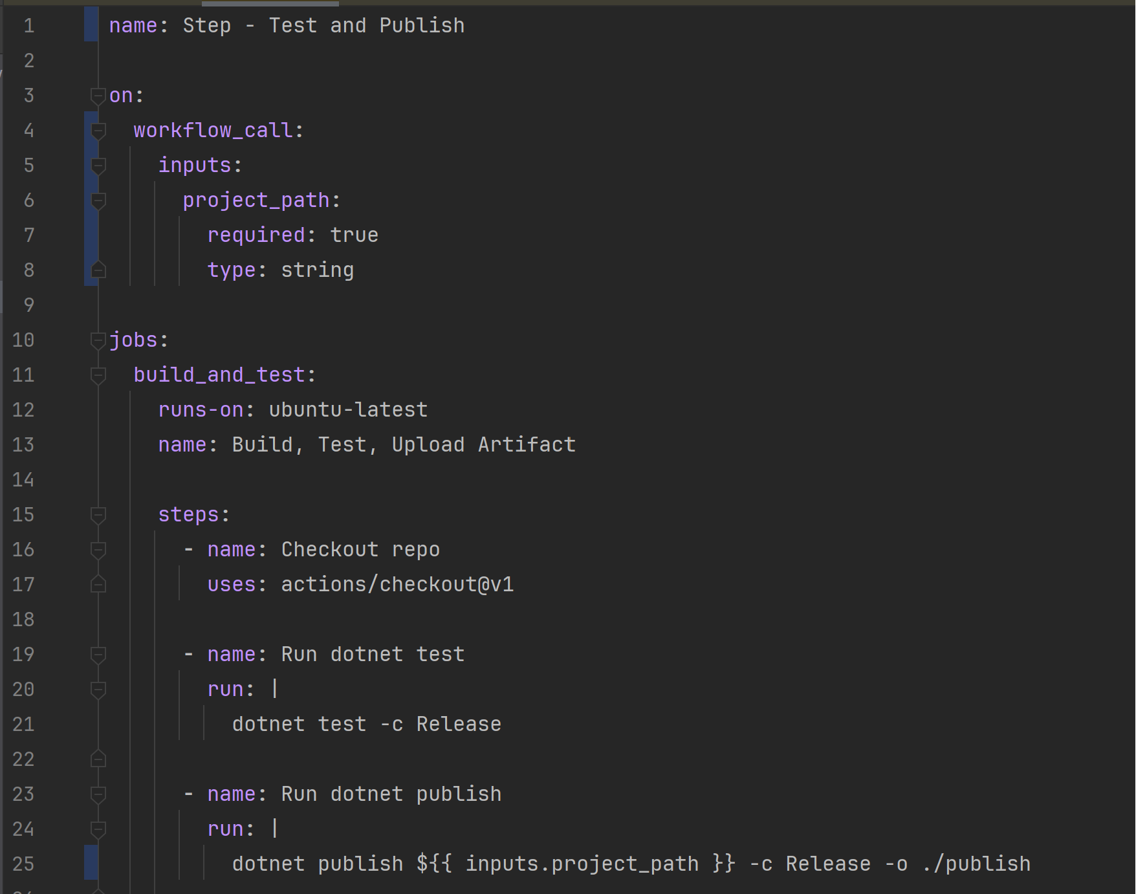
How do I reuse workflows?
scottsauber

Slide 62
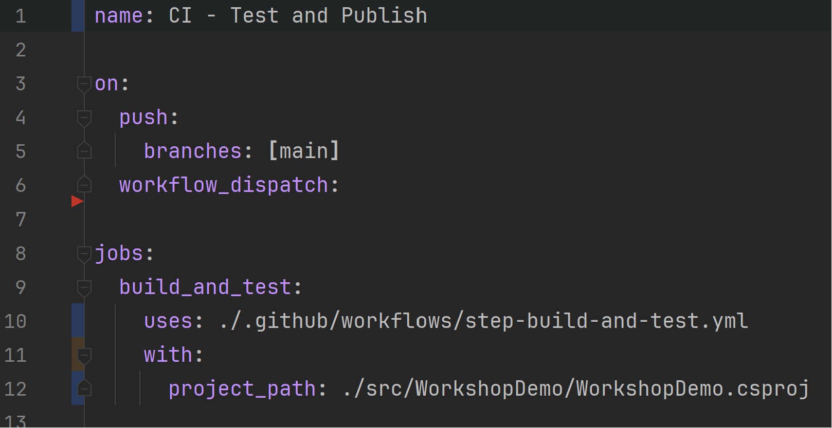
How do I consume this reusable workflow?
scottsauber

Slide 63
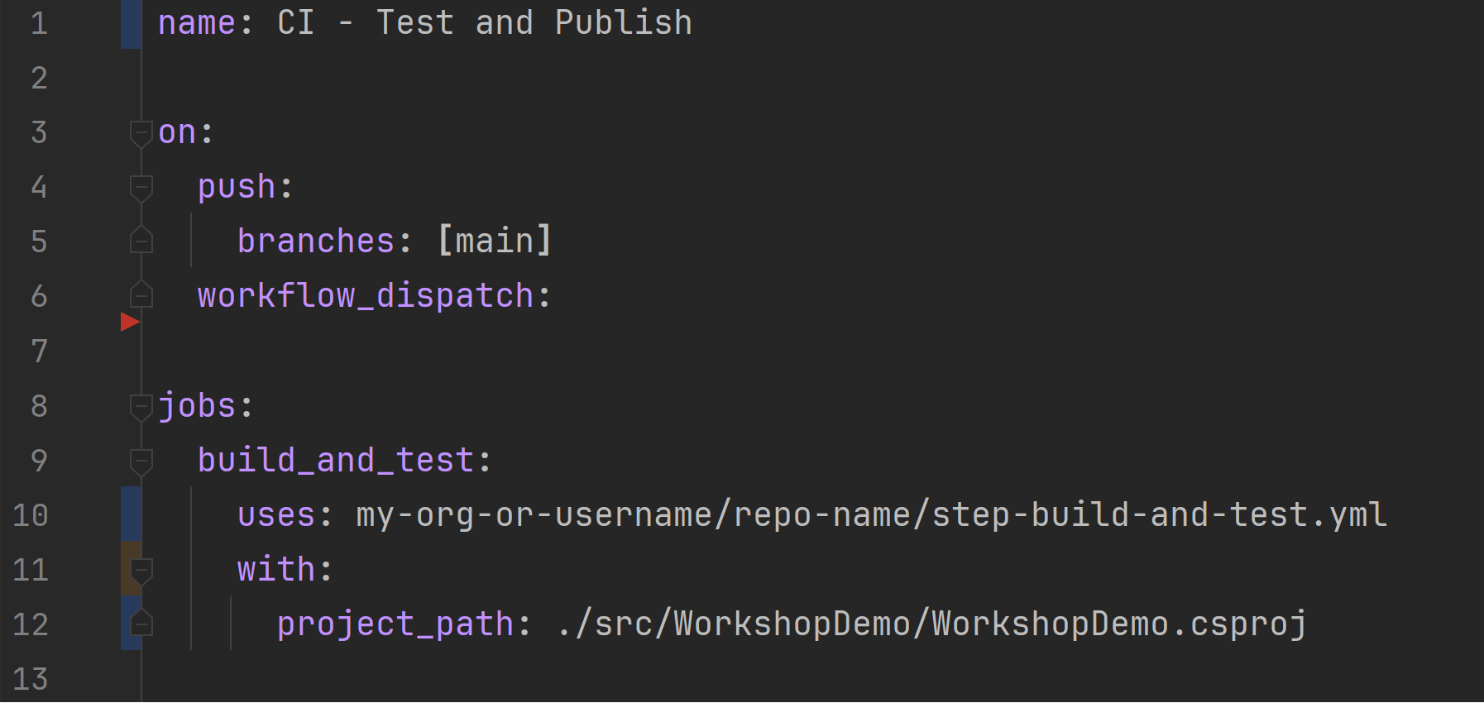
How do I consume this from another repo?
scottsauber

Slide 64
Live Demo

Slide 65
Questions?

Slide 66
Hands On for 45 mins
Module 6: https://github.com/scottsauber/workshop-dotnet-azure-github-bicep
Reminder: Email scott@saubersoftware.com if you’re doing hands on to get free Azure access:
Email you will use for Azure
GitHub username
You will receive an email with some guids you will use later, check Spam!

Slide 67
Bonus: Additional .NET Integrations in modules
.NET integrations with:
  Health Checks
  Azure Key Vault
  Azure Log Analytics
scottsauber

Slide 68
Bonus: GitHub Environments
GitHub natively has the concept of Environments
These environments can have secrets
You can also set up Protection Rules on environments
Let’s refactor our code to use Environments!
scottsauber

Slide 69
Bonus: PR Checks for Infrastructure
When you change some Bicep it’d be nice to know what it’s going to do
--whatif for PR’s
Have the –whatif comment back on the PR what it’s going to do
Example
scottsauber

Slide 70
Bonus: PR Checks for Infrastructure
Checkov security scanner
Tells you if something is misconfigured
ie TLS 1.2 is not the minimum TLS setting for an App Service
Public Storage Accounts
scottsauber

Slide 71
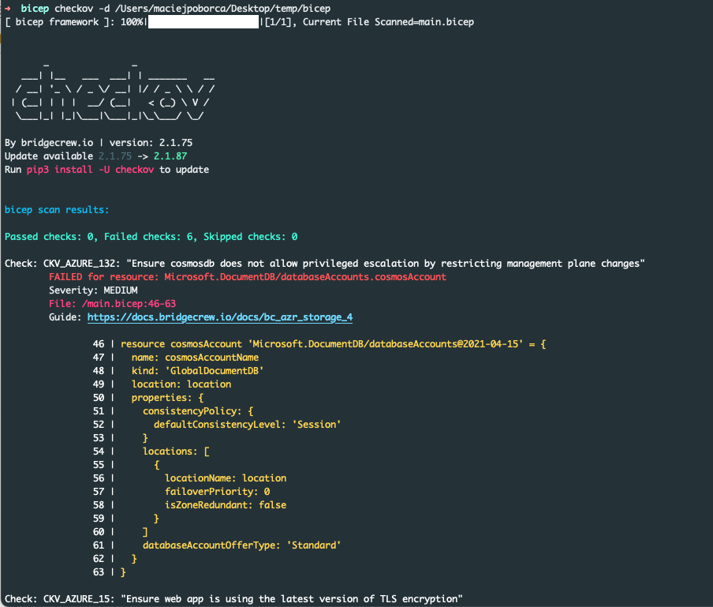
scottsauber

Slide 72
Takeaways
How to leverage Azure
Why IAC is useful and how Bicep works
How to create GitHub Actions and applies IAC to Azure
Some takeaway tips even if you had experience with this stuff
scottsauber

Slide 73
Resources
Slides at scottsauber.com (and in the repo)
https://github.com/scottsauber/workshop-dotnet-azure-github-bicep
  Main has the “final” state of things
scottsauber

Slide 74
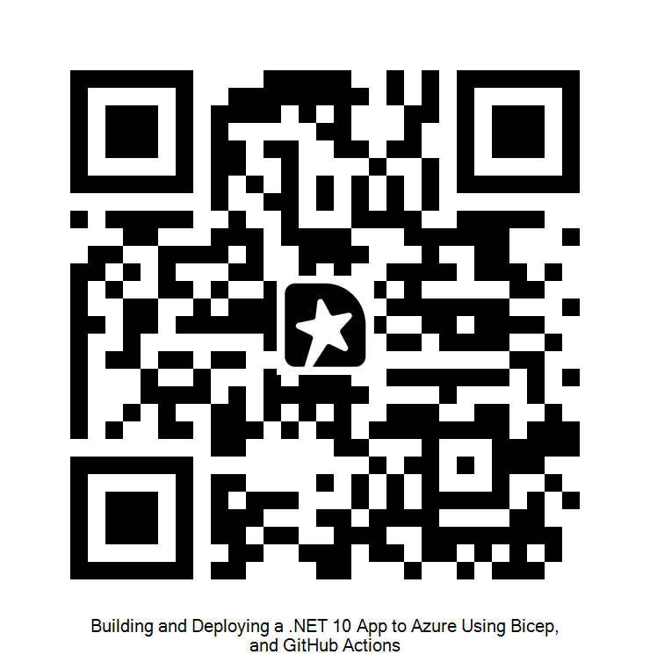
Questions?
Contact: ssauber@leantechniques.com
Feedback:
Slides at scottsauber.com
@scottsauber
@scottsauber.com

Slide 75
Thanks!
Feedback:
Slides at scottsauber.com
scottsauber

