Slide 1

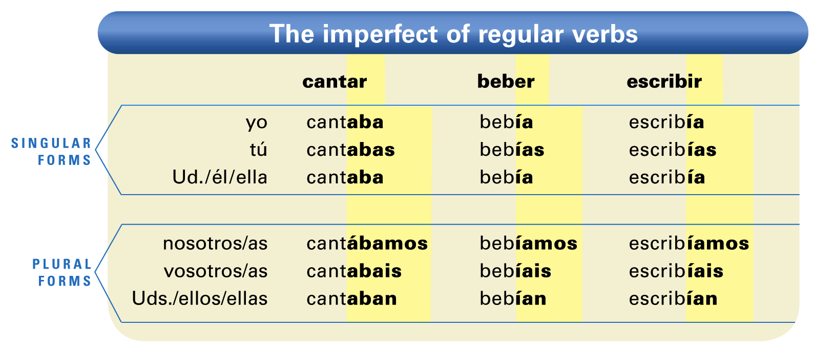
In Descubre, nivel 1, you learned the preterite tense. You will now learn the imperfect, which describes past activities in a different way.
© by Vista Higher Learning, Inc. All rights reserved.
1.1-<number>

Slide 2
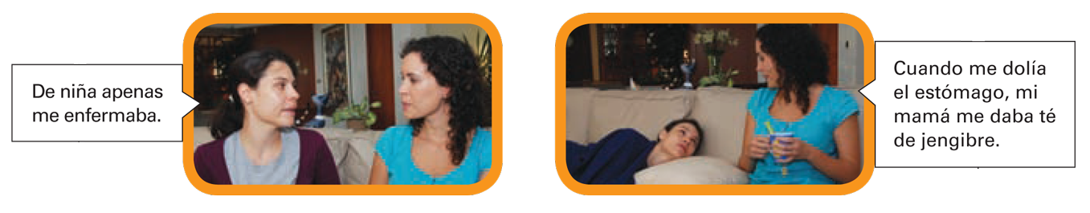
¡Atención! Note that the imperfect endings of -er and -ir verbs are the same. Also note that the nosotros form of -ar verbs always carries an accent mark on the first a of the ending. All forms of -er and -ir verbs in the imperfect carry an accent on the first i of the ending.
© by Vista Higher Learning, Inc. All rights reserved.
1.1-<number>

Slide 3
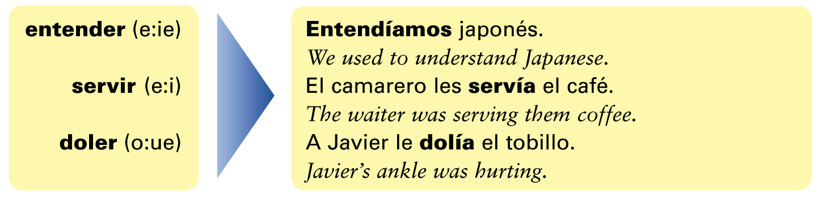
There are no stem changes in the imperfect.
© by Vista Higher Learning, Inc. All rights reserved.
1.1-<number>

Slide 4
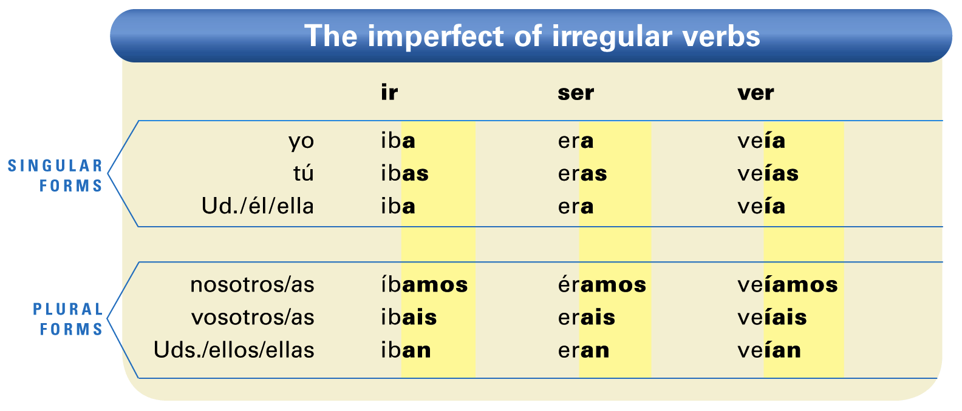
The imperfect form of hay is había (there was;
there were; there used to be).
¡Atención! Ir, ser, and ver are the only verbs that are irregular in the imperfect.
© by Vista Higher Learning, Inc. All rights reserved.
1.1-<number>

Slide 5
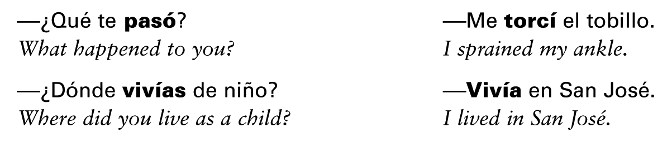
Uses of the imperfect
As a general rule, the imperfect is used to describe actions that are seen by the speaker as incomplete or “continuing,” while the preterite is used to describe actions that have been completed. The imperfect expresses what was happening at a certain time or how things used to be. The preterite, in contrast, expresses a completed action.
© by Vista Higher Learning, Inc. All rights reserved.
1.1-<number>

Slide 6
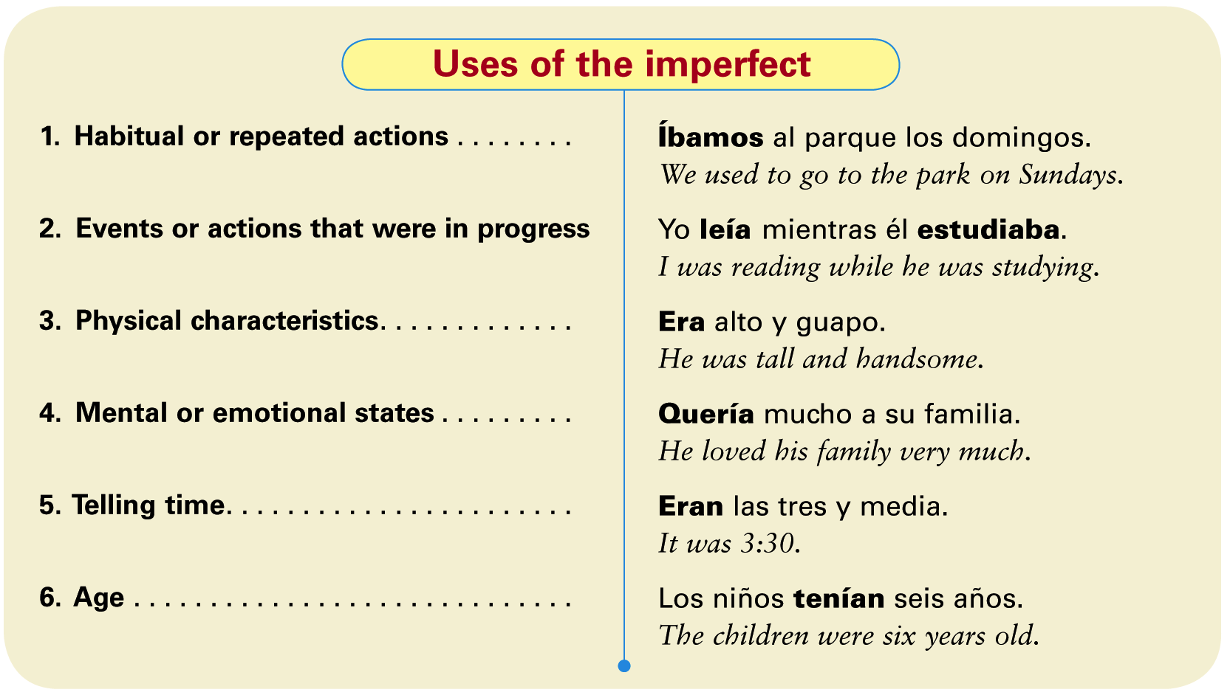
These expressions are often used with the imperfect because they express habitual or repeated actions: de niño/a
(as a child), todos los días (every day), mientras (while).
© by Vista Higher Learning, Inc. All rights reserved.
1.1-<number>

Slide 7

Indica la forma correcta de cada verbo en el imperfecto.
Mis hermanos _____ (ver) la televisión todas las tardes. Yo _____ (viajar) en el tren de las 3:30. ¿Dónde _____ (vivir) Samuel de niño? Tú _____ (hablar) con Javier. Leonardo y yo _____ (correr) por el parque. Ustedes _____ (ir) a la clínica. Nadia _____ (bailar) merengue. ¿Cuándo _____ (asistir) tú a clase de español? Yo _____ (ser) muy feliz. Nosotras _____ (comprender) las preguntas.
veían
© by Vista Higher Learning, Inc. All rights reserved.
1.1-<number>

