Slide 1

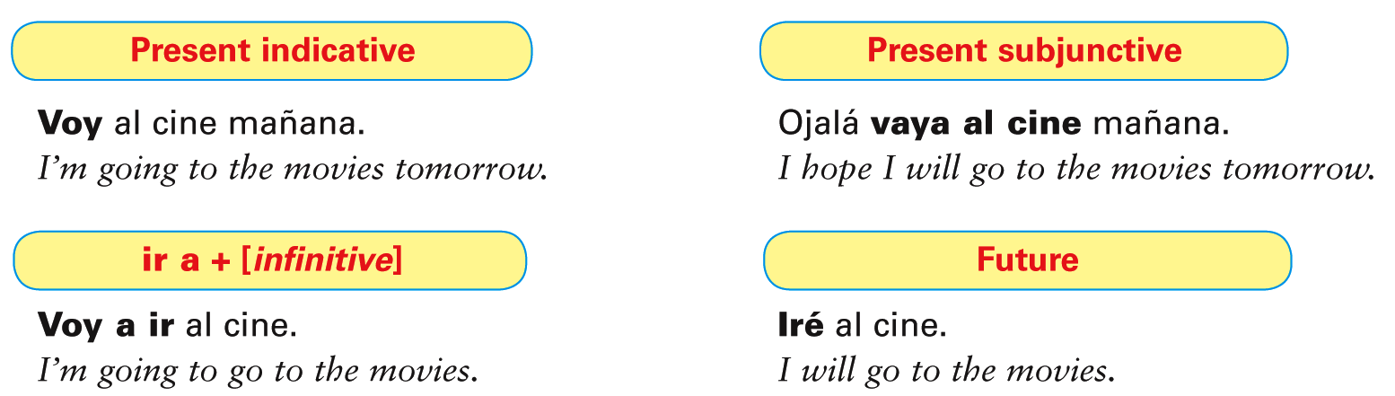
You have already learned ways of expressing the near future in Spanish. You will now learn how to form and use the future tense. Compare the different ways of expressing the future in Spanish and English.
© by Vista Higher Learning, Inc. All rights reserved.
7.1-<number>

Slide 2
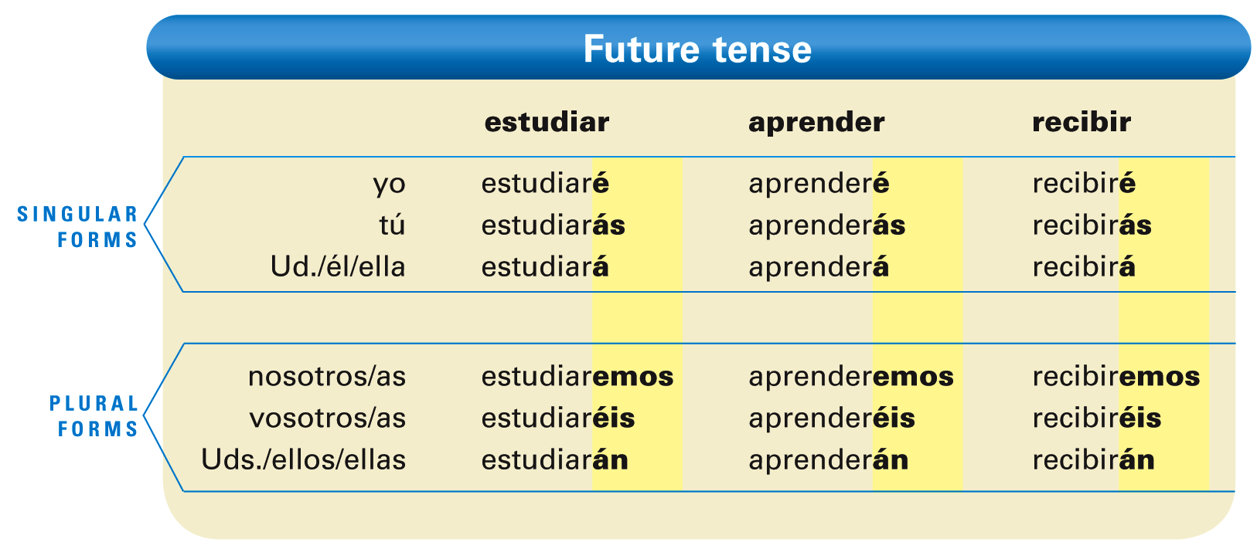
In Spanish, the future is a simple tense that consists of one word, whereas in English it is made up of the auxiliary verb will or shall, and the main verb.
© by Vista Higher Learning, Inc. All rights reserved.
7.1-<number>

Slide 3
¡Atención! Note that -ar, -er, and -ir verbs all have the same endings in the future tense.
¡Atención! Note that all of the future endings have a written accent except the nosotros/as form.
© by Vista Higher Learning, Inc. All rights reserved.
7.1-<number>

Slide 4
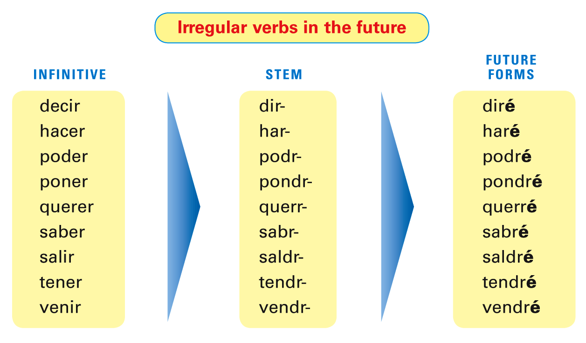
The future endings are the same for regular and irregular verbs. For regular verbs, simply add the endings to the infinitive. For irregular verbs, add the endings to the irregular stem.
© by Vista Higher Learning, Inc. All rights reserved.
7.1-<number>

Slide 5
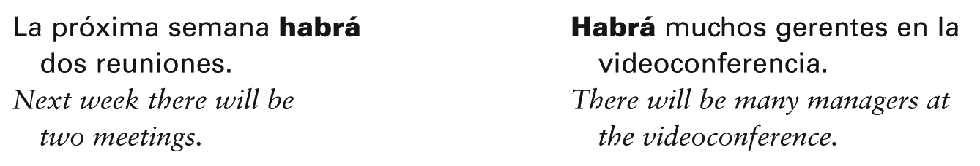
The future of hay (inf. haber) is habrá
(there will be).
© by Vista Higher Learning, Inc. All rights reserved.
7.1-<number>

Slide 6
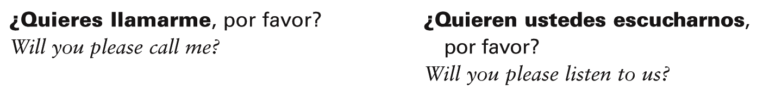
Although the English word will can refer to future time, it also refers to someone’s willingness to do something. In this case, Spanish uses querer + [infinitive], not the future tense.
© by Vista Higher Learning, Inc. All rights reserved.
7.1-<number>

Slide 7
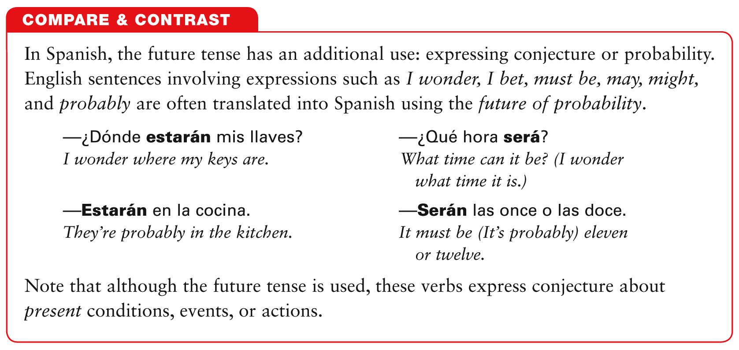
© by Vista Higher Learning, Inc. All rights reserved.
7.1-<number>

Slide 8
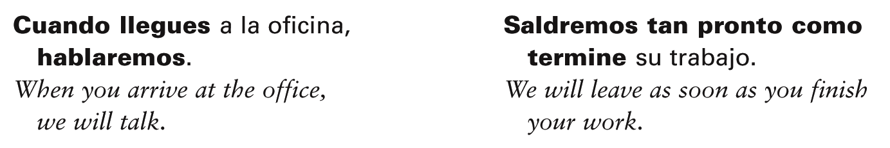
The future may also be used in the main clause of sentences in which the present subjunctive follows a conjunction of time such as cuando, después (de) que, en cuanto, hasta que, and tan pronto como.
© by Vista Higher Learning, Inc. All rights reserved.
7.1-<number>

Slide 9

Conjuga los verbos entre paréntesis en futuro.
1. (dejar, correr, invertir) yo ________________________ 2. (renunciar, beber, vivir) tú _______________________ 3. (hacer, poner, venir) Lola ______________________ 4. (tener, decir, querer) nosotros ____________________ 5. (ir, ser, estar) ustedes __________________________ 6. (solicitar, comer, repetir) usted ___________________ 7. (saber, salir, poder) yo _________________________ 8. (encontrar, jugar, servir) tú ______________________
dejaré, correré, invertiré
© by Vista Higher Learning, Inc. All rights reserved.
7.1-<number>

