Slide 1

You will now learn how to form
and use the past subjunctive (el pretérito imperfecto del subjuntivo), also called the imperfect subjunctive. Like the present subjunctive, the past subjunctive is used mainly in multiple-clause sentences that express states and conditions such as will, influence, emotion, commands, indefiniteness, and non-existence.
© by Vista Higher Learning, Inc. All rights reserved.
7.3-<number>

Slide 2
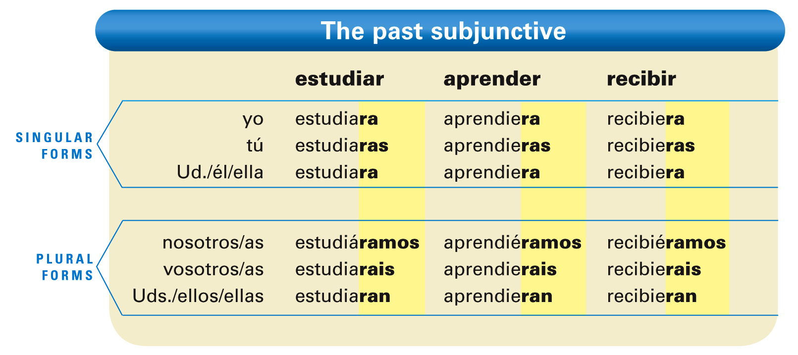
¡Atención! Note that the nosotros/as form of the past subjunctive always has a written accent.
© by Vista Higher Learning, Inc. All rights reserved.
7.3-<number>

Slide 3

The past subjunctive endings are the same for all verbs.
© by Vista Higher Learning, Inc. All rights reserved.
7.3-<number>

Slide 4
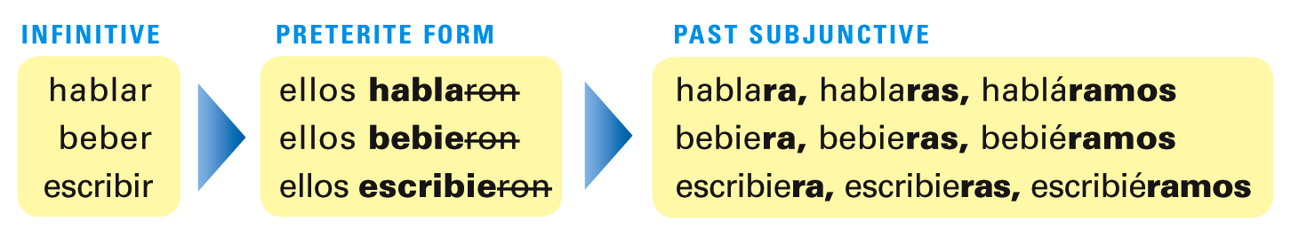
The past subjunctive is formed using the Uds./ellos/ellas form of the preterite. By dropping the -ron ending from this preterite form, you establish the stem of all the past subjunctive forms. To this stem you then add the past subjunctive endings.
© by Vista Higher Learning, Inc. All rights reserved.
7.3-<number>

Slide 5
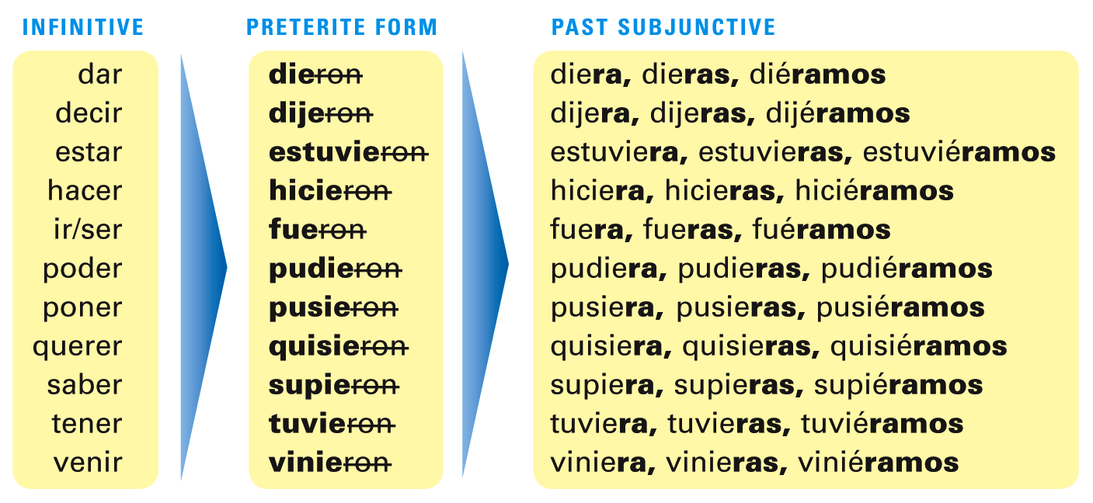
For verbs with irregular preterites, add the past subjunctive endings to the irregular stem.
© by Vista Higher Learning, Inc. All rights reserved.
7.3-<number>

Slide 6
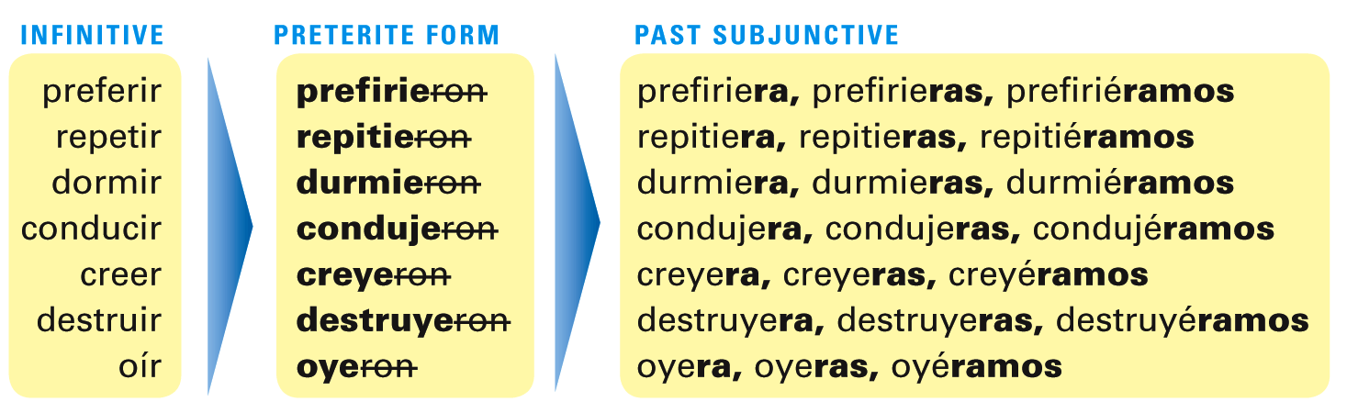
-Ir stem-changing verbs and other verbs with spelling changes follow a similar process to form the past subjunctive.
© by Vista Higher Learning, Inc. All rights reserved.
7.3-<number>

Slide 7
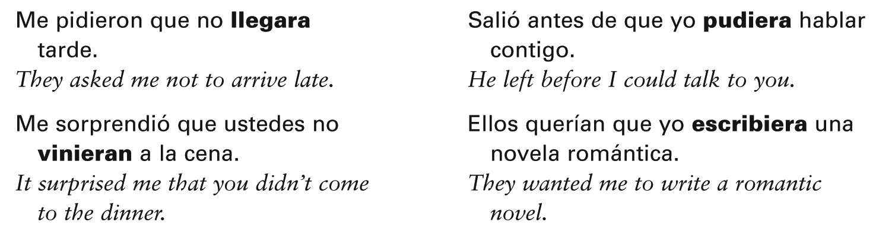
The past subjunctive is used in the same contexts and situations as the present subjunctive and the present perfect subjunctive, except that it generally describes actions, events, or conditions that have already happened.
© by Vista Higher Learning, Inc. All rights reserved.
7.3-<number>

Slide 8
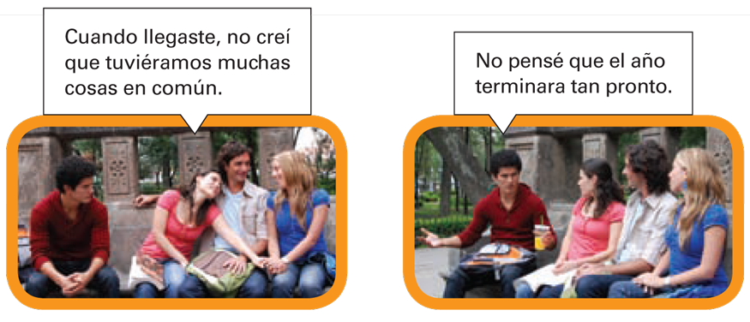
© by Vista Higher Learning, Inc. All rights reserved.
7.3-<number>

Slide 9

Indica la forma apropiada del pretérito imperfecto de subjuntivo de los verbos entre paréntesis.
Quería que tú ________ (venir) más temprano. Esperábamos que ustedes _____ (hablar) mucho más en la reunión. No creían que yo _____ (poder) hacerlo. No deseaba que nosotros _____ (invertir) el dinero ayer. Sentí mucho que ustedes no _____ (estar) con nosotros anoche. No era necesario que ellas _____ (hacer) todo. Me pareció increíble que tú _____ (saber) dónde encontrarlo. No había nadie que _____ (creer) tu historia. Mis padres insistieron en que yo _____ (ir) a la universidad. Queríamos salir antes de que ustedes _____ (llegar).
vinieras
© by Vista Higher Learning, Inc. All rights reserved.
7.3-<number>

