Slide 1

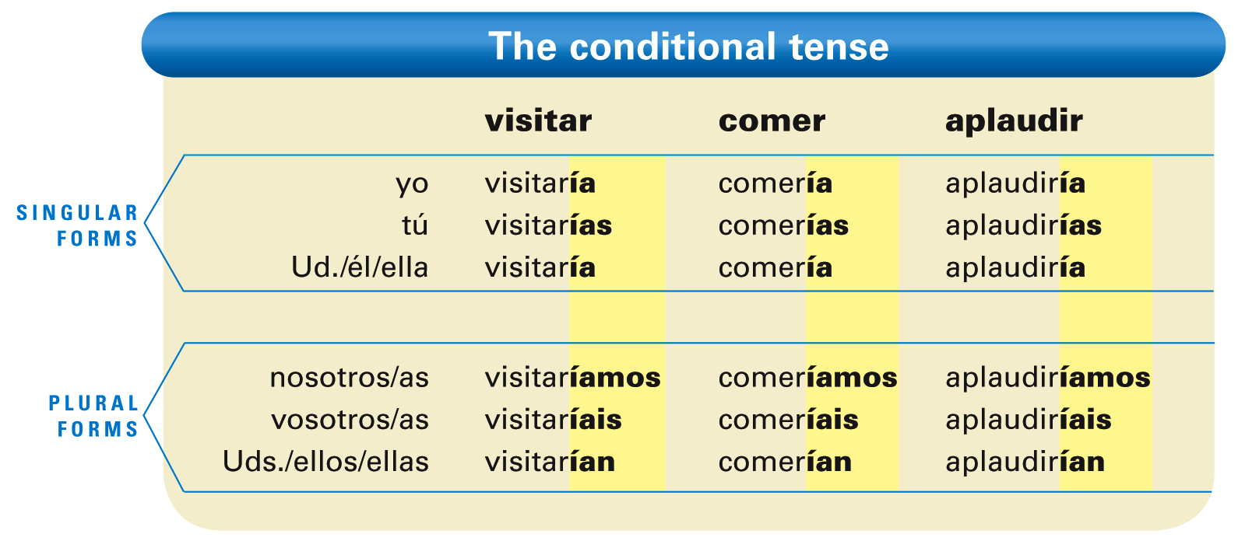
The conditional tense in Spanish expresses what you would do or what would happen under certain circumstances.
© by Vista Higher Learning, Inc. All rights reserved.
8.1-<number>

Slide 2
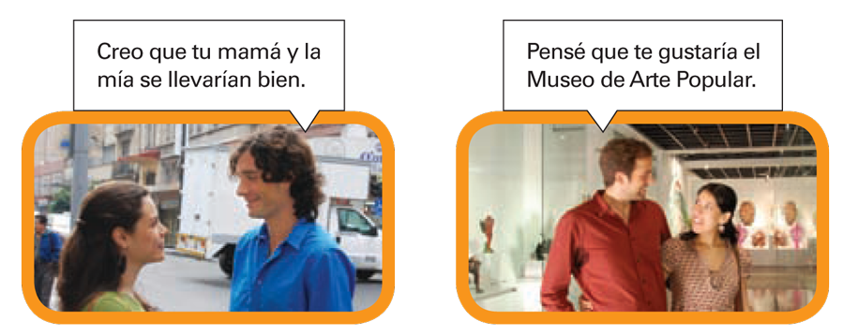
¡Atención! The polite expressions Me gustaría... (I would like...) and Te gustaría (You would like...) are examples of the conditional.
© by Vista Higher Learning, Inc. All rights reserved.
8.1-<number>

Slide 3
The conditional tense is formed much like the future tense. The endings are the same for all verbs, both regular and irregular. For regular verbs, you simply add the appropriate endings to the infinitive.
¡Atención! All forms of the conditional have an accent mark.
© by Vista Higher Learning, Inc. All rights reserved.
8.1-<number>

Slide 4
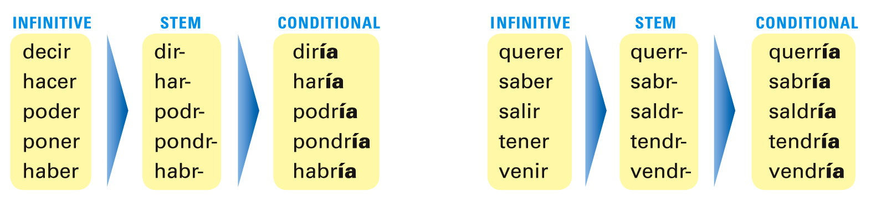
For irregular verbs, add the conditional endings to the irregular stems.
© by Vista Higher Learning, Inc. All rights reserved.
8.1-<number>

Slide 5
While in English the conditional is a compound verb form made up of the auxiliary verb would and a main verb, in Spanish it is a simple verb form that consists of one word.
© by Vista Higher Learning, Inc. All rights reserved.
8.1-<number>

Slide 6
The conditional is commonly used to make polite requests.
© by Vista Higher Learning, Inc. All rights reserved.
8.1-<number>

Slide 7
In Spanish, as in English, the conditional expresses the future in relation to a past action or state of being. In other words, the future indicates what will happen whereas the conditional indicates what would happen.
© by Vista Higher Learning, Inc. All rights reserved.
8.1-<number>

Slide 8
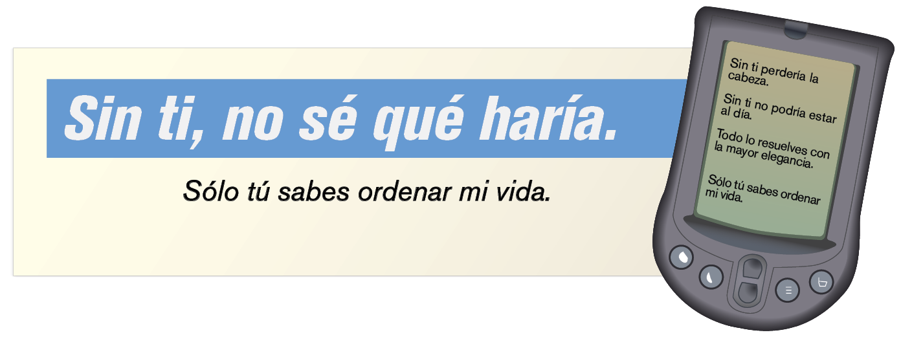
The English would is often used with a verb to express the conditional, but it can also mean used to, in the sense of past habitual action. To express past habitual actions, Spanish uses the imperfect, not the conditional.
© by Vista Higher Learning, Inc. All rights reserved.
8.1-<number>

Slide 9
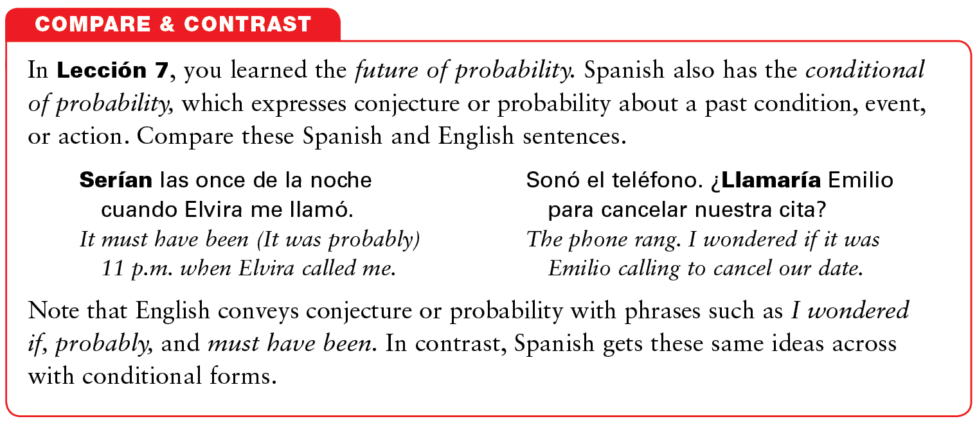
© by Vista Higher Learning, Inc. All rights reserved.
8.1-<number>

Slide 10

Indica la forma apropiada del condicional de los verbos.
Yo ____________________________ (escuchar, leer, esculpir) Tú ____________________________ (apreciar, comprender, compartir) Marcos ____________________________ (poner, venir, querer) Nosotras ____________________________ (ser, saber, ir) Ustedes ____________________________ (presentar, deber, aplaudir) Ella ____________________________ (salir, poder, hacer) Yo ____________________________ (tener, tocar, aburrirse) Tú ____________________________ (decir, ver, publicar)
escucharía, leería, esculpiría
© by Vista Higher Learning, Inc. All rights reserved.
8.1-<number>

