Slide 1
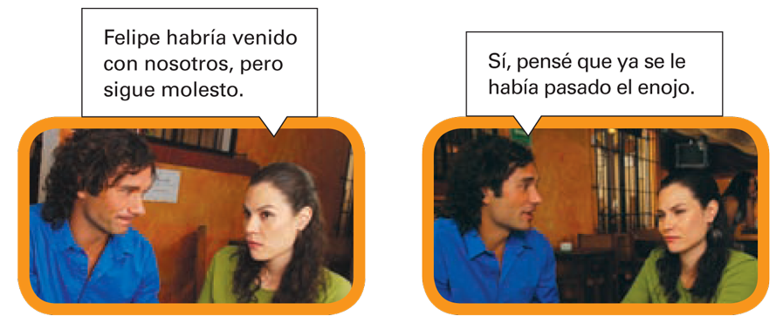
© by Vista Higher Learning, Inc. All rights reserved.
8.2-<number>

Slide 2
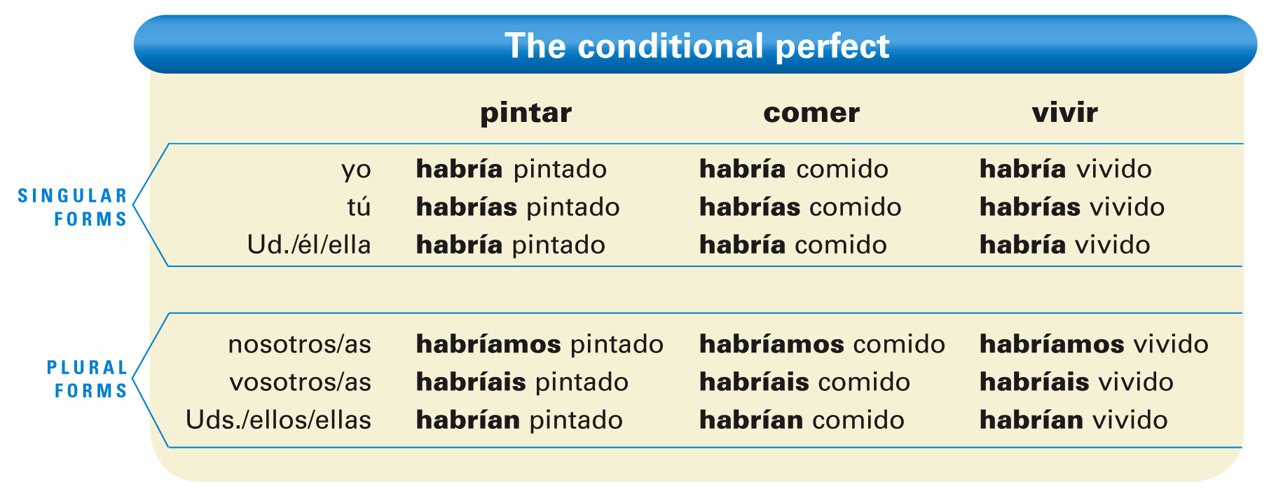
© by Vista Higher Learning, Inc. All rights reserved.
8.2-<number>

Slide 3
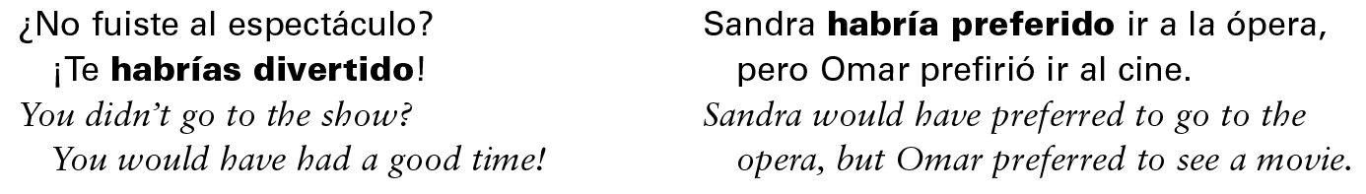
The conditional perfect is used to express an action that would have occurred, but didn’t.
© by Vista Higher Learning, Inc. All rights reserved.
8.2-<number>

Slide 4

Indica las formas apropiadas del condicional perfecto de los verbos.
Nosotros ____________________ (hacer) todos los quehaceres. Tú ____________________ (apreciar) mi poesía. Ellos ____________________ (pintar) un mural. Usted ____________________ (tocar) el piano. Ellas ____________________ (poner) la mesa. Tú y yo ____________________ (resolver) los problemas. Silvia y Alberto ____________________ (esculpir) una estatua. Yo ____________________ (presentar) el informe. Ustedes ____________________ (vivir) en el campo. Tú ____________________ (abrir) la puerta.
habríamos hecho
© by Vista Higher Learning, Inc. All rights reserved.
8.2-<number>

