Slide 1

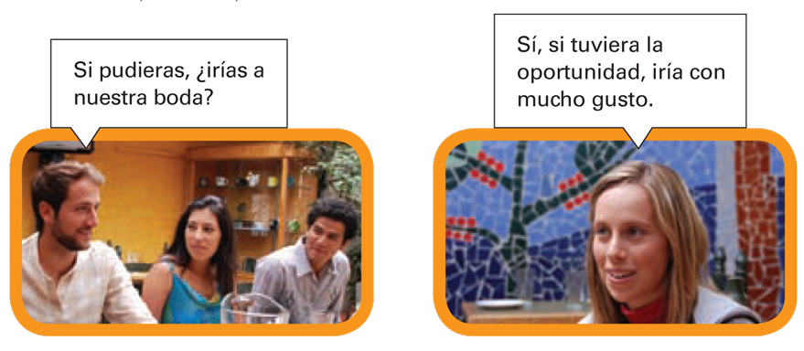
Si (If) clauses describe a condition or event upon which another condition or event depends. Sentences with si clauses consist of a si clause and a main (or result) clause.
© by Vista Higher Learning, Inc. All rights reserved.
9.1-<number>

Slide 2
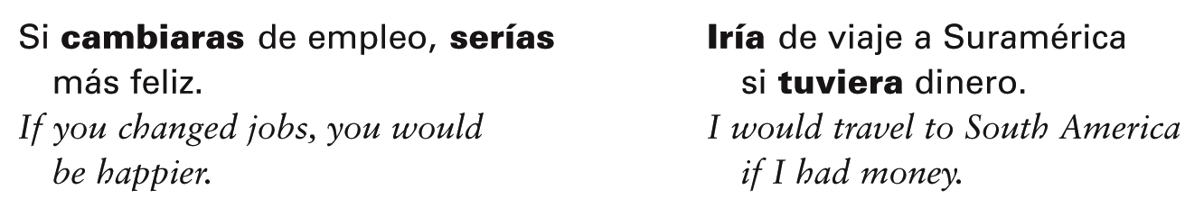
Si clauses can speculate or hypothesize about a current event or condition. They express what would happen if an event or condition were to occur. This is called a contrary-to-fact situation. In such instances, the verb in the si clause is in the past subjunctive while the verb in the main clause is in the conditional.
¡Atención! Remember the difference between
si (if) and sí (yes).
© by Vista Higher Learning, Inc. All rights reserved.
9.1-<number>

Slide 3
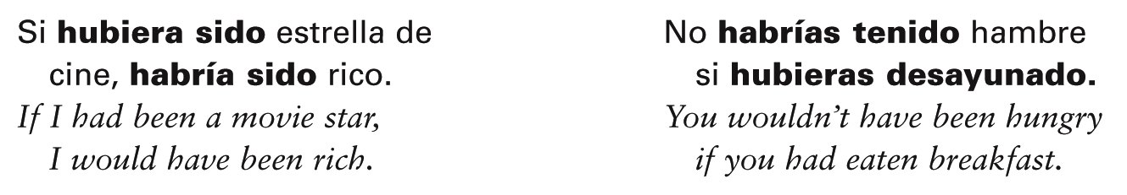
Si clauses can also describe a contrary-to-fact situation in the past. They can express what would have happened if an event or condition had occurred. In these sentences, the verb in the si clause is in the past perfect subjunctive while the verb in the main clause is in the conditional perfect.
© by Vista Higher Learning, Inc. All rights reserved.
9.1-<number>

Slide 4
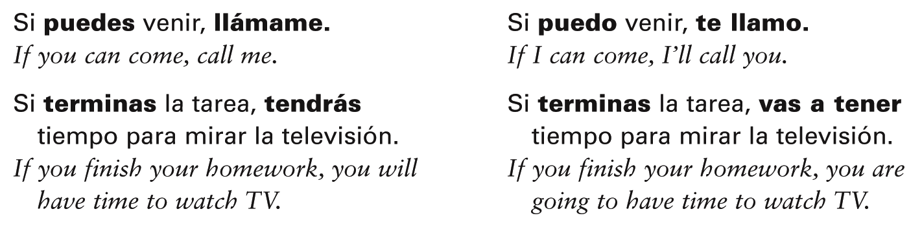
Si clauses can also express conditions or events that are possible or likely to occur.
In such instances, the si clause is in the present indicative while the main clause
uses a present, near future, future, or command form.
© by Vista Higher Learning, Inc. All rights reserved.
9.1-<number>

Slide 5
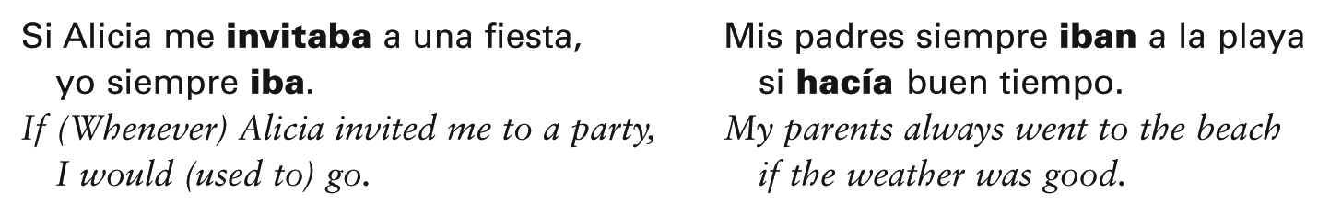
When the si clause expresses habitual past conditions or events, not a contrary-to-fact situation, the imperfect is used in both the
si clause and the main (or result) clause.
© by Vista Higher Learning, Inc. All rights reserved.
9.1-<number>

Slide 6
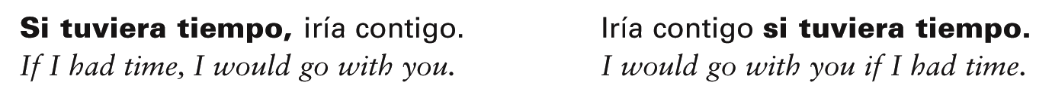
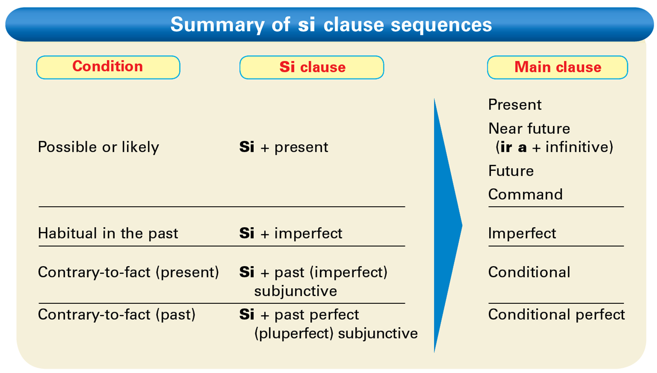
The si clause may be the first or second clause in a sentence. Note that a comma is used only when the si clause comes first.
© by Vista Higher Learning, Inc. All rights reserved.
9.1-<number>

Slide 7

Cambia los tiempos y modos de los verbos que aparecen entre paréntesis para practicar todos los tipos de oraciones con si que se muestran en la tabla anterior.
Si usted _____ (ir) a la playa, tenga cuidado con el sol. Si tú _____ (querer), te preparo la merienda. Si _____ (hacer) buen tiempo, voy a ir al parque. Si mis amigos _____ (ir) de viaje, sacaban muchas fotos. Si ella me _____ (llamar), yo la invitaría a la fiesta. Si nosotros _____ (querer) ir al teatro, compraríamos los boletos antes. Si tú _____ (levantarse) temprano, desayunarías antes de ir a clase.
va
© by Vista Higher Learning, Inc. All rights reserved.
9.1-<number>

Slide 8
Cambia los tiempos y modos de los verbos que aparecen entre paréntesis para practicar todos los tipos de oraciones con si que se muestran en la tabla anterior. (cont.)
Si ellos _____ (tener) tiempo, te llamarían. Si yo _____ (ser) astronauta, habría ido a la Luna. Si él _____ (ganar) un millón de dólares, habría comprado una mansión. Si ustedes me _____ (decir) la verdad, no habríamos tenido este problema. Si ellos _____ (trabajar) más, habrían tenido más éxito.
© by Vista Higher Learning, Inc. All rights reserved.
9.1-<number>

