Slide 1

Since Lección 3, you have been learning about subjunctive verb forms and practicing their uses. The following chart summarizes the subjunctive forms you have studied. The chart on the next page summarizes the use of the subjunctive you have seen and contrasts them with the uses of the indicative and the infinitive. These charts will help you review and synthesize what you have learned about the subjunctive in this book.
© by Vista Higher Learning, Inc. All rights reserved.
9.2-<number>

Slide 2
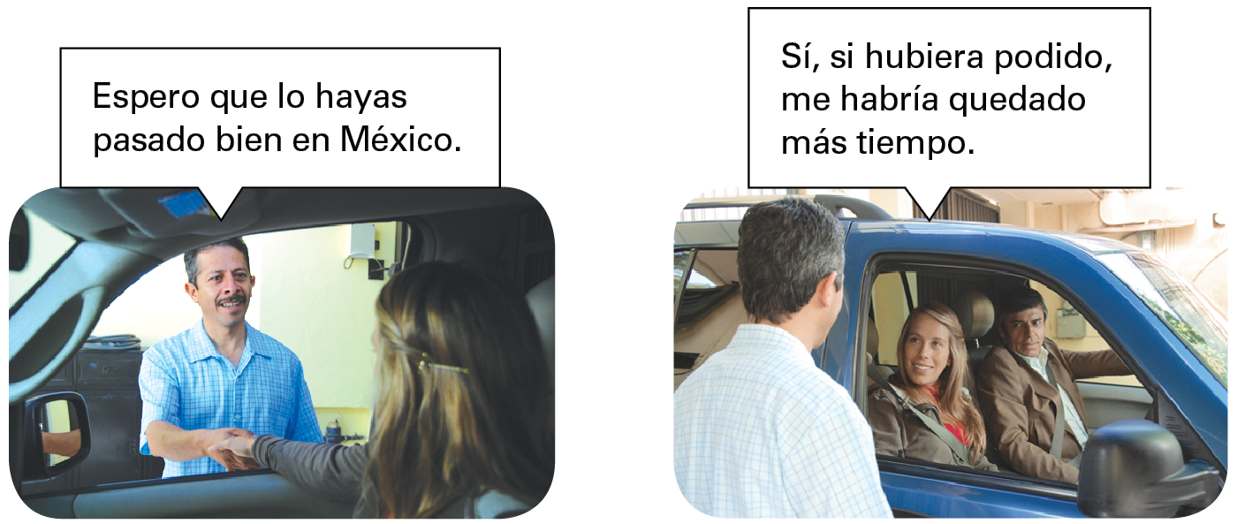
© by Vista Higher Learning, Inc. All rights reserved.
9.2-<number>

Slide 3
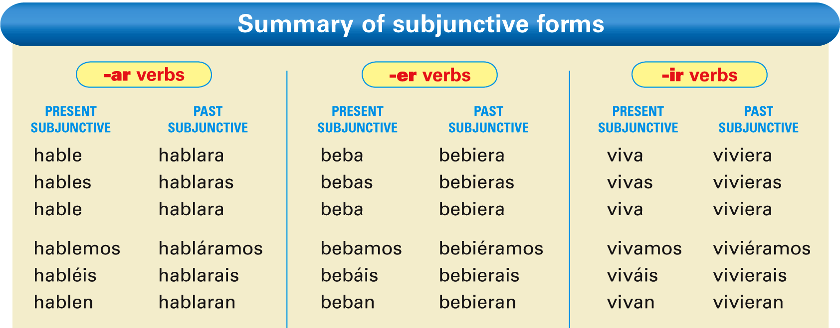
© by Vista Higher Learning, Inc. All rights reserved.
9.2-<number>

Slide 4
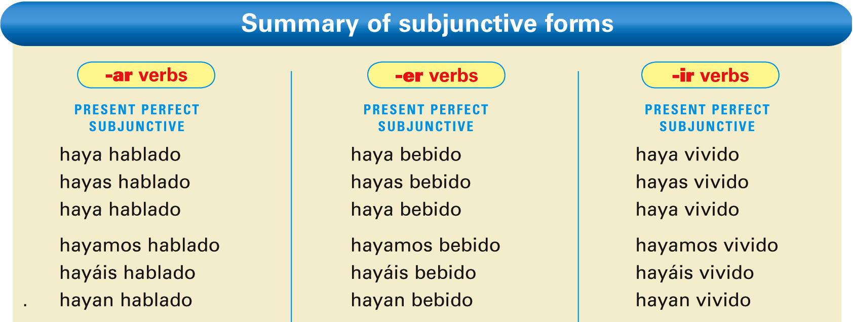
© by Vista Higher Learning, Inc. All rights reserved.
9.2-<number>

Slide 5
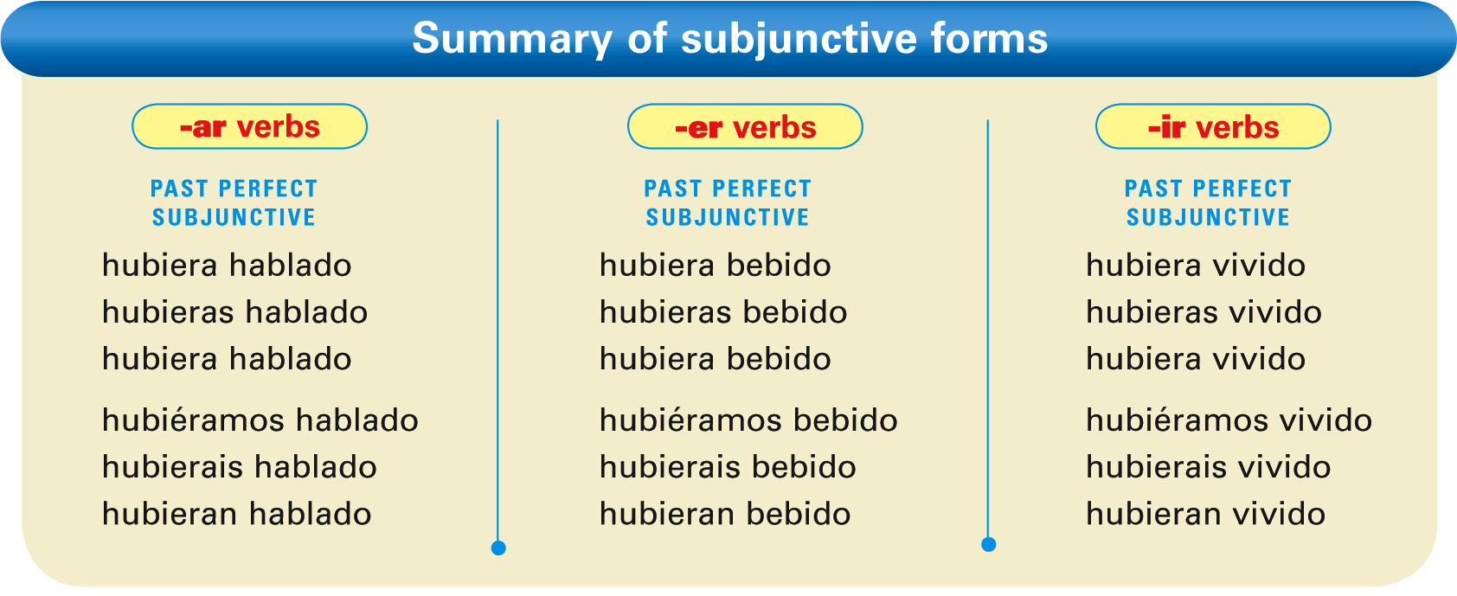
© by Vista Higher Learning, Inc. All rights reserved.
9.2-<number>

Slide 6
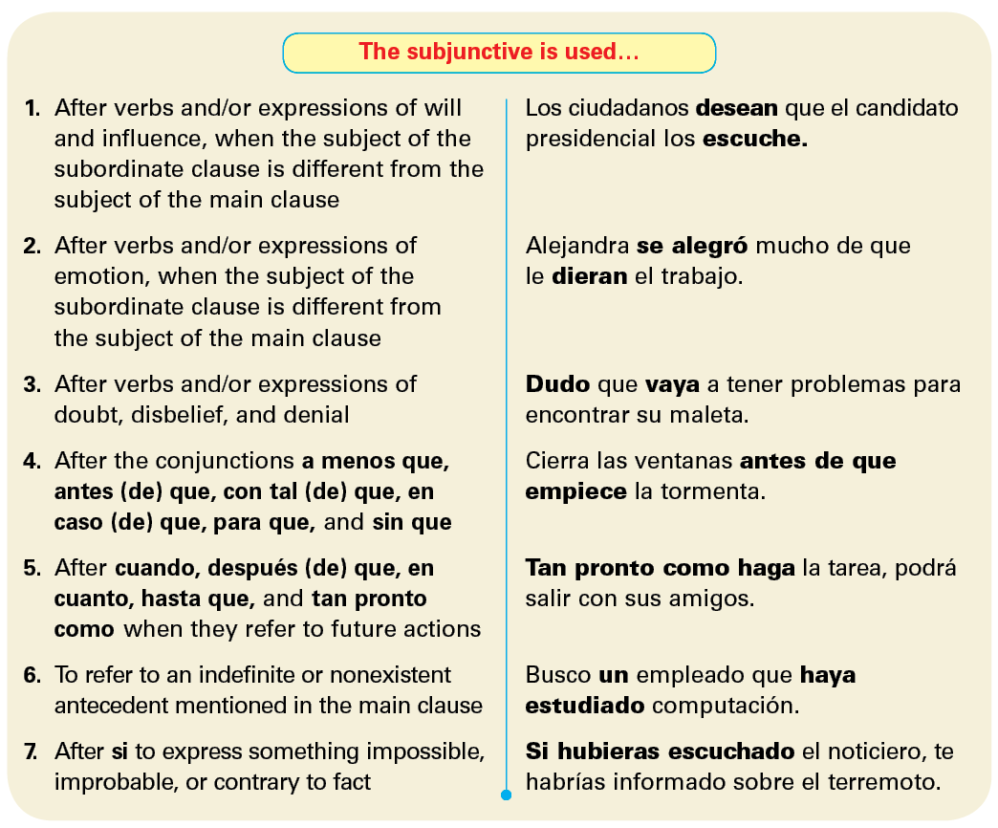
© by Vista Higher Learning, Inc. All rights reserved.
9.2-<number>

Slide 7
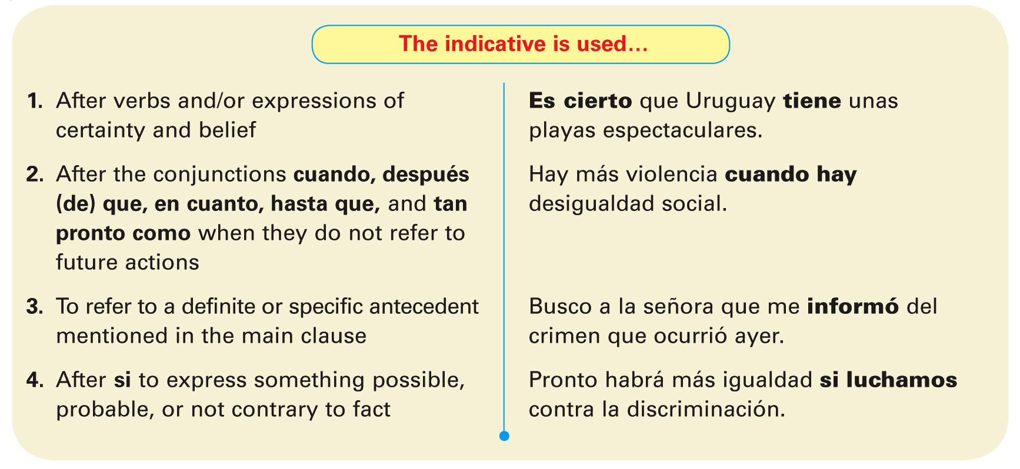
© by Vista Higher Learning, Inc. All rights reserved.
9.2-<number>

Slide 8
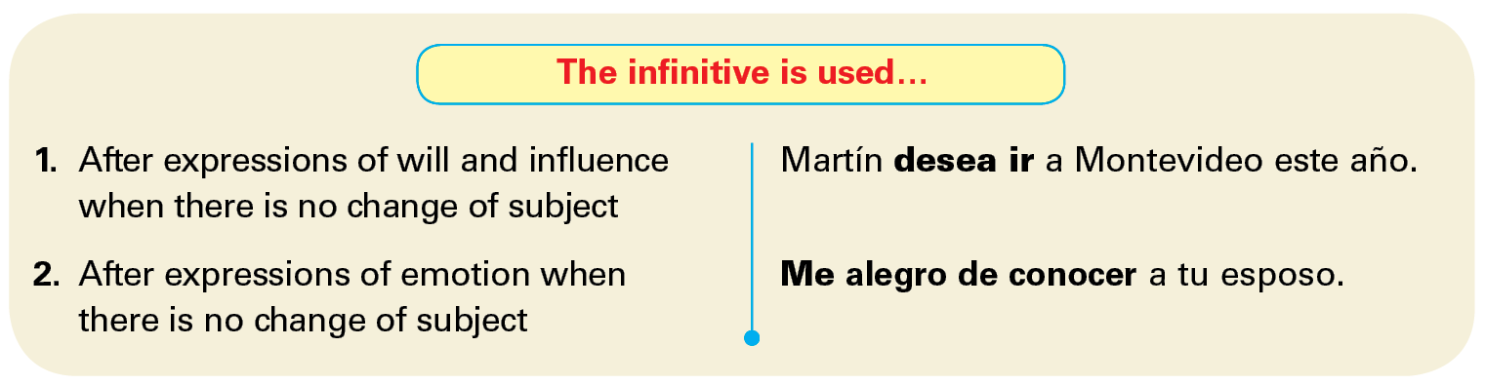
© by Vista Higher Learning, Inc. All rights reserved.
9.2-<number>

