Slide 1

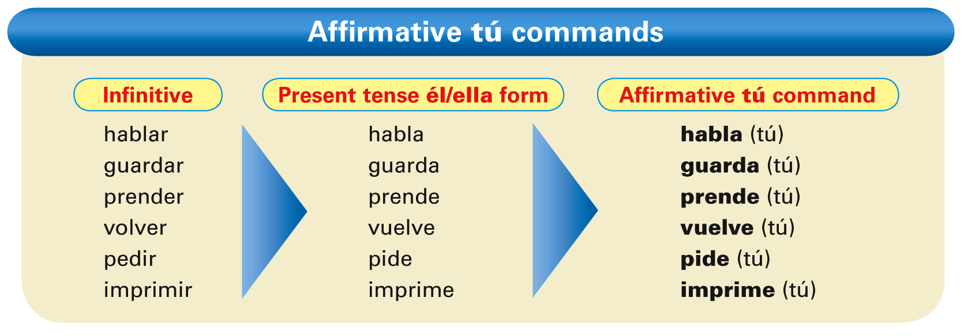
In Spanish, the command forms are used
to give orders or advice. You use tú commands (mandatos familiares) when you want to give an order or advice to someone you normally address with the familiar tú.
© by Vista Higher Learning, Inc. All rights reserved.
2.1-<number>

Slide 2
Affirmative tú commands usually have the same form as the él/ella form of the present indicative.
© by Vista Higher Learning, Inc. All rights reserved.
2.1-<number>

Slide 3
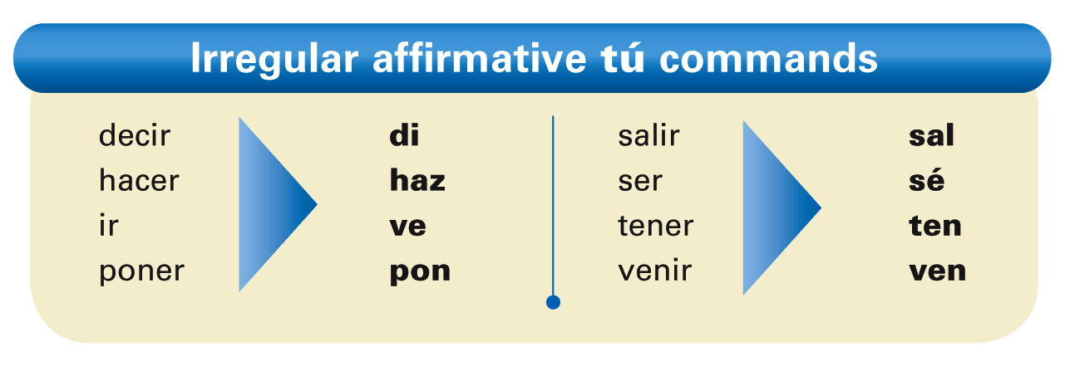
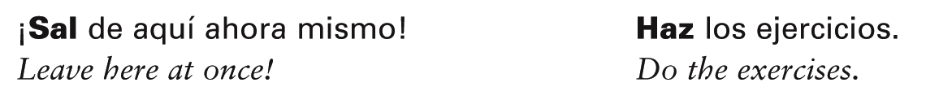
The following verbs have irregular affirmative
tú commands.
© by Vista Higher Learning, Inc. All rights reserved.
2.1-<number>

Slide 4
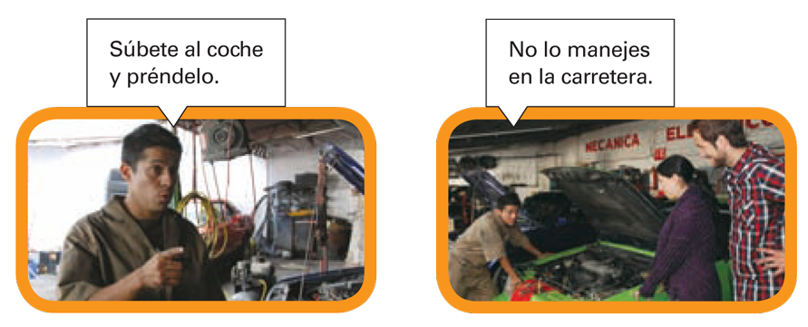
Since ir and ver have the same tú command (ve), context will determine the meaning.
© by Vista Higher Learning, Inc. All rights reserved.
2.1-<number>

Slide 5
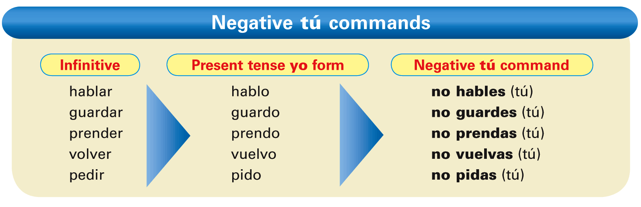
The negative tú commands are formed by dropping the final -o of the yo form of the present tense.
For -ar verbs, add -es. For -er and -ir verbs, add -as.
© by Vista Higher Learning, Inc. All rights reserved.
2.1-<number>

Slide 6
Verbs with irregular yo forms maintain the same irregularity in their negative tú commands. These verbs include conducir, conocer, decir, hacer, ofrecer, oír, poner, salir, tener, traducir, traer, venir, and ver.
© by Vista Higher Learning, Inc. All rights reserved.
2.1-<number>

Slide 7
Note also that stem-changing verbs keep their stem changes in negative tú commands.
© by Vista Higher Learning, Inc. All rights reserved.
2.1-<number>

Slide 8
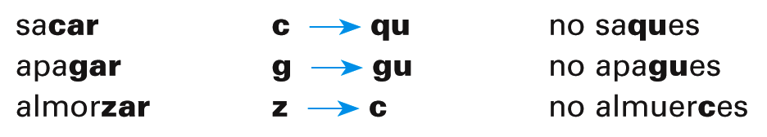
Verbs ending in -car, -gar, and -zar have
a spelling change in the negative
tú commands.
© by Vista Higher Learning, Inc. All rights reserved.
2.1-<number>

Slide 9
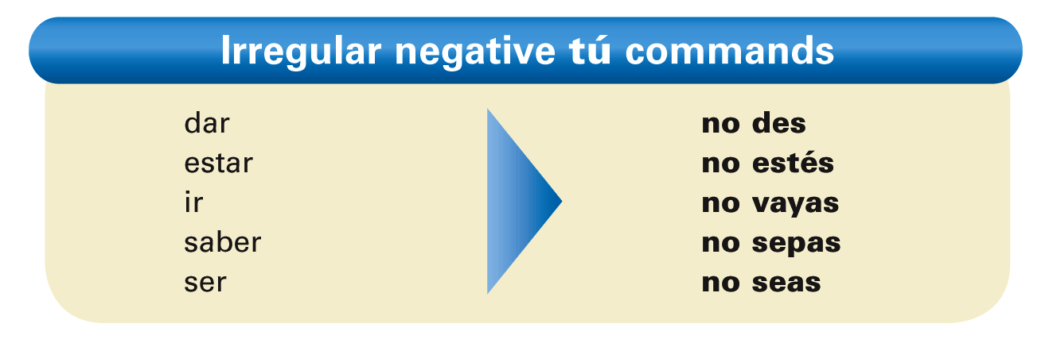
The following verbs have irregular negative
tú commands.
© by Vista Higher Learning, Inc. All rights reserved.
2.1-<number>

Slide 10
¡Atención! In affirmative commands, reflexive, indirect, and direct object pronouns are always attached to the end of the verb. In negative commands, these pronouns always precede the verb.
Bórralos. / No los borres.
Escríbeles un correo electrónico. / No les escribas un correo electrónico.
© by Vista Higher Learning, Inc. All rights reserved.
2.1-<number>

Slide 11
¡Atención! (cont.) When a pronoun is attached to an affirmative command that has two or more syllables, an accent mark is added to maintain the original stress:
borra → bórralos
prende → préndela
imprime → imprímelo
© by Vista Higher Learning, Inc. All rights reserved.
2.1-<number>

Slide 12

Indica los mandatos familiares afirmativos y negativos de estos verbos.
correr _____ más rápido. No _____ más rápido. llenar _____ el tanque. No _____ el tanque. salir _____ ahora. No _____ ahora. descargar _____ ese documento. No _____ ese documento. levantarse _____ temprano. No _____ temprano. hacerlo _____ ya. No _____ ahora.
Corre
corras
© by Vista Higher Learning, Inc. All rights reserved.
2.1-<number>

