Slide 1

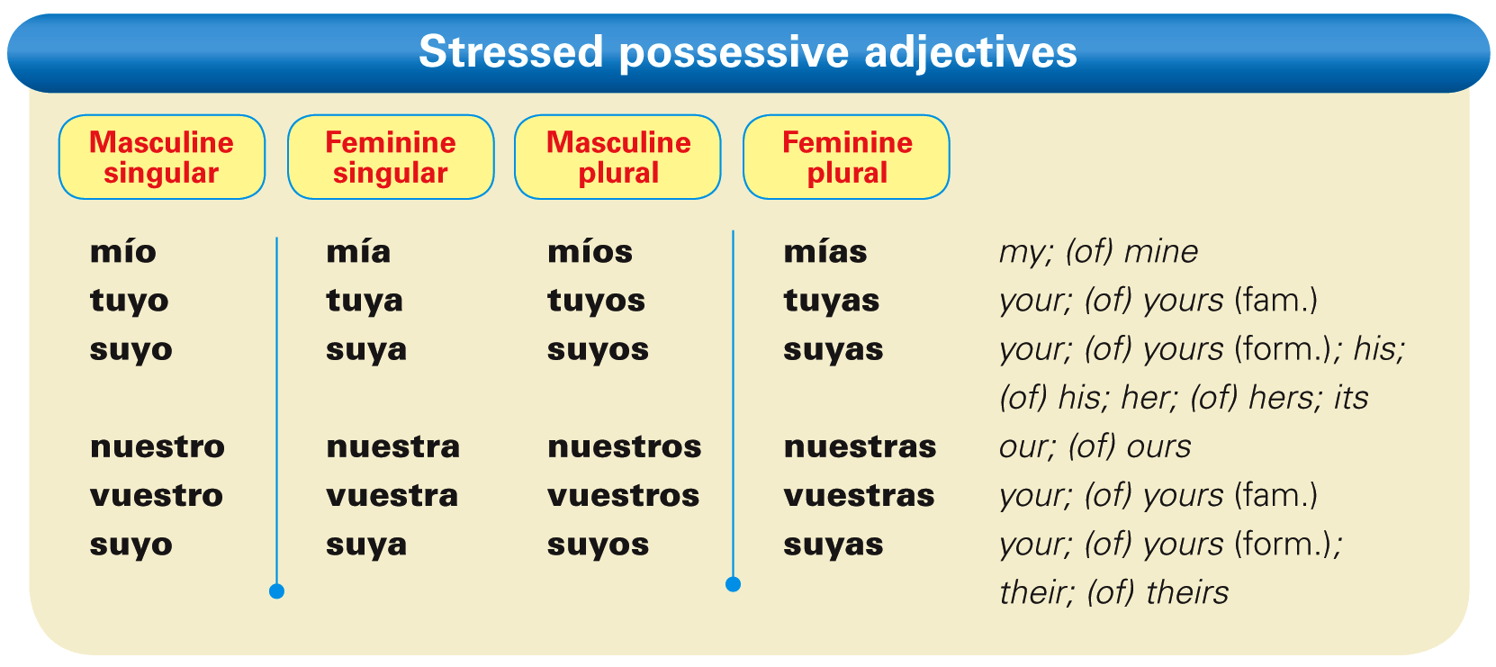
Spanish has two types of possessive adjectives: the unstressed (or short) forms you learned in Descubre, nivel 1 and the stressed (or long) forms. The stressed forms are used for emphasis or to express of mine, of yours, and so on.
© by Vista Higher Learning, Inc. All rights reserved.
2.4-<number>

Slide 2
¡Atención! Used with un/una, these possessives are similar in meaning to the English expression of mine/yours/etc.
© by Vista Higher Learning, Inc. All rights reserved.
2.4-<number>

Slide 3
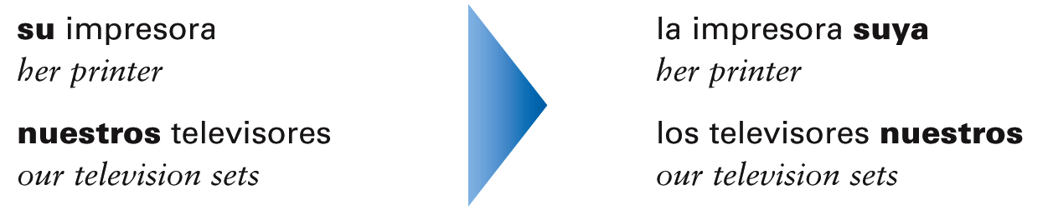
Stressed possessive adjectives agree in gender and number with the nouns they modify. While unstressed possessive adjectives are placed before the noun, stressed possessive adjectives are placed after the noun they modify.
© by Vista Higher Learning, Inc. All rights reserved.
2.4-<number>

Slide 4
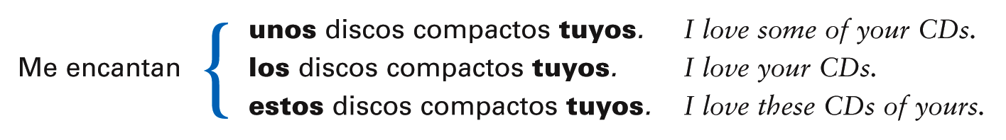
A definite article, an indefinite article, or a demonstrative adjective usually precedes a noun modified by a stressed possessive adjective.
© by Vista Higher Learning, Inc. All rights reserved.
2.4-<number>

Slide 5

Since suyo, suya, suyos, and suyas have more than one meaning, you can avoid confusion by using the construction:
[article] + [noun] + de + [subject pronoun].
© by Vista Higher Learning, Inc. All rights reserved.
2.4-<number>

Slide 6
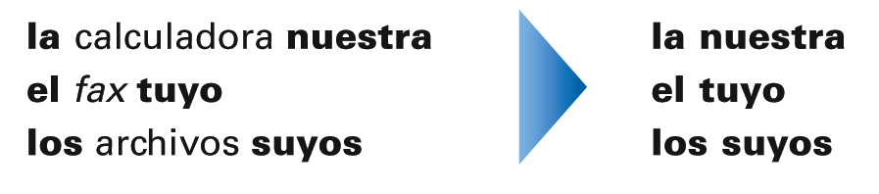
Possessive pronouns
Possessive pronouns (los pronombres posesivos) are used to replace a noun + [possessive adjective]. In Spanish, the possessive pronouns have the same forms as the stressed possessive adjectives, and they are preceded by a definite article.
© by Vista Higher Learning, Inc. All rights reserved.
2.4-<number>

Slide 7
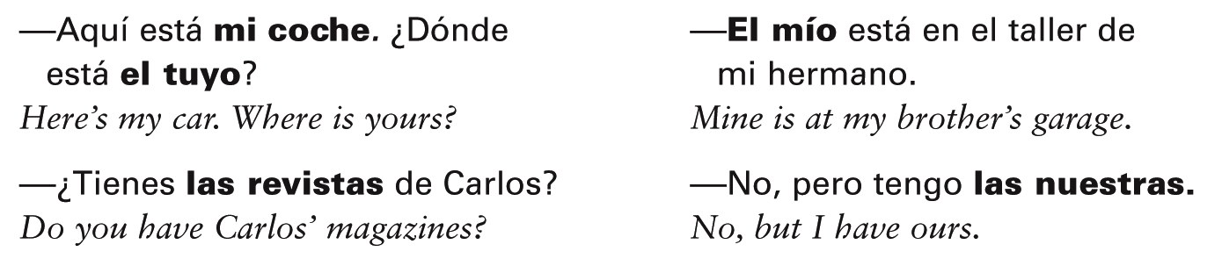
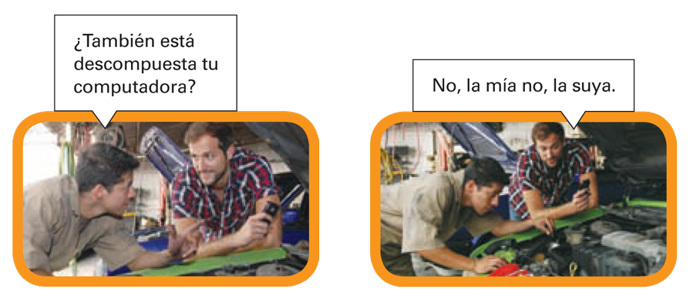
A possessive pronoun agrees in number and gender with the noun it replaces.
© by Vista Higher Learning, Inc. All rights reserved.
2.4-<number>

Slide 8

Indica las formas tónicas (stressed) de estos adjetivos posesivos y los pronombres posesivos correspondientes.
1. su cámara digital ____________ ____________ 2. mi televisor ____________ ____________ 3. nuestros discos compactos ____________ ____________ 4. tus direcciones electrónicas ____________ ____________ 5. su monitor ____________ ____________ 6. mis videos ____________ ____________ 7. nuestra impresora ____________ ____________ 8. tu estéreo ____________ ____________ 9. nuestro blog ____________ ____________ 10. mi computadora ____________ ____________
adjetivos
pronombres
la cámara digital suya la suya
© by Vista Higher Learning, Inc. All rights reserved.
2.4-<number>

