Slide 1

In Lección 5, you learned how to form past participles. You will now learn how to form the present perfect indicative (el pretérito perfecto del indicativo), a compound tense that uses the past participle. The present perfect is used to talk about what someone has done. In Spanish, it is formed with the present tense of the auxiliary verb haber and a past participle.
© by Vista Higher Learning, Inc. All rights reserved.
6.1-<number>

Slide 2
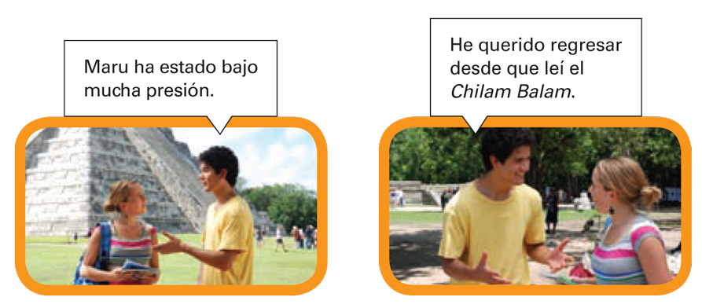
© by Vista Higher Learning, Inc. All rights reserved.
6.1-<number>

Slide 3
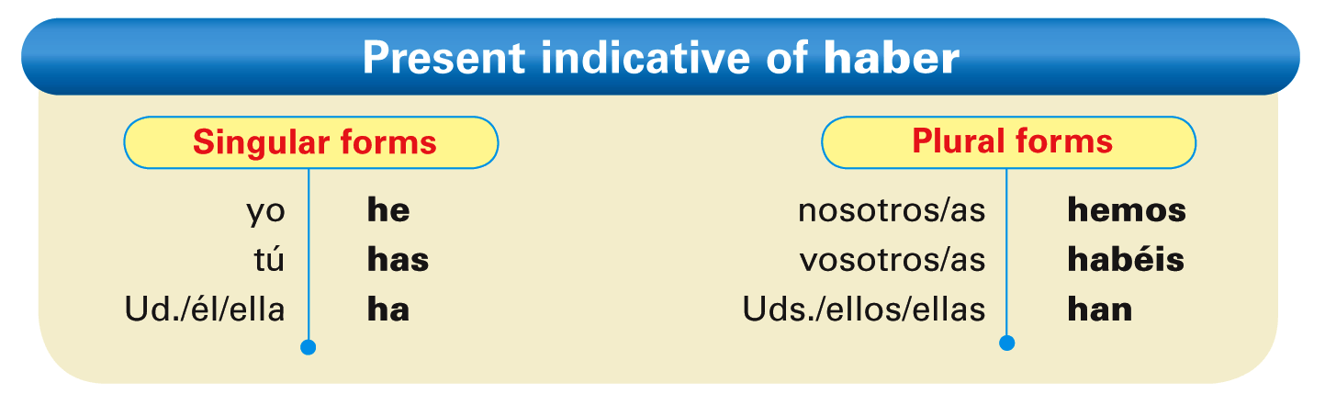
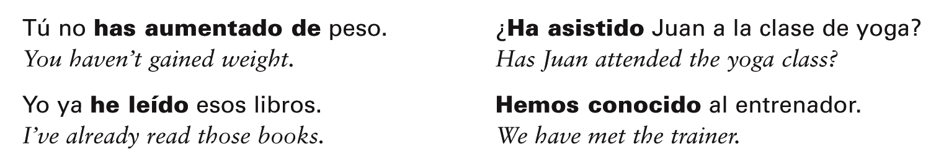
© by Vista Higher Learning, Inc. All rights reserved.
6.1-<number>

Slide 4
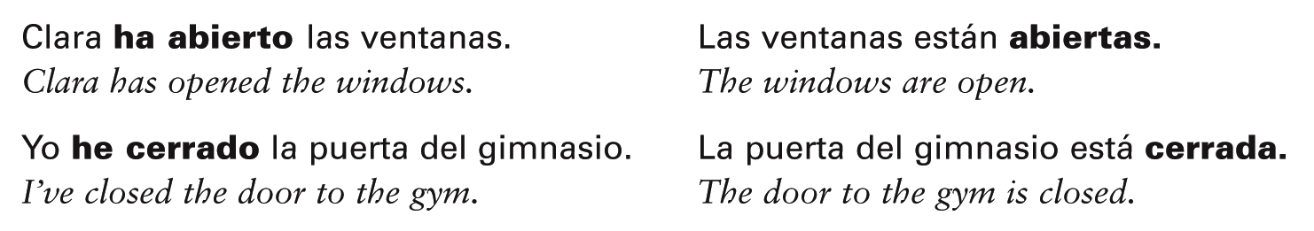
The past participle does not change in form when it is part of the present perfect tense;
it only changes in form when it is used as
an adjective.
© by Vista Higher Learning, Inc. All rights reserved.
6.1-<number>

Slide 5
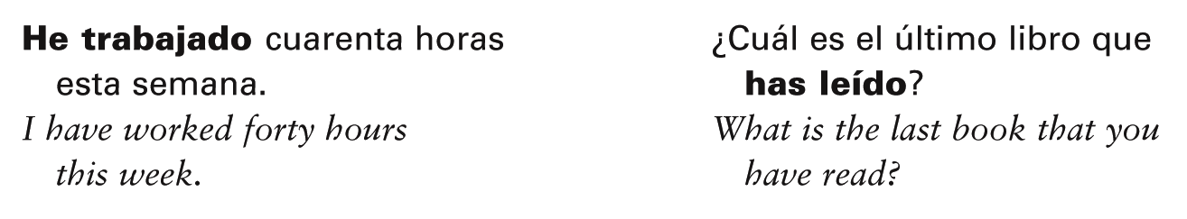
In Spanish, the present perfect indicative generally is used just as in English: to talk about what someone has done or what has occurred. It usually refers to the recent past.
© by Vista Higher Learning, Inc. All rights reserved.
6.1-<number>

Slide 6
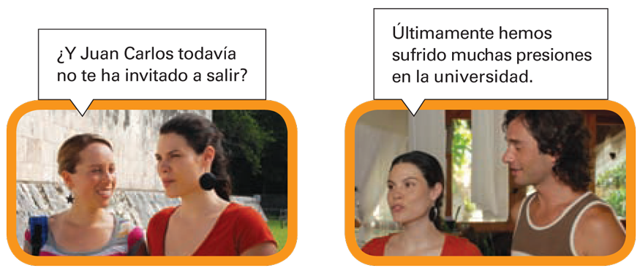
In English, the auxiliary verb and the past participle are often separated. In Spanish, however, these two elements—haber and the past participle—cannot be separated by any word.
© by Vista Higher Learning, Inc. All rights reserved.
6.1-<number>

Slide 7
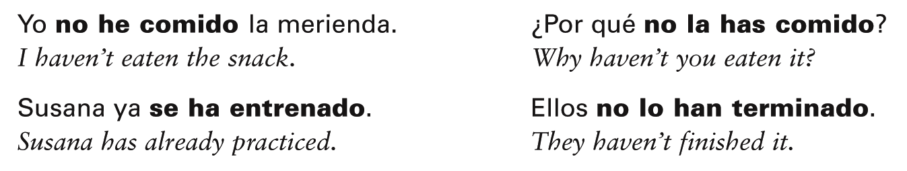
The word no and any object or reflexive pronouns are placed immediately before haber.
© by Vista Higher Learning, Inc. All rights reserved.
6.1-<number>

Slide 8
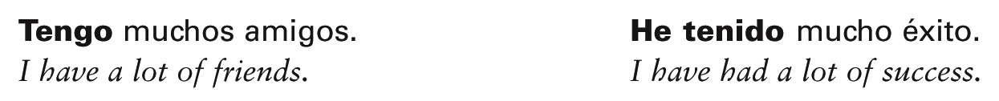
Note that to have can be either a main verb or an auxiliary verb in English. As a main verb, it corresponds to tener, while as an auxiliary, it corresponds to haber.
© by Vista Higher Learning, Inc. All rights reserved.
6.1-<number>

Slide 9
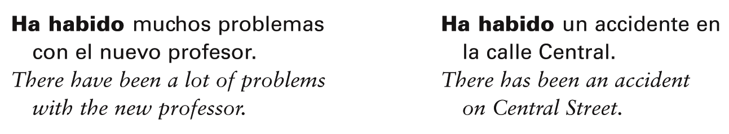
To form the present perfect of hay, use the third-person singular of haber (ha) + habido.
© by Vista Higher Learning, Inc. All rights reserved.
6.1-<number>

Slide 10

Indica el pretérito perfecto de indicativo de estos verbos.
(disfrutar, comer, vivir) yo ___________________________________ (traer, adelgazar, compartir) tú ______________________________ (venir, estar, correr) usted ______________________________ (leer, resolver, poner) ella ______________________________ (decir, romper, hacer) ellos ______________________________ (mantenerse, dormirse) nosotros ______________________________ (estar, escribir, ver) yo ______________________________ (vivir, correr, morir) él ______________________________
he disfrutado, he comido, he vivido
© by Vista Higher Learning, Inc. All rights reserved.
6.1-<number>

