Slide 1

The past perfect indicative
(el pretérito pluscuamperfecto del indicativo) is used to talk about what someone had done or what had occurred before another past action, event, or state. Like the present perfect, the past perfect uses a form of haber—in this case, the imperfect—plus the past participle.
© by Vista Higher Learning, Inc. All rights reserved.
6.2-<number>

Slide 2
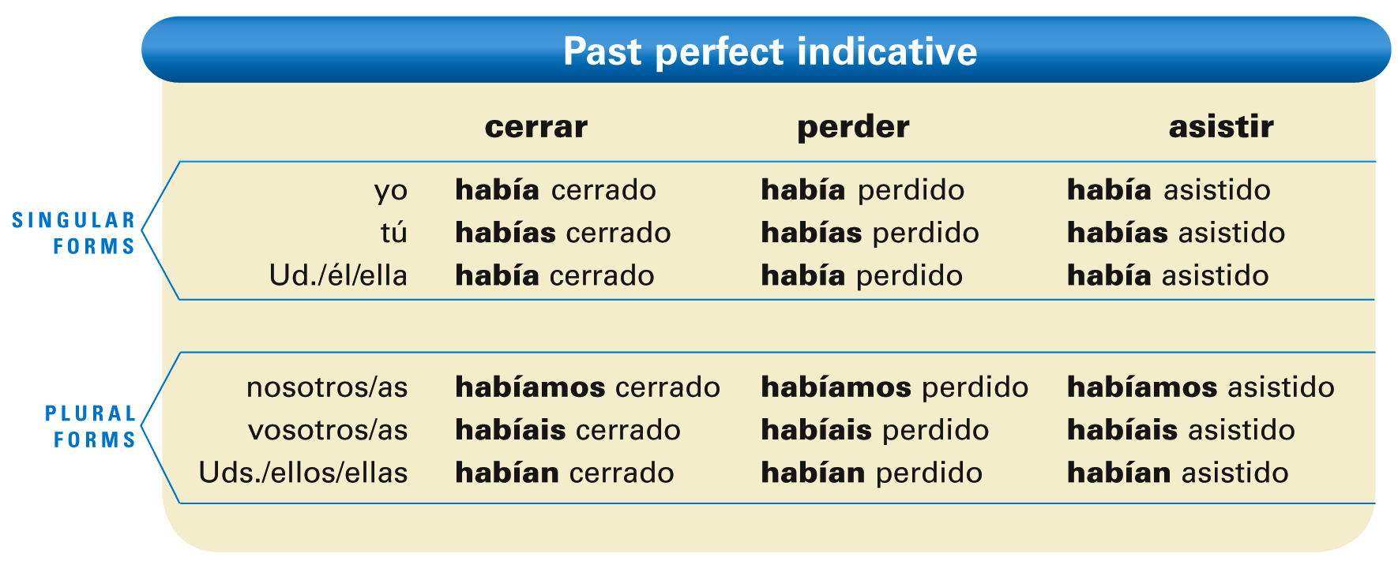

© by Vista Higher Learning, Inc. All rights reserved.
6.2-<number>

Slide 3
The past perfect is often used with the word ya (already) to indicate that an action, event, or state had already occurred before another. Remember that, unlike its English equivalent, ya cannot be placed between haber and the past participle.
© by Vista Higher Learning, Inc. All rights reserved.
6.2-<number>

Slide 4
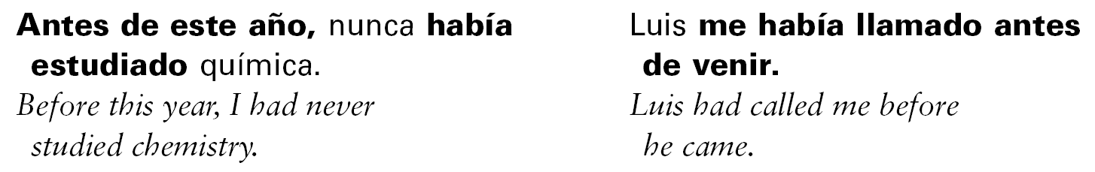
¡Atención! The past perfect is often used
in conjunction with antes de + [noun] or antes de + [infinitive] to describe when the action(s) occurred.
© by Vista Higher Learning, Inc. All rights reserved.
6.2-<number>

Slide 5

Indica el pretérito pluscuamperfecto de indicativo de cada verbo.
Nosotros ya __________________ (cenar) cuando nos llamaron. Antes de tomar esta clase, yo no __________ (estudiar) nunca el español. Antes de ir a México, ellos nunca __________ (ir) a otro país. Eduardo nunca __________ (entrenarse) tanto en invierno. Tú siempre __________ (llevar) una vida sana antes del año pasado. Antes de conocerte, yo ya te __________ (ver) muchas veces.
habíamos cenado
© by Vista Higher Learning, Inc. All rights reserved.
6.2-<number>

