Slide 1

The present perfect subjunctive
(el pretérito perfecto del subjuntivo), like the present perfect indicative, is used to talk about what has happened. The present perfect subjunctive is formed using the present subjunctive of the auxiliary verb haber and
a past participle.
© by Vista Higher Learning, Inc. All rights reserved.
6.3-<number>

Slide 2
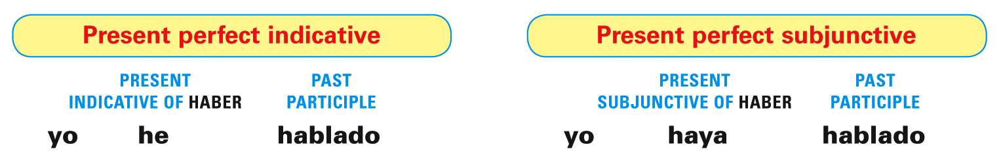
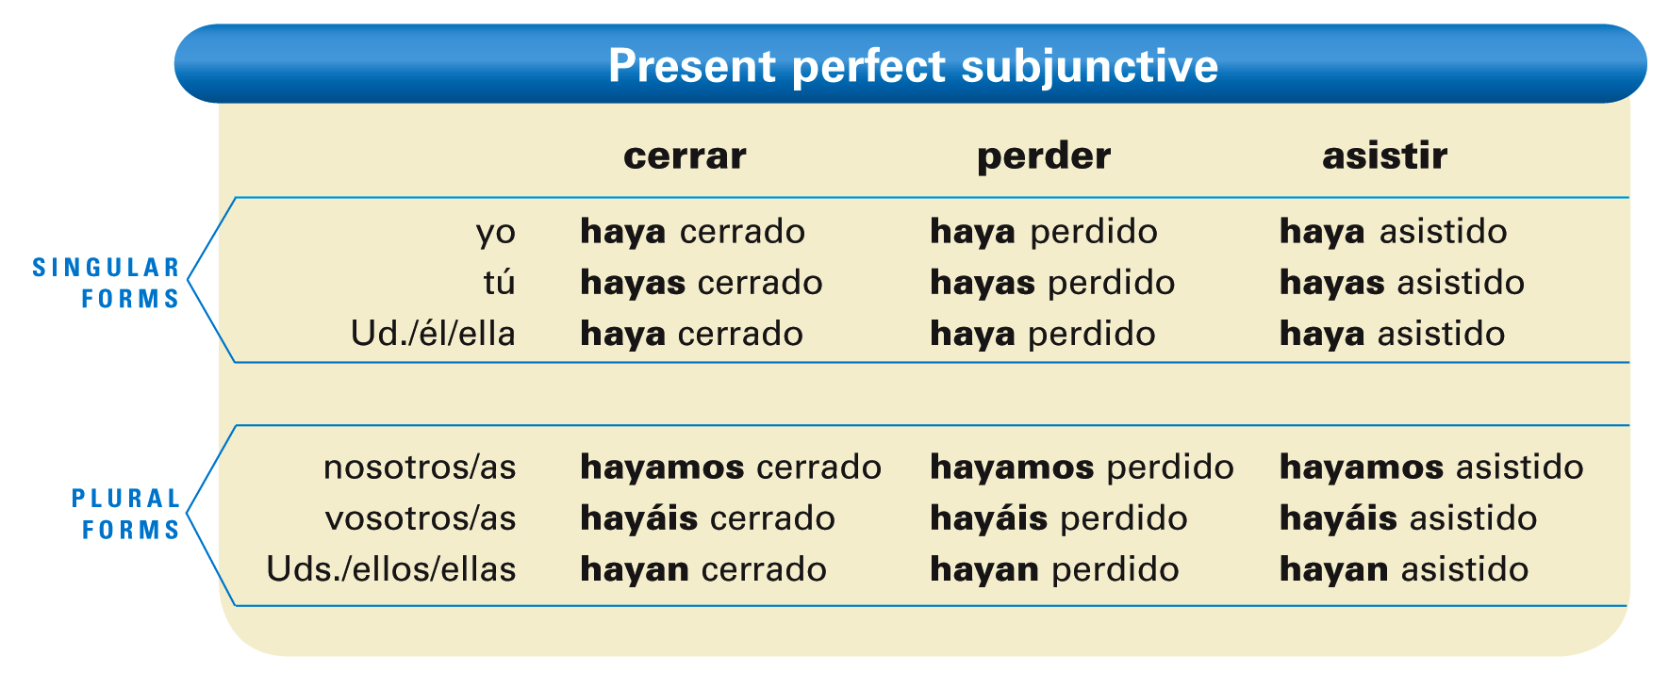
© by Vista Higher Learning, Inc. All rights reserved.
6.3-<number>

Slide 3
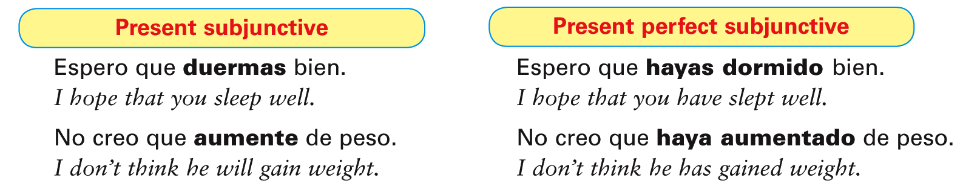
The same conditions that trigger the use of the present subjunctive apply to the present
perfect subjunctive.
© by Vista Higher Learning, Inc. All rights reserved.
6.3-<number>

Slide 4
¡ATENCIÓN! In Spanish the present perfect subjunctive is used to express a recent action.
  No creo que lo hayas dicho bien.
  I don’t think you said it right.
  Espero que él haya llegado.
  I hope he arrived.
© by Vista Higher Learning, Inc. All rights reserved.
6.3-<number>

Slide 5
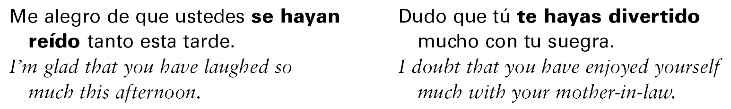
The action expressed by the present perfect subjunctive is seen as occurring before the action expressed in the main clause.
© by Vista Higher Learning, Inc. All rights reserved.
6.3-<number>

Slide 6

Indica el pretérito perfecto de subjuntivo de los verbos entre paréntesis.
Me gusta que ustedes _______________ (decir) la verdad. No creo que tú _______________ (comer) tanto. Es imposible que usted _______________ (poder) hacer tal (such a) cosa. Me alegro de que tú y yo _______________ (merendar) juntas. Es posible que yo _______________ (adelgazar) un poco esta semana. Espero que ellas _______________ (sentirse) mejor después de la clase.
hayan dicho
© by Vista Higher Learning, Inc. All rights reserved.
6.3-<number>

