Slide 1

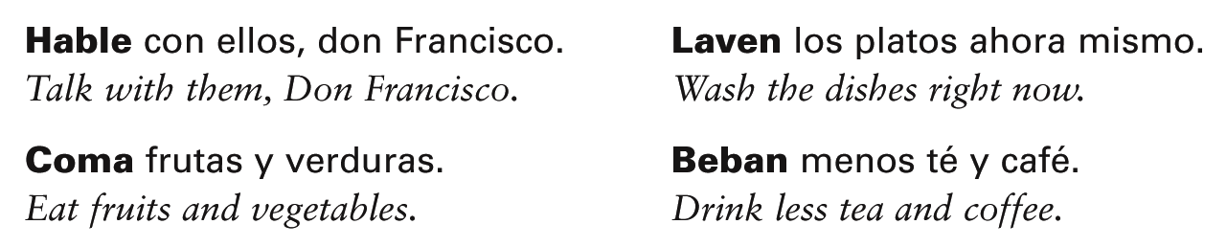
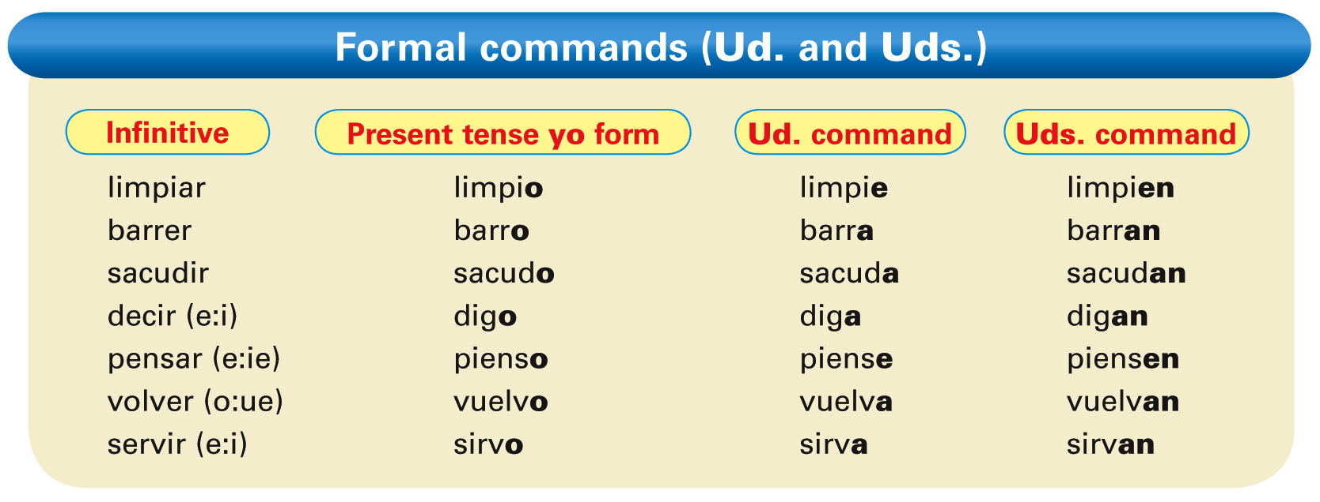
As you learned in Lección 2, the command forms are used to give orders or advice. Formal commands are used with people you address as usted or ustedes. Observe these examples, then study the chart.
© by Vista Higher Learning, Inc. All rights reserved.
3.2-<number>

Slide 2
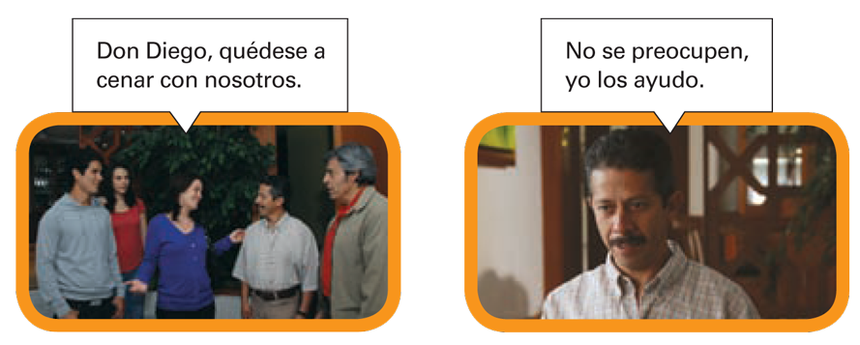
The usted and ustedes commands, like the negative tú commands, are formed by dropping the final -o of the yo form of the present tense. For -ar verbs, add -e or -en. For -er and -ir verbs, add -a or -an.
© by Vista Higher Learning, Inc. All rights reserved.
3.2-<number>

Slide 3
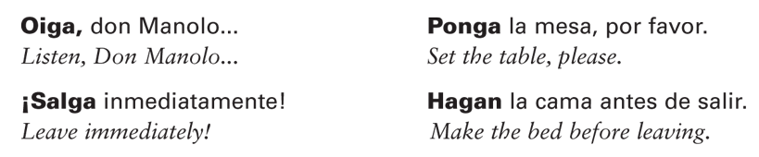
Verbs with irregular yo forms maintain the same irregularity in their formal commands. These verbs include conducir, conocer, decir, hacer, ofrecer, oír, poner, salir, tener, traducir, traer, venir, and ver.
© by Vista Higher Learning, Inc. All rights reserved.
3.2-<number>

Slide 4
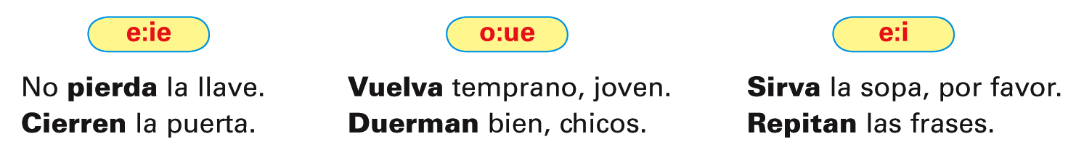
Note also that verbs maintain their stem changes in usted and ustedes commands.
© by Vista Higher Learning, Inc. All rights reserved.
3.2-<number>

Slide 5
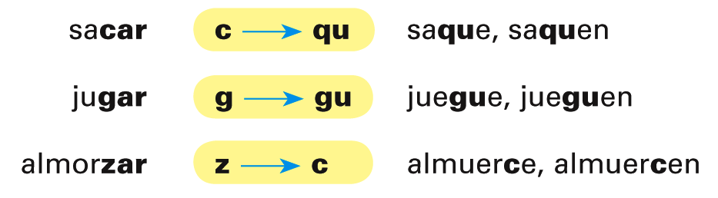
Verbs ending in -car, -gar, and -zar have a spelling change in the command forms.
© by Vista Higher Learning, Inc. All rights reserved.
3.2-<number>

Slide 6
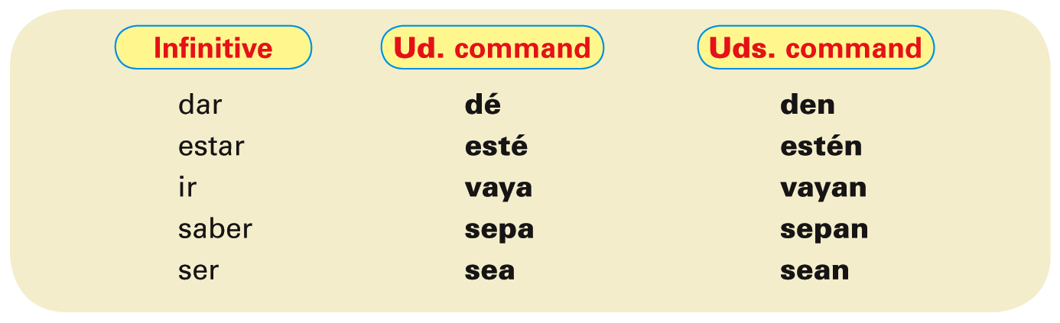
These verbs have irregular formal commands.
© by Vista Higher Learning, Inc. All rights reserved.
3.2-<number>

Slide 7
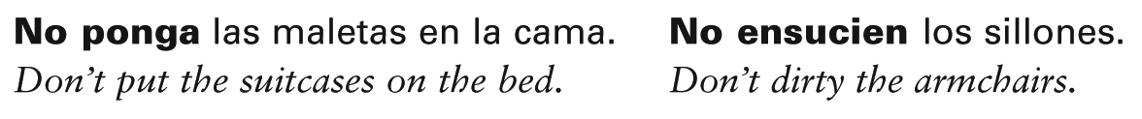
To make a formal command negative, simply place no before the verb.
© by Vista Higher Learning, Inc. All rights reserved.
3.2-<number>

Slide 8
In affirmative commands, reflexive, indirect, and direct object pronouns are always attached to the end of the verb.
© by Vista Higher Learning, Inc. All rights reserved.
3.2-<number>

Slide 9
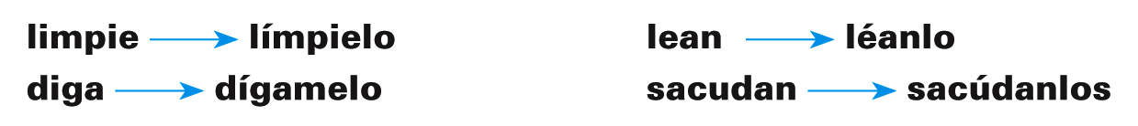
¡Atención! When a pronoun is attached to an affirmative command that has two or more syllables, an accent mark is added to maintain the original stress.
© by Vista Higher Learning, Inc. All rights reserved.
3.2-<number>

Slide 10
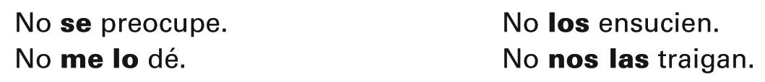
In negative commands, these pronouns always precede the verb.
© by Vista Higher Learning, Inc. All rights reserved.
3.2-<number>

Slide 11

Usted and ustedes can be used with the command forms to strike a more formal
tone. In such instances they follow the command form.
© by Vista Higher Learning, Inc. All rights reserved.
3.2-<number>

Slide 12

Indica los mandatos (commands) afirmativos y negativos correspondientes.
escucharlo (Ud.) _____________. _____________. decírmelo (Uds.) _____________. _____________. salir (Ud.) _____________. _____________. servírnoslo (Uds.) _____________. _____________. barrerla (Ud.) _____________. _____________. hacerlo (Ud.) _____________. _____________.
Escúchelo No lo escuche
© by Vista Higher Learning, Inc. All rights reserved.
3.2-<number>

