Slide 1

With the exception of commands, all the verb forms you have been using have been in the indicative mood. The indicative is used to state facts and to express actions or states that the speaker considers to be real and definite. In contrast, the subjunctive mood expresses the speaker’s attitudes toward events, as well as actions or states the speaker views as uncertain or hypothetical.
© by Vista Higher Learning, Inc. All rights reserved.
12.3-<number>

Slide 2
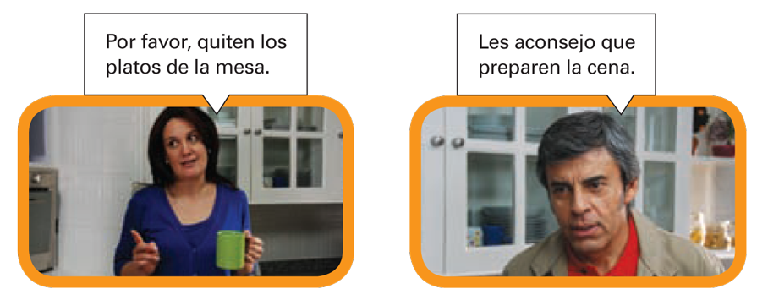
© by Vista Higher Learning, Inc. All rights reserved.
3.3-<number>

Slide 3
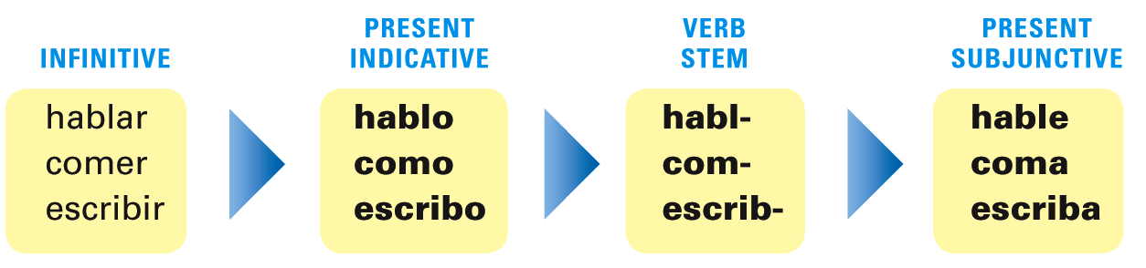
The present subjunctive is formed very much like usted commands, ustedes commands, and negative tú commands. From the yo form of the present indicative, drop the -o ending, and replace it with the subjunctive endings.
© by Vista Higher Learning, Inc. All rights reserved.
3.3-<number>

Slide 4
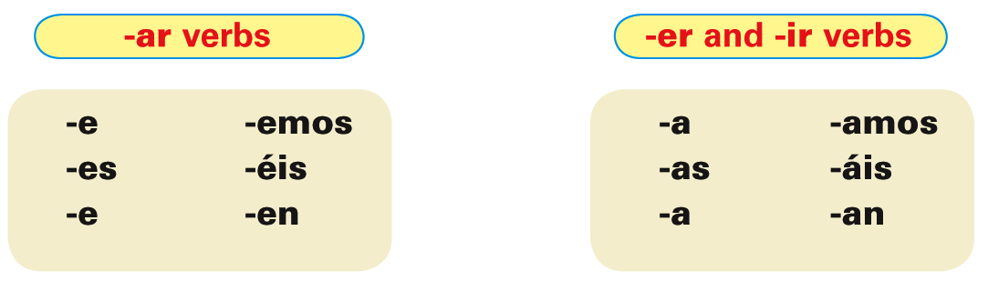
The present subjunctive endings are:
© by Vista Higher Learning, Inc. All rights reserved.
3.3-<number>

Slide 5
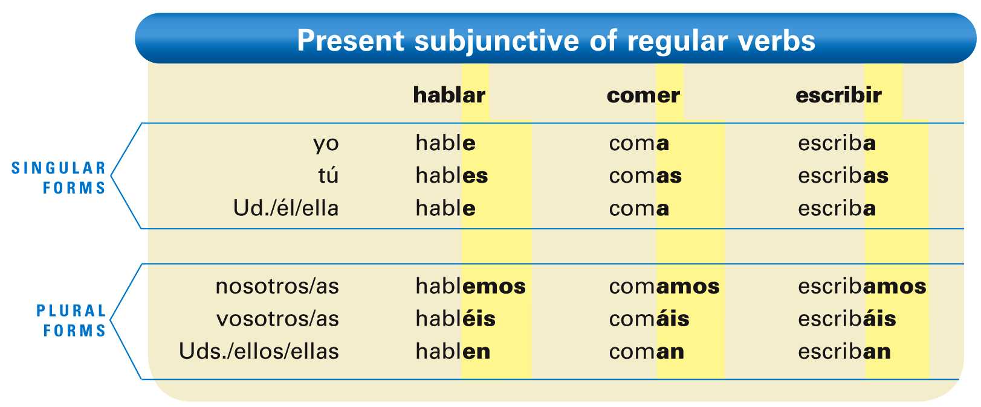
© by Vista Higher Learning, Inc. All rights reserved.
3.3-<number>

Slide 6
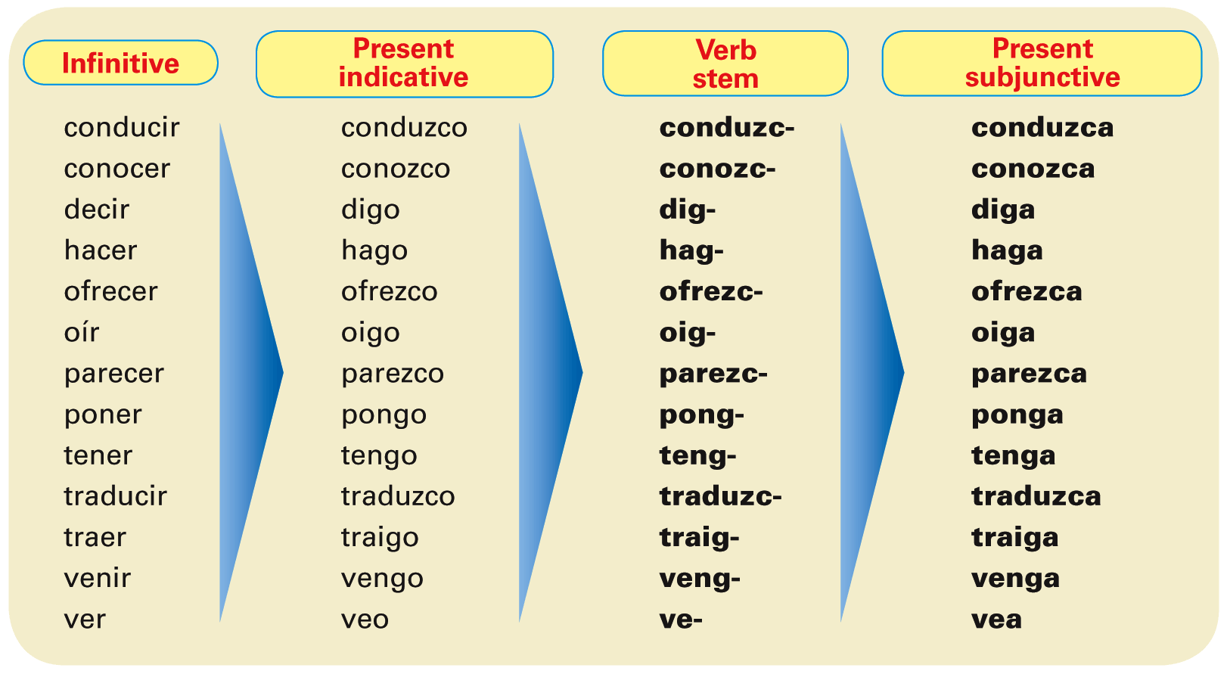
Verbs with irregular yo forms show the same irregularity in all forms of the present subjunctive.
© by Vista Higher Learning, Inc. All rights reserved.
3.3-<number>

Slide 7
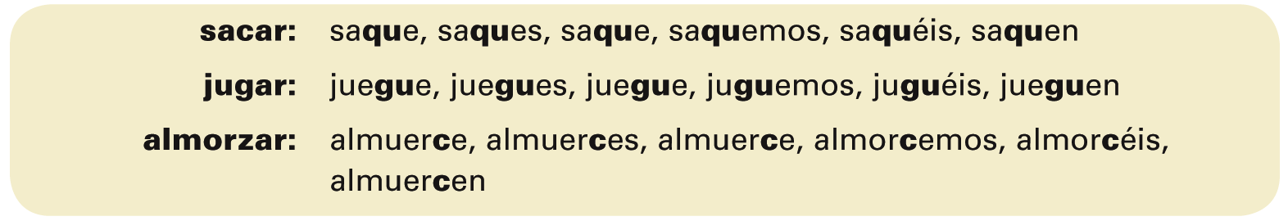
To maintain the c, g, and z sounds, verbs ending in -car, -gar, and -zar have a spelling change in all forms of the present subjunctive.
© by Vista Higher Learning, Inc. All rights reserved.
3.3-<number>

Slide 8
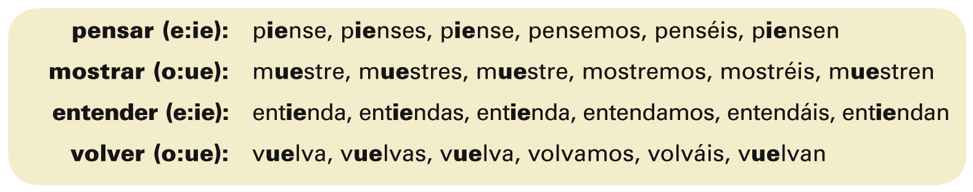
Present subjunctive of stem-changing verbs
-Ar and -er stem-changing verbs have the same stem changes in the subjunctive as they do in the present indicative.
© by Vista Higher Learning, Inc. All rights reserved.
3.3-<number>

Slide 9
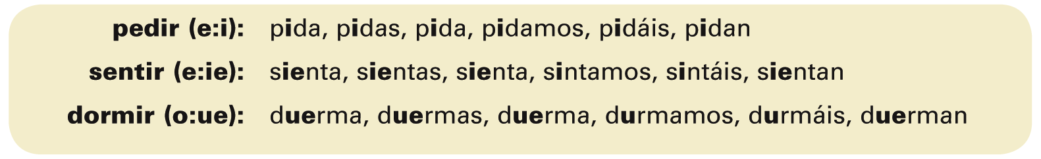
-Ir stem-changing verbs have the same stem changes in the subjunctive as they do in the present indicative, but in addition, the nosotros/as and vosotros/as forms undergo a stem change. The unstressed e changes to i, while the unstressed o changes to u.
© by Vista Higher Learning, Inc. All rights reserved.
3.3-<number>

Slide 10
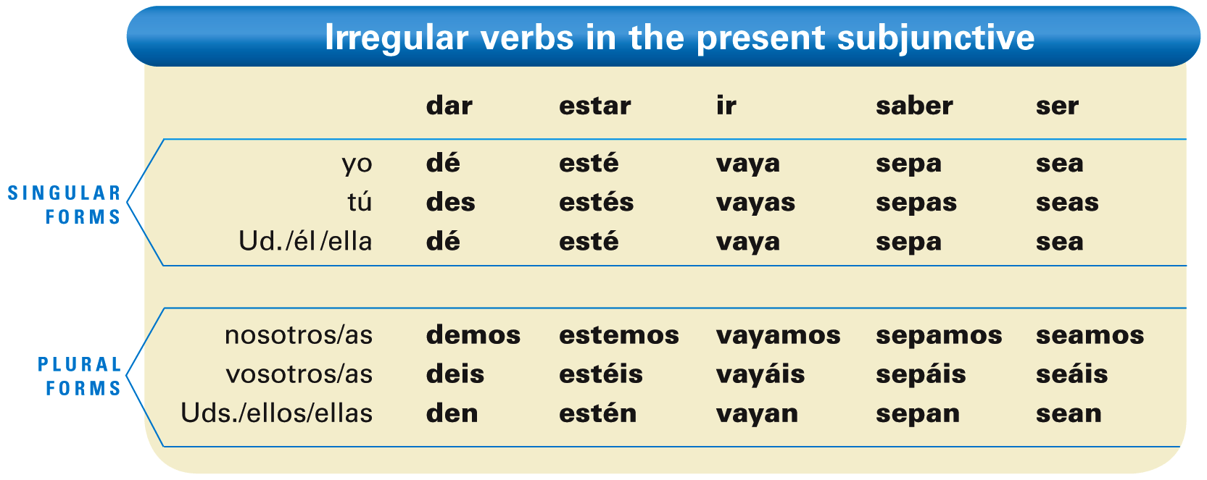
Irregular verbs in the present subjunctive
These five verbs are irregular in the present subjunctive.
© by Vista Higher Learning, Inc. All rights reserved.
3.3-<number>

Slide 11
¡Atención! The subjunctive form of hay
(there is, there are) is also irregular: haya.
© by Vista Higher Learning, Inc. All rights reserved.
3.3-<number>

Slide 12
General uses of the subjunctive
The subjunctive is mainly used to express:
1) will and influence, 2) emotion, 3) doubt, disbelief, and denial, and 4) indefiniteness and nonexistence.
© by Vista Higher Learning, Inc. All rights reserved.
3.3-<number>

Slide 13
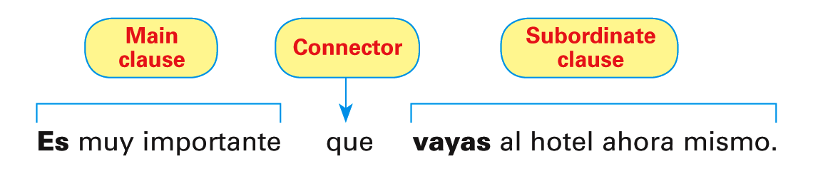
The subjunctive is most often used in sentences that consist of a main clause and a subordinate clause. The main clause contains a verb or expression that triggers the use of the subjunctive. The conjunction que connects the subordinate clause to the main clause.
© by Vista Higher Learning, Inc. All rights reserved.
3.3-<number>

Slide 14
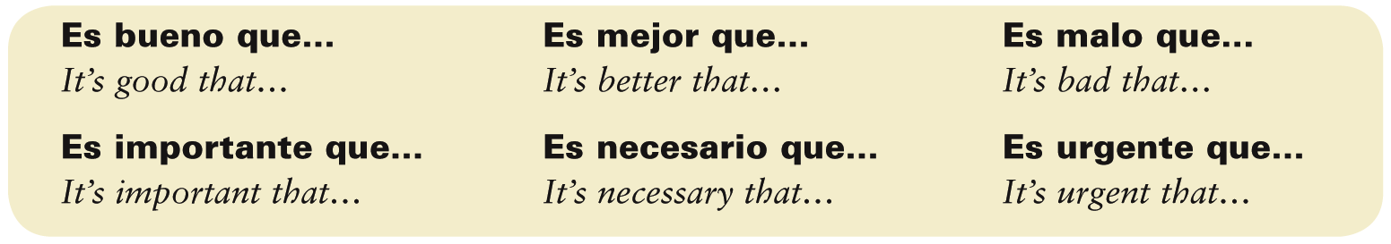
These impersonal expressions are always followed by clauses in the subjunctive:
© by Vista Higher Learning, Inc. All rights reserved.
3.3-<number>

Slide 15

Indica el presente de subjuntivo de estos verbos.
1. (alquilar, beber, vivir) que yo ______________ 2. (estudiar, aprender, asistir) que tú __________ 3. (encontrar, poder, tener) que él __________ 4. (hacer, pedir, dormir) que nosotras __________ 5. (dar, hablar, escribir) que ellos __________ 6. (pagar, empezar, buscar) que ustedes __________ 7. (ser, ir, saber) que yo __________ 8. (estar, dar, oír) que tú __________
alquile, beba, viva
© by Vista Higher Learning, Inc. All rights reserved.
3.3-<number>

