Slide 1


You will now learn how to use the subjunctive with verbs and expressions of will
and influence.
© by Vista Higher Learning, Inc. All rights reserved.
3.4-<number>

Slide 2
Verbs of will and influence are often used when someone wants to affect the actions or behavior of other people.
¡Atención! In English, verbs or expressions of will and influence often use the infinitive, such as I want you to go. This is not the case in Spanish, where the subjunctive would be used in a subordinate clause.
© by Vista Higher Learning, Inc. All rights reserved.
3.4-<number>

Slide 3
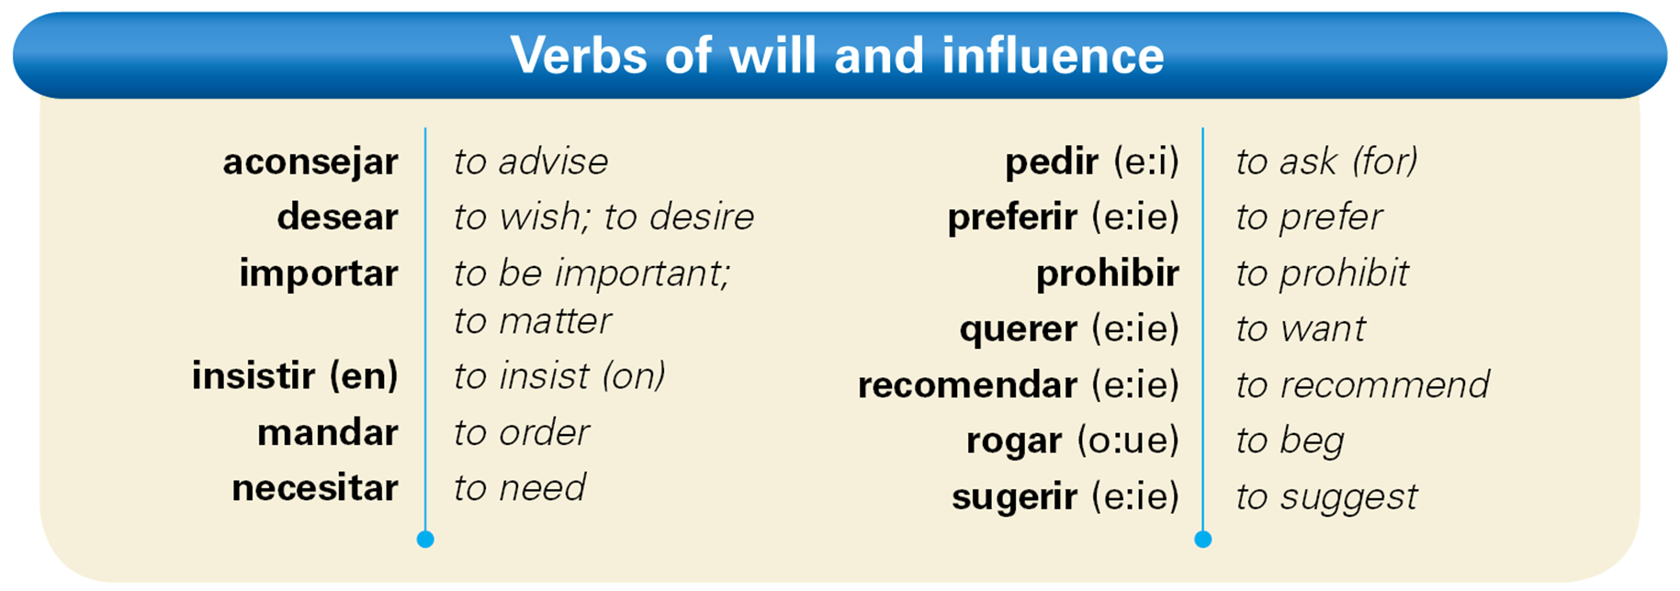
Here is a list of widely used verbs of will
and influence.
© by Vista Higher Learning, Inc. All rights reserved.
3.4-<number>

Slide 4
Some impersonal expressions, such as
es necesario que, es importante que,
es mejor que, and es urgente que, are considered expressions of will or influence.
© by Vista Higher Learning, Inc. All rights reserved.
3.4-<number>

Slide 5
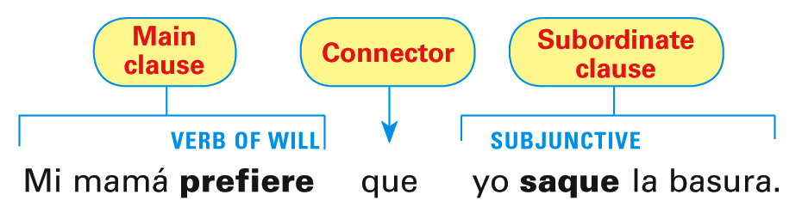
When the main clause contains an expression of will or influence, the subjunctive is required in the subordinate clause, provided that the two clauses have different subjects.
© by Vista Higher Learning, Inc. All rights reserved.
3.4-<number>

Slide 6
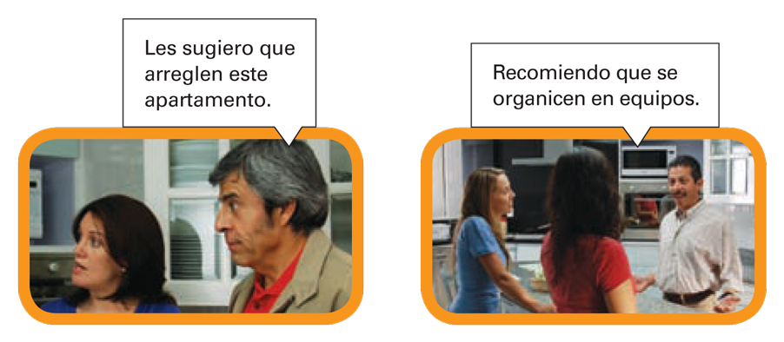
© by Vista Higher Learning, Inc. All rights reserved.
3.4-<number>

Slide 7
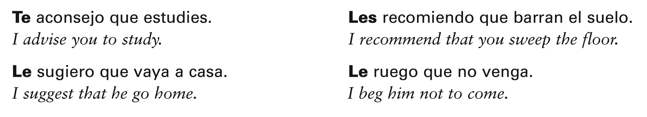
Indirect object pronouns are often used with the verbs aconsejar, importar, mandar, pedir, prohibir, recomendar, rogar,
and sugerir.
© by Vista Higher Learning, Inc. All rights reserved.
3.4-<number>

Slide 8
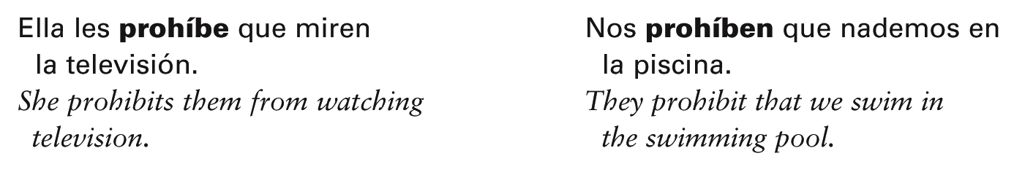
Note that all the forms of prohibir in the present tense carry a written accent, except for the nosotros/as form: prohíbo, prohíbes, prohíbe, prohibimos, prohibís, prohíben.
© by Vista Higher Learning, Inc. All rights reserved.
3.4-<number>

Slide 9
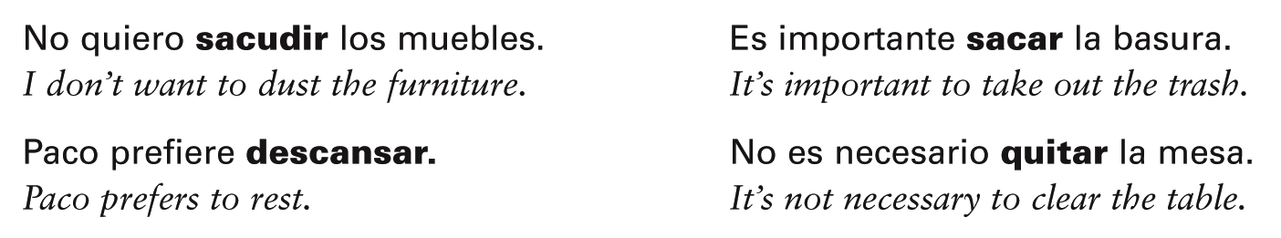
The infinitive is used with words or expressions of will and influence if there is no change of subject in the sentence.
© by Vista Higher Learning, Inc. All rights reserved.
3.4-<number>

Slide 10

Completa cada oración con la forma correcta del verbo entre paréntesis.
Te sugiero que ______ (ir) con ella al supermercado. Él necesita que yo le ______ (prestar) dinero. No queremos que tú ______ (hacer) nada especial para nosotros. Mis papás quieren que yo ______ (limpiar) mi cuarto. Nos piden que la ______ (ayudar) a preparar la comida. Quieren que tú ______ (sacar) la basura todos los días. Quiero ______ (descansar) esta noche.
vayas
© by Vista Higher Learning, Inc. All rights reserved.
3.4-<number>

Slide 11
Completa cada oración con la forma correcta del verbo entre paréntesis.
Es importante que ustedes _____ (limpiar) los estantes. Su tía les manda que _____ (poner) la mesa. Te aconsejo que no _____ (salir) con él. Mi tío insiste en que mi prima _____ (hacer) la cama. Prefiero _____ (ir) al cine. Es necesario _____ (estudiar). Recomiendo que ustedes _____ (pasar) la aspiradora.
© by Vista Higher Learning, Inc. All rights reserved.
3.4-<number>

