Slide 1

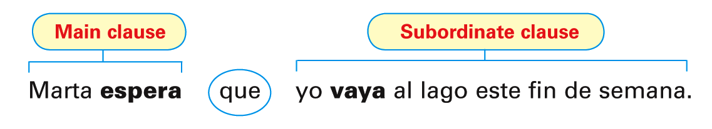
In the previous lesson, you learned how to use the subjunctive with expressions of will and influence. You will now learn how to
use the subjunctive with verbs and expressions of emotion.
© by Vista Higher Learning, Inc. All rights reserved.
4.1-<number>

Slide 2
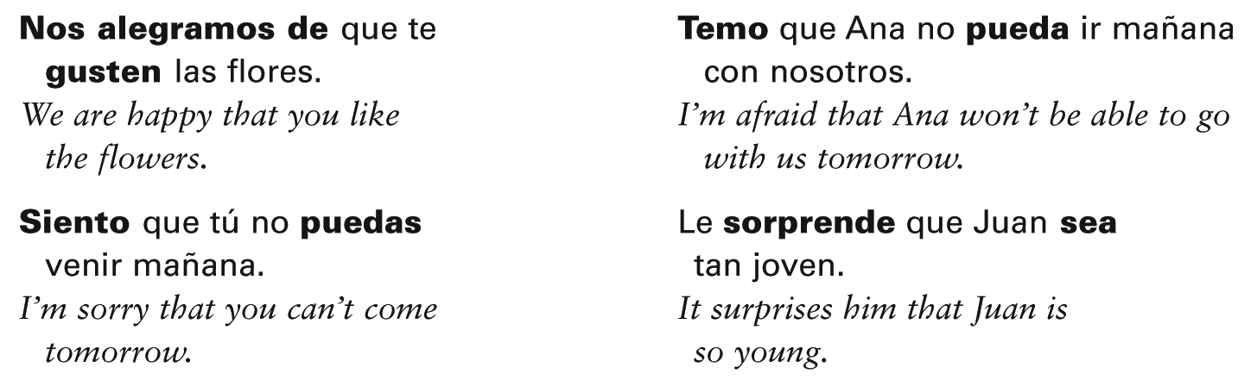
When the verb in the main clause of a sentence expresses an emotion or feeling such as hope, fear, joy, pity, or surprise, the subjunctive is required in the subordinate clause.
© by Vista Higher Learning, Inc. All rights reserved.
4.1-<number>

Slide 3
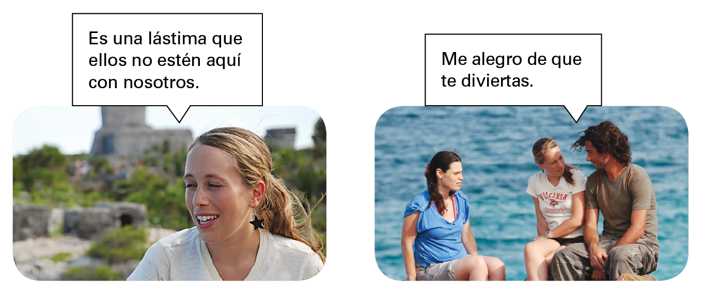
© by Vista Higher Learning, Inc. All rights reserved.
4.1-<number>

Slide 4
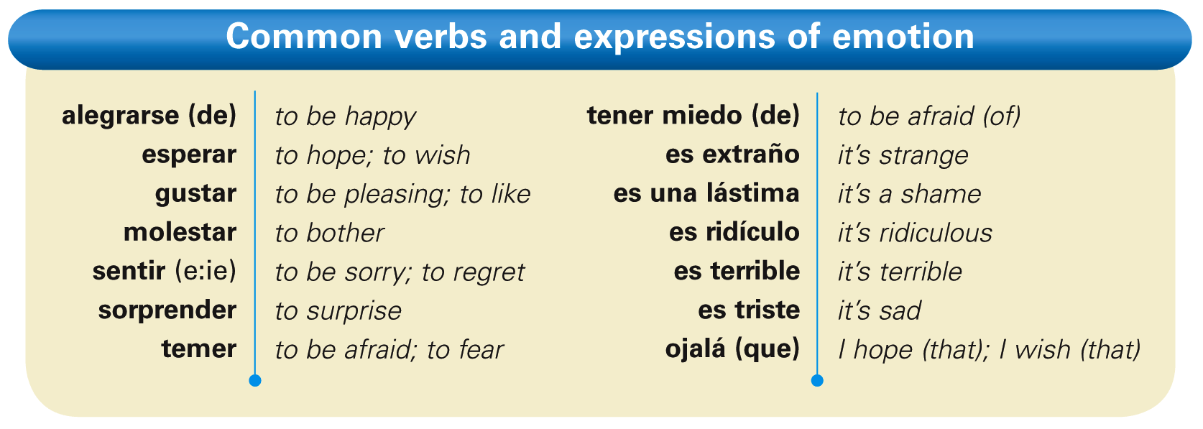
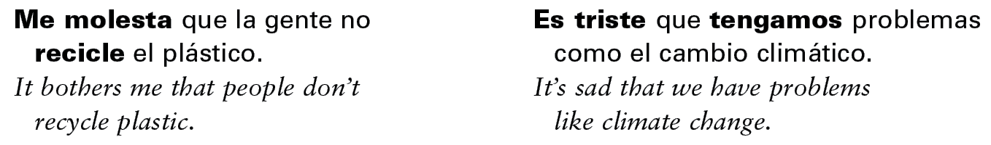
© by Vista Higher Learning, Inc. All rights reserved.
4.1-<number>

Slide 5
As with expressions of will and influence, the infinitive, not the subjunctive, is used after an expression of emotion when there is no change of subject. Compare these sentences.
© by Vista Higher Learning, Inc. All rights reserved.
4.1-<number>

Slide 6
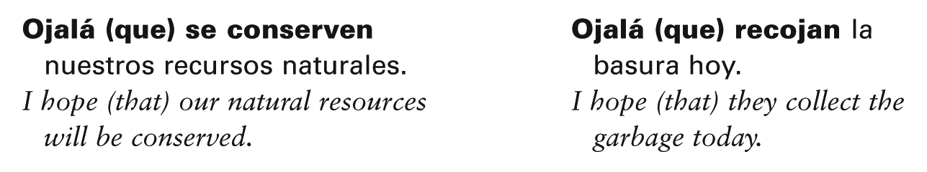
The expression ojalá (que) means I hope or
I wish, and it is always followed by the subjunctive. Note that the use of que with this expression is optional.
© by Vista Higher Learning, Inc. All rights reserved.
4.1-<number>

Slide 7

© by Vista Higher Learning, Inc. All rights reserved.
4.1-<number>

Slide 8

Completa las oraciones con las formas correctas de los verbos.
Ojalá que ellos __________ (descubrir) nuevas formas de energía. Espero que Ana nos ________ (ayudar) a recoger la basura en la carretera. Es una lástima que la gente no ________ (reciclar) más. Esperamos ________ (proteger) el aire de nuestra comunidad. Me alegro de que mis amigos ________ (querer) conservar la naturaleza. Espero que tú ________ (venir) a la reunión (meeting) del Club de Ecología. Es malo ________ (contaminar) el medio ambiente. A mis padres les gusta que nosotros ________ (participar) en la reunión. Siento que nuestras ciudades ________ (estar) afectadas por la contaminación. Ojalá que yo ________ (poder) hacer algo para reducir la calentamiento global.
descubran
© by Vista Higher Learning, Inc. All rights reserved.
4.1-<number>

