Slide 1

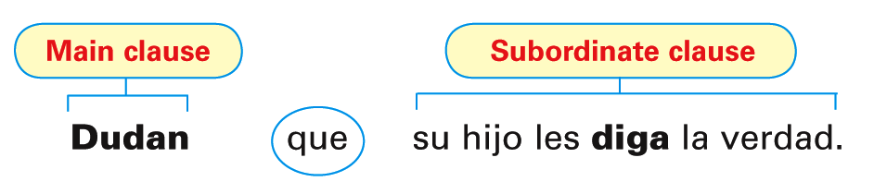
Just as the subjunctive is required with expressions of emotion, influence, and will, it is also used with expressions of doubt, disbelief, and denial.
© by Vista Higher Learning, Inc. All rights reserved.
4.2-<number>

Slide 2
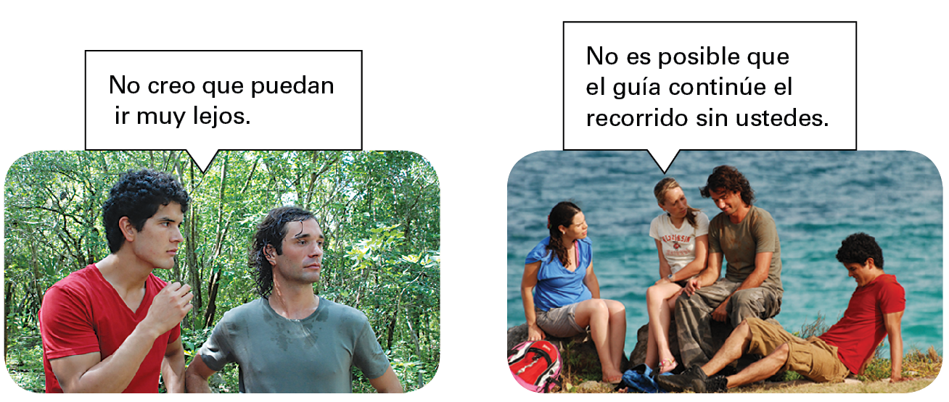
The subjunctive is always used in a subordinate clause when there is a change of subject and the expression in the main clause implies negation or uncertainty.
© by Vista Higher Learning, Inc. All rights reserved.
4.2-<number>

Slide 3
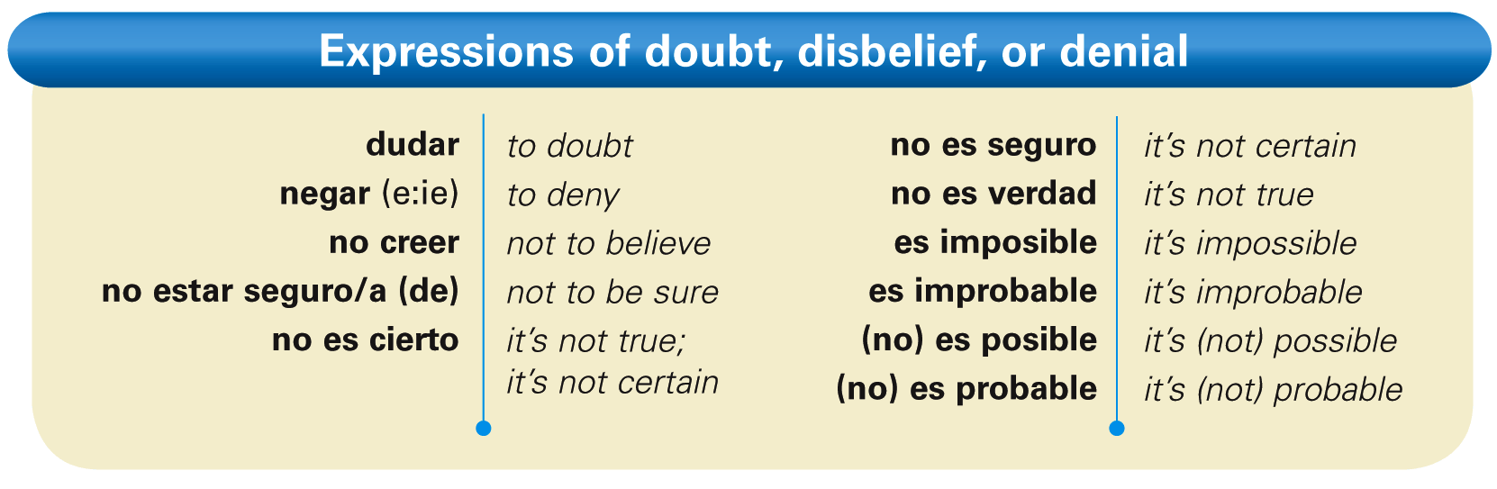
Here is a list of some common expressions of doubt, disbelief, or denial.
© by Vista Higher Learning, Inc. All rights reserved.
4.2-<number>

Slide 4
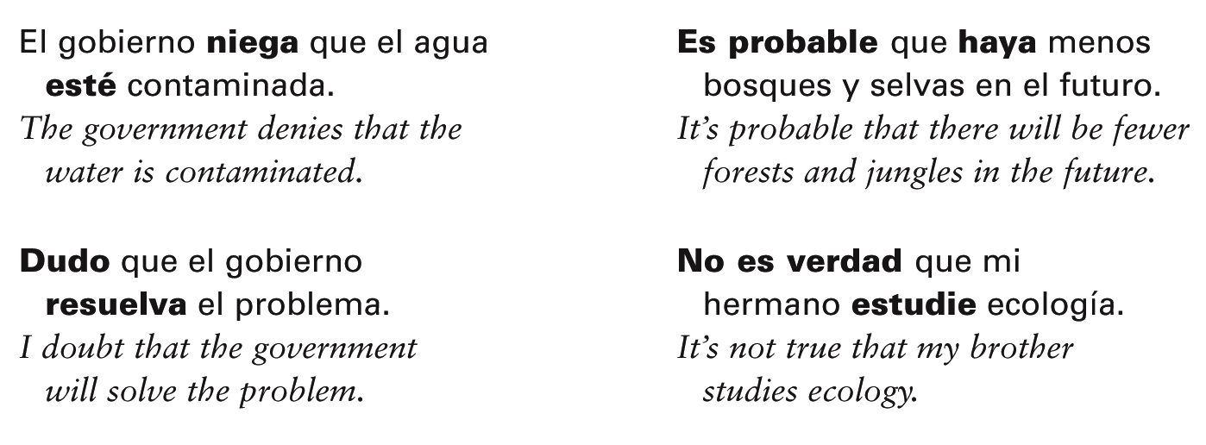
© by Vista Higher Learning, Inc. All rights reserved.
4.2-<number>

Slide 5
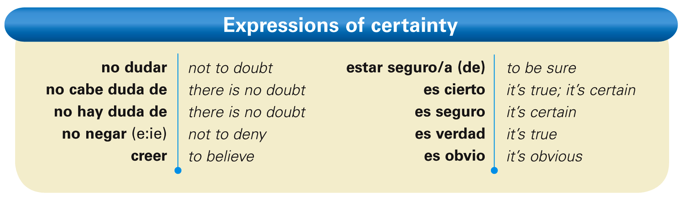
The indicative is used in a subordinate clause when there is no doubt or uncertainty in the main clause. Here is a list of some expressions of certainty.
© by Vista Higher Learning, Inc. All rights reserved.
4.2-<number>

Slide 6
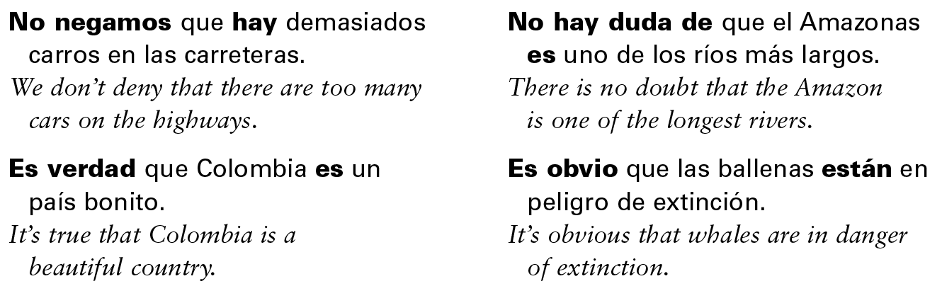
© by Vista Higher Learning, Inc. All rights reserved.
4.2-<number>

Slide 7
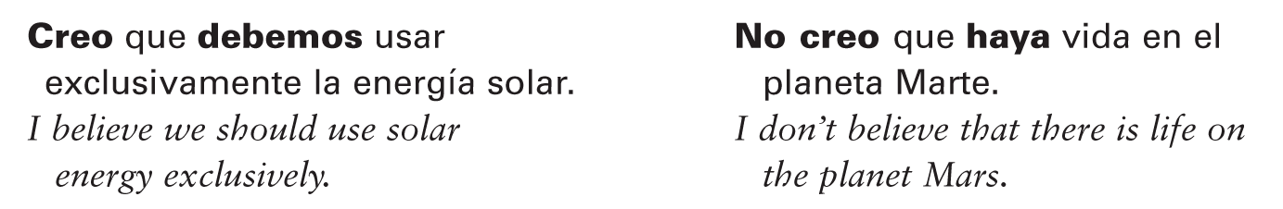
In affirmative sentences, the verb creer expresses belief or certainty, so it is followed by the indicative. In negative sentences, however, when doubt is implied, creer is followed by the subjunctive.
© by Vista Higher Learning, Inc. All rights reserved.
4.2-<number>

Slide 8
The expressions quizás and tal vez are usually followed by the subjunctive because they imply doubt about something.
© by Vista Higher Learning, Inc. All rights reserved.
4.2-<number>

Slide 9

Completa estas oraciones con la forma correcta del verbo.
Dudo que ellos __________ (trabajar). Es cierto que él __________ (comer) mucho. Es imposible que ellos __________ (salir). Es probable que ustedes __________ (ganar). No creo que ella __________ (volver). Es posible que nosotros __________ (ir). Dudamos que tú __________ (reciclar).
trabajen
© by Vista Higher Learning, Inc. All rights reserved.
4.2-<number>

Slide 10
Completa estas oraciones con la forma correcta del verbo. (cont.)
Creo que ellos __________ (jugar) al fútbol. No niego que ustedes __________ (estudiar). Es posible que ella no __________ (venir) a casa. Es probable que Lucio y Carmen __________ (dormir). Es posible que mi prima Marta __________ (llamar). Tal vez Juan no nos __________ (oír). No es cierto que Paco y Daniel nos __________ (ayudar).
© by Vista Higher Learning, Inc. All rights reserved.
4.2-<number>

