Slide 1

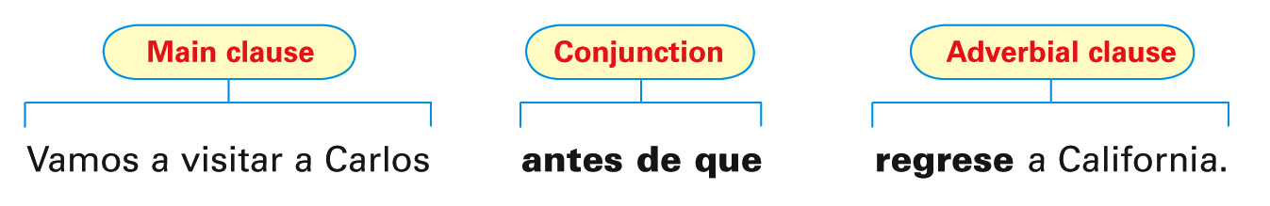
Conjunctions are words or phrases that connect other words and clauses in sentences. Certain conjunctions commonly introduce adverbial clauses, which describe how, why, when, and where an action takes place.
© by Vista Higher Learning, Inc. All rights reserved.
4.3-<number>

Slide 2
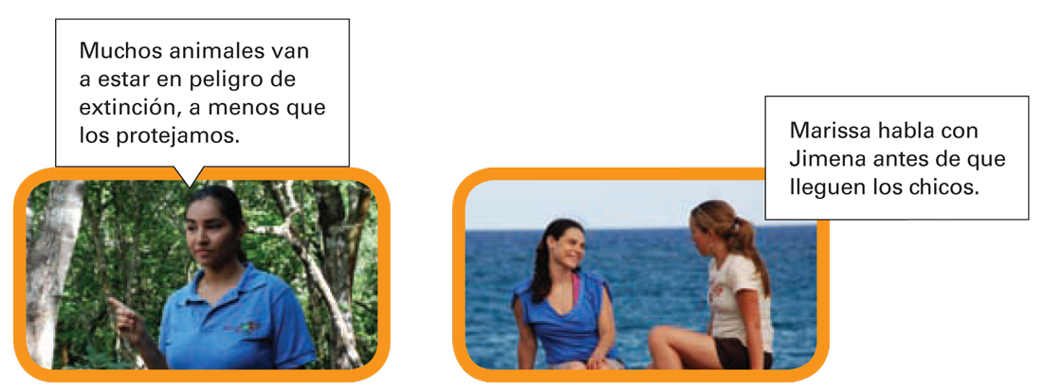
© by Vista Higher Learning, Inc. All rights reserved.
4.3-<number>

Slide 3
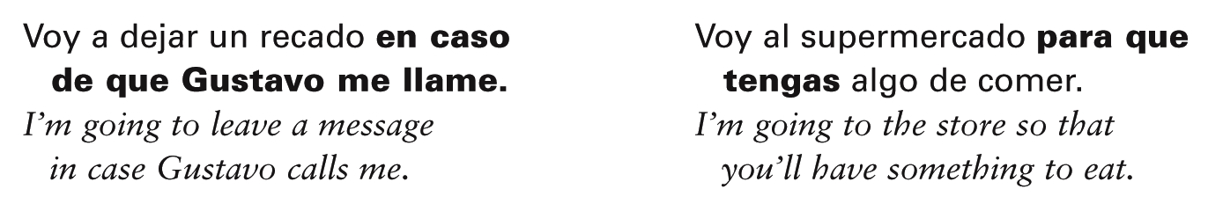
With certain conjunctions, the subjunctive is used to express a hypothetical situation, uncertainty as to whether an action or event will take place, or a condition that may or may not be fulfilled.
© by Vista Higher Learning, Inc. All rights reserved.
4.3-<number>

Slide 4
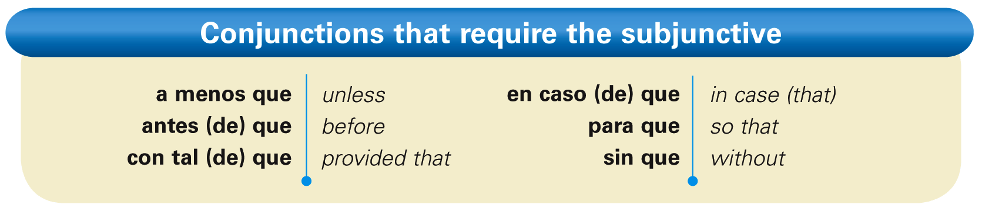
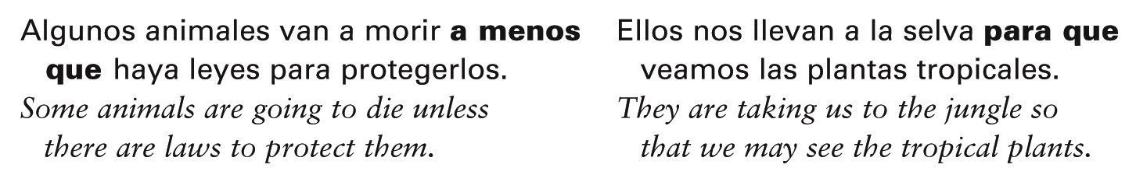
Here is a list of the conjunctions that always require the subjunctive.
© by Vista Higher Learning, Inc. All rights reserved.
4.3-<number>

Slide 5
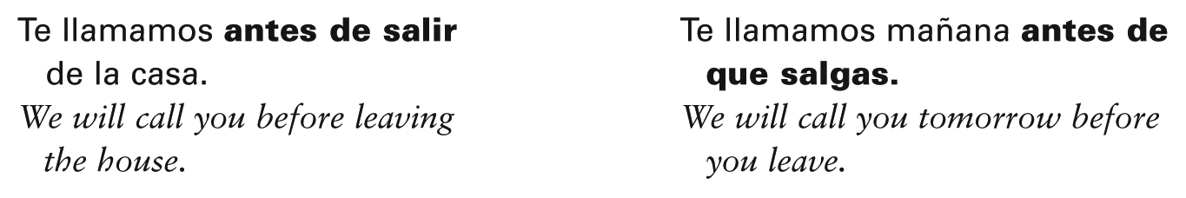
The infinitive, not que + [subjunctive], is used after the prepositions antes de, para, and sin when there is no change of subject. ¡Atención! While you may use a present participle with the English equivalent of these phrases, in Spanish you cannot.
© by Vista Higher Learning, Inc. All rights reserved.
4.3-<number>

Slide 6
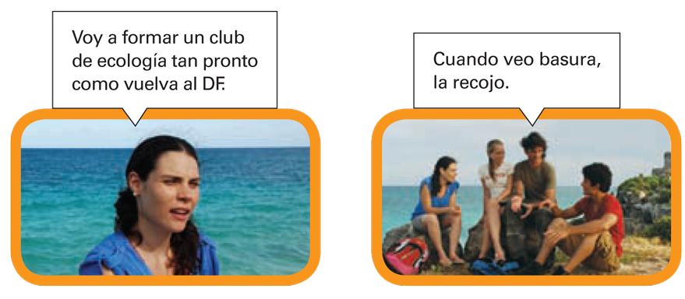
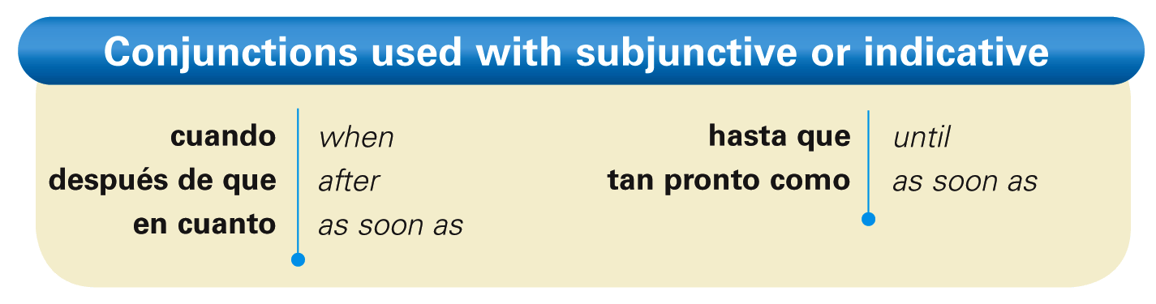
Conjunctions with subjunctive or indicative
© by Vista Higher Learning, Inc. All rights reserved.
4.3-<number>

Slide 7
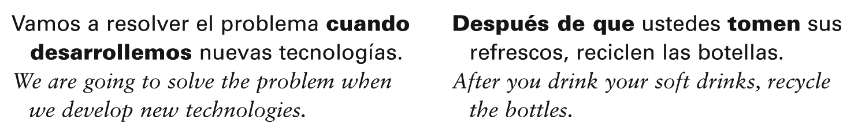
With the conjunctions above, use the subjunctive in the subordinate clause if
the main clause expresses a future action
or command.
© by Vista Higher Learning, Inc. All rights reserved.
4.3-<number>

Slide 8
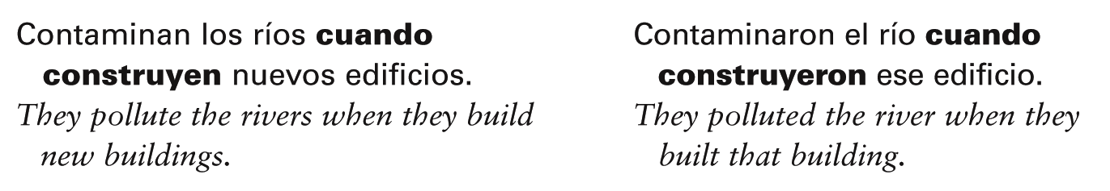
With these conjunctions, the indicative is used in the subordinate clause if the verb
in the main clause expresses an action that habitually happens, or that happened in
the past.
© by Vista Higher Learning, Inc. All rights reserved.
4.3-<number>

Slide 9

Completa las oraciones con las formas correctas de los verbos.
Voy a estudiar ecología cuando __________ (ir) a la universidad. No podemos evitar el cambio climático a menos que todos ________ (trabajar) juntos. No podemos conducir sin ________ (contaminar) el aire. Siempre recogemos mucha basura cuando ________ (ir) al parque. Elisa habló con el presidente del Club de Ecología después de que ________ (terminar) la reunión. Vamos de excursión para ________ (observar) los animales y plantas. La contaminación va a ser un problema muy serio hasta que nosotros ________ (cambiar) nuestros sistemas de producción y transporte. El gobierno debe crear más parques nacionales antes de que los bosques y ríos ________ (estar) completamente contaminados. La gente recicla con tal de que no ________ (ser) díficil.
vaya
© by Vista Higher Learning, Inc. All rights reserved.
4.3-<number>

