Slide 1

In Lección 4, you learned that the subjunctive is used in adverbial clauses after certain conjunctions. You will now learn how the subjunctive can be used in adjective clauses (cláusulas adjetivas) to express that the existence of someone or something is uncertain or indefinite.
© by Vista Higher Learning, Inc. All rights reserved.
5.1-<number>

Slide 2
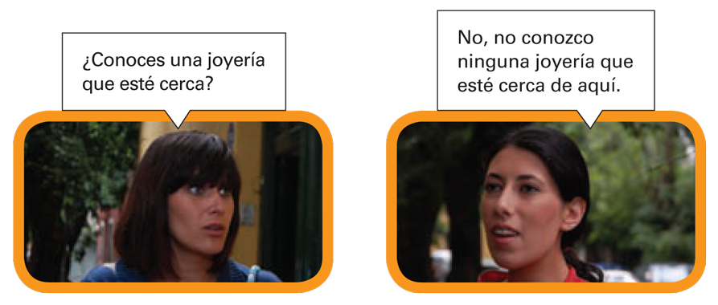
© by Vista Higher Learning, Inc. All rights reserved.
5.1-<number>

Slide 3
The subjunctive is used in an adjective
(or subordinate) clause that refers to a person, place, thing, or idea that either does not exist or whose existence is uncertain or indefinite. In the examples below, compare the differences in meaning between the statements using the indicative and those using the subjunctive.
© by Vista Higher Learning, Inc. All rights reserved.
5.1-<number>

Slide 4
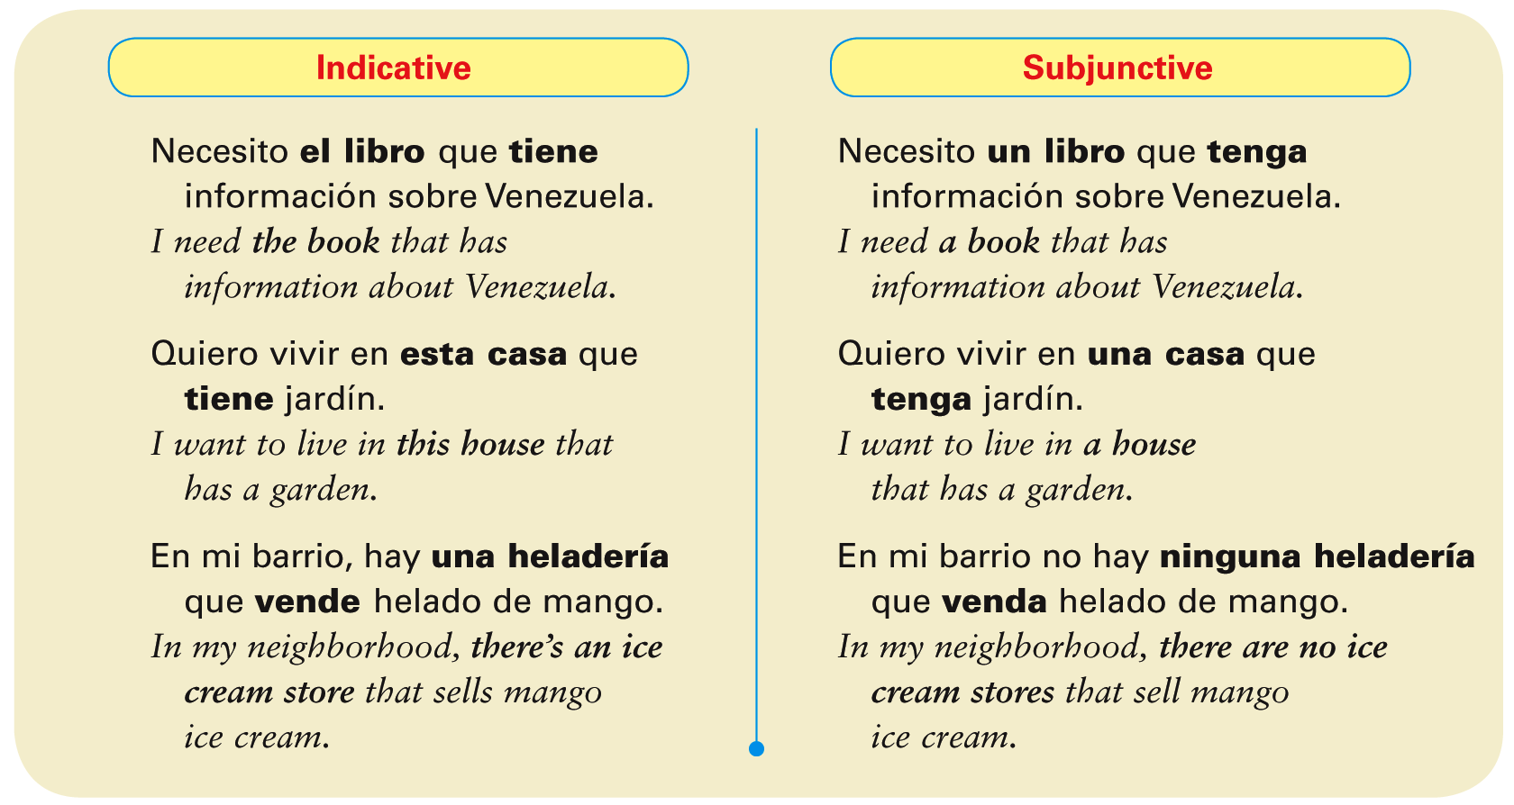
© by Vista Higher Learning, Inc. All rights reserved.
5.1-<number>

Slide 5
¡Atención! Adjective clauses are subordinate clauses that modify a noun or pronoun in the main clause of a sentence. That noun or pronoun is called the antecedent.
© by Vista Higher Learning, Inc. All rights reserved.
5.1-<number>

Slide 6
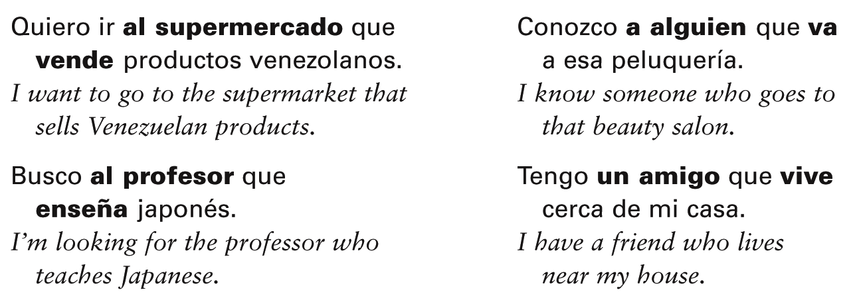
When the adjective clause refers to a person, place, thing, or idea that is clearly known, certain, or definite, the indicative is used.
© by Vista Higher Learning, Inc. All rights reserved.
5.1-<number>

Slide 7
¡Atención! Observe the important role that the indefinite article versus the definite article plays in determining the use of the subjunctive in adjective clauses.
Read the following sentences and notice
why they are different:
¿Conoces un restaurante italiano que esté cerca de mi casa
¿Conoces el restaurante italiano que está cerca de mi casa?
© by Vista Higher Learning, Inc. All rights reserved.
5.1-<number>

Slide 8
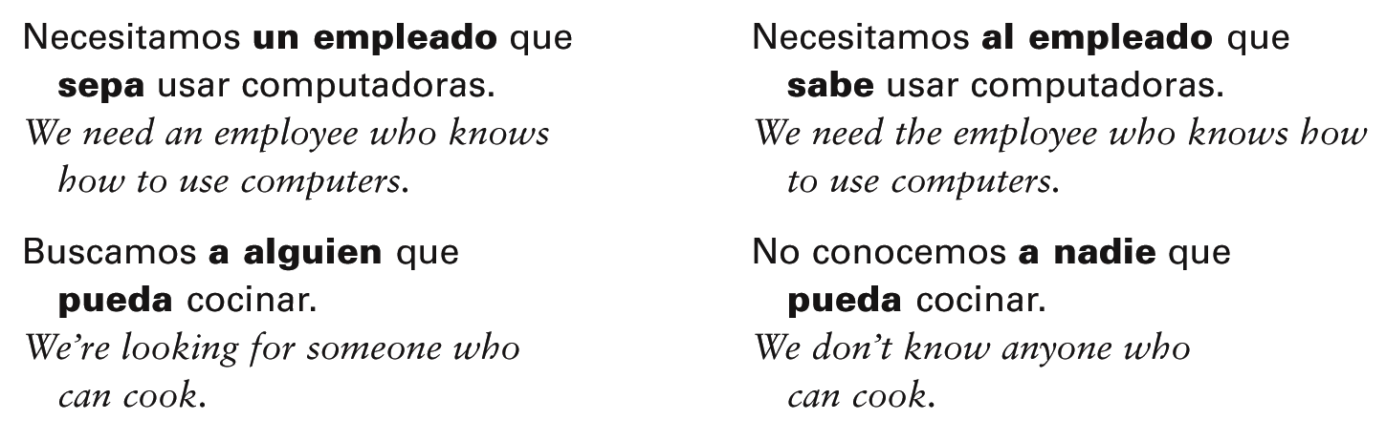
The personal a is not used with direct objects that are hypothetical people. However, as you learned in Descubre, nivel 1, alguien and nadie are always preceded by the personal a when they function as direct objects.
© by Vista Higher Learning, Inc. All rights reserved.
5.1-<number>

Slide 9
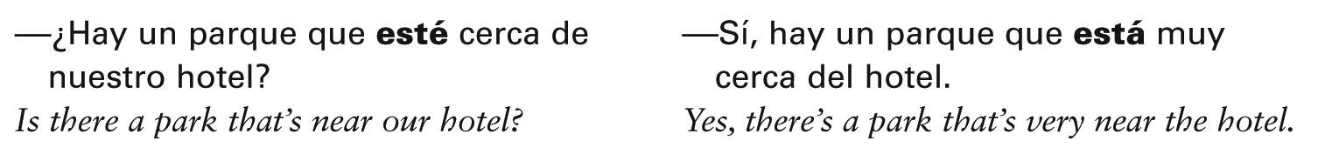
The subjunctive is commonly used in questions with adjective clauses when the speaker is trying to find out information about which he or she is uncertain. However, if the person who responds to the question knows the information, the indicative is used.
© by Vista Higher Learning, Inc. All rights reserved.
5.1-<number>

Slide 10
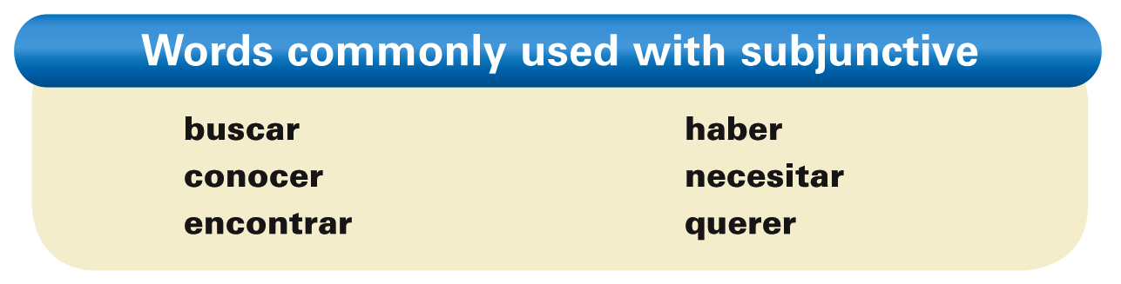
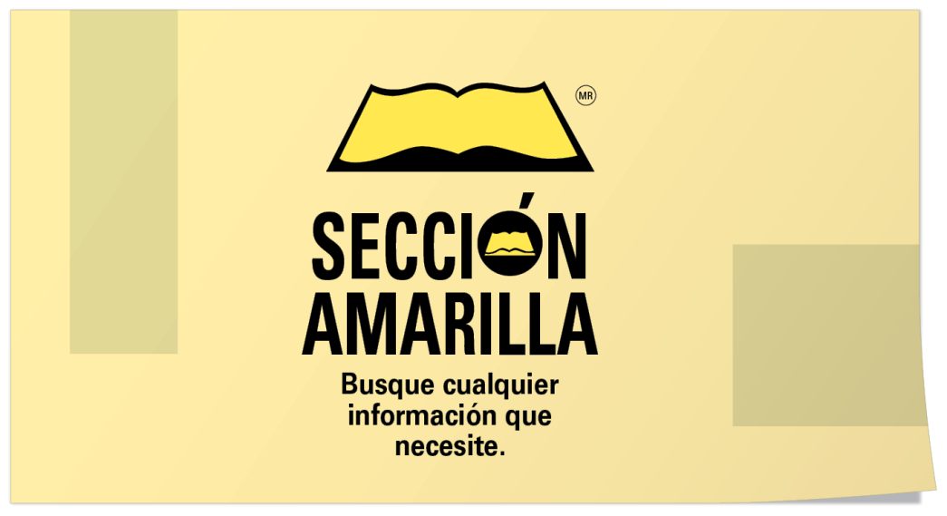
¡Atención! Here are some verbs that are commonly followed by adjective clauses in the subjunctive:
© by Vista Higher Learning, Inc. All rights reserved.
5.1-<number>

Slide 11

Escoge entre el subjuntivo y el indicativo para completar cada oración.
1. Necesito una persona que _____ (puede/pueda) cantar bien. 2. Buscamos a alguien que _____ (tiene/tenga) paciencia. 3. ¿Hay restaurantes aquí que _____ (sirven/sirvan) comida japonesa? 4. Tengo una amiga que _____ (saca/saque) fotografías muy bonitas. 5. Hay una carnicería que _____ (está/esté) cerca de aquí. 6. No vemos ningún apartamento que nos _____ (interesa/interese). 7. Conozco a un estudiante que _____ (come/coma) hamburguesas todos los días. 8. ¿Hay alguien que _____ (dice/diga) la verdad?
pueda
© by Vista Higher Learning, Inc. All rights reserved.
5.1-<number>

