Slide 1

You have already learned familiar (tú) commands and formal (usted/ustedes) commands. You will now learn nosotros/as commands, which are used to give orders
or suggestions that include yourself and
other people.
© by Vista Higher Learning, Inc. All rights reserved.
5.2-<number>

Slide 2
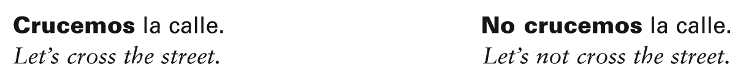
Nosotros/as commands correspond to the English Let’s.
Both affirmative and negative nosotros/as commands are generally formed by using the first-person plural form of the present subjunctive.
© by Vista Higher Learning, Inc. All rights reserved.
5.2-<number>

Slide 3
The affirmative Let’s + [verb] command may also be expressed with vamos a + [infinitive]. Remember, however, that vamos a + [infinitive] can also mean we are going to (do something). Context and tone of voice determine which meaning is being expressed.
© by Vista Higher Learning, Inc. All rights reserved.
5.2-<number>

Slide 4
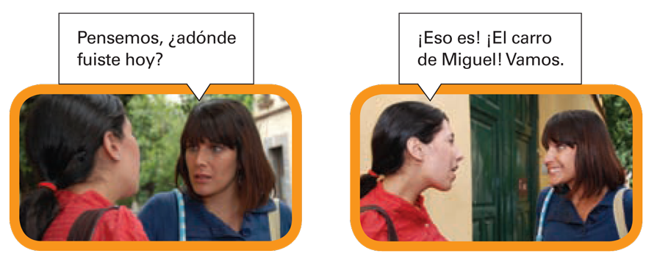
To express Let’s go, the present indicative form of ir (vamos) is used, not the subjunctive. For the negative command, however, the subjunctive is used.
© by Vista Higher Learning, Inc. All rights reserved.
5.2-<number>

Slide 5
¡Atención! When nos or se is attached to an affirmative nosotros/as command, the final –s is dropped from the verb ending.
Sentémonos allí.
Démoselo a ella.
Mandémoselo a ellos.
The nosotros/as command form of irse is vámonos. Its negative form
is no nos vayamos.
© by Vista Higher Learning, Inc. All rights reserved.
5.2-<number>

Slide 6
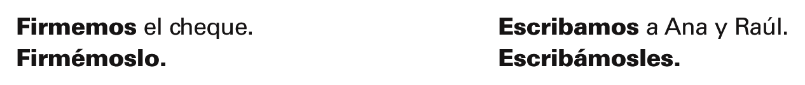
Object pronouns are always attached
to affirmative nosotros/as commands.
A written accent is added to maintain the original stress.
© by Vista Higher Learning, Inc. All rights reserved.
5.2-<number>

Slide 7
Object pronouns are placed in front of negative nosotros/as commands.
© by Vista Higher Learning, Inc. All rights reserved.
5.2-<number>

Slide 8

Indica los mandatos afirmativos y negativos de la primera persona del plural (nosotros/as) de estos verbos.
1. estudiar ___________ 2. cenar __________ 3. leer __________ 4. decidir __________ | 5. decir __________ 6. cerrar __________ 7. levantarse __________ 8. irse __________
estudiemos,
no estudiemos
© by Vista Higher Learning, Inc. All rights reserved.
5.2-<number>

