Slide 1

In In Descubre, nivel 1, you learned about present participles (estudiando). Both Spanish and English have past participles (participios pasados). The past participles of English verbs often end in -ed (to turn → turned), but many are also irregular (to buy → bought; to drive → driven).
© by Vista Higher Learning, Inc. All rights reserved.
5.3-<number>

Slide 2
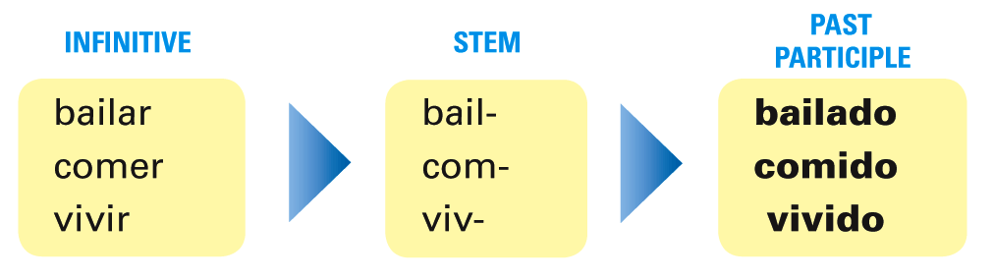
In Spanish, regular -ar verbs form the past participle with -ado. Regular -er and -ir verbs form the past participle with -ido.
© by Vista Higher Learning, Inc. All rights reserved.
5.3-<number>

Slide 3
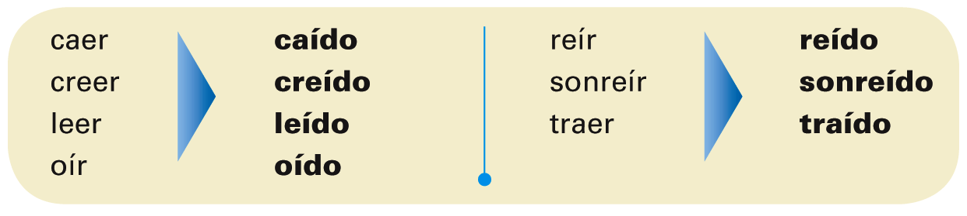
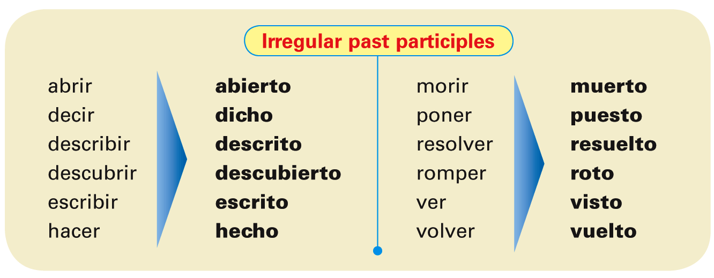
¡Atención! The past participles of -er and -ir verbs whose stems end in -a, -e, or -o carry a written accent mark on the i of the -ido ending.
© by Vista Higher Learning, Inc. All rights reserved.
5.3-<number>

Slide 4
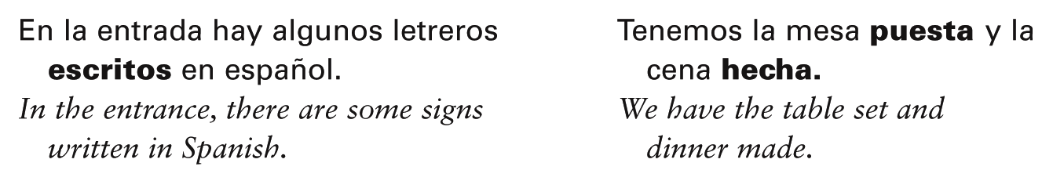
In Spanish, as in English, past participles can be used as adjectives. They are often used with the verb estar to describe a condition or state that results from an action. Like other Spanish adjectives, they must agree in gender and number with the nouns they modify.
© by Vista Higher Learning, Inc. All rights reserved.
5.3-<number>

Slide 5

Indica la forma correcta del participio pasado de estos verbos.
1. hablar ______ 2. beber _____ 3. decidir _____ 4. romper _____ | 5. escribir _____ 6. cantar _____ 7. oír _____ 8. traer _____ | 9. correr _____ 10. leer _____ 11. ver _____ 12. hacer _____
hablado
© by Vista Higher Learning, Inc. All rights reserved.
5.3-<number>

