Slide 1

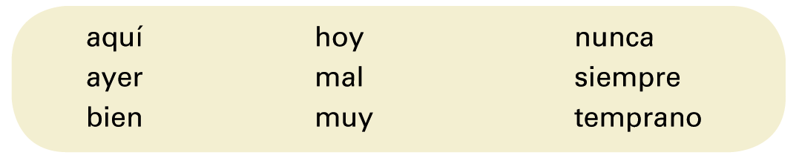
Adverbs are words that describe how, when, and where actions take place. They can modify verbs, adjectives, and even other adverbs. In previous lessons, you have already learned many Spanish adverbs, such as the ones below.
© by Vista Higher Learning, Inc. All rights reserved.
1.4-<number>

Slide 2
The most common adverbs end in -mente, equivalent to the English ending -ly.
© by Vista Higher Learning, Inc. All rights reserved.
1.4-<number>

Slide 3
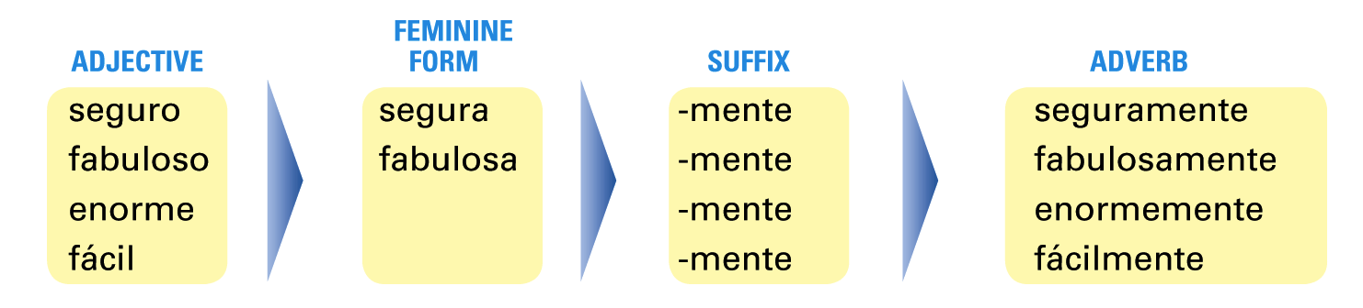
To form these adverbs, add -mente to the feminine form of the adjective. If the adjective does not have
a special feminine form, just add -mente to the standard form.
¡Atención! Adjectives do not lose their accents when adding -mente.
© by Vista Higher Learning, Inc. All rights reserved.
1.4-<number>

Slide 4
¡Atención! When a sentence contains two or more adverbs in sequence, the suffix -mente
is dropped from all but the last adverb.
Example:
El médico nos habló simple y abiertamente.
The doctor spoke to us simply and openly.
© by Vista Higher Learning, Inc. All rights reserved.
1.4-<number>

Slide 5
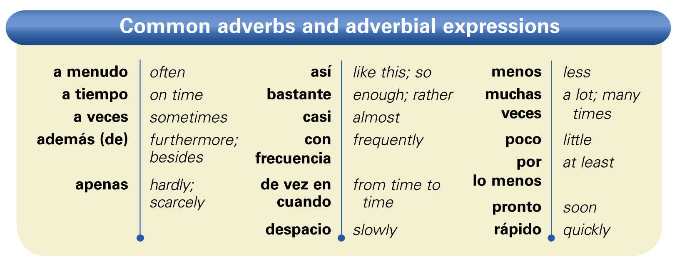
Adverbs that end in -mente generally follow the verb, while adverbs that modify an adjective or another adverb precede the word they modify.
© by Vista Higher Learning, Inc. All rights reserved.
1.4-<number>

Slide 6
¡Atención! Rápido functions as an adjective (Ella tiene una computadora rápida) as well as an adverb (Ellas corren rápido).
Note that as an adverb, rápido does not need to agree with any other word in the sentence. You can also use the adverb rápidamente (Ella corre rápidamente).
© by Vista Higher Learning, Inc. All rights reserved.
1.4-<number>

Slide 7

Transforma los adjetivos en adverbios.
1. alegre __________ 2. constante _____ 3. gradual _____ 4. perfecto _____ | 5. real _____ 6. frecuente _____ 7. tranquilo _____ 8. regular _____ | 9. maravilloso _____ 10. normal _____ 11. básico _____ 12. afortunado _____
alegremente
© by Vista Higher Learning, Inc. All rights reserved.
1.4-<number>

