Slide 1
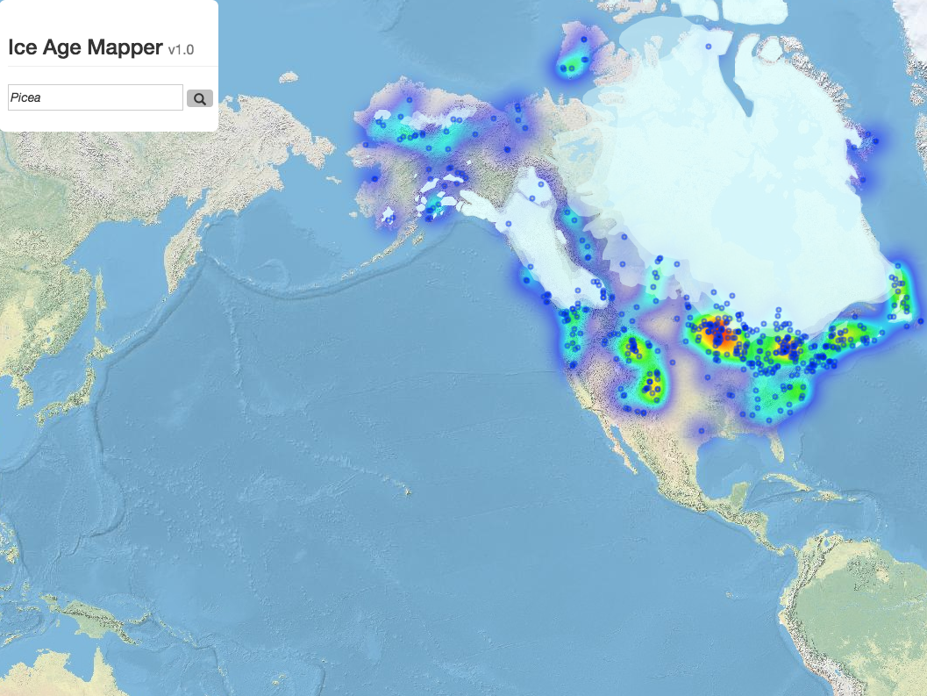
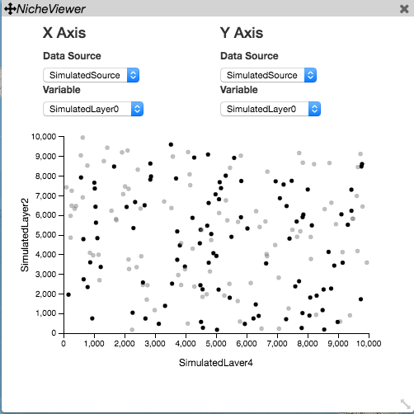
PaleoViewer:
NicheViewer
Temperature
Precipitation
An enhanced toolkit for visualizing Quaternary ecological change in multiple dimensions
Scott Farley
Poster #: D2

