Slide 1
SVM QP & Midterm Review
Rob Hall
10/14/2010

Slide 2
This Recitation
Review of Lagrange multipliers (basic undergrad calculus)
Getting to the dual for a QP
Constrained norm minimization (for SVM)
Midterm review

Slide 3
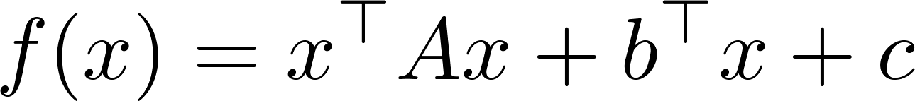
Minimizing a quadratic
“Positive definite”

Slide 4
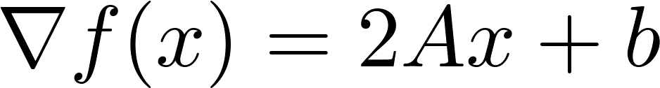
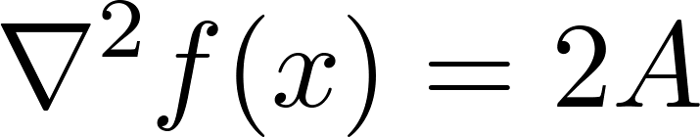
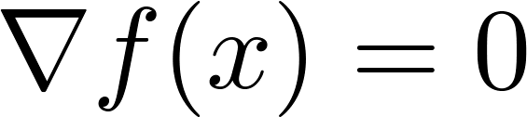
Minimizing a quadratic
“Gradient”
“Hessian”
So just solve:

Slide 5
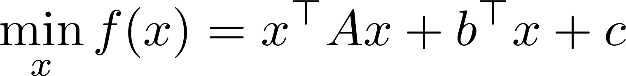
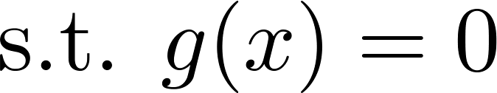
Constrained Minimization
“Objective function”
Constraint
Same quadratic shown with contours of linear constraint function

Slide 6
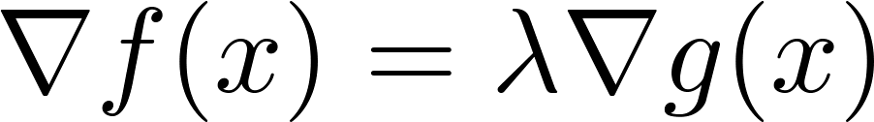

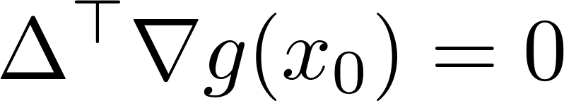
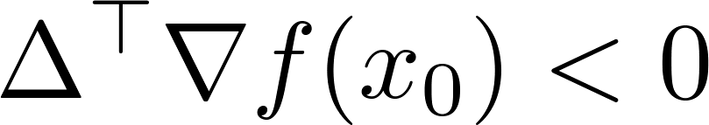
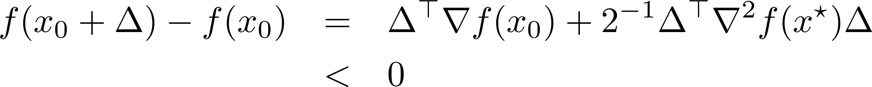
Constrained Minimization
New optimality condition
Theoretical justification for this case (linear constraint):
Otherwise, may choose so:
Remain feasible
Decrease f
Taylor’s theorem

Slide 7
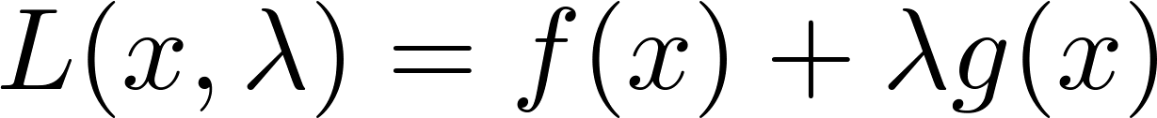
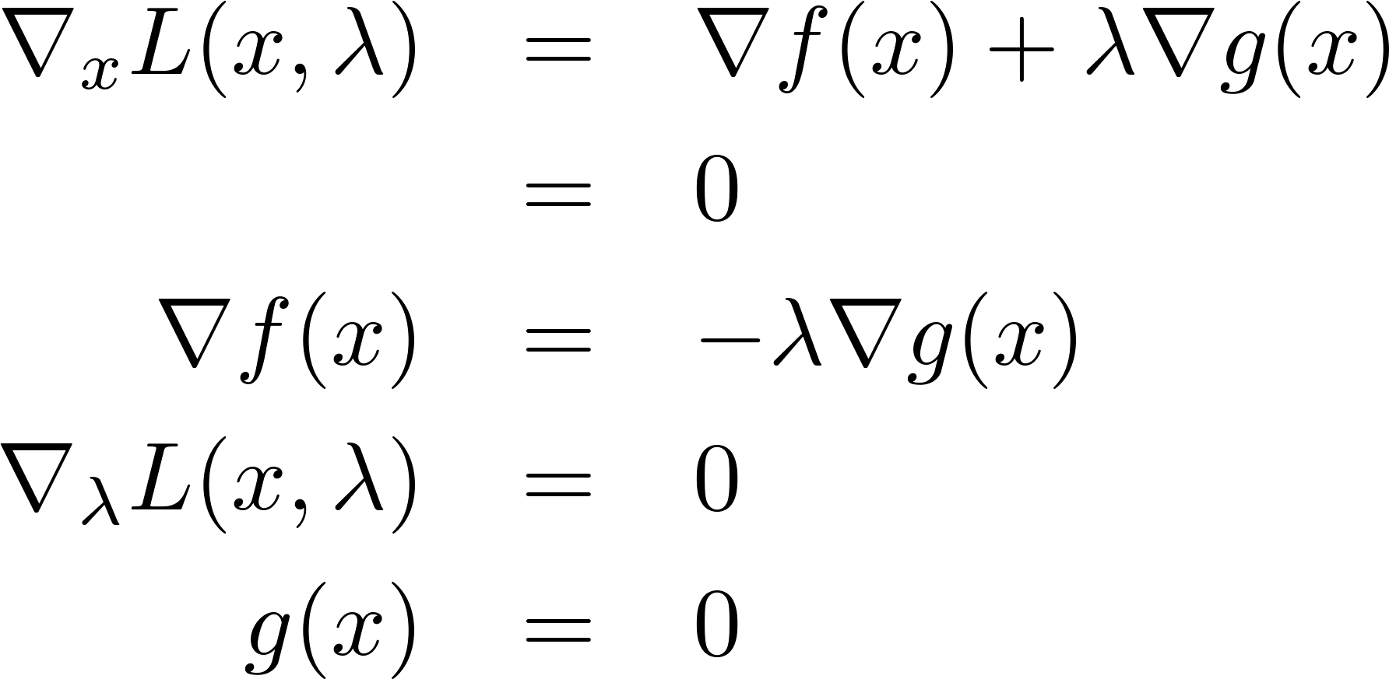
The Lagrangian
“The Lagrangian”
“Lagrange multiplier”
Stationary points satisfy:
New optimality condition
feasibility

Slide 8
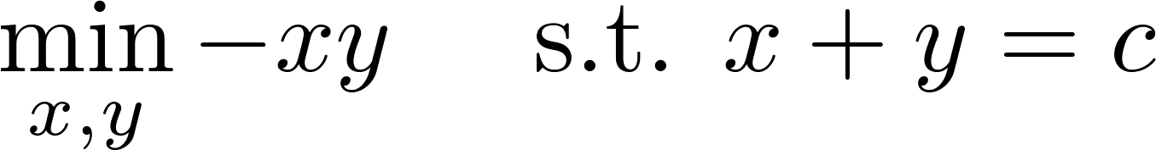
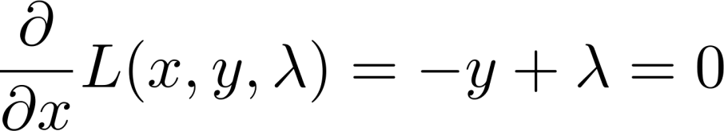
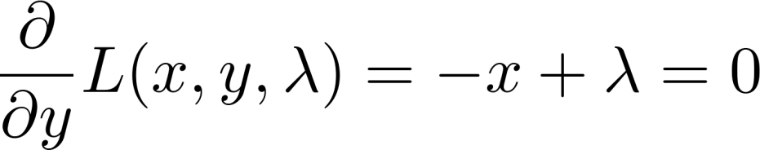
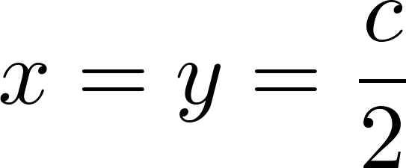
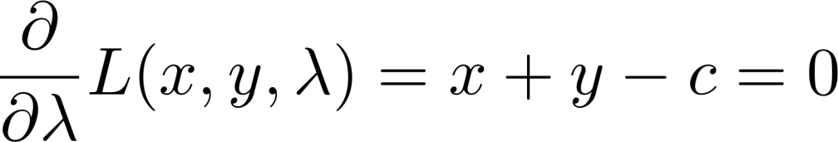
Dumb Example
Maximize area of rectangle, subject to perimeter = 2c
1. Write function
2. Write Lagrangian
3. Take partial derivatives
4. Solve system (if possible)

Slide 9
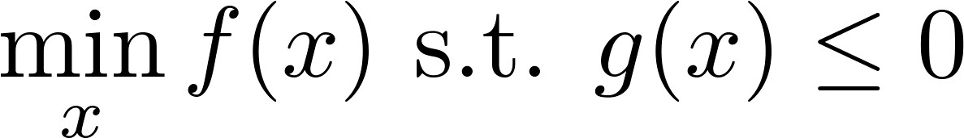
Inequality Constraints
Lagrangian (as before)
Linear equality constraint Linear inequality constraint
Solution must be on line
Solution must be in halfspace

Slide 10
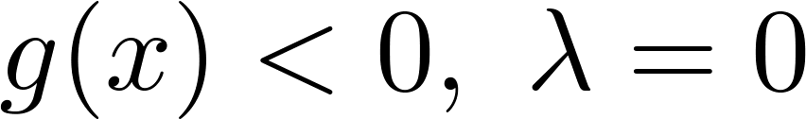

Inequality Constraints
2 cases:
Constraint “inactive”
Constraint “active”/“tight”
Why?
Why?

Slide 11
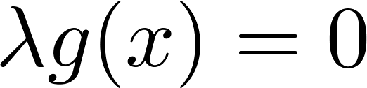
Inequality Constraints
2 cases:
Constraint “inactive”
Constraint “active”/“tight”
“Complementary Slackness”

Slide 12
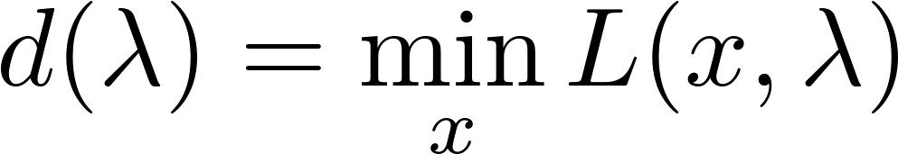
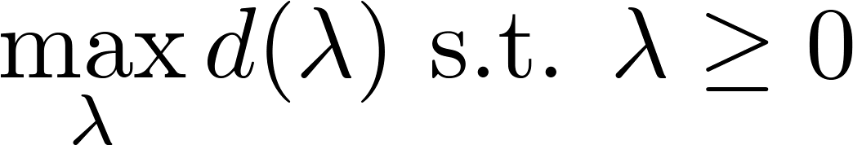
Duality
Lagrangian
Lagrangian dual function
Dual problem
Intuition:
λ | x(λ) | f(x) | g(x) | d(λ)
0 | Unconstrained minimizer | min | Maybe > 0 | Min f
1 |  | Near min | Maybe > 0 | Near min f
… |  |  |  | Non decreasing
∞ | Constrained minimizer | Constrained min | Must be 0 | > Min f
Largest value will be constrained minimum

Slide 13
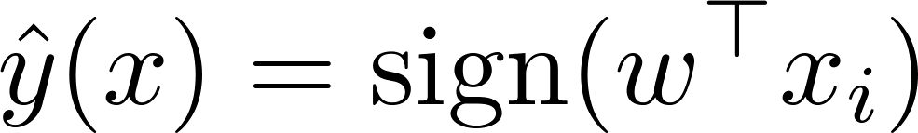
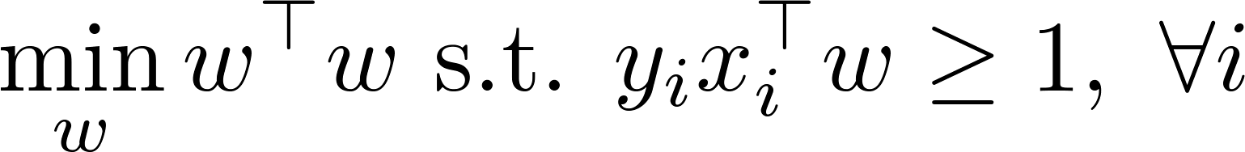
SVM
Learn a classifier of the form:
“Hard margin” SVM
Distance of point from decision boundary
Note, only feasible if data are linearly separable

Slide 14
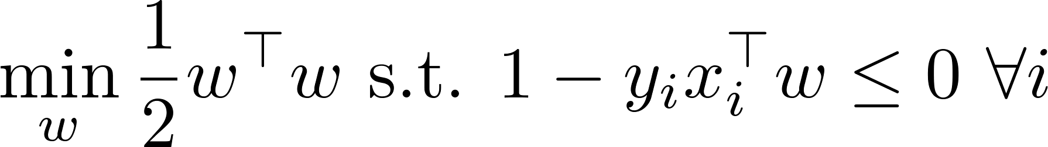
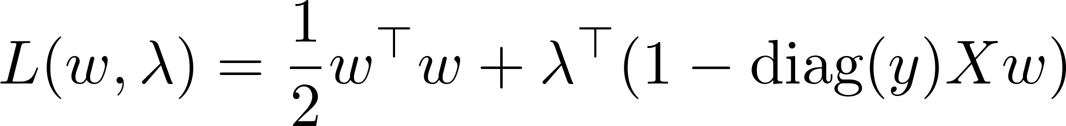
Norm Minimization
Scaled to simplify math
constraint rearranged to g(w)≤0
Vector of Lagrange multipliers.
Matrix with y_{i} on diagonal and 0 elsewhere

Slide 15
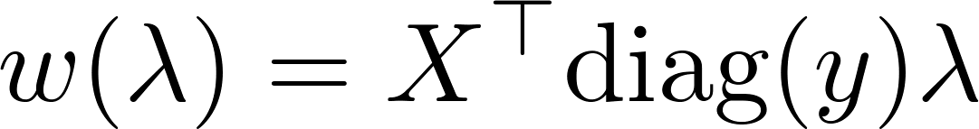
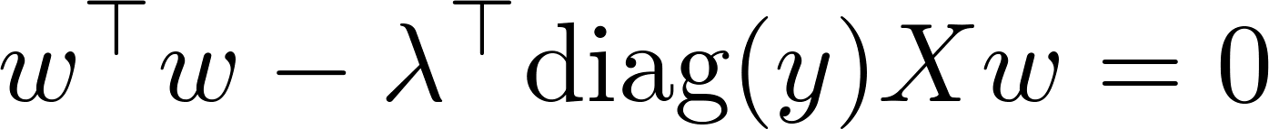
SVM Dual
Take derivative:
Leads to:
Remark: w is a linear combination of x with positive LMs, i.e., those points where the constraint is tight: i.e. support vectors
And:

Slide 16
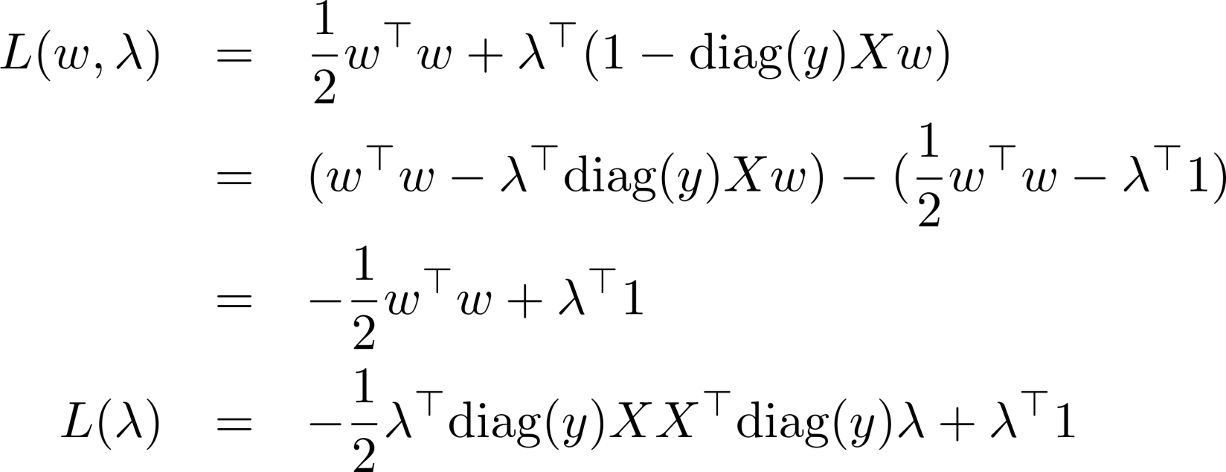
SVM Dual
Using both results we have:
“kernel trick” here (next class)
Remarks:
Result is another quadratic to maximize, which only has non-negativity constraints
No b here -- may embed x into higher dimension by taking (x,1), then last component of w = b

Slide 17
Midterm
Basics: Classification, regression, density estimation
Bayes risk
Bayes optimal classifier (or regressor)
Why can’t you have it in practice?
Goal of ML: To minimize a risk = expected loss
Why cant you do it in practice?
Minimize some estimate of risk

Slide 18
Midterm
Estimating a density:
MLE: maximizing a likelihood
MAP / Bayesian inference
Parametric distributions
Gaussian, Bernoulli etc.
Nonparametric estimation
Kernel density estimator
Histogram

Slide 19
Midterm
Classification
Naïve bayes: assumptions / failure modes
Logistic regression:
Maximizing a log likelihood
Log loss function
Gradient ascent
SVM
Kernels
Duality

Slide 20
Midterm
Nonparametric classification:
Decision trees
KNN
Strengths/weakness compared to parametric methods

Slide 21
Midterm
Regression
Linear regression
Penalized regression (ridge regression, lasso etc).
Nonparametric regression:
Kernel smoothing

Slide 22
Midterm
Model selection:
MSE = bias^2 + variance
Tradeoff bias vs variance
Model complexity
How to do model selection:
Estimate the risk
Cross validation

