Slide 1

SLALOM · ADOBE DELIVERY ACCELERATORS
The Adobe Data Collection Delivery Suite
Six Claude Code skills — from detecting a site's tags to a governed, measured Adobe implementation
Detect → Plan → Build → Publish → Audit → Reconcile — one governed pipeline, every output client-ready.
Prepared by Scott Tavares • Slalom Client Delivery
Notes:
Cover. The Adobe Data Collection Delivery Suite — six Claude Code skills that take a site from detection to a governed, measured Adobe implementation.

Slide 2






SIX SKILLS, ONE DELIVERY PIPELINE
What the Skills Are — and What They Deliver
DETECT tech-detector
Inspects the live site's martech.
DELIVERS Current-state report
1
PLAN setup-plan
Turns a scoping Q&A into a build plan.
2
DELIVERS Governed plan + property blueprint
BUILD data-collection-builder
Generates the data-collection spec.
DELIVERS SDR (CSV) + XDM schema + data elements & rules
3
PUBLISH property-creator
Provisions the property via the API.
4
DELIVERS A live Adobe Launch property
AUDIT audit-builder
Audits the live configuration.
DELIVERS Findings deck (PPTX) + audit workbook (XLSX)
5
RECONCILE data-reconciliation
Report suite vs. the live property.
6
DELIVERS Reconciliation workbook (XLSX) + decisions email
© Slalom. All Rights Reserved. Proprietary and Confidential.
Notes:
What they are. Six skills in one pipeline: Tech-Detector, Setup-Plan, Data-Collection-Builder, Property-Creator, Audit-Builder, Data-Reconciliation.

Slide 3



WHY WE USE THEM
Why the Skills Exist
01
02
03
The Problem
What It Costs
What the Skills Change
MANUAL DELIVERY
❯
WHERE THE TIME GOES
❯
GOVERNED & REPEATABLE
Adobe implementations are built by hand — clicking through Launch, hand-writing SDRs, eyeballing configs. Slow, inconsistent between consultants, hard to QA, rarely well-documented.
Weeks of senior time on repetitive setup. Errors surface late — double-counting, broken identity, missed variables — and quality depends on who happened to build it.
The repetitive, error-prone work is automated and standardized. Every stage produces a client-ready artifact from live data — the same way every time.
The shift: a bespoke, manual engagement becomes a governed, repeatable pipeline — consultants spend their hours on judgment and client decisions, not setup.
© Slalom. All Rights Reserved. Proprietary and Confidential.
3

Slide 4


WHAT YOU GET FROM THEM
The Value Add
EVIDENCE
Reusable IP & Speed
Faster delivery
GOVERNANCE
A one-off engagement becomes a repeatable asset — weeks of manual setup run in hours; the next client reuses the same accelerators.
SPEED
Consistency & Governance
Consistent & governed
CLIENT VALUE
The same standards, naming and quality bar every time — approval gates, rollback and human sign-off built into build and publish.
compounds every engagement
A Quality Floor & Evidence
Defensible & repeatable
Junior consultants ship senior-quality output — every finding sourced from live config, capturable and defensible to a skeptical client.
© Slalom. All Rights Reserved. Proprietary and Confidential.
4

Slide 5





THE BOTTOM LINE
Time Savings — Weeks to Days
Illustrative effort for a typical mid-size Adobe migration — manual delivery vs. the skills. The point isn't the exact hours; it's where senior time goes.
3–5×
~2 wks
6→1
100%
Faster end-to-end
Effort saved / migration
Skills, one pipeline
Repeatable & documented
THE MANUAL WAY
WITH THE SKILLS
×
Current-state audit — 2–3 days clicking through the UI
✓
Detect + audit — under half a day, sourced from the live site
×
SDR + XDM authored by hand — 1–2 weeks
✓
SDR + XDM generated — about a day, one universal pattern
×
Property provisioning in the UI — 3–5 days, error-prone
✓
Provisioning via Reactor API — minutes, safe to re-run
×
Reconciliation by hand — a full day of cross-referencing
✓
Reconciliation — 1–2 hours, a reviewed draft + decisions email
Net effect: a multi-week manual engagement compresses to a few governed days — and every run is documented, repeatable, and auditable.
© Slalom. All Rights Reserved. Proprietary and Confidential.
5
Notes:
Time savings. Illustrative estimates: a multi-week manual engagement compressed to days. Labeled as estimates, not measured precision.

Slide 6
HOW THEY WORK TOGETHER
One Pipeline: Detection to Decisions
Starts from the client's live site — inspected directly. Then each stage feeds the next, and every output is a client-ready artifact.
BUILD
Stand up the implementation
ASSURE
Prove it & decide
Detect
Build
Audit
tech-detector
data-collection-builder
audit-builder
Inspects the live site; reports the current stack.
Audits the live config — findings deck + workbook.
Generates the SDR, XDM schema, elements & rules.
1
2
3
4
5
6
Plan
Publish
Reconcile
setup-plan
property-creator
data-reconciliation
A short scoping Q&A → a governed build plan.
Provisions the Launch property via the API.
Report suite vs. property — workbook + email.
One governed pipeline — every output feeds the next. The client gets a documented implementation, the evidence to trust it, and the decisions to act.
© Slalom. All Rights Reserved. Proprietary and Confidential.
6
Notes:
The diagram. One pipeline in two phases — Build (detect/plan/build/publish) and Assure (audit/reconcile). Every output feeds the next.

Slide 7




WHAT LANDS ON THE TABLE
What the Skills Deliver to the Client
ONE PIPELINE, TWO KINDS OF DELIVERABLE
Build artifacts stand up the implementation; Assure artifacts prove it works and tee up the decisions only the client can make.
EVERY ENGAGEMENT
A current-state baseline of exactly what's running today — sourced from the live site, not a stale export.
BUILD DELIVERABLES
ASSURE DELIVERABLES
The SDR and Web SDK XDM schema — the documented data-collection spec
A findings audit deck + audit workbook — every claim sourced from live config
A live, published Launch property — extensions, data elements, rules, environments
A reconciliation workbook — every variable's status, orphans and no-ops surfaced
A client decisions email — the handful of calls only the client can make
© Slalom. All Rights Reserved. Proprietary and Confidential.
7
Notes:
What they deliver. Build artifacts (SDR, XDM, live property) plus Assure artifacts (audit deck + workbook, reconciliation workbook + decisions email).

Slide 8
GET STARTED IN ONE LINE
How to Invoke the Skills
Each skill triggers from natural language — type a prompt like these in Claude Code and the matching skill takes over. No commands to memorise.
Detect tech-detector
Plan setup-plan
❯
What's running on slalom.com — Web SDK or AppMeasurement?
❯
Plan the Adobe Launch migration for slalom.com.
Build data-collection-builder
Publish property-creator
❯
Build the SDR + Web SDK XDM schema for slalom.com.
❯
Create slalom.com's Launch property and publish dev → prod.
Audit audit-builder
Reconcile data-reconciliation
❯
Audit the site slalom.com
❯
Reconcile slalom.com's report suite against the property.
© Slalom. All Rights Reserved. Proprietary and Confidential.
8

Slide 9
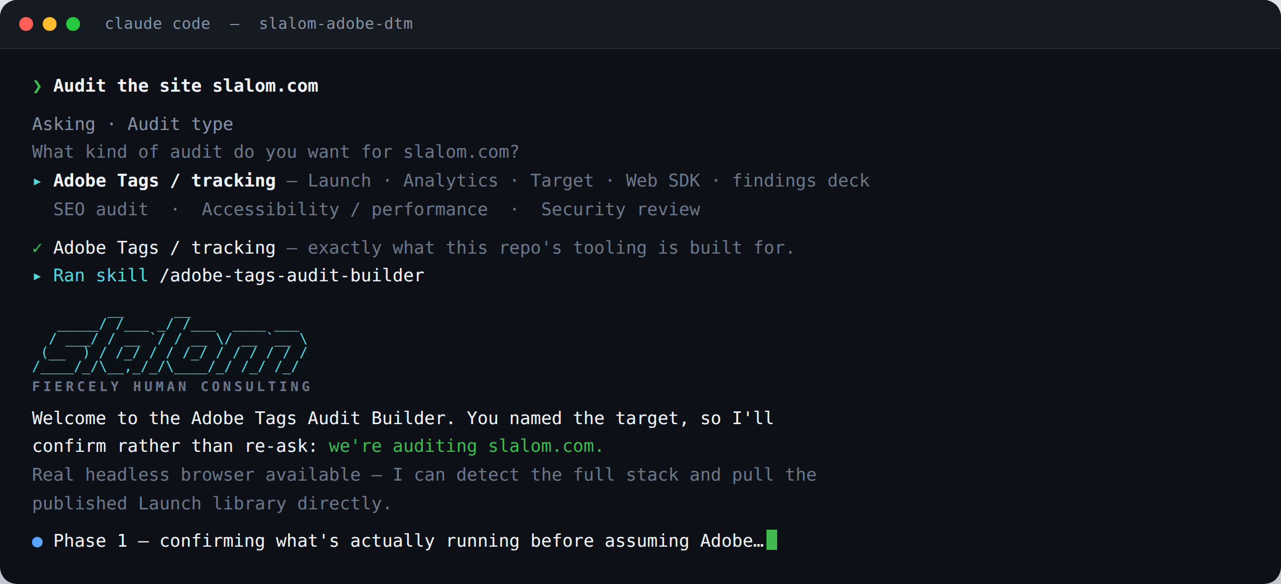
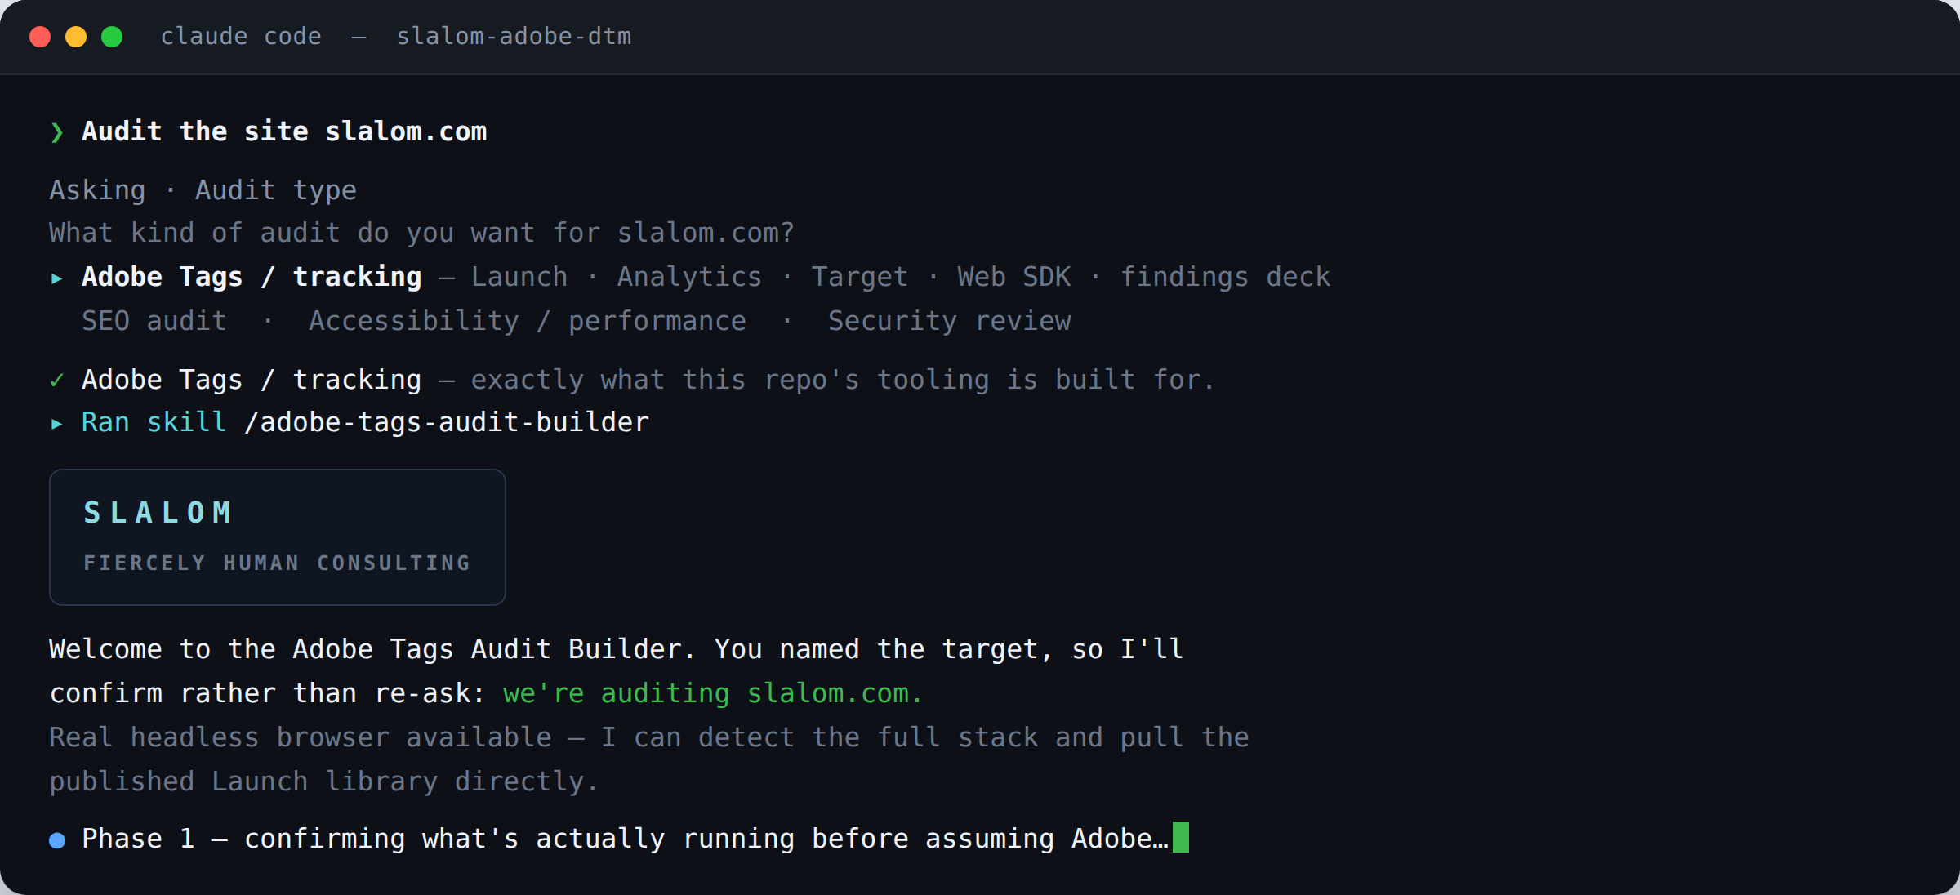
SEE IT IN ACTION
One Prompt, and the Skill Takes Over
Name your site in plain English — the skill confirms scope, works from live data, and hands back a client-ready deck.
WHAT JUST HAPPENED
1
You named the site.
That’s the entire prompt — Audit the site slalom.com
2
It routed & confirmed.
Picked the Adobe Tags audit and confirmed scope — no re-asking what you already said.
3
It works from live data.
A real headless browser detects the stack and pulls the published Launch library directly.
Produces a findings deck (PPTX) in the Slalom style.
Same pattern for every skill: name the target in one line — Detect, Build, Audit, Reconcile — and the matching skill routes, confirms, and runs.
© Slalom. All Rights Reserved. Proprietary and Confidential.
9

Slide 10
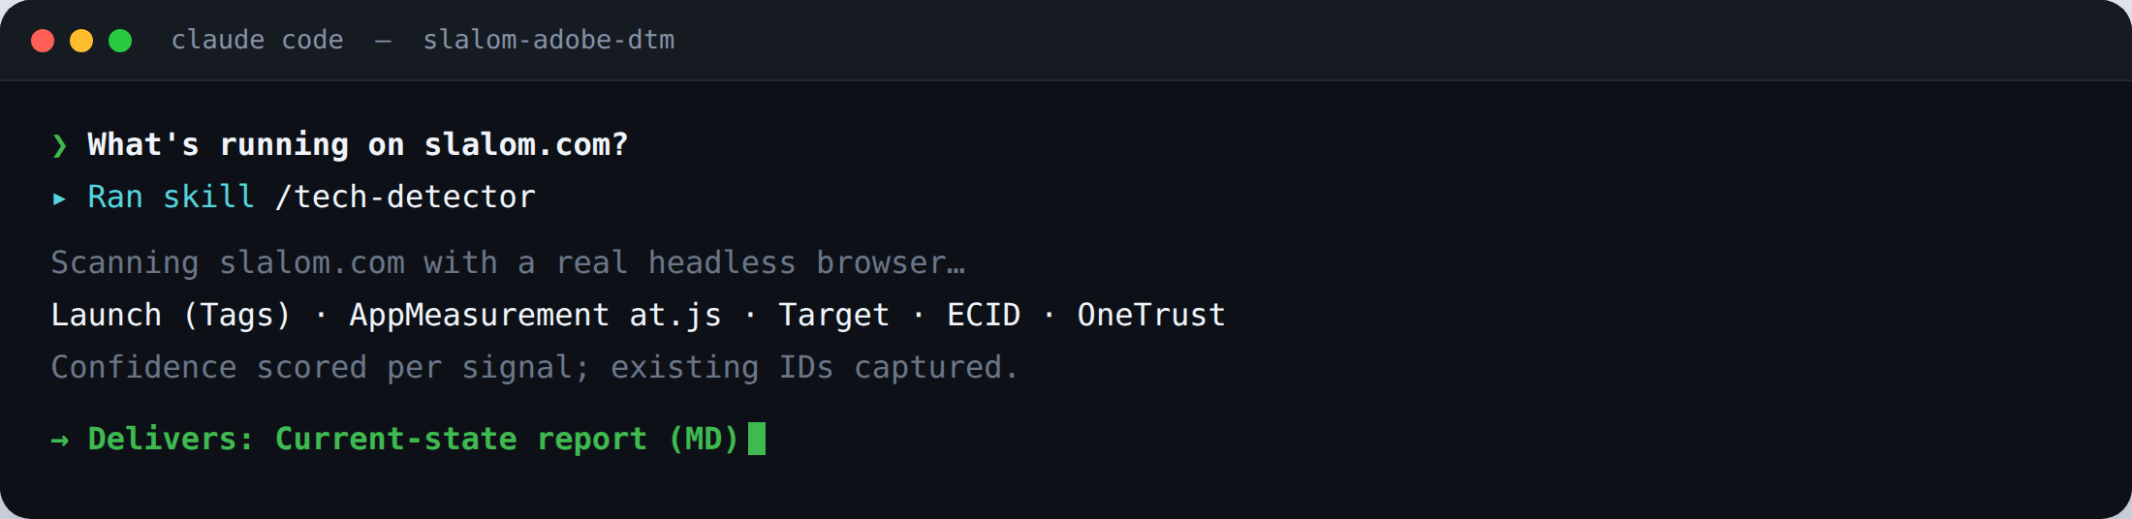

SKILL 1 OF 6 · TECH-DETECTOR
Detect — Know what's really running
WHAT IT DOES
FOR THE CLIENT
FOR SLALOM
Inspects the live site with a real browser and reports exactly what's running — tag manager, Analytics (at.js vs Web SDK), Target, ECID, data layer, consent, and the IDs already present.
A truthful, evidence-based baseline — no guessing, no stale docs. The engagement is scoped from what's actually live.
Kills days of manual discovery; every consultant starts from the same rigorous baseline; credibility in the first meeting.
DELIVERABLE
Current-state report MD
© Slalom. All Rights Reserved. Proprietary and confidential.
10

Slide 11
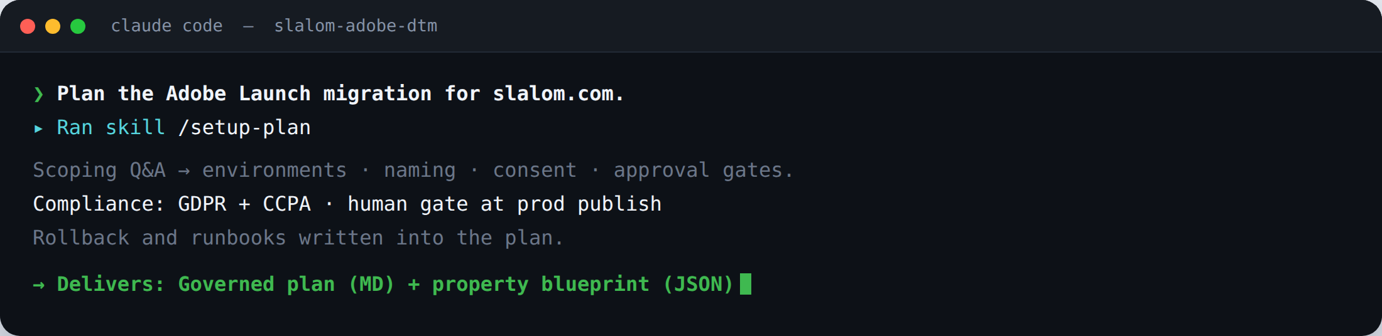
SKILL 2 OF 6 · SETUP-PLAN
Plan — Govern it before you build it
WHAT IT DOES
FOR THE CLIENT
FOR SLALOM
Turns a short scoping Q&A into a governed implementation plan — environments, naming, consent/compliance, approval gates, rollback, runbooks — plus a machine-readable property blueprint.
A defensible, compliance-aware plan before anyone touches production. Governance is decided up front, not bolted on.
Senior-quality planning in an hour; the blueprint feeds the build automatically; consistent governance on every engagement.
DELIVERABLE
Governed plan + blueprint MD · JSON
© Slalom. All Rights Reserved. Proprietary and confidential.
11

Slide 12
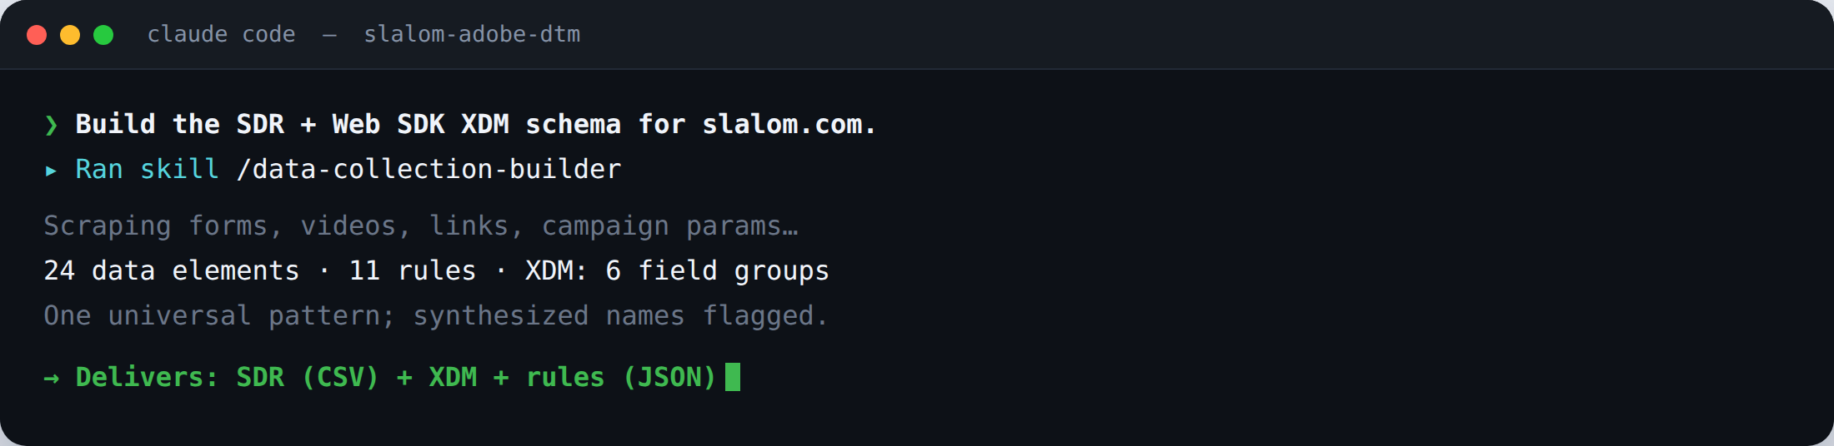
SKILL 3 OF 6 · DATA-COLLECTION-BUILDER
Build — The spec, from the real site
WHAT IT DOES
FOR THE CLIENT
FOR SLALOM
Scrapes the site and builds the data-collection spec — the SDR and Web SDK XDM schema, plus a universal set of data elements and rules (page name, forms, videos, campaign, links, IDs).
A complete, documented spec sourced from the real site — nothing missed, everything traceable to a live signal.
Weeks of hand-authoring compressed to a day; one universal pattern reused across clients; the spec is executable, not just a doc.
DELIVERABLE
SDR + XDM + rules CSV · JSON
© Slalom. All Rights Reserved. Proprietary and confidential.
12

Slide 13
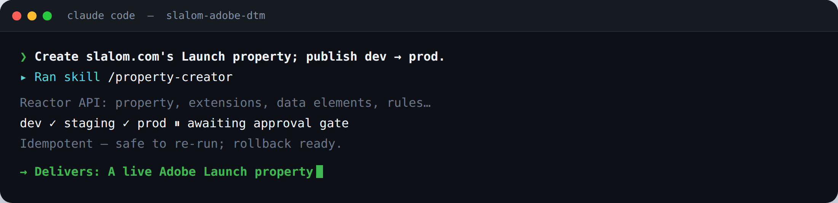
SKILL 4 OF 6 · PROPERTY-CREATOR
Publish — Stand up the property, safely
WHAT IT DOES
FOR THE CLIENT
FOR SLALOM
Provisions the Adobe Launch property end-to-end via the Reactor API — extensions, data elements, rules, libraries — and runs dev → staging → prod with approval gates, idempotency, and rollback.
A working, governed property in minutes — safe to re-run, with rollback if needed. No error-prone UI clicking.
Repeatable, auditable provisioning; junior consultants ship senior-quality builds; no drift between environments.
DELIVERABLE
Live Launch property via API
© Slalom. All Rights Reserved. Proprietary and confidential.
13

Slide 14
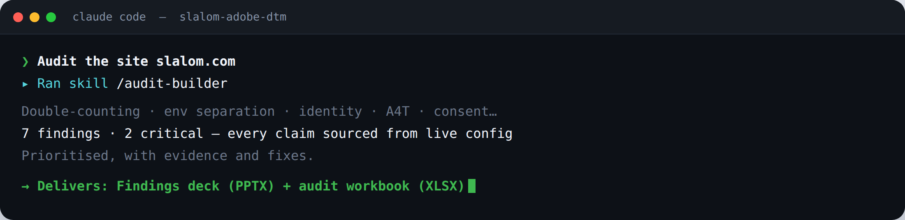
SKILL 5 OF 6 · AUDIT-BUILDER
Audit — Prove it, with evidence
WHAT IT DOES
FOR THE CLIENT
FOR SLALOM
Audits the live configuration for the issues that matter — double-counting, environment separation, identity bridge, A4T, consent-gating — every claim sourced from live config.
A client-ready, evidence-backed audit that names the real risks and the fixes — defensible to a skeptical stakeholder.
A repeatable methodology that produces a polished deck automatically; turns discovery into a delivery and sales asset.
DELIVERABLE
Findings deck + workbook PPTX · XLSX
© Slalom. All Rights Reserved. Proprietary and confidential.
14

Slide 15
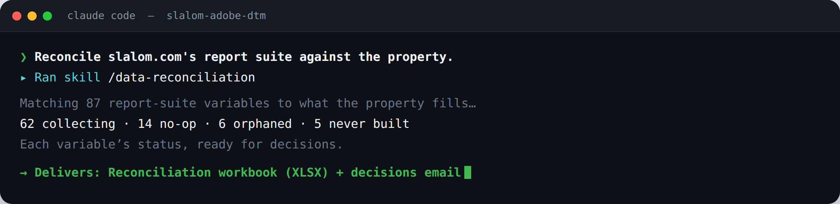
SKILL 6 OF 6 · DATA-RECONCILIATION
Reconcile — Close the loop, decide
WHAT IT DOES
FOR THE CLIENT
FOR SLALOM
Reconciles the report suite's variables against what the property actually populates — which eVars/props/events collect, and which are no-ops, orphaned, or never built.
A clear map of what's working vs. wasted, plus the handful of decisions only the client can make — no ambiguity.
Surfaces gaps that would otherwise ship silently; produces the decision artifact automatically; closes the loop with proof.
DELIVERABLE
Recon. workbook + email XLSX
© Slalom. All Rights Reserved. Proprietary and confidential.
15

Slide 16
Thank You
Detection to decisions, the same way every time. Let's talk.
Scott Tavares
Senior Principal, Adobe Multi-Solution Architect
Slalom
scott.tavares@slalom.com
© Slalom. All Rights Reserved. Proprietary and Confidential.

