Slide 1
UCS Naming
Conventions
Greg Simmons
Consulting System Engineer, Data Center
kesimmon@cisco.com

Slide 2
UCS Naming Conventions
Coverage
This document covers rules and concepts to take into consideration when creating a standard for naming user defined objects in UCS Manager.
Sections
  General Considerations
  Organizing Information
  Pools
  Policies
  Profiles
  Miscellaneous Objects
  Tools

Slide 3
UCS Naming Conventions
Assumptions and Pre-Requisites
Assumptions
  The document assumes the consumer has either attended a UCS Workshop or has worked on a UCS system so they have familiarity with the concepts of Service Profiles, Policies and Pools.
Pre-Requisites
  Server, Operating Systems, Virtualization, Network, SAN Staff to review and agree to standard
  Inventory of operating systems/major applications to be hosted on UCS

Slide 4

UCS Naming Conventions
Conventions
The first line in the title shows the section
The second line details the concept being presented on the slide
Books in the upper right indicate a reference slide.
Callouts to focus on configuration flow or to draw attention to relevant parts of the screen are shown in orange with an arrow.
  This may be also shown in green
Reminders and tips are show with an information .
To navigate to a particular screen/field, the path is shown with the arrows →
Call-Out
Object of Interest
Emphasis
 Be sure to…
Navigation → Menu → Clicks

Slide 5
UCS Naming Conventions
Overview

Slide 6

“Now remember... the first step in avoiding a trap is knowing of its existence.”
Thufir Howat
Dune, 1984
Notes:
http://www.scifiscripts.com/scripts/dune.txt

Slide 7
UCS Naming Conventions
Overview
This document does not provide The Standard for UCS Naming Conventions, instead its goal is to provide ideas and rules for naming that should be considered when defining a standard for your company.
Consider the global infrastructure not just the data center the UCS is being deployed in.
  UCS Central aggregates UCS clusters to centrally manage many of the resources discussed in this document.
It is important to pick a standard and document it.
Once the standard is defined, try to stay with it.
  Consistency drives down operational costs and decreases risk

Slide 8
UCS Naming Conventions
Benefits of a Consistent Naming Convention
Self Documenting
  By looking at the object name, the operator can easily determine what it is being used for
Easier Troubleshooting
  Instead of looking at fixed names, business relevant data can be embedded into the object names.
  Leverage description fields in objects to provide additional information that can aid in troubleshooting.
Operational Costs
  A large benefit of UCS is the ease of deploying resources. Using standardized naming allows for faster building of service profiles.

Slide 9
UCS Naming Conventions
General Guidelines for Standards Creation
UCS provides the operator with very flexible options for naming most objects (service profiles, templates, nics, hbas, pools, policies, etc.)
Keep things simple. “Less is more™”
When defining the standards, involve all of the teams that will interact with UCS
  Network, Storage, Server, Operating System, Virtualization, Security
Document and publish the agreed upon standards.
  It can be as simple as an Excel spreadsheet with values and options.
Most Important – Define a standard and stick with it.

Slide 10
UCS Naming Conventions
UCS Object Name Rules
UCS enforces object naming standards that are appropriate for the object being defined.
Generally speaking an object name should begin with a character.
Decide on a consistent case format
  All Lower, Proper Case, All Upper
Typically fields are 16 or 32 characters long.
  Recommendation: Try to stay under 12 characters.
The following characters are invalid: ‘”><)(?!@#$%^&*<space>
Examples:
  Proper Case with Dashes (Most popular)
    Windows-MAC-A
    Windows-WWN
    Exchange01
    Production-991
  Lower Case
    windows-mac-a
    windows-wwn
    exchange01
    production-991

Slide 11
UCS Naming Conventions
UCS Object Name Rules
When using ID’s prefix numbers less than 10 with a leading zero.
  For example: ESXi03
Separator characters (-_:.) should be used between words to make the name easier to read (e.g.- prod-esxi01)
  Choose a separator and make it a standard
  Recommendations
    Use “-” rather than “_”. It is more widely supported and easier to see.
    Use periods for sequential numbers (e.g.- Firmware-2.1.1t)

Slide 12
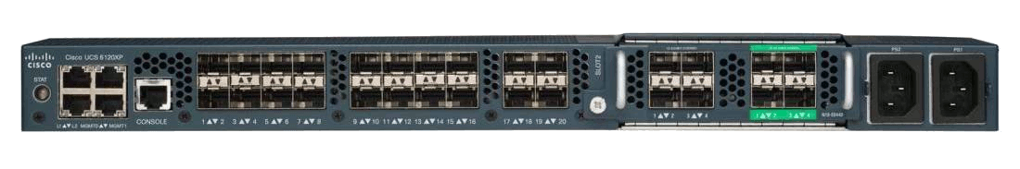
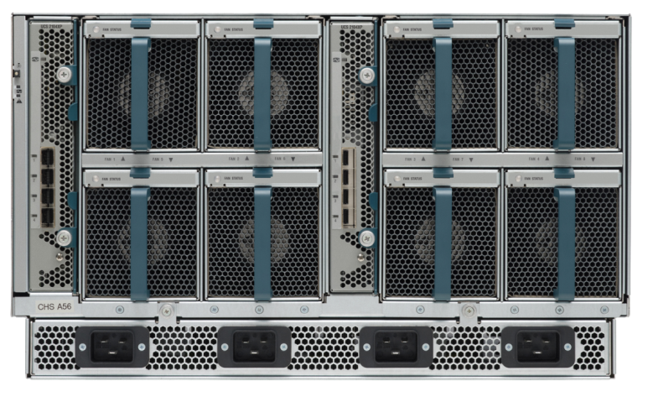
UCS Naming Conventions
Topology Definitions
Switch-L
SAN A
Switch-R
SAN B
Fabric A
Fabric B
Chassis1
Chassis n
One Fabric Interconnect is the “A” side and the other is the “B” side.
  Even if the Fabric Interconnects are in the same rack one is A and the other is B.
vNIC/vHBAs are assigned to either the A/B fabric.
Notes:
12

Slide 13
UCS Naming Conventions
Organizations

Slide 14
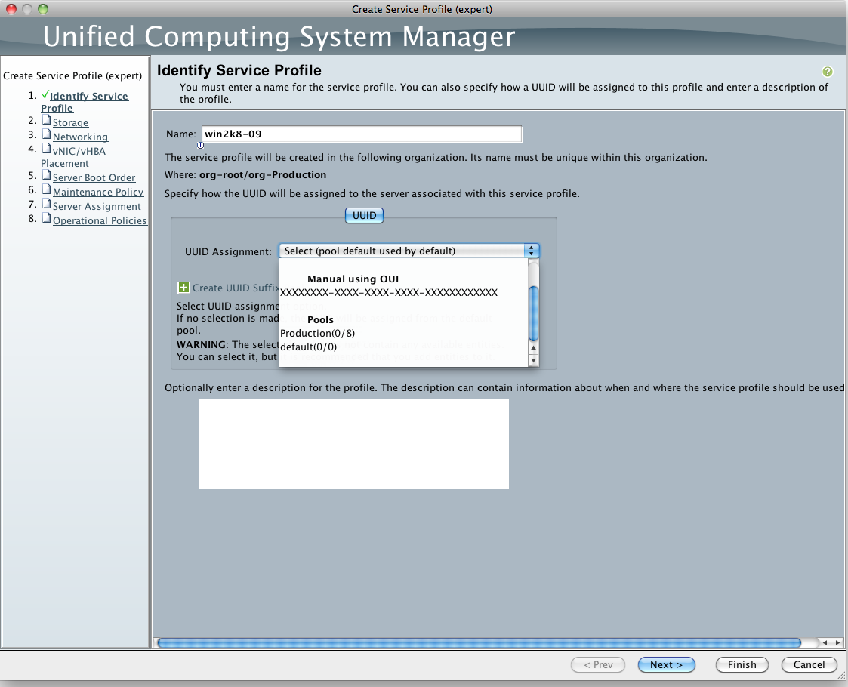
UCS Naming Conventions
Organizations
UCS supports up to 160 blades/rackmount servers being managed in a single domain.
The ability to compartmentalize the configuration and focus visibility helps reduce risk
  For example, when making a change to a Development server if the only visible resources are Development related, it removes risk of accidentally consuming a resource for another function like Production.
Running the Service Profile Wizard, the operator is only presented with appropriate options.

Slide 15
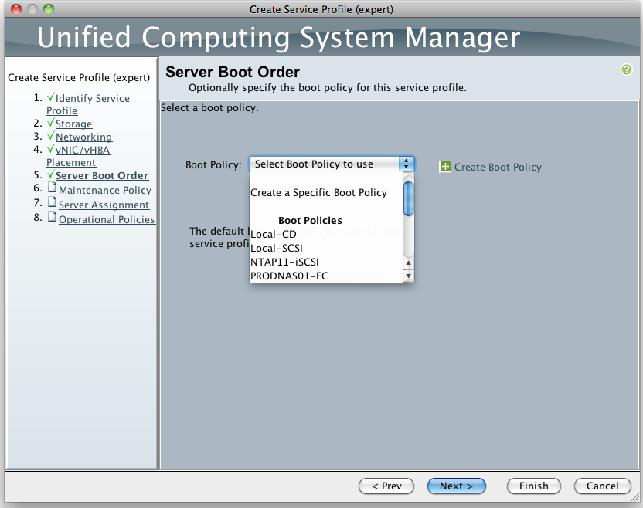
UCS Naming Conventions
Organizations
UCS provides the ability to partition the configuration using Organizations.
  UCS operators can be restricted to a specific organization/tree
  Organizations are hierarchical and can consume resources from their parents
  They provide soft barriers to keep people administering UCS on task or hard barriers by tying UCS Organizations/Roles to Active Directory/TACACs groups
Defined at the Root
Defined at the Organization
Running the Service Profile Wizard, the operator is only presented with appropriate options that merge what is available at their level and above.

Slide 16
UCS Naming Conventions
Organizations – Decide Early
Organizations impose a perceived additional layer of configuration complexity
  The operator must enter the organization of interest to make changes.
  This may require minor extra training.
UCS does not offer an easy mechanism to move resources into organizations.
  Because of this, decide early whether to leverage UCS Organizations

Slide 17
UCS Naming Conventions
Organizations – Defining What to Organize By
Organizations are given a logical name.
The organization is a container for configuration objects (pools, policies, profiles, etc.).
Organizations can be defined based on different criteria:
  Blade Owners (not popular)
  Functional Areas (e.g.- Production, QA, Development, etc.)
    They may also be subdivided into “Development-01, Development-02”
  Applications (e.g.- Exchange, UC (Unified Communications), ERP, SAP, VDI, etc.)
The most common scheme is to use Functional Areas to keep them separated from a configuration standpoint.

Slide 18
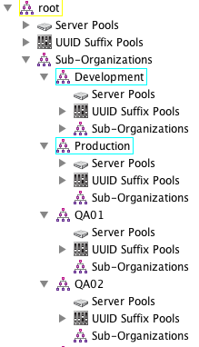
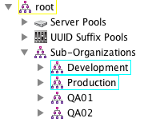
UCS Naming Conventions
Organizations – Recommendations
Description | Values
Organization | Production Development QA01 QA02 QA03 QA04
Leverage UCS organizations
Do not use more than two levels of organization (e.g.- root\Org1\SubOrg1)
  Consider going flatter as an alternative to going deep (e.g.- QA01, QA02… instead of QA\Group01, QA\Group02…)
Keep the organization name short (<12 characters if possible)

Slide 19
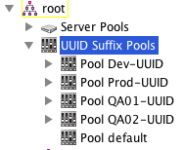
UCS Naming Conventions
Organizations – Alternative Recommendation
If the UCS cluster will always be small or homogeneous an alternate approach is to embed the application/group into the names off the objects that are created. Examples:
  The model is application focused clusters
  All the blades are running the same hypervisor
Prepend a short name to the object name to indicate who is using it (like with the Organization)
  Keep the group name short (<5 characters)
Format: <Group>-<Object Name>
Note – This method will not enable the same level of security granularity as using Organizations or insulate against cross resource utilization.
Description | Values
Group | Prod Dev QA01 QA02

Slide 20



UCS Naming Conventions
Focused or Consolidated Infrastructure
Focused Infrastructure
  Some companies prefer to have a high degree of physical isolation for security/risk mitigation at the cost of more hardware.
  This model could use organizations but might find it too much overhead given each UCS cluster is servicing a single application/group.
Consolidated Infrastructure
  Companies wishing to have more flexibility and resiliency are leveraging consolidated infrastructure where resources can be quickly re-purposed.
  This model requires organizations to reduce risk and provide security between consumers.
UC
Exchange
Prod
Database
Development
Prod/Dev/DB/Mail/UC

Slide 21
UCS Naming Conventions
Pools

Slide 22
UCS Naming Conventions – Pools
Overview
Background
MAC Pools
Storage Pools
  Word Wide Names (WWNs)
  iSCSI Qualified Names (IQNs)
Universally Unique IDentifiers (UUIDs)
Server Pools
Bringing it all Together

Slide 23
UCS Naming Conventions – Pools
Background
UCS Pools are used to track entities that must be unique for a given server/interface card.
UCS allows modification of traditionally static entities. Use this to add business relevant information into objects like MAC addresses.
Track which entities are used for the A vs. B fabric.
Consider what additional information should be embedded into the entity:
  Data Center
  UCS Cluster
  Fabric
  Application
  Operating System

Slide 24
UCS Naming Conventions – Pools
Anatomy of a Pool
Unique identities are defined in Pools.
A pool will consist of one or more Blocks of identities.
Identities within a pool cannot overlap.
Pools can overlap containing the same identities. This is not recommended.
The pool is given a logical Name.
(Recommended) Add the optional Description for the pool. This helps others looking at the configuration including Cisco TAC.
Pool
Identity
Blocks
00:25:B5:AD:09 to 00:25:B5:AD:13
00:25:B5:AD:20 to 00:25:B5:AD:25
00:25:B5:AD:55 to 00:25:B5:AD:71
Name
Description
ESX-MAC-A
MAC Addresses for ESXi on Fabric A

Slide 25
UCS Naming Conventions – Pools
Reverse Lexical Order
ID | Order Selected |  | ID | Order Selected
1 | 31 |  | 1 | 16
2 | 29 |  | 2 | 15
3 | 27 |  | 3 | 14
4 | 25 |  | 4 | 13
5 | 23 |  | 5 | 12
6 | 21 |  | 6 | 11
7 | 19 |  | 7 | 10
8 | 17 |  | 8 | 9
9 | 15 |  | 9 | 8
10 | 13 |  | 10 | 7
11 | 11 |  | 11 | 6
12 | 9 |  | 12 | 5
13 | 7 |  | 13 | 4
14 | 5 |  | 14 | 3
15 | 3 |  | 15 | 2
16 | 1 |  | 16 | 1
17 | 30
18 | 28
19 | 26
20 | 24
21 | 22
22 | 20
23 | 18
24 | 17
25 | 16
26 | 14
27 | 12
28 | 10
29 | 8
30 | 6
31 | 4
32 | 2
By default, UCS Manager picks an entry from a pool in reverse lexical notation.
  It starts at the bottom of the pool and works to top.
If a pool contains more than 16 unused objects, the selection will be made in groups of 16.
  Choose lowest group of 16
  Then pick using reverse lexical notation.
The recommendation is to keep the number of unused items in a pool to less than 16.
  If using organizations, this typically occurs organically
Unused Entries
Less than 16
Unused Entries
More than 16

Slide 26
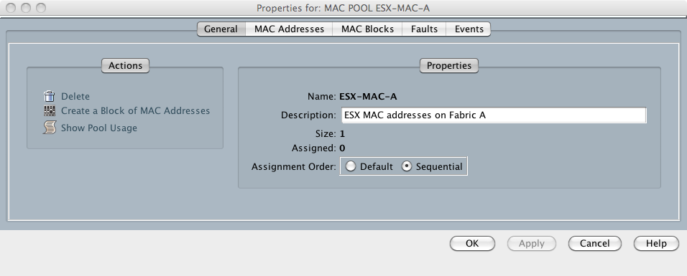
UCS Naming Conventions – Pools
Sequential Order
ID | Order Selected
1 | 1
2 | 2
3 | 3
4 | 4
5 | 5
6 | 6
7 | 7
8 | 8
9 | 9
10 | 10
11 | 11
12 | 12
13 | 13
14 | 14
15 | 15
16 | 16
17 | 17
18 | 18
19 | 19
20 | 20
21 | 21
22 | 22
23 | 23
24 | 24
25 | 25
26 | 26
27 | 27
28 | 28
29 | 29
30 | 30
31 | 31
32 | 32
UCS Manager 2.1 introduced the ability to select items from a pool sequentially.
This is set on a per pool basis.
Recommendation: If used, be sure to set all pools to be sequentially allocated.

Slide 27

UCS Naming Conventions – Pools
Synchronized Pools
Same Last Digit
By leveraging object names per A/B fabric and keeping pool sizes the same, it is possible to get consistency in what is picked from the various pools.
Keep pool sizes within a group/organization the same size.
Leverage a pool per object a given blade will use (e.g.- MAC-A, MAC-B, WWN, WWPN-A, WWPN-B).
ETH0:
00:25:B5:0A:00:03
ETH0:
00:25:B5:0B:00:03
Service Profile: Windows2008-03
UCS
Manager
Picks
00:25:B5:0A:00:01
00:25:B5:0A:00:02
00:25:B5:0A:00:03
00:25:B5:0B:00:01
00:25:B5:0B:00:02
00:25:B5:0B:00:03
Win2008-MAC-A
Win2008-MAC-B

Slide 28
UCS Naming Conventions – MAC Pools
Background
Media Access Control (MAC) addresses are unique identifiers that are assigned to network interface cards.
Network switches track which MAC addresses are reachable from a given port.
The base of the MAC address is assigned by IEEE to a manufacturer.
The manufacturer picks unique values for the rest of the address and burns this value into the card.
UCS provides the ability to easily assign a “runtime MAC address” based on the personality of the blade.

Slide 29
UCS Naming Conventions – MAC Pools
General Recommendations
Pools:
  Leverage the Cisco UCS OUI: 0025B5 to indicate a pooled object is owned by a UCS system.
  Try not to use default pools. Using custom pools will ensure the UCS configuration is self documenting.
  Create pools per UCS plus Organization plus Operating System and optionally Application
  For MAC/WWN/IQN pools, create pools for traffic that uses the A path and another pool for the B path.
ID Blocks:
  Create block ID’s in blocks of 16 if possible as allocation is reverse lexigraphical order, every 16th ID.

Slide 30
UCS Naming Conventions – MAC Pools
MAC Address – Background
MAC: AB:CD:EF:GH:IJ:KL
The first three bytes (A-F) are generally reserved for the vendor OUI. The last three bytes (G-L) are sequentially assigned.
  UCS uses 00:25:B5:xx:xx:xx by default
  VMware guests typically use their own MAC addresses
While all of the bytes can be virtualized, care must be taken to ensure the base OUI selected does not conflict with another vendor that will use the same VLAN(s) the UCS vNIC will be a member of.
Recommendations
  Use the base UCS OUI.
  Virtualize the lower half of the MAC address (G-L).
  Create distinct pools for A vs. B fabric MAC addresses.

Slide 31
UCS Naming Conventions – MAC Pools
MAC Address Recommendations – Simple
MAC: AB:CD:EF:GH:IJ:KL
Leave the first three bytes as is.
Use the G byte to denote the UCS cluster.
The H byte specifies organization/application/operating system.
Leave the I-L bytes to be assigned sequentially.
Maximum
  Sites: 16
  Orgs/Cluster: 16
  vNICs/Org: 4096
Mnemonic | Description | Values
G | Site | 1 - Boston 2 - New York 3 - San Jose 4 - Tokyo 5 - Munich
H | Organization | 1 - Core Infrastructure 2 - Production 3 - Quality Assurance D - Development
I | Fabric | A - Fabric Interconnect A B - Fabric Interconnect B
J:KL | HostID | Sequentially Assigned
Example: 00:25:B5:4D:A0:08 is a UCS Cluster (00:25:B5) in Tokyo (:4x) for Development (:xD) on the A Fabric (:Ax)

Slide 32
UCS Naming Conventions – MAC Pools
MAC Address Recommendations – Focused Infrastructure
MAC: AB:CD:EF:GH:IJ:KL
Leave the first three bytes as is.
Use the GH byte to denote the UCS Cluster.
The I byte specifies the fabric interconnect with J denoting the organization.
Leave the I-L bytes to be assigned sequentially.
Maximum
  UCS Clusters: 256
  Orgs/Cluster: 16
  vNICs/Org: 512-4096 (using Fabric)
Mnemonic | Description | Values
GH | UCS Cluster | 01 - UCS01.BXB.COM 02 - UCS02.BXB.COM 31 - UCS31.BXB.COM 44 - UCS44.JP.BXB.COM 52 - UCS52.DE.BXB.COM
i | Fabric | A - Fabric Interconnect A B - Fabric Interconnect B
J | Organization | 1 - Core Infrastructure 2 - Production 3 - Quality Assurance D - Development
KL | HostID | Sequentially Assigned
Example: 00:25:B5:44:AD:08 is a UCS Cluster (00:25:B5) on Tokyo UCS44(:4x) on the A Fabric for Development (:xD)

Slide 33
UCS Naming Conventions – MAC Pools
MAC Address Recommendations – Consolidated Infrastructure
MAC: AB:CD:EF:GH:IJ:KL
Leave the first three bytes as is.
Use the GH byte to denote the UCS Cluster.
The I byte specifies the fabric interconnect with J denoting the organization.
Leave the I-L bytes to be assigned sequentially.
Maximum
  Operating Systems: 16
  UCS Clusters: 16
  Orgs/Cluster: 16
  vNICs/Org: 512-4096 (using Fabric)
Mnemonic | Description | Values
G | OS | 3 - OVM3 4 - ESX4 5 - ESX5 8 - Windows 2008
H | UCS Cluster | 1 - UCS01.BXB.COM 2 - UCS02.BXB.COM 3 - UCS31.BXB.COM 4 - UCS44.JP.BXB.COM 5 - UCS52.DE.BXB.COM
i | Fabric | A - Fabric Interconnect A B - Fabric Interconnect B
J | Organization | 1 - Core Infrastructure 2 - Production 3 - Quality Assurance D - Development
KL | HostID | Sequentially Assigned
Example: 00:25:B5:84:AD:08 is a UCS Cluster (00:25:B5) running Windows2008 (:8x) on Tokyo UCS44(:x4) on the A Fabric for Development (:xD)

Slide 34
UCS Naming Conventions – WWN Pools
Background
Like the MAC Address, the World Wide Name (WWN) is a unique address used in Fibre Channel to identify a Host Bus Adapter (HBA).
The WWN is two bytes longer than a MAC address and has more rules associated with how it is used.
The WWN is pre-burned into the HBA.
UCS allows locally administered WWNs to be used on UCS hosted HBAs regardless of the HBA vendor.

Slide 35
UCS Naming Conventions – WWN Pools
Basic Definitions
The World Wide Node Name (WWNN) identifies a target/initiator as a whole (e.g.- storage array, UCS blade/rackmount)
A World Wide Port Name (WWPN) identifies a specific port
  In UCS this would be a vHBA on the array it could be a service processor interface
  There will generally be at least two WWPNs (A Fabric / B Fabric connectivity).
World Wide Name (WWN) is a generic term to denote either WWPN or WWNN.
Notes:
Do not exceed 128 WWPNs in a single block as this will break the pool allocation algorithm.

Slide 36
UCS Naming Conventions – WWN Pools
WWN Address – Formats
WWN: AB:CD:EF:GH:IJ:KL:MN:OP
NAA Type 2 is generally accepted for initiators
  A field is set to “2”.
NAA Type 5 is typically used by storage array vendors.
  A field is set to “5”
The OUI is registered with IEEE.
NAA Type 2
NAA Type 5
 | Vendor
Type | Code |  |  | OUI |  |  |  |  |  | Sequence
2 | 0 | 0 | 0 | 0 | 0 | 2 | 5 | B | 5 | 0 | 0 | 0 | 0 | 0 | 0
A | B | C | D | E | F | G | H | I | J | K | L | M | N | O | P
 | Vendor
Type | OUI |  |  |  |  |  | Sequence ID
5 | 0 | 0 | 0 | 0 | 0 | 2 | 5 | B | 5 | 0 | 0 | 0 | 0 | 0 | 0
A | B | C | D | E | F | G | H | I | J | K | L | M | N | O | P

Slide 37
UCS Naming Conventions – WWN Pools
WWN Address – Background
WWN: AB:CD:EF:GH:IJ:KL:MN:OP
UCS Manager enforces that the A byte must be 2 or 5.
Use a NAA type 2 format. Leave NAA type 5 for the storage arrays.
  This makes it very easy to distinguish a target vs. initiator.
  UCS (Initiator): First byte (A) should be 2.
  Storage Array (Target): Will often default to A as 5.
Use the lower end K-P bytes to embed logical information.
Create distinct pools for A vs. B fabric WWPN addresses.
  For example: ESX-WWPN-A and ESX-WWPN-B (as well as ESX-WWN)
Generally speaking there are fewer vHBA vendors so while the address is larger than a MAC address, there is a smaller risk of vendor OUI collisions.

Slide 38
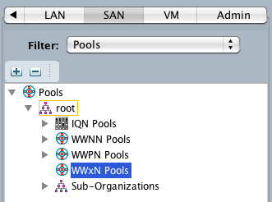
UCS Naming Conventions – WWN Pools
WWN Address – Background – UCS WWxN Pools
UCS Manager 2.1 and above establishes a “WWxN” pool that can be used to supply WWNN and WWPNs.
The recommendation is to not use this pool for production resources as it will result ID skew as servers are deployed.
  At least two WWN entries will be consumed for each server, while a minimum one entry will be consumed by MAC address and UUID.

Slide 39
UCS Naming Conventions – WWN Pools
WWN Address – Background – MDS Enforcement
MDS switches require an OUI format and will not allow a FLOGI if the OUI is all 0’s:
Event:E_DEBUG, length:146, at 154805 usecs after Fri Aug 4 21:59:43 2012
[102] Err(NAA=5 and IEEE Company ID is zero)invalid node name 50:00:00:00:00:00:00:12 from interface fc1/3; nport name is 20:00:00:00:00:00:04:02.

Slide 40
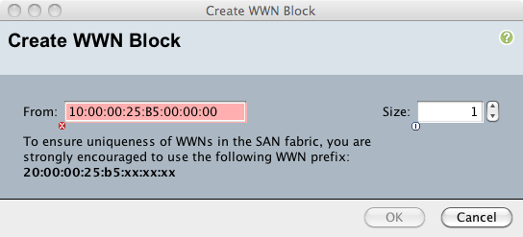
UCS Naming Conventions – WWN Pools
WWN Address – Background – UCS Enforcement
UCS Manager will enforce a proper NAA type of 2 or 5.
  It will not allow a bad value.
UCS Manager will try to enforce a best practice of 20:00:00:25:B5 as the start of the WWN.

Slide 41
UCS Naming Conventions – WWN Pools
WWN Address Recommendations – Simple
MAC: 20:00:00:25:B5:KL:MN:OP
Set the prefix to 20:00:00:25:B5.
Use the KL bytes to denote the UCS cluster.
The M byte denotes the WWN type.
The N byte specifies organization/application/operating system.
Leave the OP bytes to be assigned sequentially.
Maximum
  UCS Clusters: 256
  Orgs/Cluster: 16
  vHBAs/Org: 512-4096
Mnemonic | Description | Values
KL | UCS Cluster | 01 - UCS01.BXB.COM 02 - UCS02.BXB.COM 31 - UCS31.BXB.COM 44 - UCS44.JP.BXB.COM 52 - UCS52.DE.BXB.COM
M | Fabric | 0 - World Wide Node Name A - World Wide Port Name A B - World Wide Portname B
N | Organization | 1 - Core Infrastructure 2 - Production 3 - Quality Assurance D - Development
OP | HostID | Sequentially Assigned
Example: 20:00:00:25:B5:44:AD:08 is a UCS Cluster (00:25:B5) in Tokyo (:44) is a Port on the A fabric (:Ax) for Development (:xD)

Slide 42
UCS Naming Conventions – WWN Pools
WWN Address Recommendations – Focused Infrastructure
MAC: 20:CD:00:25:B5:KL:MN:OP
A variation on the previous example, use the CD bytes to denote the operating system. This can be very helpful to the Storage array administrator as the OS type may change how the LUN is provisioned.
Maximum
  UCS Clusters: 256
  Orgs/Cluster: 16
  Operating Systems: 256
  vHBAs/Org: 512-4096
Example: 20:05:00:25:B5:44:AD:08 is a Vmware host (:05)on a UCS Cluster (00:25:B5) in Tokyo (:44) is a Port on the A fabric (:Ax) for Development (:xD)
Mnemonic | Description | Values
CD | Operating System | 03 - Windows 2003 04 – Vmware ESXi 4.x 05 – Vmware ESXi 5.x 08 - Windows 2008 12 - Windows 2012 56 - RedHat 5.6 62 - RedHat 6.2
KL | UCS Cluster | 01 - UCS01.BXB.COM 02 - UCS02.BXB.COM 31 - UCS31.BXB.COM 44 - UCS44.JP.BXB.COM 52 - UCS52.DE.BXB.COM
M | Fabric | 0 - World Wide Node Name A - World Wide Port Name A B - World Wide Portname B
J | Organization | 1 - Core Infrastructure 2 - Production 3 - Quality Assurance D - Development
OP | HostID | Sequentially Assigned

Slide 43
UCS Naming Conventions – WWN Pools
WWN Address Recommendations – Consolidated Infrastructure
MAC: 20:00:00:25:B5:KL:MN:OP
A variation on the previous example, use the CD bytes to denote the operating system. This can be very helpful to the Storage array administrator as the OS type may change how the LUN is provisioned.
Maximum
  UCS Clusters: 16
  Orgs/Cluster: 16
  Operating Systems: 16
  vHBAs/Org: 512-4096
Example: 20:01:00:25:B5:84:AD:08 is a Vmware host (:8x)on a UCS Cluster (00:25:B5) in Tokyo (:x4) is a Port on the A fabric (:Ax) for Development (:xD)
Mnemonic | Description | Values
K | Operating System | 3 - Windows 2003 4 – Vmware ESXi 4.x 5 – Vmware ESXi 5.x 8 - Windows 2008 C - Windows 2012 D - RedHat 5.6 E - RedHat 6.2
L | UCS Cluster | 1 - UCS01.BXB.COM 2 - UCS02.BXB.COM 3 - UCS31.BXB.COM 4 - UCS44.JP.BXB.COM 5 - UCS52.DE.BXB.COM
M | Fabric | 0 - World Wide Node Name A - World Wide Port Name A B - World Wide Portname B
J | Organization | 1 - Core Infrastructure 2 - Production 3 - Quality Assurance D - Development
OP | HostID | Sequentially Assigned

Slide 44
UCS Naming Conventions – IQN Pools
Background
iSCSI uses an iSCSI Qualified Name (IQN) to specify an initiator (server) and target (storage array).
Unlike the MAC and WWN addresses, IQNs use text values and can be more descriptive.

Slide 45
UCS Naming Conventions – IQN Pools
IQN Recommendations – Background
IQN Prefix: YYYY.MM.COM.COMPANY: / Suffix: TEXT
The IQN format consists of the date field (YYYY.MM) followed by the Naming Authority in the form of the domain backwards (e.g.- com.cisco.server).
  The characters “-.:” are accepted
  The maximum IQN length cannot exceed 223 characters.
A colon “:” separates the prefix and suffix.
The text after the prefix can be arbitrary.
Filers will enforce the IQN prefix.

Slide 46
UCS Naming Conventions – IQN Pools
IQN Recommendations – Filer IQN Prefix Enforcement
IQN Prefix: YYYY.MM.COM.COMPANY / Suffix: TEXT
Some storage arrays like Network Appliance will enforce the IQN prefix conforms to the standard.
  In this example the IQN was 1990.com.cisco:vmware01
The server will be denied access to the filer until a valid IQN format is presented.
ntap01> Wed Aug 15 16:37:13 EST [ntap01: iscsi.textkey.invalidValue:warning]: ISCSI: Invalid value for iSCSI text key, 'InitiatorName’

Slide 47
UCS Naming Conventions – IQN Pools
IQN Recommendations – Recommendation
IQN Prefix: iqn.1984-12.com.cisco.<UCS>:<Text>-<Org>-<Fabric>.<ID>
  For the IQN prefix, use iqn.1984-12.com.cisco
    12/1984 was when Cisco was founded
  For the suffix use the UCS cluster name, organization and operating system name, rather than a code, separating the fields with dashes.
  For the appropriate pool, insert <Fabric>.
  UCS will insert a period after the “<Fabric>” followed by a sequential ID from the pool.
  Example: iqn.1984-12.com.cisco.ucs44:prod-vmware-a.09 is Tokyo UCS (ucs44) on a port on the A fabric for VMware.
Mnemonic | Description | Values
<UCS> | Cluster Name | ucs01 ucs02 ucs31 ucs44 ucs52
<Org> | Organization | core prod qa dev
<Text> | Operating System | vmware win2003 win2008 win2012 redhat56 redhat62
<Fabric> | Fabric | a - Fabric Interconnect A b - Fabric Interconnect B
<ID> | HostID | Sequentially Assigned

Slide 48
UCS Naming Conventions – UUID Pools
Background
The Universally Unique IDentifier (UUID) was standardized by the Open Software Foundation.
It consists of 16 bytes spread over five fields (2¹²⁸ possible values)
The hardware UUID burned into a server is typically used by software vendors as a practically unique value that can be leveraged to fingerprint a machine. Hence it is often used by licensing algorithms.

Slide 49
UCS Naming Conventions – UUID Pools
UUID Recommendations – Background
Prefix: 00000000-0000-0000 / Suffix: 0000-000000000000
The UUID is the Universally Unique Identifier for the UCS blade.
It is often used by application vendors to fingerprint the software running on a given machine.
UCS virtualizes this entity.
The UUID consists of a Prefix and Suffix which join to form the full UUID of the server.
A UCS Cluster supports up to 160 servers (Blade/Rackmount).
The recommendation is to use the Prefix to embed location intelligence and leave the Suffix to be assigned sequentially.

Slide 50
UCS Naming Conventions – UUID Pools
UUID Recommendations – Focused Infrastructure
Prefix: 000025B5-00AA-00BB / Suffix: 0000-000000000CCC
Use the first bytes to indicate it is a UCS server with the OUI 0025B5.
Use the first field for the Data Center.
The second field uses the same codes as WWN/MAC for UCS Cluster.
The third field is used for the Organization/Application/Owner.
The suffix is used sequentially for the hosts.
Maximum:
  Data Centers: >65K
  UCS Clusters: 65,535
  Organizations/Cluster: 256
  Hosts: UCS Maximum (160)
Mnemonic | Description | Values
AA | UCS Cluster | 01 - UCS01.BXB.COM 02 - UCS02.BXB.COM 31 - UCS31.BXB.COM 44 - UCS44.JP.BXB.COM 52 - UCS52.DE.BXB.COM
BB | Organization | 01 - Core Infrastructure 02 - Production 03 - Quality Assurance 0D - Development
CCC | HostID | Sequentially Assigned

Slide 51
UCS Naming Conventions – UUID Pools
UUID Recommendations – Consolidated Infrastructure
Prefix: 000025B5-00AB-00BB / Suffix: 0000-000000000DDD
Use the first bytes to indicate it is a UCS server with the OUI 0025B5.
Use the first field for the Data Center.
The second field uses the same codes as WWN/MAC for UCS Cluster.
The third field is used for the Organization/Application/Owner.
The suffix is used sequentially for the hosts.
Maximum:
  Data Centers: >65K
  UCS Clusters: 65,535
  Organizations/Cluster: 256
  Hosts: UCS Maximum (160)
Mnemonic | Description | Values
A | Operating System | 3 - Windows 2003 4 – Vmware ESXi 4.x 5 – Vmware ESXi 5.x 8 - Windows 2008 C - Windows 2012 D - RedHat 5.6 E - RedHat 6.2
B | UCS Cluster | 1 - UCS01.BXB.COM 2 - UCS02.BXB.COM 3 - UCS31.BXB.COM 4 - UCS44.JP.BXB.COM 5 - UCS52.DE.BXB.COM
CC | Organization | 01 - Core Infrastructure 02 - Production 03 - Quality Assurance 0D - Development
DDD | HostID | Sequentially Assigned

Slide 52
UCS Naming Conventions – Pools
Servers
As physical servers are initially purchased for UCS, they tend to be of the same configuration.
Over time, different hardware capabilities will come into the UCS cluster.
There is an empty pool called “default”
Pools can be defined for All Servers or to track which group owns/purchased a physical server.
Description | Values
Owner | default (Built-In) All-Servers Dev QA
 If a physical blade is a member a pool is decommissioned and it is re-acknowledged, it will need to be manually added back into the pool with UCS Manager 1.4.

Slide 53
UCS Naming Conventions – Pools
Default Pools
UCS Manager provides some default pools in the root organization.
If a default pool is empty, it generates an alarm in UCS Manager.
Recommendations
  Do not use these pools for servers.
  Create a special entry to remind UCS operators not to use these pools.
    The side effect is that the errors will be removed.

Slide 54
UCS Naming Conventions – Pools
Default Pools
Role | Pool | Values
LAN | Root/MAC-Default | 00:25:B5:44:BA:D1
SAN | Root/WWNN-Node-Default | 20:00:00:25:B5:44:BA:D1
SAN | Root/WWPN-Port-Default | 20:00:00:25:B5:44:BA:D2
SAN | Root/IQN-Default | iqn.1984-12.com.cisco.ucs44:BAD1:0
Server | Root/UUID-Default | 000025B5-0044-0000-0000-00000000BAD1
Server | Root/Server-Default | Add one physical server
Using the available hexadecimal digits “B”, “A”, “D” to indicate it is a bad identity.
In each default pool in the root organization:
  Specify the markers for UCS system and UCS identifier so if the identity shows up in the network it is clear where it came from.
  Create a single entry using the “BAD#” marker.
  Set the pool description to “Not used”
Notes:
Note- There is no option to add a bogus server to the default server pool. Add one that will always be in use so it cannot be picked.
BAD1 and BAD2 are used for WWNN and WWPN so they do not overlap.

Slide 55
UCS Naming Conventions – Pools
Summary
Determine the model to use: Focused or Consolidated
Embed the following into the identity:
  Cisco UCS Device (0025B5)
  UCS Cluster Number
  Fabric Interconnect
  Organization
  Operating System
Create distinct pools based on the criteria above
Document the codes used as new UCS clusters, Organizations and Operating Systems are added to the global environment

Slide 56
UCS Naming Conventions – Pools
Summary – Focused Infrastructure Example – Fibre Channel Based Blade
Pool | Values
MAC-A | 00:25:B5:44:AD:19
MAC-B | 00:25:B5:44:BD:19
WWN | 20:08:00:25:B5:44:0D:19
WWPN-A | 20:08:00:25:B5:44:AD:19
WWPN-B | 20:08:00:25:B5:44:BD:19
UUID | 000025B5-0044-000D-0000-000000000019
UCS System
UCS Cluster
Fabric Interconnect
Organization
Host
UCS Server (0025B5) number nineteen (19) in Tokyo UCS (44) for the Development (D) group running Windows2008 (08) fabric A / B / 0 (both) or the host.
  Note in this scheme, the identity markers are organized hierarchically from UCS as a whole down to the consumer on the host (with the exception of Host OS).

Slide 57
UCS Naming Conventions – Pools
Summary – Focused Infrastructure Example – iSCSI Based Blade
Pool | Values
MAC-A | 00:25:B5:44:AD:19
MAC-B | 00:25:B5:44:BD:19
IQN-A | iqn.1984-12.com.cisco.ucs44:dev-win2008-a.19
IQN-B | iqn.1984-12.com.cisco.ucs44:dev-win2008-b.19
UUID | 000025B5-0044-000D-0000-000000000019
UCS Server (00:25:B5/com.cisco.ucs) number nineteen (19) in Tokyo UCS (44) for the Development (D) group running Windows2008 (08) fabric A and B or the host.
UCS System
UCS Cluster
Fabric Interconnect
Organization
Host

Slide 58
UCS Naming Conventions – Pools
Summary – Consolidated Infrastructure Example – Fibre Channel Based Blade
Pool | Values
MAC-A | 00:25:B5:84:AD:19
MAC-B | 00:25:B5:84:BD:19
WWN | 20:00:00:25:B5:84:0D:19
WWPN-A | 20:00:00:25:B5:84:AD:19
WWPN-B | 20:00:00:25:B5:84:BD:19
UUID | 000025B5-0084-000D-0000-000000000019
UCS System
Operating System
UCS Cluster
Fabric Interconnect
Organization
Host
UCS Server (0025B5) number nineteen (19) in Tokyo UCS (4) for the Development (D) group running Windows2008 (8) fabric A / B / 0 (both) or the host.
  Note in this scheme, the identity markers are organized hierarchically from UCS as a whole down to the consumer on the host (with the exception of Host OS).

Slide 59
UCS Naming Conventions – Pools
Summary – Consolidated Infrastructure Example – iSCSI Based Blade
Pool | Values
MAC-A | 00:25:B5:84:AD:19
MAC-B | 00:25:B5:84:BD:19
IQN-A | iqn.1984-12.com.cisco.ucs04:dev-win2008-a.19
IQN-B | iqn.1984-12.com.cisco.ucs04:dev-win2008-b.19
UUID | 000025B5-0084-000D-0000-000000000019
UCS Server (00:25:B5/com.cisco.ucs) number nineteen (19) in Tokyo UCS (4) for the Development (D) group running Windows2008 (8) fabric A and B or the host.
UCS System
Operating System
UCS Cluster
Fabric Interconnect
Organization
Host

Slide 60
UCS Naming Conventions
Policies

Slide 61
UCS Naming Conventions – Policies
Overview
Overview
Server Policies
Network/SAN Policies

Slide 62
UCS Naming Conventions – Policies
Overview
Policy names are subject to the same rules and conventions as pool names.
Use the Description field in a policy definition to document what the policy is used for.
The policy names should be clear and provide a one to two word definition of what the policy does.
  Consider using shorter names unless more detail is needed (e.g. – If the policy will be used by Windows, simply use “Windows”. If the organization has two uses for Windows (e.g.- Prod and Backup VLAN then add in “Windows-Prod” or “Windows-Backup”)

Slide 63
UCS Naming Conventions – Policies
Overview – Policy Visibility with Organizations
Policies created in the root organization can be seen by their children.
Policies created in a sub-organization are local to that sub-organization.
  As well as only children off that sub-organization.
Recommendations
  Create policies that are leveraged by all organizations in the root so they are defined centrally (e.g. – Shared Boot, BIOS, Local Disk Configuration, etc.)
  Create policies that are unique to an organization in the sub-organization (e.g.- Booting to a storage array that is owned by the sub-organization’s group/application).

Slide 64
UCS Naming Conventions – Policies
Basic Server – General
Maintenance
  Create User-OK to require acknowledgement manually
  Schedules operate once. Append the date-time the schedule will run.
Scrub
  Create standard policies to scrub Disk/BIOS/Both.
These polices are typically defined in the root organization
Mnemonic | Examples
<Text>[-<When>] | User-OK Scheduled-08-09-12-0100
Mnemonic | Examples
Scrub-<Object> | Scrub-Disk Scrub-BIOS Scrub-All

Slide 65
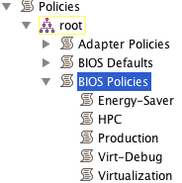
UCS Naming Conventions – Policies
Basic Server – BIOS
Create BIOS Policies for standard optimizations that may be leveraged within UCS:
  Energy-Saver: Enable power saving options
  HPC: Enable high performance options and disable sleep options
  Production: Settings used for production servers
  Virtualization: Enable BIOS settings for hypervisors
  Virt-Debug: Features of Virtualization BIOS settings, plus turn off Cisco Splash Screen
Mnemonic | Examples
<Application>[-<Modifier>] | Energy-Saver HPC Production Virtualization Virt-Debug

Slide 66
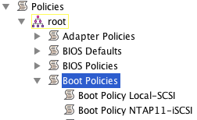
UCS Naming Conventions – Policies
Basic Server – Boot
Create a name for the storage array name.
  Use “Local” for local boot from on server drives
Specify a protocol to indicate to the UCS Operator how the storage target will connect to the storage.
  This can help in debugging. Seeing “<Host>-FC” without any Fibre Channel HBA’s would be an indication something is not fully configured.
Mnemonic | Examples
<Host>-<Protocol> | EMC11-FC NTAP01-iSCSI NTAP01-FC Local-SCSI

Slide 67
UCS Naming Conventions – Policies
Basic Server – Host Firmware Management
A UCS firmware policy can affect the firmware for the:
  Adapter
  BIOS
  Board Controller
  RAID Controller
  Any combination of the above
Specify the firmware type or All if performing a host upgrade followed by the UCS Manager version.
Mnemonic | Examples
<Firmware-Type>-<UCS-Mgr> | All-2.0.3b Adapter-1.4.3w BIOS-2.0.1t BIOS-2.0.2c RAID-2.0.1t

Slide 68
UCS Naming Conventions – Policies
Network/SAN – General
Adapter Policies
  If creating specific policies for adapters, use the mezzanine card type followed by the operating system.
Network Control Policies
  Create a Network Control Policy that enables CDP for operating systems like VMware that can use it for troubleshooting.
These polices are typically defined in the root organization
Mnemonic | Examples
<NIC>-<OS> | VIC-ESXi Broadcom-ESXi
Mnemonic | Examples
<Function> | CDP

Slide 69
UCS Naming Conventions – Policies
Network/SAN – VLAN/VSAN
VLAN
  Specify the name of the VLAN followed by the VLAN ID.
  Some UCS screens show the VLAN ID, but not all.
VSAN
  Typically there is only an A/B fabric. If yes, just use the fabric name.
  If there are multiple fabrics use the convention above.
Mnemonic | Examples
<Name>-<VLAN> | Management-991 Production-121 VDI-112 QA-140 QA-141
Simple
Mnemonic | Examples
<Name>-<Fabric> | Fabric-A Fabric-B
Mnemonic | Examples
<Name>-<VSAN>-<Fabric> | Prod-990-A Prod-991-B Backup-992-A Backup-993-B
Advanced
 Technically these are not Policy objects, but logically they define access policies so they are relevant in this context.

Slide 70
UCS Naming Conventions – Policies
Network/SAN – vNIC/vHBA Templates
Leveraging vNIC/vHBA templates helps enforce consistency for a given operating system.
Specify the template name as Operating System followed by how the network card/host bus adapter is being used.
  If using a single/dual SAN, dropping the usage is common since the vHBA is being used for all storage needs.
Append the fabric to the end.
These policies are typically defined within the sub-organization.
Mnemonic | Examples
<OS>[-<Usage>]-<Fabric> | ESX-Console-A ESX-Console-B ESX-Vmotion-A ESX-Vmotion-B Boot-iSCSI-A Boot-iSCSI-B Windows-A Windows-B
vNIC
Mnemonic | Examples
<OS>[-<Usage>]-<Fabric> | ESX-A ESX-B Windows-A Windows-B Windows-Backup-A Windows-Backup-B
vHBA

Slide 71
UCS Naming Conventions – Policies
Server Pool Usage
If servers are placed in Server Pools, a Server Pool Policy is used to map the qualification rules to the pool.
For the Server Pool Policy use the pool name and the qualification policy name.
The Server Pool Policy qualification specifies the rules for choosing a server from the pool.
  Use the operating system name followed by the qualification criteria.
Description | Values
Owner | Default (Built-In) Dev QA
Pool
Mnemonic | Examples
<Pool>-<Qualification> | Dev-ESX-iSCSI Default-Solaris-Qlogic
Policy
Mnemonic | Examples
<OS>-<Qualifier> | ESX-VIC Solaris-Qlogic Windows-64GB RedHat-12Cores
Qualification

Slide 72
UCS Naming Conventions – Pools
Summary
Create names that are short, yet clear to all groups that access UCS Manager
  Network, Server, Virtualization, Operating System, Security
Document the codes used as new objects are added to the global environment

Slide 73
UCS Naming Conventions
Profiles

Slide 74
UCS Naming Conventions – Profiles
Overview
Deployed Profiles
  Description
  User Label
Templates

Slide 75
UCS Naming Conventions – Profiles
Overview
Service Profiles establish the personality for a physical blade with a specific configuration.
  Service Profiles contain optional Description and User Label fields
Service Profile Templates create a standardized definition to create Service Profiles in a consistent manner.
  Updating Templates can be used to centrally distribute server attribute changes to many servers at the same time. Because of this, the template name should clearly indicate the class of servers it manages.
Profiles and templates are typically defined within a sub-organization.

Slide 76
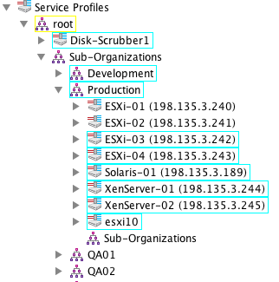
UCS Naming Conventions – Profiles
Service Profile Name
Use the name of the host that is running on the operating system associated with the service profile.
  If different domains are being used, the domain name may be appended but this can generally result in long names (e.g.- esx01.cisco.com).
By keeping the service profile name the same as the host’s name it will be easier to map them to each other.
Typically the Description field is used to denote the operating system version and patch level.
The User Label field displays in UCS menus so it can be used to show information like the Management IP address.
Mnemonic | Examples
<Hostname> | esx01 esx02 xen-ddc08 win2k3-11
Hostname
User Label

Slide 77
UCS Naming Conventions – Profiles
Service Profile Name
Use the name of the host that is running on the operating system associated with the service profile.
  If different domains are being used, the domain name may be appended but this can generally result in long names (e.g.- esx01.cisco.com).
By keeping the service profile name the same as the host’s name it will be easier to map them to each other.
Typically the Description field is used to denote the operating system version and patch level.
The User Label field displays in UCS menus so it can be used to show information like the Management IP address.
Mnemonic | Examples
<Hostname> | esx01 esx02 xen-ddc08 win2k3-11
Hostname
User Label

Slide 78
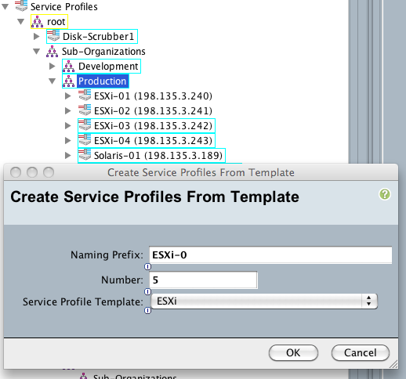
UCS Naming Conventions – Profiles
Service Profile Template
For the Service Profile Template, minimally specify the operating system name and version.
  The version information helps to remind the template creator that any host firmware package on the profile should be consistent with the version of the drivers in the operating system
Optionally specify the application if more than one template is needed for an operating system within an organization.
 When deploying servers from templates, if there are less than 10 profiles deployed with the template, use a preceding “0” to pad the name of the profile.
  In this example because there are four profiles ESXi-01 to ESXi-04, the prefix is “ESXi-0” and 5 more profiles “05”-”09” will be created.
Mnemonic | Examples
<OS>-<Version>[-<Application] | ESXi-4.01U3 ESXi-5.00 RedHat-5.6 Windows-2003SP3-DC Windows-2008R2-Exchange

Slide 79
UCS Naming Conventions
Miscellaneous

Slide 80
UCS Naming Conventions – Miscellaneous
Overview
UCS Domain Name
Backups
Blades Descriptions

Slide 81
UCS Naming Conventions – Miscellaneous
UCS Names
Specify the UCS name using established naming conventions.
  Do not append “-A” or “-B” to the hostname in UCS as UCS will automatically do this.
  In DNS, the typical format is:
    Cluster: <Host>-cluster.<domain>
    Fabric A: <Host>-a.<domain>
    Fabric B: <Host>-b.<domain>
Example:
ucs11-cluster.bxb.com
ucs11-a.bxb.com
ucs11-b.bxb.com

Slide 82
UCS Naming Conventions – Miscellaneous
UCS Backups
When backing up a UCS system, specify the cluster name followed by the reason for the backup.
Use full state backups.
Mnemonic | Examples
<UCSName>-cluster-<Reason> | ucs11-cluster-pre-2.0.2b-upgrade ucsprod01-cluster-add-chassis09

Slide 83
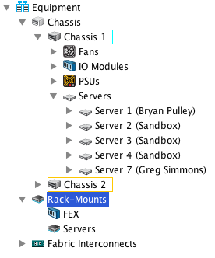
UCS Naming Conventions – Miscellaneous
Physical Server Descriptions
Like the Service Profile, the physical server’s definition also contains a User Label field.
This field can be used to track the physical owner of the blade (Person/Group).

Slide 84
UCS Naming Conventions
Tools

Slide 85
UCS Naming Conventions – Tools
Overview
Standards change and evolve. This is normal.
There are two strategies for changing UCS object names:
  Duplicate and Migrate
  Export, Modify and Import

Slide 86
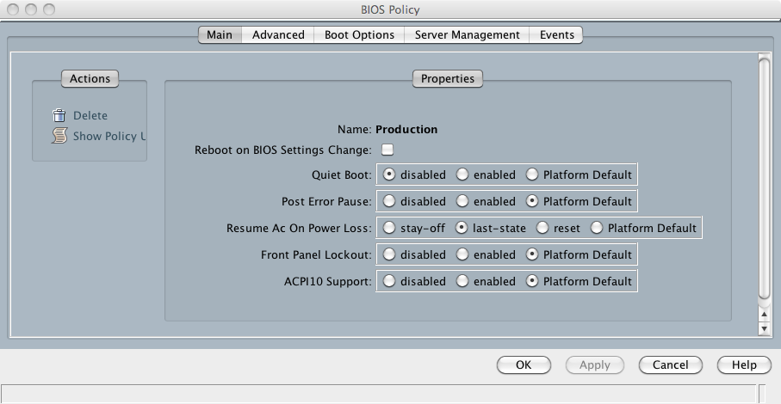
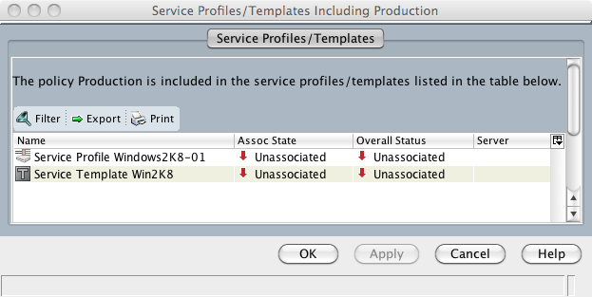
UCS Naming Conventions – Tools
Duplicate and Migrate
A new object is created with the desired new name.
All of the settings within the object are the same as the original.
Select the old object and click on the Show Usage link.
   Service Profiles/Templates do not currently support this option.
Double click on each name to visit that consumer and repoint it to the new policy/pool.
  Repeat for each object

Slide 87
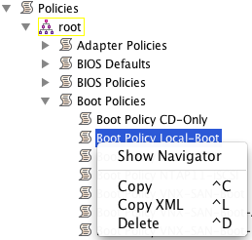
UCS Naming Conventions – Tools
Export, Modify and Import
If the object is complex (i.e.- many settings), it can be exported, modified then re-imported into UCS.
Tools like goUCS can be used on Windows/Unix systems to export an object as XML to a text file.
  Locate the object in the GUI and select Copy XML
  Find the Distinguished Name (DN) and use it with goUCS to export the object.
  Globally modify the object name “Local-Boot” in the text file.
  Import the text file containing the updated object back into UCS Manager.
<configResolveDn cookie="1347930238/9f1bafff-7d93-4af1-8f0e"
dn="org-root/boot-policy-Local-Boot”
response="yes">
<outConfig>
<lsbootPolicy childAction="deleteNonPresent"
descr="Boot from the local drives on the blade" …
</configResolveDn>
c:\goUCS>goucs ucs12 login
c:\goUCS>goucs ucs12 exportdn org-root/boot-policy-Local-Boot RenameObject
c:\goUCS>notepad cache\importable\RenameObject.xml
Modify XML content (name or options within the XML)
c:\goUCS>goucs ucs12 importdn quiet RenameObject
Are you sure[y/n]y

Slide 88
UCS Naming Conventions
References
IEEE OUI Registry
  http://standards.ieee.org/develop/regauth/oui/oui.txt
  Updated daily
Decoding World Wide Names
  http://howto.techworld.com/storage/156/how-to-interpret-worldwide-names/
IQN Specification
  Name Length
    http://tools.ietf.org/html/rfc3720
  Name Format
    http://www.ietf.org/rfc/rfc3721.txt
goUCS
  http://developer.cisco.com/web/unifiedcomputing/goucs

Slide 89
UCS Naming Conventions
References
UUID: A Universally Unique IDentifier (UUID) URN Namespace
  http://www.ietf.org/rfc/rfc4122.txt
BIOS Best Practices
  http://www.cisco.com/en/US/prod/collateral/ps10265/ps10281/whitepaper_c07-614438.pdf
  UCS M1/M2 Servers: Ask your Cisco account team for the “UCS BIOS Performance Configuration Best Practice” document.

