Slide 1

Charger Checker
Jake Paterson – H00323303
Andrew McBain – H00317910
Alexnader Wickham – H00324206
Kyle Dick - H00301592

Slide 2
Tools Used
Frontend System:
ReactJS
Tailwind CSS
Axios HTTP
Backend System:
Google hosted email provider with Nodemailer
NodeJS
Prisma
MariaDB
ExpressJS
Deployment:
Docker
Nginx

Slide 3

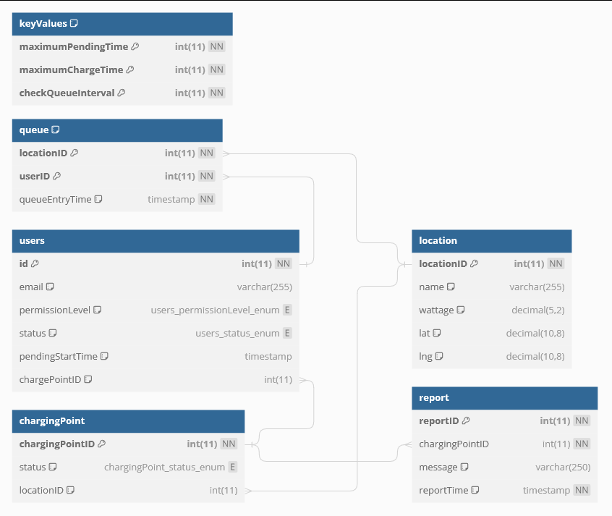
Database Schema
MariaDB
Split into 6 tables
KeyValues acts as constant values that can be changed but have no relation to other tables.
Queue table is the key table as that is what the queue system needs to function on.

Slide 4

Frontend Architecture
For the frontend we used React to create a clean user interface
Focus on reusability with components
Site meets Web Content Accessibility 2.0 AA Guidelines.
Tailwind allows for limited colour palettes to be used. Lets us have a clear theme across the site
We used Leaflet JS to create an interactive map using data from OpenStreetMap.

Slide 5
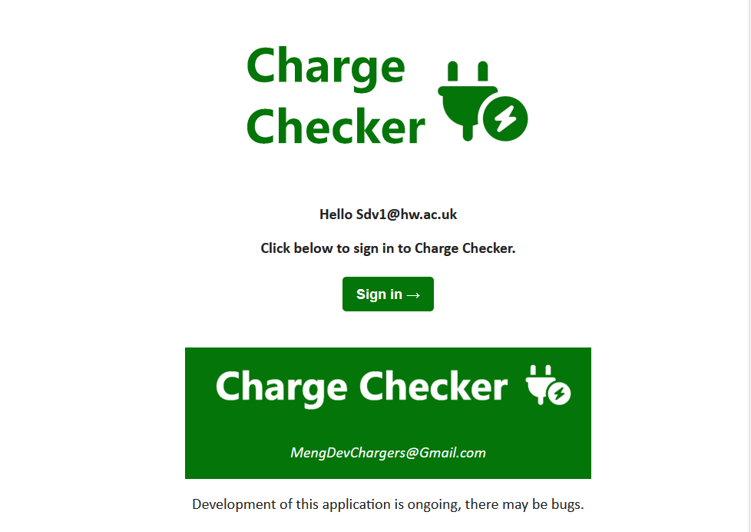
Email System Architecture
Built with Nodemailer
Hosted with Gmail
Handlebars used for email templates
Would ideally move onto University email system in future

Slide 6
Backend Architecture
Routing using express and database interaction handled by prisma
Queuing functionality for charging locations
Seamless account creation and password-less sign in
Comprehensive administration functionality

Slide 7
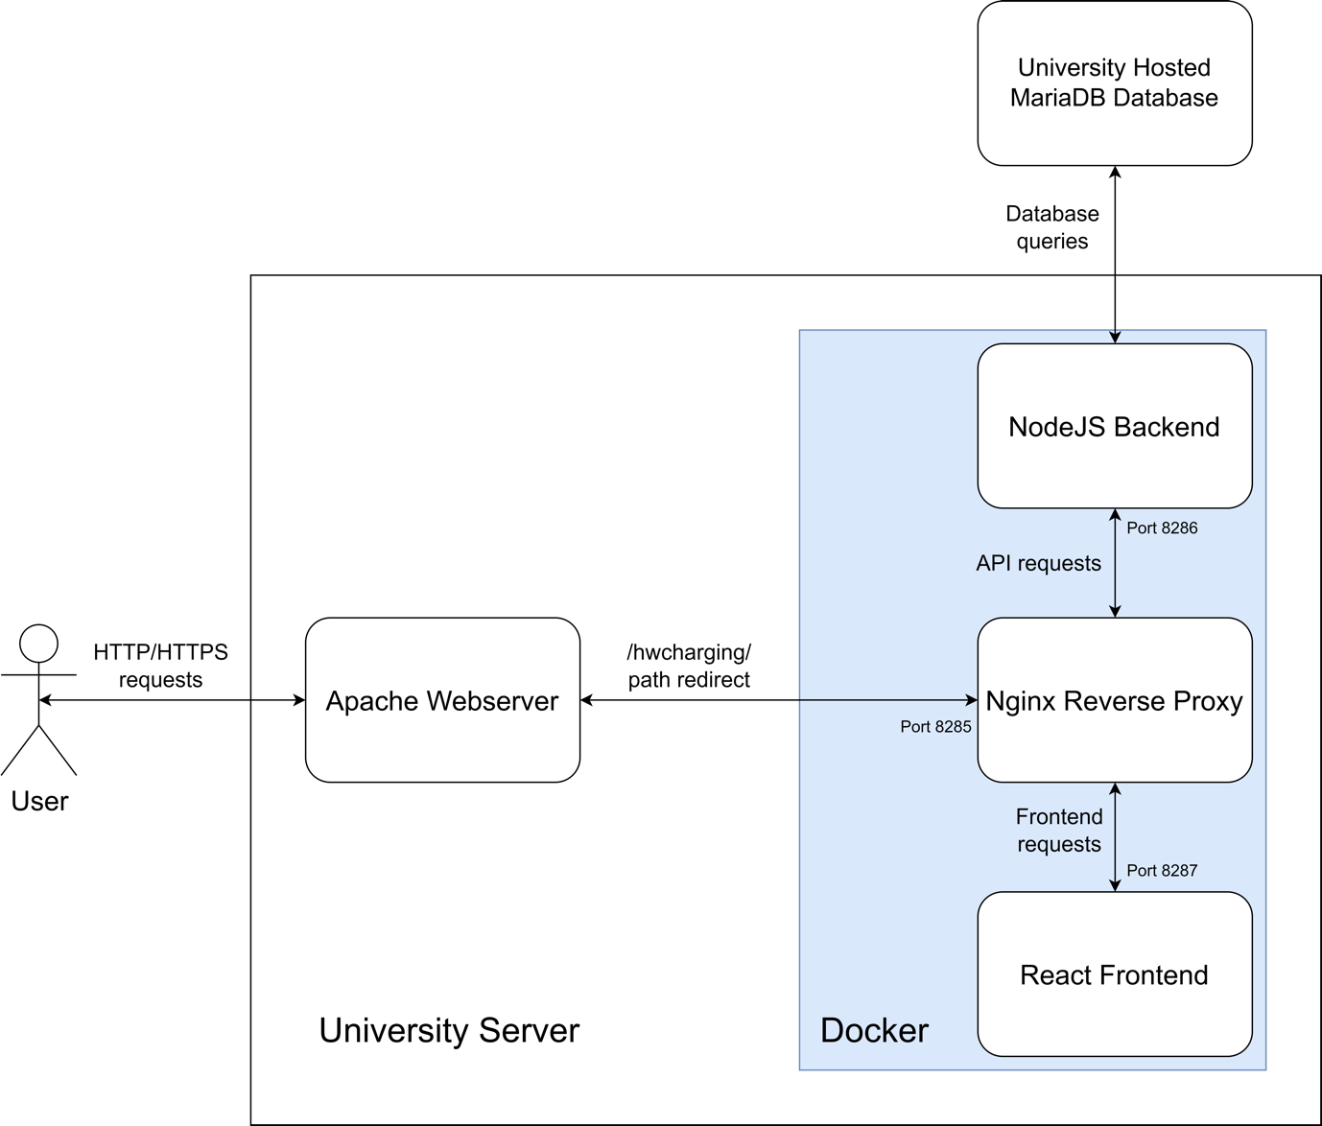
Deployment Architecture
Three Docker containers
User makes requests to the Apache Webserver
Apache Webserver redirects the requests on /hwcharging/ to Nginx
Nginx routes requests to frontend and backend
Backend makes database queries to the database

Slide 8
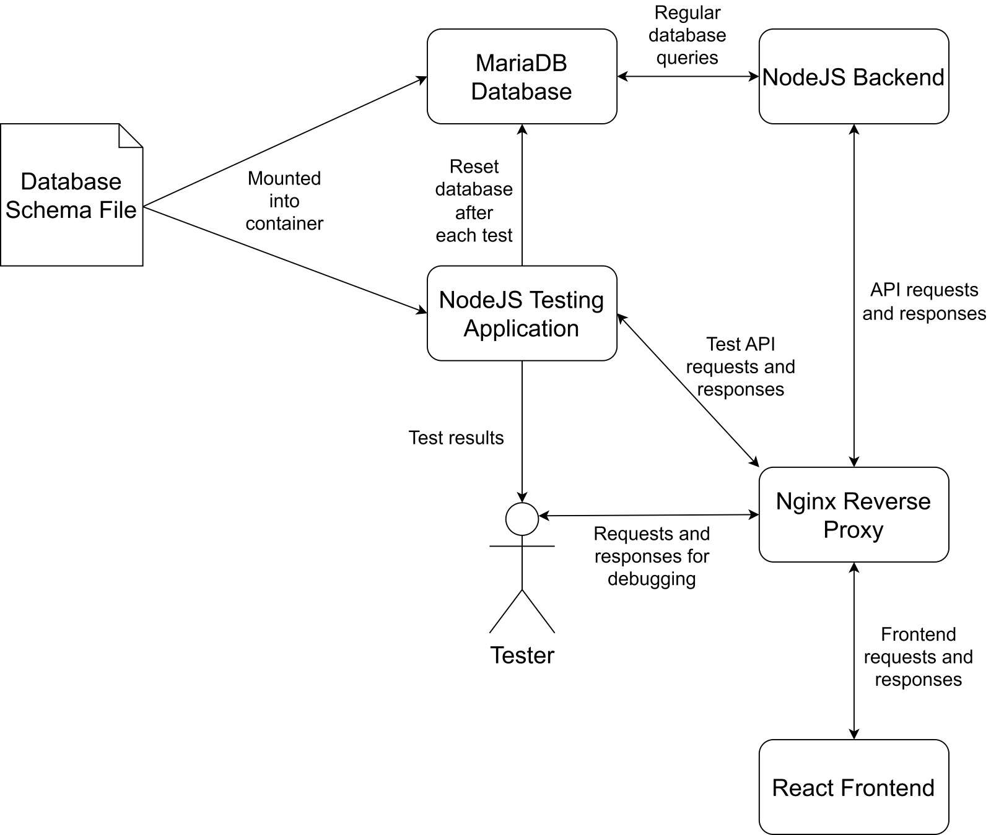
API Testing Architecture
Testing application makes requests to Nginx which are redirected to the backend
The testing application asserts that the program is in a certain state
Testing application resets the database after each test
Test output is made available to the tester through a HTTP request

Slide 9
Future Work
Have our emails sent from within the Universities own email system
Show each individual charger location on map view
Implement three strike system for missing reservations
Change cookies to extend time before removal if the user is active on the site
Refactor the queue system to instead be a notification system for users to be told when a space is available
Perform further client interviews and update accordingly

