Slide 1
MPG Calculator
Scott Morgan & Khunsa Umer

Slide 2
Why is this a useful tool?
The higher the Miles Per Gallon (MPG), the better
Do not have to pay as much for gas
Better for the environment
Electric cars are still out of the price range of the average person

Slide 3
Preprocessing
Data from Kaggle
Electric cars removed from dataset
Pandas Dataframes

Slide 4

Regression Models
Regressor | MAE city | MAE Highway
logistic | 2.25 | 3.18
ridge | 3.26 | 3.69
SGD | 3.19 | 3.68
Linear | 3.26 | 3.69
Gradient Boosting | 1.53 | 1.88
Knn | 1.92 | 2.3
Decision | 1.93 | 2.34
Several regression models tested
All tested with the same random state to avoid randomness
Calculating Mean Absolute Error (MAE)
Gradient Boosting Regressor chosen

Slide 5
Methods
80/20 Training and Validation
Testing with a single random state to avoid randomness
Tuning hyperparameters to decrease MAE as much as possible

Slide 6
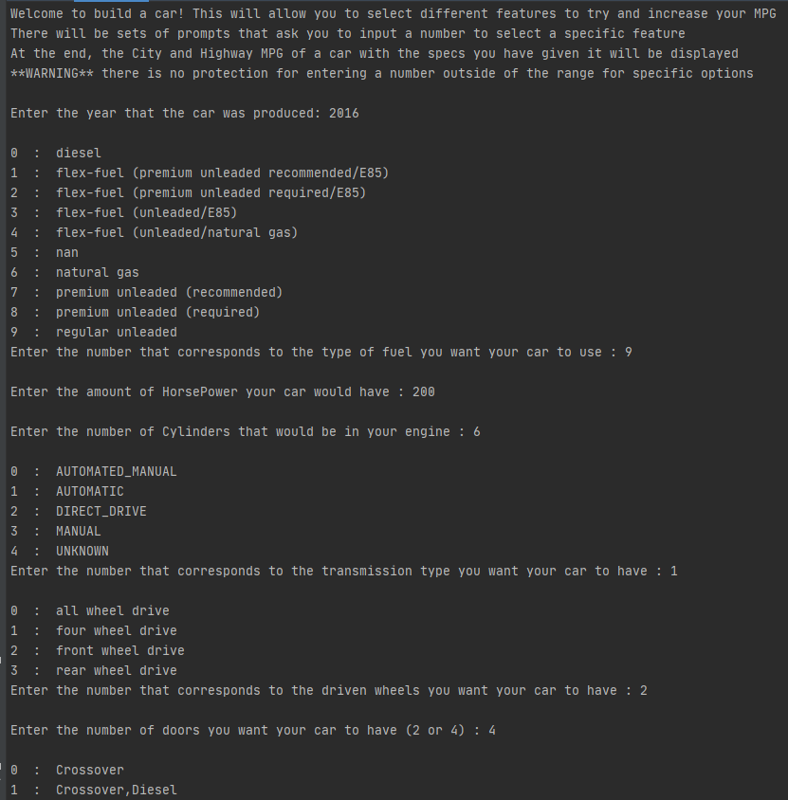
Build a Car

Slide 7
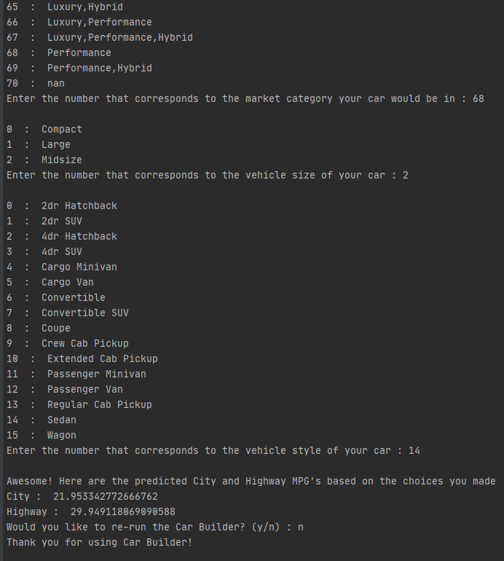
Build a Car

