Slide 1
Automatic Semantic Role Labeling
Scott Wen-tau Yih Kristina Toutanova
Microsoft Research
Notes:
Good afternoon, everyone. My name is Scott Wen-tau Yih, and this is Kristina Toutanova.
Before joining Microsoft Research, Kristina and I both did a fair amount of work on Semantic Role Labeling. Our SRL systems in last year’s CoNLL shared task competition happened to be the No.1 and No.2 systems.
So, in the following 3 hours, we’re going to tell you a lot of things about “Automatic Semantic Role Labeling.”
Since it’s a tutorial, not a conference talk, if you have any question in the middle, please feel free to interrupt us.

Slide 2
Natural Language Understanding
Question Answering
WHOM
WHAT
WHO
WHEN
Kristina hit Scott with a baseball yesterday
Who hit Scott with a baseball?
Whom did Kristina hit with a baseball?
What did Kristina hit Scott with?
When did Kristina hit Scott with a baseball?
Notes:
Since Kristina didn’t really know me before joining Microsoft, she didn’t realize how painful it is to work with a lazy person. One day, she couldn’t tolerate anymore, and hit me with a baseball.
One of the most fascinating goals of natural language processing is that we hope one day machines can “understand” our language. If a computer “understands” this sentence, then it should be able to answer these simple questions.

Slide 3
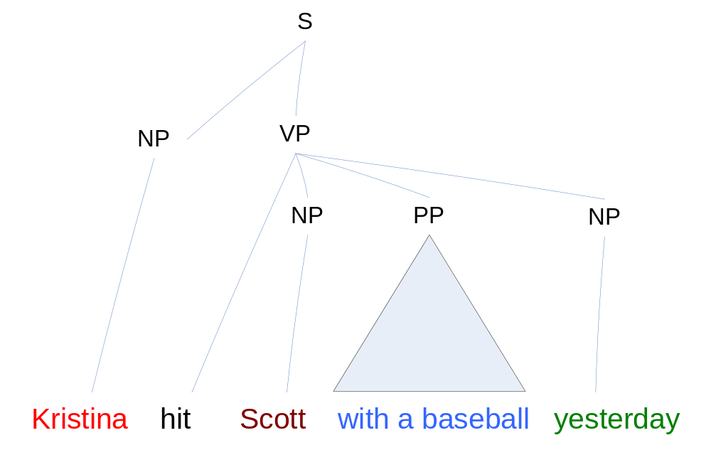
Syntactic Analysis (1/2)
Notes:
Syntactic structure of a sentence is assumed very related to the meaning of the sentence. Since the current parsing technology is pretty good already, let’s see if we can use this information to analyze the semantic of this sentence.
On this slide, we have a full parse tree, where each node or constituent here represents the phrase type of a subsequence of the sentence, such as noun phrase or verb phrase.
Given this information, we may be able to come up with some rules to identify the subject and object in this sentence, and use them to answer the questions.
------------
“Parsing is the process of reconstructing the syntactic structure of a sentence that is heard or read. Assuming that the meaning of a sentence is systematically related to its syntactic structure (compositionality), it is clear that parsing is a necessary condition for understanding a sentence.”
http://faculty.biu.ac.il/~danong1/courses/2005-2006/958/index.html
Also, we can already do a pretty good job on parsing, especially on WSJ data.

Slide 4
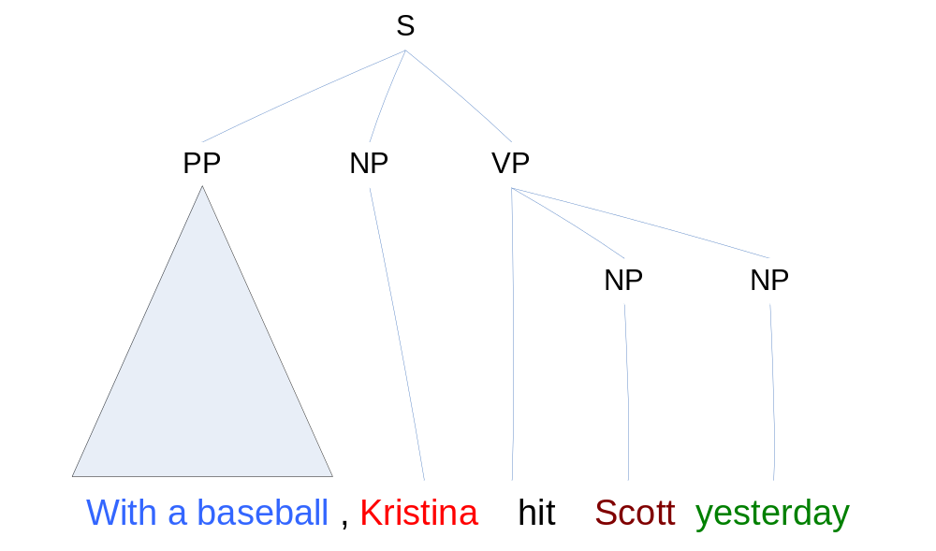
Syntactic Analysis (2/2)
Notes:
However, even a simple paraphrase of a sentence may generate a very different syntactic tree. That means, we may need to extend our system to cover this new syntactic instance.

Slide 5
Syntactic Variations
Yesterday, Kristina hit Scott with a baseball
Scott was hit by Kristina yesterday with a baseball
Yesterday, Scott was hit with a baseball by Kristina
With a baseball, Kristina hit Scott yesterday
Yesterday Scott was hit by Kristina with a baseball
Kristina hit Scott with a baseball yesterday
Agent, hitter
Thing hit
Instrument
Temporal adjunct
Notes:
But, there are actually many variations of the same sentence.
Despite the fact that there are so many syntactic variations of the sentence, what we really need is probably just a simple semantic analysis to know that Kristina is the person who hit something or someone; Scott is the vitim who got hit; the baseball is used to hit, and the whole event happened yesterday.

Slide 6
Semantic Role Labeling –
Giving Semantic Labels to Phrases
[_{AGENT} John] broke [_{THEME} the window]
[_{THEME} The window] broke
[_{AGENT}Sotheby’s] .. offered [_{RECIPIENT} the Dorrance heirs]
[_{THEME} a money-back guarantee]
[_{AGENT} Sotheby’s] offered [_{THEME} a money-back guarantee] to [_{RECIPIENT} the Dorrance heirs]
[_{THEME} a money-back guarantee] offered by [_{AGENT} Sotheby’s]
[_{RECIPIENT} the Dorrance heirs] will [_{ARM-NEG} not]
be offered [_{THEME} a money-back guarantee]
Notes:
Semantic Role Labeling, which gives semantic labels to phrases in a sentence, is exactly the analysis we want here.
In all the sentences on this slide, we don’t care whether they are active or passive, or any other order of the phrases. We only care about the semantic meaning or role of each phrase.

Slide 7
Why is SRL Important – Applications
Question Answering
  Q: When was Napoleon defeated?
  Look for: [_{PATIENT} Napoleon] [_{PRED} defeat-synset] [_{ARGM-TMP} *ANS*]
Machine Translation
  English (SVO) Farsi (SOV)
  [_{AGENT} The little boy] [_{AGENT} pesar koocholo] boy-little
  [_{PRED} kicked] [_{THEME} toop germezi] ball-red
  [_{THEME} the red ball] [_{ARGM-MNR} moqtam] hard-adverb
  [_{ARGM-MNR} hard] [_{PRED} zaad-e] hit-past
Document Summarization
  Predicates and Heads of Roles summarize content
Information Extraction
  SRL can be used to construct useful rules for IE

Slide 8
Quick Overview
Part I. Introduction
  What is Semantic Role Labeling?
  From manually created grammars to statistical approaches
    Early Work
    Corpora – FrameNet, PropBank, Chinese PropBank, NomBank
  The relation between Semantic Role Labeling and other tasks
Part II. General overview of SRL systems
  System architectures
  Machine learning models
Part III. CoNLL-05 shared task on SRL
  Details of top systems and interesting systems
  Analysis of the results
  Research directions on improving SRL systems
Part IV. Applications of SRL

Slide 9
Moving toward Statistical Approaches
Early work [Hirst 87] [Dolan, Richardson, Vanderwende, 93&98]
Available corpora
  FrameNet [Fillmore et al. 01]
    http://framenet.icsi.berkeley.edu
  PropBank [Palmer et al. 05]
    http://www.cis.upenn.edu/~mpalmer/project_pages/ACE.htm
Corpora in development
  Chinese PropBank
    http://www.cis.upenn.edu/~chinese/cpb/
  NomBank
    http://nlp.cs.nyu.edu/meyers/NomBank.html
Main Focus
Notes:
In the following slides, I’m going to first introduce some early work related to semantic analysis.
Similar to other natural language tasks, statistical approaches have become the main stream, with the help of large corpora. The current available corpora for semantic role labeling include FrameNet and PropBank. Since PropBank has been used by many systems, it will be the main focus in this tutorial. In addition, I will also introduce some corpora that are still in development.

Slide 10
Early Work [Hirst 87]
Semantic Interpretation
“The process of mapping a syntactically analyzed text of
natural language to a representation of its meaning.”
Absity – semantic interpreter by Hirst
  Based on manually created semantic rules
  Input: Nadia_{subj} bought the book_{obj} from a store in the mall.
  Output:
(a ?u
(buy ?u
(agent = (the ?x (person ?x
(propername = “Nadia”))))
(patient = (the ?y (book ?y)))
(source = (a ?z (store ?z
(location = (the ?w (mall ?w)))))))
Example taken from [Hirst 87]
Notes:
One of the early representative works is done by Hirst. In his book, Hirst defines semantic interpretation as “the process of mapping a syntactically analyzed text of natural language to a representation of its meaning.”
Hirst built a semantic interpreter called “Absity”, which is based on manually created semantic rules. Taking a sentence like this as input, it outputs some logic representation of the meaning.
----------------------------------
Another representative early work is done by Dolan et. al. at Microsoft Research. In the project called MindNet, they construct a graph of words that are labeled with semantic relations. These relations are automatically derived from on-line dictionaries and encyclopedias using manually created semantic rules.
For example, from the definition of “car”, the constructed graph is like this.
----------------------------------
Graeme Hirst. Semantic interpretation and the resolution of ambiguity (Studies in natural language processing).
(a ?u (buy ?u -> a frame, which is a buy frame
Common drawbacks:
requiring intensive manual labor
often restricted to narrow domains

Slide 11
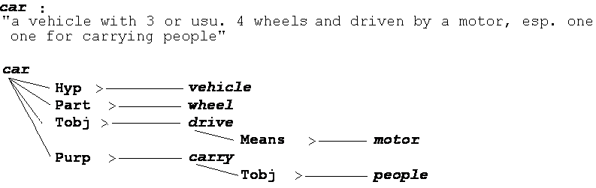
Early Work [Dolan, Richardson, Vanderwende, 93 & 98]
MindNet:
  A graph of words labeled with semantic relations automatically acquired from on-line dictionaries and encyclopedias
  MindNet identifies 24 labeled semantic relations based on manually created semantic rules
  Relations are weighted based on vertex frequency
http://research.microsoft.com/mnex
Notes:
One of the early representative works is done by Hirst. In his book, Hirst defines semantic interpretation as “the process of mapping a syntactically analyzed text of natural language to a representation of its meaning.”
Hirst built a semantic interpreter called “Absity”, which is based on manually created semantic rules. Taking a sentence like this as input, it outputs some logic representation of the meaning.
----------------------------------
Another representative early work is done by Dolan et. al. at Microsoft Research. In the project called MindNet, they construct a graph of words that are labeled with semantic relations. These relations are automatically derived from on-line dictionaries and encyclopedias using manually created semantic rules.
For example, from the definition of “car”, the constructed graph is like this.
----------------------------------
Graeme Hirst. Semantic interpretation and the resolution of ambiguity (Studies in natural language processing).
(a ?u (buy ?u -> a frame, which is a buy frame
Common drawbacks:
requiring intensive manual labor
often restricted to narrow domains

Slide 12
FrameNet [Fillmore et al. 01]
Sentences from the British National Corpus (BNC)
Annotated with frame-specific semantic roles
  Various participants, props, and other conceptual roles
Frame: Hit_target (hit, pick off, shoot)
Agent Target Instrument Manner | Means Place Purpose Subregion Time
Lexical units (LUs):
Words that evoke the frame
(usually verbs)
Core
Non-Core
Frame elements (FEs):
The involved semantic roles
  [_{Agent} Kristina] hit [_{Target} Scott] [_{Instrument} with a baseball] [_{Time} yesterday ].
Notes:
Moving toward statistical approaches for semantic role labeling, the first available corpus is FrameNet, which is developed in UC Berkeley. According to their definition, semantic frames are representations of situation types, such as eating or walking, together with lists of participants and conceptual roles that are components of such situations. For example, the frame shown on this slide is the hit_target situation.
In their terminology, there are two types of components of a frame. One is lexical units, which are words that evoke the frame, such as hit, pick off, and shoot here.
The other component is frame elements, which are the semantic roles involved in this frame.
Frame elements can be further categorized into 2 types, one is core elements, and the other is non-core frame elements.
------------------
http://framenet.icsi.berkeley.edu/index.php?option=com_wrapper&Itemid=118&frame=Hit_target&
What is a frame and how do you know when you've got one? Semantic frames are schematic representations of situation types (eating, spying, removing, classifying, etc.) together with lists of the kinds of participants, props, and other conceptual roles that are seen as components of such situations. The semantic arguments of a predicating word correspond to what we call the frame elements of the frame associated with that word.
In principle, work on a new frame begins with the native speaker analyst's intuitive judgment that some particular conceptual pattern underlies one or more lexical units in the language in a systematic way. We are satisfied with such judgments when we see that we can analyze sentences containing the words we've assigned to the frame in terms of the frame elements that we defined in characterizing the frame.
In real life, the actual experience is a kind of cognitive zigzag: a frame is proposed, and some words are suggested for illustrating the frame. Frame elements are suggested that the analyst thinks these words would have in common. In the course of doing some initial annotation, however, we often discover distinctions among the words that were not at first noticed, and often a slightly different version of the frame is formulated--one which no longer welcomes some of the words in the original list, but takes in some new ones.

Slide 13
FrameNet – Continued
Methodology of constructing FrameNet
  Define/discover/describe frames
  Decide the participants (frame elements)
  List lexical units that invoke the frame
  Find example sentences in the corpus (BNC) and annotate them
Corpora
  FrameNet I – British National Corpus only
  FrameNet II – LDC North American Newswire corpora
Size
  >8,900 lexical units, >625 frames, >135,000 sentences
http://framenet.icsi.berkeley.edu
Notes:
Human annotator – native speaker
Numbers about size are shown on their home page. It’s not clear how many are in FrameNet II and how many are in FrameNet I

Slide 14
Proposition Bank (PropBank) [Palmer et al. 05]
Transfer sentences to propositions
  Kristina hit Scott → hit(Kristina,Scott)
Penn TreeBank → PropBank
  Add a semantic layer on Penn TreeBank
  Define a set of semantic roles for each verb
  Each verb’s roles are numbered
  …[A0 the company] to … offer [A1 a 15% to 20% stake] [A2 to the public]
  …[A0 Sotheby’s] … offered [A2 the Dorrance heirs] [A1 a money-back guarantee]
  …[A1 an amendment] offered [A0 by Rep. Peter DeFazio] …
  …[A2 Subcontractors] will be offered [A1 a settlement] …
Notes:
The next corpus, which is the main focused data in this tutorial, is the proposition bank, or PropBank.
PropBank is developed in U Penn by a team led by Martha Palmer. The name of “proposition” comes from the goal of transferring sentences into propositions.

Slide 15
Proposition Bank (PropBank)
Define the Set of Semantic Roles
It’s difficult to define a general set of semantic roles for all types of predicates (verbs).
PropBank defines semantic roles for each verb and sense in the frame files.
The (core) arguments are labeled by numbers.
  A0 – Agent; A1 – Patient or Theme
  Other arguments – no consistent generalizations
Adjunct-like arguments – universal to all verbs
  AM-LOC, TMP, EXT, CAU, DIR, PNC, ADV, MNR, NEG, MOD, DIS
Notes:
The reason of using numbered role labels is because it’s difficult…
----
http://elies.rediris.es/elies11/cap5111.htm
Agent: The ‘doer’ or instigator of the action denoted by the predicate.
Patient: The ‘undergoer’ of the action or event denoted by the predicate.
Theme: The entity that is moved by the action or event denoted by the predicate.
Experiencer: The living entity that experiences the action or event denoted by the predicate.
Goal: The location or entity in the direction of which something moves.
Benefactive: The entity that benefits from the action or event denoted by the predicate.
Source: The location or entity from which something moves
Instrument: The medium by which the action or event denoted by the predicate is carried out.
Locative: The specification of the place where the action or event denoted by the predicate in situated. (Aarts 1997: 88)

Slide 16
Proposition Bank (PropBank)
Frame Files
hit.01 “strike”
  A0: agent, hitter; A1: thing hit;
  A2: instrument, thing hit by or with
  [_{A0} Kristina] hit [_{A1} Scott] [_{A2} with a baseball] yesterday.
look.02 “seeming”
  A0: seemer; A1: seemed like; A2: seemed to
  [_{A0} It] looked [_{A2} to her] like [_{A1} he deserved this].
deserve.01 “deserve”
  A0: deserving entity; A1: thing deserved;
  A2: in-exchange-for
  It looked to her like [_{A0} he] deserved [_{A1} this].
AM-TMP
Time
Proposition:
A sentence and
a target verb
Notes:
Since the same verb can have very different meanings depending on the context, the “sense” of the verb is also important when defining its semantic arguments. In PropBank, the number of senses defined is much smaller than it in WordNet. For example, there are 17 senses for the verb “hit” in WordNet, but only 3 defined in the PropBank frame file.

Slide 17
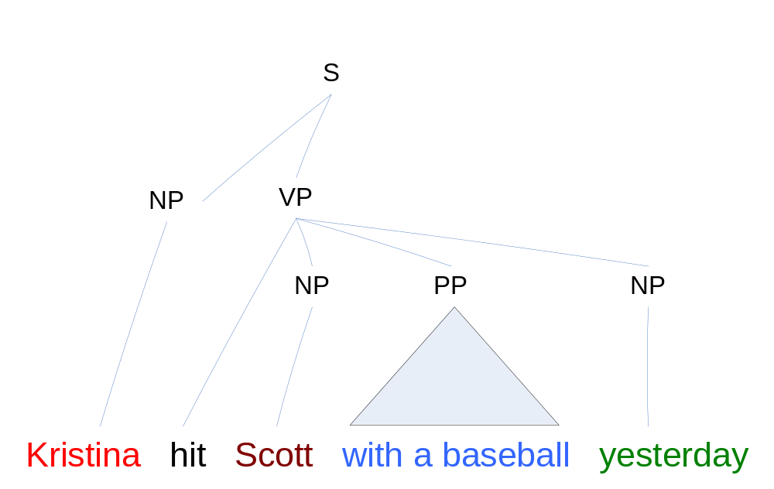
Proposition Bank (PropBank)
Add a Semantic Layer
A0
A1
A2
AM-TMP
  [_{A0} Kristina] hit [_{A1} Scott] [_{A2} with a baseball] [_{AM-TMP} yesterday].

Slide 18
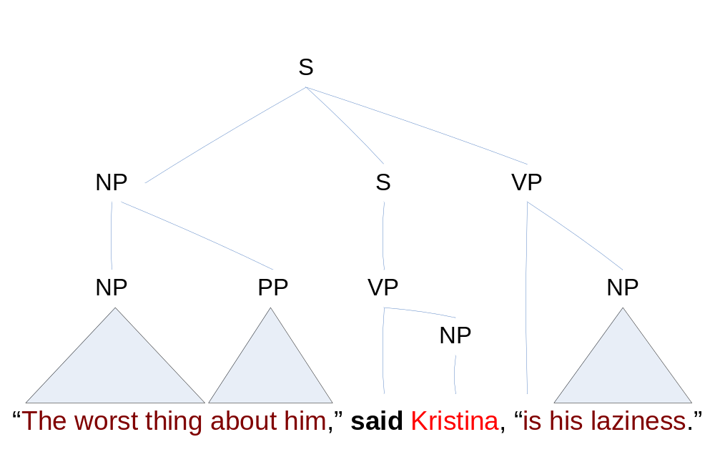
Proposition Bank (PropBank)
Add a Semantic Layer – Continued
A1
C-A1
A0
  [_{A1} The worst thing about him] said [_{A0} Kristina ] [_{C-A1} is his laziness].

Slide 19
Proposition Bank (PropBank)
Final Notes
Current release (Mar 4, 2005): Proposition Bank I
  Verb Lexicon: 3,324 frame files
  Annotation: ~113,000 propositions
  http://www.cis.upenn.edu/~mpalmer/project_pages/ACE.htm
Alternative format: CoNLL-04,05 shared task
  Represented in table format
  Has been used as standard data set for the shared tasks on semantic role labeling
  http://www.lsi.upc.es/~srlconll/soft.html
Notes:
On the website, there are also a lot of resources such as evaluation scripts and other tools, in addition to the data.

Slide 20
Corpora in Development
Chinese PropBank http://www.cis.upenn.edu/~chinese/cpb/
  Similar to PropBank, it adds a semantic layer on Penn Chinese Treebank
  A pre-release version has 250K words and 10,364 sentences; ~55%
NomBank http://nlp.cs.nyu.edu/meyers/NomBank.html
  Label arguments that co-occur with nouns in PropBank
    [_{A0} Her] [_{REL} gift] of [_{A1} a book] [_{A2} to John]
  Current Release: Sep. 2005
    93,809 instances of nouns; 2,805 different words; ~80%
    High frequency (>600) nouns have been completed
Notes:
http://www.cis.upenn.edu/~xueniwen/publications/ijcai05.pdf
http://www.cis.upenn.edu/~chinese/cpb/sighan03.pdf

Slide 21
Quick Overview
Part I. Introduction
  What is Semantic Role Labeling?
  From manually created grammars to statistical approaches
    Early Work
    Corpora – FrameNet, PropBank, Chinese PropBank, NomBank
  The relation between Semantic Role Labeling and other tasks
Part II. General overview of SRL systems
  System architectures
  Machine learning models
Part III. CoNLL-05 shared task on SRL
  Details of top systems and interesting systems
  Analysis of the results
  Research directions on improving SRL systems
Part IV. Applications of SRL

Slide 22
Relation to Other Tasks
Information extraction
Semantic parsing for speech dialogues
Deep semantic parsing
Penn Treebank function tagging
Predicting case markers
Aspects of comparisons
 | Coverage | Depth of semantics | Direct application
SRL | Broad | Shallow | No
Notes:
People have tried for a long time to derive meaning from natural language text. Thus there are many related tasks which try to achieve goals similar to those of semantic role labeling. It is important to be familiar with these related tasks and the methods for solving them; Perhaps we can learn from methods for solving these related tasks or improve systems for these related tasks using semantic role labeling.
These are the tasks I will mention. I will discuss how they compare to semantic role labeling in terms of the following characteristics, listed in the table to the right. Coverage: semantic role labeling has broad coverage because it defines semantics for the whole wall street journal Treebank, whereas some tasks concentrate on narrow domains.
Depth of semantics: Semantic role labeling has shallow semantics, because it creates shallow predicate argument semantic structures; some other tasks represent more complex phenomena and create complex nested structures; Connectedness to applications: semantic role labeling is not directly connected to applications but some of these tasks were defined specifically to help particular applications.
They differ from SRL in their coverage : broad or narrow domain, the depth of semantics, meaning the range of phenomena it tries to address; whether it is directly connected to applications: can we take the output of processing and perform some end user task that uses semantics. Unit of processing refers to whether semantics of one sentence only is built up or is there interaction across sentences.

Slide 23
Related Task: Information Extraction
Example (HUB Event-99 evaluations, [Hirschman et al. 99])
  A set of domain dependent templettes, summarizing information about events from multiple sentences
Many other task specifications: extracting information about products, relations among proteins, authors of books, etc.
<MARKET_CHANGE_1>:=
INSTRUMENT | London [gold]
AMOUNT_CHANGE | fell [$4.70] cents
CURRENT_VALUE | $308.45
DATE: | daily
Time for our daily market report from NASDAQ.
London gold fell $4.70 cents to $308.45.
Notes:
In information extraction, the task is to extract information about a limited number of domain-dependent events. For example, to extract pairs of books and their authors, information about products and their prices, and so on.
Information extraction tasks are characterized by the properties that the desired information can be captured by a relatively simple template or frame, with slots filled in by material in the text;
only a small part of the text is relevant for the filling in the frame.

Slide 24
Information Extraction versus
Semantic Role Labeling
Characteristic | IE | SRL
Coverage | narrow | broad
Depth of semantics | shallow | shallow
Directly connected to application | sometimes | no
Approaches to task: diverse
  Depends on the particular task and amount of available data
  Hand written syntactic-semantic grammars compiled into FSA
  Sequence labeling approaches (HMM, CRF, CMM)
  Survey materials: http://scottyih.org/IE-survey3.htm
  [Appelt & Israel 99], [Muslea 99]
Notes:
In comparison to SRL, IE has much narrower coverage. The depth of semantics is equally shallow, it extracts substrings of the text and assigns them slot names. Sometimes it is directly connected to applications. The approaches are diverse, including hand-written grammars for every domain and statistical sequence models. I have included some references to survey materials.

Slide 25
Related Task: Speech Dialogs
Spoken Language Understanding: extract the semantics from an utterance
Must deal with uncertainly and disfluencies in speech input
Example: task setup in a narrow flight reservations domain
(ATIS evaluations, [Price 90])
  <ShowFlight>
  <Flight>
  <DCity filler=“City”> Seattle </DCity>
  <ACity filler=“City”> Boston </ACity>
  </Flight>
  </ShowFlight>
  Sentence: “Show me all flights from Seattle to Boston”
Notes:
Another related task is spoken language understanding for dialogue systems. For example, automated systems for flight information solve the task of understanding what information about flights a user is asking about.
The extracted semantics can be defined by a small number of frames. For example, the sentence is parsed into a show flight frame which has one flight slot and which in turn has two slots – a departing and an arriving city.

Slide 26
ATIS Parsing versus
Semantic Role Labeling
Approaches to ATIS parsing (overview in [Wang et al. 05]):
  Simultaneous syntactic/semantic parsing [Miller et al. 96], knowledge-based approach [Ward 94, Dowding et al. 93]
  Current best: small semantic grammar and a sequence labeling model (no full syntactic parsing information) Error 3.8% ([Wang et al. 06]).
Characteristic | ATIS | SRL
Coverage | narrow | broad
Depth of semantics | deeper | shallow
Directly connected to application | yes | no
Notes:
As compared to SRL, ATIS parsing has narrower coverage. It has slightly deeper semantics, because of the nested nature of the target representation. It is directly connected to applications.
Approaches to this task in the past have been based on hand-written grammars, machine learning of simultaneous synt/semantic parsing; the current state of the art model uses a small domain grammar, and a sequence labeling approach

Slide 27
Related Task: Semantic Parsing for
NL Interfaces to Databases
Example: GeoQuery Domain (a domain of facts for US geography) [Zelle & Mooney 96]
  Sentence: How many cities are there in the US?
  Meaning Representation:
  answer(count(city(loc_2(countryid(usa)))))
Characteristics:
  A restricted domain for which we have a complete domain model
  Sentences are usually short but could be ungrammatical
  Syntax of target representation is more complex compared to the ATIS task
  Need to represent quantifiers (the largest, the most populated, etc.)
Notes:
Another task, which is similar to the ATIS spoken language understanding is semantic parsing for NL interfaces to databases.
Such problems have been studied for example, for parsing questions to the GeoQuery domain, which contains facts about US geography.
Here we again have a complete domain model and want to parse the sentences into logical forms which can be translated to queried to the database. The semantic representation is more complex, because there can be significant nesting; additionally quantifiers need to be resolved.

Slide 28
Semantic Parsing for NL Interfaces to Databases versus Semantic Role Labeling
Approaches
  Hand-built grammars [Androutsopoulos et al. 05] (overview)
  Machine learning of symbolic grammars – e.g. [Zelle & Mooney 96]
  Learned statistical syntactic/semantic grammar [Ge & Mooney 05] (supervised); [Zettlemoyer & Collins 05], [Wong & Mooney 06] (unsupervised)
Characteristic | NL interfaces to DB | SRL
Coverage | narrow | broad
Depth of semantics | deep | shallow
Directly connected to application | yes | no
Notes:
The table summarizes the characteristics of the task as compared to SRL. There has been extensive work on this task, based on hand-written grammars or statistical techniques. Some very interesting models have been developed recently. I have listed some references.

Slide 29
Related Task: Deep Parsing
Hand-built broad-coverage grammars create simultaneous syntactic and semantic analyses
  The Core Language Engine [Alshawi 92]
  Lexical Functional Grammar LFG ([Bresnan 01],
  [Maxwell & Kaplan 93])
  Head Driven Phrase Structure Grammar ([Pollard & Sag 94], [Copestake & Flickinger 00])
Model more complex phenomena
  Quantifiers, quantifier scope, not just verb semantics, anaphora, aspect, tense
A set of analyses is possible for each sentence according to the grammar: need to disambiguate
Until recently: no publicly available datasets or specifications for semantics
Difficult to create and expand
Notes:
Deep parsing attempts to derive deep meaning representations for general domain text. The approach is to build by hand grammars that create simultaneously syntactic and semantic representations, using sophisticated grammar formalisms , such as LFG, HPSG, etc.
The derived semantic representations model more complex semantic phenomena such as scope, aspect, and tense.
The task is ambitious and since the grammars are hand-build they are difficult to create and expand. Until recently the grammars
Another approach is to devise broad-coverage hand-built grammars that attempt to represent general semantics and cover general domains. They model more complex phenomena
Such as quantifiers, anaphora, and aspect. They are difficult to create and expand. The grammars generate multiple analyses and machine learning approaches can be used to pick one or a set of heuristics. There is starting to be some work on applications of such grammars
Usually syntax-driven semantic analyses; have some rules that create the semantics compositionally from the semantics of the parts
Rich grammars have been devised, broach coverage as well; they attemt to model complex general-doman phenomena

Slide 30
Deep Parsing versus
Semantic Role Labeling
Approach
  Hand-build grammar (possibly expand automatically)
  Treated as a parsing problem (joint syntactic and semantic disambiguation)
  For LFG ([Riezler et al. 02])
  For HPSG ([Toutanova et al. 04], [Miyao & Tsujii 05])
Characteristic | Deep Parsing | SRL
Coverage | broad | broad
Depth of semantics | deep | shallow
Directly connected to application | no | no
Notes:
Still needs disambiguation
Treated as a parsing problem (joint syntactic/semantic disambiguation)
For LFG ([Riezler et al. 02])
For HPSG ([Toutanova et al. 04] [Miyao & Tsujii 05])

Slide 31
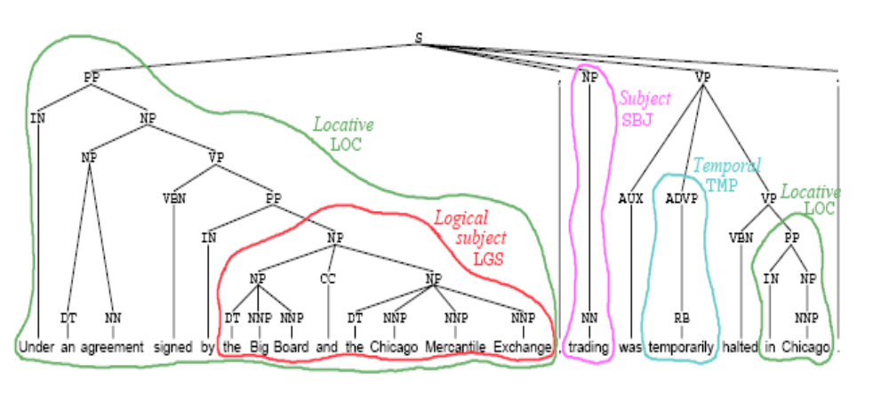
Related Task: Prediction of Function Tags [Blaheta&Charniak 00]
The Penn Treebank contains annotation of function tags for some phrases: subject, logical subject, adjuncts (temporal, locative, etc.)
Slide from Don Blaheta 03 thesis defense
Notes:
The last two related tasks I wanted to mention briefly are more syntactic in nature, but still can represent some semantics; the first task is Penn Treebank function tagging.
The Penn Treebank contains function tags on some phrasses, such as subject and deep subject, also temporal and locations; s

Slide 32
Prediction of Function Tags versus Semantic Role Labeling
Approach: a classifier based on voted perceptions and other ML techniques
  Using rich syntactic information from Penn Treebank parse trees
  Grammatical tags F1 96.4, other tags F1 83.8 [Blaheta 03]
Characteristic | Predicting Function Tags | SRL
Coverage | broad | broad
Depth of semantics | shallower | shallow
Directly connected to application | no | no
Notes:
Since it recovers information on top of Penn Treebank trees it is similar to SRL; it is more shallow though; there has been some work on this task by Don Blaheta who employed similar techniquest to the ones now used for SRL

Slide 33
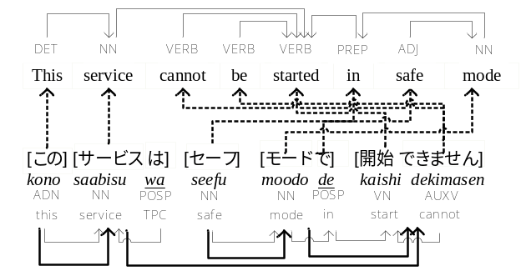
Related Task: Predicting Case Markers
Some languages have case markers
  They indicate the syntactico-semantic relation between a phrase and the phrase it modifies
  Needed for Machine Translation, foreign language learning
In Japanese, case markers indicate e.g subject, object, location.
  More similar to function tags than to semantic role labels
Good news: no annotated data is required!
  The case markers are part of the surface string
Notes:
A similar task arises when we want to translate from a language that does not represent semantic relations in the surface text to one that does. For example, Japanese has surface words (called case markers), which represent semantic relations (like location, direction) and grammatical relations (like subject, object). Thus in order to translate from E to J we need to solve a task similar to SRL.
The good news is that no specific annotated training data is needed because the semantic relations are parts of the surface text. Thus only parallel E – J sentences are needed.

Slide 34
Predicting Case Markers versus Semantic Role Labeling
Characteristic | Predicting Case Markers | SRL
Coverage | broad | broad
Depth of semantics | shallower | shallow
Directly connected to application | yes | no
Approaches
  Using content words from the target language only plus dependency information [Uchimoto et al. 02]
  Using syntactic and word features from the source and target languages [Suzuki & Toutanova 06]; per case marker error using automatic parses: 8.4%
Notes:
This task is more shallow and is more connected to applications, as compared to SRL. In recent work Hisami Suzuki and I have developed machine learning models similar to the ones used for SRL, to predict case markers in Japanese with a fairly high accuracy.
The task of case marker prediction does not require labeled data:
Just use sentences which naturally contain case markers
Case markers correspond more closely to functional tags than semantic role labels:
Grammatical function (object, subject, topic)
Relation (location, direction)
Similar machine learning techniques have been found successful for both:
using syntactic structures and machine learning algorithms

Slide 35
Summary of Part I – Introduction
What is Semantic Role Labeling?
Corpora for Semantic Role Labeling
  We will discuss mainly PropBank.
Related tasks to SRL
  Information extraction
  Deep semantic parsing
  Penn Treebank function tagging
  Predicting case markers
Next part: overview of SRL systems

Slide 36
Quick Overview
Part I. Introduction
  What is Semantic Role Labeling?
  From manually created grammars to statistical approaches
    Early Work
    Corpora – FrameNet, PropBank, Chinese PropBank, NomBank
  The relation between Semantic Role Labeling and other tasks
Part II. General overview of SRL systems
  System architectures
  Machine learning models
Part III. CoNLL-05 shared task on SRL
  Details of top systems and interesting systems
  Analysis of the results
  Research directions on improving SRL systems
Part IV. Applications of SRL

Slide 37
Part II: Overview of SRL Systems
Definition of the SRL task
  Evaluation measures
General system architectures
Machine learning models
  Features & models
  Performance gains from different techniques
Notes:
I will start with a formal definition of semantic role labeling. Then I will describe the general architecture of such systems, presenting the major components used, and the way they are integrated with each other. Then I will delve into implementation of these components by statistical models : the kind of features they use as well as the performance gains due to the different techniques.

Slide 38
Development of SRL Systems
Gildea & Jurafsky 2002
  First statistical model on FrameNet
7+ papers in major conferences in 2003
19+ papers in major conferences 2004, 2005
3 shared tasks
  Senseval 3 (FrameNet) – 8 teams participated
  CoNLL 04 (PropBank) – 10 teams participated
  CoNLL 05 (PropBank) – 19 teams participated
Notes:
The interest is growing

Slide 39
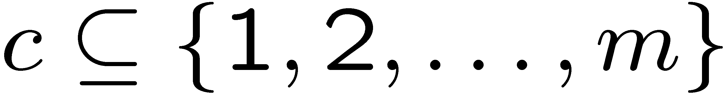
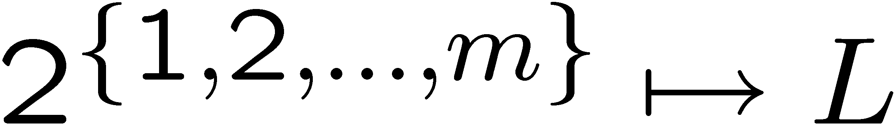
Task Formulation
Most general formulation: determine a labeling on (usually but not always contiguous) substrings (phrases) of the sentence s, given a predicate p
[_{A0} The queen] broke [_{A1} the window].
[_{A1} By working hard], [_{A0} he] said, [_{C-A1} you can get exhausted].
Every substring c can be represented by a set of word indices
More formally, a semantic role labeling is a mapping from the set of substrings of s to the label set L. L includes all argument labels and NONE.
Notes:
Looks fine

Slide 40
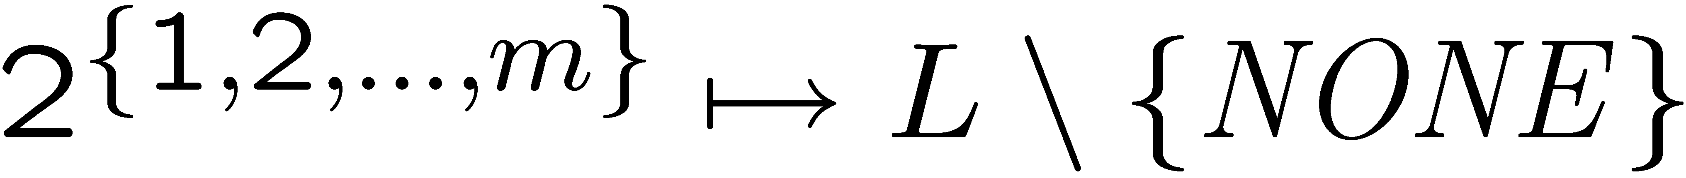
Subtasks
Identification:
  Very hard task: to separate the argument substrings from the rest in this exponentially sized set
  Usually only 1 to 9 (avg. 2.7) substrings have labels ARG and the rest have NONE for a predicate
Classification:
  Given the set of substrings that have an ARG label, decide the exact semantic label
Core argument semantic role labeling: (easier)
  Label phrases with core argument labels only. The modifier arguments are assumed to have label NONE.
Notes:
Conceptually, the task can be separated in the two subtasks: identification and classification.

Slide 41
Evaluation Measures
  Correct: [_{A0} The queen] broke [_{A1} the window] [_{AM-TMP} yesterday]
  Guess: [_{A0} The queen] broke the [_{A1} window] [_{AM-LOC} yesterday]
  Precision ,Recall, F-Measure {tp=1,fp=2,fn=2} p=r=f=1/3
  Measures for subtasks
    Identification (Precision, Recall, F-measure) {tp=2,fp=1,fn=1} p=r=f=2/3
    Classification (Accuracy) acc = .5 (labeling of correctly identified phrases)
    Core arguments (Precision, Recall, F-measure) {tp=1,fp=1,fn=1} p=r=f=1/2
Correct | Guess
{The queen} →A0 {the window} →A1 {yesterday} ->AM-TMP all other → NONE | {The queen} →A0 {window} →A1 {yesterday} ->AM-LOC all other → NONE
Notes:
The evaluation measures employed are based on precision, recall, and f-measure of argument phrases. Measures on the subtasks are also being used.
As an example, consider the

Slide 42
Part II: Overview of SRL Systems
Definition of the SRL task
  Evaluation measures
General system architectures
Machine learning models
  Features & models
  Performance gains from different techniques

Slide 43
Terminology: Local and Joint Models
Local models decide the label of each substring independently of the labels of other substrings
This can lead to inconsistencies
  overlapping argument strings
    By [_{A1} working [_{A1} hard ] , he] said , you can achieve a lot.
  repeated arguments
    By [_{A1} working] hard , [_{A1} he] said , you can achieve a lot.
  missing arguments
[_{A0} By working hard , he ] said , [_{A0} you can achieve a lot].
Joint models take into account the dependencies among labels of different substrings
Notes:
Before I introduce the general architecture, I want to introduce some terminology on the kinds of models that have been built.
One approach is to build local models, which classifiy each substring in the sentence independently. This can lead to inconsistenices which can be easily avaided if we get rid of the independence.
Joint models bla bla

Slide 44
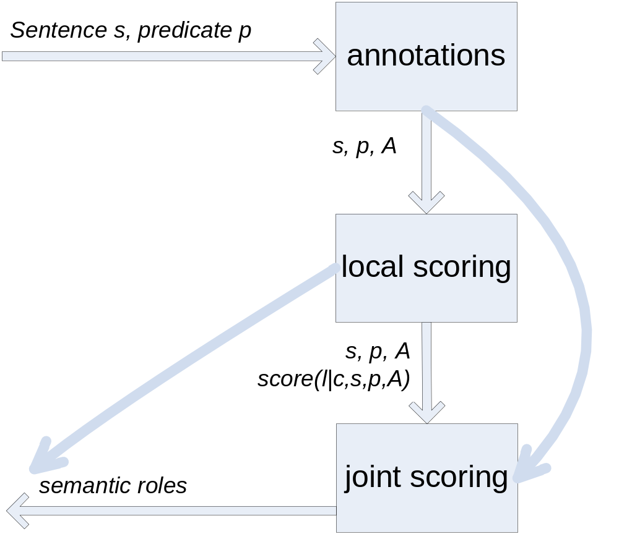
Basic Architecture of a Generic SRL System
Local scores for phrase labels do not depend on labels of other phrases
Joint scores take into account dependencies among the labels of multiple phrases
Notes:
Xue and Palmer 2004
Architecture : parse with collins, filter out non-arguments (filter out 80% of the nodes in a tree), recall is 99.3% using gold standard trees
local scoring – (1) score with a local model [arg,none] , and pass nodes with p(arg|none)> .2 for gold .1 for automatic, it seems
local scorig – (2) score with a local model pr(cls|node), cls in args + none
Why is that? Even if a system.
Results reported on propbank feb 04
Different sets of features used for Id and Cls and claims that different features are better but no proof
Interesting new features – syntactic frame and PP parent (describe better)
Using gold standard trees : id 93.8 f, cls core 94.96 (f-measure), argm 95.42, argm+ 92.95
complete task 90.58 core, 90.55 argm, 88.51 argm+
Using auto trees id 81.3 f, core 78.16, argm 77.76 argm+ 76.21

Slide 45
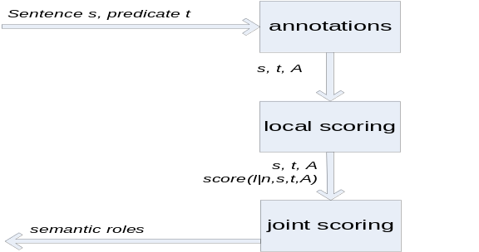
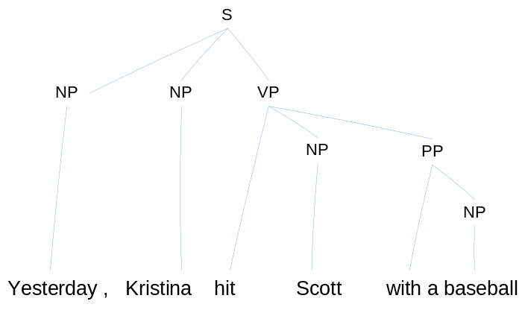
Annotations Used
Syntactic Parsers
  Collins’, Charniak’s (most systems) CCG parses ([Gildea & Hockenmaier 03],[Pradhan et al. 05]) TAG parses ([Chen & Rambow 03])
Shallow parsers
    [_{NP}Yesterday] , [_{NP}Kristina] [_{VP}hit] [_{NP}Scott] [_{PP}with] [_{NP}a baseball].
Semantic ontologies (WordNet, automatically derived), and named entity classes
    (v) hit (cause to move by striking)
        propel, impel (cause to move forward with force)
WordNet hypernym
Notes:
The annotation sare used as a way to derive useful features and also as a way to decide likely phrases that have argument labels. Constituents are most likely to have arguments

Slide 46
Annotations Used - Continued
Most commonly, substrings that have argument labels correspond to syntactic constituents
  In Propbank, an argument phrase corresponds to exactly one parse tree constituent in the correct parse tree for 95.7% of the arguments;
    when more than one constituent correspond to a single argument (4.3%), simple rules can join constituents together (in 80% of these cases, [Toutanova 05]);
  In Propbank, an argument phrase corresponds to exactly one parse tree constituent in Charniak’s automatic parse tree for approx 90.0% of the arguments.
    Some cases (about 30% of the mismatches) are easily recoverable with simple rules that join constituents ([Toutanova 05])
  In FrameNet, an argument phrase corresponds to exactly one parse tree constituent in Collins’ automatic parse tree for 87% of the arguments.
Notes:
It turns out using parse trees as annotations can be a very good way to limit the number of possible substrings of the sentence that can have argument labels.
We can consider only substrings that

Slide 47
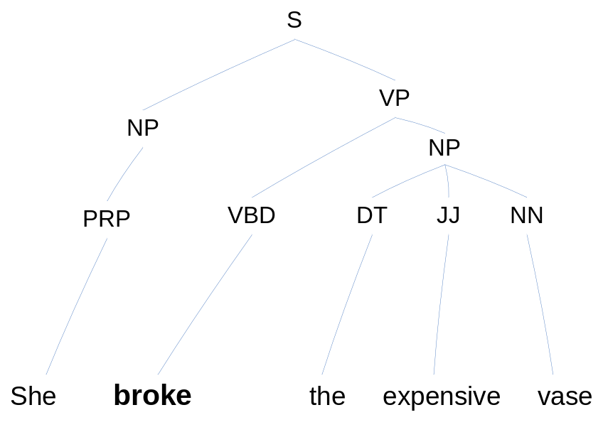
Labeling Parse Tree Nodes
Given a parse tree t, label the nodes (phrases) in the tree with semantic labels
To deal with discontiguous arguments
  In a post-processing step, join some phrases using simple rules
  Use a more powerful labeling scheme, i.e. C-A0 for continuation of A0
A0
NONE
Another approach: labeling chunked sentences. Will not describe in this section.
Notes:
Let’s say we have annotated the sentence with a parse tree; this has been the most successful approach. To start from a syntactic parse tree and to label the constituents in that parse tree with SRL labels. The rest of the substrings have labels NONE.
Maybe also add a slide on labeling chunked representations, here or later

Slide 48
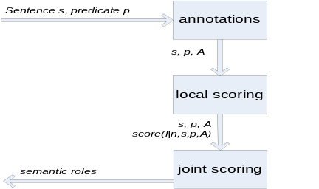

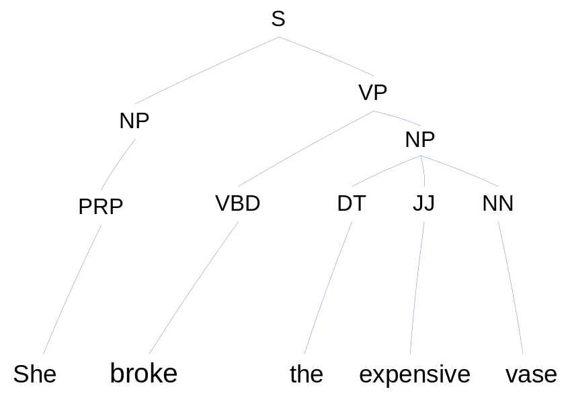
Local Scoring Models
Notation: a constituent node c, a tree t, a predicate node p , feature map for a constituent
Target labels
Two (probabilistic) models
  Identification model
  Classification model
Sometimes one model
c
p
Notes:
Then I will talk about local scoring models. Let’s say we apply a local scoring model. The goal is to assign a score to each constituent for each of the possible labels. And of course as in general machine learning, we need to extract some features from the node and then build a possibly probabilitistc model. One approach as been to build 2 modes. One for id and one for cls or one only

Slide 49
Why Split the Task into
Identification and Classification
Different features are helpful for each task
  Syntactic features more helpful for identification, lexical features more helpful for classification
  Example: the identity of the predicate, e.g. p=“hit” is much more important for classification than for identification ([Pradhan et al. 04]):
    Identification all features: 93.8 no predicate: 93.2
    Classification all features: 91.0 no predicate: 82.4
  Some features result in a performance decrease for one and an increase for the other task [Pradhan et al. 04]
Splitting the task increases computational efficiency in training
  In identification, every parse tree constituent is a candidate (linear in the size of the parse tree, avg. 40)
  In classification, label a small number of candidates (avg. 2.7)
Notes:
Why do people split ; i,ii

Slide 50
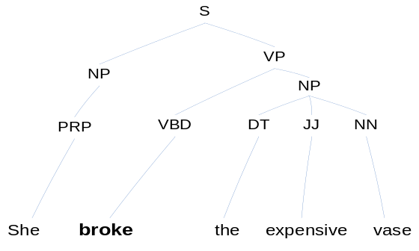
Combining Identification and Classification Models
Step 1. Pruning. Using a hand-specified filter.
Step 2. Identification. Identification model (filters out candidates with high probability of NONE)
Step 3. Classification. Classification model assigns one of the argument labels to selected nodes (or sometimes possibly NONE)
A0
A1
Notes:
Looks fine

Slide 51

Combining Identification and Classification Models – Continued
or
One Step. Simultaneously identify and classify using
A0
A1
Notes:
Chain rule of decompositoin

Slide 52
Combining Identification and Classification Models – Continued
[Gildea&Jurafsky 02]
  Identification + Classification for local scoring experiments
  One Step for joint scoring experiments
[Xue&Palmer 04] and [Punyakanok et al. 04, 05]
  Pruning + Identification + Classification
[Pradhan et al. 04] and [Toutanova et al. 05]
  One Step
Notes:
Researchers have used id+cls, one step, or all three stages

Slide 53
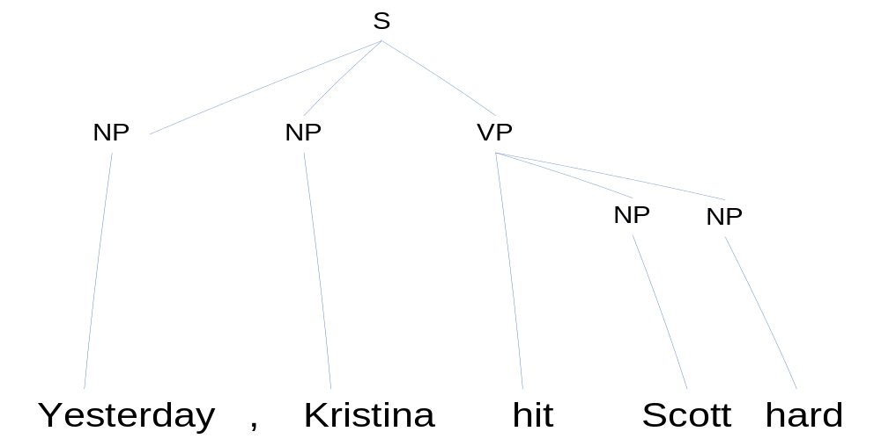
Joint Scoring Models
These models have scores for a whole labeling of a tree (not just individual labels)
  Encode some dependencies among the labels of different nodes
A0
AM-TMP
NONE
A1
AM-TMP
Notes:
Joint Scoring models as a said before take into account some dependencies ; the joint probability of a labeling of the full parse tree does not decompose

Slide 54
Combining Local and Joint Scoring Models
Tight integration of local and joint scoring in a single probabilistic model and exact search [Cohn&Blunsom 05] [Màrquez et al. 05],[Thompson et al. 03]
  When the joint model makes strong independence assumptions
Re-ranking or approximate search to find the labeling which maximizes a combination of local and a joint score [Gildea&Jurafsky 02] [Pradhan et al. 04] [Toutanova et al. 05]
  Usually exponential search required to find the exact maximizer
Exact search for best assignment by local model satisfying hard joint constraints
  Using Integer Linear Programming [Punyakanok et al 04,05] (worst case NP-hard)
More details later

Slide 55
Part II: Overview of SRL Systems
Definition of the SRL task
  Evaluation measures
General system architectures
Machine learning models
  Features & models
    For Local Scoring
    For Joint Scoring
  Performance gains from different techniques

Slide 56
Gildea & Jurafsky (2002) Features
Key early work
  Future systems use these features as a baseline
Constituent Independent
  Target predicate (lemma)
  Voice
  Subcategorization
Constituent Specific
  Path
  Position (left, right)
  Phrase Type
  Governing Category
  (S or VP)
  Head Word
Target | broke
Voice | active
Subcategorization | VP→VBD NP
Path | VBD↑VP↑S↓NP
Position | left
Phrase Type | NP
Gov Cat | S
Head Word | She
Notes:
Looks fine

Slide 57

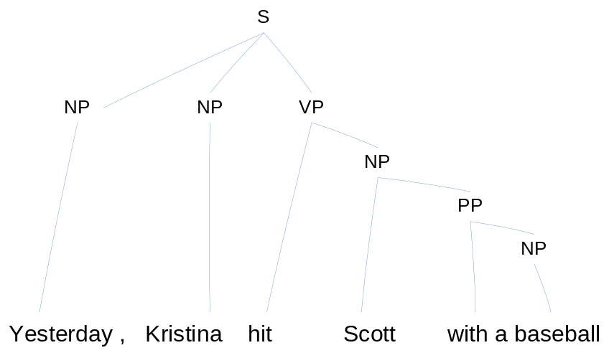
Evaluation using Correct and Automatic Parses
For a correct parse, 95.7% of arguments correspond to a single constituent and their boundaries are easy to consider
For an automatic parse (Charniak’s parser), about 90% of the arguments correspond to a single constituent;
- the arguments for which the parser made a bracketing error are difficult to get
- additionally, attachment errors and labeling errors make the task much harder
Wrong!

Slide 58
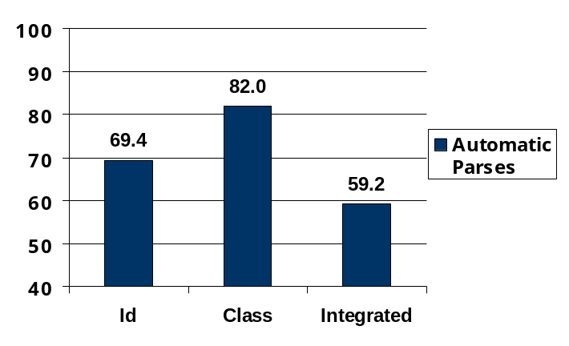
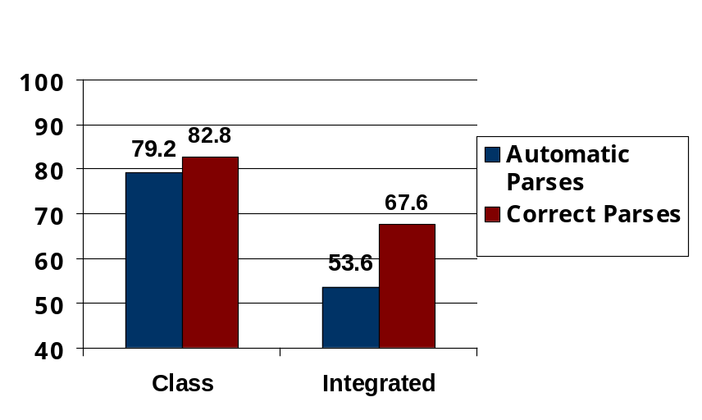
Performance with Baseline Features using the G&J Model
Machine learning algorithm: interpolation of relative frequency estimates based on subsets of the 7 features introduced earlier
FrameNet Results
Propbank Results
Just by changing the learning algorithm 67.6 → 80.8 using SVMs [Pradhan et al. 04]),
Notes:
For automatic parse trees, how many arguments are we losing due to parse error
Same number for PropBank
Maybe add slide on starting from correct versus gold standard parse trees
Looks fine

Slide 59
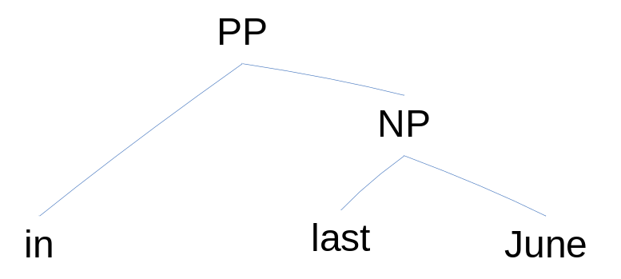
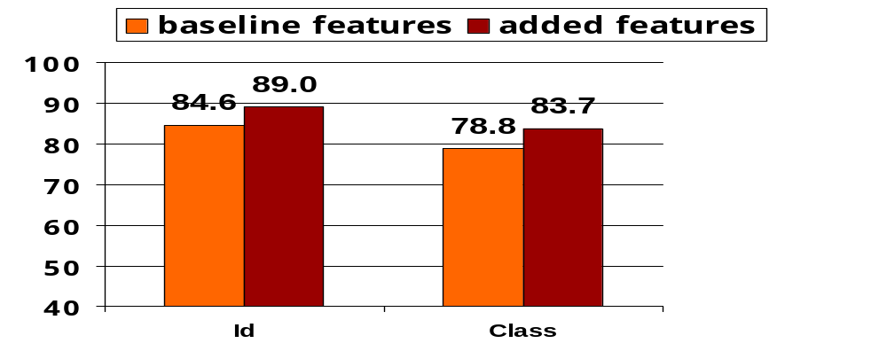
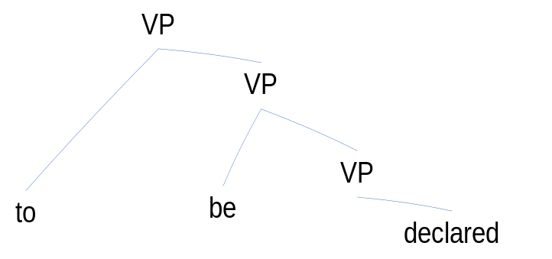
Surdeanu et al. (2003) Features
Content Word (different from head word)
Head Word and Content Word POS tags
NE labels (Organization, Location, etc.)
Head word
Content word
Head word
Content Word
Gains from the new features using correct parses; 28% error reduction for Identification and 23% error reduction for Classification
Notes:
Looks fine

Slide 60
Pradhan et al. (2004) Features
More structural/lexical context (31% error reduction from baseline due to these + Surdeanu et al. features)
Last word / POS
First word / POS
Parent constituent Phrase Type / Head Word/ POS
Left constituent Phrase Type / Head Word/ POS
Right constituent Phrase Type / Head Word/ POS
Notes:
Looks fine

Slide 61
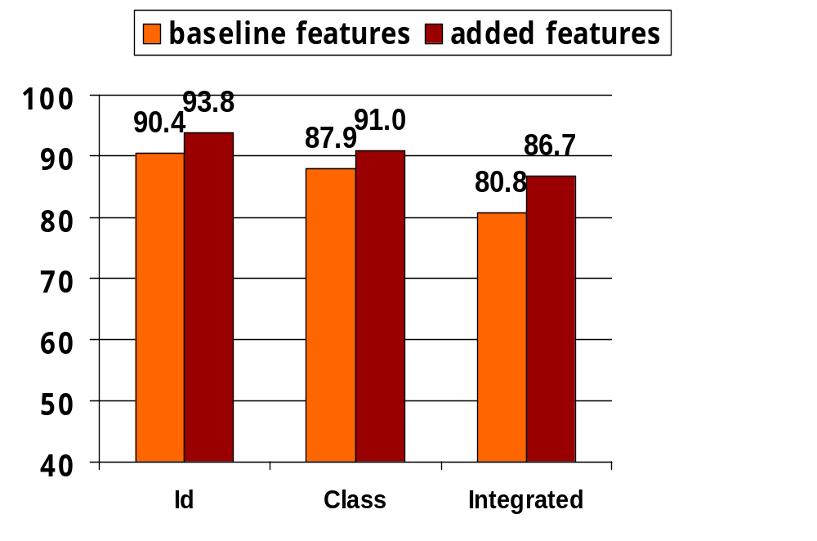
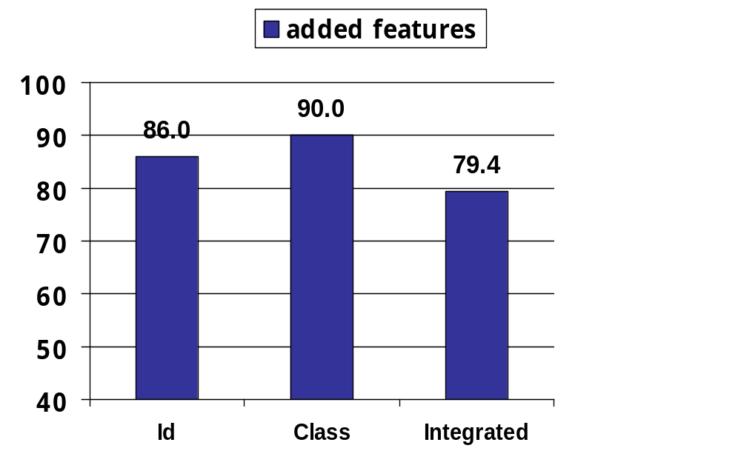
Pradhan et al. (2004) Results
f-measure
f-measure
Results on correct parse trees
Results on automatic parse trees
Baseline results higher than Gildea and Jurafsky’s due to a different classifier - SVM
These are the highest numbers on Propbank version July 2002
Notes:
Looks fine

Slide 62
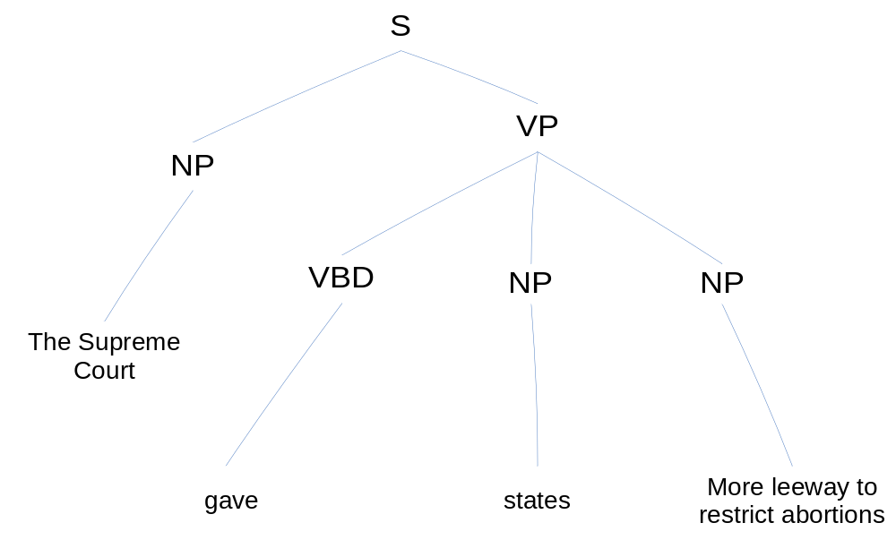
Xue & Palmer (2004) Features
Added explicit feature conjunctions in a MaxEnt model, e.g. predicate + phrase type
Syntactic frame feature (helps a lot)
Head of PP Parent (helps a lot)
  If the parent of a constituent is a PP, the identity of the preposition (feature good for PropBank Feb 04)
np_give_NP_np
np_give_CURR_np
np_v_NP_np
Notes:
Looks fine

Slide 63
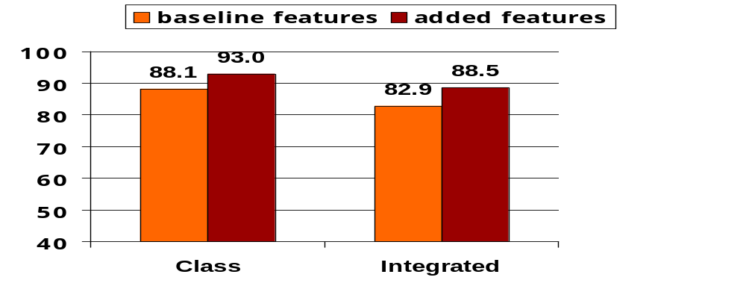
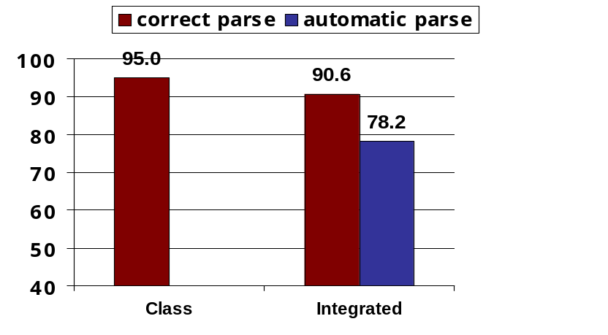
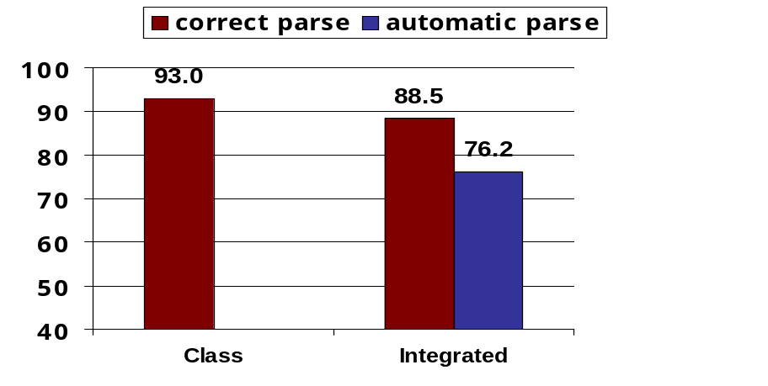
Xue & Palmer (2004) Results
A newer version of Propbank – February 2004
All Arguments Correct Parse
Core Arguments
All Arguments
Results not better than [Pradhan et al. 04], but comparable.
Notes:
Looks fine

Slide 64
Machine Learning Models Used
Back-off lattice-based relative frequency models ([Gildea&Jurafsky 02], [Gildea& Palmer 02])
Decision trees ([Surdeanu et al. 03])
Support Vector Machines ([Pradhan et al. 04])
Log-linear models ([Xue&Palmer 04][Toutanova et al. 05])
SNoW ([Punyakanok et al. 04,05])
AdaBoost, TBL, CRFs, …
Notes:
More work – 15 mins to summarize
Maybe emphasize the use of smoothing techniques

Slide 65
Joint Scoring: Enforcing Hard Constraints
Constraint 1: Argument phrases do not overlap
    By [_{A1} working [_{A1} hard ] , he] said , you can achieve a lot.
  Pradhan et al. (04) – greedy search for a best set of non-overlapping arguments
  Toutanova et al. (05) – exact search for the best set of non-overlapping arguments (dynamic programming, linear in the size of the tree)
  Punyakanok et al. (05) – exact search for best non-overlapping arguments using integer linear programming
Other constraints ([Punyakanok et al. 04, 05])
  no repeated core arguments (good heuristic)
  phrases do not overlap the predicate
  (more later)
Notes:
The first way has been to enforce some hard constraints; do nothing in training but in testing find a global assignment that satisfies some hand-specified constraints

Slide 66
Gains from Enforcing Hard Constraints
Argument phrases do not overlap
  Pradhan et al. (04) good gains for a baseline system: 80.8 → 81.6 correct parses
  Toutanova et al. (05) a small gain from non-overlapping for a model with many features 88.3 → 88.4 correct parses
Other hard constraints (no repeating core arguments, set of labeled arguments allowable, etc.)
  Punyakanok et al. (04) evaluation of this aspect only when using chunked sentences (not full parsing) 87.1 → 88.1 correct parses 67.1 → 68.2 automatic parses
Notes:
Looks fine

Slide 67
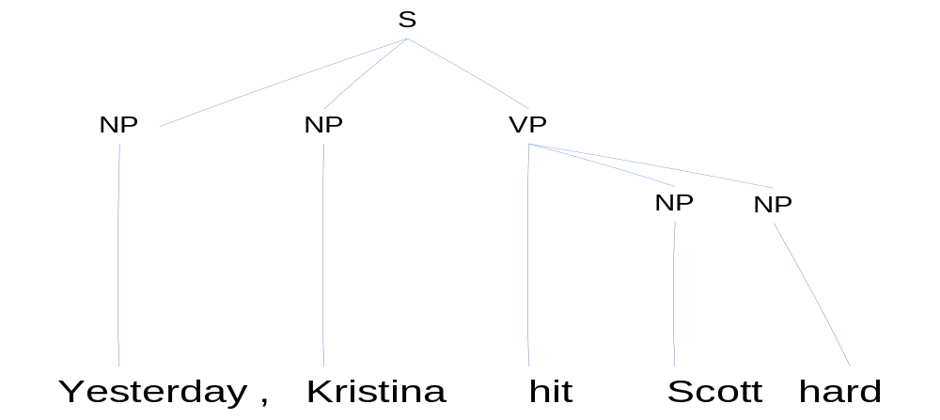
Joint Scoring: Integrating Soft Preferences
A0
AM-TMP
A1
AM-TMP
There are many statistical tendencies for the sequence of roles and their syntactic realizations
  When both are before the verb, AM-TMP is usually before A0
  Usually, there aren’t multiple temporal modifiers
  Many others which can be learned automatically
Notes:
In this case we want to learn (in training) global preferences for the complete set of arguments. Since the semantic frame of verbs is a joint structure, with strong dependencies between the arguments, we may be able to gain from exploiting joint information

Slide 68
Joint Scoring: Integrating Soft Preferences
Gildea and Jurafsky (02) – a smoothed relative frequency estimate of the probability of frame element multi-sets:
  Gains relative to local model 59.2 → 62.9 FrameNet automatic parses
Pradhan et al. (04 ) – a language model on argument label sequences (with the predicate included)
  Small gains relative to local model for a baseline system 88.0 → 88.9 on core arguments PropBank correct parses
Toutanova et al. (05) – a joint model based on CRFs with a rich set of joint features of the sequence of labeled arguments (more later)
  Gains relative to local model on PropBank correct parses 88.4 → 91.2 (24% error reduction); gains on automatic parses 78.2 → 80.0
Notes:
Calculate relative error reductions

Slide 69
Combining Annotations and Combining Systems
Punyakanok et al. (05) combine information from systems trained on top n parse trees produced by Charniak’s parser and Collins’ parser.
  Effectively constituents from all trees can be selected as arguments
  Constraints for non-overlap and other constraints are enforced through ILP
  Gains 74.8 → 77.3 on automatic parses (CoNLL 05 dev set)
Haghighi et al. (05) combine top n Charniak parse trees
  This is achieved in a Bayesian way: sum over the parse trees approximated by max
  Gains 79.7 → 80.3 on automatic parses (CoNLL 05 test set)
Pradhan et al. (05) combine different syntactic views
  Charniak syntactic parse, Combinatory Categorial Grammar parse
  Gains 77.0 → 78.0 on automatic parses (CoNLL 05 dev set)
Other systems in CoNLL 2005
More later on all of these
Notes:
Insert gains for Pradhan’s approach

Slide 70
Summary of Part II –
System Overview
Introduced SRL system architecture:
  annotations, local scoring, joint scoring
Described major features helpful to the task
  showed that large gains can be achieved by improving the features
Described methods for local scoring, combining identification and classification models
Described methods for joint scoring
  gains from incorporating hard constraints
  gains from incorporating soft preferences
Introduced the concept of combining systems and annotations
  significant gains possible
Next part: more details on the systems in CoNLL 2005

Slide 71

Break!!
[_{A0} We] [_{AM-MOD} will] see [_{A1} you] [_{AM-TMP} after the break].

Slide 72
Quick Overview
Part I. Introduction
  What is Semantic Role Labeling?
  From manually created grammars to statistical approaches
    Early Work
    Corpora – FrameNet, PropBank, Chinese PropBank, NomBank
  The relation between Semantic Role Labeling and other tasks
Part II. General overview of SRL systems
  System architectures
  Machine learning models
Part III. CoNLL-05 shared task on SRL
  Details of top systems and interesting systems
  Analysis of the results
  Research directions on improving SRL systems
Part IV. Applications of SRL
Notes:
Welcome back. In the second half of the tutorial, we will first go through some SRL systems in the CoNLL-05 shared task, and learn some lessons from them. Finally, we will introduce some applications of SRL.

Slide 73
Part III: CoNLL-05 Shared Task on SRL
Details of top systems and interesting systems
  Introduce the top 4 systems
  Describe 3 spotlight systems
Analysis of the overall results
  General performance
  System properties
  Per argument performance
Directions for improving SRL systems

Slide 74
Details of CoNLL-05 Systems
Top performing systems
  #3 Màrquez et al. (Technical University of Catalonia)
  #4 Pradhan et al. (University of Colorado at Boulder)
  #1 Punyakanok et al. (U. of Illinois at Urbana-Champaign)
  #2 Haghighi et al. (Stanford University)
Spotlight systems
  Yi & Palmer – integrating syntactic and semantic parsing
  Cohn & Blunsorn – SRL with Tree CRFs
  Carreras – system combination
Kristina’s system
Scott’s system

Slide 75
SRL as Sequential Tagging [Màrquez et al.]
A conceptually simple but competitive system
SRL is treated as a flat sequential labeling problem represented in the BIO format.
System architecture
  Pre-processing (sequentialization)
    FP_{CHA}: full-parse, based on Charniak’s parser
    PP_{UPC}: partial-parse, based on UPC chunker & clauser
  Learning using AdaBoost
  Greedy combination of two systems

Slide 76
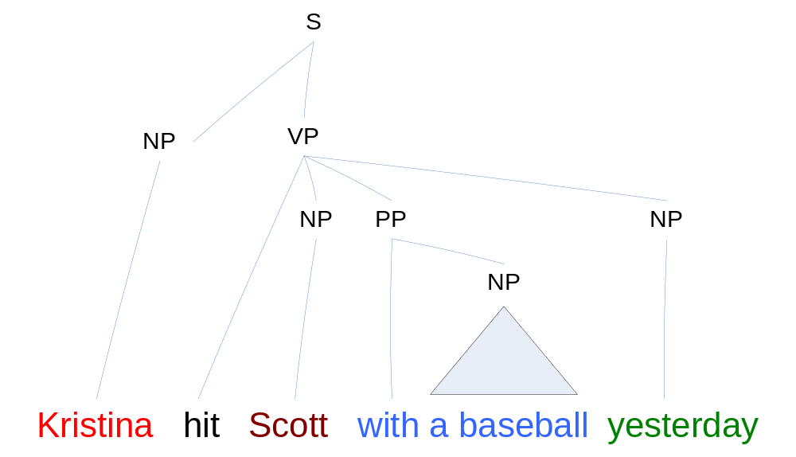
Sequentialization – Full Parse
[Màrquez et al.] – Continued
Explore the sentence regions defined by the clause boundaries.
The top-most constituents in the regions are selected as tokens.
Equivalent to [Xue&Palmer 04] pruning process on full parse trees
Kristina | B-A0
hit | O
Scott | B-A1
with a baseball | B-A2
yesterday | B-AM-TMP
A0
A1
A2
AM-TMP
Notes:
A parse tree and the corresponding tokens

Slide 77
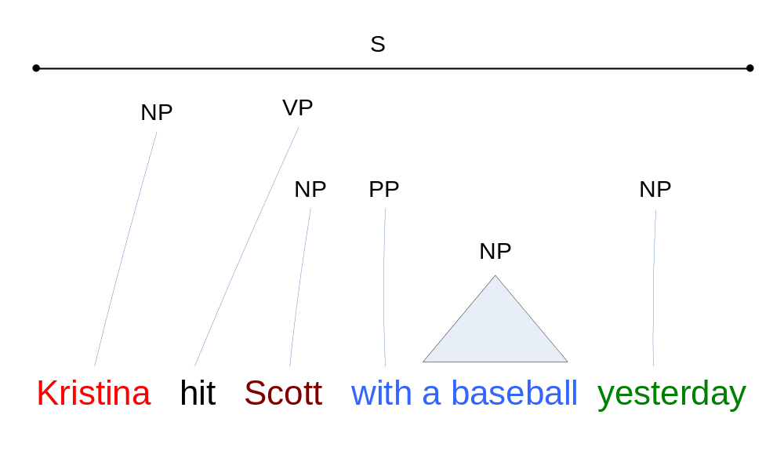
Sequentialization – Partial Parse
[Màrquez et al.] – Continued
Only clauses and base chunks are available.
Chunks within the same clause are selected as tokens.
Kristina | B-A0
hit | O
Scott | B-A1
with | B-A2
a Baseball | I-A2
yesterday | B-AM-TMP
A0
A1
A2
AM-TMP
A2
Notes:
A parse tree and the corresponding tokens

Slide 78
Greedy Combination
[Màrquez et al.] – Continued
Join the maximum number of arguments from the output of both systems
  More impact on Recall
Different performance on different labels
  FP_{CHA}: better for A0 and A1; PP_{UPC}: better for A2-A4
Combining rule
  Adding arguments A0 and A1 from FP_{CHA}
  Adding arguments A2, A3, and A4 from PP_{UPC}
  Repeat Step 1&2 for other arguments
  Drop overlapping/embedding arguments

Slide 79
Results
[Màrquez et al.] – Continued
Overall results on development set
 | F₁ | Prec. | Rec.
PP_{UPC} | 73.57 | 76.86 | 70.55
FP_{CHA} | 75.75 | 78.08 | 73.54
Combined | 76.93 | 78.39 | 75.53
Final results on test sets
  WSJ-23 (2416 sentences)
    77.97 (F₁), 79.55 (Prec.), 76.45 (Rec.)
  Brown (426 sentences; cross-domain test)
    67.42 (F₁), 70.79 (Prec.), 64.35 (Rec.)
Notes:
WSJ Test: 2416 propositions; Brown Test: 426 propositions
The Brown Corpus of Standard American English was the first of the modern, computer readable, general corpora. It was compiled by W.N. Francis and H. Kucera, Brown University, Providence, RI.
The corpus consists of one million words of American English texts printed in 1961. The texts for the corpus were sampled from 15 different text categories to make the corpus a good standard reference. Today, this corpus is considered small, and slightly dated.
The Brown corpus consists of 500 texts, each consisting of just over 2,000 words. The texts were sampled from 15 different text categories. The number of texts in each category varies (see below).
More comprehensive information about the Brown corpus can be found in the Brown Corpus Manual (external link).
A. PRESS: REPORTAGE (44 texts)
B. PRESS: EDITORIAL (27 texts)
C. PRESS: REVIEWS (17 texts)
D. RELIGION (17 texts)
E. SKILL AND HOBBIES (36 texts)
F. POPULAR LORE (48 texts)
G. BELLES-LETTRES (75 texts)
H. MISCELLANEOUS: GOVERNMENT & HOUSE ORGANS (30 texts)
J. LEARNED (80 texts)
K: FICTION: GENERAL (29 texts)
L: FICTION: MYSTERY (24 texts)
M: FICTION: SCIENCE (6 texts)
N: FICTION: ADVENTURE (29 texts)
P.FICTION: ROMANCE (29 texts)
R. HUMOR (9 texts)

Slide 80
Semantic Role Chunking Combining Complementary Syntactic Views [Pradhan et al.]
Observation: the performance of an SRL system depends heavily on the syntactic view
  Syntactic parse trees generated by full parsers
    Charniak’s, Collins’, …
  Partial syntactic analysis by chunker, clauser, etc.
Usage of syntactic information
  Features (e.g., path, syntactic frame, etc.)
  Argument candidates (mostly the constituents)
Strategy to reduce the impact of incorrect syntactic info.
  Build individual SRL systems based on different syntactic parse trees (Charniak’s and Collins’)
  Use the predictions as additional features
  Build a final SRL system in the sequential tagging representation

Slide 81
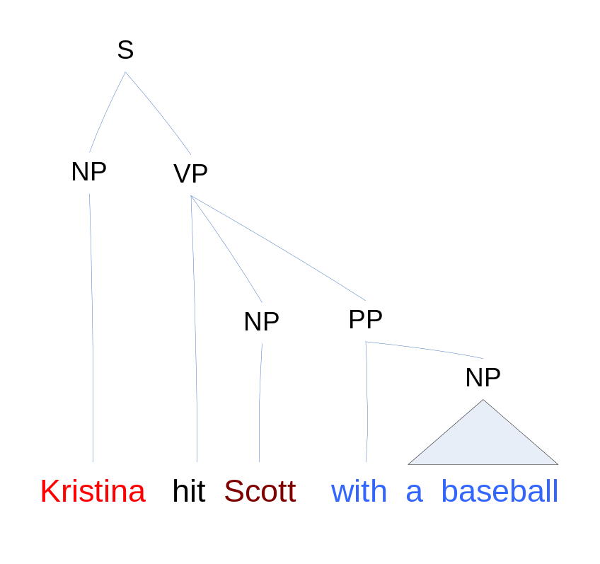
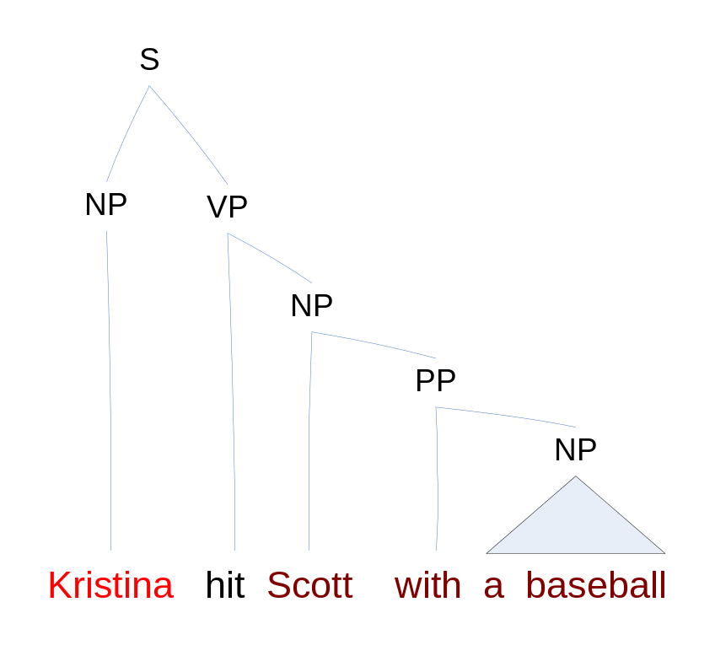
Constituent Views
[Pradhan et al.] – Continued
Parse Tree #1
Parse Tree #2
A0
A1
A2
A0
A1

Slide 82
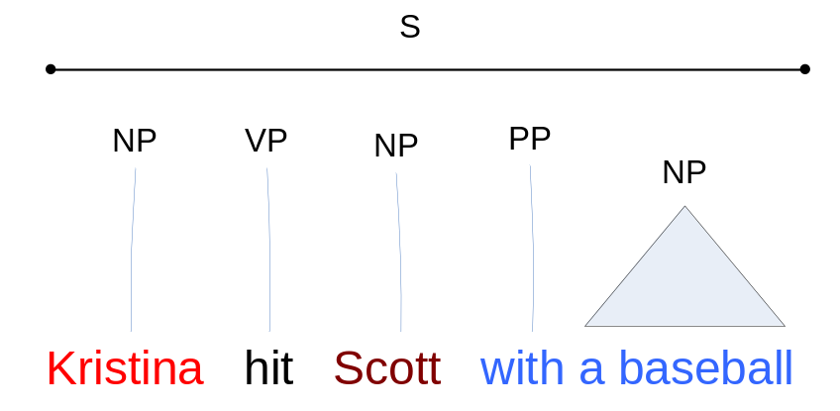
Chunk View
[Pradhan et al.] – Continued
Sequentialization using base chunks [Hacioglu&Ward 03]
Chunker: Yamcha [Kudo&Matsumoto 01]
  http://chasen.org/~taku/software/yamcha/
Chunks | True Label | Pred #1 | Pred #2
Kristina | B-A0 | B-A0 | B-A0
hit | O | O | O
Scott | B-A1 | B-A1 | B-A1
with | B-A2 | B-A2 | I-A1
a Baseball | I-A2 | I-A2 | I-A2
Notes:
Modify the example slightly to include the I- tags
Add animation
Ideally, use the same sentence as in the last slide

Slide 83
Algorithm
[Pradhan et al.] – Continued
Generate features from Charniak’s and Collins’ parse trees
Add a few features from one to the other, and construct two SRL systems
Represent the output as semantic BIO tags, and use them as features
Generate the final semantic role label set using a phrase-based chunking paradigm

Slide 84
Architecture
[Pradhan et al.] – Continued
Charniak
Collins
Words
Phrases
BIO
BIO
BIO
Features
Chunker
BIO
Semantic Role Labels
Slide from Pradhan et al. (CoNLL 2005)

Slide 85
Results
[Pradhan et al.] – Continued
Overall results on development set
System | F₁ | Prec | Rec
Charniak | 77 | 80 | 75
Collins | 76 | 79 | 74
Combined | 78 | 81 | 76
Performance (F₁) on Test sets
  Submitted system: WSJ-23 77.4, Brown 67.1
  Bug-fixed system: WSJ-23 78.6, Brown 68.4
Software: ASSERT (Automatic Statistical SEmantic Role Tagger)
  http://oak.colorado.edu/assert

Slide 86

Generalized Inference [Punyakanok et al.]
The output of the argument classifier often violates some constraints, especially when the sentence is long.
Use the integer linear programming inference procedure [Roth&Yih 04]
  Input: the local scores (by the argument classifier), and structural and linguistic constraints
  Output: the best legitimate global predictions
  Formulated as an optimization problem and solved via Integer Linear Programming.
  Allows incorporating expressive (non-sequential) constraints on the variables (the arguments types).
Notes:
The next system I’m going to introduce is my system, which is the winning system in last year’s CoNLL shared task.
Compared to other systems, the main difference of this system is its joint inference procedure.
To ‘correct’ the mistakes made by the local classifiers, we use an inference procedure based on integer linear programming, which is first described in one of my papers in 2004.

Slide 87
Integer Linear Programming Inference
[Punyakanok et al.] – Continued
For each argument a_{i} and label t
  Set up a Boolean variable: a_{i,t} ∈ {0,1}
    indicating if a_{i} is classified as t
Goal is to maximize
  Σ _{i} score(a_{i} = t ) a_{i,t}
  Subject to the (linear) constraints
    Any Boolean constraint can be encoded this way.
If score(a_{i} = t) = P(a_{i} = t), then the objective is
  Find the assignment that maximizes the expected number of arguments that are correct
  Subject to the constraints.
Notes:
So the basic formulation is like this. Suppose our local argument classifiers have predicted the scores of the possible labels of the argument candidates.
---------
Specifically for this SRL. For each argument a_{i}, we introduce Boolean variables a_{i,t} to indicate if the argument is classified as type t.
The goal of the inference is to find the assignment to these variables that maximize the summation of the scores of the chosen arguments with respect to the constraints.
Note that if the score is the probability that an argument is assigned to a particular type, optimizing this objective is equivalent to trying to maximize the expected number of correct arguments.

Slide 88
Examples of Constraints
[Punyakanok et al.] – Continued
No duplicate argument classes
  Σ_{a ∈ POTARG} x_{{a = A0}} ≤ 1
C-ARG
  ∀a’ ∈ POTARG ,
  Σ (a ∈ POTARG) Λ (a is before a’ ) x_{{a = A0}} ≥ x_{{a’ = C-A0}}
Many other possible constraints:
  No overlapping or embedding
  If the verb is of type A, no argument of type B
    hit can take only A0-A2 but NOT A3-A5
  Relations between number of arguments
Joint inference can be used also to combine different SRL Systems.
Any Boolean rule can be encoded as a set of linear constraints.
If there is a C-arg phrase, there is an arg before it
Notes:
Animation to show the following 3 constraints step by step
Binary constraints
Summation = 1 assures that it’s assigned only one label
Non-overlapping constraints
Remember to put a small bar picture

Slide 89
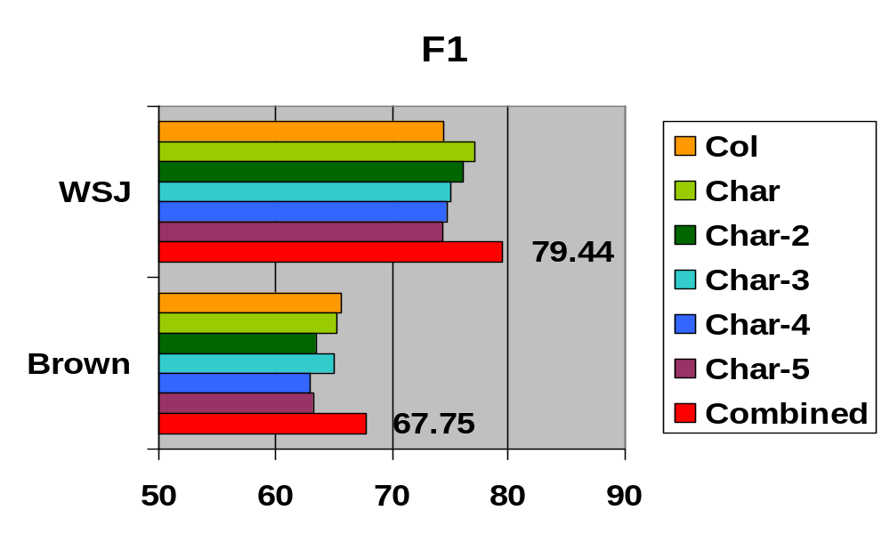
Results
[Punyakanok et al.] – Continued
Char: Charniak’s parser (5-best trees)
Col: Collins’ parser
Online Demo: http://l2r.cs.uiuc.edu/~cogcomp/srl-demo.php
Notes:
Here is the final results. We gain about 2 points in F1.

Slide 90

A Joint Model for SRL [Haghighi et al.]
The main idea is to build a rich model for joint scoring, which takes into account the dependencies among the labels of argument phrases.
  One possible labeling suggested by local models
A0
AM-TMP
A1
AM-TMP

Slide 91

Joint Discriminative Reranking [Haghighi et al.] – Continued
For computational reasons: start with local scoring model with strong independence assumptions
Find top N non-overlapping assignments for local model using a simple dynamic program [Toutanova et al. 05]
Select the best assignment among top N using a joint
log-linear model [Collins 00]
The resulting probability of a complete labeling L of the tree for a predicate p is given by:

Slide 92
Joint Model Features
[Haghighi et al.] – Continued
A0
AM-TMP
A1
AM-TMP
Repetition features: count of arguments with a given label c(AM-TMP)=2
Complete sequence syntactic-semantic features for the core arguments:
[NP_A0 hit NP_A1] , [NP_A0 VBD NP_A1] (backoff)
[NP_A0 hit] (left backoff)
[NP_ARG hit NP_ARG] (no specific labels)
[1 hit 1] (counts of left and right core arguments)

Slide 93
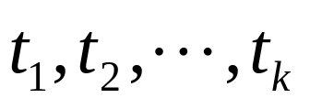
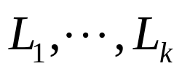
Using Multiple Trees
[Haghighi et al.] – Continued
Using the best Charniak’s parse, on development set
  Local Model: 74.52(F₁); Joint Model: 76.71(F₁)
Further enhanced by using Top K trees
  For top k trees from Charniak’s parser find corresponding best SRL assignments and choose the tree and assignment that maximize the score (approx. joint probability of tree and assignment)
Final Results:
  WSJ-23: 78.45 (F₁), 79.54 (Prec.), 77.39 (Rec.)
  Brown: 67.71 (F₁), 70.24 (Prec.), 65.37 (Rec.)
  Bug-fixed post-evaluation: WSJ-23 80.32 (F₁) Brown 68.81 (F₁)

Slide 94
Details of CoNLL-05 Systems
Top performing systems
  Màrquez et al. (Technical University of Catalonia)
  Pradhan et al. (University of Colorado at Boulder)
  Punyakanok et al. (U. of Illinois at Urbana-Champaign)
  Haghighi et al. (Stanford University)
Spotlight systems
  Yi & Palmer – integrating syntactic and semantic parsing
  Cohn & Blunsom – SRL with Tree CRFs
  Carreras – system combination
Notes:
20 minutes
Nancy McCracken, On the Amount of Training Data in SRL. (PDF)

Slide 95
The Integration of Syntactic Parsing and Semantic Role Labeling [Yi & Palmer]
The bottleneck of the SRL task: parsing
  With [Xue&Palmer 04] pruning, given different parsers: 12%~18% arguments are lost (Development Set: WSJ-22)
What do we want from syntactic parsing?
  Correct constituent boundaries
  Correct tree structures: expressing the dependency between the target verb and its arguments (e.g., the path feature)
The proposed approach:
  Combine syntactic parsing & argument identification (different cut of the task)
    Train a new parser on the training data created by merging the Penn Treebank & the PropBank (sec 02-21)
Slide from Yi&Palmer (CoNLL 2005)

Slide 96
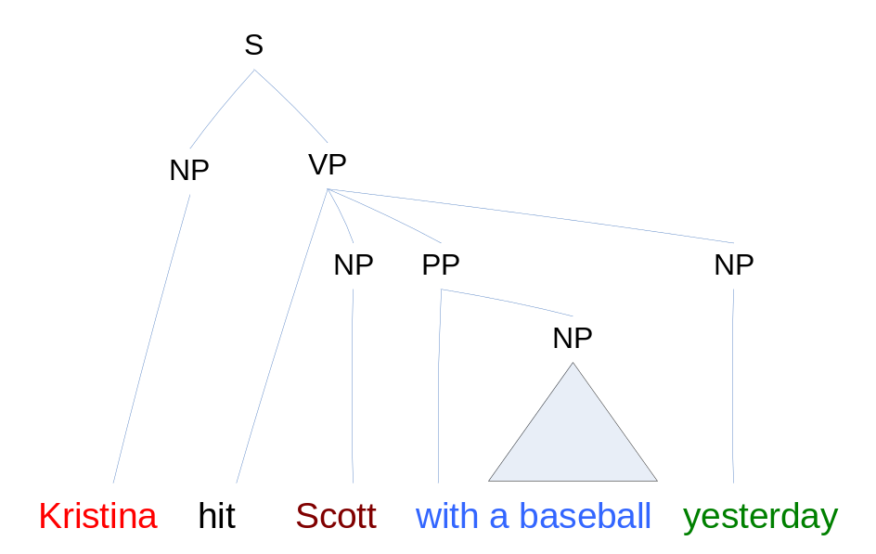
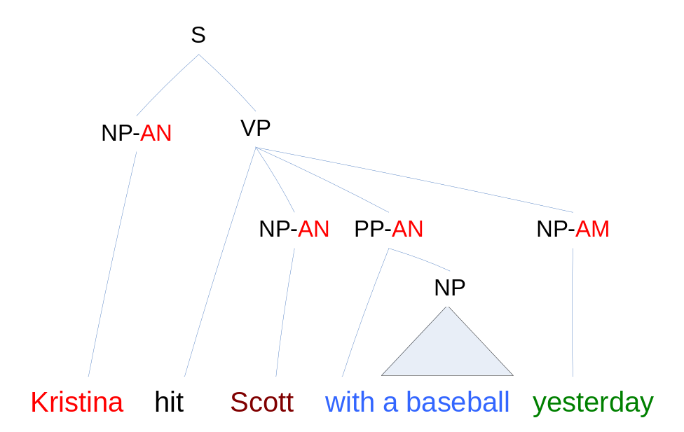
Data Preparation & Base Parser
[Yi & Palmer] – Continued
Data preparation steps
  Strip off the Penn Treebank function tags
  2 types of sub-labels to represent the PropBank arguments
    AN: core arguments
    AM: adjunct-like arguments
Train new maximum-entropy parsers [Ratnaparkhi 99]
Based on Yi&Palmer’s slides (CoNLL 2005)

Slide 97
Results & Discussion
[Yi & Palmer] – Continued
Overall results on development set
 | F₁ | Prec. | Rec.
AN-parser | 67.28 | 71.31 | 63.68
AM-parser | 69.31 | 74.09 | 65.11
Charniak | 69.98 | 76.31 | 64.62
Combined | 72.73 | 75.70 | 69.99
Final F₁ – WSJ-23: 75.17, Brown: 63.14
Worse than using Charniak’s directly
  Because of weaker base parser?
Hurt both parsing and argument identification?

Slide 98
SRL with Tree CRFs [Cohn & Blunsom]
A different joint model – apply tree CRFs
  Generate the full parse tree using Collins’ parser
  Prune the tree using [Xue&Palmer 04]
  Label each remaining constituent the semantic role or None
  Learn the CRFs model
Efficient CRF inference methods exist for trees
  Maximum Likelihood Training: sum-product algorithm
  Finding the best in Testing: max-product algorithm

Slide 99
Tree Labeling
[Cohn & Blunsom] – Continued
None
V
A0
A1
A2
AM-TMP
None

Slide 100
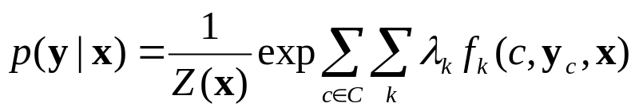


Model and Results
[Cohn & Blunsom] – Continued
Definition of CRFs
Maximum log-likelihood training
  Use sum-product to calculate marginal
Inference
  Use max-product to find the best labeling
Results: Final F₁ – WSJ-23: 73.10, Brown: 63.63
Findings [Cohn&Blunsom CoNLL-05 slides]:
  CRFs improved over maxent classifier (+1%)
  Charniak parses more useful (+3%)
  Very few inconsistent ancestor/dependent labelings
  Quite a number of duplicate argument predictions
Data from Cohn&Blunsom’s slide (CoNLL 2005)

Slide 101
System Combination [Carreras et al.]
How much can we gain from combining different participating systems at argument level?
  Each system proposes arguments, scored according to overall F₁ on development
  The final score for an argument is the sum of scores given by systems
Greedy Selection
  Repeat, until no more arguments in the candidate list
    Select argument candidate with the best score
    Removing overlapping arguments from candidate list

Slide 102
Results & Discussion
[Carreras et al.] – Continued
WSJ-23 | F₁ | Prec. | Rec.
punyakanok+haghighi+pradhan | 80.21 | 79.10 | 81.36
punyakanok | 79.44 | 82.28 | 76.78
Brown | F₁ | Prec. | Rec.
haghighi+marquez+pradhan+tsai | 69.74 | 69.40 | 70.10
punyakanok | 67.75 | 73.38 | 62.93
The greedy method of combing systems increases recall but sacrifices precision.
The gain on F₁ is not huge.
Notes:
Suggest dynamic programming or ILP methods for combining systems, instead of ad-hoc greedy search

Slide 103
Part III: CoNLL-05 Shared Task on SRL
Details of top systems and interesting systems
  Introduce the top 4 systems
  Describe 3 spotlight systems
Analysis of the overall results
  General performance
  System properties
  Per argument performance
Directions for improving SRL systems

Slide 104
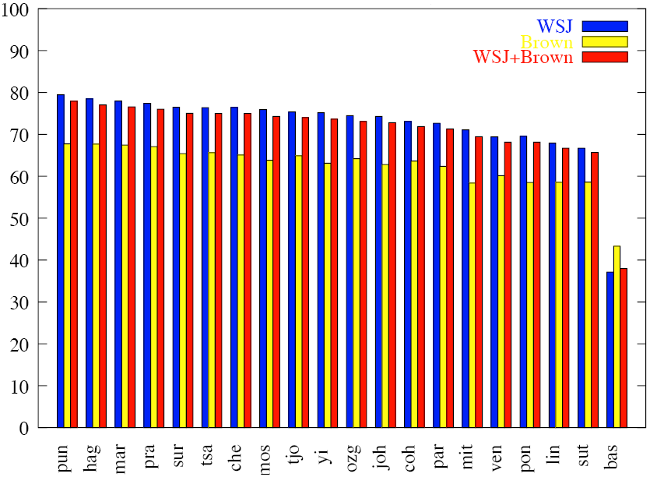
Results on WSJ and Brown Tests
F₁: 70% ~ 80%
Small differences
Every system suffers from cross-domain test (~10%)
Figure from Carreras&Màrquez’s slide (CoNLL 2005)
Notes:
Systems are ranked by their performance on the WSJ+Brown test. The significance intervals for the F rates in
that column have been obtained with bootstrap resampling [Nor89]. F rates outside of these intervals are
assumed to be significantly different from the related F rate (p<0.05).

Slide 105
System Properties
Learning Methods
  SNoW, MaxEnt, AdaBoost, SVM, CRFs, etc.
  The choice of learning algorithms is less important.
Features
  All teams implement more or less the standard features with some variations.
  A must-do for building a good system!
  A clear feature study and more feature engineering will be helpful.

Slide 106
System Properties – Continued
Syntactic Information
  Charniak’s parser, Collins’ parser, clauser, chunker, etc.
  Top systems use Charniak’s parser or some mixture
  Quality of syntactic information is very important!
System/Information Combination
  8 teams implement some level of combination
  Greedy, Re-ranking, Stacking, ILP inference
  Combination of systems or syntactic information is a good strategy to reduce the influence of incorrect syntactic information!

Slide 107
Per Argument Performance
CoNLL-05 Results on WSJ-Test
Core Arguments
(Freq. ~70%)
Adjuncts (Freq. ~30%)
 | Best F₁ | Freq.
TMP | 78.21 | 6.86%
ADV | 59.73 | 3.46%
DIS | 80.45 | 2.05%
MNR | 59.22 | 2.67%
LOC | 60.99 | 2.48%
MOD | 98.47 | 3.83%
CAU | 64.62 | 0.50%
NEG | 98.91 | 1.36%
 | Best F₁ | Freq.
A0 | 88.31 | 25.58%
A1 | 79.91 | 35.36%
A2 | 70.26 | 8.26%
A3 | 65.26 | 1.39%
A4 | 77.25 | 1.09%
Arguments that need
to be improved
Data from Carreras&Màrquez’s slides (CoNLL 2005)

Slide 108
Groups of Verbs in WSJ-Test
By their frequencies in WSJ-Train
 | 0 | 1-20 | 21-100 | 101-500 | 501-1000
Verbs | 34 | 418 | 359 | 149 | 18
Props | 37 | 568 | 1098 | 1896 | 765
Args. | 70 | 1049 | 2066 | 3559 | 1450
CoNLL-05 Results on WSJ-Test – Core Arguments
 | 0 | 1-20 | 21-100 | 101-500 | 501-1000
Args. % | 0.9 | 12.8 | 25.2 | 43.4 | 17.7
Best F₁ | 73.38 | 76.05 | 80.43 | 81.70 | 80.31
Arguments of low-frequency
verbs need to be improved
Data from Carreras&Màrquez’s slides (CoNLL 2005)

Slide 109
Part III: CoNLL-05 Shared Task on SRL
Details of top systems and interesting systems
  Introduce the top 4 systems
  Describe 3 spotlight systems
Analysis of the overall results
  General performance
  System properties
  Per argument performance
Directions for improving SRL systems

Slide 110
Directions for Improving SRL
Better feature engineering
  Maybe the most important issue in practice
Joint modeling/inference
  How to improve current approaches?
Fine-tuned learning components
  Can a more complicated system help?
Cross domain robustness
  Challenge to applying SRL systems
Notes:
10 mins

Slide 111
Better Feature Engineering
Gildea&Jurafsky ’02
Target predicate
Voice
Subcategorization
Path
Position (left, right)
Phrase Type
Governing Category
Head Word
Surdeanu et al ’03
Content Word
Head Word POS
Content Word POS
Named Entity
Xue&Palmer ’04
Feature conjunctions
Syntactic frame
Head of PP Parent
Pradhan et al ’04
Phrase Type / Head Word / POS of
Left/Right/Parent constituent
First/Last word/POS
Individual feature contribution is not clear
  Every set of features provide some improvement, but…
  Different system, different corpus, different usage
Notes:
Review of key features
The improvement of each feature
Directions
Features used in syntactic parsing
Features used in word sense disambiguation

Slide 112
Joint Model/Inference
Unless pure local model reaches prefect results, joint model/inference often can improve the performance
Greedy rules
  Fast & Effective
  With no clear objective function
  Often increase recall by sacrificing precision
Integer linear programming inference [Roth&Yih 04]
  With clear objective function
  Can represent fairly general hard constraints
  More expensive to integrate soft (statistical) constraints
Joint Model [Toutanova et al. 05] [Cohn&Blunsom 05]
  Capture statistical and hard constraints directly from the data
  Need re-ranking to avoid complexity problems [Toutanova et al. 05]
  Capture only local dependency [Cohn&Blunsom 05]

Slide 113
Fine-tuned Learning Components
Separate core arguments and adjuncts
  Adjuncts are independent of the target verb
  Performance may be enhanced with specific features
      Pradhan et al. (2005) did feature selection for each argument type
Train systems for different (groups of) verbs
  Verbs (or senses) may have very different role sets
  Example: stay.01(remain) vs. look.02 (seeming)
[_{A1} Consumer confidence] stayed [_{A3} strong] in October.
[_{A0} The demand] looked [_{A1} strong] in October.

Slide 114
Cross Domain Robustness
The performance of SRL systems drops significantly when applied on a different corpus
  ~10% F₁ from WSJ to Brown
  The performance of all the syntactic taggers and parsers drops significantly
    All trained on WSJ
May not build a robust system without data
  Semi-supervised learning
  Active learning
Notes:
POS: UPC: 97.36 vs. 94.73; Charniak: 92.29 vs. 87.89
Chunker: 94.89 vs. 91.73; Clauser: 88.36 vs. 78.95; Collins: 85.41 vs. 82.00; Charniak: 88.25 vs. 80.84
WSJ Test: 2416 propositions; Brown Test: 426 propositions

Slide 115
Summary of Part III:
CoNLL-05 Shared Task on SRL
Described the details of top performing SRL systems
  Implement generally all standard features
  Use good syntactic information – Charniak’s parser & more
  Deploy system/information combination schemes
  Achieve ~80% F₁ on WSJ, ~70% F₁ on Brown
Introduced some interesting systems
  Train syntactic parser and argument identifier together
  Apply Tree CRFs model
  Investigate the performance of a large system combination

Slide 116
Summary of Part III:
CoNLL-05 Shared Task on SRL – Continued
Analyzed the results of the CoNLL-05 systems
  General performance
    Performance on WSJ is between 70% and 80%
    The differences among systems are small
    Every system suffers from cross-domain test; ~10% F₁ drop on Brown corpus
  Per argument performance
    Core arguments A1 and A2 and some frequent adjunct arguments need to be improved
    Arguments of low-frequency verbs need to be improved

Slide 117
Summary of Part III:
CoNLL-05 Shared Task on SRL – Continued
Directions for improving SRL systems
  Perform careful feature study
  Design better features
  Enhance current joint model/inference techniques
  Separate models for different argument sets
  Improve cross domain robustness
Next part: Applications of SRL systems

Slide 118
Quick Overview
Part I. Introduction
  What is Semantic Role Labeling?
  From manually created grammars to statistical approaches
    Early Work
    Corpora – FrameNet, PropBank, Chinese PropBank, NomBank
  The relation between Semantic Role Labeling and other tasks
Part II. General overview of SRL systems
  System architectures
  Machine learning models
Part III. CoNLL-05 shared task on SRL
  Details of top systems and interesting systems
  Analysis of the results
  Research directions on improving SRL systems
Part IV. Applications of SRL

Slide 119
Part IV: Applications
Information Extraction
  Reduce development time
Summarization
  Sentence matching
Question Answering
  Understand questions better
Textual Entailment
  Deeper semantic representation
Notes:
Now we are getting to the important question of how SRL has been useful to represent meaning in applications. I will discuss some inteesrting ways in which knowledge of predicate-argument structures has been used in these applications.

Slide 120
SRL in Information Extraction [Surdeanu et al. 03]
Information Extraction (HUB Event-99 evaluations, [Hirschman et al 99] )
  A set of domain dependent templettes, summarizing information about events from multiple sentences
<MARKET_CHANGE_1>:=
INSTRUMENT | London [gold]
AMOUNT_CHANGE | fell [$4.70] cents
CURRENT_VALUE | $308.45
DATE: | daily
Time for our daily market report from NASDAQ.
London gold fell $4.70 cents to $308.45.
Notes:
We said before that IE is a task where we learn to extract information about specific events which can be summarized in a template frame with slots. The general approach has been to learn a separate system for every new information extraction task and every new domain. The idea in Surdeanu et al’s work is to use semantic role labeling as a general meaning representation and learn how to map from the Propbank predicate-argument structures to frames specific to each IE task.

Slide 121
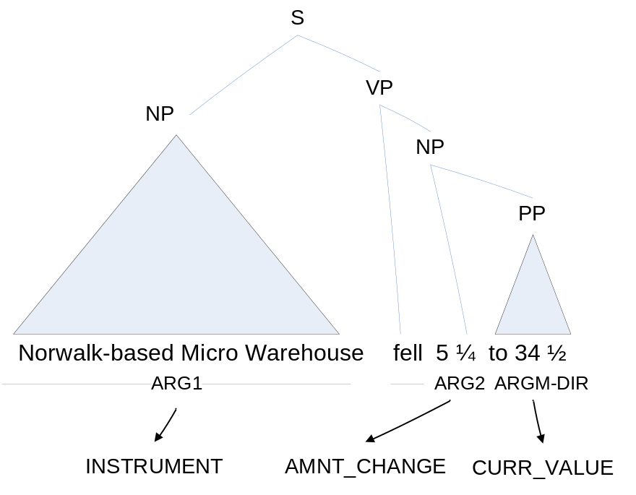
SRL in Information Extraction [Surdeanu et al. 03]-Continued
Find predicate argument relations and map resulting structures into templettes via hand-written simple rules
ARG1 and MARKET_CHANGE_VERB => INSTRUMENT
ARG2 and (MONEY or PERCENT or QAUNTITY) and MARKET_CHANGE_VERB => AMOUNT_CHANGE
(ARG4 or ARGM_DIR) and NUMBER and MARKET_CHANGE_VERB=> CURRENT_VALUE
Notes:
The approach they propose is rather than learning a classifier specific to these slots, first label; prose this approach

Slide 122
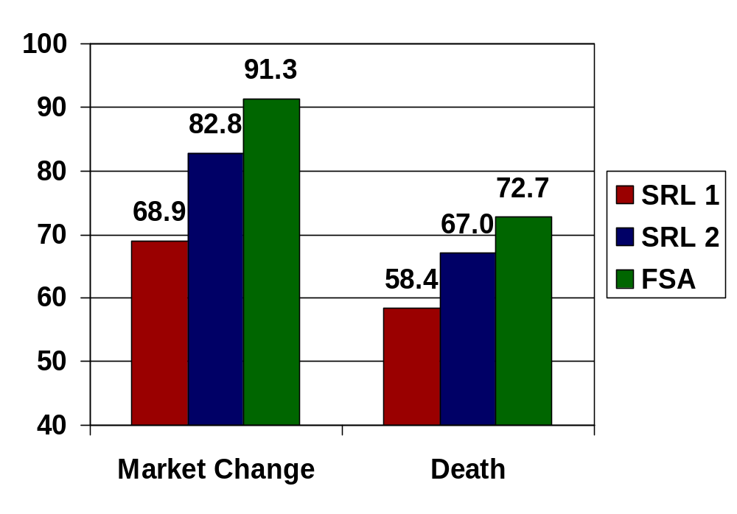
SRL in Information Extraction [Surdeanu et al. 03]-Continued
Results
  SRL 1
    Identification 71.9
    Classification 78.9
  SRL 2
    Identification 89.0
    Classification 83.7
  FSA is a traditional finite state approach
Better SRL leads to significantly better IE performance.
The FSA approach does better but requires intensive human effort (10 person days).
The systems using SRL require 2 hours of human effort.
Notes:
Read the paper again; what are the two systems: baseline system and additional features

Slide 123
SRL in Summarization
(SQUASH, [Melli et al. 05] SFU)
The task is to generate a 250-word summary from multiple documents
  Given a specified topic and level of detail (specific, general)
  Title: American Tobacco Companies Overseas
  Narrative: In the early 1990's, American tobacco companies tried to expand their business overseas. What did these companies do or try to do and where? How did their parent companies fare?
  Granularity: specific
The system uses SRL extensively for:
  Estimating a significance score for a sentence
    which entities participate in which semantic relations
  Estimating sentence similarity
    which entities participating in which semantic relations are contained in two sentences
Notes:
SRL has been used in topic focussed summarization by the system SQAUSH

Slide 124
SRL in Summarization
(SQUASH, [Melli et al. 05]-Continued)
It is not possible to remove just the SRL component from the system since SRL is used throughout
Improving the SRL system improves Summarization performance (ROUGE-2 scores on the development set)
  Naïve SRL 0.0699
  ASSERT SRL 0.0731
This is a pretty large improvement considering the impact of other successful features
  Bias toward the first sentences 0.0714 → 0.0738
The overall placement of an earlier version of SQUASH was 7th out of 25 systems in DUC 2005
Notes:
Check placement in DUC 2005

Slide 125
SRL in Question Answering
[Narayanan & Harabagiu 04]
Parsing Questions
Parsing Answers
Result: exact answer= “approximately 7 kg of HEU”
Q: What kind of materials were stolen from the Russian navy?
PAS(Q): What [_{A1} kind of nuclear materials] were [Predicate:stolen]
[_{A2} from the Russian Navy]?
A(Q): Russia’s Pacific Fleet has also fallen prey to nuclear theft; in 1/96, approximately 7 kg of HEU was reportedly stolen from a naval base in Sovetskaya Gavan.
PAS(A(Q)): [_{A1(P1)} Russia’s Pacific Fleet] has [_{AM-DIS(P1)} also]
[P1: fallen] [_{A1(P1)} prey to nuclear theft];
[_{AM-TMP(P2)} in 1/96], [_{A1(P2)} approximately 7 kg of HEU]
was [_{AM-ADV(P2)} reportedly] [P2: stolen]
[_{A2(P2)} from a naval base] [_{A3(P2)}in Sovetskawa Gavan]
Slide from Harabagiu and Narayanan (HLT 2004)
Notes:
Looks fine

Slide 126
SRL in Question Answering
[Narayanan & Harabagiu 04]-Continued
Parsing Questions
Parsing Answers
Result: exact answer= “approximately 7 kg of HEU”
Q: What kind of materials were stolen from the Russian navy?
FS(Q): What [_{GOODS} kind of nuclear materials] were [_{Target-Predicate} stolen]
[_{VICTIM} from the Russian Navy]?
A(Q): Russia’s Pacific Fleet has also fallen prey to nuclear theft; in 1/96, approximately 7 kg of HEU was reportedly stolen from a naval base in Sovetskaya Gavan.
FS(A(Q)): [_{VICTIM(P1)} Russia’s Pacific Fleet] has also fallen prey to [_{GOODS(P1)} nuclear ]
[_{Target-Predicate(P1)} theft]; in 1/96, [_{GOODS(P2)} approximately 7 kg of HEU]
was reportedly [_{Target-Predicate (P2)} stolen]
[_{VICTIM (P2)} from a naval base] [_{SOURCE(P2)} in Sovetskawa Gavan]
Slide from Harabagiu and Narayanan (HLT 2004)
Notes:
Looks fine

Slide 127
SRL in Question Answering
[Narayanan & Harabagiu 04]-Continued
Evaluation of gains due to predicate-argument information.
Percent of questions for which the correct answer type was identified through using each structure.
Question: What is the additional value compared to matching based on syntactic analyses?
Structure Used | Percent of Questions
Answer Hierarchy | 12%
PropBank analyses | 32%
FrameNet analyses | 19%
Notes:
Looks fine
Looks fine
For 12 % of questions, the correct answer type was identified through classification into the Answer Hierarchy
For 32 % of questions the correct answer type was identified through matching question and answer structures using Propbank-based analyses
For 19 % of questions the correct answer type was identified through matching the question and answer structures using Framenet-based analyses
Read some more on this answer type stuff

Slide 128
SRL in Textual Entailment
[Braz et al. 05]
Does a given text S entail a given sentence T
  S: The bombers had not managed to enter the building
  T: The bombers entered the building
Evaluating entailment by matching predicate argument structure
  S1: [_{ARG0}The bombers] had [_{ARGM_NEG}not] managed to [_{PRED}enter] [_{ARG1} the building]
  T1: [_{ARG0}The bombers] [_{PRED}entered] [_{ARG1} the building]
S does not entail T because they do not have the same set of arguments
Notes:
Looks fine

Slide 129
SRL in Textual Entailment
[Braz et al. 05]-Continued
SRL forms the basis of the algorithm for deciding entailment.
It is also extensively used in rewrite rules which preserve semantic equivalence.
Not possible to isolate the effect of SRL and unknown whether a syntactic parse approach can do similarly well.
Results on the PASCAL RTE challenge 2005
  Word based baseline: 54.7
  System using SRL and syntactic parsing: 65.9
The system placed 4th out of 28 runs by 16 teams in the PASCAL RTE Challenge
Notes:
Double check the placement

Slide 130
Summary of Part IV: Applications
Information Extraction
  SRL has advantages in development time; good SRL → good IE
  FSA systems are still about 10% better.
Summarization
  Sophisticated sentence matching using SRL
  Improving SRL improves summarization.
Question Answering
  Having more complex semantic structures increases the number of questions that can be handled about 3 times.
Textual Entailment
  SRL enables complex inferences which are not allowed using surface representations.
Action item: evaluate contributions of SRL vs. syntactic parsing
  None of the systems performs a careful comparison
Notes:
Add specific numbers

Slide 131
Conclusions
Semantic Role Labeling is relatively new but has attracted a lot of interest
Large corpora with annotated data are available
  FrameNet, PropBank
It provides a novel broad-coverage level of semantic interpretation
  Shallower than some alternatives (Deep Parsing for limited and broad domains)
  Deeper than others (Penn Treebank analyses with function tags)
Tasks which profit from Penn Treebank syntactic analyses should profit from this semantic layer

Slide 132
Conclusions
Current State of the Art systems
Achieve about 80% per-argument F-measure (60% whole propositions correct)
  Performance is respectable but still there is a lot of room for improvement
  Inter-annotator agreement is 99% for all nodes given gold-standard syntactic parses (chance agreement is 88%); not comparable to system results
Build on the strength of statistical parsing models
  Perform poorly when the syntactic parsers do so
Use syntactic information extensively
Have mechanisms for increasing robustness to parser error
Use powerful machine learning techniques
Model dependencies among argument labels
A0
A1

Slide 133
Conclusions
Directions for Improving SRL
Increase robustness to syntactic parser error
Find ways to collect additional knowledge
  Use unlabeled data
  Share information across verbs
  Can applications create more data for SRL automatically?
Improve the statistical models
  Other features, other dependencies
Improve search/inference procedures

Slide 134
Conclusions
Major Challenges
Need to connect SRL to natural language applications
  Study the additional value of semantic labels compared to surface representations and syntactic analyses
  Apply SRL to other applications
    More Information Extraction applications
    ATIS labeling and NL interfaces to databases
  Have we defined the corpora well?
    Validate the annotation standards through application domains
  What level of accuracy is needed in order for SRL to be useful?

Slide 135
Final Remarks
Semantic Role Labeling is an exciting area of research!
  Progress is fast
  There is still room for large contributions
Provides robust broad-coverage semantic representations
Easy integration with applications (Information Extraction, Question Answering, Summarization, Textual Entailment)
  Good results in tasks
Tools available online that produce SRL structures
  ASSERT (Automatic Statistical SEmantic Role Tagger) http://oak.colorado.edu/assert
  UIUC system (http://l2r.cs.uiuc.edu/~cogcomp/srl-demo.php)

Slide 136
Acknowledgment
We’d like to thank the following people, who kindly provided their slides to us.
  Lucy Vanderwende, Sameer Pradhan, Xavier Carreras, Lluís Màrquez, Szu-ting Yi, Srini Narayanan, and Sanda Harabagiu
We are very grateful to Joshua Goodman, who gave us many valuable comments and helped us to prepare the materials better.
We are also thankful to our colleagues and friends who attended our practical talk and gave us many useful feedbacks.
Finally, we thank the audience of our tutorial for their interest and also the questions and discussions.

Slide 137
References: Introduction
Hiyan Alshawi, editor. The core language engine. MIT Press, 1992.
Ion Androutsopoulos, Graeme Ritchie, and Peter Thanisch. Natural language interfaces to databases - an introduction. In Journal of Natural Language Engineering 1(1), 1995.
Douglas Appelt and David Israel. Introduction to Information Extraction technology. Tutorial at IJCAI 1999.
Don Blaheta and Eugene Charniak. Assigning function tags to parsed text. In Proceedings of NAACL 2000.
Don Blaheta. Function tagging. PhD Thesis, Brown CS Department, 2003.
Joan Bresnan. Lexical-functional syntax. Blackwell, 2001.
Ann Copestake and Dan Flickinger. An open-source grammar development environment and broad-coverage English grammar using HPSG. In Proceedings of LREC-2000.
John Dowding, Jean Gawron, Doug Appelt, John Bear, Lynn Cherny, Robert Moore, and Douglas Moran. Gemini: a natural language system for spoken-language understanding. In Proceedings of ACL 1993.

Slide 138
References: Introduction
Charles J. Fillmore, Charles Wooters, and Collin F. Baker. Building a large lexical databank which provides deep semantics. In Proceedings of the Pacific Asian Conference on Language, Information and Computation 2001.
Ruifang Ge and Raymond Mooney. A statistical semantic parser that integrates syntax and semantics. In Proceedings of CoNLL 2005.
Graeme Hirst. Semantic interpretation and the resolution of ambiguity (Studies in natural language processing). Cambridge University Press, 1987.
Lynette Hirschman, Patricia Robinson, Lisa Ferro, Nancy Chinchor, Erica Brown, Ralph Grishman, and Beth Sundheim. Hub 4 Event99 general guidelines and templettes, 1999.
John T. Maxwell and Ronald M. Kaplan. The interface between phrasal and functional constraints. In Computational Linguistics,19(4), 1993.

Slide 139
References: Introduction
Ion Muslea. Extraction patterns for Information Extraction tasks: a survey. In Proceedings of the AAAI Workshop on Machine Learning for IE, 1999.
Yusuke Miyao and Jun'ichi Tsujii. Probabilistic disambiguation models for wide-coverage HPSG parsing. In Proceedings of ACL 2005.
Scott Miller, Robert Bobrow, Robert Ingria, and Richard Schwartz. A Fully statistical approach to natural language interfaces. In Proceedings of ACL 1996.
Martha Palmer, Dan Gildea, and Paul Kingsbury. The Proposition Bank: An annotated corpus of semantic roles. In Computational Linguistics, 31(1), 2005.
Carl Pollard and Ivan A. Sag. Head-Driven Phrase Structure Grammar. University of Chicago Press, 1994.
Patti Price. Evaluation of spoken language systems: the ATIS domain. In Proceedings of the third DARPA Speech and Natural Language Workshop, 1990.

Slide 140
References: Introduction
Stefan Riezler, Tracy H. King, Ronald M. Kaplan, Richard Crouch, John T. Maxwell III, and Mark Johnson. Parsing the Wall Street Journal using a Lexical-Functional grammar and discriminative estimation techniques. In Proceedings of ACL 2002.
Hisami Suzuki and Kristina Toutanova. Learning to predict case markers in Japanese. In Proceedings of ACL-COLING 2006.
Kristina Toutanova, Penka Markova, and Christopher D. Manning. The leaf projection path view of parse trees: Exploring string kernels for HPSG parse selection. In Proceedings of EMNLP 2004.
Kiyotaka Uchimoto, Satoshi Sekine and Hitoshi Isahara. Text generation from keywords. In Proceedings of COLING 2002.
Ye-Yi Wang, John Lee, Milind Mahajan, and Alex Acero. Combining statistical and knowledge-based spoken language understanding in conditional models. In Proceedings of ACL-COLING 2006.

Slide 141
References: Introduction
Ye-Yi Wang, Li Deng, and Alex Acero. Spoken language understanding: An introduction to the statistical framework. In IEEE Signal Processing Magazine, Vol 27 No. 5. 2005.
Wayne Ward. Recent Improvements in the CMU spoken language understanding system. In Proceedings of Human Language Technology Workshop, 1994.
Yuk Wah Wong and Raymond Mooney. Learning for semantic parsing with statistcial machine translation. In Proceedings of HLT/NAACL 2006.
John Zelle and Raymond Mooney. Learning to parse database queries using inductive logic programming. In Proceedings of AAAI 1996.
Luke Zettlemoyer and Michael Collins. Learning to map sentences to logical form: structured classification with probabilistic Categorial Grammars. In Proceedings of UAI 2005.

Slide 142
References: Overview of SRL Systems
John Chen and Owen Rambow. Use of deep linguistic features for the recognition and labeling of semantic arguments. In Proceedings of EMNLP 2003.
Xavier Carreras and Lluís Màrquez. Introduction to the CoNLL-2005 shared task: Semantic role labeling. In Proceedings of CoNLL 2005.
Trevor Cohn and Philip Blunsom. Semantic role labelling with tree Conditional Random Fields. In Proceedings of CoNLL 2005.
Daniel Gildea and Daniel Jurafsky. Automatic labeling of semantic roles. In Computational Linguistics, 28(3), 2002.
Daniel Gildea and Martha Palmer. The necessity of parsing for predicate argument recognition. In Proceedings of ACL 2002 .
Daniel Gildea and Julia Hockenmaier. Identifying semantic roles using Combinatory Categorial Grammar. In Proceedings of EMNLP 2003.

Slide 143
References: Overview of SRL Systems
Aria Haghighi, Kristina Toutanova, and Christopher Manning. A joint model for semantic role labeling. In Proceedings of CoNLL 2005.
Lluís Màrquez, Pere Comas, Jesús Giménez, and Neus Català.
Semantic role labeling as sequential tagging. In Proceedings of CoNLL 2005.
Sameer Pradhan, Wayne Ward, Kadri Hacioglu, James H. Martin and Dan Jurafsky. Semantic role labeling using different syntactic views. In Proceedings of ACL 2005.
Sameer Pradhan, Wayne Ward, Kadri Hacioglu, James Martin, and Dan Jurafsky. Shallow semantic parsing using Support Vector Machines. In Proceedings of HLT 2004.
Vasin Punyakanok, Dan Roth, Wen-tau Yih and Dav Zimak. Semantic role labeling via Integer Linear Programming inference. In Proceedings of COLING 2004.

Slide 144
References: Overview of SRL Systems
Vasin Punyakanok, Dan Roth, and Wen-tau Yih. The necessity of syntactic parsing for semantic role labeling. In Proceedings of IJCAI 2005.
Mihai Surdeanu, Sanda Harabagiu, John Williams, and Paul Aarseth. Using predicate-argument structures for Information Extraction. In Proceedings of ACL 2003.
Kristina Toutanova. Effective statistical models for syntactic and semantic disambiguation. PhD Thesis, Stanford CS Department, 2005.
Kristina Toutanova, Aria Haghighi, and Christopher D. Manning. Joint learning improves semantic role labeling. In Proceedings of ACL 2005.
Nianwen Xue and Martha Palmer. Calibrating features for semantic role labeling. In Proceedings of EMNLP 2004.

Slide 145
References:
CoNLL-05 Shared Task on SRL
Xavier Carreras and Lluís Màrquez. Introduction to the CoNLL-2005 shared task: Semantic role labeling. In Proceedings of CoNLL 2005.
Trevor Cohn and Philip Blunsom. Semantic role labelling with tree Conditional Random Fields. In Proceedings of CoNLL-2005.
Michael Collins and Terry Koo. Discriminative reranking for natural language parsing. In Computational Linguistics 31(1), 2005.
Daniel Gildea and Daniel Jurafsky. Automatic labeling of semantic roles. In Computational Linguistics, 28(3), 2002.
Kadri Hacioglu and Wayne Ward. Target word detection and semantic role chunking using Support Vector Machines. In Proceedings of HLT-NACCL 2003.
Aria Haghighi, Kristina Toutanova, and Christopher Manning. A Joint model for semantic role labeling. In Proceedings of CoNLL-2005.

Slide 146
References:
CoNLL-05 Shared Task on SRL
Vasin Punyakanok, Dan Roth, and Wen-tau Yih. Generalized inference with multiple semantic role labeling systems. In Proceedings of CoNLL-2005.
Taku Kudo and Yuji Matsumoto. Chunking with Support Vector Machines. In Proceedings of NAACL 2001.
Lluís Màrquez, Pere Comas, Jesús Giménez, and Neus Català.
Semantic role labeling as sequential tagging. In Proceedings of CoNLL 2005.
Sameer Pradhan, Wayne Ward, Kadri Hacioglu, James Martin, and Dan Jurafsky. Shallow semantic parsing using Support Vector Machines. In Proceedings of HLT 2004.
Sameer Pradhan, Kadri Hacioglu, Wayne Ward, James H. Martin, and Daniel Jurafsky. Semantic role chunking combining complementary syntactic views. In Proceedings of CoNLL 2005.
Dan Roth and Wen-tau Yih. A Linear Programming formulation for global inference in natural language tasks. In Proceedings of COLING 2004.

Slide 147
References:
CoNLL-05 Shared Task on SRL
Mihai Surdeanu, Sanda Harabagiu, John Williams, and Paul Aarseth. Using predicate-argument structures for Information Extraction. In Proceedings of ACL 2003.
Kristina Toutanova, Aria Haghighi, and Christopher D. Manning. Joint learning improves semantic role labeling. In Proceedings of ACL 2005.
Szu-ting Yi and Martha Palmer. The integration of syntactic parsing and semantic role labeling. In Proceedings of CoNLL 2005.
Nianwen Xue and Martha Palmer. Calibrating features for semantic role labeling. In Proceedings of EMNLP 2004.

Slide 148
References: Applications
Rodrigo de Salvo Braz, Roxana Girju, Vasin Punyakanok, Dan Roth, and Mark Sammons. An inference model for semantic entailment in natural language. In Proceedings of AAAI 2005.
Lynette Hirschman, Patricia Robinson, Lisa Ferro, Nancy Chinchor, Erica Brown, Ralph Grishman, and Beth Sundheim. Hub 4 Event99 general guidelines and templettes, 1999.
Gabor Melli, Yang Wang, Yudong Liu, Mehdi M. Kashani, Zhongmin Shi, Baohua Gu, Anoop Sarkar and Fred Popowich. Description of SQUASH, the SFU question answering summary handler for the DUC-2005 summarization task. In Proceedings of DUC 2005.
Srini Narayanan and Sanda Harabagiu. Question answering based on semantic structures. In Proceedings of COLING 2004.
Mihai Surdeanu, Sanda Harabagiu, John Williams, and Paul Aarseth. Using predicate-argument structures for Information Extraction. In Proceedings of ACL 2003.

