Slide 1
Similarity Models for Ad Relevance Measures
Scott Wen-tau Yih (Microsoft Research)
Joint work with Ning Jiang (Microsoft AdCenter)

Slide 2
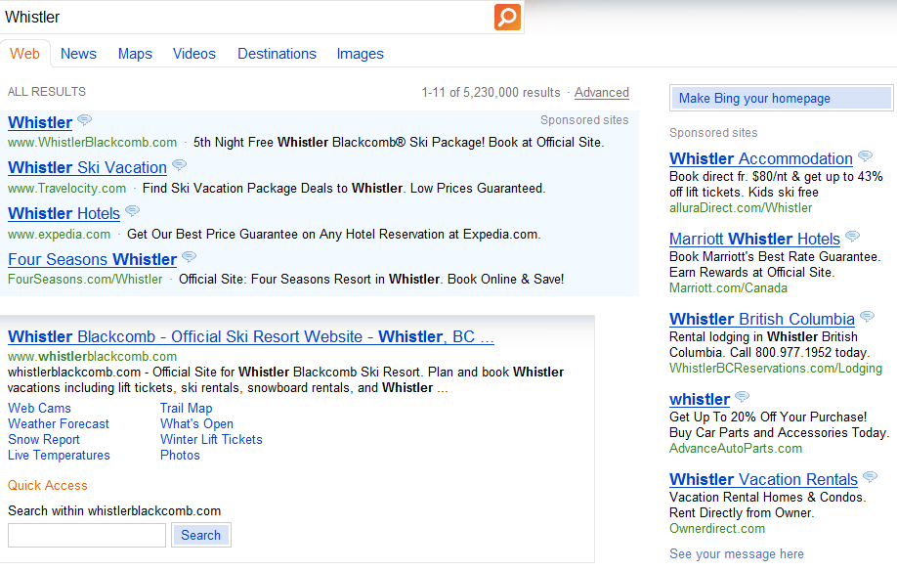
Paid-Search Ad Relevance
Query | Ad
Whistler | Whistler Accommodation Book direct fr. $80/nt & get up to 43% off list tickets. Kids ski free alluraDirect.com/Whistler

Slide 3
Paid-Search Ad Relevance
Query | Ad
Whistler | whistler Get Up To 20% Off Your Purchase! Buy Car Parts and Accessories Today. AdvanceAutoParts.com

Slide 4

Vector Space Model
v_{qry}
cos($θ$)
θ
v_{ad}
Construct better term-vectors
Query: Pseudo relevance feedback [Broder et al. CIKM-08]
Ad: Extracting landing page content [Choi et al. WWW-10]
Pros – Computational efficiency
Similarity score serves as a strong feature
Ad selection can be done via inverted index
Cons – Ad-hoc heuristics
Term-vectors may not be easily tuned
Different but related terms cannot be matched
e.g., (used, car) vs. (pre-owned, auto)

Slide 5

Goal – Learn Vector Representation
Approach: Siamese neural network architecture
Train the model using labeled (query, ad-page)
Optimize for pre-selected similarity function (cosine)
$$y$$
v_{qry}
v_{ad}

Slide 6

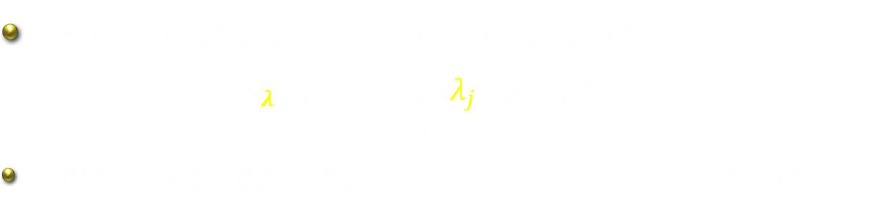

TWEAK: Term-weighting Learning
Learning the term-weighting function
$${tw}_{λ}\left(t_{i},D\right)=\sum_{j}{λ_{j}⋅φ_{j}(t_{i},D)}$$
Term-level features: TF, DF, Loc, IsCap, InTitle, etc.
v_{qry}
v_{ad}
$$t_{1}$$
$$t_{n}$$

Slide 7

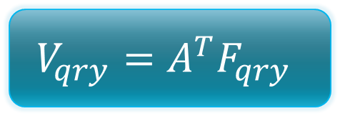





S2Net – Dimensionality Reduction
Model form is the same as LSA/PCA
Learning the projection matrix discriminatively
v_{qry}
v_{ad}
$$c_{1}$$
$$c_{k}$$
$$V_{qry}=A^{T}F_{qry}$$
$$A_{d×k}$$
$$t_{1}$$
$$t_{n}$$

Slide 8
28.5% improvement!

