Slide 1
The Necessity of Syntactic Parsing for Semantic Role Labeling
Scott Wen-tau Yih
Microsoft Research
Joint work with Vasin Punyakanok, Dan Roth
Department of Computer Science
University of Illinois at Urbana-Champaign
Notes:
This is a joint work with Vasin Punyakanok and Dan Roth.

Slide 2
Semantic Role Labeling (1/2)
For each verb in a sentence
  Identify all constituents that fill a semantic role
  Determine their roles
    Core Arguments, e.g., Agent, Patient or Instrument
    Their adjuncts, e.g., Locative, Temporal or Manner
A0 : leaver
A2 : benefactor
I left my pearls to my daughter-in-law in my will.
A1 : thing left
AM-LOC

Slide 3
Semantic Role Labeling (2/2)
PropBank [Kingsbury & Palmer02] provides a large human-annotated corpus of semantic verb-argument relations.
  It adds a layer of generic semantic labels to Penn Tree Bank II.
  (Almost) all the labels are on the constituents of the parse trees.
Core arguments: A0-A5 and AA
  different semantics for each verb
  specified in the PropBank Frame files
13 types of adjuncts labeled as AM-arg
  where arg specifies the adjunct type
Notes:
Why is it important?

Slide 4
Why is SRL important?
Shallow Semantic Parsing:
a predicate – argument structure of the sentence
Higher level NLP tasks can gain from this information
  Information Extraction
  Question Answering
  Textual Entailment
Does
The president visited Iraq last week.
imply
The senator will visit the President hotel in Iraq next week.

Slide 5
This Paper
Explores ways to improve SRL
  Best System in CoNLL-05 Shared Task!!
State of the Art (as of 2004)
  CoNLL-04 shared task (The first shared task on SRL)
    Only shallow parsing (chunker and clauser) is allowed
    Only 4 sections of WSJ are used for training
    F₁: the best system achieves 69.5% [Hacioglu et al.]
  When automatic full syntactic parsing is allowed
    F₁: 79.4 [Pradhan et al. 04], 76.21 [Xue&Palmer 04]
  Not a fair comparison – different data, different evaluation metrics
Notes:
We are the best system in CoNLL-05 shared task!
Read this paper if you want to win the competition!
How do we win the competition?

Slide 6
To Improve SRL (1/2)
We exploit full-parsing. In addition,
  Provide a fair comparison between using full-parsing and shallow-parsing
  The difference is not as high as previously thought – only 5% in F₁.
  Pruning (argument candidate filter) is really the stage where full-parsing helps.

Slide 7
To Improve SRL (2/2)
Our inference procedure pushes our system to the top
  It’s general and effective, and has been used also in other problems (e.g., entity/relation, coreference resolution, word sense disambiguation).
  It’s easy: once the problem is formulated in an integer linear program, it can be solved using off the shelf packages (e.g., Xpress-MP or CPLEX).
Different SRL systems can be easily combined via joint inference.

Slide 8
Outline
System Architecture
  Pruning → Argument Identification
  → Argument Classification → Inference
Compare shallow-parsing and full-parsing
  Experimental Setting
  Argument Classification, Argument Identification, Pruning
Combine different SRL systems through joint inference
Notes:
First, I am going to describe the basic system, and then explain how we can extend the inference stage to perform inference over the outputs of multiple SRL systems.

Slide 9
System Architecture
Strikes and mismanagement were cited and
Premier Ryzhkov warned of tough measures
Pruning
Strikes and mismanagement were cited and Premier Ryzhkov warned of tough measures
Argument Identification
Strikes and mismanagement were cited and Premier Ryzhkov warned of tough measures
Argument Classification
Strikes and mismanagement were cited and
Premier Ryzhkov warned of tough measures
A0
A0
Inference
Strikes and mismanagement were cited and
Premier Ryzhkov warned of tough measures
A0
A1

Slide 10
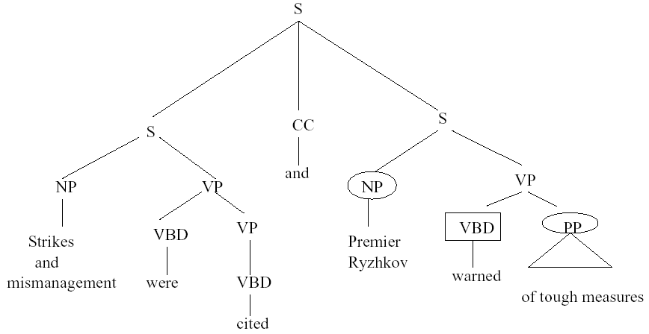
Pruning
Heuristics suggested by Xue&Palmer (2004)

Slide 11
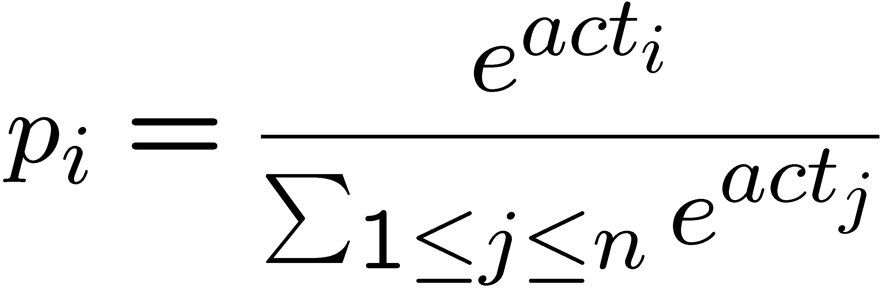
Argument Identification & Classification
Both argument identifier and argument classifier are trained phrase-based classifiers.
Features (some examples)
  voice, phrase type, head word, path, chunk, chunk pattern, etc.
Learning Algorithm – SNoW
  Sparse network of linear functions
    weights learned by regularized Winnow multiplicative update rule
  When probability estimation is needed, we use softmax

Slide 12
Inference
The output of the argument classifier often violates some constraints, especially when the sentence is long.
The integer linear programming inference procedure [Roth&Yih 04]
Input: the probability estimation (by the argument classifier), and structural and linguistic constraints
  Output: the best legitimate global predictions
  Formulated as an optimization problem and solved via Integer Linear Programming.
  Allows incorporating expressive (non-sequential) constraints on the variables (the arguments types).
Notes:
Finally we use an inference procedure to find the final outputs that satisfy some constraints.
We formulate this as an Integer Linear Programming problem which is very powerful. It allows incorporating expressive constraints over the variables of the problem.

Slide 13
Integer Linear Programming Inference
For each argument a_{i}
  Set up a Boolean variable: a_{i,t} indicating if a_{i} is classified as t
Goal is to maximize
  Σ _{i} score(a_{i} = t ) a_{i,t}
  Subject to the (linear) constraints
    Any Boolean constraints can be encoded this way.
If score(a_{i} = t ) = P(a_{i} = t ), the objective is to find the assignment that maximizes the expected number of arguments that are correct and satisfies the constraints.
Notes:
Specifically for this SRL. For each argument a_{i}, we introduce Boolean variables a_{i,t} to indicate if the argument is classified as type t.
The goal of the inference is to find the assignment to these variables that maximize the summation of the scores of the chosen arguments with respect to the constraints.
Note that if the score is the probability that an argument is assigned to a particular type, optimizing this objective is equivalent to trying to maximize the expected number of correct arguments.

Slide 14
Constraints
Any Boolean rule can be encoded as a set linear constraints.
No duplicate argument classes
  Σ_{a ∈ POTARG} x_{{a = A0}} ≤ 1
R-ARG
  ∀ a2 ∈ POTARG , Σ_{a ∈ POTARG} x_{{a = A0}} ≥ x_{{a2 = R-A0}}
C-ARG
  a2 ∈ POTARG ,
  Σ (a ∈ POTARG) Λ (a is before a2 ) x_{{a = A0}} ≥ x_{{a2 = C-A0}}
Many other possible constraints:
    Unique labels
    No overlapping or embedding
    Relations between number of arguments
    If verb is of type A, no argument of type B
Joint inference can be used also to combine different SRL Systems.
If there is an R-arg phrase, there is an arg Phrase
If there is an C-arg phrase, there is an arg before it
Notes:
Animation to show the following 3 constraints step by step
Binary constraints
Summation = 1 assures that it’s assigned only one label
Non-overlapping constraints
Remember to put a small bar picture

Slide 15
Outline
System Architecture
  Pruning → Argument Identification
  → Argument Classification → Inference
Compare shallow-parsing and full-parsing
  Experimental Setting
  Argument Classification, Argument Identification, Pruning
Combine different SRL systems through joint inference

Slide 16
Experimental Setting
Gold standard data (from Penn TreeBank II)
  Full parsing: the complete full parse trees
  Shallow parsing: clauses and atomic phrases
Automatic parsers
  Full parsing: Charniak’s parser (v0.4)
  Shallow parsing: POS tagger [Even-Zohar&Roth,01],
  chunker [Punyakanok&Roth,01], clauser [Carreras&Marquez,03]
Pruning heuristics cannot work on shallow parsing.
Some features (e.g., path) are simplified in shallow parsing.

Slide 17
Summary of the Experiments
We want to identify where full-parsing helps the most.
Is it argument classification?
  Assume the argument boundaries are known
  (i.e., perfect pruning and argument identification)
Is it argument identification?
  Assume the pruning stage has done a decent job
  Compare full-parsing and shallow-parsing in
    The quality of the argument identifiers
    How the argument identifiers affect the final results
Is it pruning?
  14% in gold standard data; 5% in automatic parses
NO!
NO!
Pruning
Identification
Classification
YES!
Inference

Slide 18
Compare Argument Classification
When the argument boundaries are known
  Full parsing provides more features
  How much do they help?
Pruning
Identification
Accuracy | Full Parsing | Shallow Parsing | Diff
Gold Standard | 91.32 | 91.00 | 0.32
Automatic Parses | 90.93 | 90.69 | 0.24
Classification
Inference
When the argument boundaries are known,
the performance of the full parsing systems is about the same as the shallow parsing systems.

Slide 19
Compare Argument Identification (1/2)
Pruning
Given the pruning results
(from the gold parse trees)
  Full parsing provides more features
  How much do they help in argument identification
  and later stages?
Performance of the binary argument identifiers
Identification
Classification
Inference
F₁ | Full Parsing | Shallow Parsing | Diff
Gold Standard | 95.03 | 92.68 | 2.35
Automatic Parses | 92.59 | 90.29 | 2.3

Slide 20
Compare Argument Identification (2/2)
Pruning
What are the overall results?
Identification
Pruning using the gold parse trees
Classification
Argument Identification (Full Parsing)
Argument Identification (Shallow Parsing)
Inference
Argument Classification (Full Parsing)
Argument Classification (Shallow Parsing)
Inference
Inference

Slide 21
Compare Argument Identification (2/2)
What are the overall results?
F₁ | Full Parsing | Shallow Parsing | Diff
Gold Standard | 89.08 | 84.61 | 4.47
Automatic Parses | 84.63 | 85.08 | -0.45
Full parsing helps in argument identification.
However, when the automatic shallow parser is more accurate than the full parser, using the full parsing information may not have advantages over shallow parsing.

Slide 22
Compare Pruning (1/2)
Can we use classifiers to replace the pruning heuristics?
I left my nice pearls to her
Word-based start and end classifiers
  Classify start(word)
    start(word) = 1 ⇔ “word begins argument”
  Classify end(word)
    end(word) = 1 ⇔ “word ends argument”
(w_{i},...,w_{j}) is a candidate iff
P(start(w_{i})=1) ≥ threshold
P(end(w_{i})=1) ≥ threshold
Pruning
Identification
Classification
Inference
I left my nice pearls to her
[ [ [ [ [
] ] ] ] ]
Notes:
How exactly does threshold works?
Also, we have some obvious constraints.
Candidates do not overlap clauses.
Candidates do not cover predicate.
Candidates do not lie strictly inside a clause that does not cover predicate.

Slide 23
Compare Pruning (2/2)
Word-based classifiers pruning seems better!!
Is the overall system performance also better?
F₁ in Pruning | via Full Parsing | via Classifiers | Diff
Gold Standard | 40.96 | 45.35 | -4.39
Automatic Parses | 36.04 | 39.17 | -3.13

Slide 24
Compare Pruning (2/2)
Overall
Difference
Word-based classifiers pruning seems better!!
Is the overall system performance also better?
Final F₁ | via Full Parsing | via Classifiers | Diff
Gold Standard | 89.08 | 75.31 | 13.77
Automatic Parses | 76.29 | 71.06 | 5.23
The “quality” of classifier pruning is not good – many overlapping candidates
The most crucial contribution of full parsing is in pruning. The tree structure helps in discriminating candidates and makes the work easy to the following stages.

Slide 25
Inference with Multiple Systems
The performance of SRL heavily depends on the very first stage – pruning
  which is derived directly from the full parse trees
Joint Inference allows improvement over semantic role labeling classifiers
  Combine different SRL systems through joint inference
  Systems are derived using different full parse trees
Notes:
Based on what we found, which is also intuitive, the quality of the systems depends on the quality of the full parse trees. If we can combine different SRL systems that are derived from different full parse trees, we hope that by doing joint inference, the results may be improved.

Slide 26
Naïve Joint Inference
..., traders say, unable to cool the selling panic in both stocks and futures.
traders the selling panic in both stocks and futures
a₁
a₁
a₄
Null | A0 | A1 | A2
0.3 | 0 | 0.7 | 0
Null | A0 | A1 | A2
0.2 | 0.4 | 0.2 | 0.2
traders the selling panic in both stocks and futures
b₁
b₂
b₃
Null | A0 | A1 | A2
0.3 | 0.3 | 0.2 | 0.2
Null | A0 | A1 | A2
0.1 | 0.2 | 0.4 | 0.3
Null | A0 | A1 | A2
0.1 | 0.3 | 0.2 | 0.4
Notes:
We run the systems separately and then perform joint inference over their argument classifiers’ outputs.
Assume here that we have two systems. System A predicts two arguments and system B predicts these three. The easiest way to do the inference is to treat them as different arguments. Throwing everything into our ILP, and let it find the best output. In this case, we will get these final three arguments.
This actually works okay, but we have to thank Szu-ting from University of Pennsylvania. She found that simply using greedy approach actually works better which leads us to investigate this joint inference more.
One problem is that here you see that the argument suggests by system A has really high score but it is not chosen because the summation of the other two is higher. In a sense, it seems like the system prefer more and shorter arguments.

Slide 27
Joint Inference – Phantom Candidates
a₁
a₁
a₄
a₂
a₃
b₁
b₂
b₃
Null | A0 | A1 | A2
0.55 | 0.2 | 0.15 | 0.1
b₄
Default Priors
Notes:
One simple fix, we add something called phantom candidates. The fact that system A doesn’t output anything for the two arguments output by system B, doesn’t really mean that it has no opinion on the these arguments. It is just that we don’t know what they are. So, we assume that system A predicts them with some prior probability. Now the score of each argument is the average over the outputs from all systems.

Slide 28
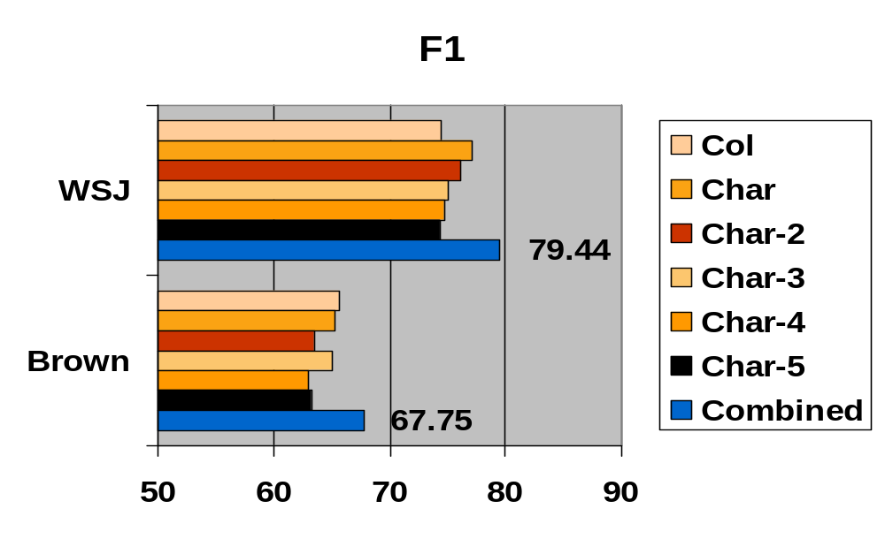
Results of Joint Inference
Char: Charniak’s parser (5-best trees)
Col: Collins’ parser
Notes:
Here is the final results. We gain about 2 points in F1.

Slide 29
Conclusions
We exploit full-parsing.
  We made a fair comparison between SRL systems using
  full-parsing and shallow-parsing.
  We found that
    Full-parsing is crucial to SRL, but the difference gap is not big
    The main contribution of full-parsing is in pruning
Our integer linear programming inference is crucial
  It resolves the inconsistency in the output of previous stages.
  Different systems can be combined via joint inference.
Best system in CoNLL-05 shared task!!
Online Demo: http://l2r.cs.uiuc.edu/~cogcomp/
Notes:
Also the best system in CoNLL-05 shared task

