Slide 1



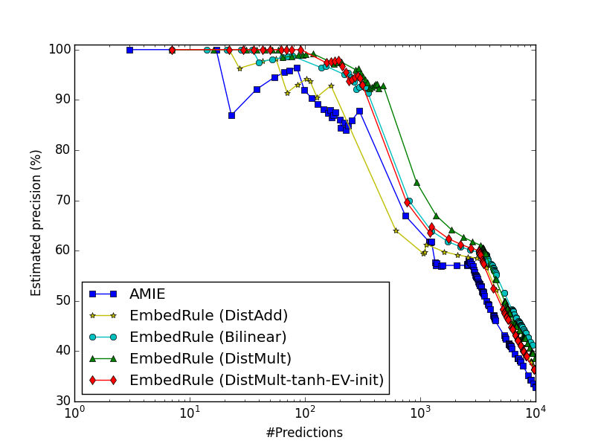
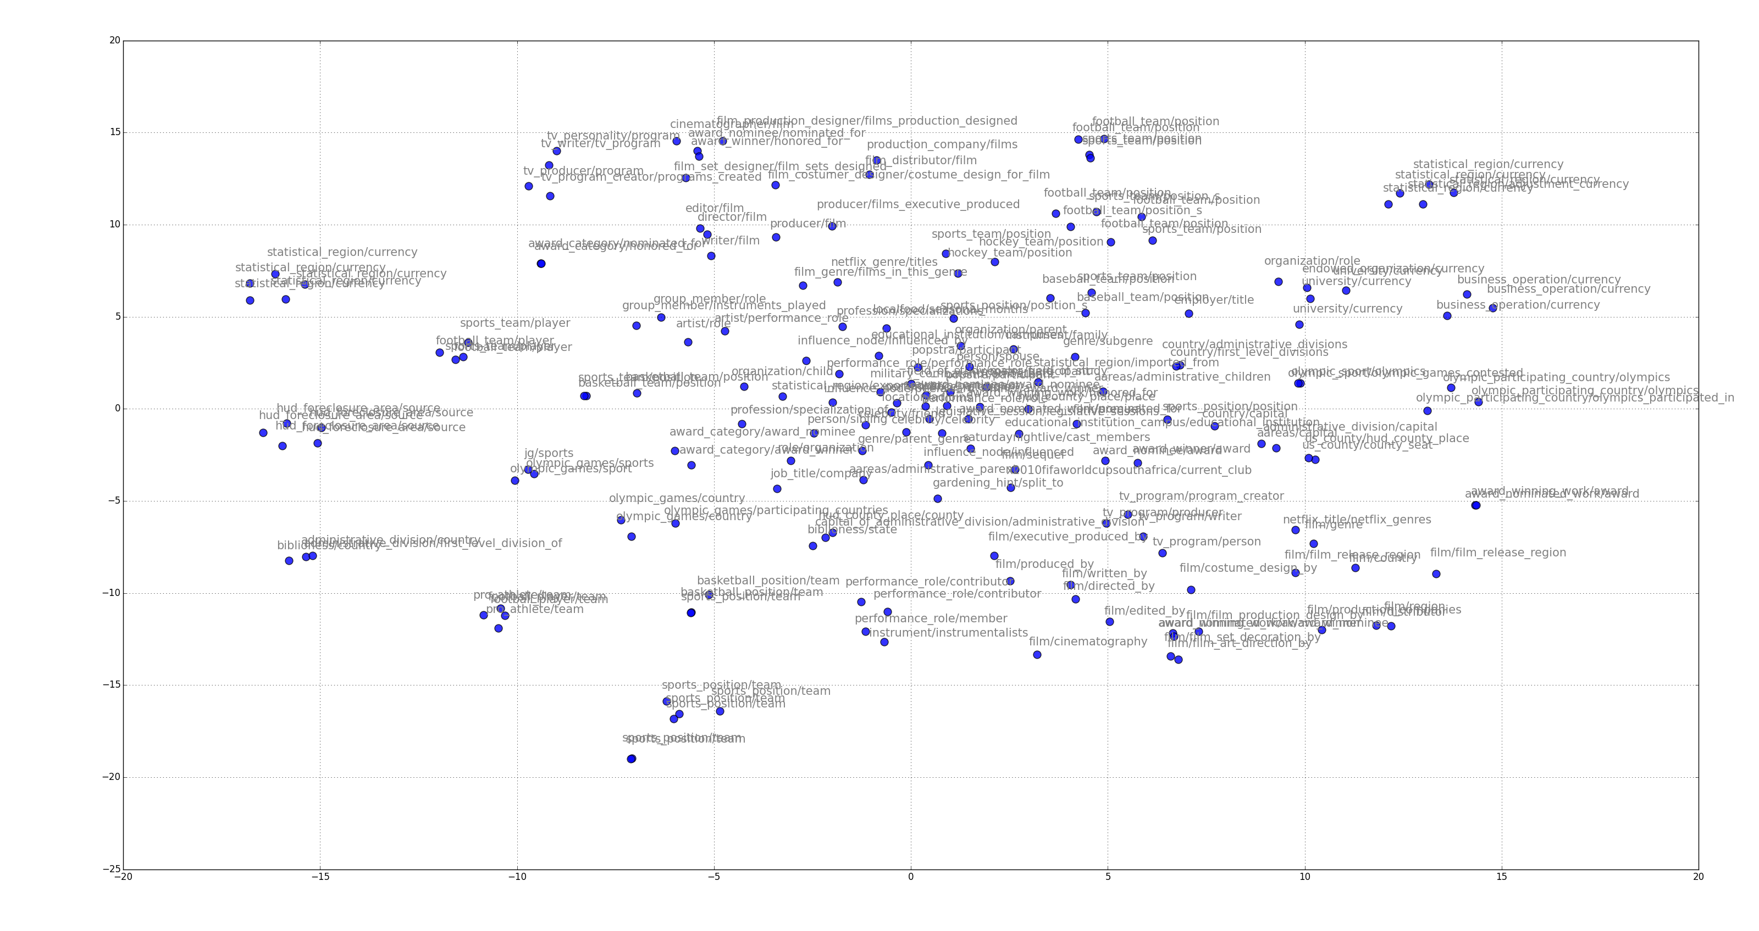
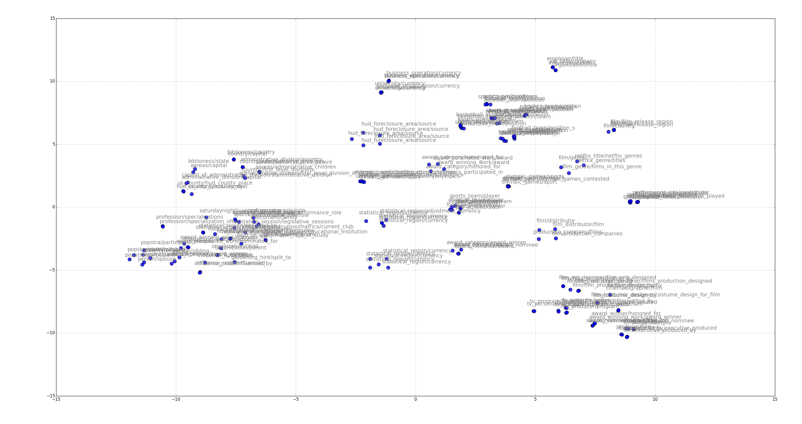
Embedding Entities and Relations for Learning and Inference in Knowledge Bases
Bishan Yang¹, Wen-tau Yih², Xiaodong He², Jianfeng Gao², Li Deng²
¹Cornell University, ²Microsoft Research
Fast and Accurate! Horn-clause Rule Mining using Knowledge Base Embedding.
Representation learning for Knowledge Bases
Experimental Setup
Inference Task II: Rule Extraction
Large-scale knowledge bases (KBs) such as Freebase and YAGO store knowledge about real-world entities in the form of RDF triples (i.e., (subject, predicate, object)).
How to represent entities and relations?
How to learn from existing knowledge?
How to infer new knowledge?
Related Work
Matrix/Tensor Factorization
RESCAL [Nickel et al., 2011; 2012]
[Jenatton et. al., 2012]
TRESCAL [Chang et al., 2014]
Neural-Embedding models
TransE [Bordes et al., 2013]
NTN [Socher et. al., 2013]
TransH [Wang et al., 2014]
Tatec [García-Durán et. al., 2014]
(Nicole Kidman, Nationality, Australia)
(Hugh Jackman, Nationality, Australia)
(Hugh Jackman, Friendship, Nicole Kidman)
(Nicole Kidman, PerformIn, Cold Mountain)
(Cold Mountain, FilmInCountry, U.S.A.)
…
 | FB15k (Freebase) | FB15k-401 | WN (WordNet)
Entities | 14,951 | 14,541 | 40,943
Relations | 1,345 | 401 | 18
Train | 483,142 | 456,974 | 141,442
Test | 50,071 | 55,876 | 5,000
Valid | 50,000 | 47,359 | 5,000
Training specifics:
Mini-batch SGD with AdaGrad
Randomly sample negative examples (corrupting both subject and object)
L2 regularization
Entity vector dim = 100
Can relation embeddings capture relation composition? For example, in Horn clauses like
Embedding-based Horn-clause rule extraction
For each relation r
KNN search on possible relation combinations (paths) by computing
Figure 1: RDF triples in KBs
Table 1: Data statistics
Nicole Kidman
LivesIn
Sydney
Models | Bilinear Param | Linear Param | Scoring Function
NTN
Bilinear+Linear
TransE (DistAdd) | -
Bilinear |  | -
Bilinear-diag (DistMult) |  | -
Results on FB15k-401: matrix multiplication better captures relation composition!
Friendship
BornIn
Nationality
PerformIn
Hugh Jackman
LocateIn
U.S.A
FilmInCountry
Nationality
Australia (Movie)
Australia (Nation)
Table 2: Compared models
Figure 2: Knowledge graph
Contributions
Inference Task I: Link Prediction
A neural network framework that unifies several popular neural-embedding models, including TransE [Bordes et al., 2013] and NTN [Socher et. al., 2013]
A simple bilinear-based model that achieves the state-of-the-art performance on link prediction on Freebase and WordNet
Propose the modeling of relation composition using matrix multiplication of relation embeddings
Propose an embedding-based rule extraction method that outperforms AMIE [Galárraga et al., 2013], a state-of-the-art rule mining approach for large KBs, on extracting closed-path Horn-clause rules on Freebase
Main Results: bilinear > linear, diagonal matrix > full matrix > tensor
Figure 4: Aggregated precision of top length-2 rules. AMIE [Galárraga et al., 2013] is an association-rule-mining-based approach for large-scale KBs. EmbedRule denotes our embedding-based approach, where DistAdd uses additive composition while Bilinear, DistMult and DistMult-tanh-EV-init uses multiplicative composition. Precision is the ratio of predictions that are in the test data to all the generated unseen predictions.
Models | FB15k |  | FB15k-401 |  | WN
 | MRR | HITS@10 | MRR | HITS@10 | MRR | HITS@10
NTN | 0.25 | 41.4 | 0.24 | 40.5 | 0.53 | 66.1
Bilinear+Linear | 0.30 | 49.0 | 0.30 | 49.4 | 0.87 | 91.6
TransE (DistAdd) | 0.32 | 53.9 | 0.32 | 54.7 | 0.38 | 90.9
Bilinear | 0.31 | 51.9 | 0.32 | 52.2 | 0.89 | 92.8
Bilinear-diag (DistMult) | 0.35 | 57.7 | 0.36 | 58.5 | 0.83 | 94.2
Additional results
t-SNE visualization of relation embeddings
Table 3: Link prediction results. MRR denotes the mean reciprocal rank and HITS@10 denotes top-10 accuracy, both the higher the better.
celebrity_frienship
location_division
influenced
Location_division
Capital_of
hub_county
Representation Learning Framework
Result breakdown on FB15k-401: multiplicative distance > additive distance
Ranking loss:
Models | Predicting subject entities |  |  |  | Predicting object entities
 | 1-to-1 | 1-to-n | n-to-1 | n-to-n | 1-to-1 | 1-to-n | n-to-1 | n-to-n
DistAdd | 70.0 | 76.7 | 21.1 | 53.9 | 68.7 | 17.4 | 83.2 | 57.5
DistMult | 75.5 | 85.1 | 42.9 | 55.2 | 73.7 | 46.7 | 81.0 | 58.8
celebrity_friendship
celebrity_dated
persion_spouse
Table 4: Results (HITS@10) by different relation categories: one-to-one, one-to-many, many-to-one and many-to-many.
Figure 5: Relation embeddings of DistAdd
Figure 6: Relation embeddings of DistMult
Entity Representation: nonlinearity > linearity, pre-trained entity vectors > pre-trained word vectors
Examples of top extracted rules (based on DistMult-tanh-EV-init)
Methods | MRR | HITS@10 | MAP (w/ type checking)
DistMult | 0.36 | 58.5 | 64.5
DistMult-tanh | 0.39 | 63.3 | 76.0
DistMult-tanh-WV-init | 0.28 | 52.5 | 65.5
DistMult-tanh-EV-init | 0.42 | 73.2 | 88.2
Nicole Kidman
Nationality
Australia
Figure 3: A neural network framework for multi-relational learning
Table 5: Variants of DistMult: (1) adding non-linearity (2) using pre-trained word vectors (3) using pre-trained entity vectors. MAP with type checking applies entity type information to filter predicted entities.

