Slide 1
SRL via Generalized Inference
Vasin Punyakanok, Dan Roth,
Wen-tau Yih, Dav Zimak, Yuancheng Tu
Department of Computer Science
University of Illinois at Urbana-Champaign
Notes:
This is the presentation of the UIUC group. I’m Wen-tau Yih, and this is a work with several of my colleagues and our advisor Dan Roth, and the slides are mainly prepared by Dav Zimak.

Slide 2
Outline
Find potential argument candidates
Classify arguments to types
Inference for Argument Structure
  Cost Function
  Constraints
  Integer linear programming (ILP)
Results & Discussion
Notes:
We follow a now seemingly standard approach to SRL.
Given a sentence, first we find a set of potential argument candidates by identifying
which words are at the border of an argument.
Then, once we have a set of potential arguments, we use a phrase-level classifier to tell us how likely an argument is to be of each type.
Finally, we use all of the information we have so far to find the assignment of types to argument that gives us the “optimal” global assignment.
Similar approaches (with similar results) use inference procedures tied to their represntation.
Instead, we use a general inference procedure by setting up the problem as a linear programming problem.
This is really where our technique allows us to apply powerful information that similar approaches can not.

Slide 3
Find Potential Arguments
An argument can be any consecutive words
I left my nice pearls to her
Restrict potential arguments
  BEGIN(word)
    BEGIN(word) = 1 ⇔ “word begins argument”
  END(word)
    END(word) = 1 ⇔ “word ends argument”
Argument
  (w_{i},...,w_{j}) is a potential argument iff
    BEGIN(w_{i}) = 1 and END(w_{j}) = 1
I left my nice pearls to her
[ [ [ [ [
] ] ] ] ]
Reduce set of potential arguments

Slide 4
Details – Word-level Classifier
BEGIN(word)
  Learn a function
    Φ^{B}(word,context,structure) → {0,1}
END(word)
  Learn a function
    Φ^{E}(word,context,structure) → {0,1}
POTARG = {arg | BEGIN(first(arg)) and END(last(arg))}

Slide 5
Arguments Type Likelihood
Assign type-likelihood
  How likely is it that arg a is type t?
  For all a ∈ POTARG , t ∈ T
    P (argument a = type t )
I left my nice pearls to her
[ [ [ [ [
] ] ] ] ]
0.3 0.2 0.2 0.3
I left my nice pearls to her
0.6 0.0 0.0 0.4
A0
C-A1
A1
Ø

Slide 6
Details – Phrase-level Classifier
Learn a classifier
  ARGTYPE(arg)
  Φ^{P}(arg) → {A0,A1,...,C-A0,...,AM-LOC,...}
  argmax_{t∈{A0,A1,...,C-A0,...,LOC,...}} w^{t} Φ^{P}(arg)
Estimate Probabilities
  Softmax
  P(a = t) = exp(w^{t} Φ^{P}(a)) / Z

Slide 7
What is a Good Assignment?
Likelihood of being correct
  P(Arg a = Type t)
    if t is the correct type for argument a
For a set of arguments a₁, a₂, ..., a_{n}
  Expected number of arguments that are correct
    Σ _{i} P( a_{i} = t_{i} )
We search for the assignment with maximum expected correct

Slide 8
Inference
Maximize expected number correct
  T* = argmax_{T} Σ _{i} P( a_{i} = t_{i} )
Subject to some constraints
  Structural and Linguistic (R-A1→A1)
I left my nice pearls to her
0.3 0.2 0.2 0.3
0.6 0.0 0.0 0.4
I left my nice pearls to her
0.1 0.3 0.5 0.1
0.1 0.2 0.3 0.4
Cost = 0.3 + 0.4 + 0.5 + 0.4 = 1.6
Cost = 0.3 + 0.4 + 0.3 + 0.4 = 1.4
Cost = 0.3 + 0.6 + 0.5 + 0.4 = 1.8
Non-Overlapping
Blue→Red & N-O
Independent Max

Slide 9
Everything is Linear
Cost function
  Σ_{a ∈ POTARG} P(a=t) = Σ_{a ∈ POTARG , t ∈ T} P(a=t) I_{{a=t}}
Constraints
  Non-Overlapping
    a and a’ overlap ⇔ I_{{a=Ø}} + I_{{a’=Ø}} ≥ 1
  Linguistic
    ∃ R-A0 → ∃ A0 ⇔ ∀a, I_{{a=R-A0}} ≤ Σ_{a’} I_{{a’=A0}}
    No duplicate A0 ⇔ Σ_{a} I_{{a=A0}} ≤ 1
Integer Linear Programming [Roth&Yih, CoNLL04]

Slide 10
Results on Perfect Boundaries
Assume the boundaries of arguments
(in both training and testing) are given.
Development Set
 | Precision | Recall | F₁
without inference | 86.95 | 87.24 | 87.10
with inference | 88.03 | 88.23 | 88.13

Slide 11
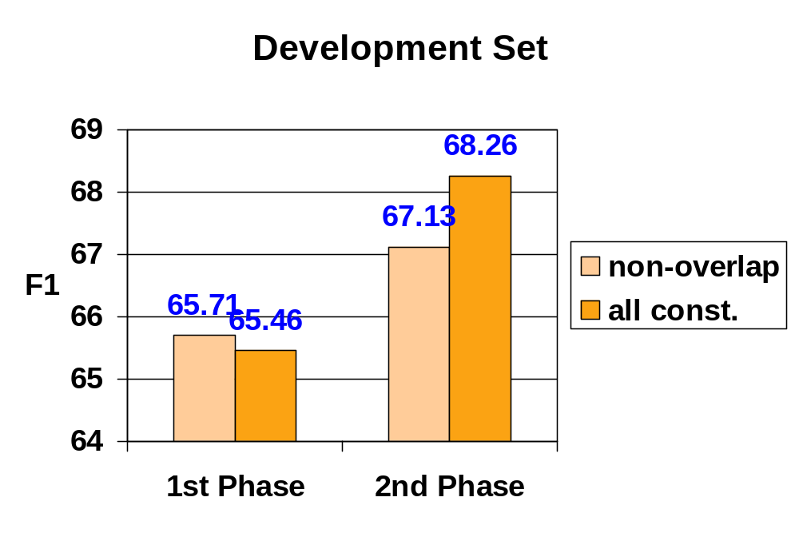
Results
Overall F₁ on Test Set : 66.39

Slide 12
Discussion
Data analysis is important !!
  F₁: ~45% → ~65%
    Feature engineering, parameter tuning, …
Global inference helps !
  Using all constraints gains more than 1% F₁ compared to just using non-overlapping constraints
  Easy and fast: 15~20 minutes
Performance difference ?
  Not from word-based vs. chunk-based

Slide 13
Thank you
yih@uiuc.edu

