Slide 1
Learning and Inference over Constrained Output
Scott Wen-tau Yih
Microsoft Research
Joint work with Vasin Punyakanok, Dan Roth, Dav Zimak
Department of Computer Science
University of Illinois at Urbana-Champaign
Notes:
-I am Scott Wen-tau Yih.
work with VP, DR and Dav Zimak
At University of Illinois
-We present a comparison between two learning approaches for structured output.
Use classifiers LEARNED INDEPENDENTLY to label structured output
versus
Learn with respect to structured output
-Main point:
IBT should perform better, but it’s not always the case.
And Everything else equal, it’s important to ISOLATE the effect of learning using the output structure to learning w/o output structure knowledge.

Slide 2

Structured Output
Car part recognition
  Label the parts of a car.
Local Approach
  Learn a classifier for each part
Global Approach
  Assume we know it is a car.
    No more than four wheels in the image
    No more than four lights in the image
    Relative positions of the parts
Notes:
Story:
Suppose we want to label the parts of a car, given an image. It is natural to decompose the problem in to a set of classifiers, one for each part type say. In this case, we can learn the classifiers as simple local classifiers that output the part type of a small piece of the car. Unfortunately, this method can not use the knowledge of the structure of a car during luring – there are at most 4 wheels or at most 4 lights. Infomation of this type can obviously help in classification, and indeed can help learning converge to the correct hypothesis.
With the global approach, we use this knowledge.

Slide 3
Identifying Phrase Structure
[_{NP} He ] [_{VP} reckons ] [_{NP} the current account deficit ] [_{VP} will narrow ]
[_{PP} to ] [_{NP} only # 1.8 billion ] [_{PP} in ] [_{NP} September ]
He reckons the current account deficit will narrow to only # 1.8 billion in
September
Classifiers
  Recognizing “The beginning of NP”
  Recognizing “The end of NP”
  (or: word based classifiers: BIO representation)
  Also for other kinds of phrases…
Some Constraints
  Phrases do not overlap
  Order of phrases
  Length of phrases
Use classifiers to infer a coherent set of phrases
Notes:
First, let me give an example to illustrate what we mean by sequential inference and how it is related to the classifiers.
Here is an example of text chunking in natural language. In this task, given a sentence like this, we want to identify some kinds of phrases as in this example. We have here some noun phrases, NP, verb phrases, VP, and prepositional phrases, PP each of which is identified by the open and close brackets.
One way to deal with this problem is to use many classifiers, one to identify the beginning of noun phrases, one to identify the end of it, and we can have these classifiers for all possible types of phrases.
But the problem is the classifiers might not be consistent with one another. That means we will have some constraints over the final output. In this case, we can see that all phrases do not overlap, but what will we do if the outputs of the classifiers do not follow this constraint. We can also have other constraints such as the order of the phrases or the length of them which can also be probabilistic.
That means what we want to deal with is a problem that has several different classifiers, has some constraints over the outcomes of them, and from the outputs of classifiers we want to infer the final predictions that satisfy those constraints.

Slide 4
Semantic Role Labeling
For each verb in a sentence
  Identify all constituents that fill a semantic role
  Determine their roles
    Core Arguments, e.g., Agent, Patient or Instrument
    Their adjuncts, e.g., Locative, Temporal or Manner
A0 : leaver
A2 : benefactor
A1 : utterance
C-A1 : utterance
A1 : thing left
A0 : leaver
I left my pearls to my daughter-in-law in my will.
The pearls which I left to my daughter-in-law are fake.
The pearls, I said, were left to my daughter-in-law.
A1 : thing left
R-A1
A0 : sayer
A2 : benefactor
AM-LOC

Slide 5
Semantic Role Labeling – Constraints
If there is an R-ARG phrase, there is an ARG Phrase.
If there is an C-ARG phrase, there is an ARG before it.
No duplicate argument classes
Unique labels
No overlapping or embedding
Relations between number of arguments
If verb is of type A, no argument of type B
Punyakanok, Roth, Yih, The Necessity of Syntactic Parsing for Semantic Role Labeling, Natural Language 1 Session

Slide 6
L+I: Learning plus Inference
Testing: Inference with Constraints
Training w/o Constraints
IBT: Inference-based Training
Learning the components together!
y₂
y₁
y₃
f₁(x)
y₄
X
f₂(x)
y₅
x₃
f₃(x)
Y
x₄
f₄(x)
x₁
x₅
f₅(x)
x₂
x₇
x₆
Notes:
Figure1: Collection of X1,…,Xn and Collection of Y1…Ym with links among X and links among Y and between.
Figure2: Collection of X1,…,Xn and single Y
Description:
Task is to predict a “consistent” output that respects the structural dependencies among Y1…Ym and from X to Y.
One way is to learn a classifier using the structure so that the final classifiers are consistent.
Second way is to learn classifiers that predict each Y separately and then consolidate the predications post learning inference phase.
================
3 basic learning strategies
Local learning only
Local learning + Inference
Inference based Training
Also refer to others’ work
The benefits of each strategy.

Slide 7
Two Approaches: L+I and IBT
Learning + Inference (L+I)
Learn each f_{i} separately
Ignore constraints during training
Introduce constraints only during evaluation
MEMM [McCallum et al.]
CSCL [Punyakanok&Roth]
Named Entity, Shallow Parsing, etc.
Inference-based Training (IBT)
Learn f₁…f_{c} together
Use constraints during training
Conditional Random Fields
[Lafferty et al.]
Discriminative training for HMMs [Collins]
L+I: cheaper computation and modular
But intuitively, IBT should be better in the limit
Which one is better? When and Why?
Notes:
WE LOOKED AT TWO APPROACHES TO LEARN f1…fn
1 - Easy to learn the classifiers separately!
f_arg0, f_arg1, etc…
Ensure constraints are met ONLY during evaluation
Call it L+I
2 - Alternate and PRICIPLED method is IBT
f. are learned together
f is CORRECT when used with INFERENCE since it was trained that way
we still view as classifiers, but constraints used during training
Example Collins and other…
Question is FUNDAMENTAL to learning using structured: WHICH IS BETTER?
SHOULD STRCUTURE BE USED WHEN LEARNING?
=================
Related Work
L+I strategy is used in many NLP tasks
e.g., Chunking, Named Entity Recognition [CoNLL ’00, ‘02]
Maximum Entropy Markov Models [McCallum et al.]
CSCL [Punyakanok&Roth]
IBT – learning for structured output
Conditional Random Fields [Lafferty et al.]
Discriminative training for HMMs [Collins]
=================
Learning Local and Global Classifiers
Learning Local Classifiers: No inference during learning
For each example (x, y) ∈ D, the learning algorithm tries to ensure that each component of y produces the correct output.
Global constraints are enforced only at evaluation time.
Learning Global Classifiers: Train to produce correct global output
Feedback from the inference process determines which classifiers to provide feedback to; together, the classifiers and the inference yield the desired result.
At each step a subset of the classifiers are updated according to inference feedback.

Slide 8
Claims
When the local classification problems are “easy”, L+I outperforms IBT.
  In many applications, the components are identifiable and easy to learn (e.g., argument, open-close, PER).
Only when the local problems become more difficult, IBT outperforms L+I but needs a larger number of training examples.
We provide experimental results and theoretical intuition to support our claims.
Notes:
Take-home messages:
It is a reasonable assumption that local classification is easy, because: (1) we already identify the important components
In many applications, the components are identifiable and easy to learn. Person & Subject

Slide 9
Outline
Formal definitions
  Problem, algorithms
Experiments
  Synthetic data
  Real-world NLP problems
Theoretical intuition : analysis of generalization bounds

Slide 10
Problem Definition
Input: X = (x₁, …, x_{c}), where x_{i} ∈ R^{d}
Output: Y = (y₁, …, y_{c}), where y_{i} ∈ {-1,+1}
Structural Constraints C over the output Y
  C ⊆ {-1,+1}^{c}, which indicates the set of legitimate global labels
Learn function f, Y = argmax _{Y’ ∈ C} f (X, Y’), f (X, Y’) = Σ f_{i} (x_{i}, y’)
Local scoring functions: f₁,…, f_{c} f_{i} (x_{i}, y’) = w_{i}· φ(x_{i}, y’)
Each local scoring function can be used as a linear classifier
Goal: to predict coherent output that respects
  the structural dependencies among Y
  the conditional dependencies from X to Y
Online setting: local learner = Perceptron
Notes:
!! Constraints can be weighted!
Task at hand
predict a set of outputs from a set of inputs.
Outputs have some structure
Structure = Constraints
Goal:
Learn a mapping from input X to output Y
Consistent with structure on the output via C(Y)
(and of course, Correct)
View f as a composition of set of LOCAL classifiers
Each one predicts a single variable in output from the input
Figure1: Collection of X1,…,Xn and Collection of Y1…Ym with links among X and links among Y and between.
Figure2: Collection of X1,…,Xn and single Y
Description:
Task is to predict a “consistent” output that respects the structural dependencies among Y1…Ym and from X to Y.
One way is to learn a classifier using the structure so that the final classifiers are consistent.
Second way is to learn classifiers that predict each Y separately and then consolidate the predications post learning inference phase.

Slide 11
Perceptron-based Global Learning
Initialize W = (w₁, w₂, …, w_{c}) ∈ R^{cd}
for each global example (X,Y) do
Y’ = argmax_{Y’’∈C} W ⋅ Φ(X,Y’’)
if Y’ ≠ Y then
W = W + Φ(X,Y) - Φ(X,Y’’)
Global prediction
is made by
the inference
procedure
Weights are updated according to the global prediction (after inference), not the local predictions.
Learns f₁…f_{c} consistent with constraints
Notes:
-Some details of the algorithm:
SIMPLE ALGORITHM, NO SOPHISTICATED TRICKS (loss, max margin)
Both perceptron-based algorithms
L+I learns linear functions for each output variable type
IBT learns single LARGER linear function viewed over joint feature space
SAME NUMBER OF TOTAL PARAMETERS
L+I has fewer parameters per classifier
-L+I ignores constraints during training.
-IBT uses inference during training via argmax…
-BOTH USE INFERENCE DURING EVALUATION
-IBT SHOULD BE BETTER, but we found L+I BETTER FOR SRL !!!!!!!!!!!!!

Slide 12
Perceptron-based Global Learning
True Global Labeling
Y
-1
1
-1
-1
1
Local Predictions
Apply Constraints:
Y’
-1
1
1
1
1
Y’
-1
1
-1
1
1
f₁(x)
X
f₂(x)
x₃
f₃(x)
Y
x₄
f₄(x)
x₁
x₅
f₅(x)
x₂
x₇
x₆
Notes:
Figure1: Collection of X1,…,Xn and Collection of Y1…Ym with links among X and links among Y and between.
Figure2: Collection of X1,…,Xn and single Y
Description:
Task is to predict a “consistent” output that respects the structural dependencies among Y1…Ym and from X to Y.
One way is to learn a classifier using the structure so that the final classifiers are consistent.
Second way is to learn classifiers that predict each Y separately and then consolidate the predications post learning inference phase.
================
3 basic learning strategies
Local learning only
Local learning + Inference
Inference based Training
Also refer to others’ work
The benefits of each strategy.

Slide 13
Expressivity Note
It’s possible that the local classifiers are not linearly separable but the global classifier is.
  Global separability does not imply local separability.
If the local classifiers are linearly separable then the global classifier is.
  Local separability implies global separability.
In the theoretical analysis, we assume that the global classifier is linearly separable but the local ones are not.

Slide 14
Outline
Formal definitions
  Problem, algorithms
Experiments
  Synthetic data
  Real-world NLP problems
Theoretic intuition: analysis of generalization bounds

Slide 15
Simulation on Synthetic Data
Generate a structured output example
X = (x₁, …, x_{c}) → Y = (y₁, …, y_{c})
Constraints C
  Randomly choose half of {-1,+1}^{c}
  e.g. when c=2, C may be {(-1,+1), (+1,-1)}
Control the difficulty, k, of the learning problem
  k=0: locally separable
  k=1: local learning problem – hardest possible
  k= (# inconsistent local values) / (# examples)

Slide 16
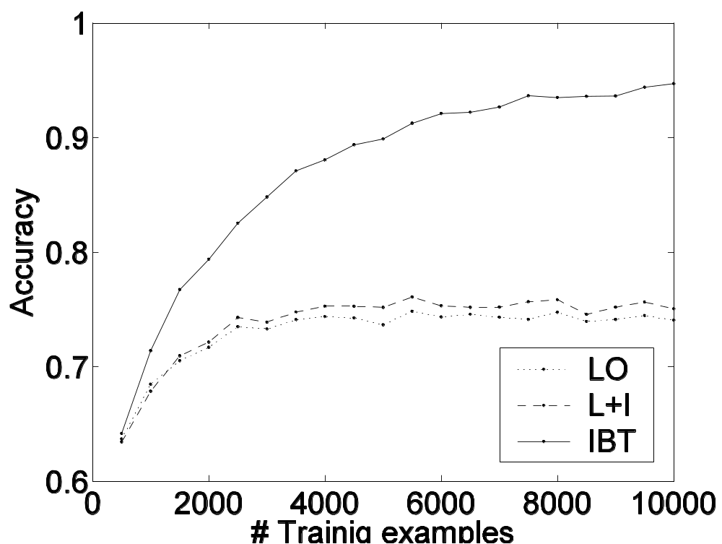
Result 1: Inseparability k = 1
IBT
L+I
Notes:
COLOR: IBT, L+I
Some Results….
First,
When the the local problems are difficult, IBT outperforms L+I always,
since on this problem,
IBT is guaranteed to converge,
but L+I is guaranteed to fail at local level
constraints help when evaluating, but not enough
However…

Slide 17
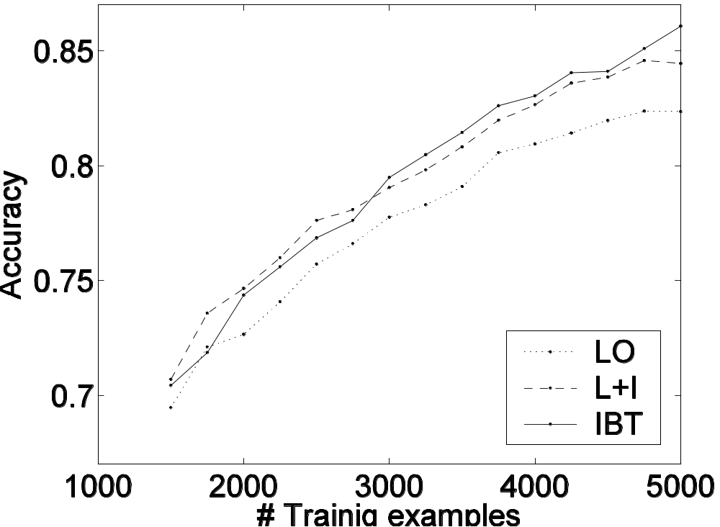
Result 2: Inseparability k = 0.15
IBT
L+I
Notes:
THERE IS ALWAYS THE CROSS POINT, BUT THE POSITION DEPENDS ON THE DIFFICULTY OF THE LEARNING
However,
As the local classification problem becomes more difficult,
L+I can be better than IBT.
With enough examples, of course IBT would converge on this data set.
But… interesting to notice that when we don’t have MANY examples (> 3000 here for 100dim 5token problem)
L+I outperforms IBT

Slide 18
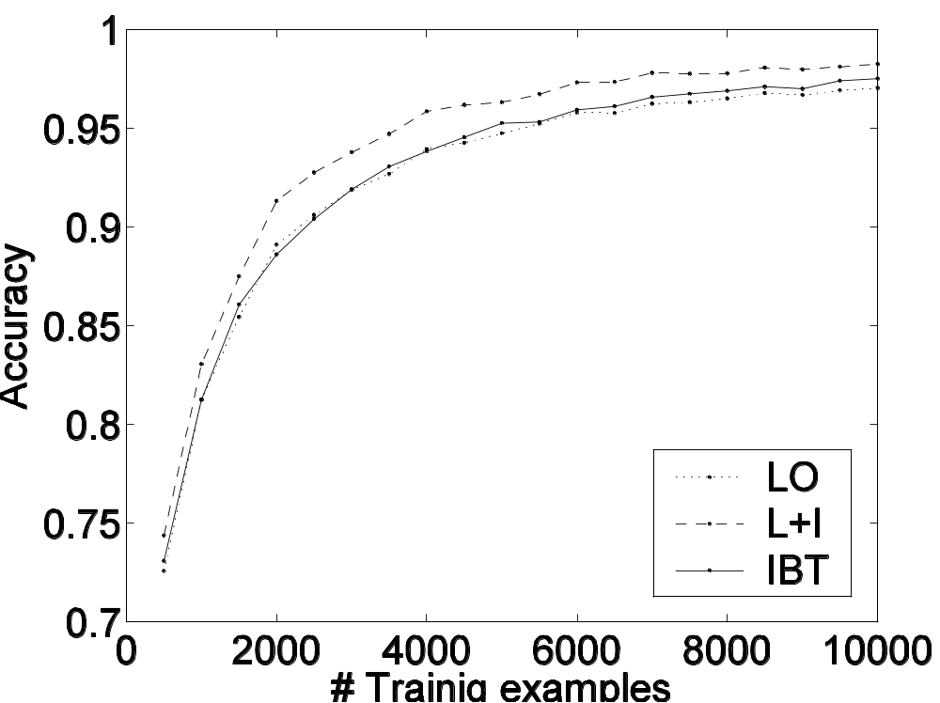
Result 3: Locally Separable k = 0
L+I
IBT
Notes:
When the local learning task is completely separable, L+I seems to outperform IBT always.
Benefits from rasy learning problem (low dim)`

Slide 19
Real-World NLP Problems
Semantic Role Labeling (SRL)
  Given a sentence, the goal is to identify the semantic arguments of each verb in this sentence.
  It can be treated as a phrase labeling problem.
Noun Phrase Identification (NPI)
  Given a sentence, the goal is to identify the base noun phrases.

Slide 20
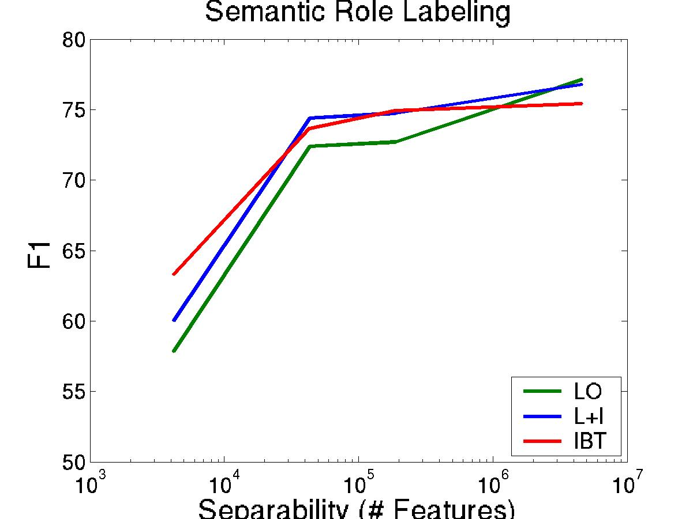
Experimental Results on SRL
L+I is better when the local problems are identifiable.
Difficulty of the learning problem
(# features)
hard
easy

Slide 21
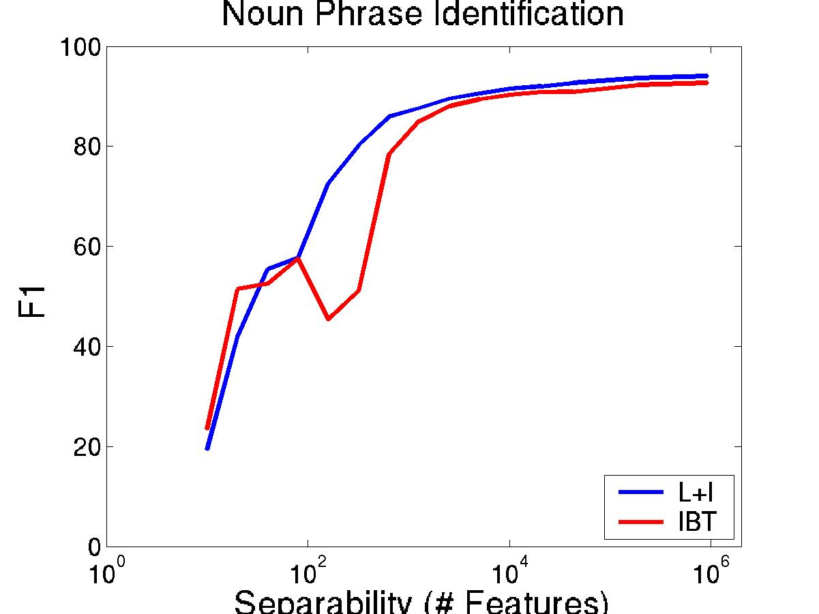
Experimental Results on NPI
L+I is better when the local problems are identifiable.
Difficulty of the learning problem
(# features)
hard
easy

Slide 22
Outline
Formal definitions
  Problem, algorithms
Experiments
  Synthetic data
  Real-world NLP problems
Theoretical intuition: analysis of generalization bounds

Slide 23
Generalization Bound Intuition
Assume the training and testing data are drawn from the same but unknown distribution.
The generalization bound quantifies the error in the testing data.
We seek local and global generalization bounds.
ε ≤ ε_{opt} + ( 32(log N_{H}(m)) + log (4/δ)) / m )^{1/2}
  ε_{opt} optimal error of H
  m sample size
  N_{H}(m) growth function ~ complexity of H
  [Anthony&Bartlett ‘99]

Slide 24
Analysis of Local Learning
For each component (c components in total)
  Input x_{i} ∈ R^{d}
  Output y_{i} ∈ {-1,1}
  Hypothesis h(x_{i}) = sign(⟨w^{i},x_{i}⟩ + θ_{i}), w_{i} ∈ R^{d}
Properties
  Independently trained
  Weight space is R^{d}
  c classifiers
  m examples
  Independent error ε_{opt} > 0 (when locally inseparable)
  N_{H}(m) ≤ m^{d}
Notes:
COLOR IMPORTANT BULLETS
Intuition: Global training (IBT) ‘effectively’ and ‘robustly’ learns in the hyp space.
I+L does NOT!!!
BECAUSE: Constraints are available to the IBT, but not L+I during training
REMINDER: Constraints could be hard, soft, represented as features, etc…
Very simple example:
INPUT (x1,x2) \in RxR
FUNCTION : y1 = (x1 > 0), y2 = (x2 > 0)
SIMPLE LEARNING
Learn separately fcn for each -- linear, easiest threshold can imagine
h1 = w1x1> 0, h2 = w2x2 > 0
Now Add constraint
XOR (y1, y2) \in {(0,1),(1,0)}
Explicitliy --- we see data this way…
Or, can be made in features phi(y1=1 & y2=1) and w(y1=1 & y2=1) = -infty
LEARN FCN TO RESPECT CONSTRAINTS AND IS CONSISTENT WITH DATA
h(x1,x2) = argmax_{y \in Constraints} W.\Phi(x,y).
w1y1x1 + w2y2x2 -infty \phi(y1=1 & y2=1) - infty \phi (y1=0 && y2=0)
Linear function over some feature space -- the difference, is that this function is separable if we can use the constraints (I.e. the features with the whole output) and not separable w/o.

Slide 25
Analysis of Global Learning
For each component (c components in total)
  Input x = (x₁,…,x_{c}), x_{i} ∈ R^{d} → x ∈ R^{cd}
  Output y = (y₁,…,y_{c}), y_{i} ∈ {-1,1} → y ∈ {-1,1}^{c}
  IBT:∑_{i} f_{i}(x_{i}, y_{i}) > ∑_{i} f_{i}(x_{i}, y_{i}’)
    Where y and y’ satisfy constraints!
    f_{i}(x_{i}, y_{i}) = y_{i} ⋅(⟨w^{i},x_{i}⟩ + θ_{i}), w_{i} ∈ R^{d} → w ∈ R^{cd}
Properties
  All Parameters are trained together
  Weight space is R^{cd}
  One classifier
  m examples
  No global error: ε_{opt} = 0
  N_{H}(m) ≤ (m2^{c})^{cd}
Notes:
COLOR IMPORTANT BULLETS
Intuition: Global training (IBT) ‘effectively’ and ‘robustly’ learns in the hyp space.
I+L does NOT!!!
BECAUSE: Constraints are available to the IBT, but not L+I during training
REMINDER: Constraints could be hard, soft, represented as features, etc…
Very simple example:
INPUT (x1,x2) \in RxR
FUNCTION : y1 = (x1 > 0), y2 = (x2 > 0)
SIMPLE LEARNING
Learn separately fcn for each -- linear, easiest threshold can imagine
h1 = w1x1> 0, h2 = w2x2 > 0
Now Add constraint
XOR (y1, y2) \in {(0,1),(1,0)}
Explicitliy --- we see data this way…
Or, can be made in features phi(y1=1 & y2=1) and w(y1=1 & y2=1) = -infty
LEARN FCN TO RESPECT CONSTRAINTS AND IS CONSISTENT WITH DATA
h(x1,x2) = argmax_{y \in Constraints} W.\Phi(x,y).
w1y1x1 + w2y2x2 -infty \phi(y1=1 & y2=1) - infty \phi (y1=0 && y2=0)
Linear function over some feature space -- the difference, is that this function is separable if we can use the constraints (I.e. the features with the whole output) and not separable w/o.

Slide 26
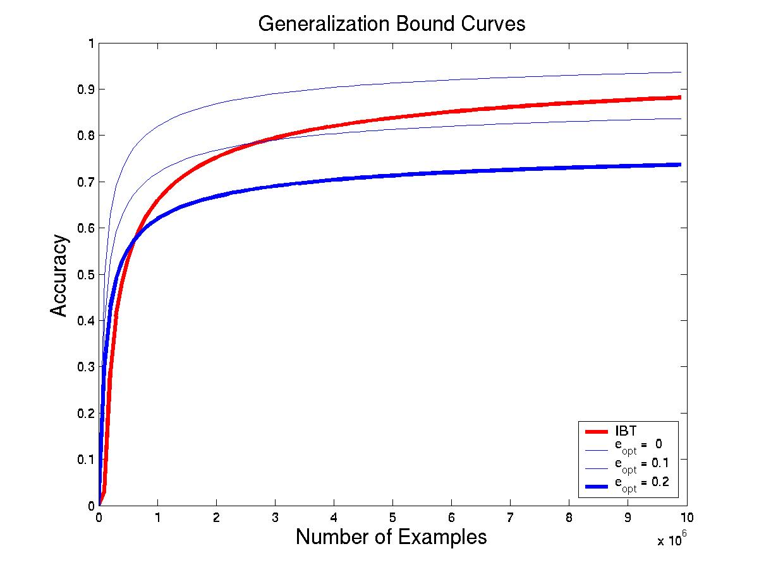
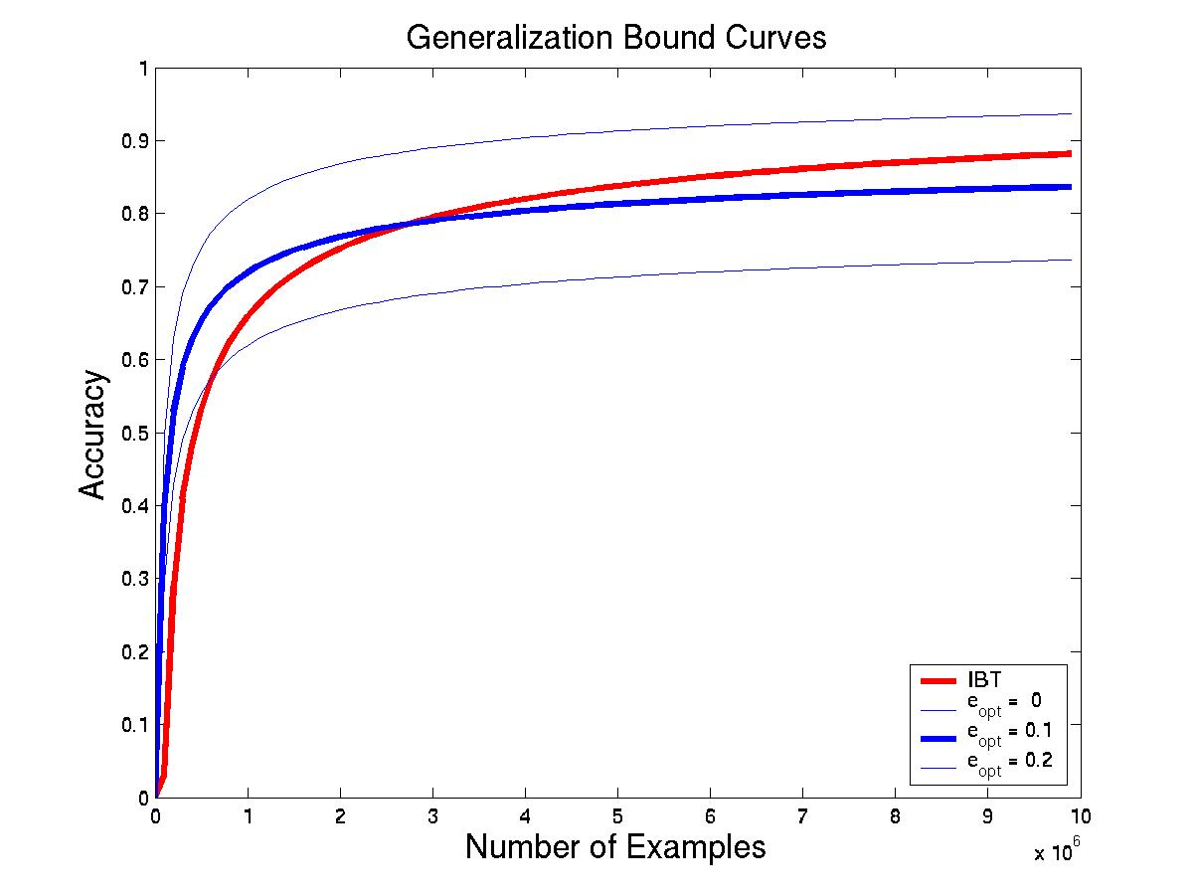
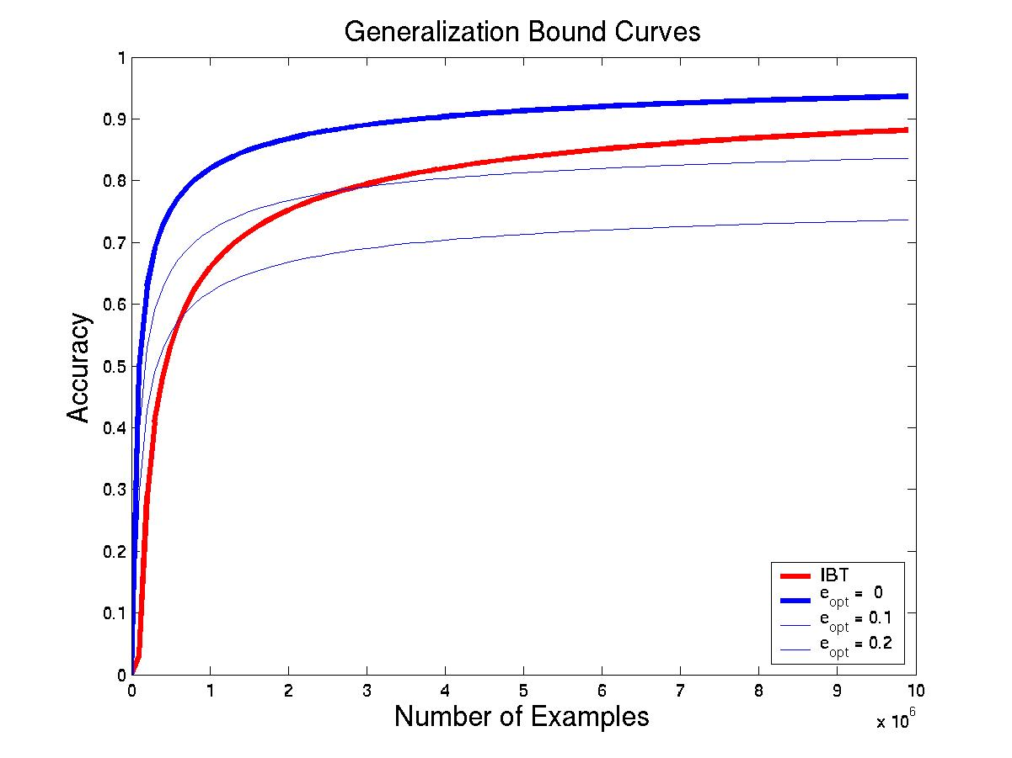
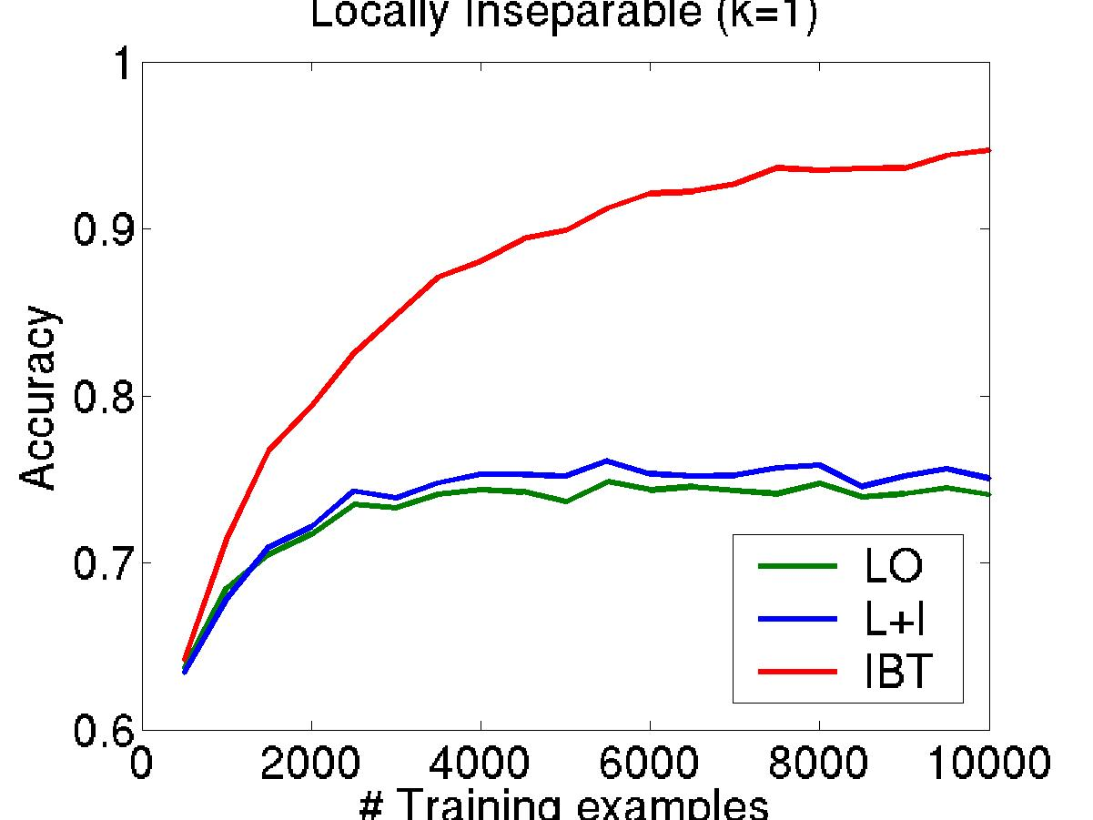
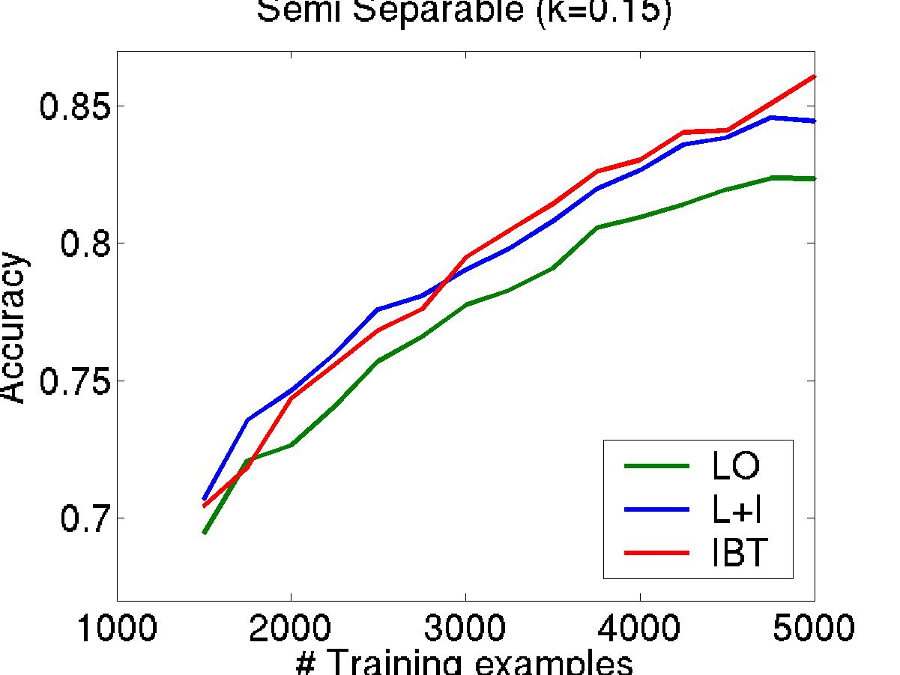
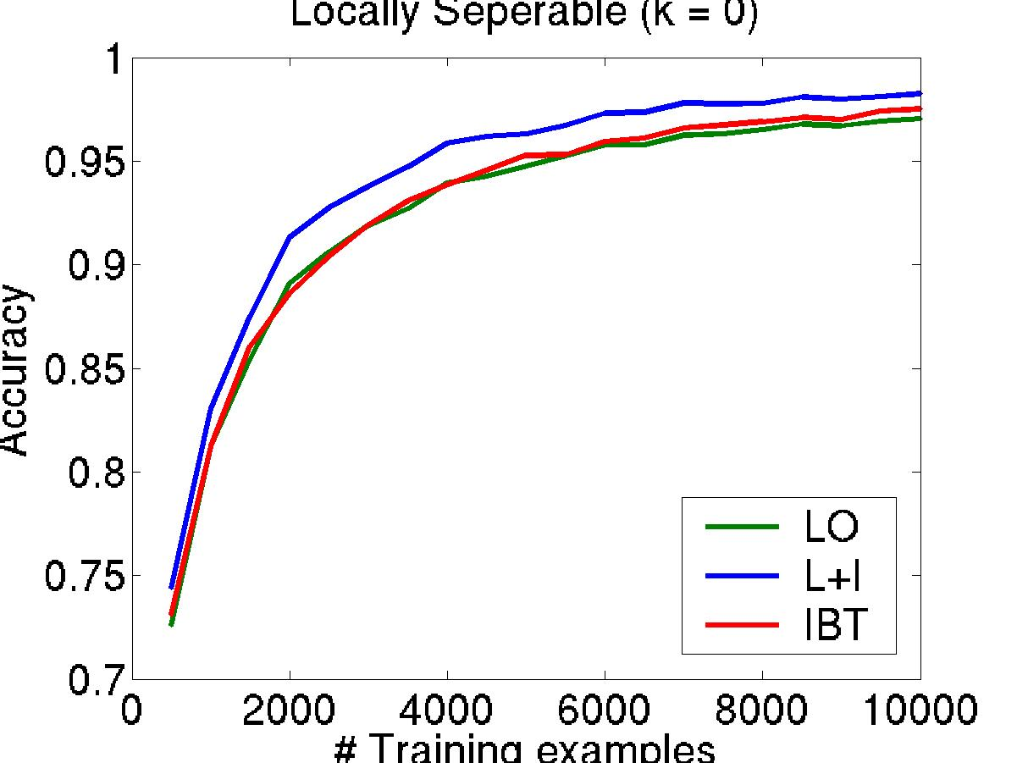
Bound Prediction
Local ε ≤ ε_{opt} + ( ( d log m + log 1/δ ) / m )^{1/2}
Global ε ≤ 0 + ( ( cd log m + c²d + log 1/δ ) / m )^{1/2}
Bounds
Simulated Data
ε_{opt}=0.1
ε_{opt}=0
ε_{opt}=0.2
Notes:
Caption/text: bound vs. simulated data
ARROW: Eopt = 0, 0.1, 0.2

Slide 27
Conclusions
L+I is more efficient and modular.
IBT is better in the limit.
We show that:
When the local classification is “easy”, L+I outperforms IBT.
Only as the local problems become more difficult, IBT outperforms L+I but needs a larger number of training examples.
We presented experimental results and theoretical intuition.
More theoretical understanding is needed.
Notes:
Take-home messages:
It is a reasonable assumption that local classification is easy, because: (1) we already identify the important components
In many applications, the components are identifiable and easy to learn. Person & Subject

