Slide 1
Dual Coordinate Descent Algorithms for Efficient Large Margin Structured Prediction
Ming-Wei Chang and Scott Wen-tau Yih
Microsoft Research

Slide 2
Motivation
Many NLP tasks are structured
Parsing, Coreference, Chunking, SRL, Summarization, Machine translation, Entity Linking,…
Inference is required
Find the structure with the best score according to the model
Goal: a better/faster linear structured learning algorithm
Using Structural SVM
What can be done for perceptron?

Slide 3
Two key parts of Structured Prediction
Common training procedure (algorithm perspective)
Perceptron:
Inference and Update procedures are coupled
Inference is expensive
But we only use the result once in a fixed step
Inference
Update
Structure

Slide 4
Observations
Inference
Structure
Update
Update
Structure

Slide 5


Observations
Infer
$$y$$
$$y$$
Update
Inference and Update procedures can be decoupled
If we cache inference results/structures
Advantage
Better balance (e.g. more updating; less inference)
Need to do this carefully…
We still need inference at test time
Need to control the algorithm such that it converges

Slide 6
Questions
Can we guarantee the convergence of the algorithm?
Can we control the cache such that it is not too large?
Is the balanced approach better than the “coupled” one?
Yes!
Yes!
Yes!

Slide 7
Contributions
We propose a Dual Coordinate Descent (DCD) Algorithm
For L2-Loss Structural SVM; Most people solve L1-Loss SSVM
DCD decouples Inference and Update procedures
Easy to implement; Enables “inference-less” learning
Results
Competitive to online learning algorithms; Guarantee to converge
[Optimization] DCD algorithms are faster than cutting plane/ SGD
Balance control makes the algorithm converges faster (in practice)
Myth
Structural SVM is slower than Perceptron

Slide 8
Outline
Structured SVM Background
Dual Formulations
Dual Coordinate Descent Algorithm
Hybrid-Style Algorithm
Experiments
Other possibilities

Slide 9

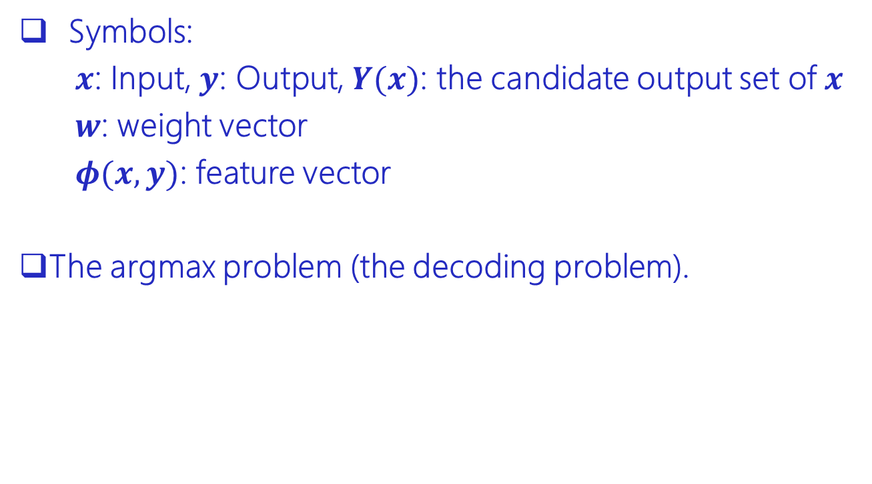
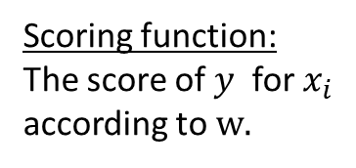
Structured Learning
Symbols:
$x$: Input, $y$: Output, $Y(x)$: the candidate output set of $x$
$w$: weight vector
$φ(x,y)$: feature vector
The argmax problem (the decoding problem).
Candidate output set
Scoring function:
The score of $y$ for $x_{i}$ according to $w.$

Slide 10







The Perceptron Algorithm
Until Converge
Pick an example $x_{i}$
Notation
Infer
$$y$$
$$y$$
Update
Gold structure
Prediction
=

Slide 11
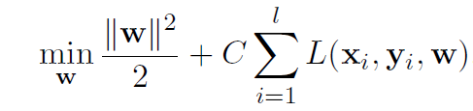
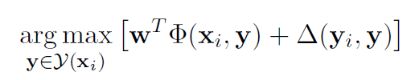
Structural SVM
Loss: How wrong your prediction is?
Objective function
Distance-Augmented Argmax

Slide 12
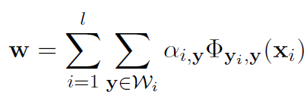

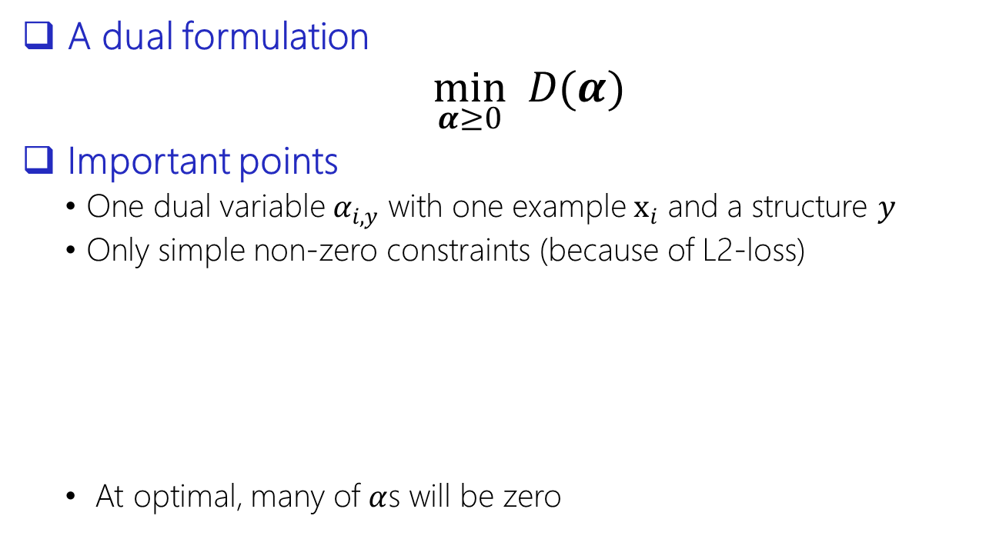
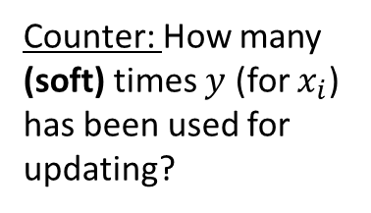
Dual formulation
A dual formulation
$\min_{α≥0} D(α)$
Important points
One dual variable $α_{i,y}$ with one example $x_{i}$ and a structure $y$
Only simple non-zero constraints (because of L2-loss)
At optimal, many of $α$s will be zero
Counter: How many (soft) times $y$ (for $x_{i}$) has been used for updating?

Slide 13
Outline
Structured SVM Background
Dual Formulations
Dual Coordinate Descent Algorithm
Hybrid-Style Algorithm
Experiments
Other possibilities

Slide 14

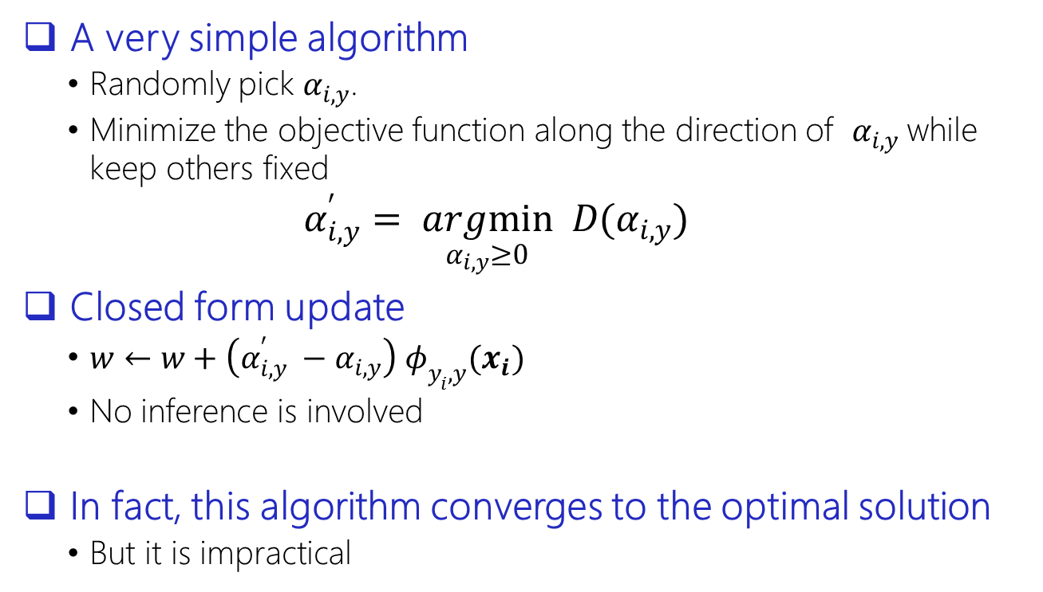
Dual Coordinate Descent algorithm
A very simple algorithm
Randomly pick $α_{i,y}$.
Minimize the objective function along the direction of $α_{i,y}$while keep others fixed
$α_{i,y}^{′}= \underset{α_{i,y}≥0}{argmin} D(α_{i,y})$
Closed form update
$w←w+\left(α_{i,y}^{′} −α_{i,y}\right) φ_{y_{i},y}(x_{i})$
No inference is involved
In fact, this algorithm converges to the optimal solution
But it is impractical
$$y$$
Update

Slide 15
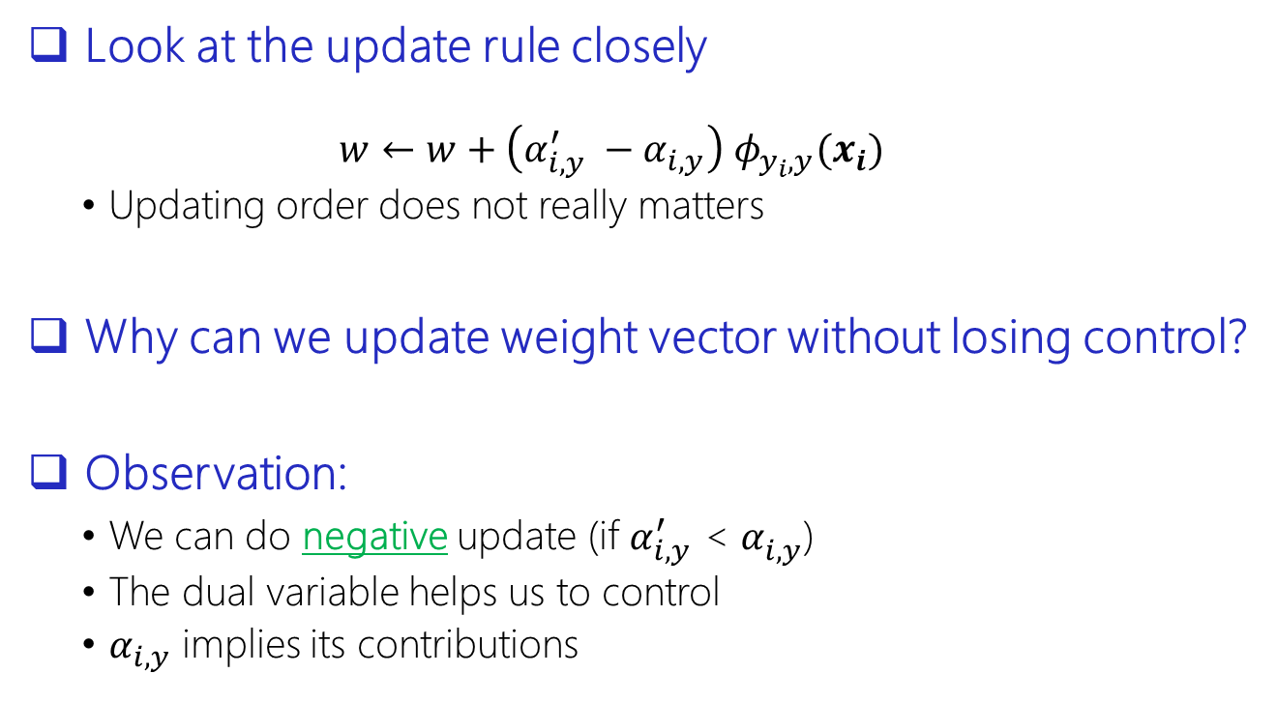
What are the role of dual variables?
Look at the update rule closely
$$w←w+\left(α_{i,y}^{′} −α_{i,y}\right) φ_{y_{i},y}(x_{i})$$
Updating order does not really matters
Why can we update weight vector without losing control?
Observation:
We can do negative update (if $α_{i,y}^{′}$ < $α_{i,y}^{}$)
The dual variable helps us to control
$α_{i,y}$ implies its contributions

Slide 16


Problem: too many structures
Only focus on a small set of structure for each example
Function UpdateAll$(i, w)$
For one example $x_{i}$
For each $y$ in the $W_{i}$
Update $α_{i,y}$ and the weight vector $w$
Again; Update only

Slide 17



DCD-Light
For each iteration
For each example
inference
If it is wrong enough
UpdateAll($i$,$w$)
To notice
Distance-augmented inference
No average
We will still update even if the structure is correct
UpdateAll is important
Infer
$$y$$
Grow working set;
Update Weight Vector;

Slide 18
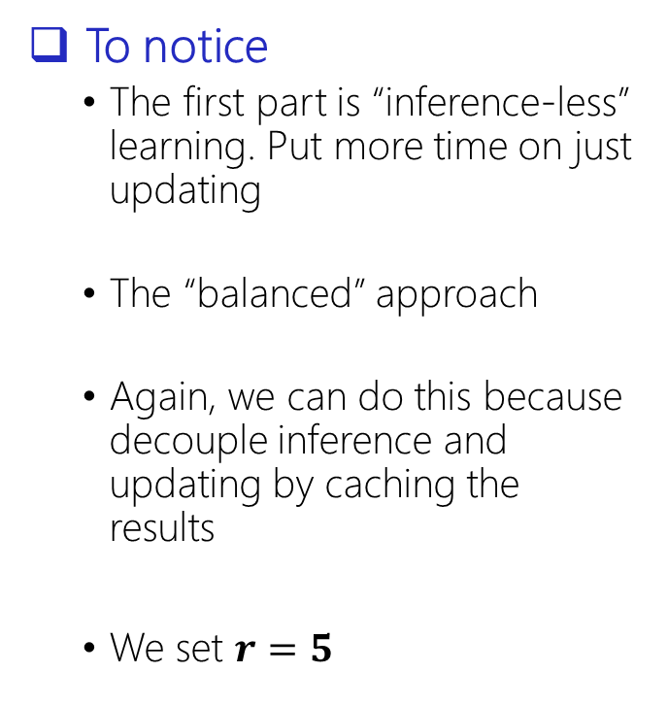

DCD-SSVM
For each iteration
For $r$ round
For each example
UpdateAll($i$,$w$)
For each example
If we are wrong enough
UpdateAll($i$,$w$)
To notice
The first part is “inference-less” learning. Put more time on just updating
The “balanced” approach
Again, we can do this because decouple inference and updating by caching the results
We set $r=5$
Inference-less Learning
DCD-Light;

Slide 19
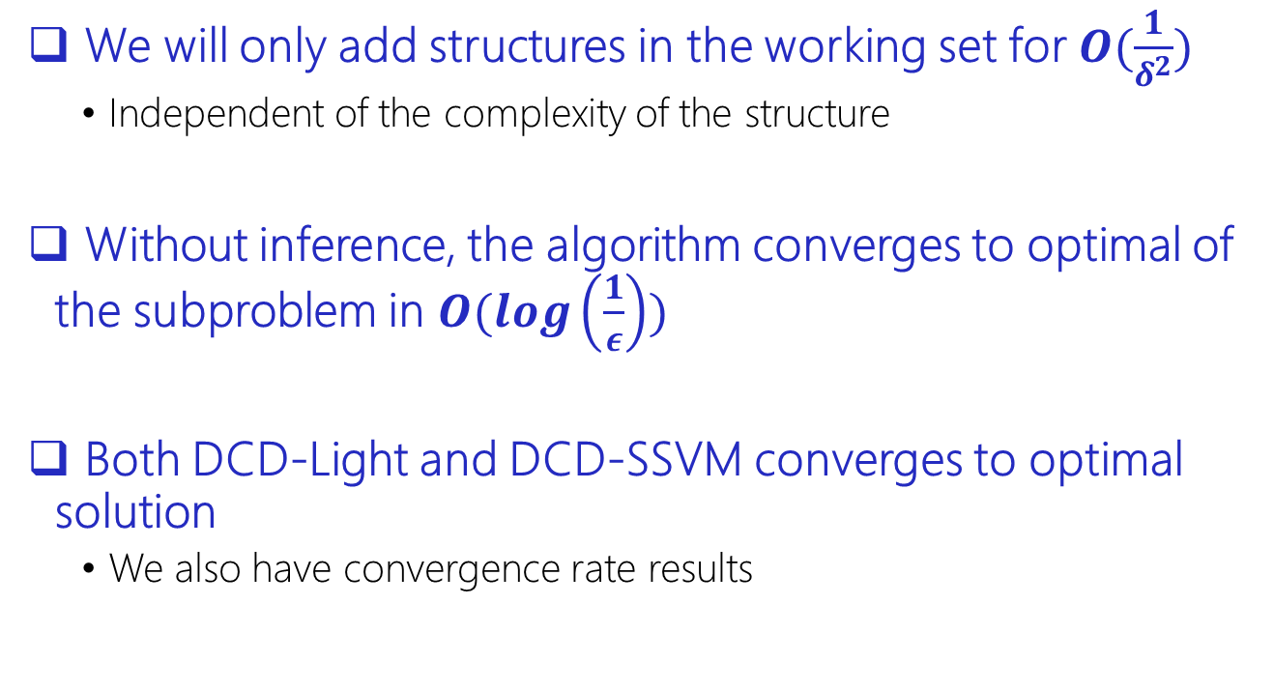
Convergence Guarantee
We will only add structures in the working set for $O(\frac{1}{δ^{2}})$
Independent of the complexity of the structure
Without inference, the algorithm converges to optimal of the subproblem in $O(log\left(\frac{1}{ε}\right))$
Both DCD-Light and DCD-SSVM converges to optimal solution
We also have convergence rate results

Slide 20
Outline
Structured SVM Background
Dual Formulations
Dual Coordinate Descent Algorithm
Hybrid-Style Algorithm
Experiments
Other possibilities

Slide 21
Settings
Data/Algorithm
Compared to Perceptron, MIRA, SGD, SVM-Struct and FW-Struct
Work on NER-MUC7, NER-CoNLL, WSJ-POS and WSJ-DP
Parameter C is tuned on the development set
We also add caching and example permutation for Preceptron, MIRA, SGD and FW-Struct
Permutation is very important
Details in the paper

Slide 22
Research Questions
Is “balanced” a better strategy?
Compare DCD-Light, DCD-SSVM, and Cutting plane method [Chang et al. 2010]
How does DCD compare to other SSVM algorithms?
Compare to SVM-struct [Joachims et al. 09]; FW-struct [Lacoste-Julien et al. 13]
How does DCD compare to online learning algorithms?
Compare to Perceptron [Collins 02], MIRA [Crammar 05], and SGD

Slide 23
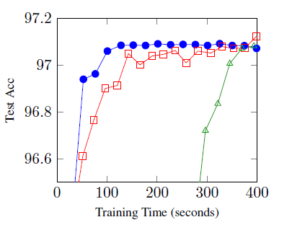
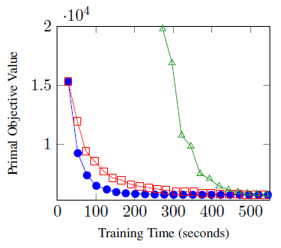

Compare L2-Loss SSVM algorithms
Same Inference code!
[Optimization] DCD algorithms are faster than cutting plane methods (CPD)

Slide 24
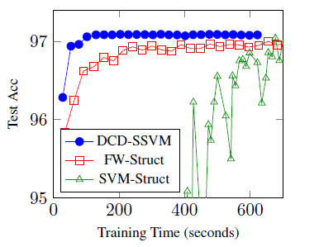
Compare to SVM-Struct
SVM-Struct in C, DCD in C#
Early iterations of SVM-Struct are not very stable
Early iterations for our algorithm are still good

Slide 25
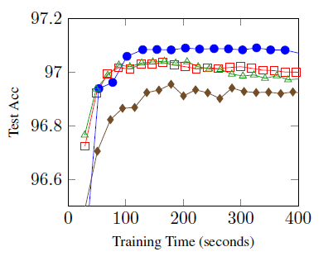
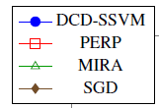
Compare Perceptron, MIRA, SGD
Data\Algo | DCD | Percep.
NER-MUC7 | 79.4 | 78.5
NER-CoNLL | 85.6 | 85.3
POS-WSJ | 97.1 | 96.9
DP-WSJ | 90.8 | 90.3

Slide 26
Questions
Can we guarantee the convergence of the algorithm?
Can we control the cache such that it is not too large?
Is the balanced approach better than the “coupled” one?
Yes!
Yes!
Yes!

Slide 27
Outline
Structured SVM Background
Dual Formulations
Dual Coordinate Descent Algorithm
Hybrid-Style Algorithm
Experiments
Other possibilities

Slide 28
Parallel DCD is faster than Parallel Perceptron
Infer
$$y$$
$$y$$
Update
N workers
1 workers
With cache buffering techniques; multi-core DCD can be much faster than multi-core Perceptron [Chang et al. 2013]

Slide 29
Conclusion
We have proposed dual coordinate descent algorithms
[Optimization] DCD algorithms are faster than cutting plane/ SGD
Decouple inference and learning
There is value for developing Structural SVM
We can design more elaborated algorithms
Myth: Structural SVM is slower than perceptron
Not necessary
More comparisons need to be done
The hybrid approach is the best overall strategy
Different strategies are needed for different datasets
Other ways of caching results
Thanks!

