Slide 1
WikiQA: A Challenge Dataset for Open-Domain Question Answering
Yi Yang*, Scott Wen-tau Yih#, Christopher Meek#
*Georgia Institute of Technology, Atlanta
#Microsoft Research, Redmond

Slide 2




Open-domain Question Answering
“What are the names of Obama’s daughters?”
Question Answering with Knowledge Base
Large-scale knowledge bases (e.g., Freebase)
KB-specific semantic parsing (e.g., [Berant+ 13], [Yih+ 15])
Question Answering with Free Text
High-quality, reliable text (e.g., Wikipedia, news articles)

Slide 3
Answer Sentence Selection
Given a factoid question, find the sentence in the candidate set that
Contains the answer
Can sufficiently support the answer
Q: Who won the best actor Oscar in 1973?
S₁: Jack Lemmon was awarded the Best Actor Oscar for Save the Tiger (1973).
S₂: Academy award winner Kevin Spacey said that Jack Lemmon is remembered as always making time for others.

Slide 4
QASent Dataset [Wang+ 07]
Based on the TREC-QA data
Standard benchmark for answer sentence selection
Dependency tree matching (e.g., [Wang+ 07], [Wang+ 10], [Yao+ 13])
Tree kernel SVMs (e.g., [Severyn & Moschitti 13])
Latent word alignment with lexical semantic matching (e.g., [Yih+ 13])
Deep neural network models (e.g., [Yu+ 14], [Wang+ 15])

Slide 5



Issues with QASent Dataset
Question distribution
Contain questions from human editors
Candidate selection bias
Output from the systems participating in TREC-QA
Sentences need to share non-stopwords from the questions
Excluding questions that have no correct answers
Q: How did Seminole war end?
A: Ultimately, the Spanish Crown ceded the colony to United States rule.

Slide 6
WikiQA Dataset
Question distribution
Questions sampled from Bing query logs
Candidate selection
Candidate sentences are from summary paragraphs of Wikipedia pages
Including questions that have no correct answers
Answer Triggering: detecting whether a correct answer exists in candidate sentences

Slide 7
Outline
Introduction
WikiQA Dataset
Data construction and annotation
Data statistics
Experiments
Conclusion

Slide 8

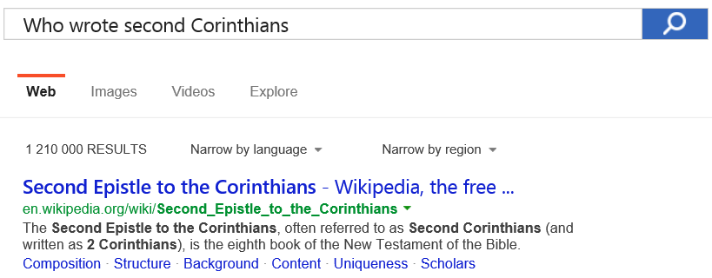
Data Construction – Questions
Questions sampled from Bing query logs
Search queries starting with a WH-word
Filter out entity queries (e.g., “how I met your mother”)
Select queries issued by at least 5 users and have clicks to Wikipedia

Slide 9

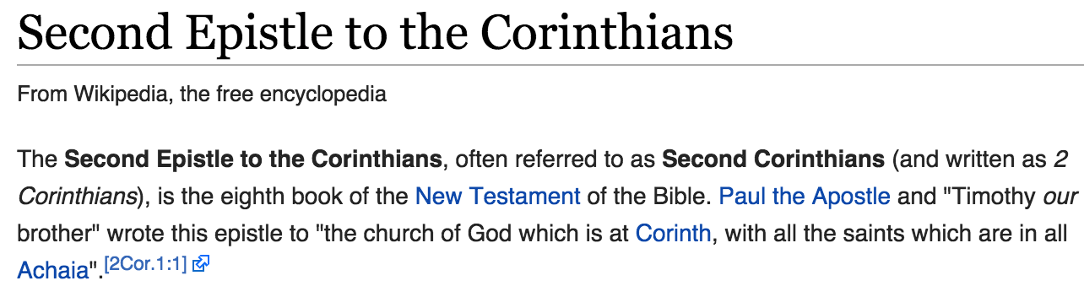
Data Construction – Sentences
Candidate sentences
Use all sentences from the summary paragraph of the Wikipedia page
“Who wrote second Corinthians?”

Slide 10
Sentence Annotation by Crowdsourcing
Step 1: Does the short paragraph answer the question?
Question: Who wrote second Corinthians?
Second Epistle to the Corinthians The Second Epistle to the Corinthians, often referred to as Second Corinthians (and written as 2 Corinthians), is the eighth book of the New Testament of the Bible. Paul the Apostle and “Timothy our brother” wrote this epistle to “the church of God which is at Corinth, with all the saints which are in all Achaia”.

Slide 11
Sentence Annotation by Crowdsourcing
Step 2: Check all the sentences that can answer the question in isolation (assuming coreferences and pronouns have been resolved correctly)
Question: Who wrote second Corinthians?
Second Epistle to the Corinthians
The Second Epistle to the Corinthians, often referred to as Second Corinthians (and written as 2 Corinthians), is the eighth book of the New Testament of the Bible.
Paul the Apostle and “Timothy our brother” wrote this epistle to “the church of God which is at Corinth, with all the saints which are in all Achaia”.

Slide 12
Data Statistics: # Questions
13.4x

Slide 13
Data Statistics: # Questions & Sentences
3.5x

Slide 14
Question Classes (UIUC Question Taxonomy)
Category “Description/Definition” has the most questions

Slide 15
Outline
Introduction
WikiQA Dataset
Experiments
Baseline systems
Evaluation on answer sentence selection
Evaluation metric & results on answer triggering
Conclusion

Slide 16

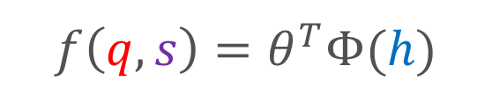

Baseline Systems
Word matching count (Wd-Cnt)
# non-stopwords in Q that also occur in S
Latent word alignment (Wd-Algn) [Yih+ ACL-13]
Convolutional NN (CNN) [Yu+ DLWorkshop-14]
Convolutional NN & Wd-Cnt (CNN-Cnt)
$q$: What is the fastest car in the world?
$$f\left(q,s\right)=θ^{T}Φ(h)$$
$$h$$
$s$: The Jaguar XJ220 is the dearest, fastest and most sought after car on the planet.

Slide 17
Evaluation on Answer Sentence Selection

Slide 18
Evaluation on Answer Sentence Selection
* 1,242 (40.8%) questions that have correct answer sentences in the candidate set

Slide 19
Answer Triggering
Given a question and a candidate answer sentence set
Detect whether there exist correct answers in the sentences
Return a correct answer if there exists one
Evaluation metric
Question-level precision, recall and F1 score
Data – All questions in WikiQA are included in this task

Slide 20
Evaluation on Answer Triggering

Slide 21
Evaluation on Answer Triggering

Slide 22
Evaluation on Answer Triggering

Slide 23
Conclusion (1/2)
WikiQA: A new dataset for open-domain QA
Question distribution: questions sampled from Bing query logs
Candidate selection: sentences from Wikipedia summary paragraphs
Enable “Answer Triggering” by including questions w/o answers
Experiments
Different model behaviors on WikiQA and QASent datasets
Simple word-matching baseline is no longer strong
Answer triggering remains a challenging task

Slide 24

Conclusions (2/2)
Future Work
Investigate advanced semantic matching methods
Encoder-decoder semantic matching (e.g., [Sutskever+ NIPS-14])
Structured text semantic matching (e.g., [Hu+ NIPS-14])
Improve the performance of answer triggering
Data & Evaluation Script: http://aka.ms/WikiQA
Includes “answer phrases” labeled by authors

