Slide 1
Search-based Neural Structured Learning for Sequential Question Answering
Mohit Iyyer, Wen-tau Yih, Ming-Wei Chang. ACL-2017

Slide 2
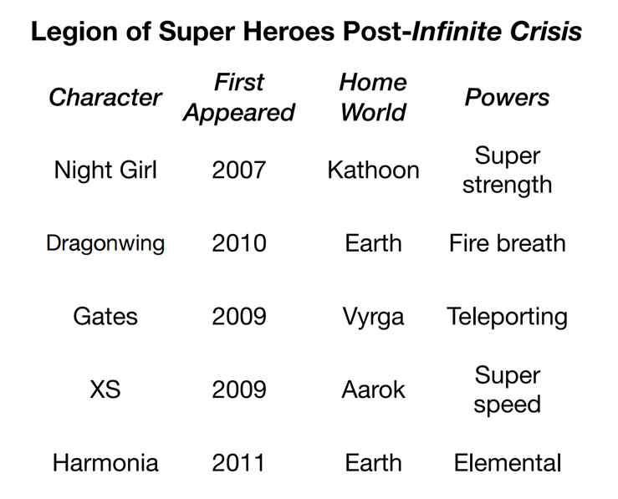
Answer Highly Compositional Questions
“What is the power of the super hero who is from the most common home world and appeared after 2010?”
Challenging research problem
Advocated in semantic parsing [Pasupat & Liang 2015]
But, a natural way to interact with a question answering system?

Slide 3



Answer Sequences of Simple Questions
Who are the super heroes from Earth?
Dragonwing and Harmonia
Who appeared after 2010?
Harmonia
What is her power?
Elemental

Slide 4
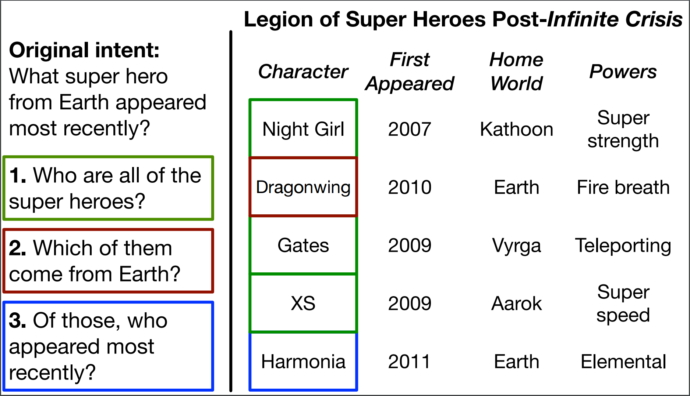
Our Task: Sequential Question Answering (SQA)
MSR SQA Dataset (aka.ms/sqa)
Sequences of questions, with annotated answers (coordinates)

Slide 5
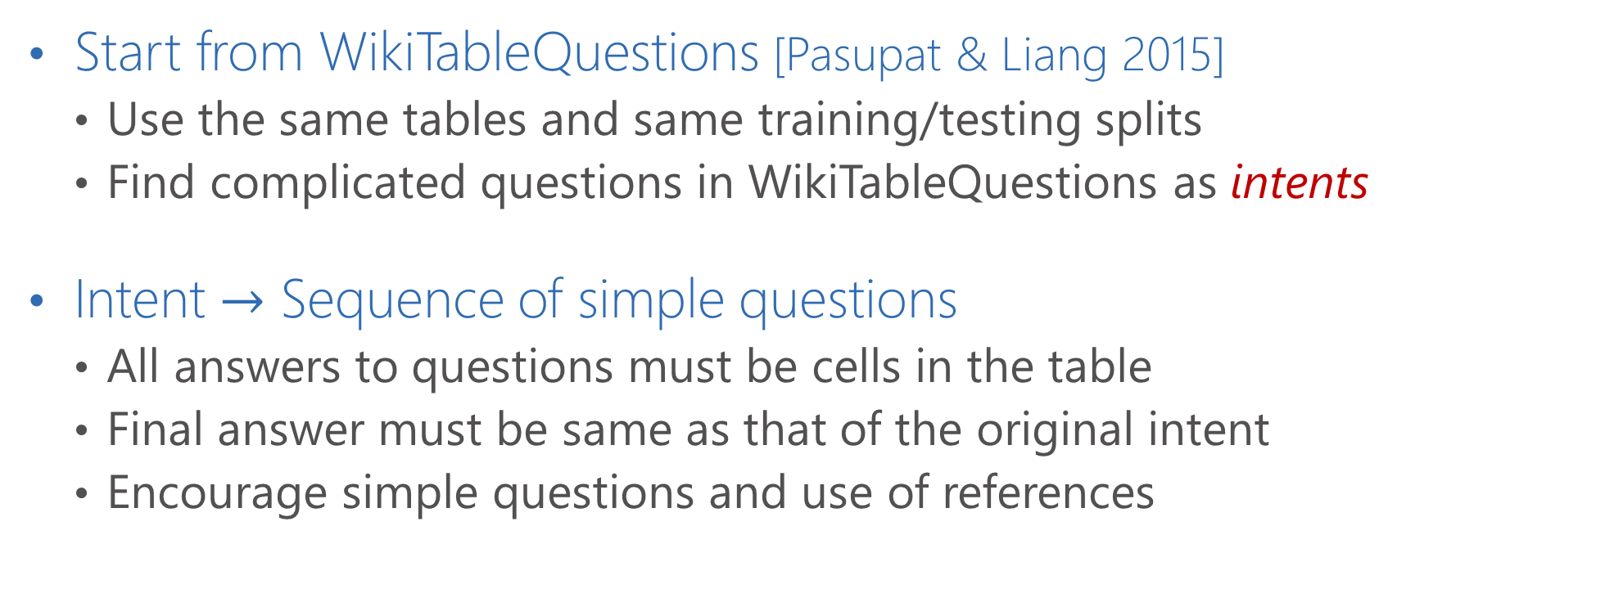
SQA Dataset Creation (1/2)
Start from WikiTableQuestions [Pasupat & Liang 2015]
Use the same tables and same training/testing splits
Find complicated questions in WikiTableQuestions as intents
Intent $→$ Sequence of simple questions
All answers to questions must be cells in the table
Final answer must be same as that of the original intent
Encourage simple questions and use of references

Slide 6
SQA Dataset Creation (2/2)
Original Intent
What super hero from Earth appeared most recently?
Sequence of simple questions
Who are all of the super heroes?
Which of them came from Earth?
Of those, who appeared most recently?
Data statistics
2,022 intents
6,066 question sequences (3 annotators per intent)
17,533 total questions (~2.9 questions per sequence)

Slide 7
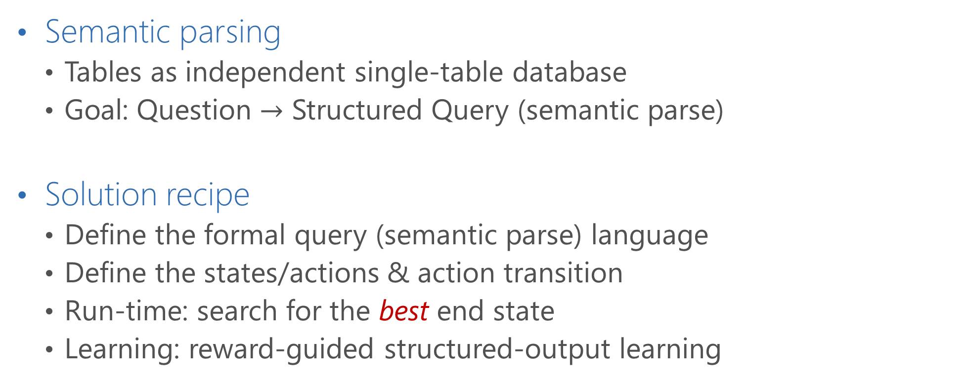
Approach: Dynamic Semantic Parser (DynSP)
Semantic parsing
Tables as independent single-table database
Goal: Question $→$ Structured Query (semantic parse)
Solution recipe
Define the formal query (semantic parse) language
Define the states/actions & action transition
Run-time: search for the best end state
Learning: reward-guided structured-output learning

Slide 8
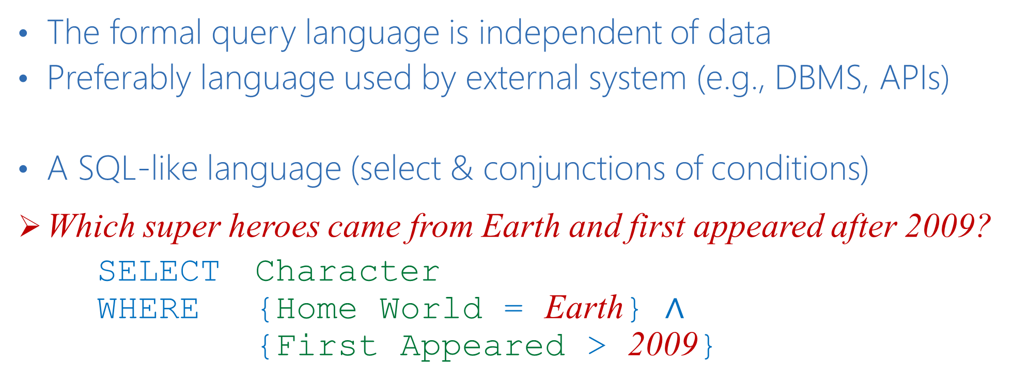
Formal Query Language
The formal query language is independent of data
Preferably language used by external system (e.g., DBMS, APIs)
A SQL-like language (select & conjunctions of conditions)
Which super heroes came from Earth and first appeared after 2009?
SELECT Character WHERE {Home World = Earth} $∧$ {First Appeared > 2009}

Slide 9
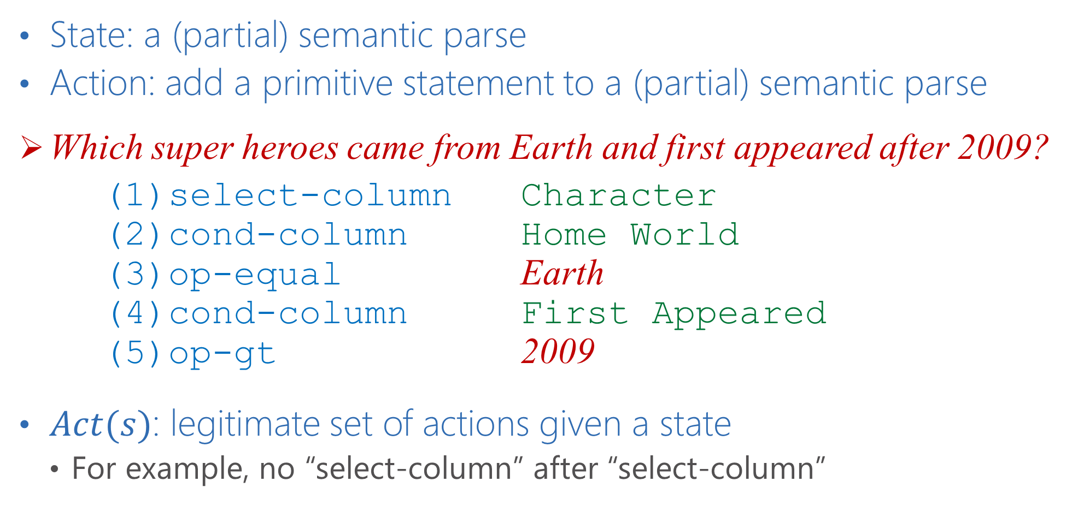
States & Actions
State: a (partial) semantic parse
Action: add a primitive statement to a (partial) semantic parse
Which super heroes came from Earth and first appeared after 2009?
(1)select-column Character (2)cond-column Home World (3)op-equal Earth (4)cond-column First Appeared (5)op-gt 2009
$Act(s)$: legitimate set of actions given a state
For example, no “select-column” after “select-column”

Slide 10











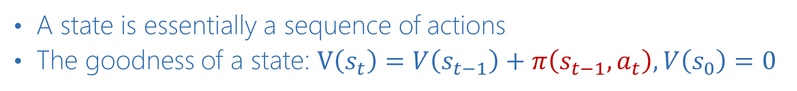
Search
Which super heroes came from Earth?
(1)select-column Character (2)cond-column Home World (3)op-equal Earth
$$s_{1}$$
Cond on “Home World”
$$s_{2}$$
Select “Character”
Value = “Earth”
$$s_{0}$$
$$⋯$$
$$s_{3}$$
$$s_{1}^{′}$$
$$⋯$$
$$s_{2}^{′}$$
$$⋯$$
Select “Powers”
$$s_{1}^{′′}$$
$$s_{2}^{′′}$$
A state is essentially a sequence of actions
The goodness of a state: $V\left(s_{t}\right)=V\left(s_{t−1}\right)+π\left(s_{t−1},a_{t}\right), V\left(s_{0}\right)=0$

Slide 11


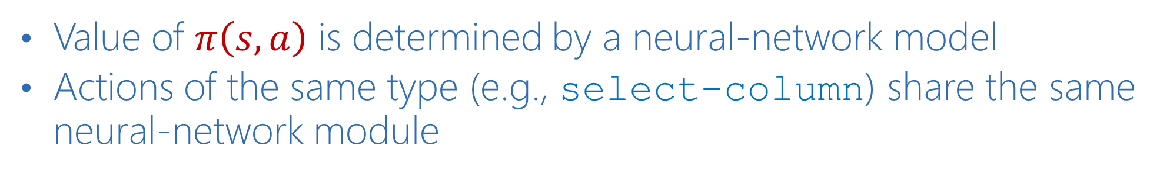





Neural Network Modules (1/2)
Value of $π\left(s,a\right)$ is determined by a neural-network model
Actions of the same type (e.g., select-column) share the same neural-network module
Which super heroes came from Earth? ,
$$a_{1}$$
$$a_{2}$$
$$a_{3}$$
$$s_{0}$$
Select “Character”
$$s_{1}$$
Cond on “Home World”
$$s_{2}$$
Value = “Earth”
$$s_{3}$$
$$π(s_{0},a_{1})$$
$$π(s_{1},a_{2})$$
$$π(s_{2},a_{3})$$

Slide 12
Neural Network Modules (2/2)
Modules are selected dynamically as search progresses
Similar to [Andreas et al. 2016], but structures are not pre-determined
Network design reflects the semantics of the action
Select “Character”
Bi-LSTM Word Embedding
character
Word Embedding initialized with GloVe
Q: Which super heroes came from Earth?

Slide 13
Reward-guided Structured Learning
Indirect supervision: only answers are available
Algorithm (for each question):
Find the reference semantic parse that evaluates to the gold answers
Find the predicted semantic parse based on the current model
Derive loss by comparing them; update model parameters by stochastic gradient decent

Slide 14

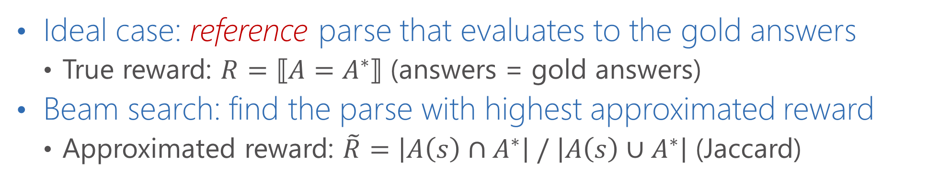
Find the Reference Semantic Parse
Ideal case: reference parse that evaluates to the gold answers
True reward: $R=⟦A=A^{∗}⟧$ (answers = gold answers)
Beam search: find the parse with highest approximated reward
Approximated reward: $\tilde{R}=\left|A\left(s\right)∩A^{∗}\right| / \left|A\left(s\right)∪A^{∗}\right|$ (Jaccard)
$Q=$ “Which super heroes came from Earth?”, $A^{∗}=$ {Dragonwing, Harmonia}
$$s_{1}$$
Cond on “Home World”
$$s_{2}$$
Select “Character”
Value = “Earth”
$$s_{0}$$
$$⋯$$
$$s_{3}$$
$$s_{1}^{′}$$
$$⋯$$
$$s_{2}^{′}$$
$$⋯$$
Select “Powers”
$$s_{1}^{′′}$$
$$s_{2}^{′′}$$

Slide 15
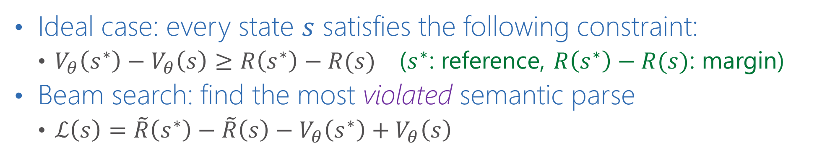
Find the Predicted Semantic Parse
Ideal case: every state $s$ satisfies the following constraint:
$V_{θ}\left(s^{∗}\right)−V_{θ}\left(s\right)≥R\left(s^{∗}\right)−R(s)$ ($s^{∗}$: reference, $R\left(s^{∗}\right)−R(s)$: margin)
Beam search: find the most violated semantic parse
$ℒ\left(s\right)=\tilde{R}\left(s^{∗}\right)−\tilde{R}\left(s\right)−V_{θ}\left(s^{∗}\right)+V_{θ}\left(s\right)$
$Q=$ “Which super heroes came from Earth?”, $A^{∗}=$ {Dragonwing, Harmonia}
$$s_{1}$$
Cond on “Home World”
$$s_{2}$$
Select “Character”
Value = “Earth”
$$s_{0}$$
$$⋯$$
$$s_{3}$$
$$s_{1}^{′}$$
$$⋯$$
$$s_{2}^{′}$$
$$⋯$$
Select “Powers”
$$s_{1}^{′′}$$
$$s_{2}^{′′}$$

Slide 16
Extension to Question Sequence
For questions that are not the first in a sequence, allow a special subsequent statement
Modules of subsequent conditions consider both previous and current questions
Answers would be a subset of previous answers
Which super heroes came from Earth?
Which of them breathes fire?
SUBSEQUENT WHERE {Powers = Fire breath}

Slide 17
Related Work
Floating Parser (FP) [Pasupat & Liang. ACL-15]
Map questions to logical forms
Feature-rich system that aims to output the correct semantic parse
Neural Programmer (NP) [Neelakantan et al. ICLR-17]
Neural modules that are not tied to a specific formal language
Output a probability distribution over table cells given a question
Both FP & NP were designed for WikiTableQuestions
Contains more long, complicated but independent questions

Slide 18
Results: Answer Accuracy (%)

Slide 19
Results: Answer Accuracy (%)

Slide 20
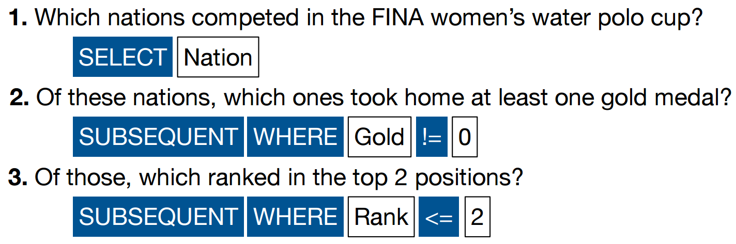
Cherry

Slide 21
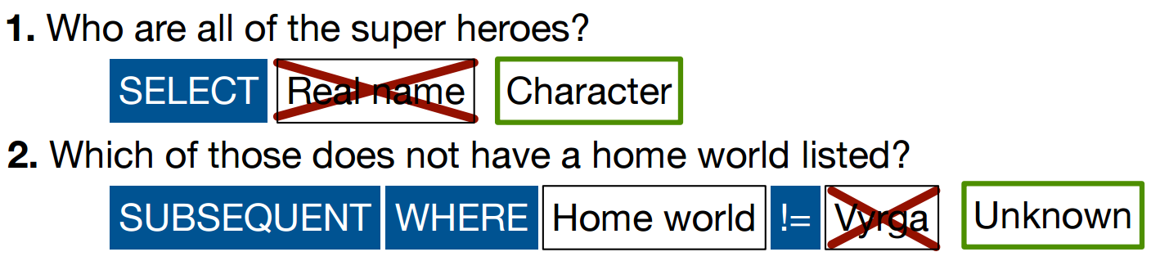
Lemon: Semantic Matching Errors

Slide 22
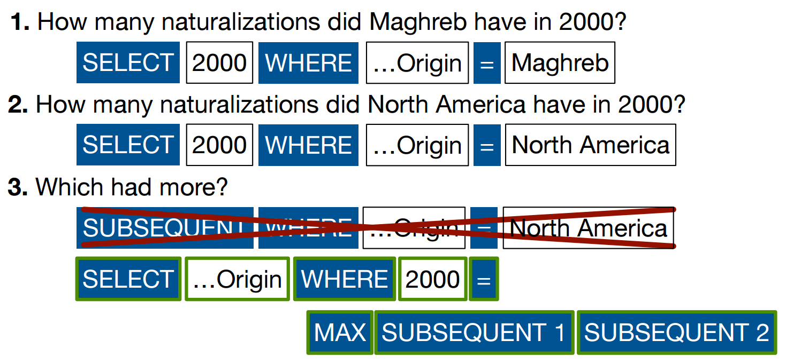
Lemon: Language Expressiveness

Slide 23
Reflections on DynSP
An end-to-end joint learning framework
Formulated as a state/action search problem
Neural networks constructed dynamically as search progresses
A first step towards “Conversational QA”
Next steps
Efficient training to test more expressive formal languages and neural network modules
External data or interactive learning for better semantic matching

