Slide 1
Measuring Word Relatedness Using Heterogeneous Vector Space Models
Scott Wen-tau Yih (Microsoft Research)
Joint work with Vahed Qazvinian (University of Michigan)

Slide 2
Measuring Semantic Word Relatedness
How related are words “movie” and “popcorn”?

Slide 3
Measuring Semantic Word Relatedness
Semantic relatedness covers many word relations, not just similarity [Budanitsky & Hirst 06]
Synonymy (noon vs. midday)
Antonymy (hot vs. cold)
Hypernymy/Hyponymy (Is-A) (wine vs. gin)
Meronymy (Part-Of) (finger vs. hand)
Functional relation (pencil vs. paper)
Other frequent association (drug vs. abuse)
Applications
Text classification, paraphrase detection/generation, textual entailment, …

Slide 4

Sentence Completion (Zweig et al. ACL-2012)
The physics professor designed his lectures to avoid ____ the material: his goal was to clarify difficult topics, not make them confusing. (a) theorizing (b) elucidating (c) obfuscating (d) delineating (e) accosting

Slide 5
Sentence Completion (Zweig et al. ACL-2012)
The physics professor designed his lectures to avoid ____ the material: his goal was to clarify difficult topics, not make them confusing. (a) theorizing (b) elucidating (c) obfuscating (d) delineating (e) accosting
The answer word should be semantically related to some keywords in the sentence.

Slide 6



Vector Space Model
Distributional Hypothesis (Harris 54)
Words appearing in the same context tend to have similar meaning
Basic vector space model (Pereira 93; Lin & Pantel 02)
For each target word, create a term vector using the neighboring words in a corpus
The semantic relatedness of two words is measured by the cosine score of the corresponding vectors
$$v_{w_{1}}$$
cos($θ$)
θ
$$v_{w_{2}}$$

Slide 7
Need for Multiple VSMs
Representing a multi-sense word (e.g., jaguar) with one vector could be problematic
Violating triangle inequality
Multi-prototype VSMs (Reisinger & Mooney 10)
Sense-specific vectors for each word
Discovering senses by clustering contexts
Two potential issues in practice
Quality depends heavily on the clustering algorithm
The corpus may not have enough coverage

Slide 8
Our Work – Heterogeneous VSMs
Novel Insight
Vectors from different information sources bias differently
Jaguar: Wikipedia (cat), Bing (car)
Heterogeneous vector space models provide complementary coverage of word sense and meaning
Solution
Construct VSMs using general corpus (Wikipedia), Web (Bing) and thesaurus (Encarta & WordNet)
Word relatedness measure: Average cosine score
Strong empirical results
Outperform existing methods on 2 benchmark datasets

Slide 9
Roadmap
Introduction
Construct heterogeneous vector space models
Corpus – Wikipedia
Web – Bing search snippets
Thesaurus – Encarta & WordNet
Experimental evaluation
Task & datasets
Results
Conclusion

Slide 10
Corpus-based VSM (Lin & Pantel 02)
Construction
Collect terms within a window of [-10,+10] centered at each occurrence of a target word
Create TFIDF term-vector
Refinement
Vocabulary Trimming (removing stop-words)
Top 1500 high DF terms are removed from vocabulary
Term Trimming (local feature selection)
Top 200 high-weighted terms for each term-vector
Data
Wikipedia (Nov. 2010) – 917M words

Slide 11
Web-based VSM (Sahami & Heilman 06)
Construction
Issue each target word as a query to Bing
Collect terms in the top 30 snippets
Create TFIDF term-vector
Vocabulary trimming: top 1000 high DF terms are removed
No term trimming
Compared to corpus-based VSM
Reflects user preference
May bias different word sense and meaning

Slide 12
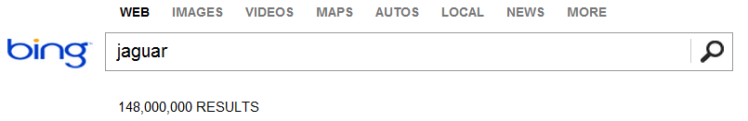
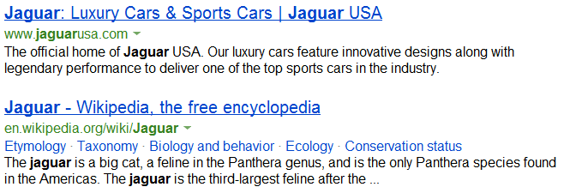
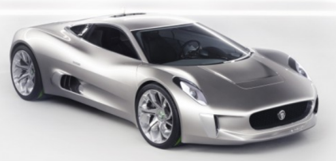

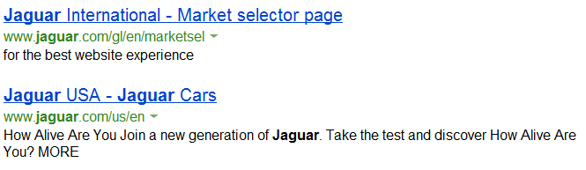
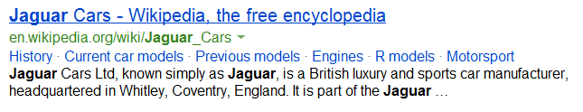

Slide 13
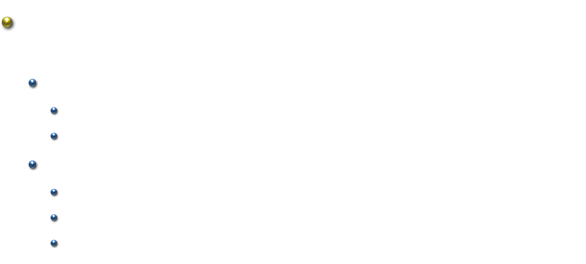
Thesaurus-based VSM (1/2)
Addresses two well-known weaknesses of distributional similarity
Co-occurrence $≠$ synonymous
“bread” vs. “butter” – high score because of “bread and butter”
Related, but shouldn’t be scored higher than synonyms
Words in general corpora follow Zipf’s law
Frequency of any word is inversely proportional to its rank
Some words occur very infrequently in the corpus
As a result, the term vector contains only few, noisy terms

Slide 14
Thesaurus-based VSM (2/2)
Construction
Create a TFIDF “document”-term matrix
Each “document” is a group of synonyms (synset)
Each word is represented by the corresponding column vector – the synsets it belongs to
Data
WordNet – 227,446 synsets, 190,052 words
Encarta thesaurus – 46,945 synsets, 50,184 words

Slide 15
Roadmap
Introduction
Construct heterogeneous vector space models
Corpus – Wikipedia
Web – Bing search snippets
Thesaurus – Encarta & WordNet
Experimental evaluation
Task & datasets
Results
Conclusion

Slide 16
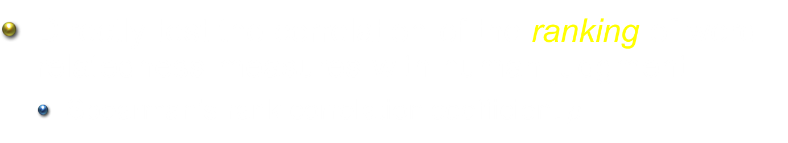


Evaluation Method
Data: list of word pairs with human judgment
Word 1 | Word 2 | Human Score (mean)
midday | noon | 9.3
tiger | jaguar | 8.0
cup | food | 5.0
forest | graveyard | 1.9
… | … | …
Directly test the correlation of the ranking of word relatedness measures with human judgment
Spearman’s rank correlation coefficient $ρ$

Slide 17
Results: WordSim-353 (Finkelstein et al. 01)
Assessed on a 0-10 scale by 13-16 human judges

Slide 18
Results: MTurk-287 (Radinsky et al. 11)
Assessed on a 1-5 scale by 10 Turkers

Slide 19
Conclusion
Combining heterogeneous VSMs for measuring word relatedness
Better coverage on word sense and meaning
A simple and yet effective strategy
Future Work
Other combination strategy or model
Extending to longer text segments (e.g., phrases)
More fine-grained word relations
Polarity Inducing LSA for Synonymy and Antonymy (Yih, Zweig & Platt, EMNLP-2012)

