Slide 1
Integer Linear Programming Inference for Conditional Random Fields
Scott Wen-tau Yih
Microsoft Research
Joint work with Dan Roth
Department of Computer Science
University of Illinois at Urbana-Champaign

Slide 2






Structured Output
Car part recognition
Label the parts of a car.
Local approach
Learn a classifier for each part
Global Approach
Assume that we know it is a car.
No more than four wheels in the image
No more than four lights in the image
Relative positions of the parts

Slide 3
Semantic Role Labeling (SRL)
For each verb in a sentence
Identify all constituents that fill a semantic role
Determine their roles
Core Arguments, e.g., Agent, Patient or Instrument
Their adjuncts, e.g., Locative, Temporal or Manner
A0 : leaver
A2 : benefactor
I left my pearls to my daughter-in-law in my will.
A1 : thing left
AM-LOC

Slide 4
Identifying Phrase Structure
[_{NP} He ] [_{VP} reckons ] [_{NP} the current account deficit ] [_{VP} will narrow ]
[_{PP} to ] [_{NP} only # 1.8 billion ] [_{PP} in ] [_{NP} September ]
He reckons the current account deficit will narrow to only # 1.8 billion in
September
Classifiers
Recognizing “The beginning of NP”
Recognizing “The end of NP”
(or: word based classifiers: BIO representation)
Also for other kinds of phrases…
Some Constraints
Hard and declarative: Phrases do not overlap
Soft and statistical: learn Prob(NP→VP) from the data
Non-sequential and declarative: If PP then NP in the sentence
Inference (used in testing or training): Find the best global prediction subject to the constraints

Slide 5
Questions/Issues
Incorporating different types of constraints
Allow both statistical and declarative constraints
Allow non-sequential constraints (generally difficult)
Do more constraints help?
Training frameworks for structured output
Learning + Inference vs. Inference-based Training

Slide 6
This Paper
Integer Linear Programming based Inference
It allows incorporating non-sequential/expressive constraints.
It reduces to a polynomial scheme when constraints are sequential. (e.g., it can model Viterbi)
Not necessarily increases complexity and very efficient in practice
More constraints help
In a domain such as SRL, where many complex constraints exist, incorporating these constraints helps significantly.
A simple learning plus inference strategy may work better when more constraints are available. (more in [IJCAI-05a])

Slide 7
Outline
Background of CRFs and Viterbi
Model, Training, Inference
Notes on Viterbi
Integer Linear Programming based Inference
Incorporating constraints in the ILP inference
Experiments
ILP means Integer Linear Programming in this talk.

Slide 8
Conditional Random Fields
Sequence labeling case
CRFs are linear-chain MRFs that model Pr(y|x)
The potential functions are decided by features over x
y
y₁
y₂
y₃
y₄
y₅
x
x₁
x₂
x₃
x₄
x₅
Local feature functions: f ¹, …, f ^{K}
Maps a pair of sequences (y,x) and a token index i to f ^{k}(y,x,i) ∈ R
Global feature vector: F(y,x)=Σ⟨f ¹(y,x,i), …, f ^{K}(y,x,i)⟩
Pr_{λ}(y|x) = exp(λ·F(y,x)) / Z _{λ}(x)

Slide 9
Learning CRFs models
Training of CRFs requires estimating the weight vector λ
1. Maximize likelihood of the training set T={(x_{k},y_{k})}, 1 ≤ k ≤ N
Need to calculate the expectation of each feature function
2. Discriminative training via voted Perceptron [Collins 02, Sha&Pereira 03]
Need to find the best global prediction (argmax inference)
Sum over all possible output sequences ⇒ forward-backward algorithm
Best over all possible output sequences ⇒ Viterbi algorithm

Slide 10
Inference
0
1
2
3
4
A
A
A
A
A
s
B
B
B
B
B
t
C
C
C
C
C

Slide 11
Inference via Viterbi
-log M₄
0
1
2
3
4
A
A
A
A
A
s
B
B
B
B
B
t
C
C
C
C
C
A
B
B
C
C
At step i, it records all the optimal sequences ending at label y, for all y
Equivalently, find the shortest path from s to t

Slide 12
Notes on Viterbi
Very simple and efficient
Some declarative constraints can already be added by modifying matrix entries
0
1
2
3
4
A
A
A
A
A
s
B
B
B
B
B
t
C
C
C
C
C
A
B
B
C
C

Slide 13
Notes on Viterbi
A
B
C
A
.2
.5
.3
M₃=
B
.1
.4
.5
Very simple and efficient
Some declarative constraints can already be added by modifying matrix entries
C
.2
.6
.2
ε
0
1
2
3
4
A
A
A
A
A
s
B
B
B
B
B
t
C
C
C
C
C
A
B
B
A
A
Token pairs cannot be (C,B)

Slide 14
Notes on Viterbi
A
B
C
A
.3
.4
.3
ε
ε
M₂=
B
.4
.4
.2
ε
ε
Very simple and efficient
Some declarative constraints can already be added by modifying matrix entries
C
.2
.5
.3
ε
ε
0
1
2
3
4
A
A
A
A
A
s
B
B
B
B
B
t
C
C
C
C
C
A
B
C
A
A
No more than 2 B’s in the sequence
If token 1 is B then token 3 is C
Token 2 can only be C

Slide 15
Outline
Background of CRFs and Viterbi
Integer Linear Programming based Inference
Using ILP to find the shortest path (Viterbi)
It reduces to Linear Programming
Incorporating expressive constraints in ILP inference
Experiments

Slide 16
Notes on Integer Linear Programming
Integer Linear Programming = Linear Programming + Integer constraints on variables
The cost function is still linear.
The constraints are still linear.
ILP is usually solved by branch-and-bound search using the LP solver as the basic routine.
If LP returns integral solutions, then the ILP is solved.
Otherwise, divide the problem to several LP problems.
Some ILP problems can be solved by LP
the coefficient matrix is totally unimodular
specific cost functions and coefficient matrices

Slide 17
Finding Shortest Path using ILP
x_{ad}
a
2
d
x_{cd}
1
x_{dt}
4
5
1
x_{sc}
x_{de}
s
c
t
2
x_{ce}
3
5
x_{ba}
x_{bt}
x_{bs}
8
b
e
1
x_{eb}
Shortest path: s→c→e→b→a→d→t, cost = 10
Binary decision variable x_{uv} to indicate if edge u→v is in the shortest path

Slide 18
Finding Shortest Path using ILP
x_{ad}=1
a
2
d
x_{cd}=0
1
x_{dt}=1
4
5
1
x_{sc}=1
x_{de}=0
s
c
t
2
x_{ce}=1
3
5
x_{ba}=1
x_{bt}=0
8
x_{bs}=0
b
e
1
x_{eb}=1
Shortest path: s→c→e→b→a→d→t, cost = 10
Binary decision variable x_{uv} to indicate if edge u→v is in the shortest path

Slide 19
Finding Shortest Path using ILP
Total cost of the picked edges – Cost of the path
Start node has one more outward edge.
Each node except s and t should have the same number of inward edges and outward edges in the path.
Target node has one more inward edge.
Because the coefficient matrix is totally unimodular [Wolsey 98]
Binary constraints
Linear programming solution is always integral.

Slide 20
Graph in CRFs and HMMs
-log M₃₄
0
1
2
3
4
A
A
A
A
A
s
B
B
B
B
B
t
C
C
C
C
C
A
B
B
C
C

Slide 21
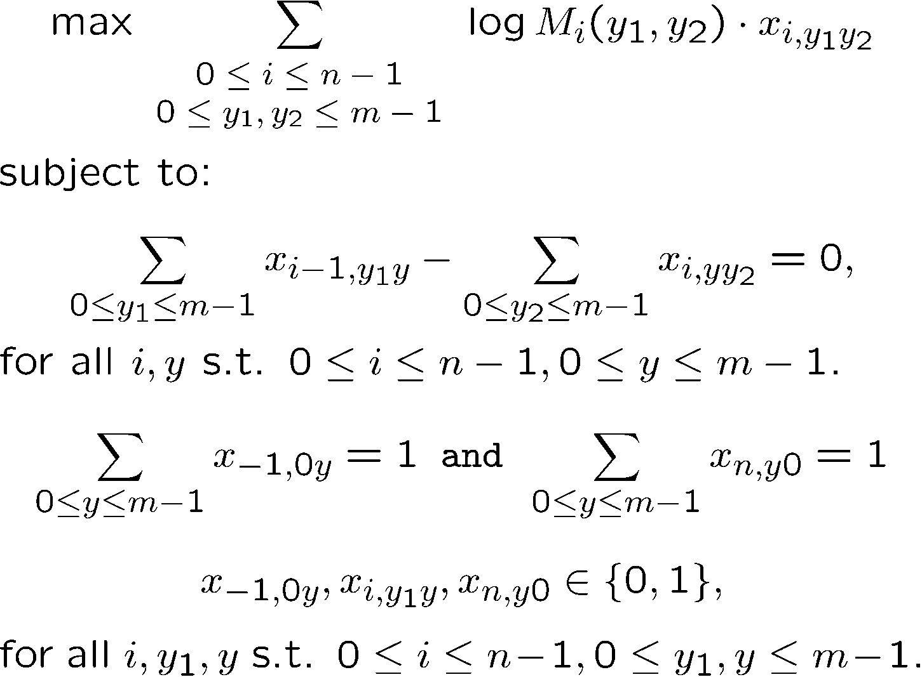
Corresponding (Integer) Linear Program
Cost Function
Constraints

Slide 22
Outline
Background of CRFs and Viterbi
Integer Linear Programming based Inference
Incorporating constraints in the ILP inference
Allows non-sequential/expressive constraints
Does not necessarily increase complexity
Experiments

Slide 23
Constraints Example #1
If label A appears, then label B must also appear.
0
1
2
3
4
A
A
A
A
A
s
B
B
B
B
B
t
C
C
C
C
C

Slide 24
Constraints Example #2
Tokens 1 ~ 3 share the same label.
If token 1 is label l then tokens 2,3 have to be l.
0
1
2
3
4
A
A
A
A
A
s
B
B
B
B
B
t
C
C
C
C
C
Any Boolean rule can be encoded as linear constraints.
whether token i is assigned label y

Slide 25
Some Properties of this ILP Inference
Allows expressive constraints
See paper for more examples
Any Boolean rule can be represented by a set of linear (in)equalities
The additional constraints are added to the basic integer linear program.
Solved using off-the-shelf packages
For example, Xpress-MP or CPLEX
If the additional constraints don’t change the solution, LP is enough
Otherwise, the computational time depends, but usually fast in practice

Slide 26
Outline
Background of CRFs and Viterbi
Integer Linear Programming based Inference
Incorporating constraints in the ILP inference
Experiments – contribution of expressive constraints
Setting for the Semantic Role Labeling task
Additional constraints
Comparing different training frameworks

Slide 27
Semantic Role Labeling
For each verb in a sentence
Identify all constituents that fill a semantic role
Determine their roles, such as, Agent, Patient or Instrument
No two arguments share the same label
Use IO representation
A0: leaver | V | A1: thing left |  | A2: benefactor
I | left | my | pearls | to | my | daughter-in-law | in | my | will | .
I-A0 | O | I-A1 | I-A1 | I-A2 | I-A2 | I-A2 | O | O | O | O
X
Y

Slide 28
Constraints
No duplicate argument labels (no dup)
e.g., no two discontinuous segments are both A0
Specific token sequence share same labels (cand)
Derive argument candidates from the parse tree
At least one argument in a sentence (argument)
Not all of the tokens are label O
Given the verb position (verb pos)
The label of the verb should be O
Disallow some arguments (disallow)
Derive from the frame files in the PropBank corpus

Slide 29
Results of CRFs Models
Learning with statistical constraints only
F₁
CRF-ML
CRF-D
basic (Viterbi)
66.46
diff
69.14
diff
+ no dup
67.10
+0.64
69.74
+0.60
+ cand
71.78
+4.68
73.64
+3.90
+ argument
71.71
-0.07
73.71
+0.07
+ verb pos
71.72
+0.01
73.78
+0.07
+ disallow
71.94
+0.22
73.91
+0.13

Slide 30
Outline
Background of CRFs and Viterbi
Integer Linear Programming based Inference
Incorporating constraints in the ILP inference
Experiments – contribution of expressive constraints
Setting for the Semantic Role Labeling task
Additional constraints
Comparing different training frameworks
y
y₁
y₂
y₃
y₄
y₅
x
x₁
x₂
x₃
x₄
x₅

Slide 31
Results of Simple Learning + Inference
Learning an independent token label classifier
Inference using a similar (but simpler) ILP method
F₁
Voted Perceptron
Voted Winnow
basic
58.15
diff
54.32
diff
+ no dup
64.33
+6.18
61.87
+7.55
+ cand
74.17
+9.84
71.72
+9.85
+ argument
74.02
-0.15
71.76
+0.04
+ verb pos
74.03
+0.01
71.84
+0.08
+ disallow
74.49
+0.46
72.04
+0.20

Slide 32
Training Efficiency
CRF-D (global): Learning with all constraints discriminatively
 | CRF-ML | CRF-D | CRF-D (global) | VP | VW
Best F₁ | 71.94 | 73.91 | 69.82 | 74.49 | 72.04
Time (hrs) | 48 | 38 | 145 | 0.8 | 0.8
When more expressive and informative constraints are available, simple L+I strategy may be better.
For more discussion, see Vasin Punyakanok, Dan Roth, Wen-tau Yih, Dav Zimak, Learning and Inference over Constrained Output, IJCAI-05

Slide 33
Final Notes on SRL Experiments
Goals
Demonstrate the new inference/learning framework
Show the contribution of complicated constraints
The Semantic Role Labeling task is simplified here
Only deal with core arguments
Smaller training set
A different ILP inference method helps us win a competition
Best system in CoNLL-05 shared task!!
Vasin Punyakanok, Dan Roth, Wen-tau Yih The Necessity of Syntactic Parsing for Semantic Role Labeling, IJCAI-05

Slide 34
Conclusions
We studied models for structured output learning problems in the presence of expressive constraints.
Inference based on Integer Linear Programming
It allows incorporating non-sequential/expressive constraints.
Very efficient in practice
More constraints help
Has been demonstrated in the SRL task
L+I strategy may work better with much less computational cost

