Slide 1

Sort - Simple Object Relational Toolkit
Simpler object peristence
Name
Job title
Date here

Slide 2

Presentation Overview

Slide 3

Presentation Overview
Problems with the mybatis approach.
  Combining data across modules is too dificult and not performant.
  Modules need to provide batch and client mapping files with a lot of duplication.
  No lazy loading.
  "Where exists" is not possible with the UI filter
  The condition framework cannot be reused between modules.
  Saving logic has to be manually implemented.
Features provided by sort.
  Queries can be safely combined across modules to return fully populated models.
  Query Classes provides compile time safety of query expressions.
  Batch and Client modes can be controlled by the framework with no work for the programmer.
  Lazy and eager loading
  Querying overview
  Persistence
Future Features.
  Better handling of permissions
  Applying audit diffs to loaded models
  N-Eyes support
  Caching with read-only models
Click to add comments

Slide 4
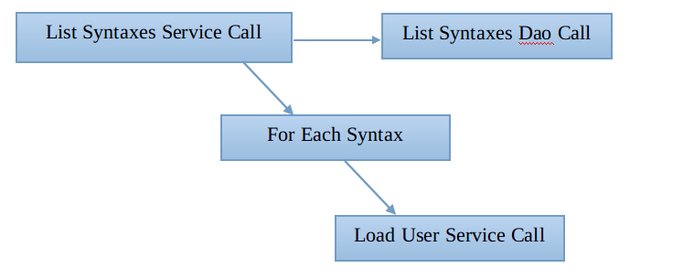
Problems with the mybatis approach.
Combining data across modules is too dificult and not performant
  Joining syntax to user for display in the UI is not straight forward.
    Each Syntax object returned from MI must refer to a User object with only the ID set.
    The hand coded service must then iterate through all Syntaxes switching out the empty User object with one loaded from MAC.
  Displaying a list of 100 syntaxes could cause 100 database requests to MAC_USER.

Slide 5
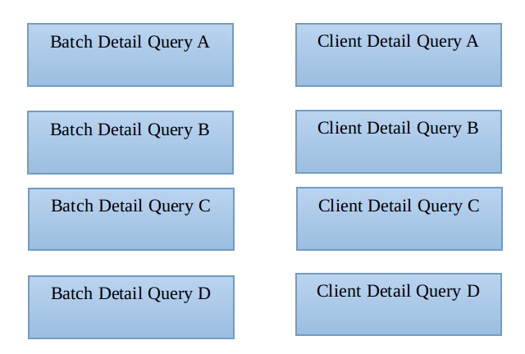
Problems with the mybatis approach.
Modules need to provide batch and client mapping files with a lot of duplication
  Batch files have no access-control and no mac session.
  Client files have full access-control via mac session.
  Each query also requires it's own service and dao methods.

Slide 6
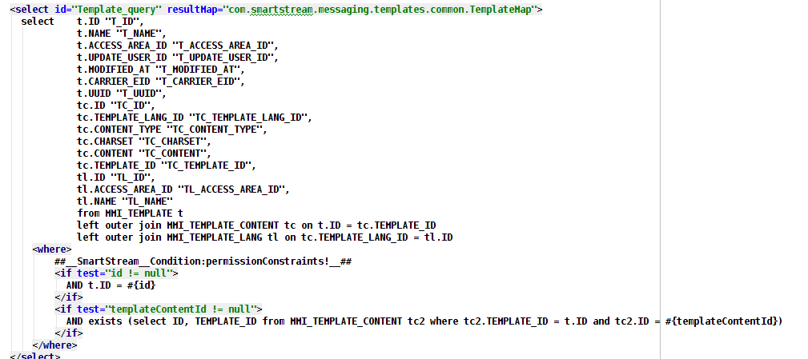
Problems with the mybatis approach.
Sample client query

Slide 7
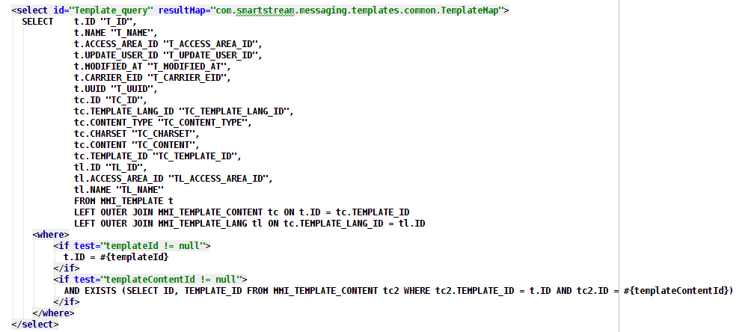
Problems with the mybatis approach.
Same almost identical query for batch

Slide 8
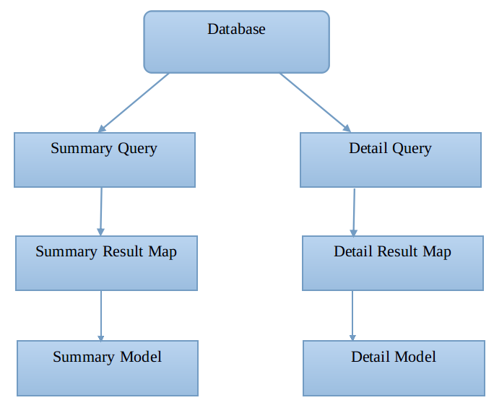
Problems with the mybatis approach.
No lazy loading
  Boundaries to the data model have to be decided upfront
  eg. have accessAreaId property and not the accessArea object.
  Seperate model classes for summary and detail views.
  Seperate result-maps and queries are required to pull out and populate the summary and detail models.
    ResultMap + Query for summary view.
    ResultMap + Query for detail editor.

Slide 9
Problems with the mybatis approach.
"Where exists" is not possible with the UI filter
  Eg Filter on syntaxes which have a mapping to "fundsCode"
  The filter framework cannot generate subquerys because it has no knowledge of table names or foreign-key references.

Slide 10
Problems with the mybatis approach.
Mix of manual query writing and dynamic filter requires tricky setup in the dao and UI
  Column prefixes must be specified
  addColumnPrefixToTableMapping("MF_", "feed");
  Alias mappings are required to convert between filter property and query condition
  newMapping.put("message.id", "msg.ID");
  TableMetaInfo properties must be kept in synch with the dao implementation.
  message.id -> tableMetaInfo -> filter -> dao -> msg.ID -> query.
Support for different SQL dialects must be managed by the programmer
Developers can break existing queries when introducing changes
Developers have to specify the jdbc types of null parameters
  Eg #{object.tokenPrefix,jdbcType=VARCHAR},

Slide 11
Problems with the mybatis approach.
The condition framework cannot be used across modules
  Requires knowledge of actual property names and types used in the DAO implementation.
  No compile time safety for the query attribute changes.
  Prevents module A from safely creating expressions to execute against module B.
  Changing the DAO layer means all of the UI conditions have to be tested.
  new BinaryCondition<>(String.class, "name", Operator.EQUALS, "Test")
  .setConjunction(Type.AND, new Expression(
  new BinaryCondition<>(String.class, "viewID", Operator.EQUALS, "Bla")
  .setConjunction(Type.OR, new BinaryCondition<>(String.class, "viewID", Operator.EQUALS, "Blub")
  .setConjunction(Type.AND, new Expression(
  new PolyadicCondition<>(long.class, "ownedByAccessAreaID", Operator.IN, 12l, 1l, 9l)
  .setConjunction(Type.AND, new BinaryCondition<>(boolean.class, "valid", Operator.EQUALS, true))
  ).setNegate(true)
  )))
  .setConjunction(Type.OR, new BinaryCondition<>(int.class, "ownedByUserID", Operator.EQUALS, 42)));

Slide 12
Problems with the mybatis approach.
Saving logic has to be manually implemented, this includes:
  Saving foreign key relations before the current model.
  Saving many relations after the current model.
  Deleting relations which were removed (if cascade is not used).
  Primary key generation.
  Detecting constraint violations upfront for better error reporting to the UI.
  Adding the optimistic lock sql.
  Making sure audit information is saved correctly.
  All this logic usually involves a lot of jdbc calls.
Syncing the saved model back to the client has to be manually managed
  Can cause problems with
    Reinsert attempt on the second save.
    Optimistic lock failure on the second save.

Slide 13
Features provided by sort

Slide 14
Features provided by sort
Sort is a framework for querying and peristing data
  Modules provide their own query object API which can be shared between modules.
  Manages 1:1, 1:N and N:M relations between objects,
  Data can be eagerly loaded or lazily fetched as needed.
  Morph prevents duplicate copies of the same model a consistent source of errors in the UI.
  PreparedStatements are used for all query parameters to prevent SQL injection.
  Morph automatically handles object state when querying or persisting data.
    Querying
      Any existing objects on the client are updated by the query result
    Persisting
      Persisted object state (generated PKs, updated optimistic locks etc) automatically applied back to the client.

Slide 15
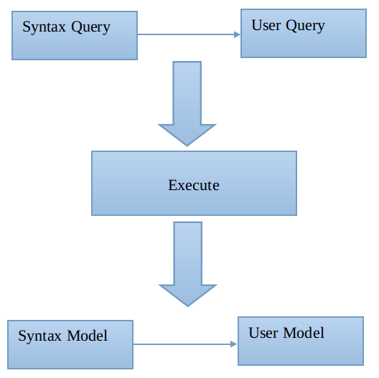
Features provided by sort
Queries can be safely combined across modules to return fully populated models
  With eager loading
  QSyntax qsyntax = new QSyntax();
  QUser quser = qsyntax,joinToUser():
  list = context.execute( syntax );
  syntax = list.get(0);
  user = syntax.getUser();
  With lazy loading
  QSyntax qsyntax = new QSyntax();
  list = context.execute( syntax );
  user = syntax.getUser();
  user.getName();

Slide 16
Features provided by sort
Query Classes provides compile time safety of query expressions
  The compiler catches if a property has been renamed, or if it's type has changed.
  Refactoring tools can be used!
  Any module can grab the QTest query class and use it safely.
  The Java compiler also makes sure that the value types are correct, ie that viewID takes a string parameter and ownedByUserID takes an integer.
  QTest qtest = new QTest();
  qtest.where( qtest.name().equal("Test"))
  .and( qtest.viewID().equal("Bla"))
  .or( qtest.viewID().equal("Blub"))
  .andNot( qtest.ownedByAccessAreaID().in(12l, 1l, 9l)
  .and( qtest.valid().equal( true ) ))
  .or( qtest.ownedByUserID().equal( 42 ) )

Slide 17
Features provided by sort
Batch and Client modes can be controlled by the framework with no work for the programmer
  Same Query API can be used for batch and client mode.
Access Control for client requests
  Loading
    Access Area constraints can be automatically added to queries.
    Permission constraints can be automatically added to queries.
  Persisting
    Optimistic Locks are automatically verified and updated.
    Permissions on each required insert, update and delete are automatically verified.
    Audit logs are automatically generated.

Slide 18
Features provided by sort
Full eager loading of data using outer joins
  Eg Defines a query to load syntaxes, their owners, their structure, the structure's fields and the syntax mappings from the database in one roundtrip.
  QSyntax qsyntax = new QSyntax();
  qsyntax.joinToUser();
  qsyntax.joinToStructure().joinToFields();
  qsyntax.joinToMappings();
  qsyntax.where( qsyntax.id().equal( 10 ) );
  syntax = context.performQuery( qsyntax ).getSingleResult();

Slide 19
Features provided by sort
Lazy loading of data using registered queries
  A model can be fetched when it's data is accessed.
  The query used by the fetch can be customized by the programmer at any point.
  Allows for fetching to match each specific use case.
  Eg register a mapping query to load the subsyntax, it's user, structure and structure fields on fetch.
  qmapping = new QMapping();
  qsubsyntax = qmapping.joinToSubSyntax();
  qsubsyntax.joinToStructure().joinToFields();
  qsubsyntax.joinToUser();
  context.registerQuery(qmapping);
  mappings = syntax.getMappings(); //lazy load
Lazy loading and eager loading can be combined to optimally handle database access

Slide 20
Features provided by sort
Lazy Loading of individual properties
  Specific properties can be removed from the query if they are not required for display.
  The specific properties are only fetched when they are individually accessed.
  Usefull for UI views which provide summary data.
  Eg Lazy loads the content property of a structure.
  qstructure = new QStructure();
  qstructure.disableContent();
  structures = context.executeQuery( qstructure ).getList();
  structures.get(0).getName():
  structures.get(0).getContent();

Slide 21
Features provided by sort
Supports complex where clauses
  Eg
  List all root syntaxes as well as syntaxes with name "Fred" which are either XML or CSV based.
  qsyntax = new QSyntax()
  .where( qyntax.syntaxType().equal(ROOT) )
  .or( qsyntax.name().equal("Fred" )
  .and( qsyntax.structureType().equal(XML)
  .or( qsyntax.structureType().equal(CSV) )
  )
  );

Slide 22
Features provided by sort
Supports "where exists" subqueries
  Can be used across modules, eg List all XML syntaxes created by user "Paul"
  qsyntax = new QSyntax();
  quser = syntax.existsUser();
  qsyntax.where( qsyntax.structureType().equal( XML ) )
  .andExists( quser.where( quser.name().equal("Paul") );
  Access Control constraints can be automatically applied to subqueries so that the user can only filter based on objects which he has access to.
  Exists filtering can go many layers deep, eg filter on syntaxes with structures which have a field of length 250.
  Exists support could be added to the filter dialog to allow the user to perform more complex filters.

Slide 23
Features provided by sort
Querying on base types
  Querying on the base type returns all models which inherit from that type.
  Syntax model is the parent of XmlSyntax and CsvSyntax.
  //query for all types of syntaxes (Xml, Csv, etc)
  qsyntax = new QSyntax();
  List<Syntax> listA = ctx.execute( qsyntax ).getList();
  if (listA.get(0) instanceof XmlSyntax) {
  //cast to XmlSyntax and get the XML structure
  xmlStructure = ((XmlSyntax)listA.get(0)).getXmlStructure();
  }
  //query for XML Syntaxes
  qxmlsyntax = new QXmlSyntax();
  List<XmlSyntax> listB = ctx.execute( qxmlsyntax ).getList();
  //query for CSV Syntaxes
  qcsvsyntax = new QCsvSyntax();
  List<CsvSyntax> listC = ctx.execute( qcsvsyntax ).getList();

Slide 24
Features provided by sort
Supports Query Batching (multiple result-sets)
  A QueryBatcher can send multiple queries to the server and return all results.
  Depending of the database vendor, a composite query can also be sent to the database and the multiple result-sets can be returned in one roundtrip.
  QueryBatcher batch = new QueryBatcher();
  batch.add( qsyntax );
  batch.add( qtemplates );
  batch.add( qusers );
  context.executeQueries( batch );
  syntaxes = batch.getResult(0, Syntax.class);
  templates = batch.getResult(1, Template.class);
  users = batch.getResult(2, User.class);

Slide 25
Features provided by sort
Persistence
  No hand written JDBC required.
    Performs all inserts, updates and deletes.
  Cascades operations based on relationships (Owns vs Refers To).
  Filters out entities with no changes.
  Optimistic Locking.
  Reorders statements to allow batching.
  Improved error reporting.
  Caching of prepared statements.
  Primary key generator plugins
  Complete audit log generation.
  Full access control check for all JDBC operations.
  Batch loading of original database data.

Slide 26
Features provided by sort
No hand written JDBC required
  Load a Persist Request with objects and then invoke persist
  Eg. Save a full syntax model and delete a different full syntax model.
  entityContext.persist( new PersistRequest()
  .save( syntaxModel )
  .delete( otherSyntaxModel )
  );

Slide 27
Features provided by sort
Cascades operations based on relationships
  Owns
    Persists always cascade to owned entities (1:1, 1:N).
  Refers / Depends On
    New entities which are referred to will be created. (1:1,1:N).
Filters out entities with no changes
  Only JDBC operations which will modify data are performed.
  It is possible to re-perist a whole object graph which will cause no insert, update or delete, will generate no audit logs and will perform no permission checks.

Slide 28
Features provided by sort
Optimistic Locking
  Relation - Owns - updating freshness when owned data changes.
    Let entity A own entity B
    Entity A supports optimistic locking, entity B does not.
    Entity B has been modified.
    Entity A's optimistic lock will be updated accordingly.
  Relation - Depends On - extending freshness checks.
    Let entity A depend on entity B.
    User's copy of entity B is out of date.
    User tries to save entity A.
    Persist will fail due to out of date entity B.
    "We don't want to save a mapping based on an out of date structure."

Slide 29
Features provided by sort
Reorders statements to allow batching
  Statements are added to insert, update and delete groups; to respect FK constraints, the groups are then executed in the following order.
    All insert statements.
    All update statements.
    All delete statements.
  Reordering statements within these groups allows JDBC batch operations to be used.
    Insert statements:
      Ordering restricted by FK constraints.
    Update statements:
      Can be reordered at will, no primary keys are added or removed.
    Delete statements:
      Ordering restricted by FK constraints.
  Insert and delete statement reordering is performed by analysing FK dependencies within the statement group.

Slide 30
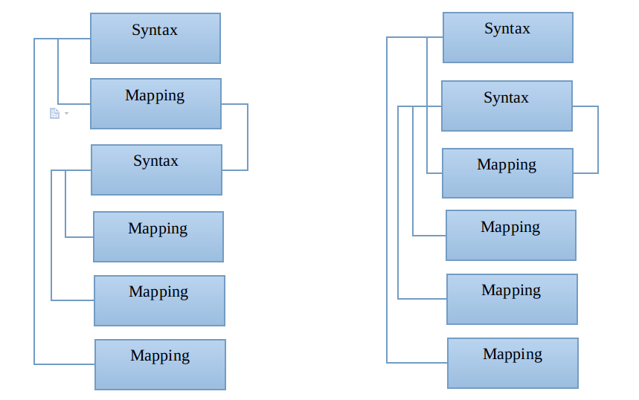
Features provided by sort
Statement reordering continued...
  Create statement reordering reduces the number of JDBC operations from 4 to 2.

Slide 31
Features provided by sort
Improved error reporting
  Centralized persistence logic allows for better and consistent error handling.
  Analysis of failed inserts, updates and deletes is possible allowing for detailed error handling.
    PrimaryKeyExistsException
      A query is performed to check if an entity with the PK already existed.
    UniqueConstraintViolatedException (todo)
      Query for records in the database that would cause constraint violations with the data being persisted.
    InvalidDataException (todo)
      Checks the size of the data against the specified column length.
      Reports the object and the property which caused the problem.
      Perhaps java beans validation can be used here too.
    RequiredPropertyException
      We can add the NULL, NOT NULL information to sort and then throw sensible errors
      if the NOT NULL constraint is violated.

Slide 32
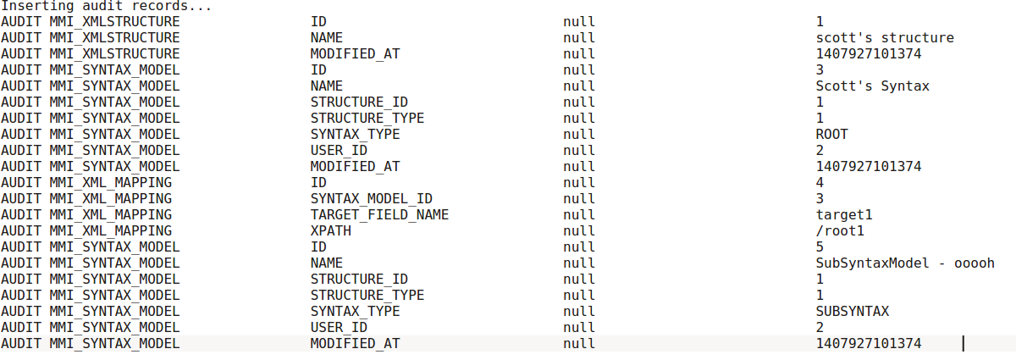
Features provided by sort
Complete audit log generation
  A full audit log of all actual changes is generated with each persist request.
  The audit data can be inserted into the database as part of the same transaction.

Slide 33
Features provided by sort
Full access control check for all JDBC operations
  All unchanged entities are filtered out before the access control check.
  All JDBC operations which will actually be performed are then verified with an access control check.
  If any one operation is not allowed then the whole transaction is rolled back.
Batch loading of original database data.
  The original database data is required for all existing records to
    Generate the audit logs
    Compare the optimistic locks (if applicable).
  All entities of the same type are fetched with the same query using OR operators to expand the range of the query.
  QueryBatching is used to potentially execute different queries in one database roundtrip.

Slide 34
Future Features

Slide 35
Future Features
Better handling of permissions
  Allow models to be loaded with relations for which permission was denied.
    The syntax listing page could automatically show user name as "xxx", as syntax does not depend
    on user for it's logical definition.
  Fail loading of models if depends-on or owns relations have permission denied.
    Eg. Loading of a full syntax should fail if the user does not have permissions to view the mappings.
Applying audit diffs to loaded models
  We want to step back and forward in time, using the audit data.
  The datamodel used by sort makes it very easy to apply diffs to loaded models.
  This feature can be built into sort requiring no specific code in the each module.
  The UI can then simply be redrawn based on the updated model.

Slide 36
Future Features
N-Eyes support
  N-Eyes support would also be implemented in sort requiring little backend work from each module.
Caching with read-only models
  The datamodel used by sort also makes caching very easy.
  sort can provide a read-only mode which prevents data from being modified. This
  allows cached data to be safely reused, negating the need to clone the data each time it is pulled from the cache.
  Cache flushing events between modules. Eg Notify MI when an access-area identifier has changed.
Support "count" in query projection and in where clause
  Would also allow the filter dialog to offer a "count" filter attribute.
  EG. Filter on feeds with error count > 0

Slide 37
Last

Slide 38
Last
The full sort framework is one bundle with 7275 lines of code
Lines of code for all MI daos + XML= 8445
Request that MI switch to sort as part of the UI redesign. This will reduce the amount of CRUD code in MI and simplify UI development.

