Slide 1
Frameworks Workshop

Slide 2
PyTorch

Slide 3
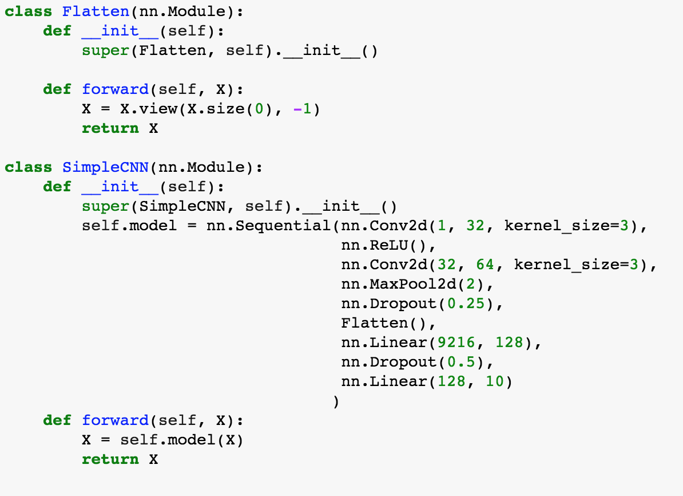
Create Model

Slide 4
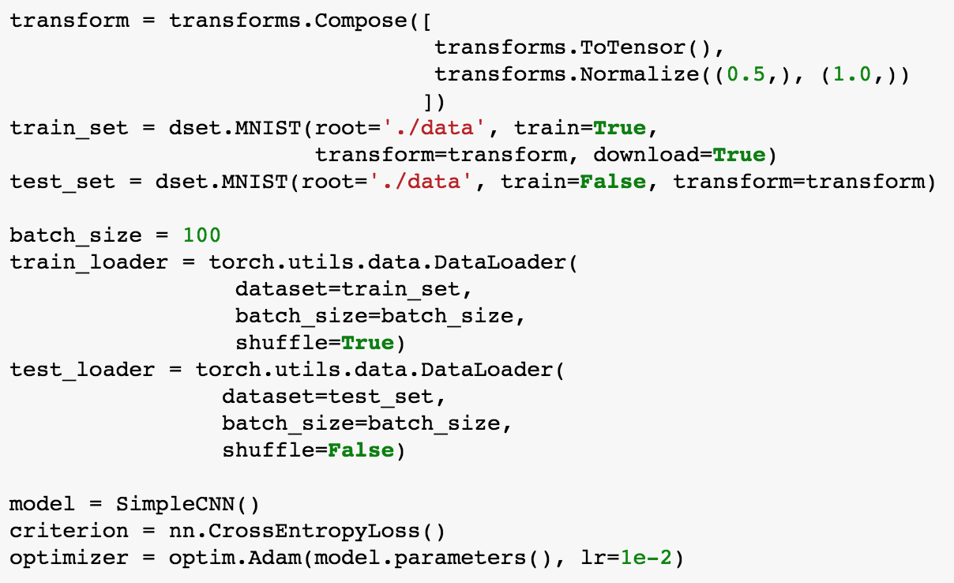
Load Data and Variables

Slide 5
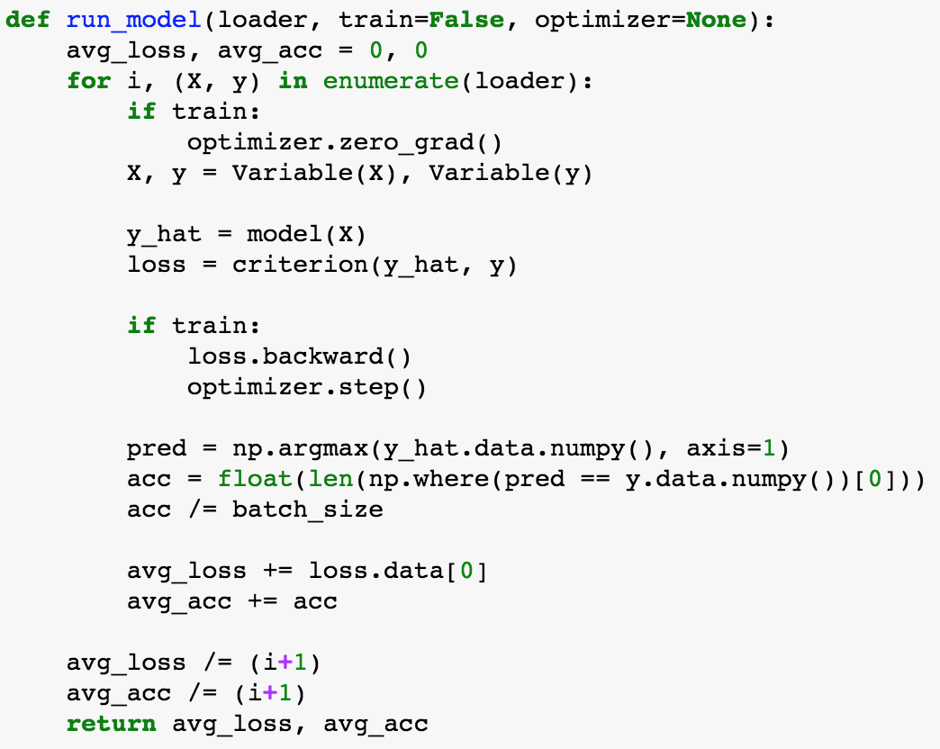
Define Run Function

Slide 6
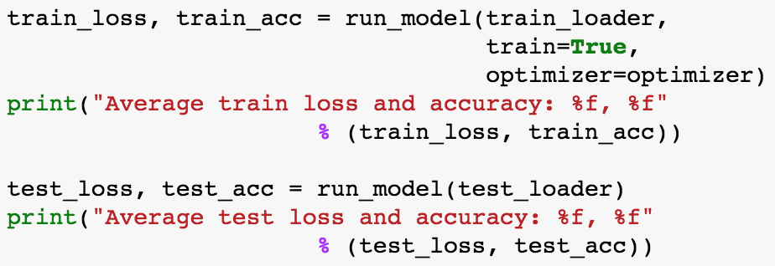
Train and Eval Model

Slide 7
TENSORFLOW

Slide 8
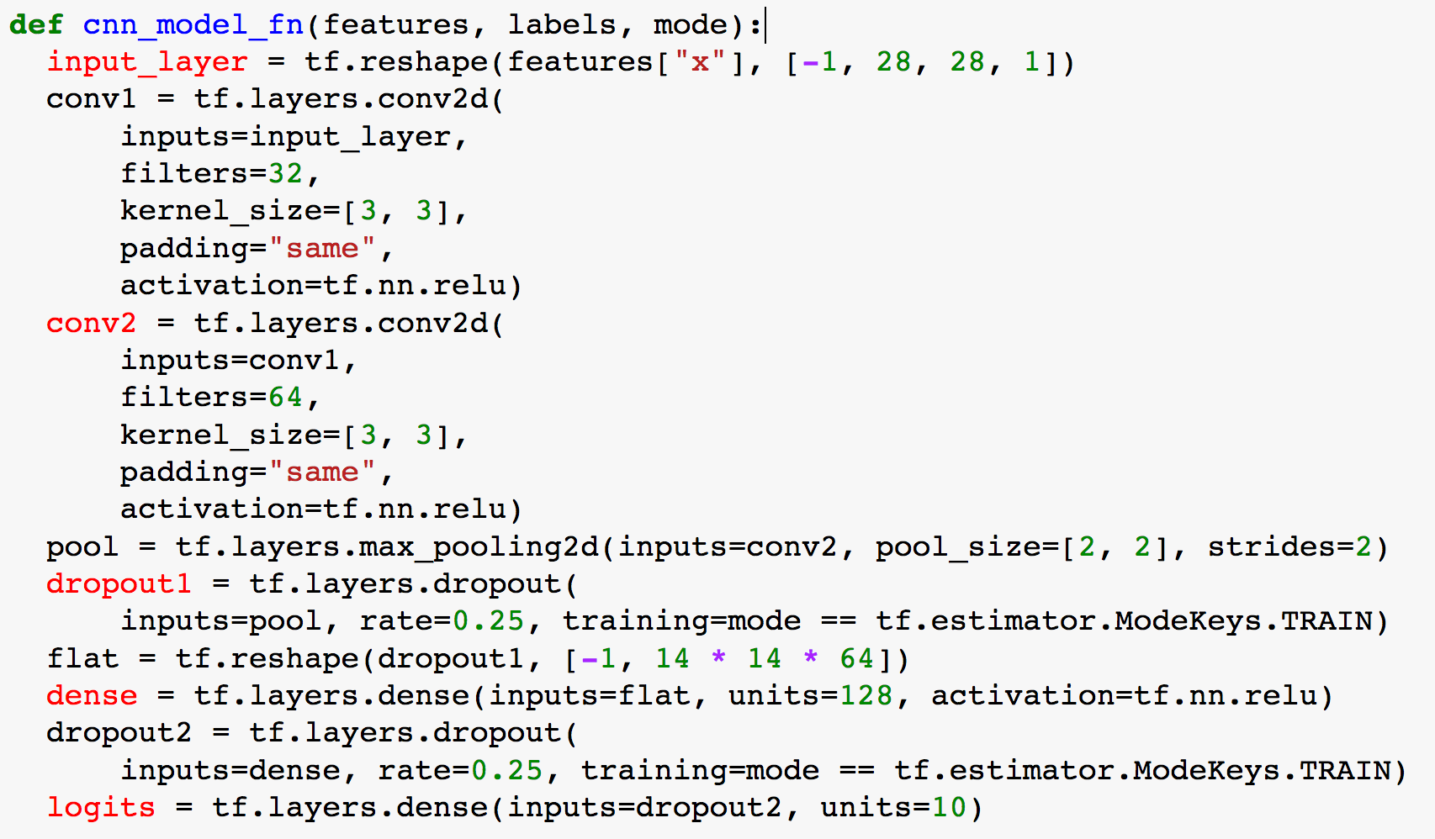
Create Model

Slide 9
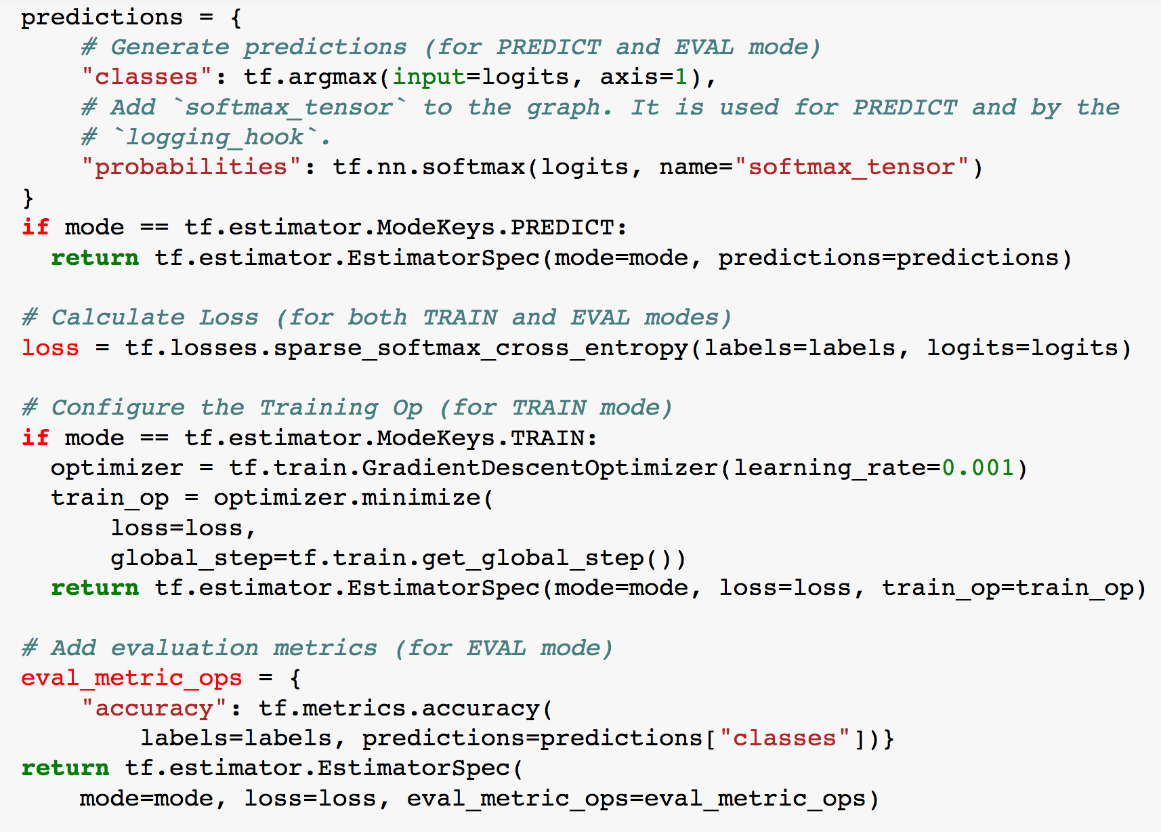
Setting up loss function and loss

Slide 10
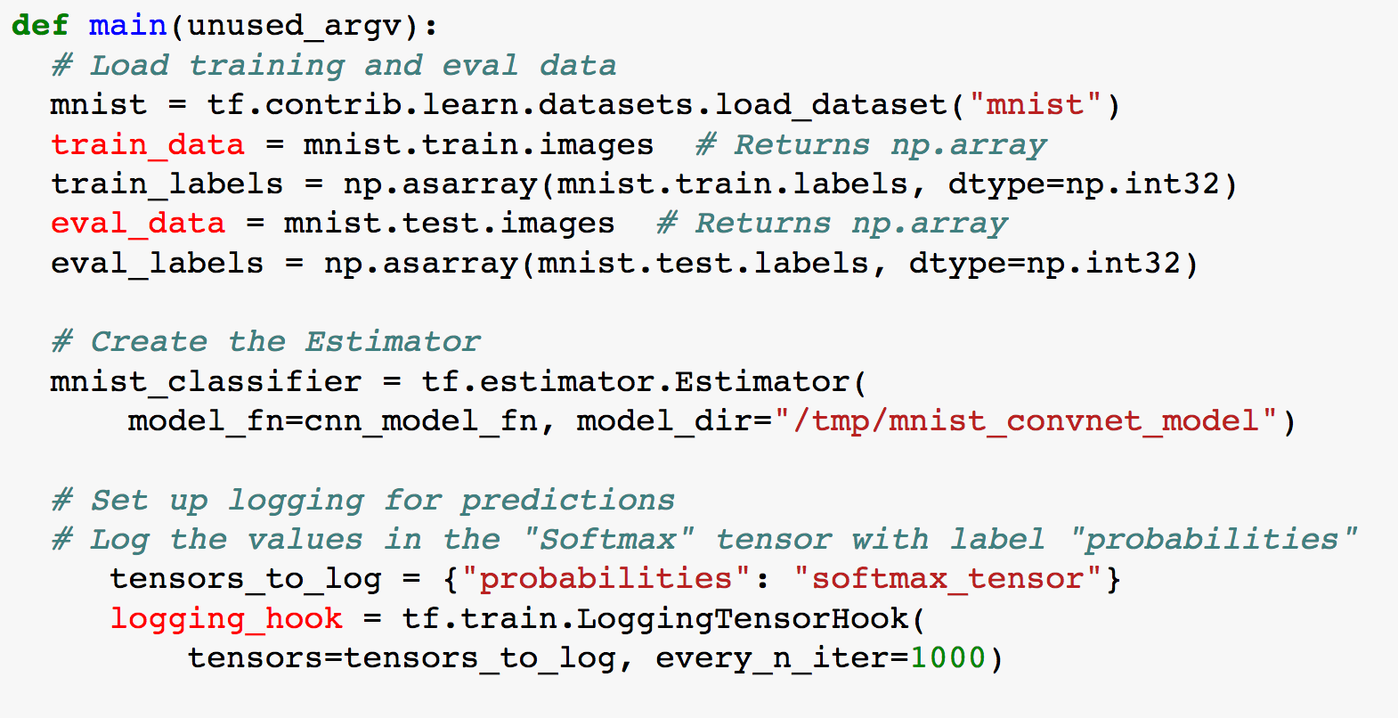
Loading and preparing data

Slide 11
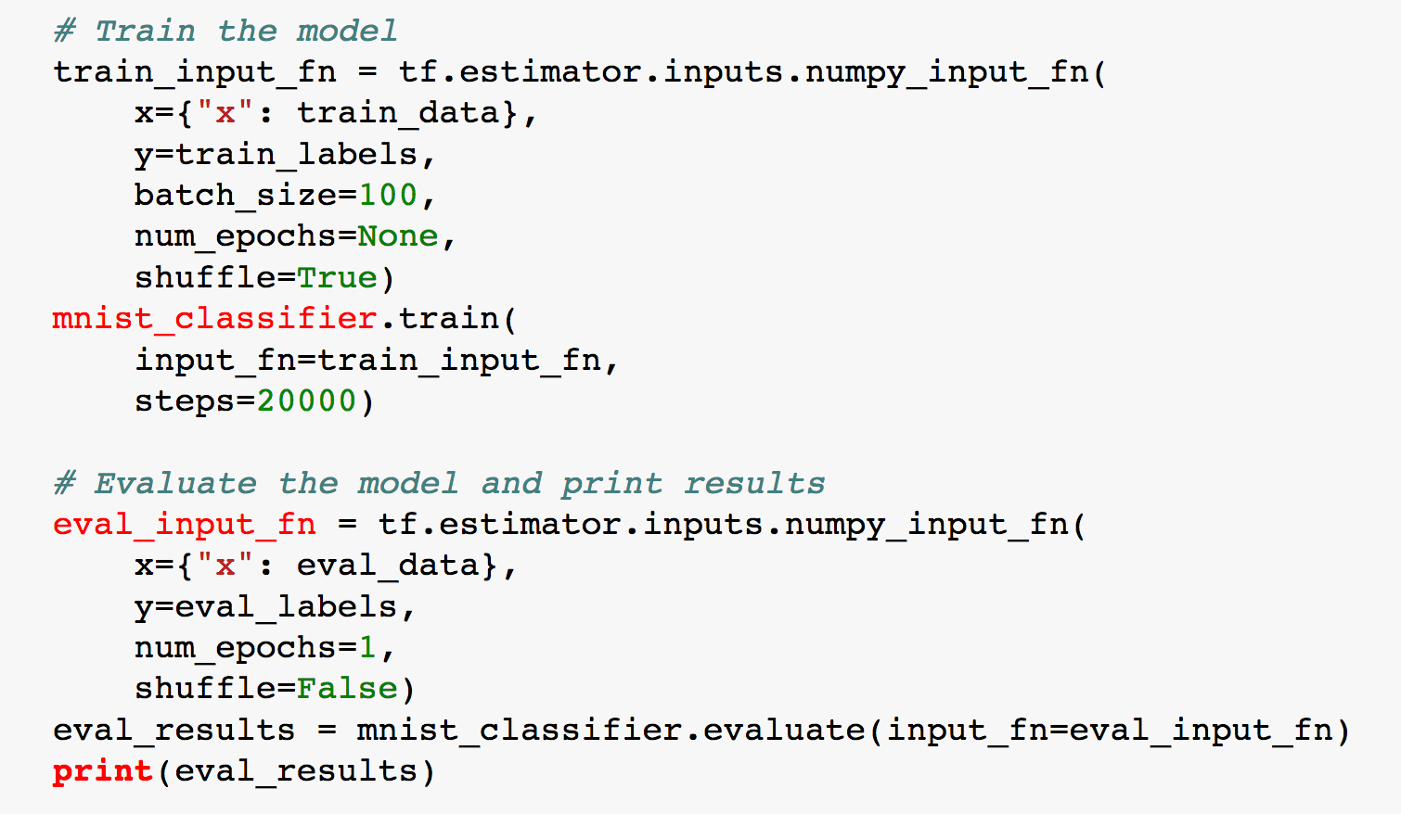
Train and Eval Model

